Slide 1
How Do Vision Transformer Worker
苏展（Zhan Su） 2022-5-28

Slide 2
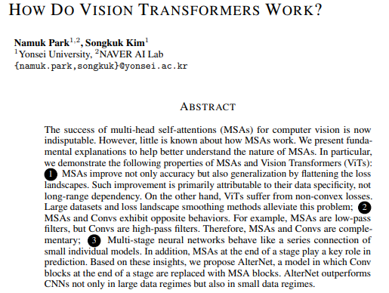

Slide 3
How Do Vision Transformers Work?——Before we start it
● Imperial results are reported in a variety of different forms and entirety of observations is hard to grasp.
I read the paper carefully twice and I am still not 100% sure I understand ALL the intricacies of every experiment and how those unequivocally lead to insights drawn.
● It is very hard to keep track of these different measures and little intuition is given for why these are ultimately "the right" measures to look at for a given empirical evaluation.

Slide 4
How Do Vision Transformers Work?——Empirical Observations
MSAs improve the predictive performance of CNNs
ViTs predict well-calibrated uncertainty
(How it works?)
2. Robust against data corruptions, image occlusions and adversarial attacks, particularly robust against high-frequency noises (How MSAs differ from conv?)
3. MSAs closer to the last layer significantly improve predictive performance (What to do?)

Slide 5
How Do Vision Transformers Work?——Q1: Inductive Biases
MSA is generalized spatial smoothing
Weak inductive bias: can model long-range dependencies
- Appropriate constraints may help (Swin, Twins, ..)

Slide 6
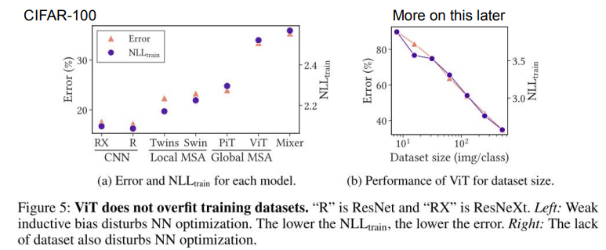
How Do Vision Transformers Work?——Q1: Inductive Biases
Conclusion 1: The stronger the inductive biases, the stronger the representations. Weak inductive biases disrupt NN training.

Slide 7
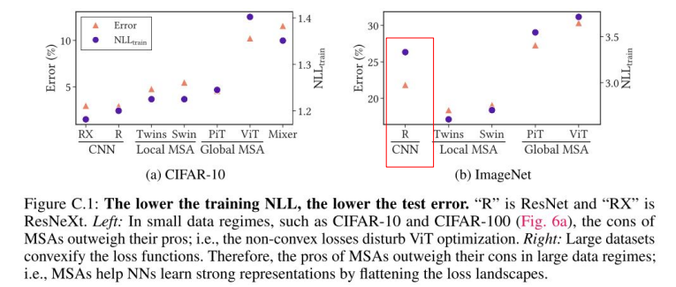
How Do Vision Transformers Work?——Q1: Inductive Biases
Conclusion 1: The stronger the inductive biases, the stronger the representations. Weak inductive biases disrupt NN training.

Slide 8
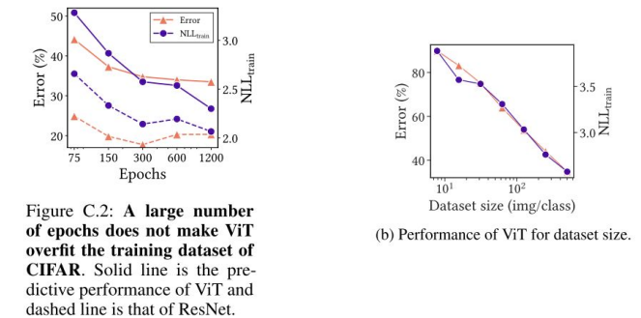
How Do Vision Transformers Work?——Q1: Inductive Biases
Before we trust it , does ViT overfit the dataset? - No, even the dataset is small
ViT’s poor performance in small data regimes is not due to overfitting

Slide 9
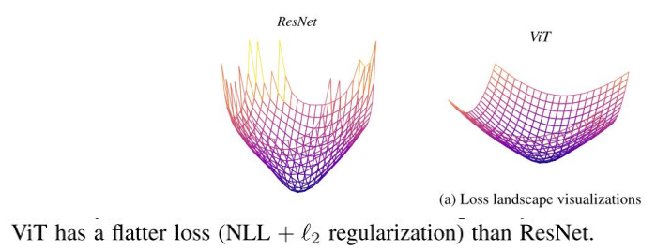
How Do Vision Transformers Work?——Q1: Inductive Biases
Conclusion 2: ViT’s non-convex losses lead to poor performance.
Warning: Use 'NLL + L2' on 'augmented datasets'.
Measuring criteria without l2 on clean datasets would give incorrect (even opposite) results.

Slide 10
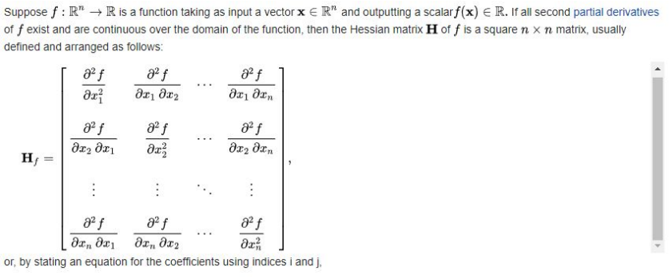
Hessian Max Eigenvalue Spectrum
Hessian matrix: https://en.wikipedia.org/wiki/Hessian_matrix

Slide 11
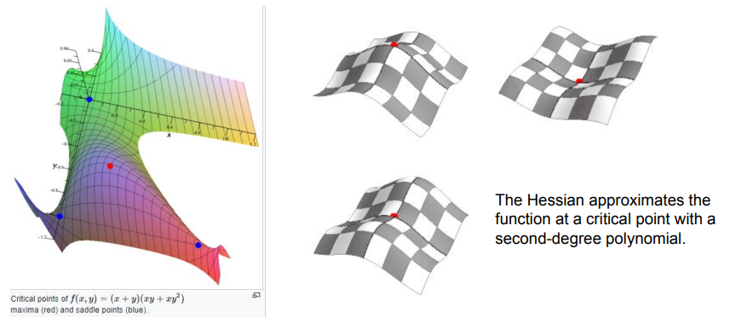
Hessian Max Eigenvalue Spectrum
The eigenvalues of Hessian matrix: https://en.wikipedia.org/wiki/Second_partial_derivative_test

Slide 12
Hessian Max Eigenvalue Spectrum
Why eigenvalues matter? https://web.stanford.edu/group/sisl/k12/optimization/MO-unit4-pdfs/4.10applicationsofhessians.pdf

Slide 13
In this case

Slide 14
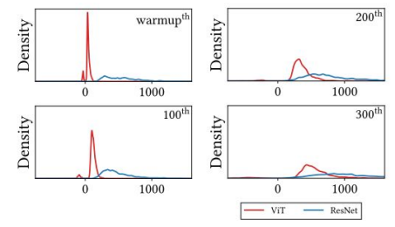
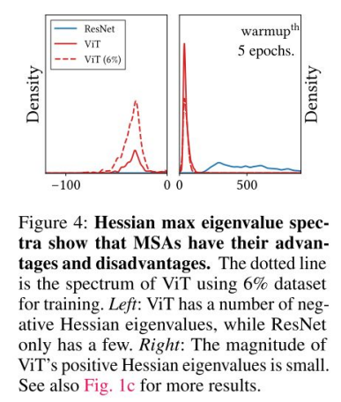
How Do Vision Transformers Work?——Q1: Inductive Biases
Conclusion 2: ViT’s non-convex losses lead to poor performance.
The effect of inductive biases: Suppresses negative eigenvalues.

Slide 15
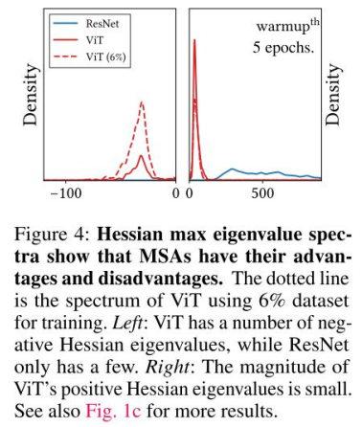
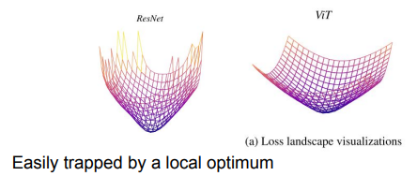
How Do Vision Transformers Work?——Q1: Inductive Biases
Conclusion 2: ViT’s non-convex losses lead to poor performance.
Somehow caused by MSA
- Which might not be a bad thing (regarding generalization & performance)

Slide 16
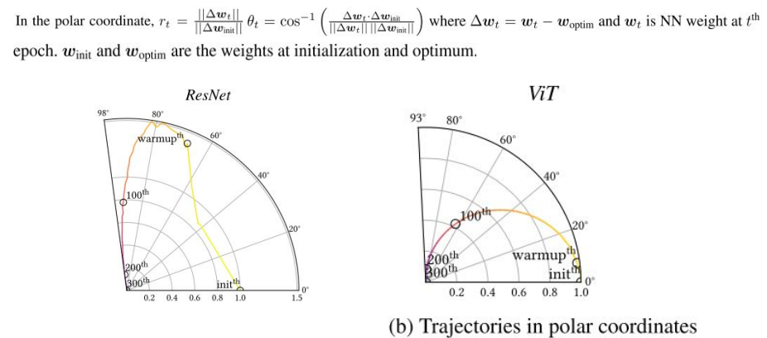
How Do Vision Transformers Work?——Q1: Inductive Biases
Conclusion 2: ViT’s non-convex losses lead to poor performance.

Slide 17
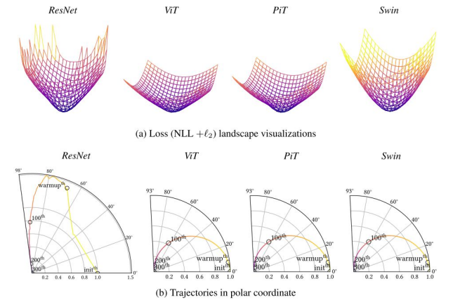
How Do Vision Transformers Work?——Q1: Inductive Biases
Conclusion 2: ViT’s non-convex losses lead to poor performance.
More models?

Slide 18
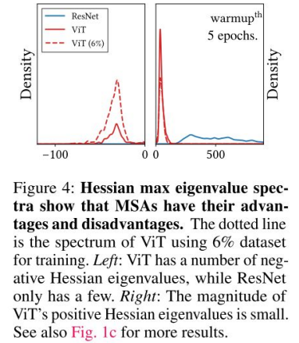
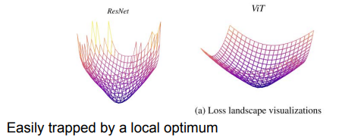
How Do Vision Transformers Work?——Q1: Inductive Biases
Conclusion 2: ViT’s non-convex losses lead to poor performance.
Caused by MSA (SA + Multi-head)
Which might not be a bad thing (regarding generalization & performance)
Can be fixed by tons of data
Notes:
、

Slide 19
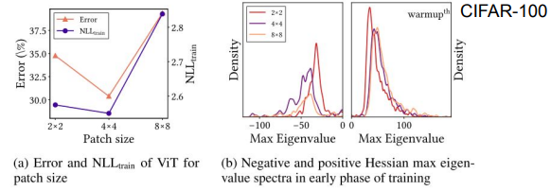
How Do Vision Transformers Work?——Q1: Inductive Biases
Find the sweet point between the inductive biases and the sizes of datasets Effect of inductive biases: Suppresses neg. eigenvalues.

Slide 20
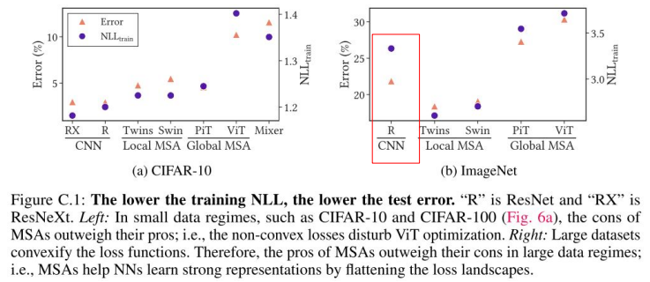
How Do Vision Transformers Work?——Q1: Inductive Biases
Conclusion 1: The stronger the inductive biases, the stronger the representations. Weak inductive biases disrupt NN training.

Slide 21
How Do Vision Transformers Work?——Q1: Inductive Biases
A local MSA in Swin produces negative eigenvalues, but significantly reduces the magnitude of eigenvalues. A multi-stage architecture in PiT suppresses negative Hessian eigenvalues.

Slide 22
How Do Vision Transformers Work?——Q1: Inductive Biases
Number of heads <==> loss landscape convexity
TL;DR: more heads => convex

Slide 23
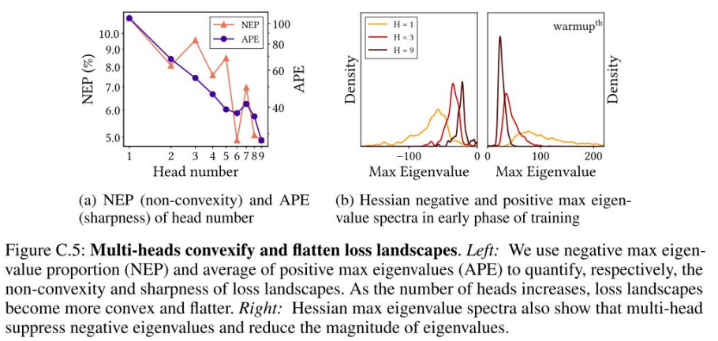
How Do Vision Transformers Work?——Q1: Inductive Biases

Slide 24
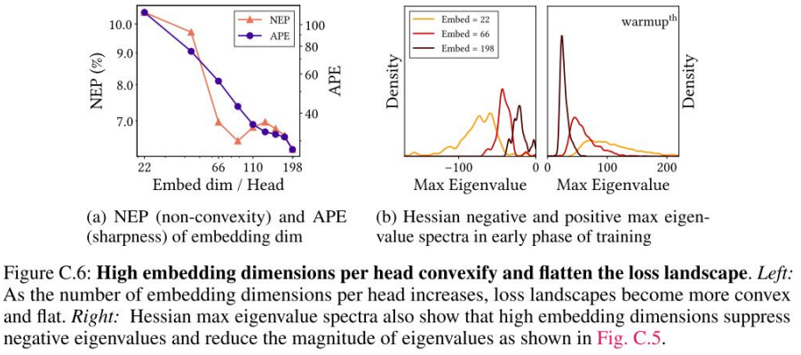
How Do Vision Transformers Work?——Q1: Inductive Biases

Slide 25
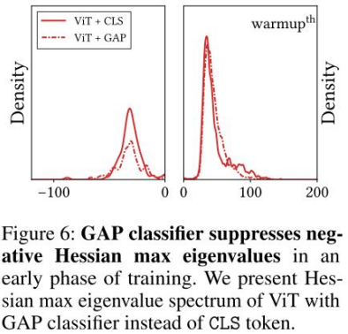
How Do Vision Transformers Work?——Q1: Inductive Biases
Conclusion 3: Loss landscape smoothing methods aids in ViT training.
GAP(Global Average Pooling) convexify the loss
SAM (Sharpness-Aware Minimization) improves the predictive performance of ViT.

Slide 26
How Do Vision Transformers Work?——Q1: Inductive Biases
Short summary:
We assume: Inductive biases ⇔ Loss landscape convexity ⇔ Hessian max eigenvalue norm
Usually, weak inductive biases disrupt NN training (stronger the inductive biases, the stronger the representations)
But this can be fixed by a large dataset
We need to find a sweet spot.

Slide 27
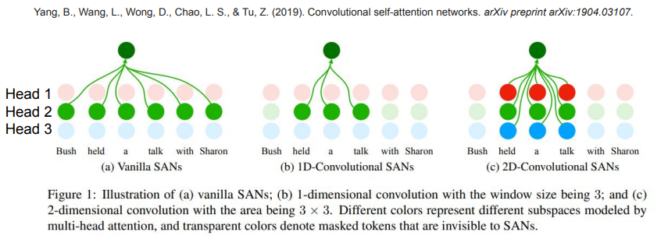
How Do Vision Transformers Work?——Q1: Inductive Biases
Data Specificity (not long-range dependency)
Replace global MSA with 2D conv MSA

Slide 28
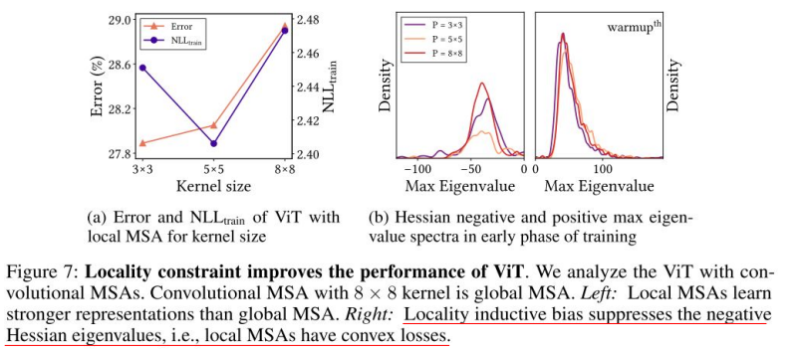
How Do Vision Transformers Work?——Q1: Inductive Biases
Data Specificity (not long-range dependency)
Replace global MSA with 2D conv MSA

Slide 29
How Do Vision Transformers Work?——Q1: How do MSAs improve optimization?
MSA is generalized spatial smoothing
Weak inductive bias: can model long-range dependencies - Appropriate constraints may help (Swin, Twins, ..)
Loss landscapes are flatter than ConvNets a. Better the performance and generalization b. Non-convexity (bad for optimization) --- but can be fixed by a large amount of data
The data specificity(attention) instead of long-range dependency helps

Slide 30
How Do Vision Transformers Work?——Q2: Do MSAs Act Like Convs?
Convs: data-agnostic and channel-specific
MSA: data-specific and channel-agnostic
MSAs and Convs are complementary.
They are complementary

Slide 31
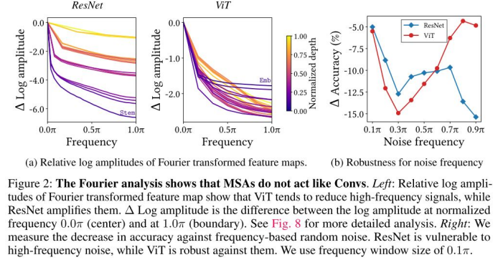
How Do Vision Transformers Work?——Q2: Feature Analysis
Conclusion 1: MSAs are low-pass filters, but Convs are high-pass filters.

Slide 32
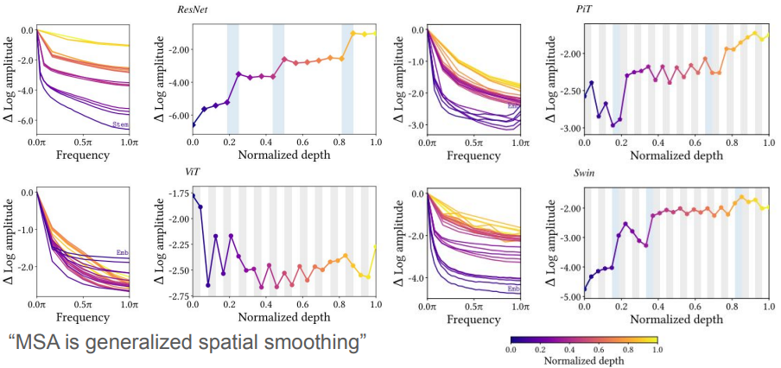
How Do Vision Transformers Work?——Q2: Feature Analysis

Slide 33
How Do Vision Transformers Work?——Q2: Feature Analysis
Conclusion 2: MSAs aggregate feature maps, but Convs do not.
The variance accumulates in every NN layer and tends to increase as the depth increases.
Feature map variance in ResNet peaks at the ends of each stage.

Slide 34
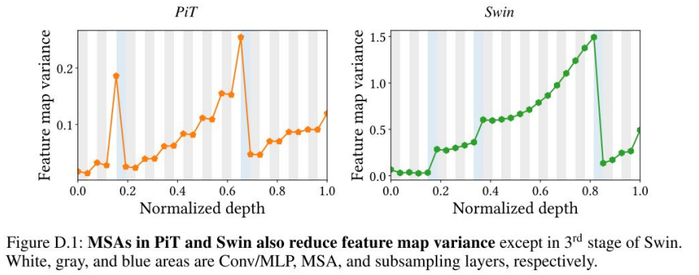
How Do Vision Transformers Work?——Q2: Feature Analysis
Conclusion 2: MSAs aggregate feature maps, but Convs do not.

Slide 35
How Do Vision Transformers Work?——Q2: Do MSAs Act Like Convs?
Convs: data-agnostic and channel-specific
MSA: data-specific and channel-agnostic
MSAs and Convs are complementary:
MSAs are low-pass filters, but Convs are high-pass filters.
MSAs aggregate feature maps, but Convs do not.

Slide 36
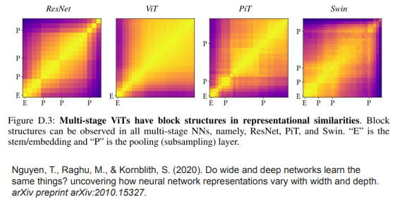
How Do Vision Transformers Work?——Q3: How to MSAs + Conv?
The pattern of feature map variance repeats itself at every stages.
Multi-stage NNs behave like individual models.

Slide 37
Minibatch Centered Kernel Alignment (CKA)

Slide 38
Minibatch Centered Kernel Alignment (CKA)

Slide 39
Minibatch Centered Kernel Alignment (CKA)

Slide 40
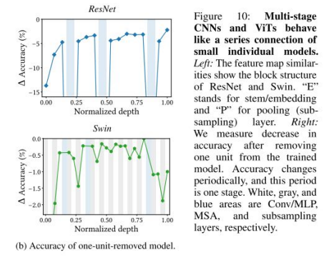
How Do Vision Transformers Work?——Q3: How to MSAs + Conv?
One NN unit is removed from already trained ResNet and Swin during the testing phase.
Observations regarding ResNet:
Removing an early stage layers hurts more;
Removing a layer at the beginning of a stage hurts more

Slide 41
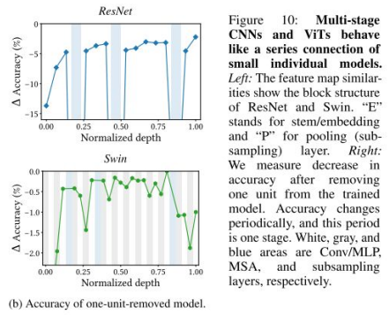
How Do Vision Transformers Work?——Q3: How to MSAs + Conv?
One NN unit is removed from already trained ResNet and Swin during the testing phase.
Observations regarding Swin:
At the beginning of a stage, removing an MLP hurts accuracy.
At the end of a stage, removing an MSA seriously impairs the accuracy

Slide 42
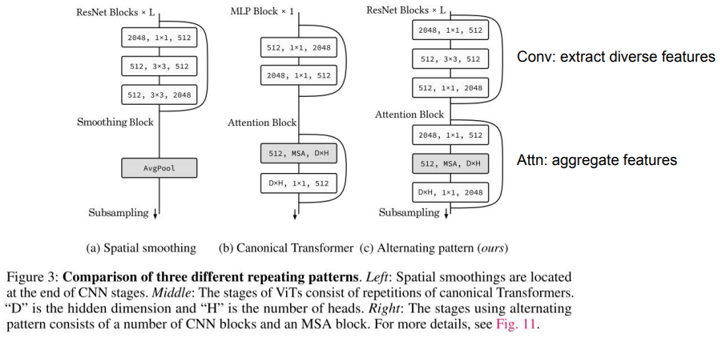
How Do Vision Transformers Work?——Q3: How to MSAs + Conv?

Slide 43
How Do Vision Transformers Work?——Q3: How to MSAs + Conv?
Rules:
Alternately replace Conv blocks with MSA blocks from the end.
If the added MSA block does not improve predictive performance, replace a Conv block located at the end of an earlier stage with an MSA block .
Use more heads and higher hidden dimensions for MSA blocks in late stages.

Slide 44
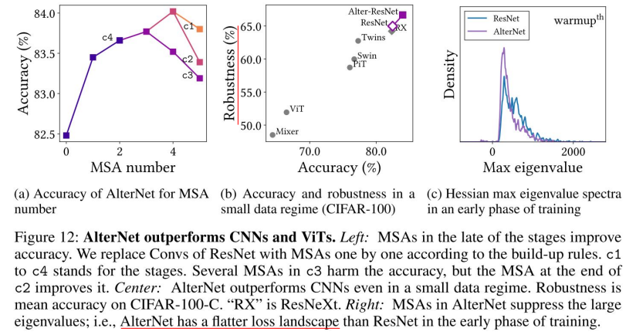
How Do Vision Transformers Work?——Results

Slide 45
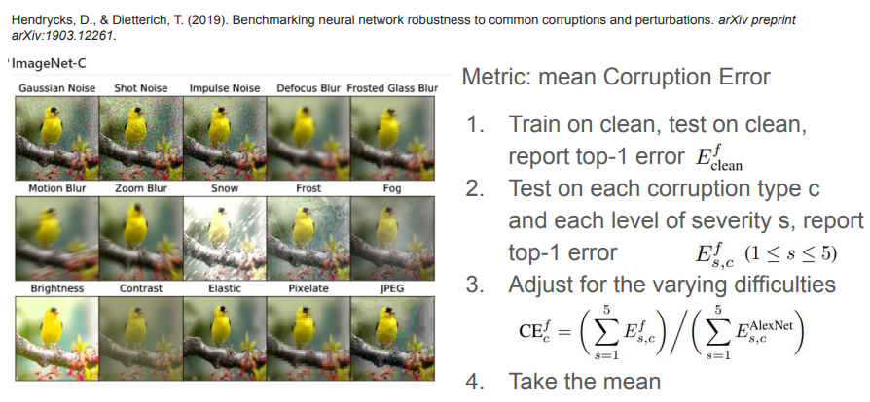
Not the robustness here, but I prefer to cover it here

Slide 46
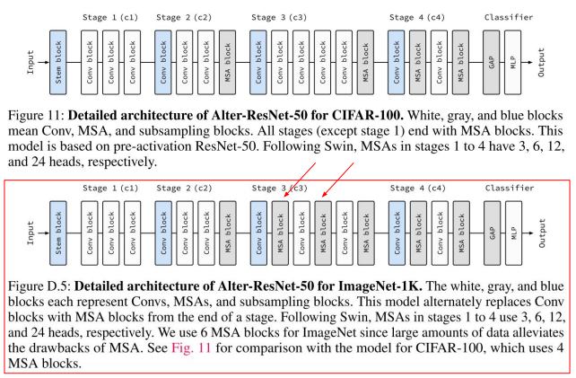
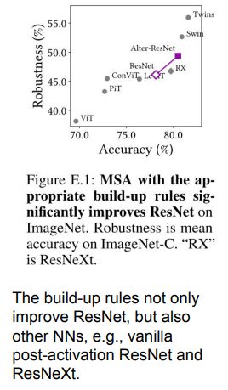
More on ImageNet-C

Slide 47
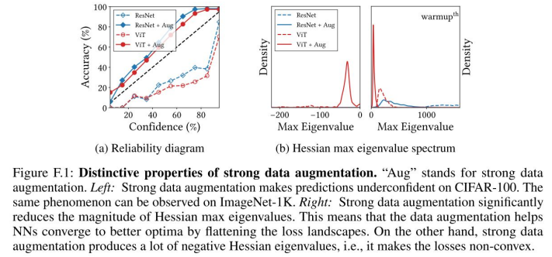
One more thing..Data Augmentation
Data augmentation can harm uncertainty calibration
2. Data augmentation reduces the magnitude of Hessian eigenvalues

Slide 48
Final Conclusions
How MSAs work?
Inductive biases ⇔ Loss landscape convexity ⇔ Hessian max eigenvalue norm
Usually, weak inductive biases disrupt NN training, but this can be fixed by a large dataset
How MSAs differ from Conv?
MSAs are low-pass filters, but Convs are high-pass filters.
MSAs aggregate feature maps, but Convs do not.
How to combine Conv and MSAs? (Build-up rules)
Alternately replace Conv blocks with MSA blocks from the end.
If the added MSA block does not improve predictive performance, replace a Conv block located at the end of an earlier stage with an MSA block .
Use more heads and higher hidden dimensions for MSA blocks in late stages.

Slide 49
Thank you

