Slide 1
Few-Shot Video Classification via Temporal Alignment
Kaidi Cao, Jingwei Ji, Zhangjie Cao, Chien-Yi Chang
Juan Carlos Niebles
Stanford University
CVPR 2020

Slide 2
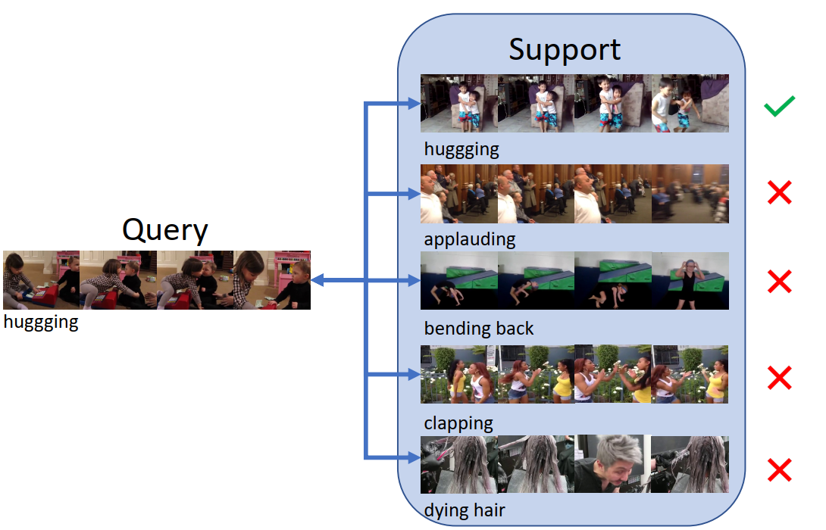
Few-Shot Video Classification
Problem

Slide 3
Few-Shot Video Classification
Problem
Majority of recent few-shot learning work focuses on image
Videos are more complicated with an additional temporal dimension.
Previous approaches: using a pooling layer

Slide 4
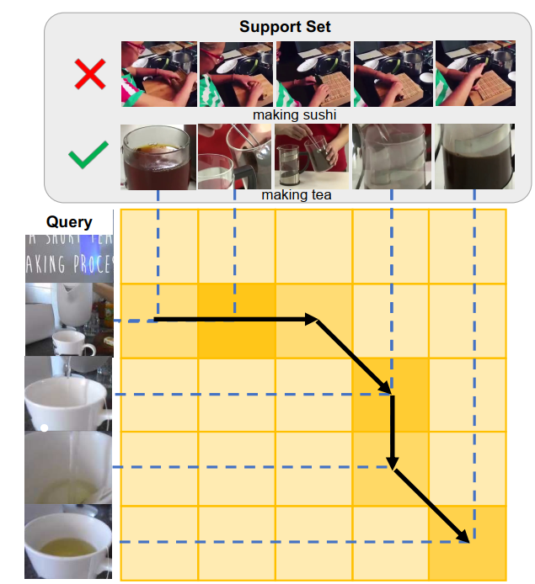
Motivation
Problem
Temporal ordering matters
If there is a pouring water procedure before the
close-up of tea -> making tea instead of serving it
A DTW-based method
Like TSN sampling T segments of the video and
choosing a snippet of each.

Slide 5
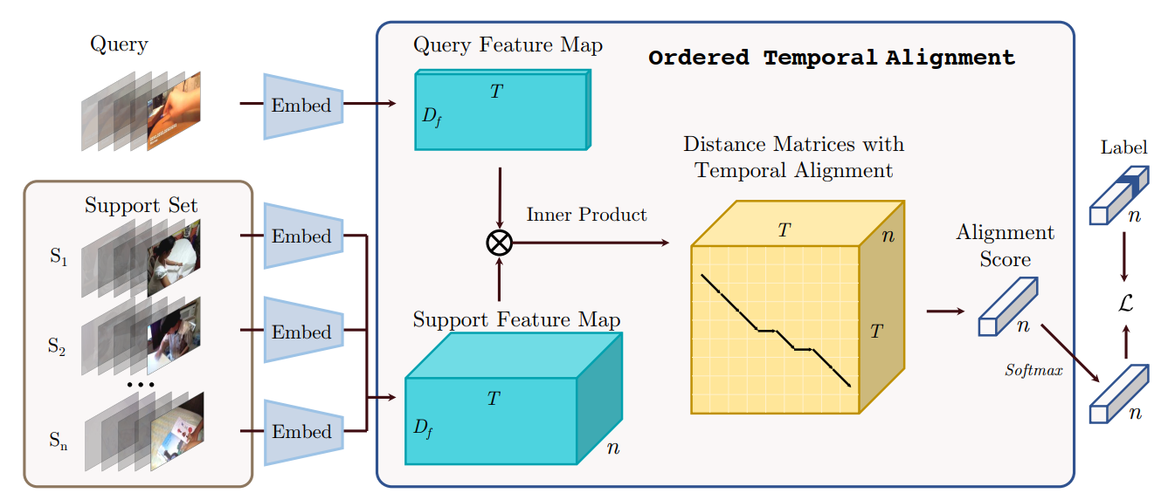
METHOD

Slide 6
Method
Problem Formulation
Few-shot learning problem as a metric learning problem
Learning a distance function $φ\left(f_{φ}\left(x_{1}\right),f_{φ}\left(x_{2}\right)\right)$
Embedding Function
Two video samples from $C_{train}$

Slide 7
METHOD
CNN generating a compact representation of the trimmed video that encapsulates its visual content
$$x=\left\{x^{1}, x^{2}, …,x^{T}\right\}$$
$$f_{φ}(x)=\left\{f_{φ}(x^{1}),f_{φ}(x^{2}), …,f_{φ}(x^{T})\right\}$$

Slide 8
METHOD
Frame-level distance value between the l-th frame of video $x_{i}$ and the m-th frame of video $x_{j}$ $$D\left(l,m\right)=1−\frac{f_{φ}\left(x_{i}^{l}\right).f_{φ}\left(x_{j}^{m}\right)}{\left|\left|f_{φ}\left(x_{i}^{l}\right)\right|\right| \left|\left|f_{φ}\left(x_{i}^{l}\right)\right|\right|}$$

Slide 9
METHOD
Defining $W⊂{\left\{0,1\right\}}^{T×T}$
a set of set of possible binary alignment matrices, where $∀w ∈ W, w_{lm} = 1$ if the l-th frame of video $x_{i}$ is aligned to the m-th frame of $x_{j}$
The goal is to find the best alignment $w^{∗}∈W$:
$w^{∗}= \underset{w∈W}{argmin}{<W,D>}$, $φ\left(f_{φ}\left(x_{i}\right),f_{φ}\left(x_{j}\right)\right)=<w^{∗},D>$

Slide 10
METHOD
A DTW based method to solve the $w^{∗}= \underset{w∈W}{argmin}{<W,D>}$

Slide 11
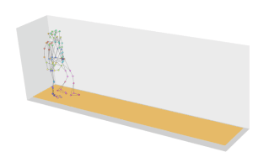
METHOD
Dynamic time warping
measuring similarity between two temporal sequences, which may vary in speed

Slide 12
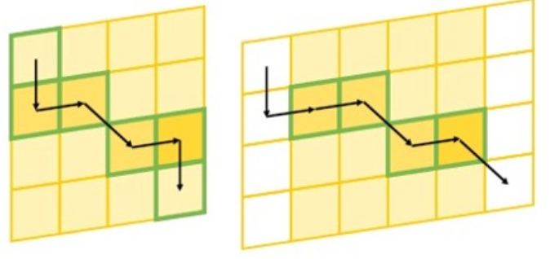
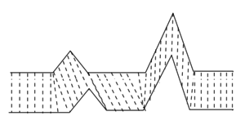
METHOD
Cumulative distance function
$γ\left(l,m\right)=D\left(l,m\right)+min⁡\{γ\left(l−1,m−1\right),$
$$γ\left(l−1,m\right),$$
$$γ\left(l,m−1\right)\}$$
Relaxing the boundary condition
Two column of zeros
$$w\left(1, 1\right)=w\left(T,T\right)=1$$

Slide 13
METHOD
Cumulative distance function
$γ\left(l,m\right)=D\left(l,m\right)+min⁡\{γ\left(l−1,m−1\right),$
$$γ\left(l−1,m\right),$$
$$γ\left(l,m−1\right)\}$$
Differentiable min
$\min\left(t_{1},t_{2},…,t_{n}\right)=−λlog\sum_{i=1}^{n}{e^{−\frac{t_{i}}{λ}}} if λ→0$

Slide 14
METHOD
Training
given a pair of ground-truth videos $\left(x_{i}, x_{j}\right),$ the video distance measure is:
$$φ\left(f_{φ}\left(x\right),f_{φ}\left(\hat{x}\right)\right)=γ(T,T+1)$$
$$L=−log⁡\frac{\exp\left(−φ\left(f_{φ}\left(x\right),f_{φ}\left(\hat{x}\right)\right)\right)}{\sum_{s∈S}{exp⁡(−φ(f_{φ}\left(x\right),f_{φ}\left(s\right))}}$$
the training process can be regarded as a distance metric learning process, but all the learnable parameters are in the feature embedding module, with a fixed metric applied.
Inference:
$$s^{∗}= \underset{s∈S}{argmin}{φ(q,s)}$$

Slide 15
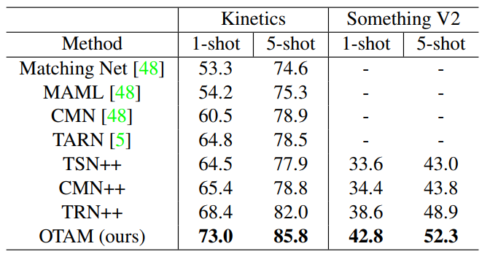
Experiments
Kinetics and Something-Something V2 dataset
Sampling 64 classes for meta training, 12 classes for validation, and 24 classes for meta testing
ResNet-50 as the backbone network for TSN
feed frames of a video to a ResNet-50 network pretrained on ImageNet, and then average frame-level
Fine-tune the backbone

Slide 16
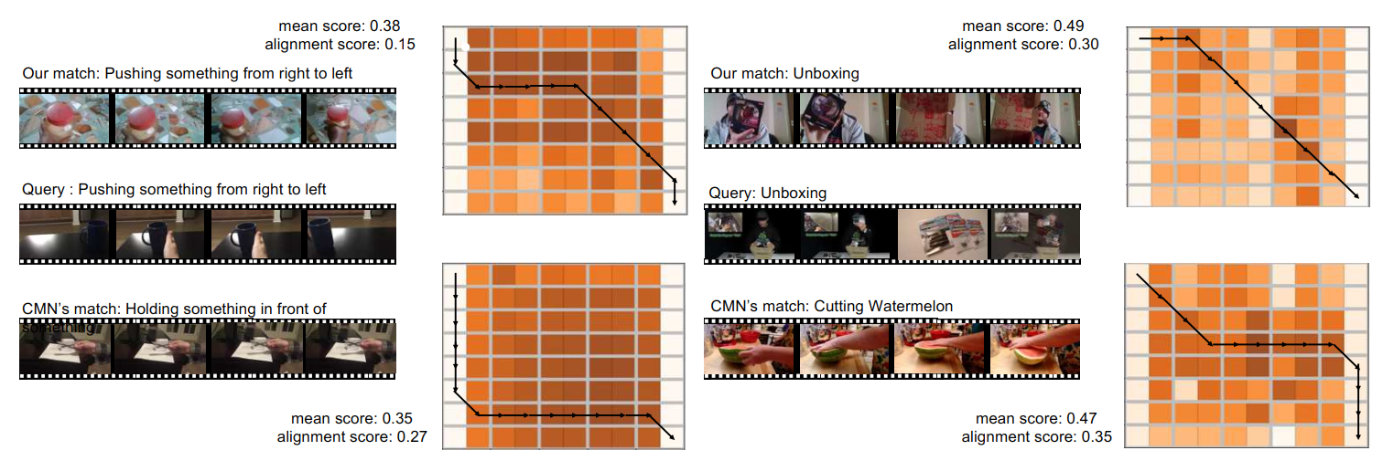
Experiments

Slide 17
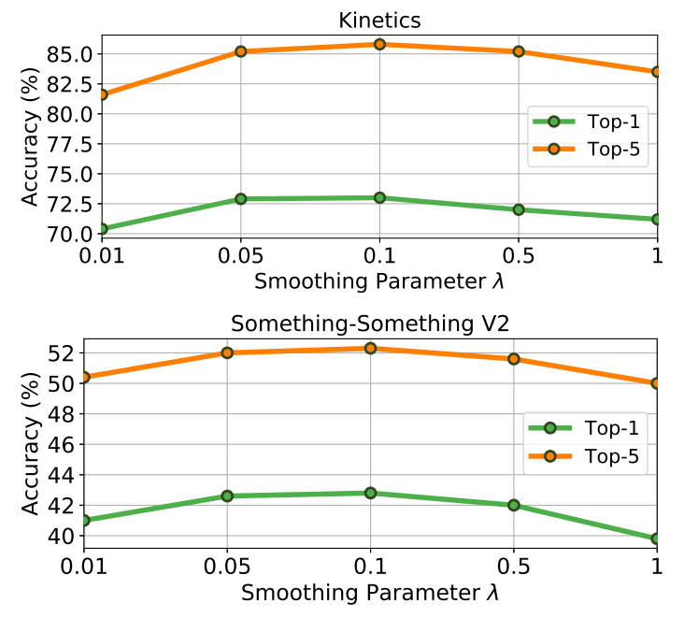
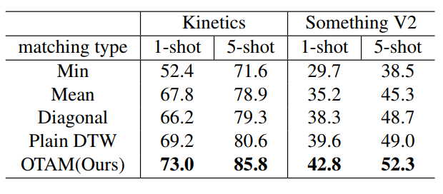
Experiments
Using other temporal alignments
Smoothing factor sensitivity; comparing the effect of using different smoothing factors.

Slide 18
Thank you for your attention

