Slide 1
D3S – A Discriminative Single Shot Segmentation Tracker CVPR 2020
Authors:
Alan Lukežič: Ph.D. Student, Visual Cognitive Systems Lab, University of Ljubljana
Jiri Matas: Professor, Center for Machine Perception, Czech Technical University
Matej Kristan: Associate Professor, Visual Cognitive Systems Lab, University of Ljubljana

Slide 2
Outline
Introduction
D3S Segmentation Network
Target Visual Models
GIM (Geometrically Invariant Model)
GEM (Geometrically Constrained Euclidean Model)
Segmentation Refinement Pathway
Segmentation to Rotated Box Tracking Method
Initialization of Tracker
Training Details
Ablation Study
Evaluation
Quantitative
Qualitative

Slide 3
Introduction
Two related tasks addressed in this paper:
Visual Object Tracking: Estimating target[s] location using BB given the BB ground-truth in first frame
Semi-Supervised Video Object Segmentation: Estimating the segmentation mask of target[s] given the mask ground-truth in the first frame
Contributions:
Developing discriminative single-stage segmentation tracker
Converting segmentation mask to rotated bounding box
State-of the-art VOS Methods:
Train offline VOS network on video sequences
Fine-tune the network on the first frame of test sequence
BB is a poor representation of location compared with binary segmentation mask:
VOT Challenge 2020 provided mask annotations to narrow the gap between two tasks
Multi-task learning to increase the performance

Slide 4
Introduction [Cont’d]
VOS Datasets:
Youtube VOS
DAVIS ’16
DAVIS ‘17
VOS datasets consider less challenging scenarios:
The target[s] exist in roughly all the frames
Low background distractors
Limited appearance change
Large objects with normal motion
Less than 100 frames
The performance of top VOS methods is poor on VOT datasets
SiamMask[CVPR’19]:
First tracker with good results on both VOS and SOT
Two stage method
Drawbacks:
No online adaptation
Solves SOT and VOS separately

Slide 5
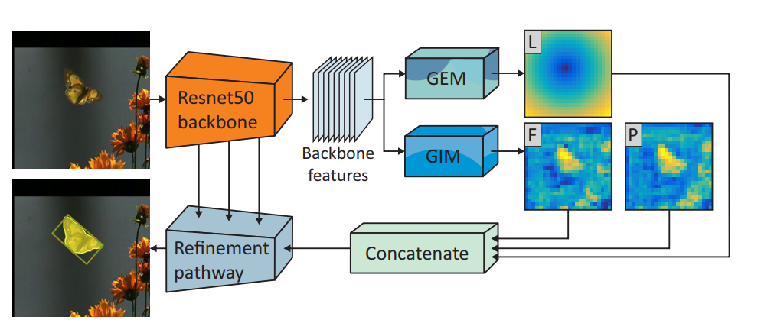
D3S Network Architecture
Trained end-to-end using VOS datasets
Combination of three papers:
GEM (Geometrically Constrained Euclidean Model): ATOM [CVPR’19]
GIM(Geometrically Invariant Model): VideoMatch [ECCV’18]
Refinement Pathway: SharpMask [ECCV’16]

Slide 6
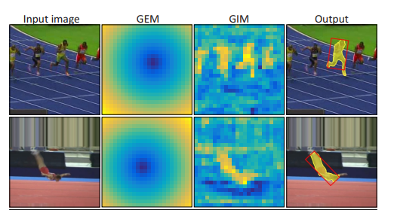
Target Visual Models in D3S
GEM:
Adaptive and highly discriminative
Geometrically constrained to Euclidean motion
Discriminatively adapt to target even in the presence
of distractors
GIM:
Invariant to broad range of transformation
Allows localization under significant deformation
Siamese-Based

Slide 7
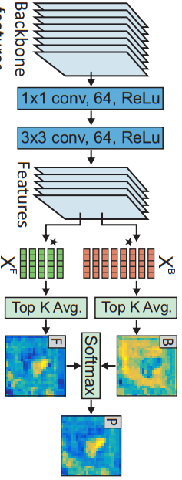
Geometrically Invariant Model
Segmentation of deformable target using loose spatial contraints
1 * 1 Convolution for channel reduction
Two convolution layers to make feature optimal for segmentation
Siamese-based method considering the mask in first frame as the template
from VideoMatch [ECCV’18]
What about updating the template model? (Inspired by template update methods for Siamese trackers)
K=3

Slide 8
Geometrically Constrained Euclidean Model
Robust localization using DCF of ATOM [CVPR’19]
Target Location Channel (L) as the Euclidean distance between maximum correlation and pixels in search region
1 * 1 convolution
Reduce computation complexity
Train more robust DCF

Slide 9
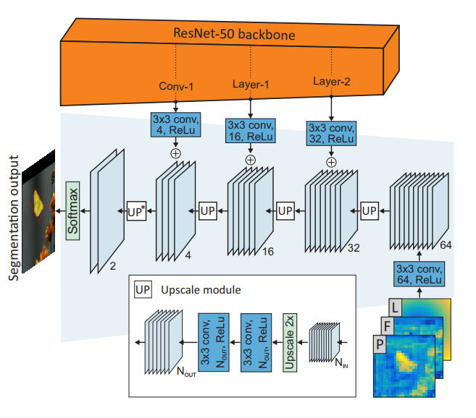
Segmentation Refinement
3 * 3 Conv on concat(L,F,P) to increase the channels
Combine features of different layers of backbone with upscaled coarse segmentation
Method adopted from SharpMask [ECCV’16]
Similar refinement pathway used in SiamMask

Slide 10
Segmentation mask to BB
Binarize the mask using threshold=0.5
Keep the largest connected component of mask
Fit ellipse to that component
Use center, minor, and major axis of ellipse to initialize the rotated BB
Maximize the $IOU^{MOD}$ between the initial rectangle and mask component:
$IOU^{MOD}=\frac{N_{IN}^{+}}{αN_{IN}^{−}+N_{IN}^{+}+N_{OUT}^{+}} α=0.25$
While the method is trained just on YoutubeVOS, it achieves state-of-the-art results on tracking datasets

Slide 11
Initialization
GIM and GEM need mask and BB ground-truth of the first frame, respectively
First frame annotation is mask:
Use mask to initialize GIM
Fit BB to mask to initialize GEM, and use initialization method of ATOM
First frame annotation is BB:
Use BB to initialize GEM using method in ATOM
Consider the whole box as foreground samples, and run method for one iteration. Use estimated output mask to initialize GIM.
Inspired by GrabCut, we can do this initialization iteratively.
Increasing the number of iterations did not increase the performance

Slide 12
Training
Search region: 384 * 384 patch
GIM and Refinement path pre-trained on 3471 sequences of Youtube-VOS
Target Location Channel constructed by perturbing ground-truth
Batch size: 64
40 $epochs$ with 1000 $\frac{iterations}{epoch}$ and ADAM optimizer
Learning rate of ${10}^{−3}$ with 0.2 decay rate every 15 epochs
Loss function: cross entropy
D3S runs at 25 fps on a single Nvidia GTX 1080 GPU

Slide 13
Evaluation on Tracking Datasets
TrackingNet
Got-10k
VOT 2018
VOT 2016

Slide 14
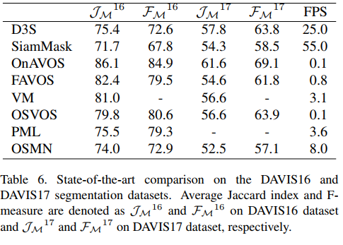
Evaluation on Segmentation Datasets

Slide 15
Ablation Study

Slide 16
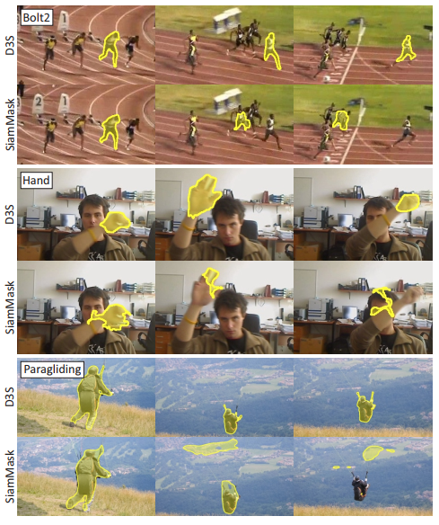
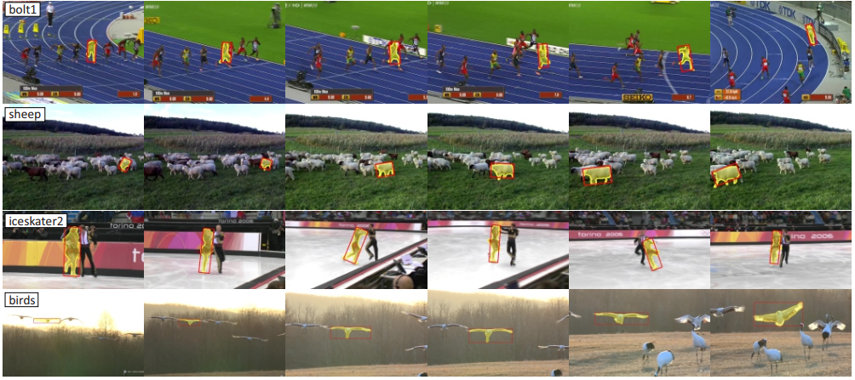
Comparison with SiamMask
Performance in Presence of Distractors

Slide 17
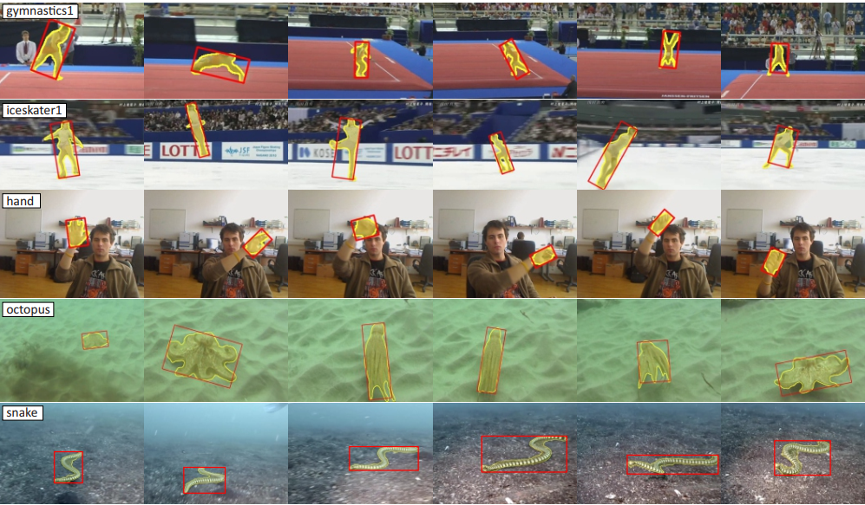
Performance in Appearance Change and Deformation

Slide 18
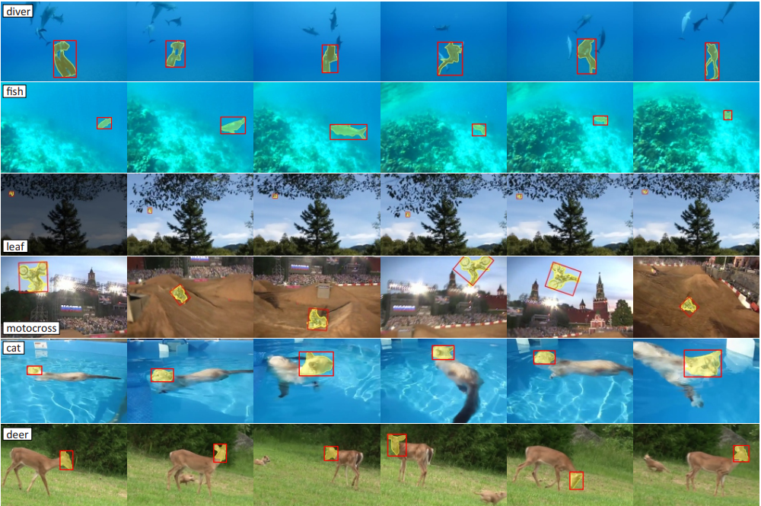
Difficult Examples

Slide 19
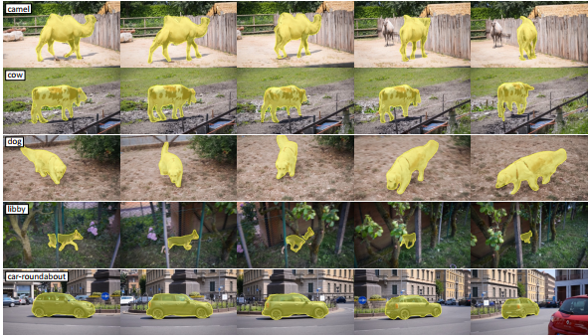
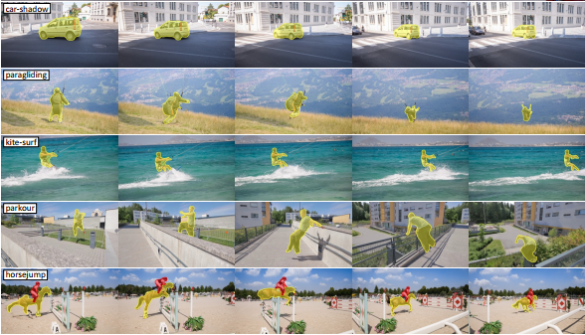
Performance on Davis Dataset

