Slide 1
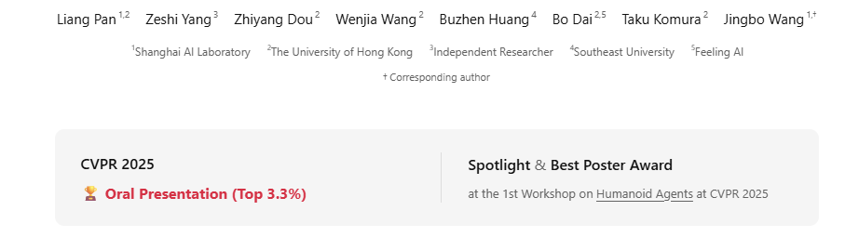
TokenHSI: Unified Synthesis of Physical Human-Scene Interactions through Task Tokenization

Slide 2
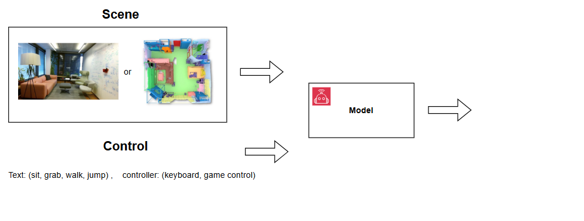
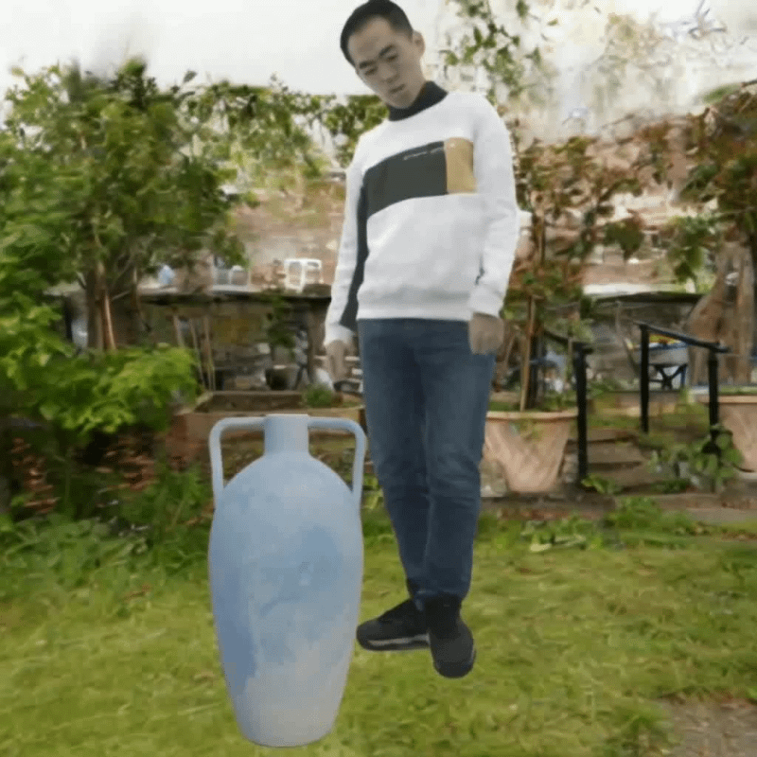
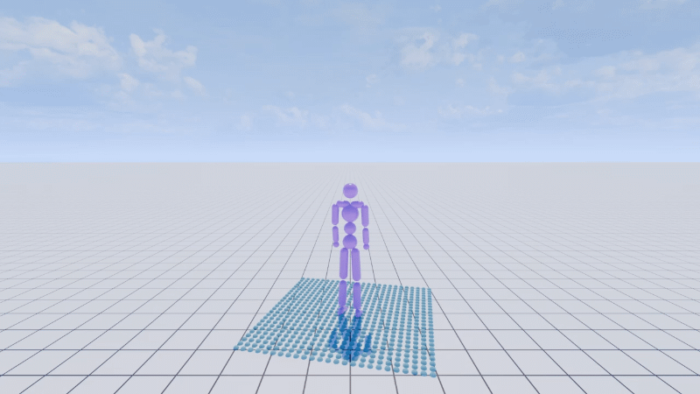
Background and Motivation
Human Scene Interactions → (Game, Video Generation, VR/AR)
Notes:
Talk about The key insight is to model the humanoid proprioception
, we aim to establish a unified controller for learning versatile human-scene interaction skills and to explore an effective method for adapting learned skills to new tasks and environments, thereby narrowing the gap between simulated characters and real-world humans

Slide 3
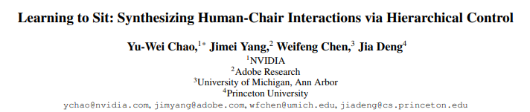
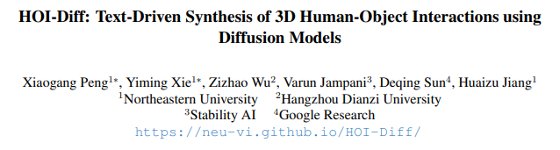
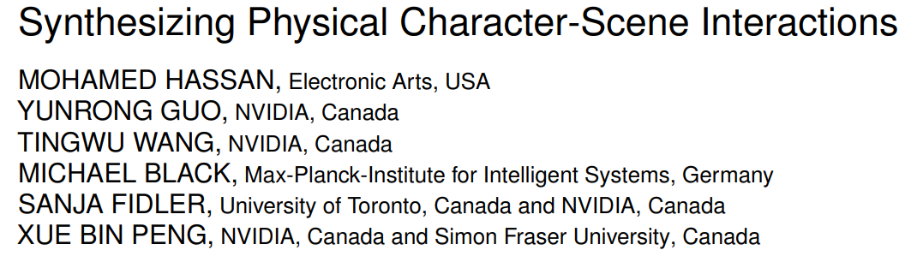
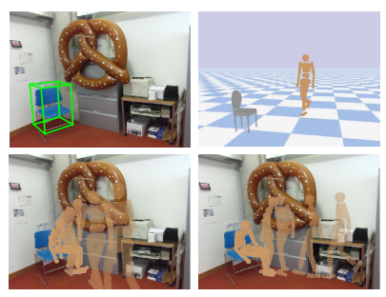
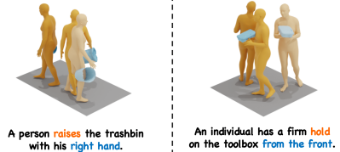
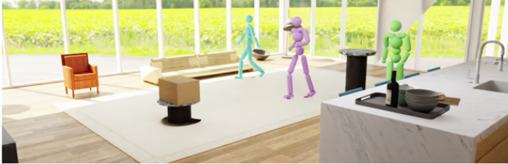
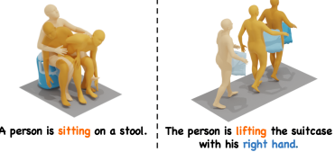
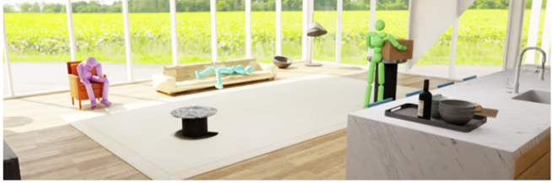
Existing work
Tackle Specific Interaction Problem
Object Level Interaction
Scene Level Multi-Task Interaction
Notes:
Talk about The key insight is to model the humanoid proprioception
, we aim to establish a unified controller for learning versatile human-scene interaction skills and to explore an effective method for adapting learned skills to new tasks and environments, thereby narrowing the gap between simulated characters and real-world humans

Slide 4
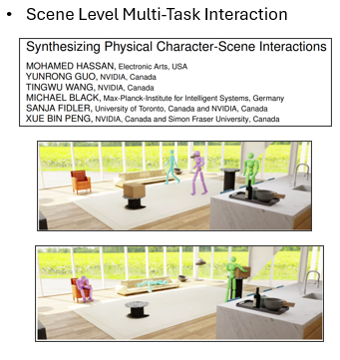
Research Gap - TokenHSI
Human can learn new skills quickly …
  Many experiences from skills learned in past
  Can we apply the same to models
TokenHSI
  a unified transformer-based policy
    enables effective knowledge sharing across skills, thereby facilitating the multi-task training.
Tasks: Sit, Lie down, Carry
  Train Policy per task
Notes:
Indiviudal policy required
Why HSI good

Slide 5
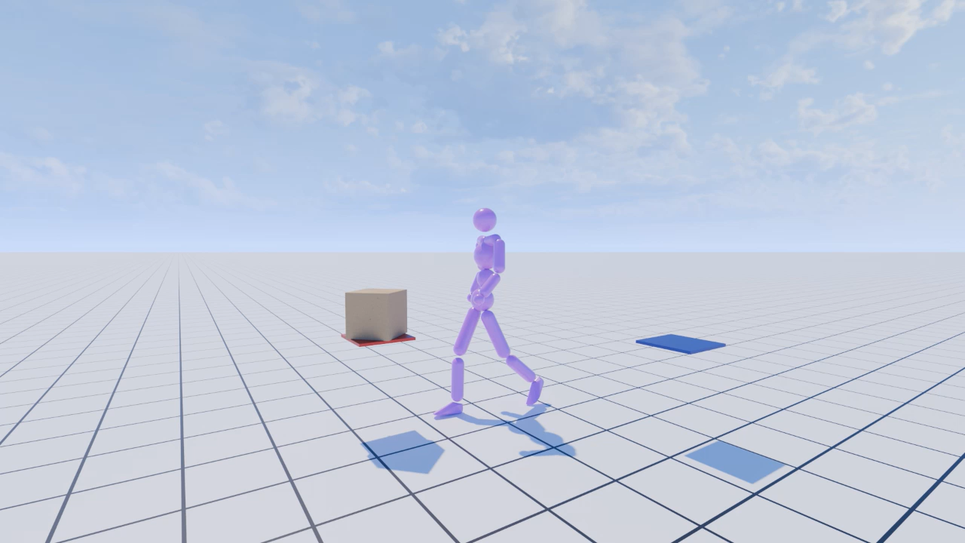
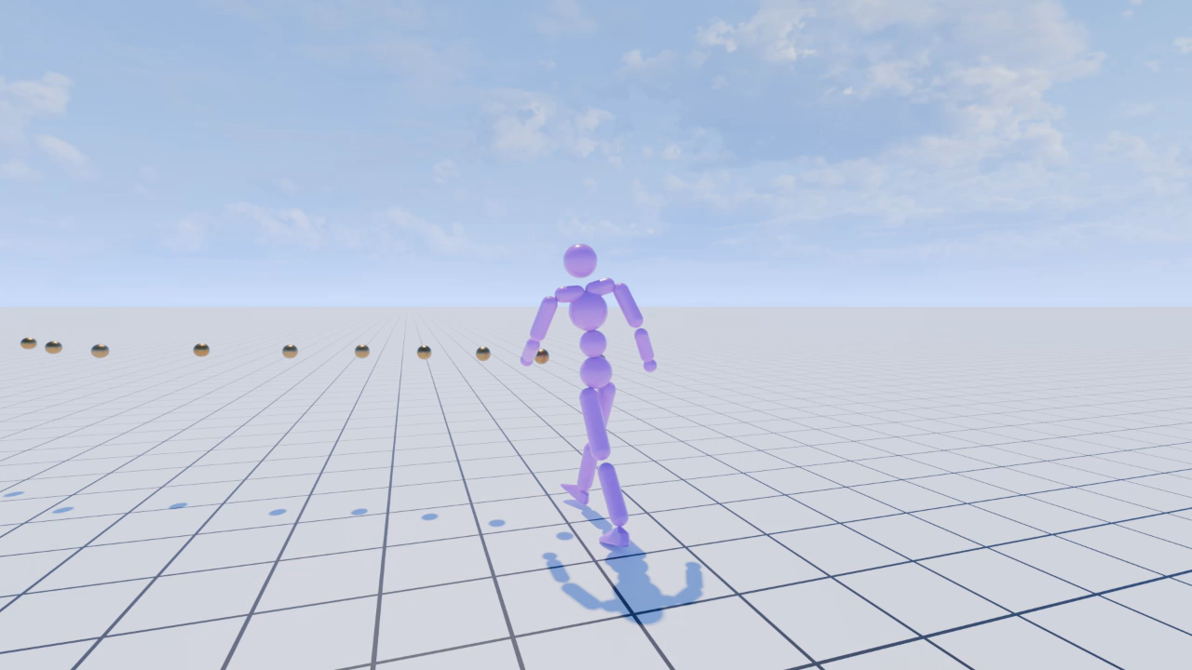
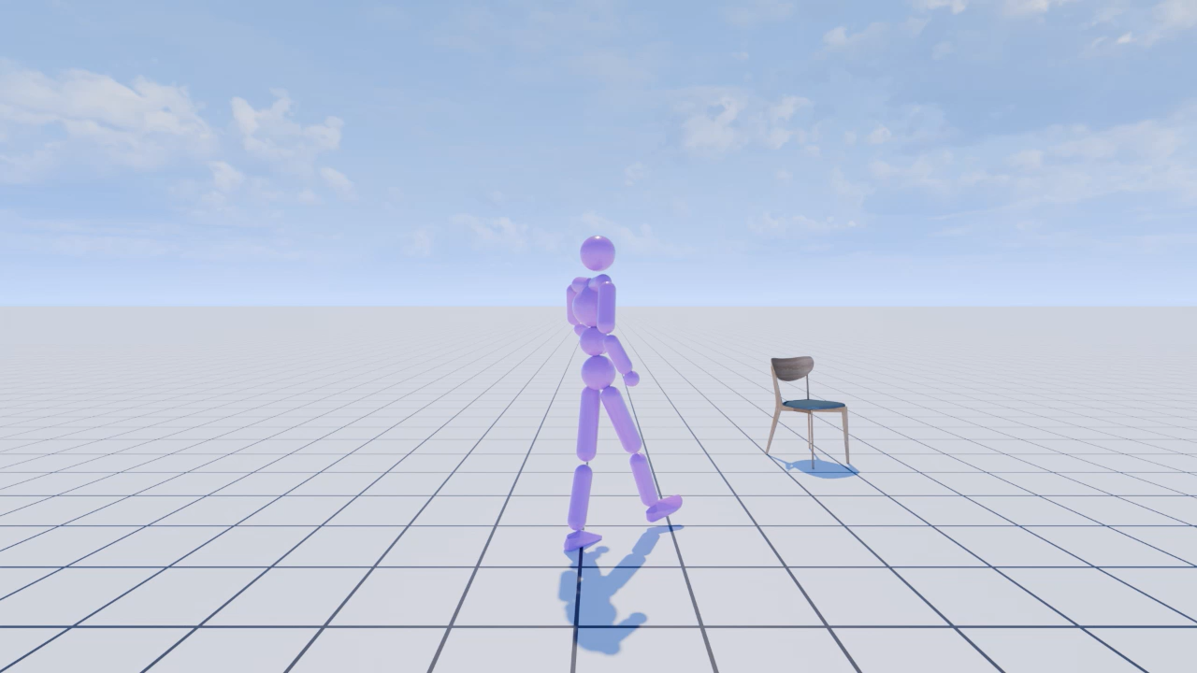
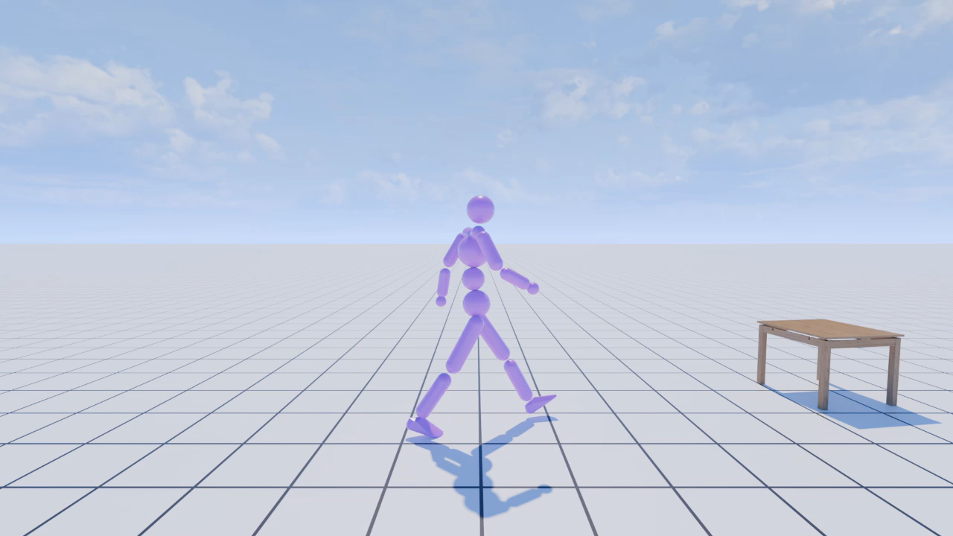
Task definition
Training: 4 main tasks → Foundation Skill Learning
  Carry
  Follow
  Sit
  Climb (stairs)
Notes:
Fundation Skill Learning
When new task comes in, these experieemecne can be learned
- combination of different task (as example)

Slide 6
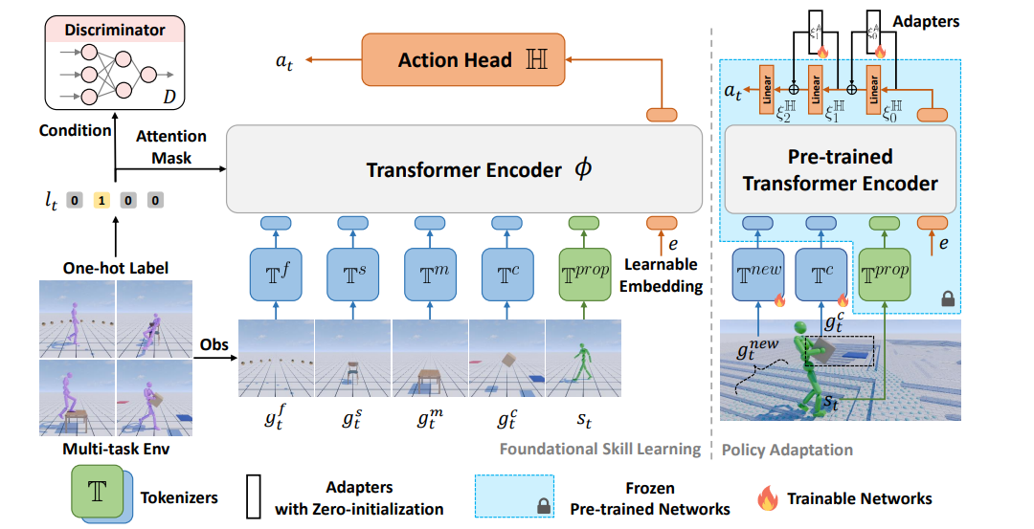


Methodology
Notes:
Talk about The key insight is to model the humanoid proprioception
-----------
Talk about Mask
--------------
Tokenizer → MLP → 64 dim
Transformer → 4 layers (2 attention head with 512 dim each)
Learnable Embedding → 64 dim
Action Head, MLP with 1024 → 512 → 32
---------------------------
Depends on the task,
Gtf → 2* 10
Gst → 3 target position, 3 char position, 6 chari’s orientation 6D rotation, 2 for chari facing direction, and 24 for 8 bounding point box. Totla of 38
Gct → box rotation, translation velcoity

Slide 7
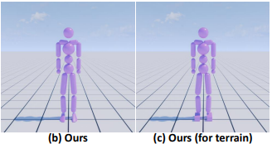
Methodology
15 rigid bodies
12 controllable joints
$$T^{prop}∈ℝ^{222} :issacn gym^{′}s body representaiton$$
Joints, Body orientation, position, velocity etc.
Notes:
Talk about The key insight is to model the humanoid proprioception
-----------
Talk about Mask
--------------
Tokenizer → MLP → 64 dim
Transformer → 4 layers (2 attention head with 512 dim each)
Learnable Embedding → 64 dim
Action Head, MLP with 1024 → 512 → 32
---------------------------
Depends on the task,
Gtf → 2* 10
Gst → 3 target position, 3 char position, 6 chari’s orientation 6D rotation, 2 for chari facing direction, and 24 for 8 bounding point box. Totla of 38
Gct → box rotation, translation velcoity

Slide 8
Training & Evaluation
Training Step:
  Choose task
  Simulate the action in Issac Gym
  Task reward + Style reward
  Critic V function (MLP)
  PPO Update
Training : 50K Proximal Policy Optimization iteration
  512 trials (per task) for evaluation

Slide 9
Environment and Success Definition
Follow:
  20 points
  within 30 cm from the end point
Sit and Climb.
  object is spawned between 1 m and 5 m from the character with randomized orientation
  the pelvis to lie within a 20 cm radius sphere centered at the target location
Carry
  box is placed between 1–9 m from the character
  random orientation
  Similar to above for success definition

Slide 10
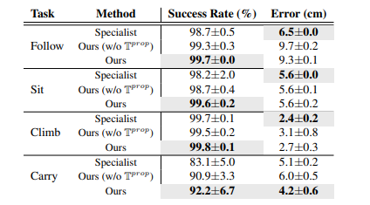
Empirical Result

Slide 11
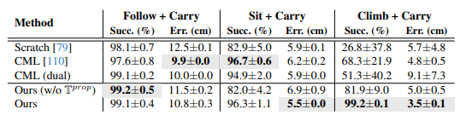
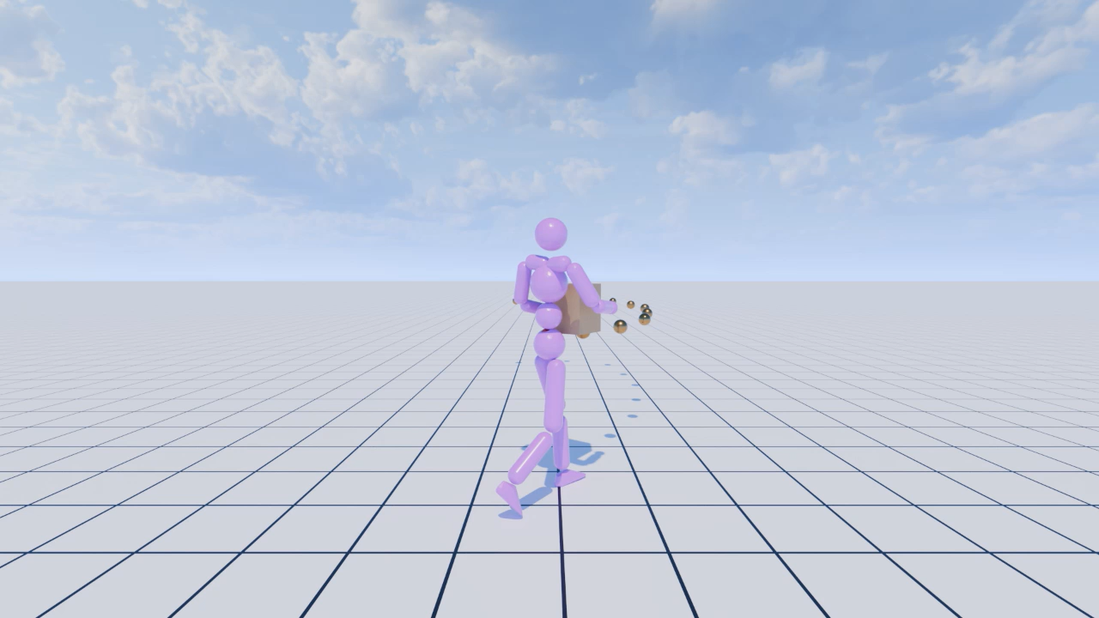
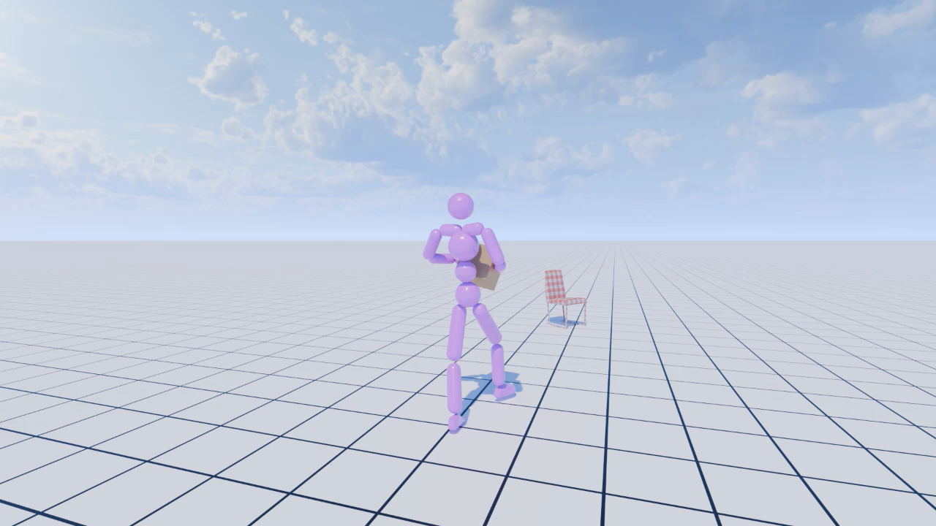
“New Task” (Task Composition)
Notes:
CML: inorudce new policy but with old policy’s guidance

Slide 12
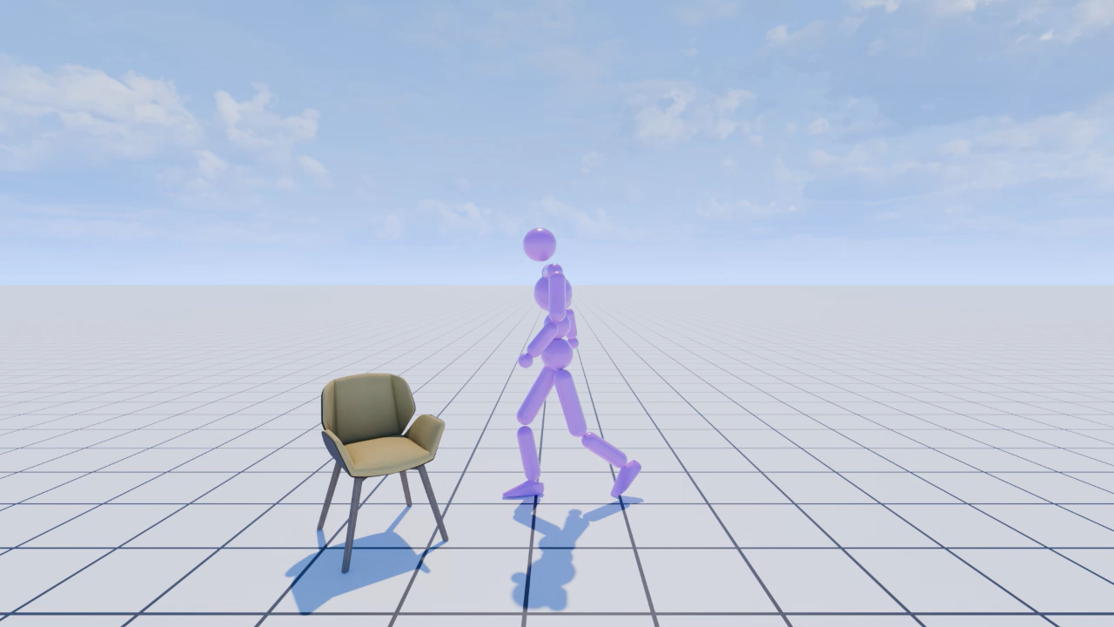
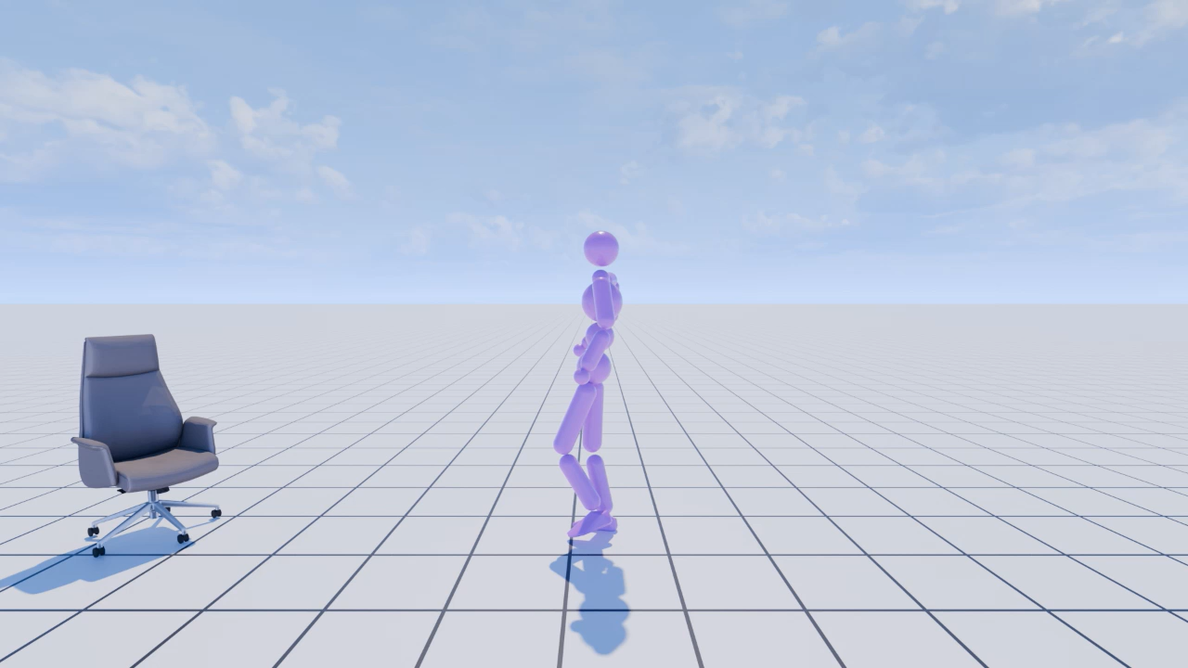
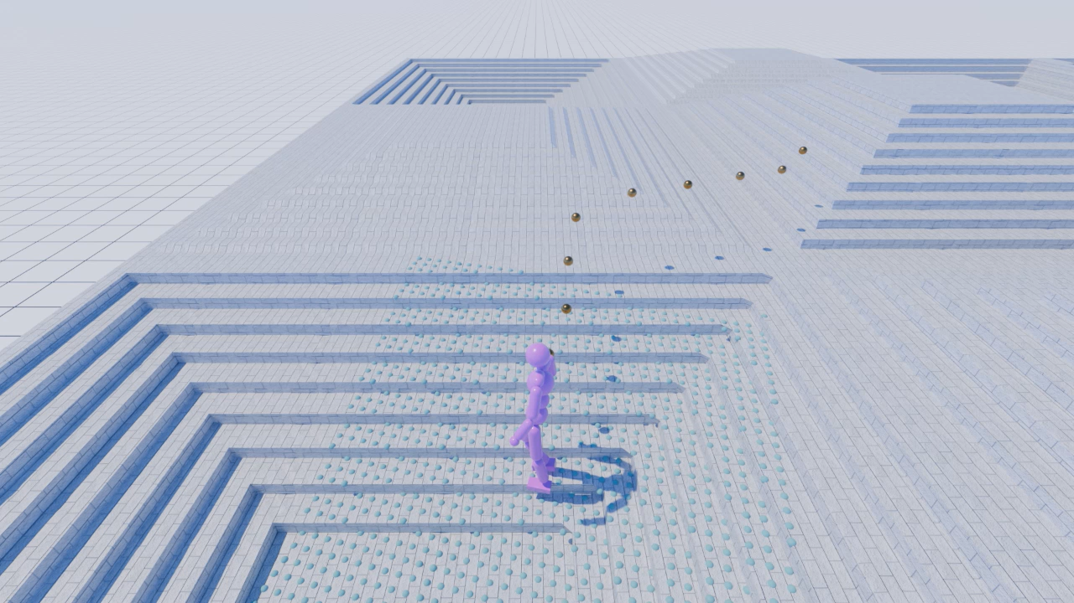
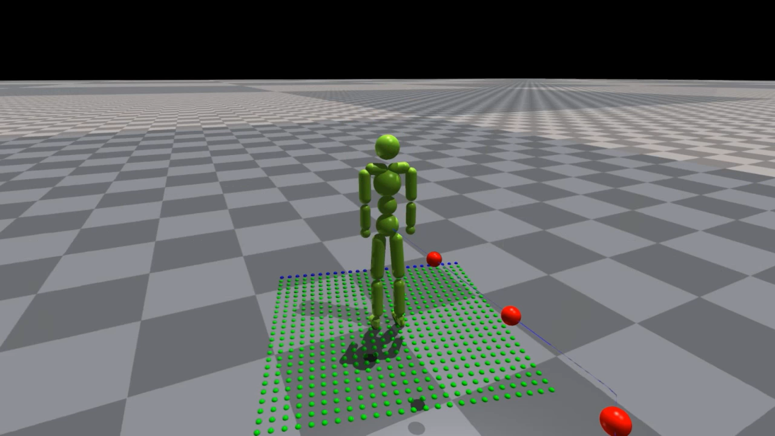
New Task (More…)

Slide 13
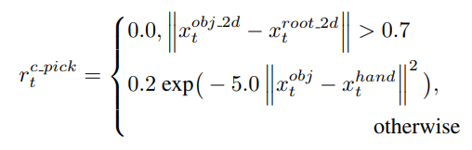
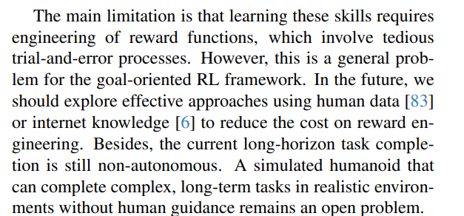
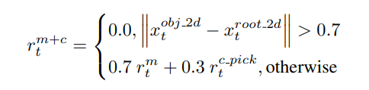
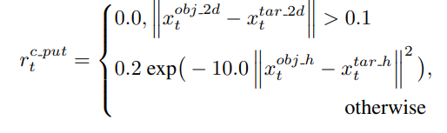
Limitation: Reward Design
Luck and Pain (10 Reward Function)

