Slide 1
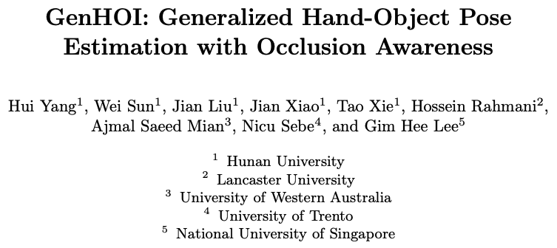
GenHOI: Generalized Hand-Object Pose Estimation with Occlusion Awareness
Journal Club
ECCV 2026
Presenter: Pengyu Zhang

Slide 2
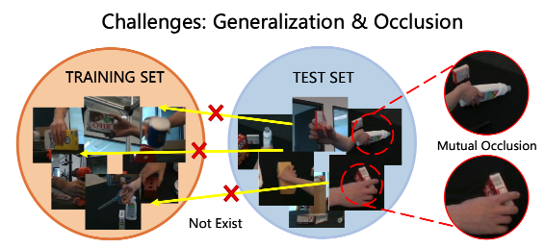
Motivation
Existing hand-object pose estimation (HOPE) models only utilize appearance cues to capture surface patterns, which limits generalization to unseen categories and diverse interaction scenarios.
Existing methods rely on keypoints detection, which makes it highly sensitive to occlusions.

Slide 3
Contributions
Hierarchical semantic prompts are introduced, which encode object states, hand configurations, and interaction patterns through textual descriptions. This supports pose estimation under occlusion with stronger generalization.
Furthermore, hand priors are leveraged as stable spatial references to extract implicit constraints. This helps the model infer object poses across variations in object shapes and interaction patterns, which improves generalization.
A multi-modal masked modeling strategy is designed over RGB images, predicted point clouds, and textual descriptions, to learn occlusion-aware representations and infer missing visual cues.

Slide 4
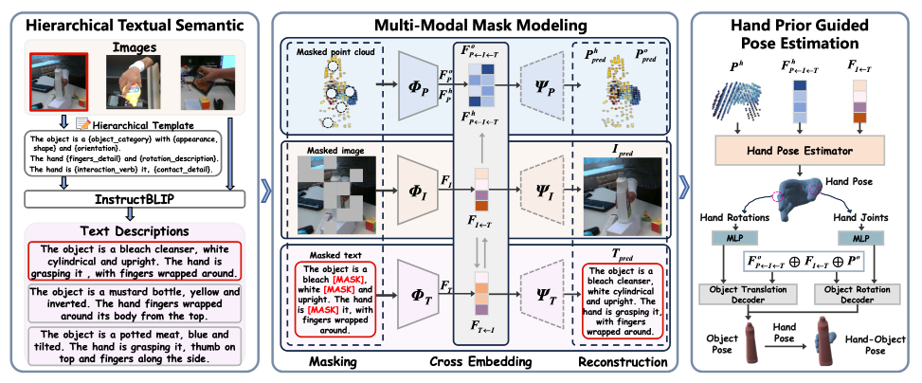
Framework
Hierarchical Textual Semantic: generates hierarchical description via InstructBLIP following the hierarchical template.
Multi-Modal Mask Modeling: reconstructs three modalities via interacted features.
Hand Prior Guided Pose Estimation: estimates the object pose with the guidance of hand pose.

Slide 5
Framework
Hierarchical Textual Semantic
The semantic information is generated via InstructCLIP, contains object-level semantics, hand-level semantics and interaction-level semantics.
Object-level semantics: The object is a {object_category} with a {shape, appearance}, and {orientation_description}.
Hand-level semantics: The hand {fingers_detail} and {rotation_description}.
Interaction-level semantics: The hand is {interaction_verb} it, {contact_detail}.

Slide 6
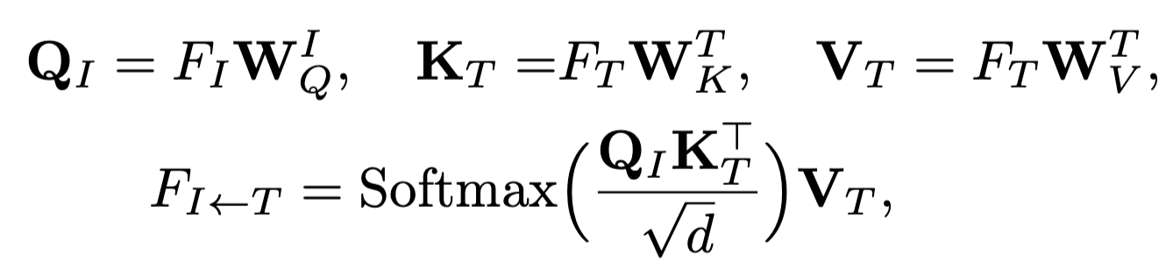
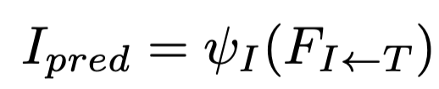

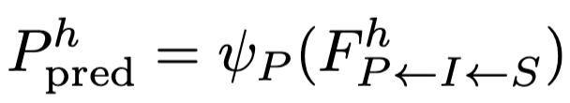
Framework
Multi-Modal Mask Modeling
Modality-specific mask modeling strategy are used to enhance occlusion awareness and improve cross-modal consistency.
Those modalities are masked individually.
The interacted features are used to reconstruct each modality.
Interact RGB with text
Interact text with RGB
Interact text with point cloud
T

Slide 7



Framework
Hand Prior Guided Pose Estimation
Hand pose is first predicted with the guidance of learned Signed Distance Function.
Feature concatenation
T
Object pose is then obtained using hand pose estimation.

Slide 8
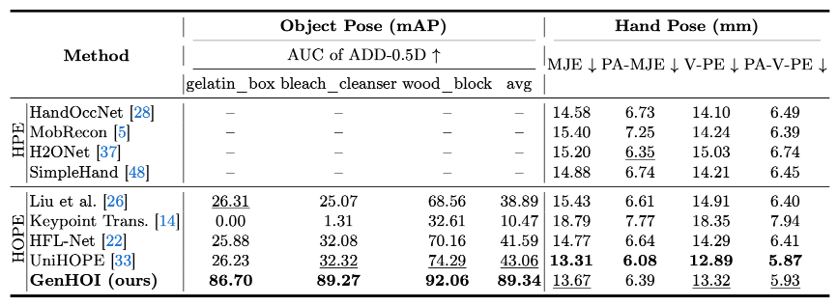
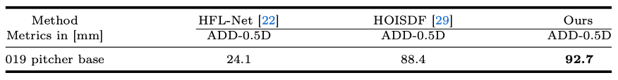
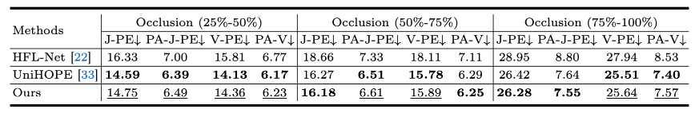
Experiments on Unknown Objects and Occlusion Scenes
Evaluation of hand and object pose estimation on the DexYCB S3 split (3 unseen objects are included.).
Quantitative results on the unseen object (“019 pitcher base”) from the HO3Dv2 dataset.
Quantitative comparison of hand mesh with across occlusion levels on DexYCB S3 split dataset.
Notes:
Our method achieves com-parable performance under heavy occlusion despite UniHOPE includes a dedi-cated hand-occlusion removal module.

Slide 9
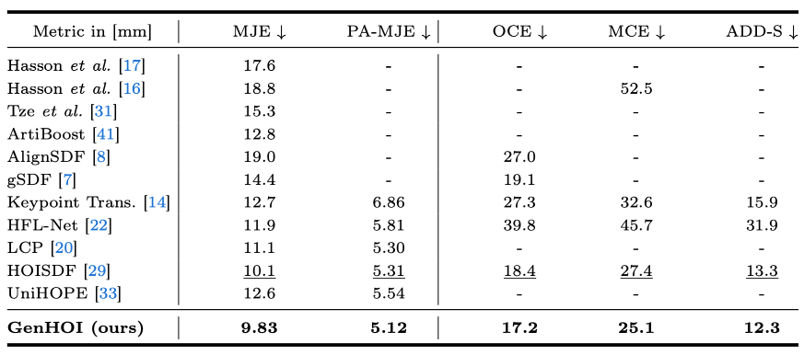
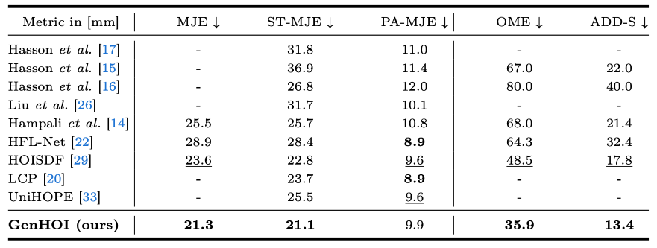
Comparison on Full Sets of DexYCB and HO3D
Comparison with SOTA hand-object pose estimation methods on the DexYCB S0 split dataset.
Comparison with SOTA hand-object pose estimation methods on the HO3Dv2 dataset.

Slide 10
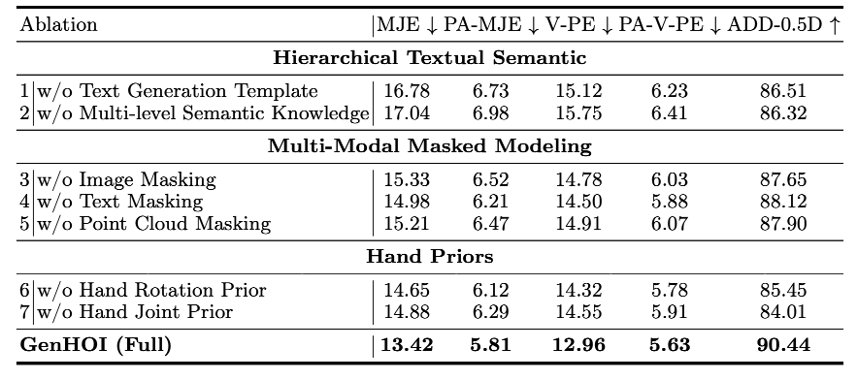
Ablation Analysis
Ablation study of our proposed components on the DexYCB dataset S3 split.
Text description shows important roles for pose estimation.
Image masking contributes the most to performance.
The removal of hand priors leads to a clear drop in object pose accuracy.

Slide 11
Conclusion and Takeaways
Text description, representing hand details, object shape and interaction, shows important role for pose estimation.
Mask modeling is a reasonable solution for handling both hand and object occlusion.
Prior works^{[1, 2]} provide an evaluation protocol for occlusion-aware pose estimation on DexYCB.
[1] Wang et al. (CUHK). UniHOPE: A Unified Approach for Hand-Only and Hand-Object Pose Estimation. In CVPR 2025.
[2] Yang et al. (Hunan University) GenHOI: Generalized Hand-Object Pose Estimation with Occlusion Awareness. In ECCV 2026.

