Slide 1
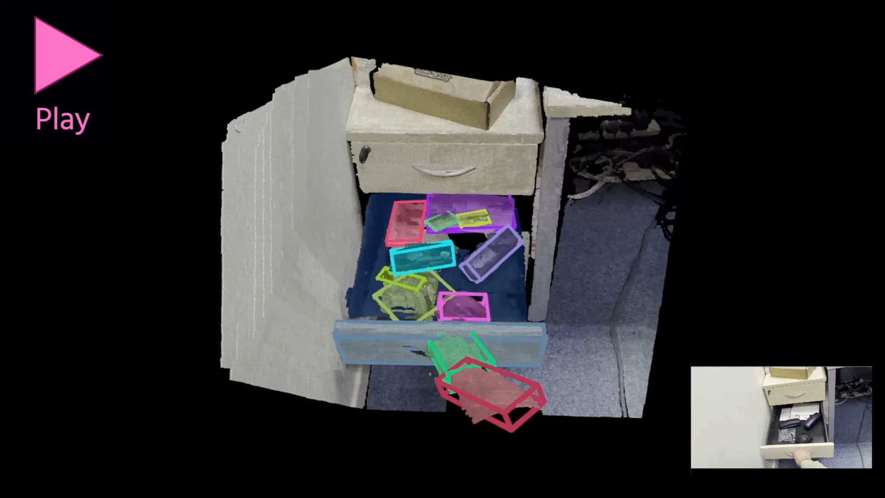
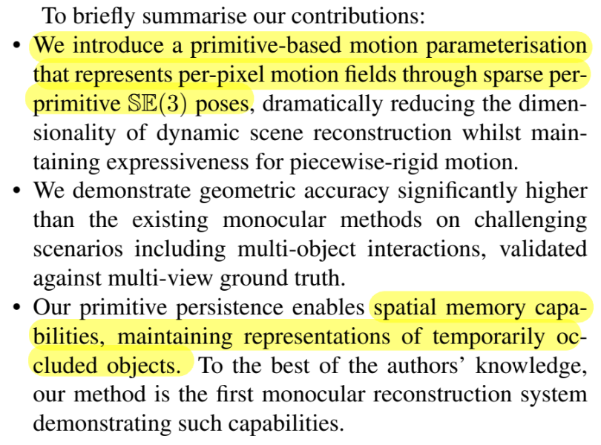
4D Primitive-Mâché
Glueing Primitives for Persistent 4D Scene Reconstruction
Kirill Mazur Marwan Taher Andrew Davison
Dyson Robotics Lab | Imperial College London
CVPR 2026 Oral
https://makezur.github.io/4DPM/
4D Primitive-Mâché builds persistent and replayable 4D reconstructions of dynamic scenes by glueing 3D primitives together.

Slide 2
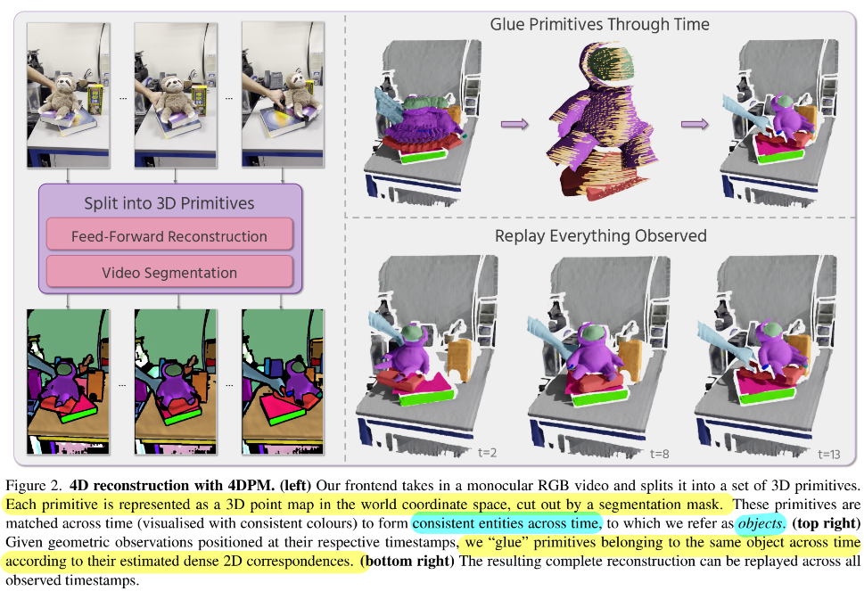
Pipeline

Slide 3

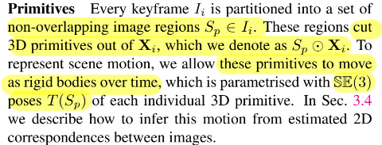
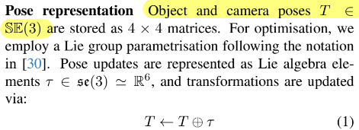

Formulation
point maps $X_{k}^{t}∈ℝ^{H×W×3}$,
3D geometry captured from camera $k$ and warped to time $t$ in world coordinates.
video sequence $ℐ=\left\{I_{0},…,I_{n} | I_{i}∈ℝ^{H×W×3}\right\}$,
Key Difference:
Prior works:
reconstructs image-aligned point maps only at their respective observation times, yielding $\left\{X_{0}^{0} , X_{1}^{1} , … , X_{n}^{n}\right\}$.
4DPM:
the scene reconstruction at time $t$ is the collection $𝒳^{t}=\left\{X_{0}^{t} , … , X_{n}^{t}\right\}$.
We achieve this by taking observation-time point maps from a feed-forward model ($π^{3}$) as input to our 3D primitive glueing method.

Slide 4
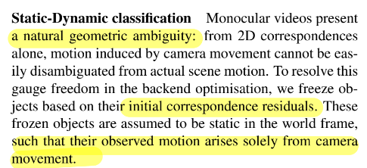
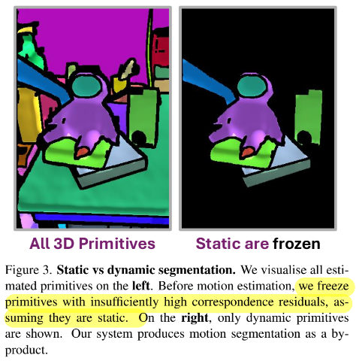
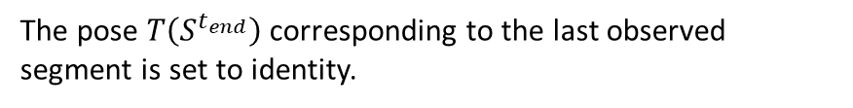
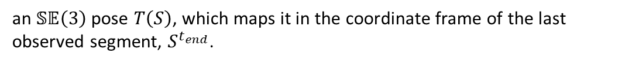

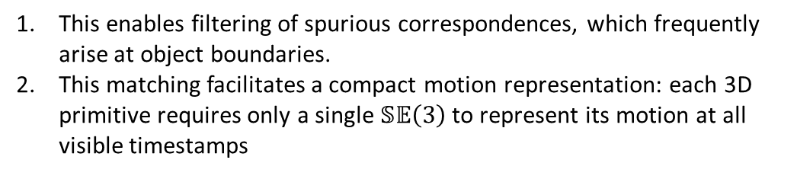
Objects
Is this a limitation?
The scene primitives are clustered into object groups $𝓞$.
Each object $𝒪$ is a set of primitives, grouped by time $𝒪=\left\{S^{t_{s​t​a​r​t}} , … , S^{t_{e​n​d}}\right\}$.
Assumption: each object-like entity is rigidly moving in the scene.
Why form object-like structures?
This enables filtering of spurious correspondences, which frequently arise at object boundaries.
This matching facilitates a compact motion representation: each 3D primitive requires only a single $𝕊​𝔼​\left(3\right)$ to represent its motion at all visible timestamps
object $𝓞$’s motion:
an $𝕊​𝔼​\left(3\right)$ pose $T​\left(S\right)$, which maps it in the coordinate frame of the last observed segment, $S^{t_{e​n​d}}$.
The pose $T​\left(S^{t_{e​n​d}}\right)$ corresponding to the last observed segment is set to identity.

Slide 5
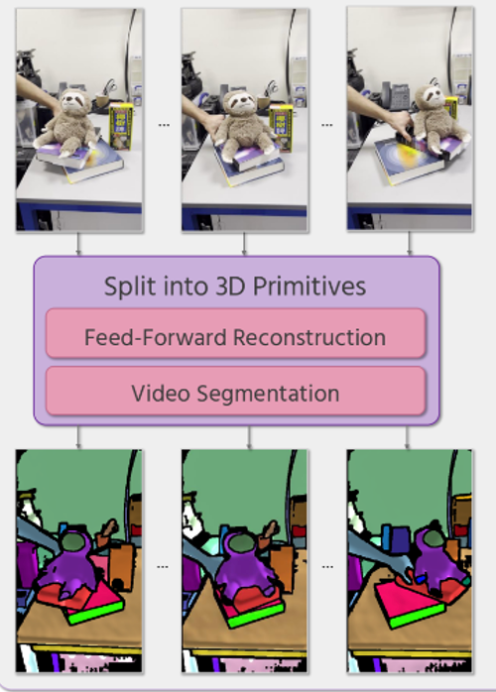
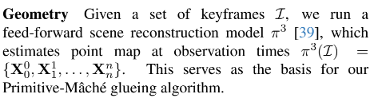
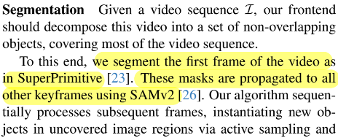

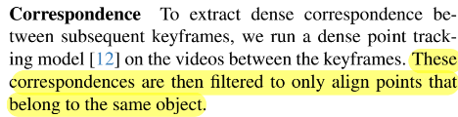
Frontend

Slide 6
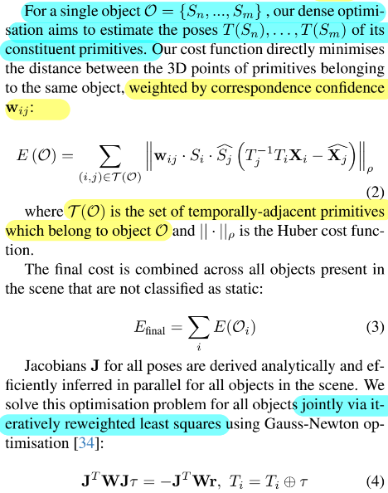
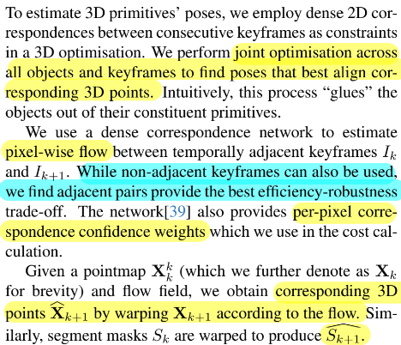
Backend

Slide 7
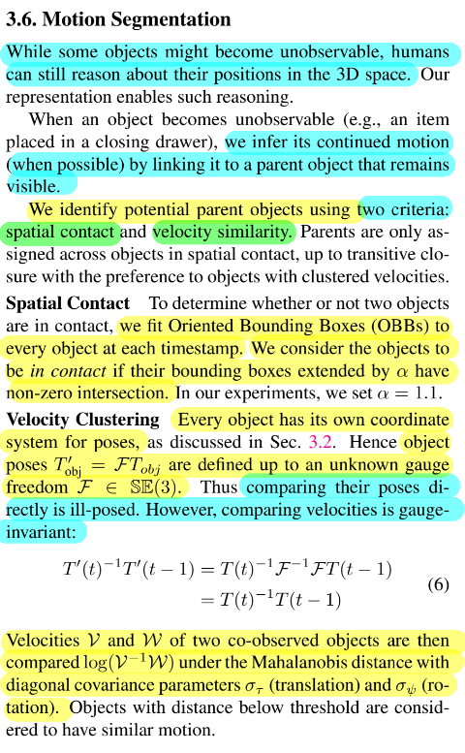

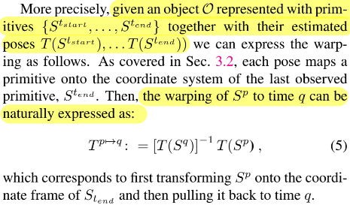

Slide 8
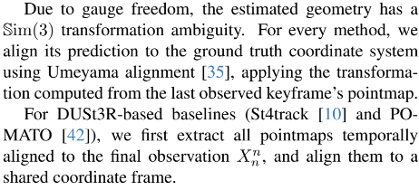

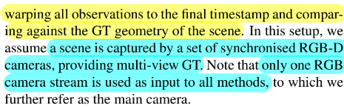
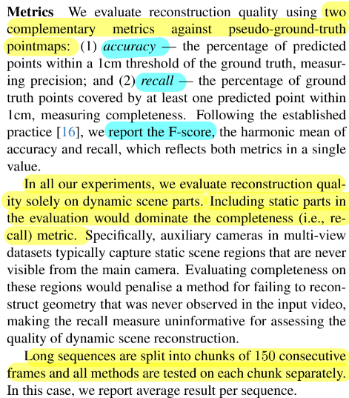
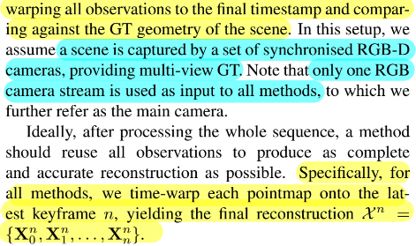
Experiments
How to evaluation this task:

Slide 9
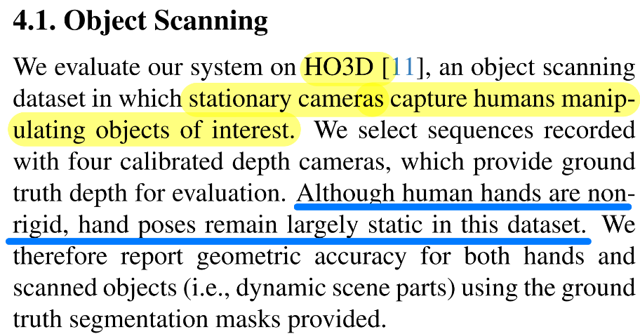
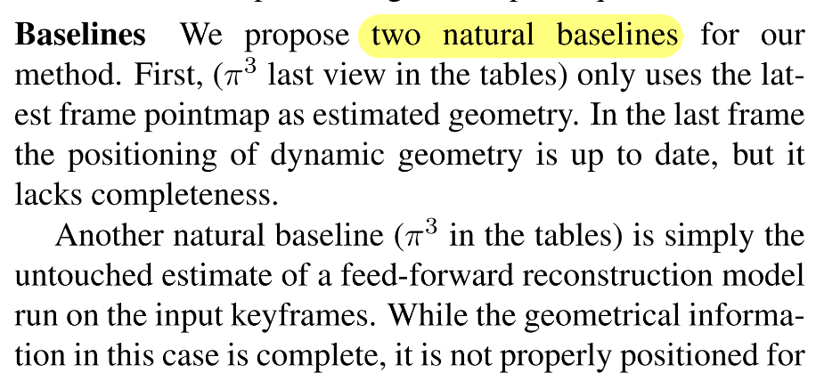
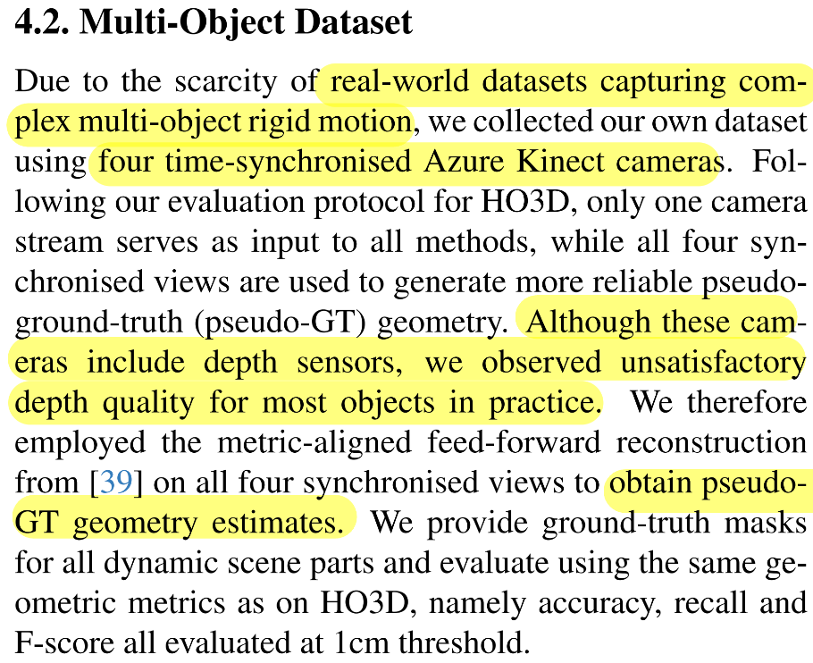
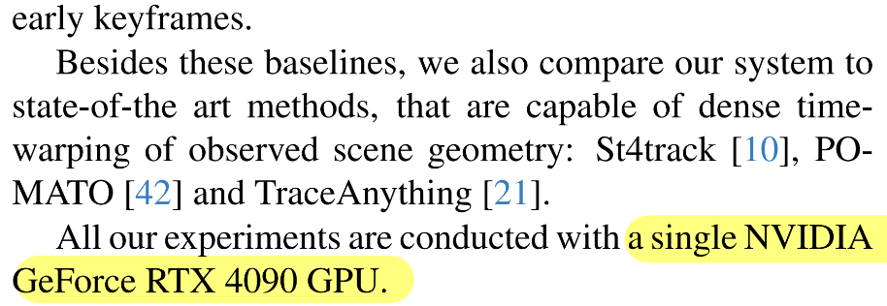
Experiments

Slide 10
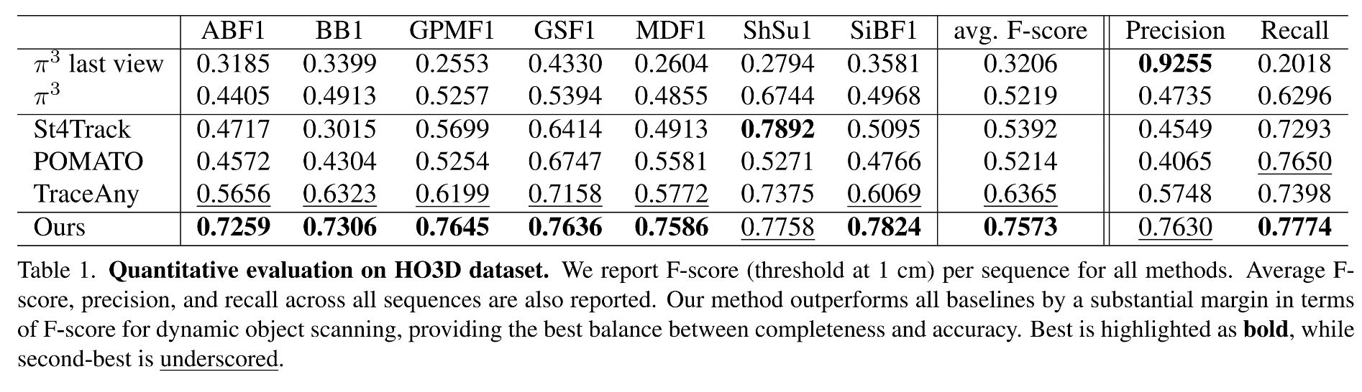
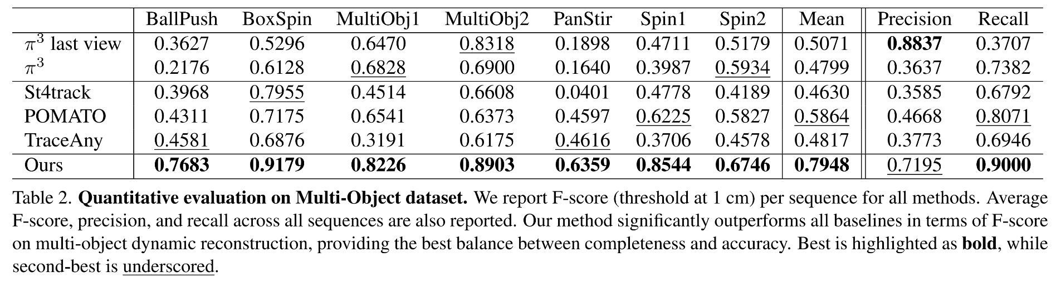
Experiments

Slide 11
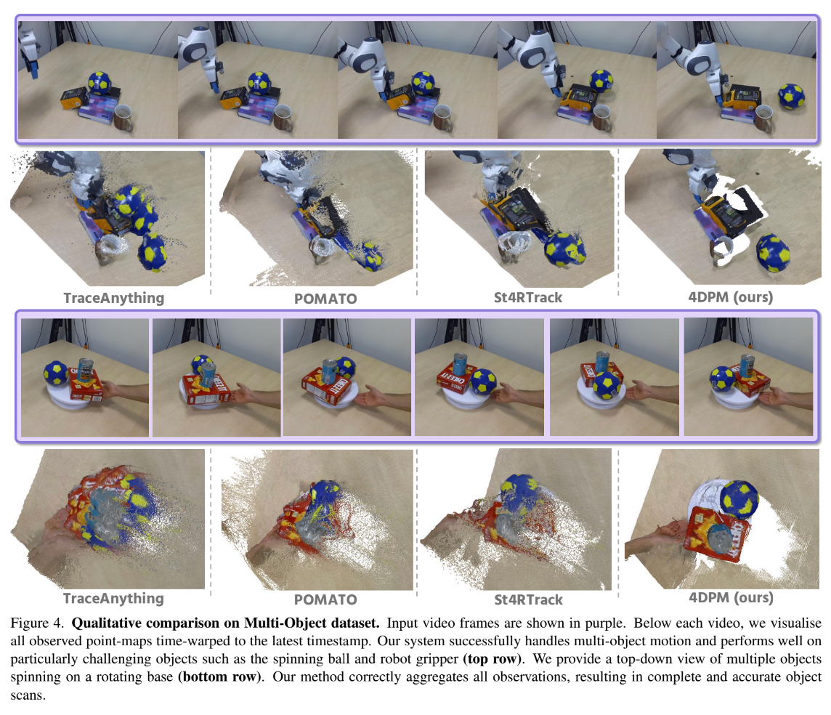
Experiments

Slide 12
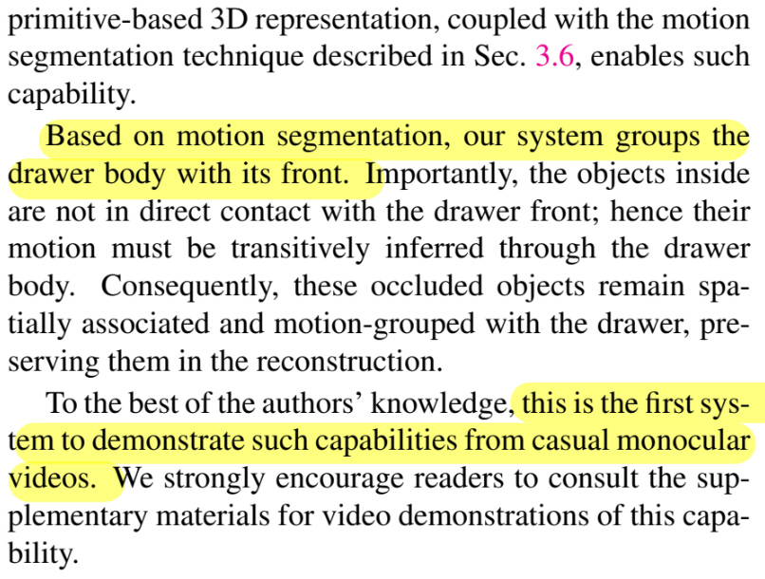
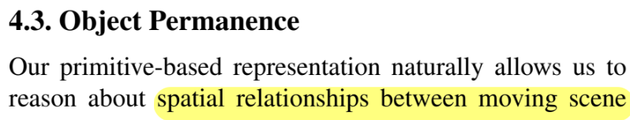
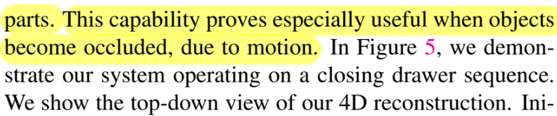
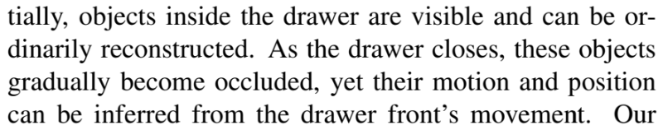
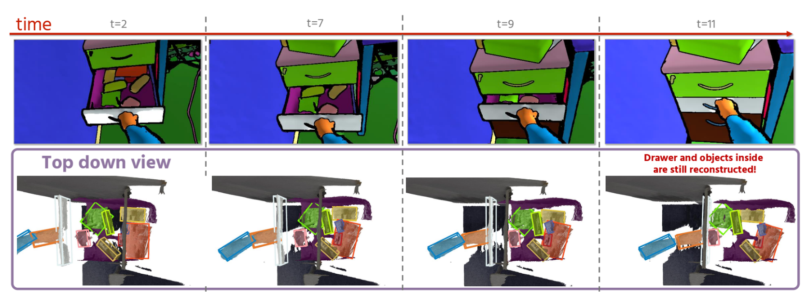
Experiments

Slide 13
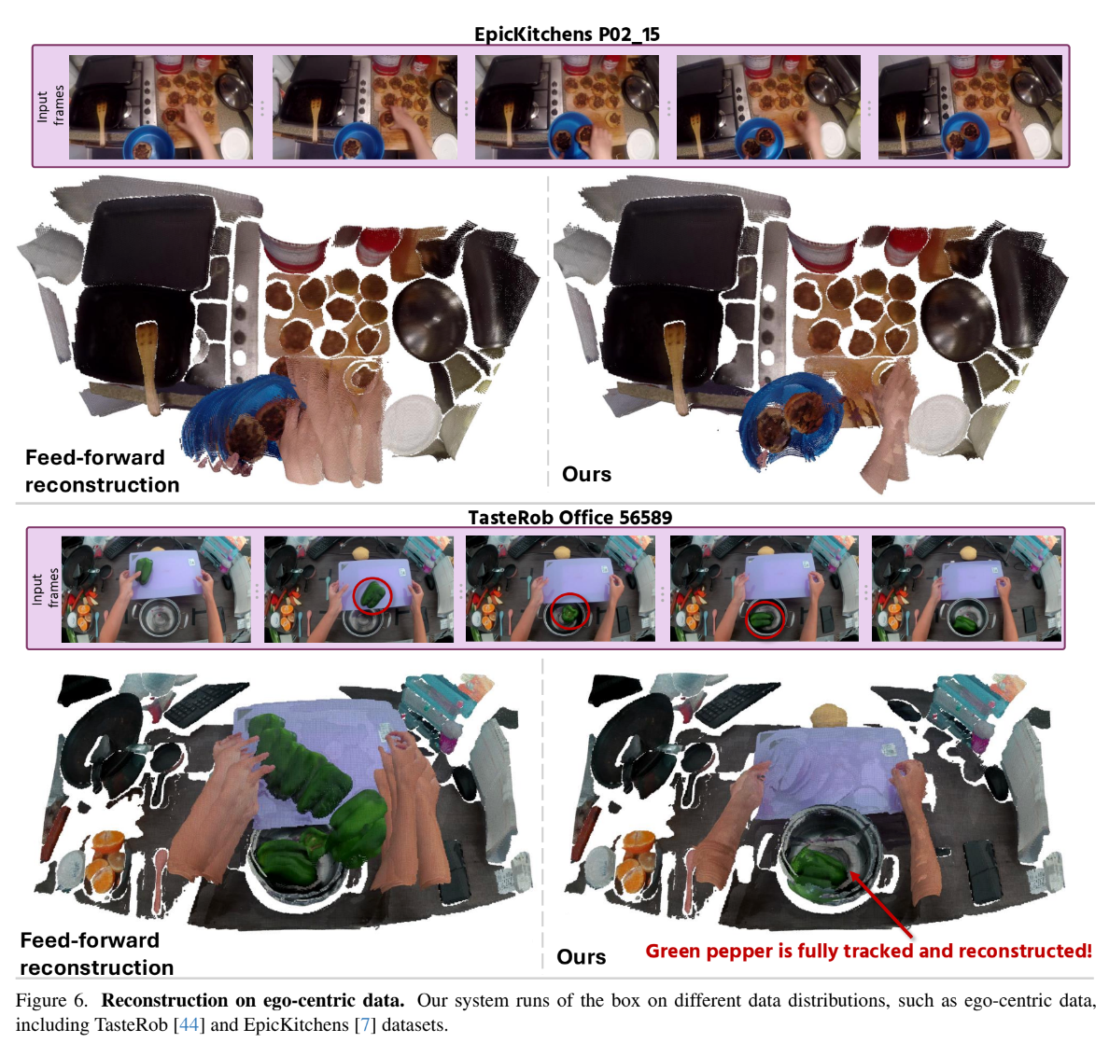
Experiments

Slide 14
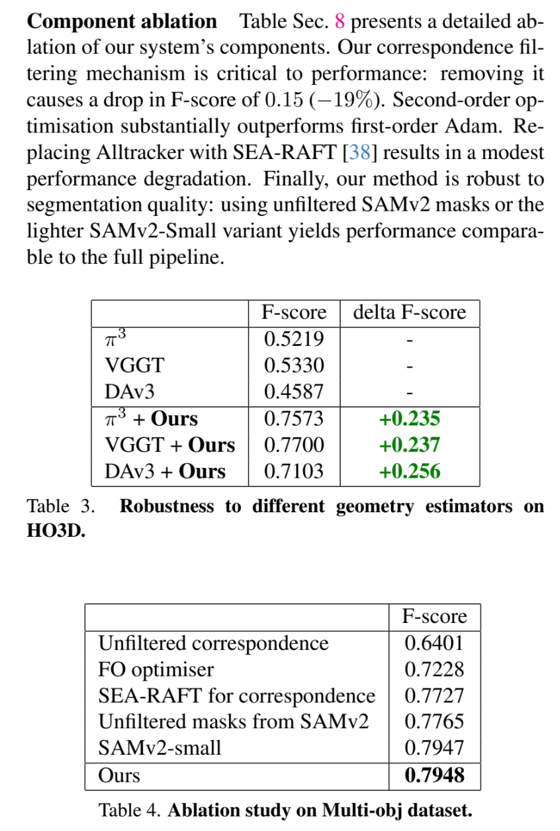
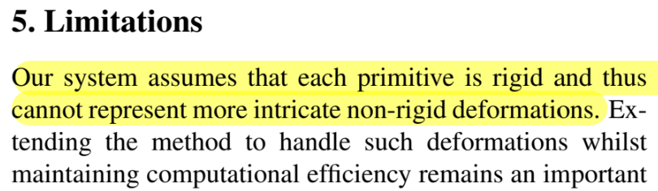
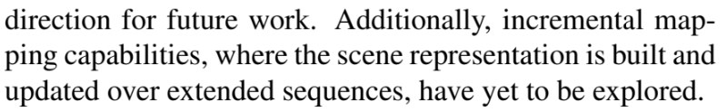

Slide 15
