Slide 1
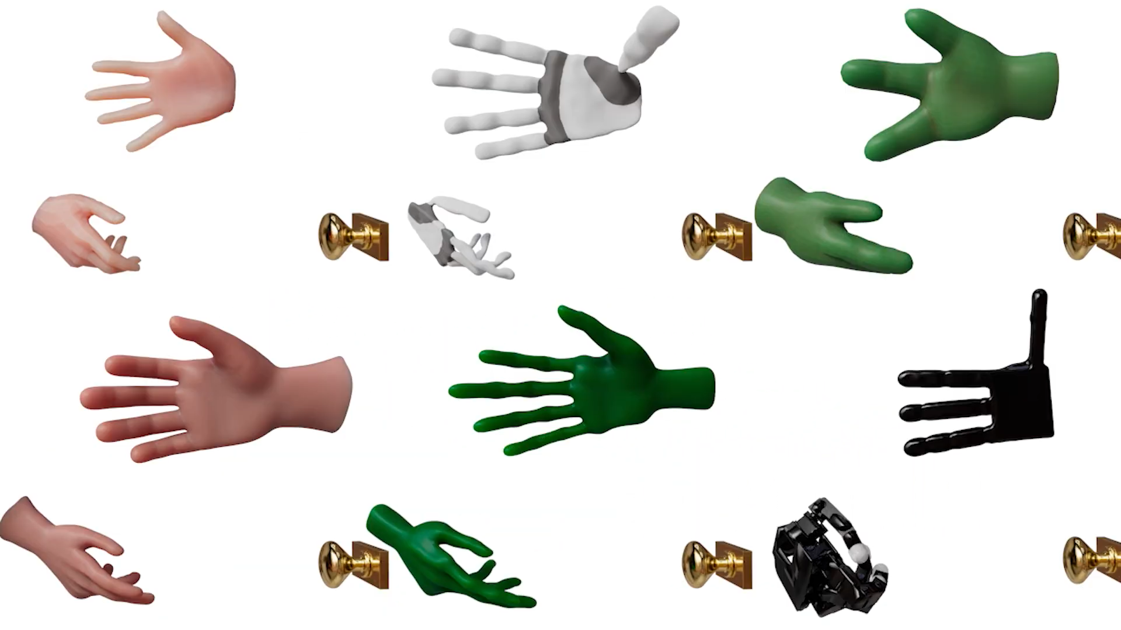

Kinematic Motion Retargeting for Contact-Rich Anthropomorphic Manipulations

Slide 2
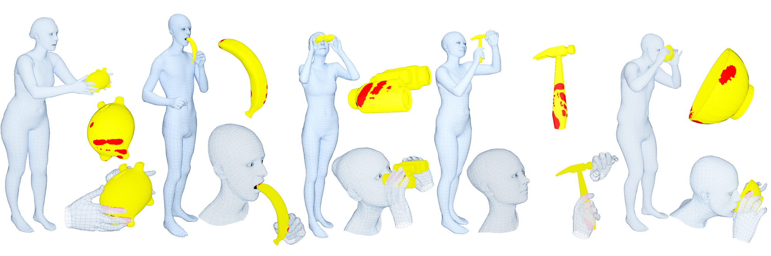
GRAB dataset

Slide 3
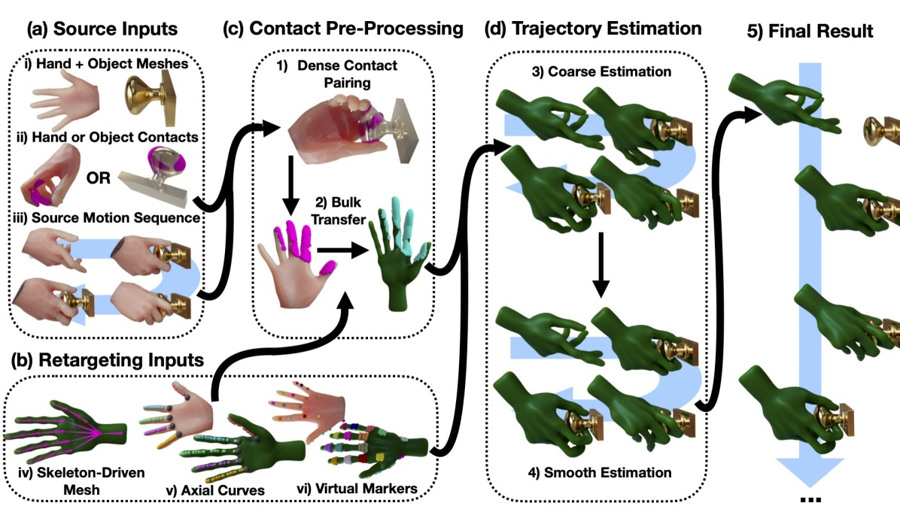
Method

Slide 4
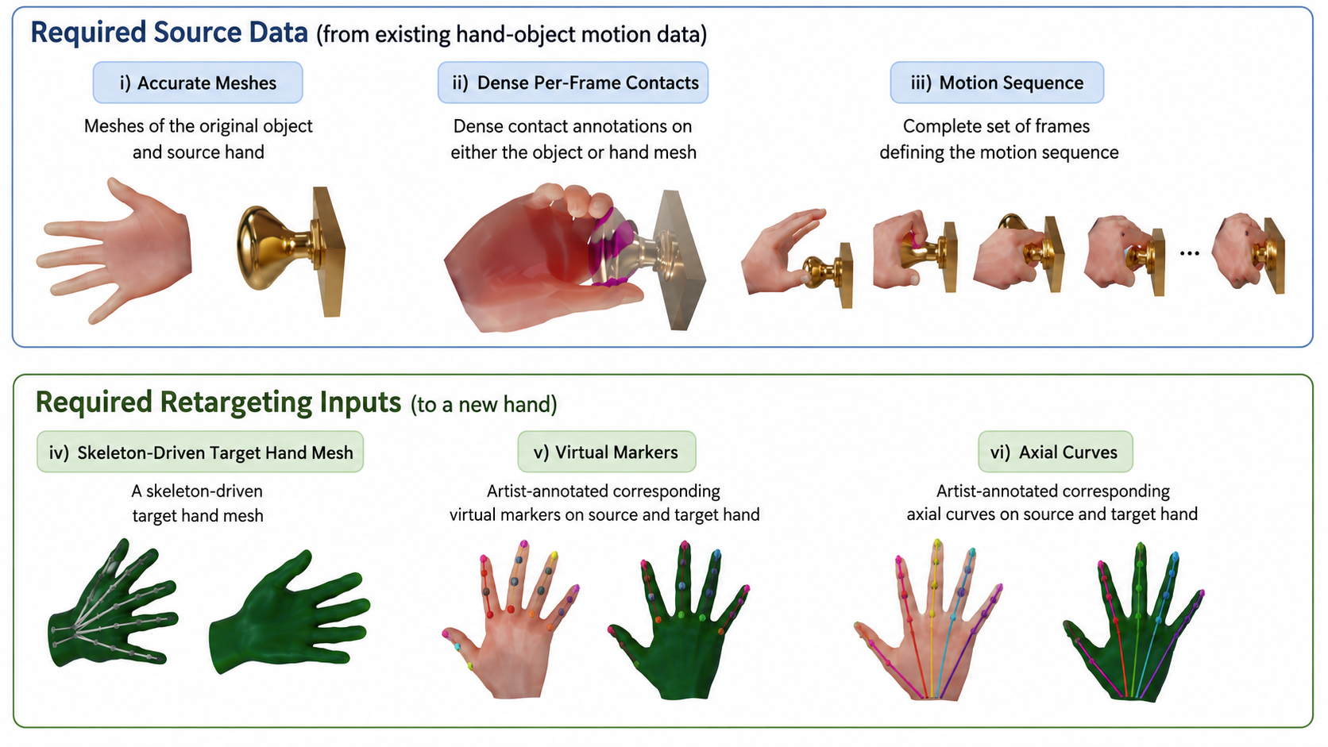
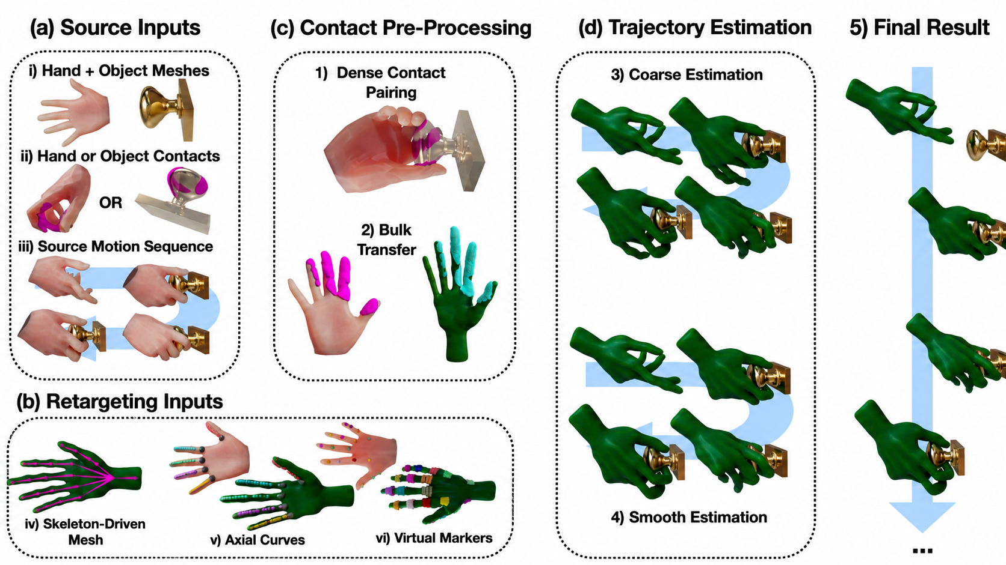
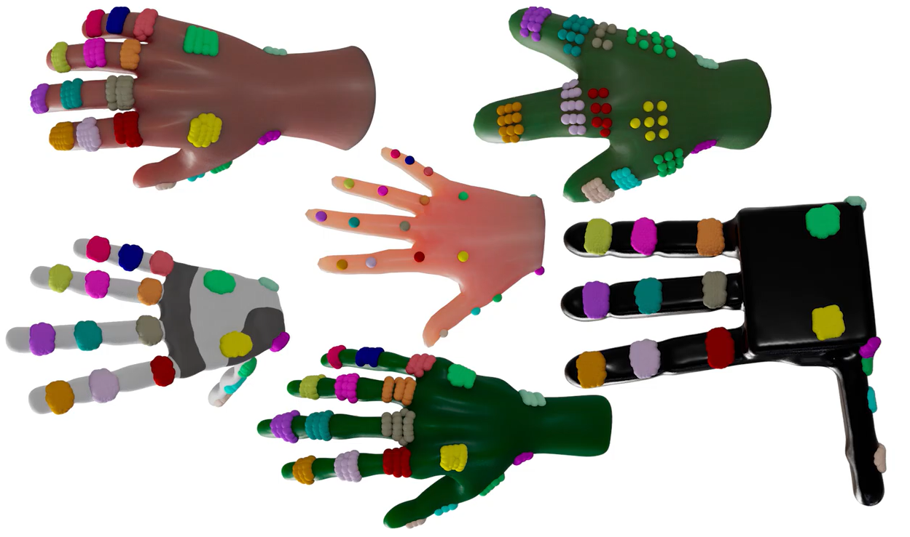
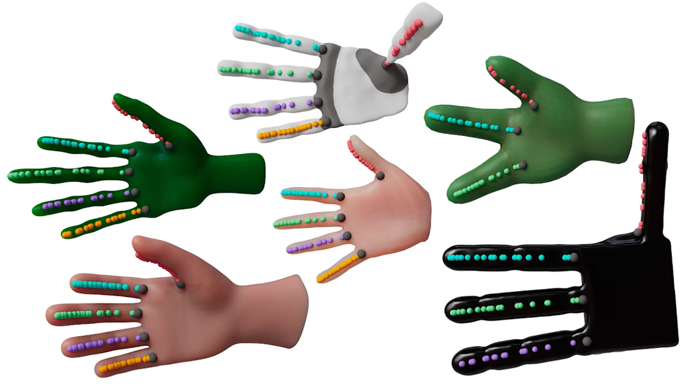
Inputs

Slide 5
Contact Pre-Processing
Notes:
Contact data in practice often comes as a dense set of points on just one surface — e.g. the GRAB dataset gives you contact points on the object, but not automatically paired with a corresponding point on the hand. Before you can transfer anything, you need a one-to-one correspondence: for every contact point on the object, which point on the hand is touching it right there?

Slide 6
Contact Pre-Processing
Contact Pairing
Contacts stored as barycentric coordinates → mesh-resolution agnostic (works across coarse MANO mesh and finer target meshes)
GRAB only gives contacts on one side (the object) → recover hand-side pairing via raycasting along surface normals
Ray outcomes: 0 hits = discard · 1 hit = invert ray (started inside hand) · 2+ hits = keep closer, discard if beyond threshold
Notes:
Contact data in practice often comes as a dense set of points on just one surface — e.g. the GRAB dataset gives you contact points on the object, but not automatically paired with a corresponding point on the hand. Before you can transfer anything, you need a one-to-one correspondence: for every contact point on the object, which point on the hand is touching it right there?

Slide 7
Virtual Marker Alignment
A fixed, one-time-annotated correspondence between a point (or region) on the source hand and a point (or region) on the target hand
Notes:
The problem this solves. Contact data doesn't exist for the whole motion — during pregrasp (hand approaching, not touching yet) or after release, there's nothing for the contact term to grab onto. Virtual markers exist to give the pose solver something stable to aim at at all times, contact or no contact.

Slide 8
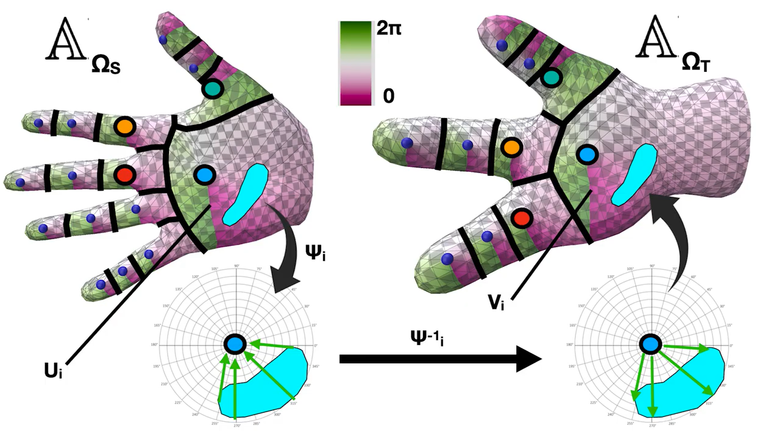
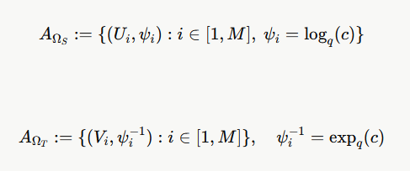
Contact Alignment

Slide 9
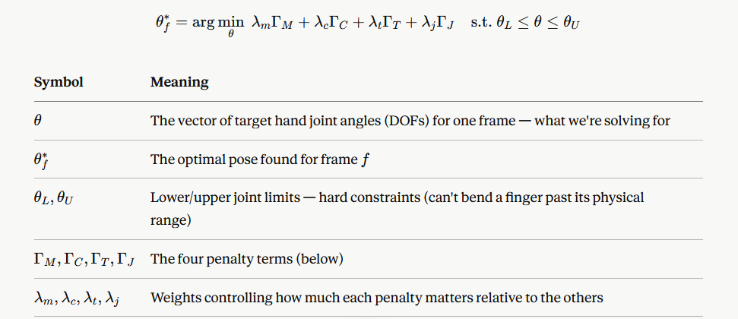
Motion Retargeting
The objective formulation :
Notes:
"Every frame, we're solving one small optimization problem: find the joint angles for the target hand that best satisfy four things at once. First, get the virtual markers close to where they should be — that's the stable, always-available anchor. Second, get the transferred contact points touching correctly — not just close, but with the surface facing the right way too. Third, don't let the hand poke through the table. And fourth, don't do anything wilder than necessary — stay close to a natural rest pose. These four goals are combined into one weighted score, and a numerical solver called NLopt, using a method called MMA, searches for the joint angles that make that score as low as possible, while respecting each joint's physical range of motion.“
**$Γ_{M}$ — marker penalty (Eq. 4):** sums the L2 (straight-line) distance between each virtual marker's current position and its transferred target, across all $M$markers. "Are the fixed reference points where they should be?"
**$Γ_{C}$ — contact penalty (Eq. 5):** sums, over all $C$contacts, a distance term $Γ_{CD,c}$(is the contact point close to its transferred target?) plus a normal-alignment term $Γ_{CN,c}$(is the hand surface facing the right way at that contact, not just nearby?). "Is the hand actually gripping correctly, not just approximately touching?“
**$Γ_{T}$ — table penalty (Eq. 6):** summed over sample points $s$on the hand, where $Γ_{SD}$is the table's signed distance function. Only activates (penalizes) when a point has gone below the table surface — i.e. it only fires on actual penetration, otherwise contributes zero.
$Γ_{J}$— prior/regularizer (Eq. 7): penalizes each of the $J$DOFs for drifting far from either a rest pose or a previously-set value — keeps the solution from doing anything wild or unnecessary beyond what the other terms demand

Slide 10
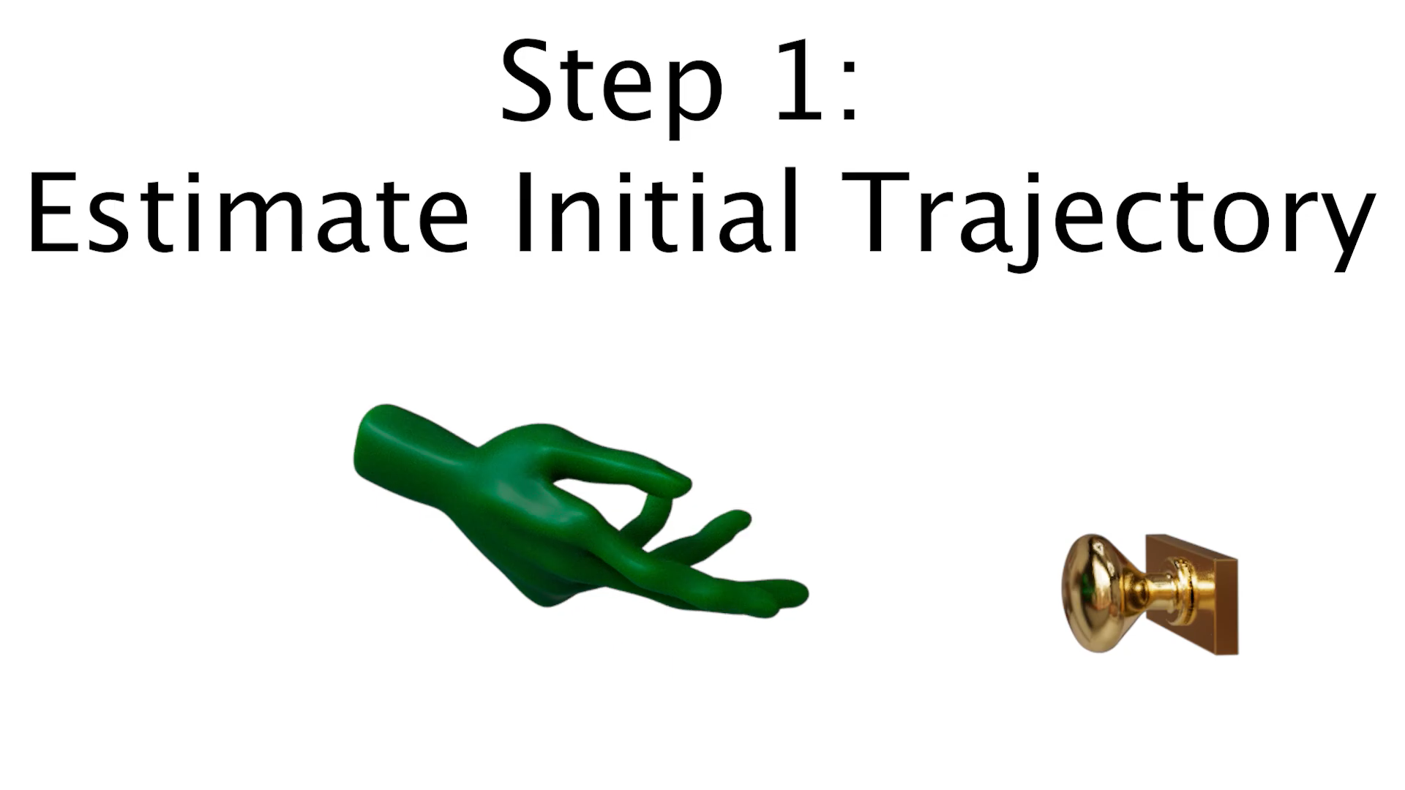
Motion Retargeting – Step 1
Notes:
"For each frame, they first solve just for the root — the wrist's overall position and orientation — then use that as a starting guess to solve the full hand pose, all the finger joints included. Solving root first matters, because a bad root guess biases the rest of the solve toward the wrong answer. Also, unlike a lot of prior work, they don't chain each frame off the previous one's result. That sounds counterintuitive — wouldn't the previous frame be a good starting guess? — but it turns out that lets small errors snowball over a long motion. Solving every frame fresh avoids that drift."

Slide 11
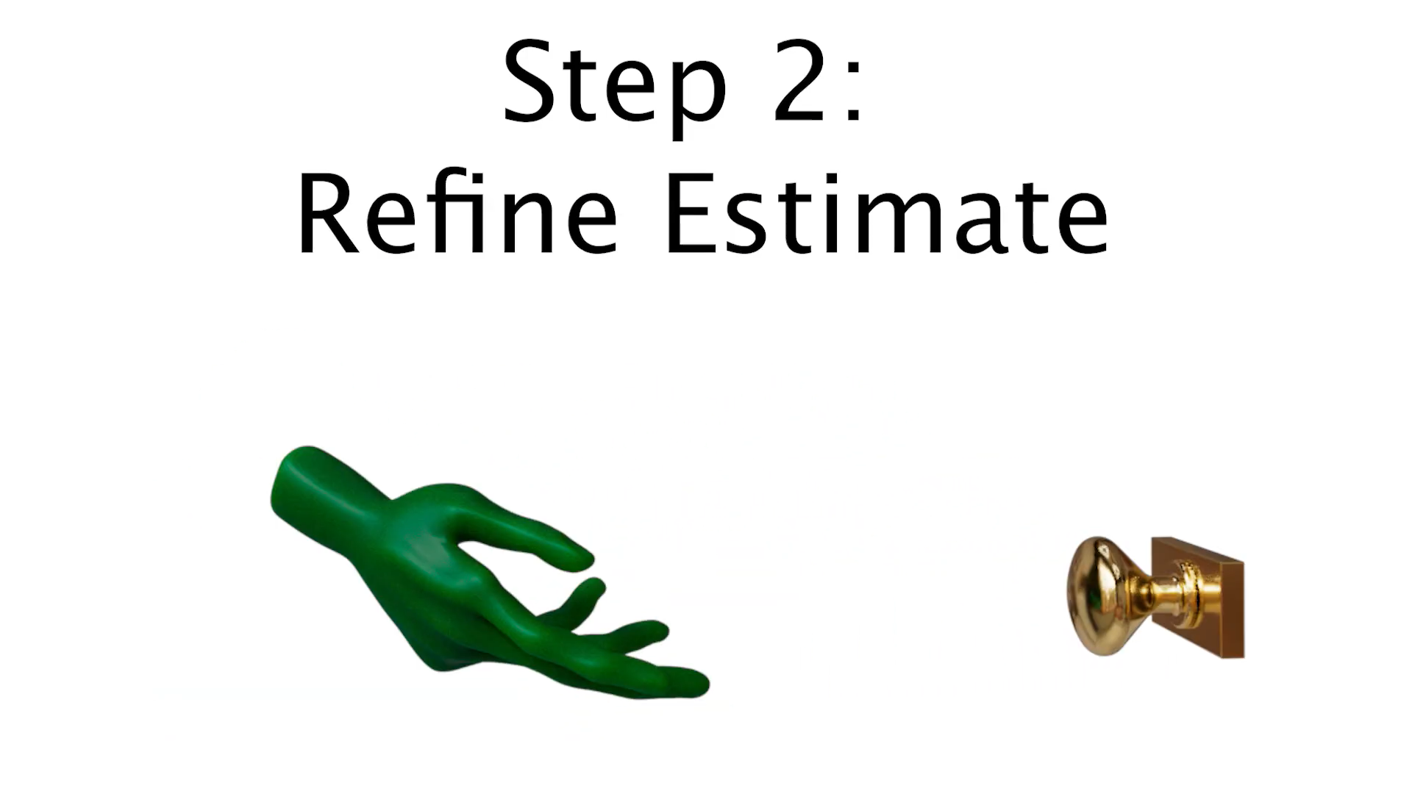
Motion Retargeting – Step 2
Notes:
"Since they solved every frame independently, the result is accurate but jittery — there's nothing forcing frame 10 and frame 11 to move smoothly together. So they scan for any joint where the motion accelerates faster than a set threshold, replace that bad frame with a simple interpolation between its good neighbors, and re-solve it with a better starting guess. they repeat this, because fixing one jump can sometimes reveal another nearby, until things settle down or we hit a max number of tries. To keep this fast, we also apply some basic smoothing filters beforehand, which cuts down how many bad frames we need to fix in the first place."

Slide 12
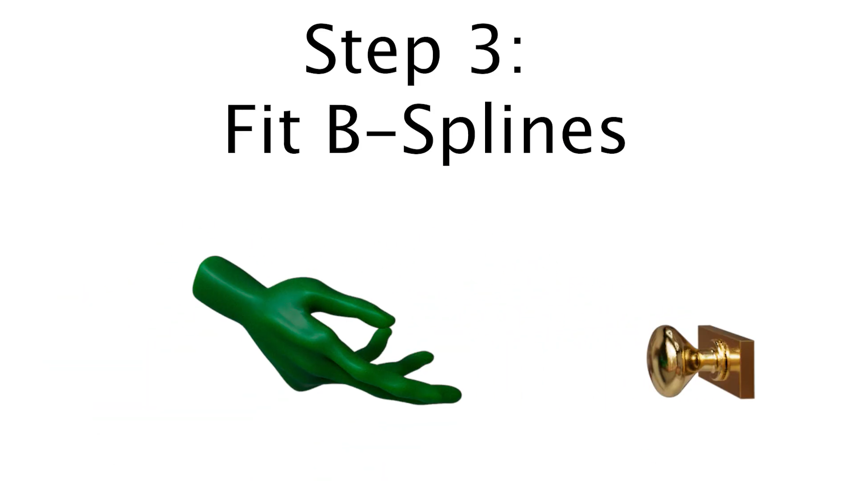
Motion Retargeting – Step 1
Notes:
"The last step takes the refined, per-frame values for each joint and fits a smooth curve through them — a cubic B-spline — solved with least squares. This guarantees the final motion has no jitter at all, not just in position but in velocity and acceleration too. It also happens to double as a really convenient editing tool: an artist can just drag a control point to touch up the motion locally, without needing to redo any of the optimization."

Slide 13
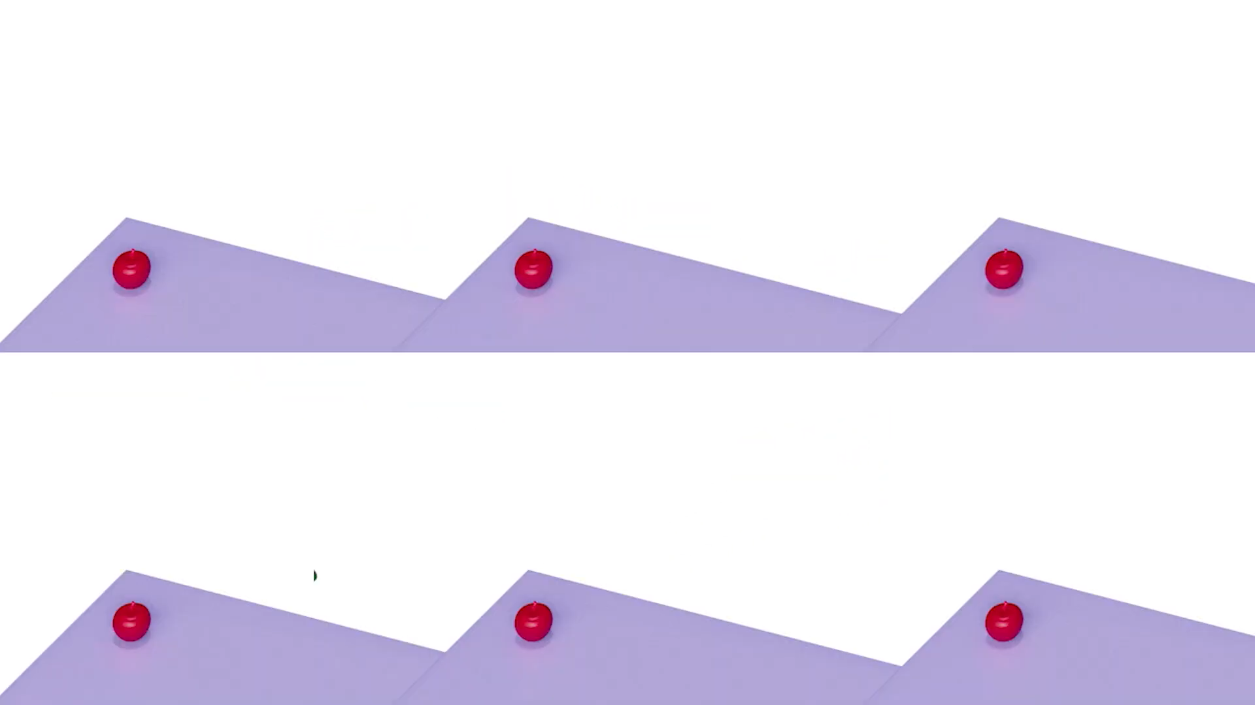
Results

Slide 14
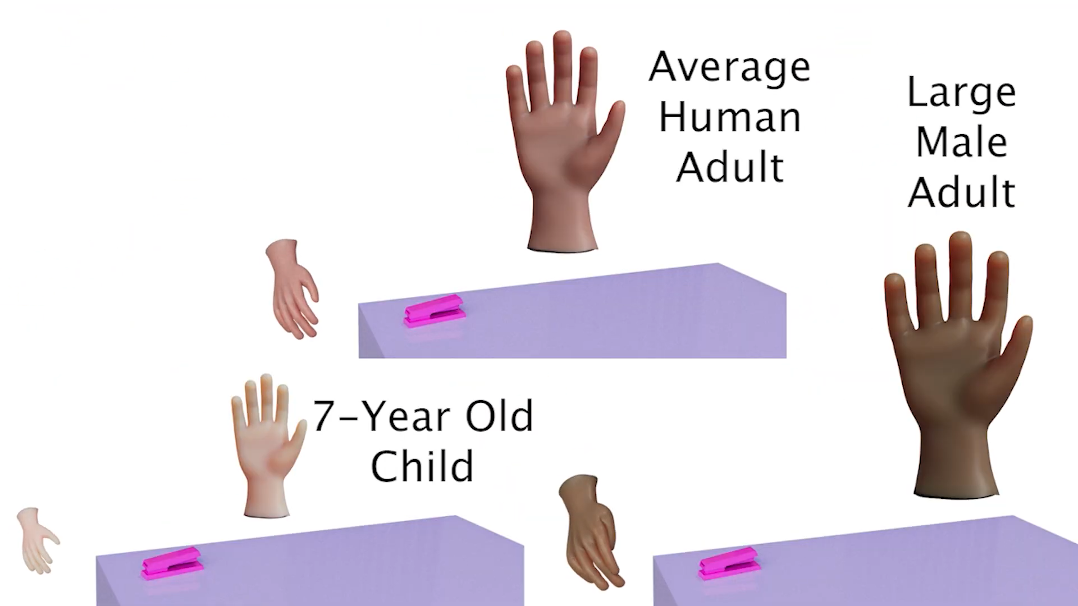
Different Hand Size

Slide 15
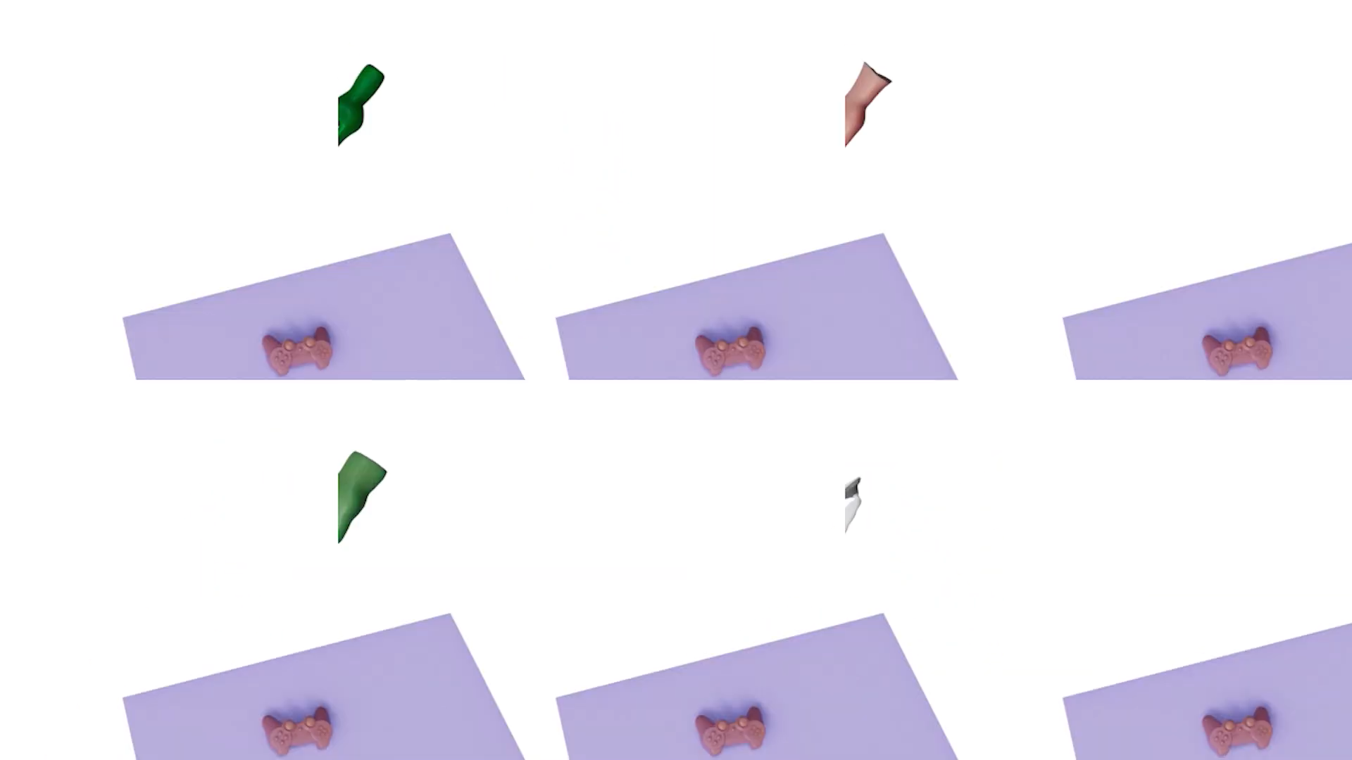
Bimanual Manipulation

Slide 16
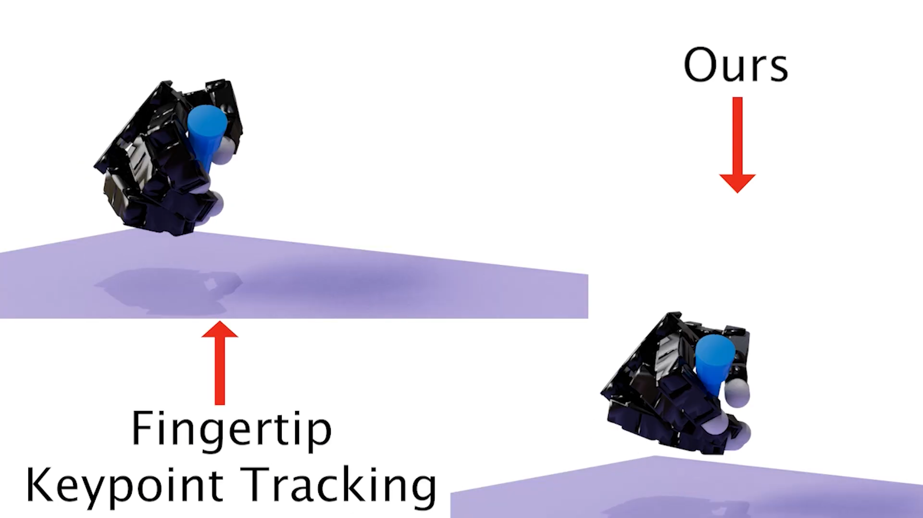
Comparison

Slide 17
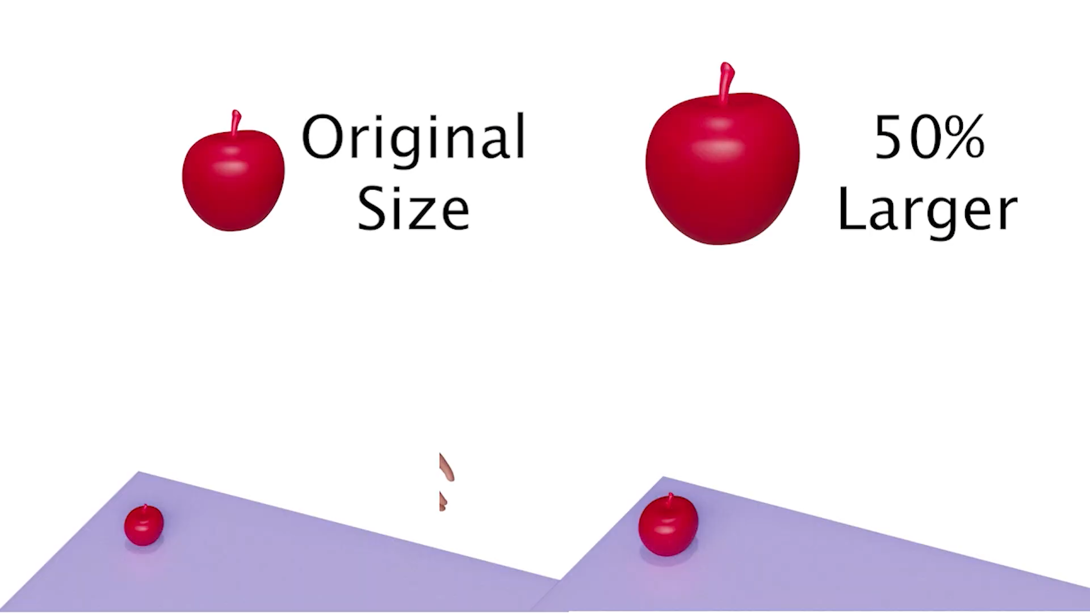
Limitaions

Slide 18
Thank You

