Slide 1
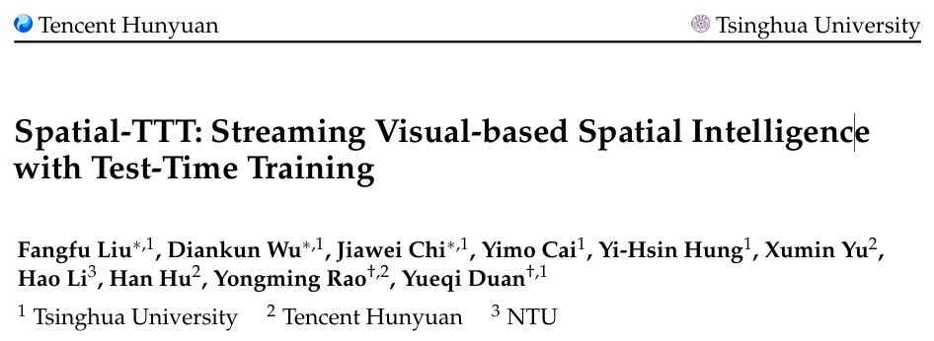
Spatial-TTT: Streaming Visual-based Spatial Intelligence with Test-TimeTraining
ECCV 2026
Reporter: Pengyu Zhang
Date: Jun-30-2026

Slide 2
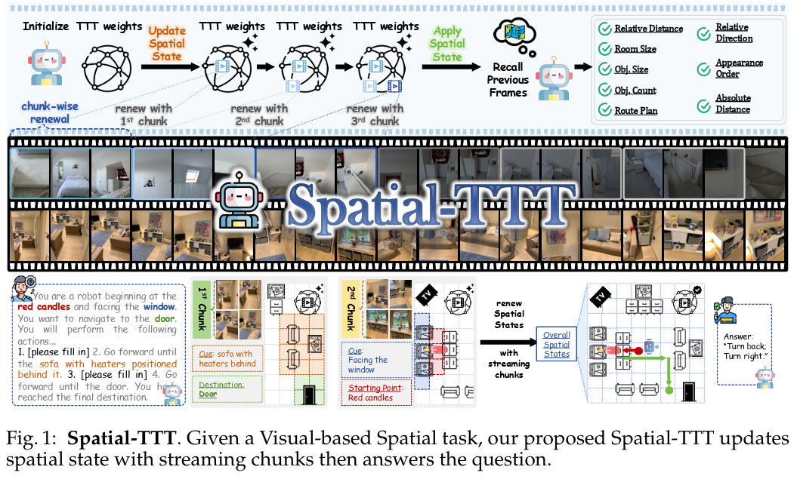
Motivation
Spatial intelligence requires models to understand 3D structure and geometric relationships from continuous visual streams, not just isolated images.
The main challenge is how spatial information is selected, organized, and retained over time.
Contribution
Spatial-TTT(Test-Time Training) is proposed for streaming visual-based spatial intelligence, where online fast-weight updates serve as compact memory to accumulate spatial evidence from long-horizon videos. Specifically, a hybrid TTT architecture with large-chunk updates and parallel sliding-window attention is proposed for efficient long spatial-context compression and reasoning. Also, a spatial-predictive mechanism to capture geometric correspondence and spatiotemporal continuity, and construct dense scene descriptions to supervise effective fast-weight updates.

Slide 3
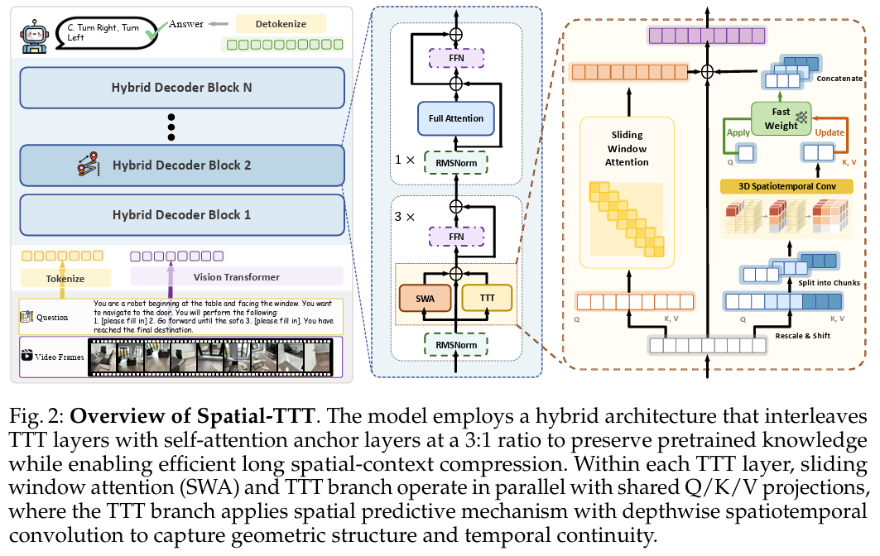

Method
Based on Qwen3-VL-2B-Instruct, 75% layers are TTT layers and 25% layers are standard self-attention anchor layers.
In TTT layer, sliding window attention (SWA) and TTT branch are used.
SWA focuses on short-term memory with the recent previous frames. TTT branch focuses on long-term memory for fast update.
In traditional operation, each token is isolated, ignoring the geometric and temporal continuity. In TTT branch, Spatial-Predictive Mechanism reshape tokens into a spatiotemporal grid and aggregate neighborhood information through local aggregation

Slide 4
Training and Inference
Offline Training
Existing spatial intelligence datasets are sparse and local. Typical spatial QA only queries a small part of the scene. The answers are often short, such as multiple-choice options or integers.
To bridge this gap, the authors construct a dense scene-description dataset from SceneVerse annotations. For each training example, the model receives a spatial video stream and generates a comprehensive description of the underlying 3D scene.
Stage 1 -- Dense Scene-Description Training
This stage teaches fast weights to retain comprehensive scene-level information using the collected dense scene-description dataset.
Stage 2 -- Spatial VQA Fine-tuning
In this stage, the model is fine-tuned with spatial VQA samples, including relative direction/distance estimation, spatial counting, route planning, and room size estimation. The purpose is to teach the model to selectively retain task-relevant spatial evidence via fast-weight updates and retrieve accumulated spatial knowledge when reasoning.
Online Inference
In online inference, only fast weights in TTT branch is trainable. The TTT pending KV cache accumulates key-value pairs; once it reaches the chunk size, those KV pairs are used to perform one fast-weight update, and then the pending cache is cleared.

Slide 5
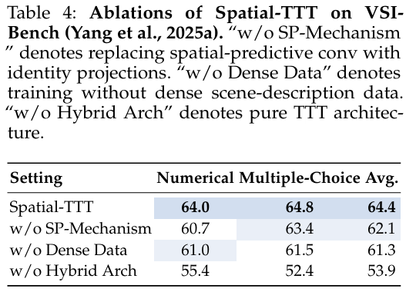
Ablation Analysis
Without Spatial-Predictive Mechanism.
Without dense scene-description dataset.
Without Hybrid Architecture.
3D spatiotemporal convolution on Q/K/V is useful for capturing geometric correspondence and temporal continuity
The proxy task is helpful for learning the global context information.
Self-attention anchor layers with pretrained weights are important for preserving pretrained cross-modal alignment and semantic reasoning ability.

Slide 6
Conclusion and Takeaways
Spatial-TTT addresses long-horizon video spatial reasoning by treating test-time training as a compact adaptive memory mechanism.
Test-time training is an efficient way to learn temporal information during inference
By setting a proxy task, the model can learn more comprehensive knowledge for better main task.

