Slide 1
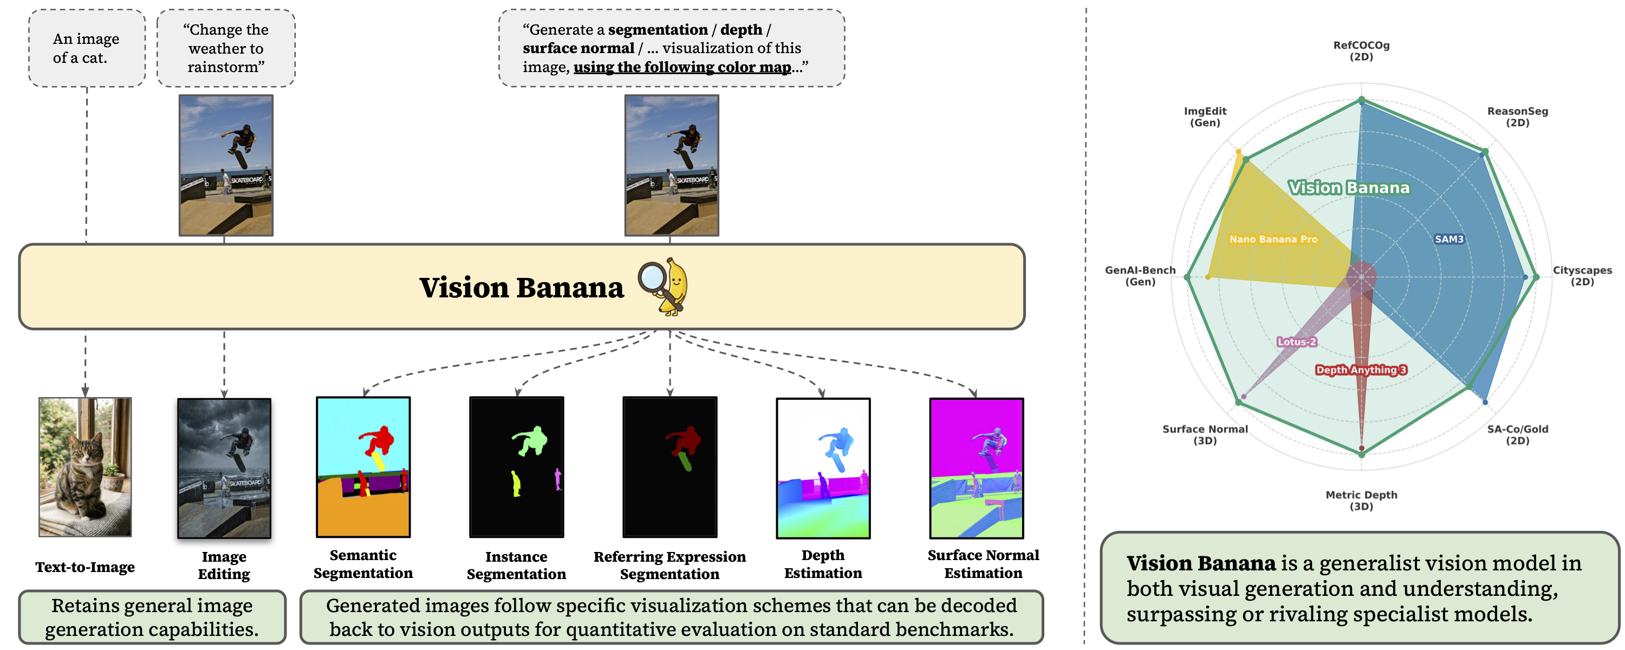
Image Generators are Generalist Vision Learners
Reframing Visual Understanding as Image Generation
One generative model, one RGB output interface, and multiple vision capabilities.
Valentin Gabeur et al. | Google DeepMind, 2026

Slide 2
Does Visual Generation Imply Visual Understanding?
Observation
Complex objects and scenes
Spatial relationships
Realistic geometry and lighting
Precise text-conditioned modifications
→
Open question
Do these capabilities indicate that image generators have learned general visual representations?
“The ability to create visual content may imply an ability to understand it.”

Slide 3
The Missing Link: From Plausible Images to Measurable Predictions
Previous observation
Image generators can already produce outputs that resemble segmentation, depth, and surface-normal maps.
Two unresolved problems
Unreliable output formats
Generated colors and structures may not strictly follow the prompt.
Loss of generality
Specialized heads, custom architectures, or full fine-tuning can damage generation ability.
Required: precise, decodable outputs without turning the generator into a task-specific model.

Slide 4
Perception as Image Generation
Unified formulation
Input image +
task instruction
→
Generated RGB
visualization
→
Decoded
vision output
Examples
Segmentation
Metric depth
Surface normals
Color-coded masks
Invertible false-color image
RGB-encoded directions
The architecture and output modality remain unchanged. Only the instruction and RGB encoding scheme change.

Slide 5
Lightweight Instruction Tuning Unlocks Visual Understanding
Training data
Nano Banana Pro
2D: in-house annotations on web images
3D: synthetic data from rendering engines
No training splits from evaluation benchmarks
↓
Instruction-tuning mixture
Original generation data
Vision-task
data
Goal
Low mixing ratio
Teach output alignment — not visual perception from scratch.
↓
Shared weights across tasks
No specialized prediction heads
Generation data reduces forgetting
Vision Banana

Slide 6
How Different Vision Tasks Become RGB Images
Semantic segmentation
Instance segmentation
Referring segmentation
Prompt-defined class colors
cat → red
exit sign → blue
background → purple
Decode by color matching.
One class per inference
Different instances receive different colors.
Decode by color clustering.
Free-form language specifies what to segment.
Examples:
• the man in the pink shirt
• the stretching cat
• the game control device
The output format is constrained, while the semantic target remains open-vocabulary.

Slide 7
A Generator Competes with Segmentation Specialists
Semantic segmentation
Referring segmentation
Cityscapes mIoU
RefCOCOg cIoU
SAM 3: 65.2
SAM 3 + Gemini: 73.4
Vision Banana: 69.9
Vision Banana: 73.8
+4.7 points
Reasoning segmentation
Instance segmentation
ReasonSeg gIoU
SA-Co/Gold pmF1
SAM 3 Agent: 77.0
DINO-X: 55.2
Vision Banana: 79.3
Vision Banana: 54.0
Comparable
Best zero-shot transfer result on three of four segmentation benchmarks.

Slide 8
Beyond Mask Prediction: Language-Grounded Visual Reasoning
Vision Banana can ground:
Appearance — “the man in the pink T-shirt”
Actions — “the stretching cat”
Functional meaning — “the game control device”
Multilingual visual text
Fine-grained concepts — “crescent-shaped croissants”
Generative pretraining connects language, semantics, appearance, and visual structure.

Slide 9
Metric Depth Estimation through an Invertible RGB Code
Challenge
Important properties
Metric depth is continuous, unbounded, and physically meaningful.
RGB values are bounded in [0, 1]³.
Strictly invertible
More resolution for nearby depths
No camera intrinsics during training or prediction
Encoding pipeline
Metric depth d
→
Power-transformed
distance
→
RGB cube
trajectory
→
Depth
visualization
→
Inverse map →
meters

Slide 10
Strong 3D Geometry Emerges from Generative Pretraining
Metric depth estimation
Surface normal estimation
Average δ₁ across six datasets
Average indoor mean angular error ↓
UniK3D: 0.823 | MoGe-2: 0.802 | Vision Banana: 0.882
Lotus-2: 16.558° | Vision Banana: 15.549°
Shared datasets with Depth Anything V3: 0.918 → 0.929
Synthetic 3D supervision only; no benchmark training data

Slide 11
Understanding without Forgetting Generation
GenAI-Bench pairwise win rate
ImgEdit pairwise win rate
Vision Banana 53.5% vs. Nano Banana Pro 46.5%
Vision Banana 47.8% vs. Nano Banana Pro 52.2%
Vision Banana remains approximately on par with its base generator.

Slide 12
What Does This Paper Establish?
Main contributions
Open questions
1
Unified output interface
How much vision-task supervision is required?
How much comes from model scale or proprietary data?
Is full-image generation efficient for dense prediction?
Can the framework extend to video, tracking, and embodied control?
How robust is RGB decoding to small color errors?
Vision tasks are parameterized as RGB image generation.
2
Generalist vision model
One model supports 2D, 3D, generation, and editing.
3
Strong empirical evidence
Vision Banana rivals or surpasses several zero-shot specialists.
4
Minimal loss of generation
Lightweight tuning preserves the base model.
Generative pretraining may become a foundation not only for visual creation, but also for general visual understanding.

