Slide 1
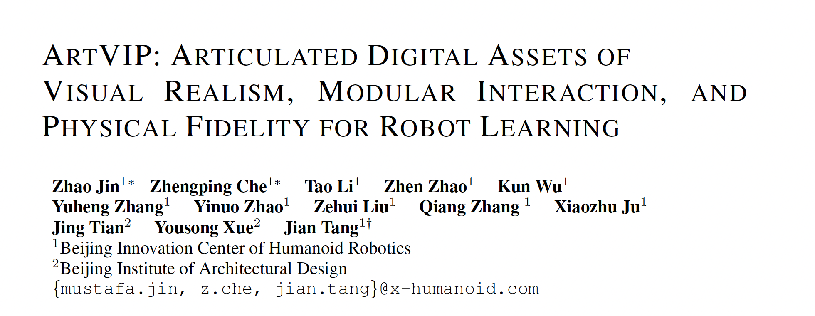
ICLR 2026
Jiahui; Jun 15th 2026

Slide 2
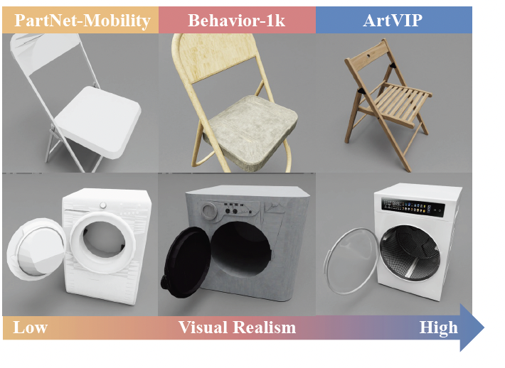

ICLR 2026

Slide 3
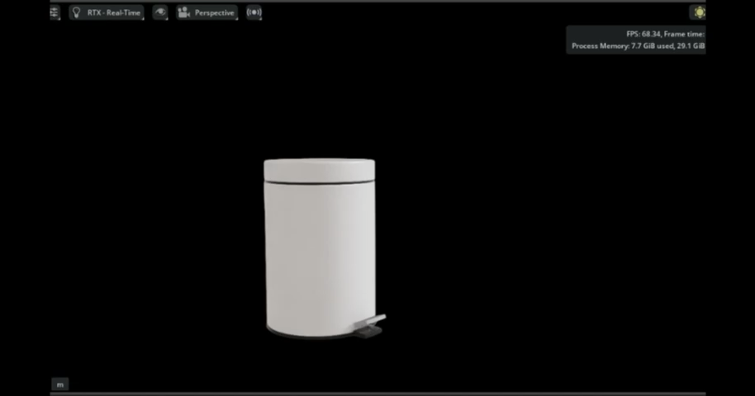
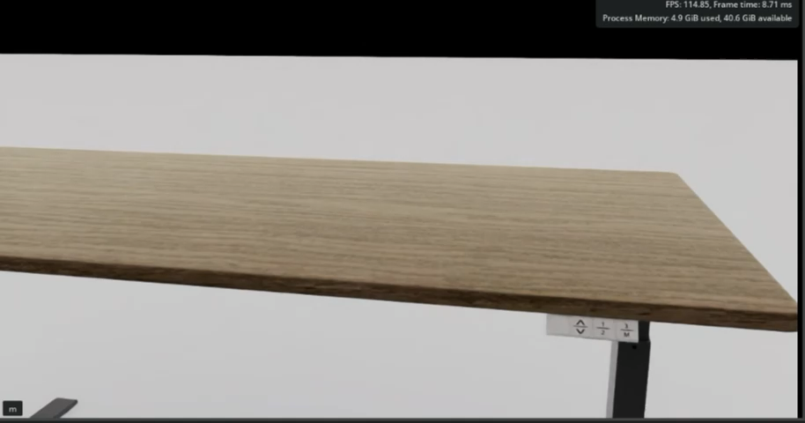

ICLR 2026

Slide 4
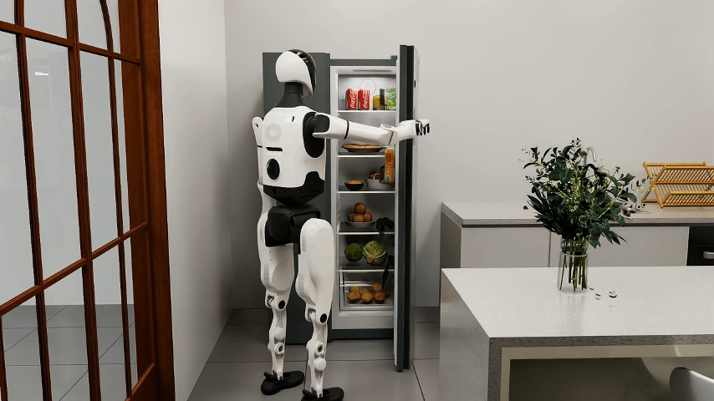
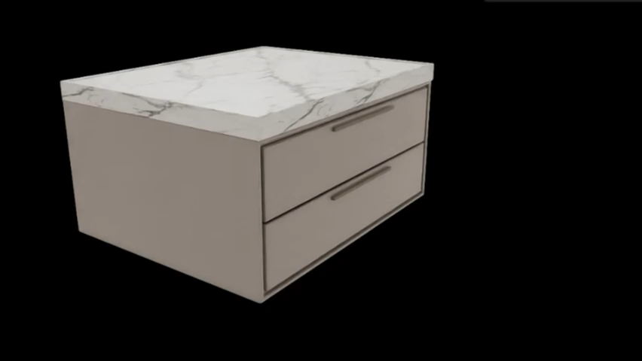
ICLR 2026

Slide 5
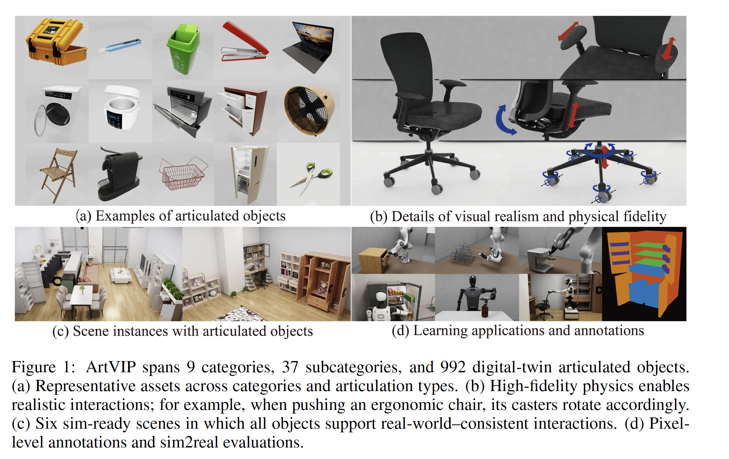
ArtVIP

Slide 6
Comparison with SOTA Dataset
Paper / Dataset
Number of Data
Category Coverage
Short Description
2019 CVPR
PartNet
26,671 objects
24 categories
Large-scale part-level annotation and hierarchy; not primarily a robot-simulation-ready articulated asset dataset.
2026 CVPR
Artiverse
5,402 assets
20 super-categories
61 main categories
88 sub-categories
Broad articulated-object coverage across furniture, appliances, tools, and everyday household objects.
2026 arXiv TR
Articraft-10K
10,000 assets
245 categories
Large-scale generated articulated assets, including waffle makers, drones, exercise bikes, mixers, and hinged boxes.
2024 arXiv
BEHAVIOR-1K
9,000+ objects
1,900+ categories
Rich household simulation with fluids, deformable, light/reflection, and transparency; practically constrained within OmniGibson.
2026 ICLR
ArtVIP
992 articulated
digital twins
9 categories
37 subcategories
Smaller scale, but emphasizes visual realism, modular interaction, tuned collision geometry, and joint dynamics for robot learning.

Slide 7
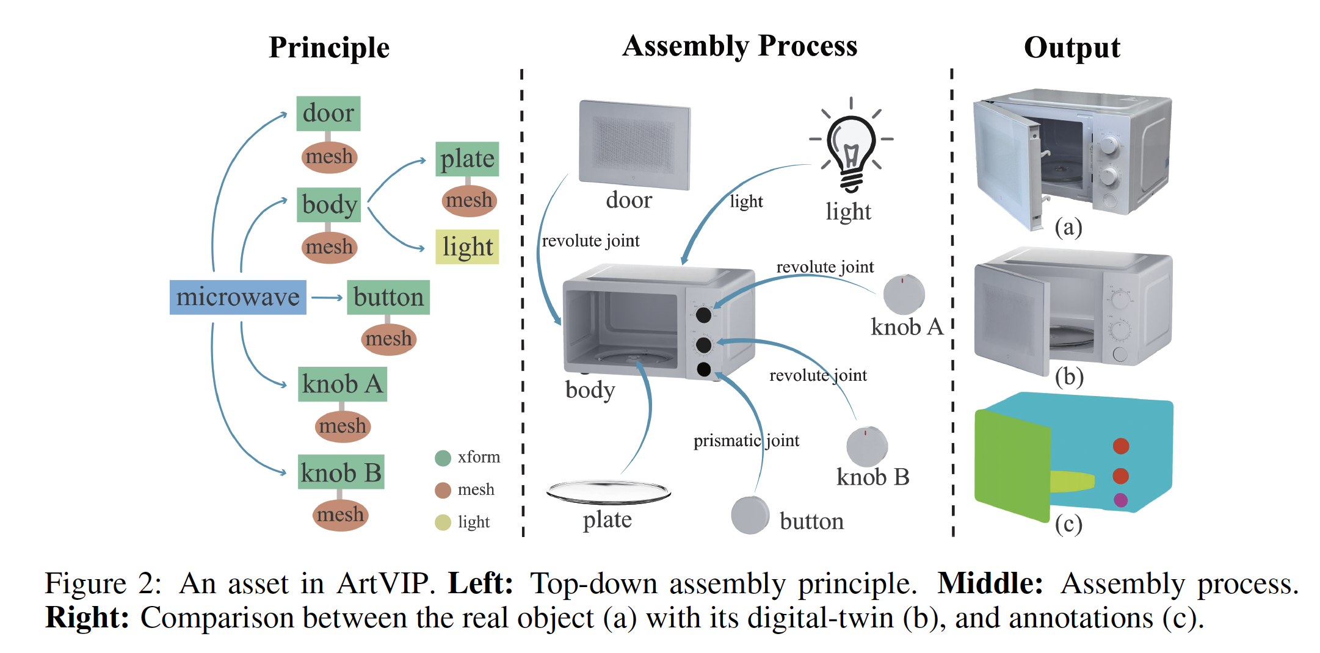

Slide 8
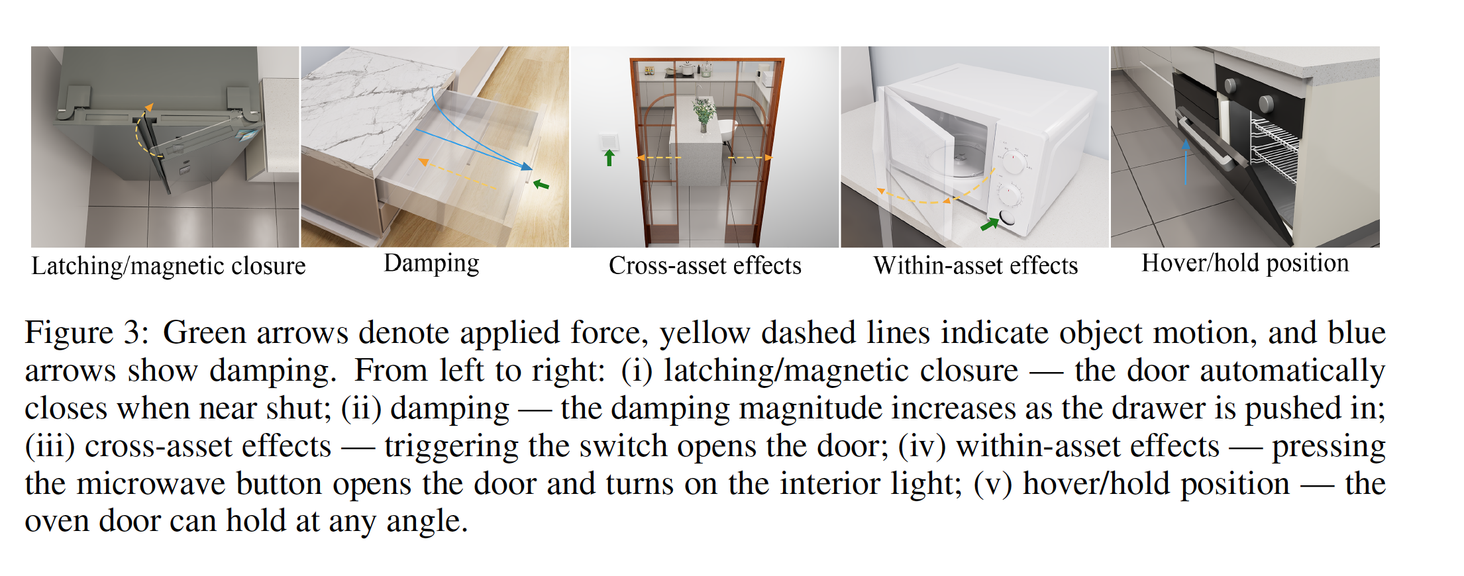

Slide 9
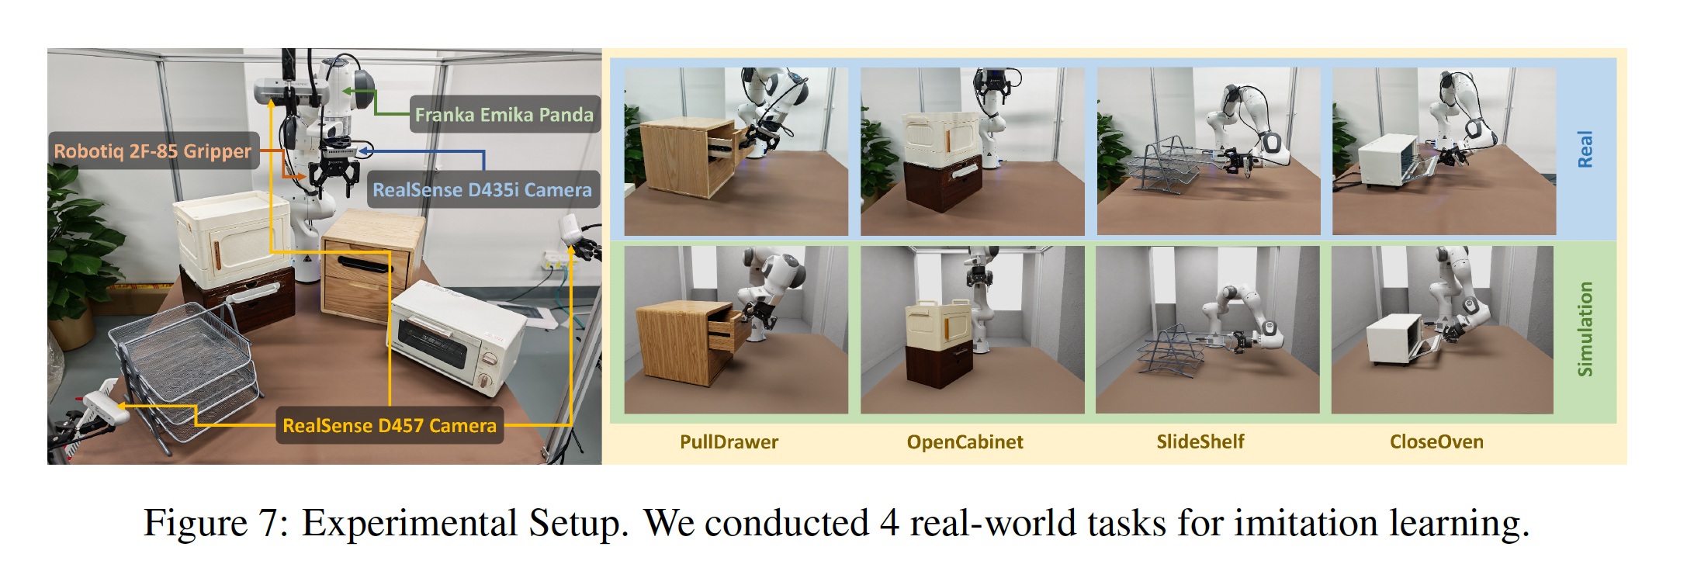
Evaluation

Slide 10
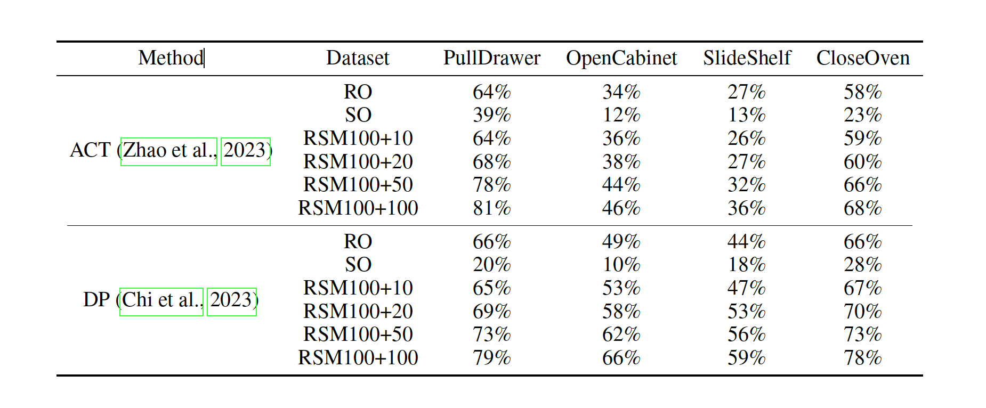
Evaluation

Slide 11
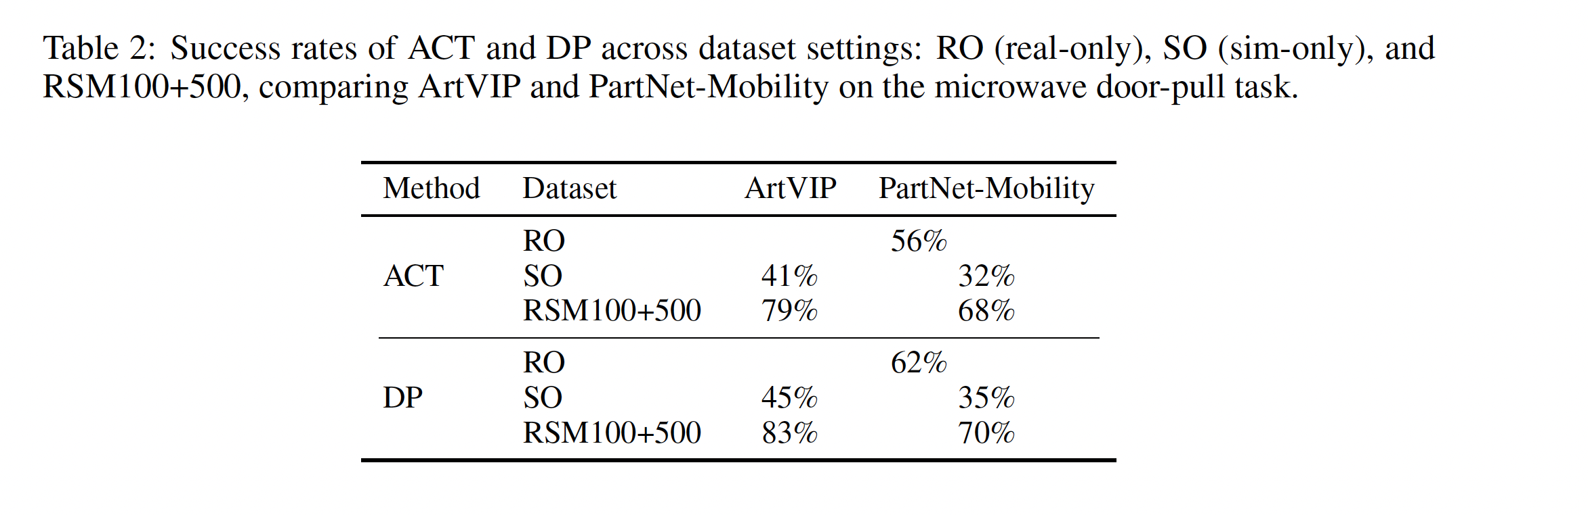
Evaluation

Slide 12
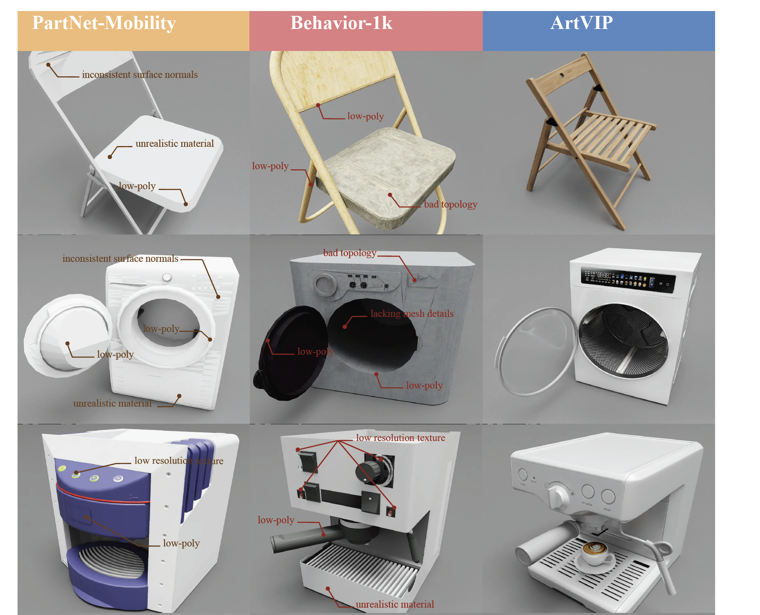
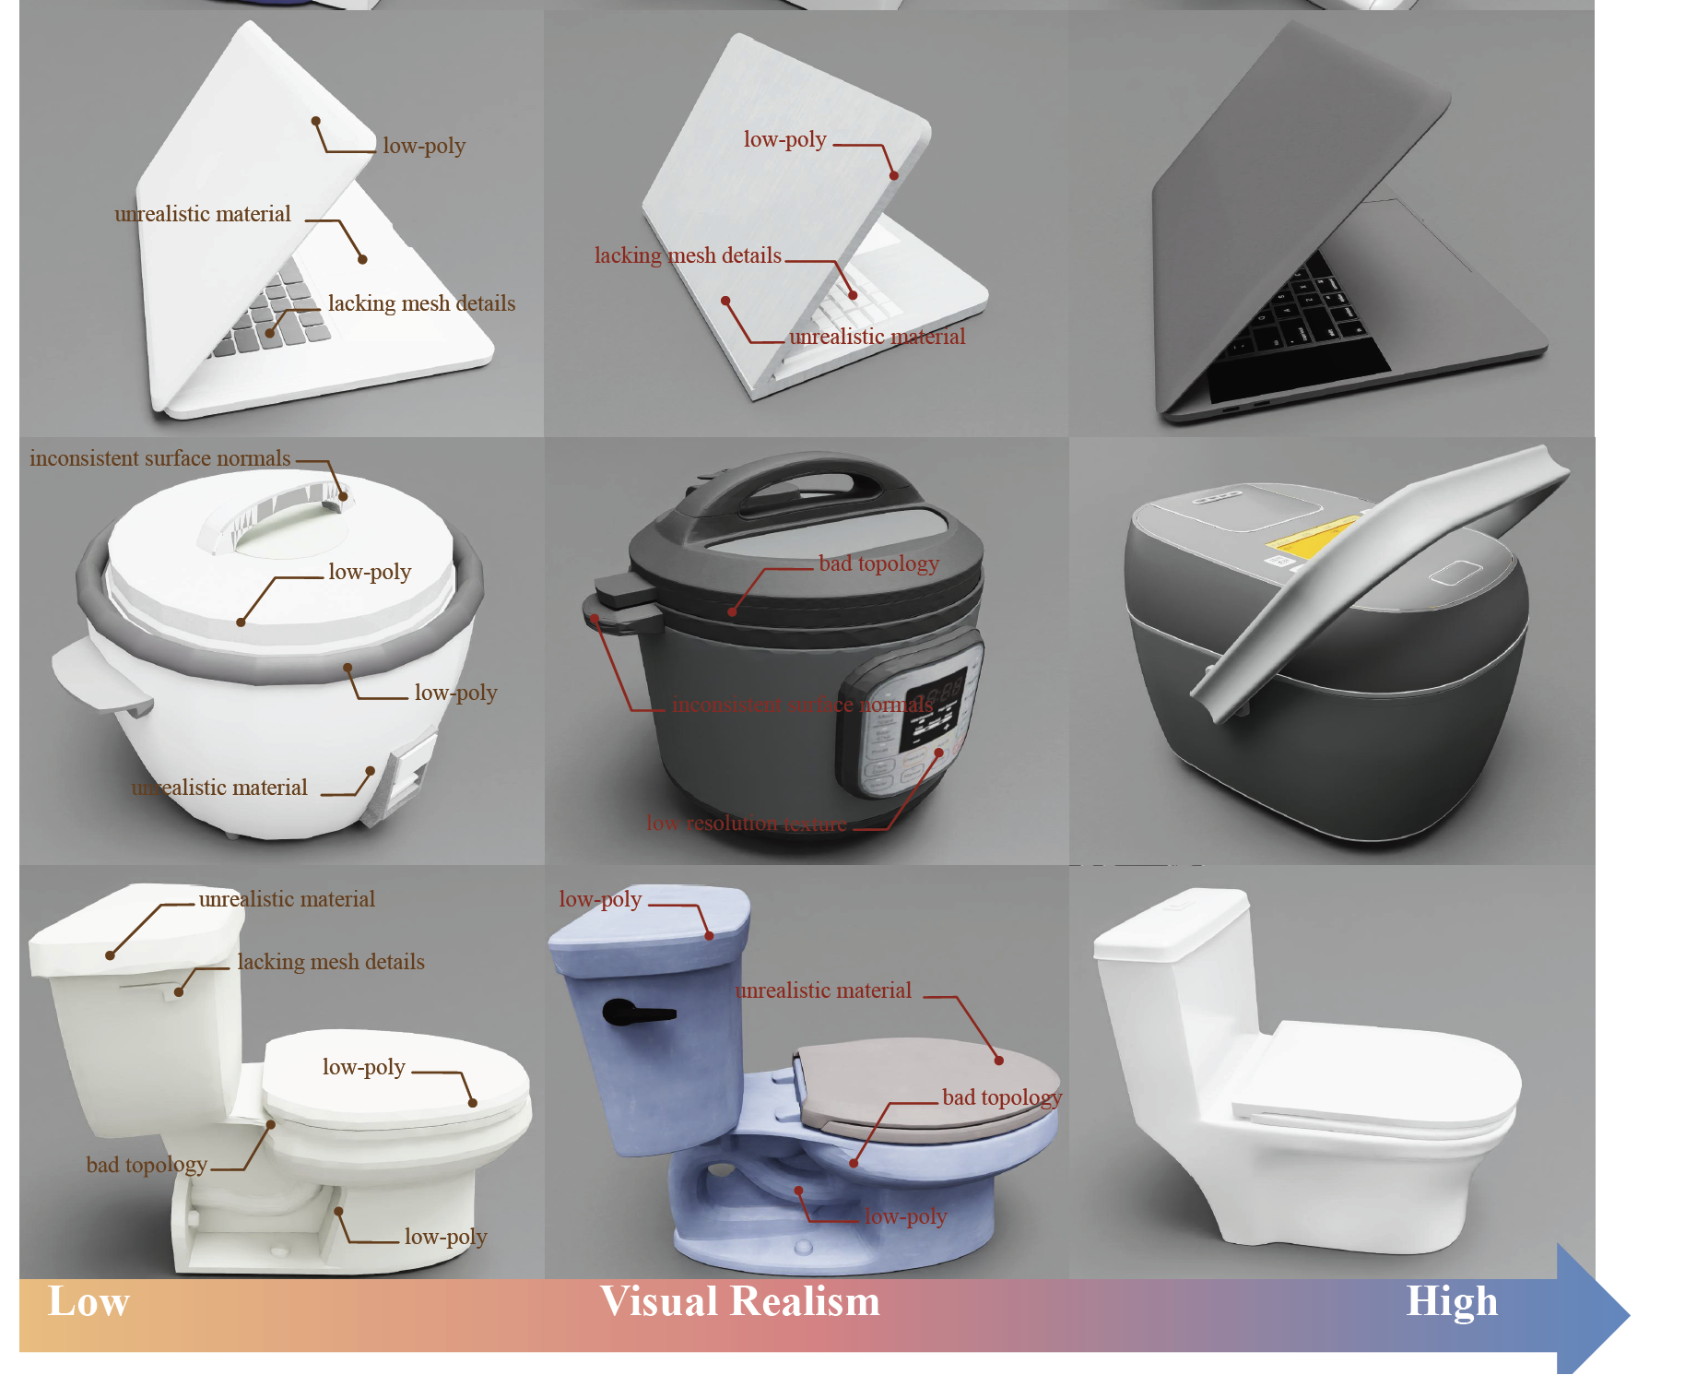
Comparison

