Slide 1
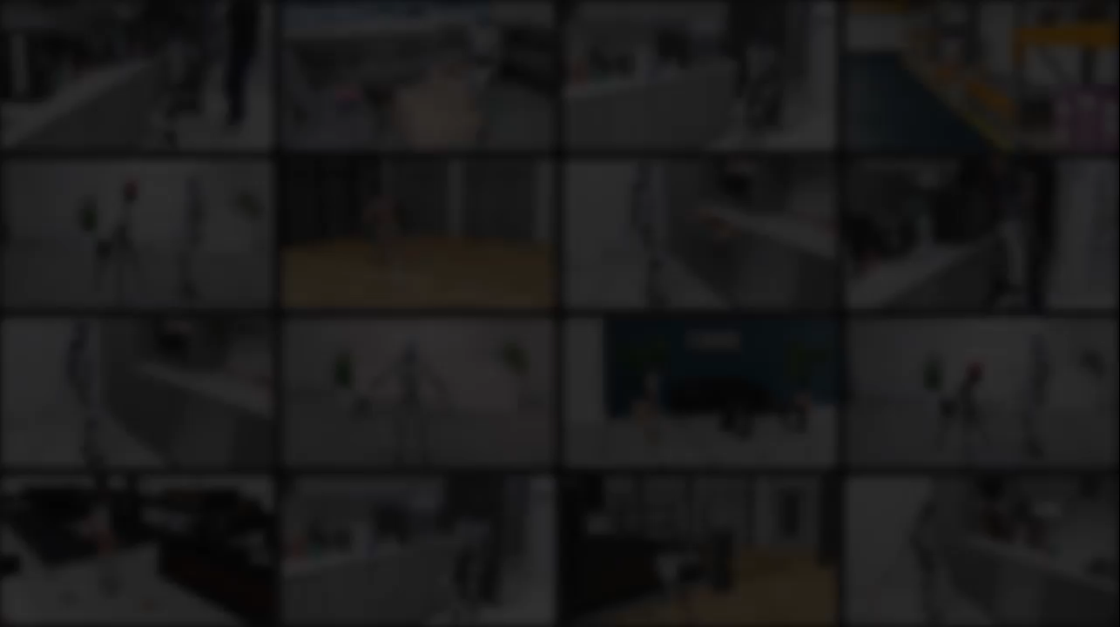
DreamControl
Human-Inspired Whole-Body Humanoid Control for Scene Interaction via Guided Diffusion
Dvij Kalaria^{1,2} , Sudarshan Harithas^{2,3} , Pushkal Katara¹ , Sangkyung Kwak¹ , Sarthak Bhagat¹ ,
S. Shankar Sastry², Srinath Sridhar³, Sai Vemprala¹, Ashish Kapoor¹, Jonathan Huang¹
¹General Robotics ²UC Berkeley ³Brown University
to appear at ICRA 2026

Slide 2
Motivation and Goals
Notes:
(~10 sec) Quick background — if your audience knows RL, you can skip or accelerate these two slides.

Slide 3
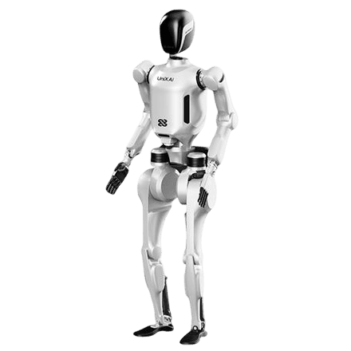
Why Whole-Body Humanoid Control Is Hard?
27 DoF for Body + 12 DoF for Hand
⚠ The Challenges:
1. Whole-Body Coordination
2. Dynamic Stability and Balance
3. Multiple Timescales
4. Long-Horizon Planning
5. Robot Complexity
Notes:
Challenges in Whole-Body Humanoid Loco-Manipulation
Presentation Notes
Modern humanoid robots can already perform impressive motions like dancing and kung-fu.
However, real-world assistance tasks are much harder because robots must interact with their environment while maintaining balance.
Main Challenges
1. Whole-Body Coordination
Tasks require simultaneous use of:
legs for locomotion and balance,
arms and hands for manipulation,
torso for stabilization.
Example tasks:
opening drawers,
lifting boxes,
pressing buttons.
2. Dynamic Stability and Balance
Humanoid robots are naturally unstable because:
they have many degrees of freedom,
are underactuated,
and have a high center of mass.
Small mistakes can easily cause the robot to fall.
3. Multiple Timescales
The robot must solve:
short-term balance control in milliseconds,
while also planning long-horizon actions lasting several seconds.
These two requirements must work together simultaneously.
4. Long-Horizon Planning
Manipulation tasks often require a sequence of actions:
walking toward an object,
positioning the body,
grasping,
and completing the task.
Planning these long sequences is difficult.
5. Bimanual Manipulation Complexity
Coordinating both arms and hands precisely is very high-dimensional.
RL exploration becomes extremely difficult due to the large action space.

Slide 4
Why Some Approaches Fall Short?
RL alone → sparse rewards, no exploration guidance → 0% success
Teleoperation data → expensive, hard to scale
Diffusion policy → needs whole-body tele-op data (scarce)
Splitting upper and lower body → misses coordinated whole-body motion
Notes:
6. Reinforcement Learning Limitations
Direct RL methods often:
fail to learn stable behaviors,
produce unnatural motions,
and generalize poorly to real robots.
7. Data Collection Problem
Whole-body teleoperation data is limited and expensive to collect.
Robotics suffers from what the paper calls the “100,000-year data gap.”
8. Sim-to-Real Transfer
Policies trained in simulation may not work reliably on real humanoids.
Unrealistic or extreme motions worsen this problem.
Key Motivation of DreamControl
The paper proposes combining:
diffusion-based human motion priors,
with reinforcement learning.
This helps generate:
more natural motions,
better exploration,
and improved sim-to-real transfer.

Slide 5
Background: Reinforcement Learning
What is RL and why PPO?
Notes:
(~10 sec) Quick background — if your audience knows RL, you can skip or accelerate these two slides.

Slide 6
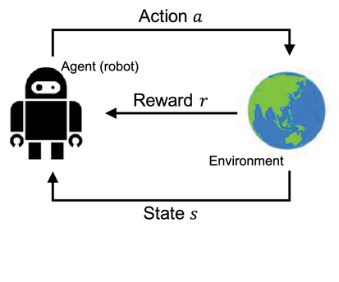
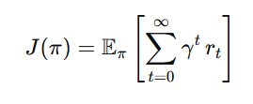
Quick RL Recap
Reinforcement Learning (RL) in 60 Seconds
Goal: learn policy π(s) → a that maximizes discounted cumulative rewards
Trial-and-error: agent acts, gets feedback (reward), updates policy
Key insight: no need for labelled demos — only a reward function
Notes:
(~1 min)
RL is at the heart of DreamControl, so let's make sure everyone is on the same page.
The loop:
- The AGENT (the robot's neural network policy) observes the current STATE of the environment — joint angles, velocities, gravity direction, etc.
- It outputs an ACTION — target joint angles for the robot's 27 degrees of freedom.
- The ENVIRONMENT (IsaacSim physics simulator) applies that action, and returns the NEW STATE plus a REWARD scalar.
- The agent updates itself to get more reward in the future.
No demonstrations needed — just a reward signal. That's the power of RL. The catch is that for complex tasks, reward is sparse and exploration is hard. That's exactly what DreamControl solves.
Crucially, they run 8,192 parallel simulations on a single GPU — this gives them enormous sample throughput.

Slide 7
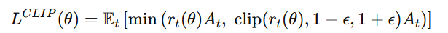
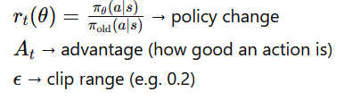
Quick PPO Recap
Maximize reward while keeping policy updates stable
Update policy a little at a time (stay “proximal” to old policy)
Objective Function:
Notes:
(~1 min)
PPO is the go-to RL algorithm for continuous control robotics tasks.
The core idea: we want to improve the policy by moving in the direction of higher reward, but we DON'T want to make large sudden changes — that can destabilise training, especially with a complex action spaces.
PPO solves this with a CLIPPED SURROGATE OBJECTIVE. It limits how much the new policy can differ from the old one. The ratio r(θ) = π_new / π_old is clipped to [1-ε, 1+ε], typically ε=0.2. This creates a trust region — big updates are simply ignored.
Â (the advantage estimate) tells the algorithm: "this action was better than average — reinforce it." PPO then applies the clipped objective to avoid over-committing.
In DreamControl: 2,000 iterations × 8,192 parallel envs = massive sample throughput from a single GPU. This is what makes training feasible.

Slide 8
DreamControl: The Method
Diffusion Prior + Reinforcement Learning
Notes:
(~10 sec) Now let's get into the actual DreamControl methodology.

Slide 9
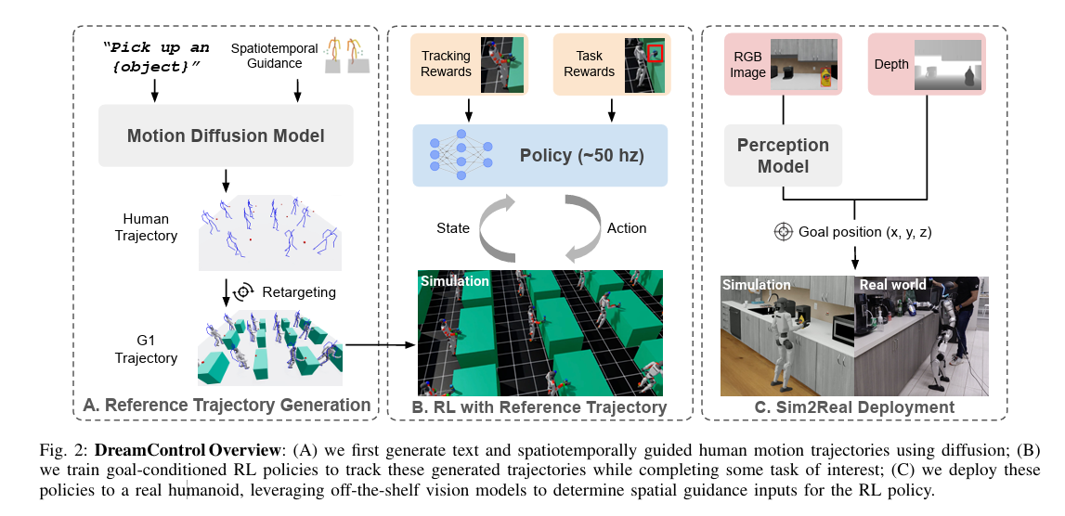
DreamControl Method
Notes:
(~1.5 min)
DreamControl has two stages working in tandem — this is the key insight of the paper.
STAGE 1 — "Dream":
Use a pre-trained human motion diffusion model (OmniControl) to generate a reference trajectory. You give it a text prompt like "open the drawer" plus a spatiotemporal goal — for example, "the right wrist should reach position X at time T". OmniControl generates a plausible human motion.
RETARGETING:
The human skeleton doesn't match the G1 robot. PyRoki solves an IK optimisation to transfer the motion: minimise difference in relative keypoint positions and joint angles between human and robot bodies. Bad trajectories (physically infeasible, self-collisions) are filtered out.
STAGE 2 — "Control":
An RL policy (PPO) is trained in IsaacSim to TRACK those retargeted trajectories while also completing the actual task. The tracking reward gives dense gradient signal to guide exploration. The task reward (sparse) confirms success.
KEY: The diffusion prior is NEVER used at test time. The robot policy is autonomous — it doesn't need the diffusion model or the trajectory to act. Training uses the trajectories implicitly through rewards.

Slide 10
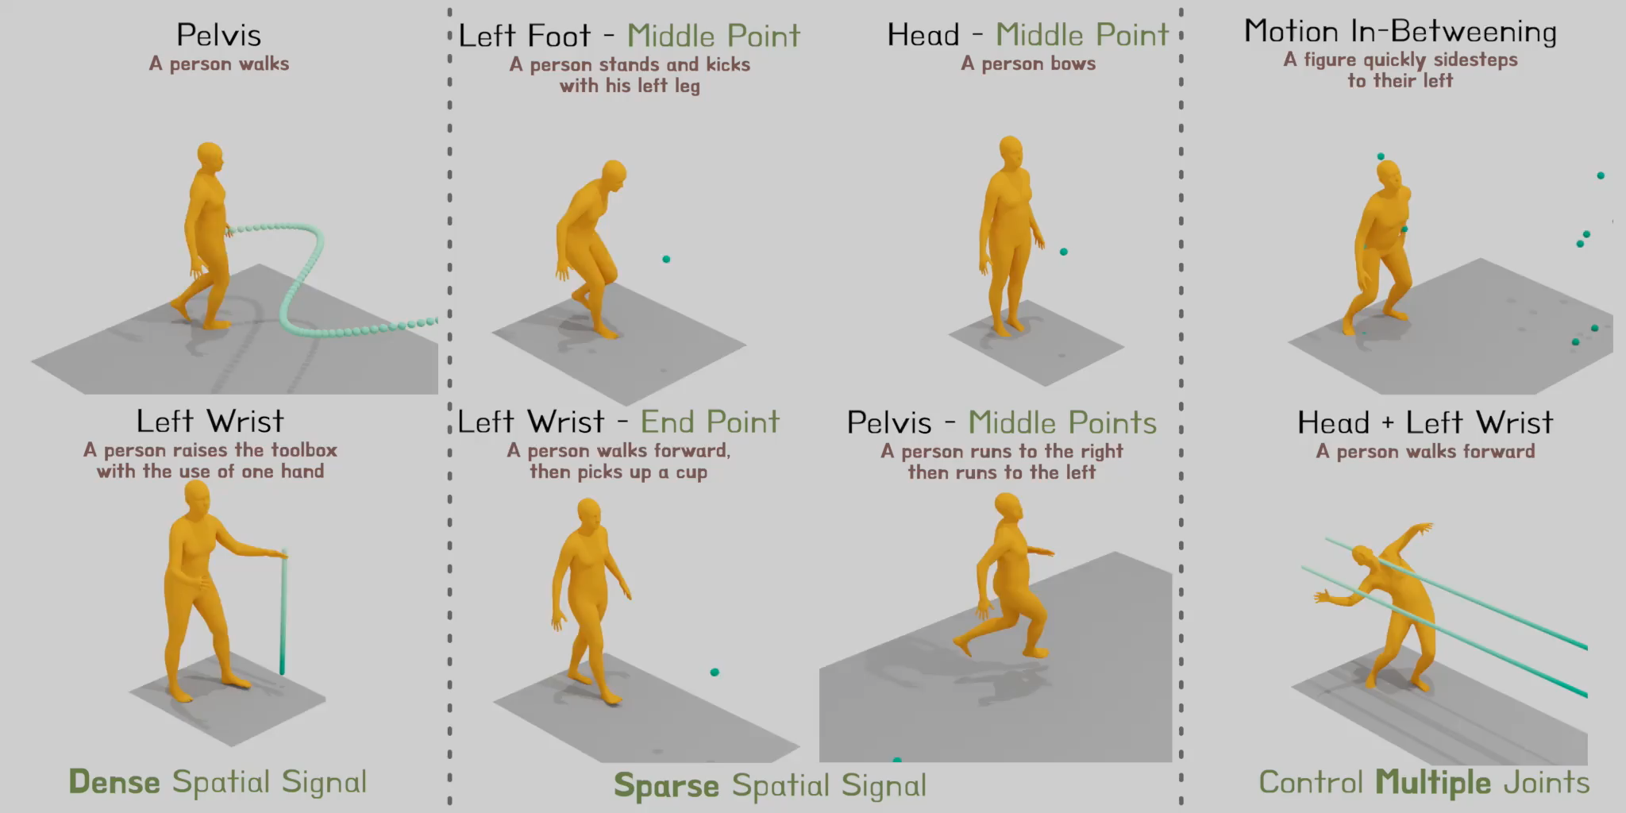
Stage 1: Human Motion Prior — OmniControl
Text + spatiotemporal guidance → reference trajectory
Notes:
OmniControl is a diffusion transformer trained on HumanML3D — a large motion-capture dataset of human movements. It takes TWO kinds of input:
1. TEXT — describing what the person should do, e.g., "open the drawer"
2. SPATIOTEMPORAL CONSTRAINTS — "joint j should be at location p at time t"
This spatiotemporal guidance is the key innovation. For a pick task: you specify where the object is (say, at 0.5m height, 0.3m in front), and OmniControl generates a motion where the wrist naturally arrives at that point. This is how the trajectory connects to the physical scene.
After generation, retargeting maps the SMPL human skeleton (which uses different proportions) to the Unitree G1 robot. PyRoki does IK optimisation minimising keypoint position differences.
Filtering removes bad trajectories: if the person's motion requires falling through the floor, or the joints collide, or the motion is physically infeasible — these are discarded.
For tasks OmniControl wasn't trained on — like pulling a drawer below waist level — they fall back to IK-based optimisation on a base "standing" pose, giving the RL a starting point even without a natural human analog.
The end result: for each task, a diverse SET of reference trajectories, each corresponding to a slightly different object position or motion variation.

Slide 11
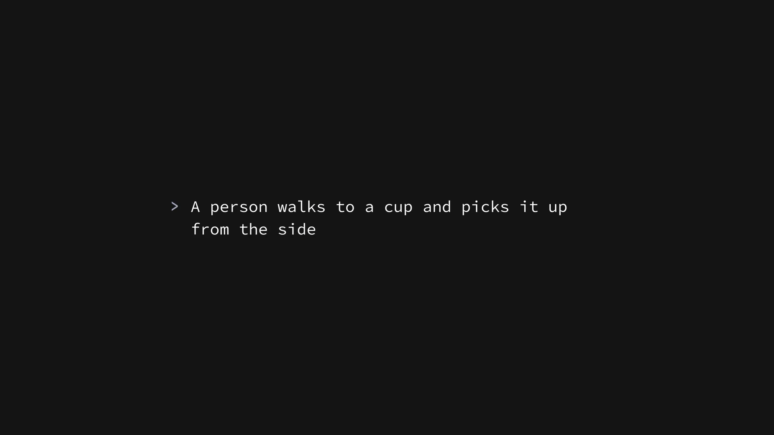

Slide 12
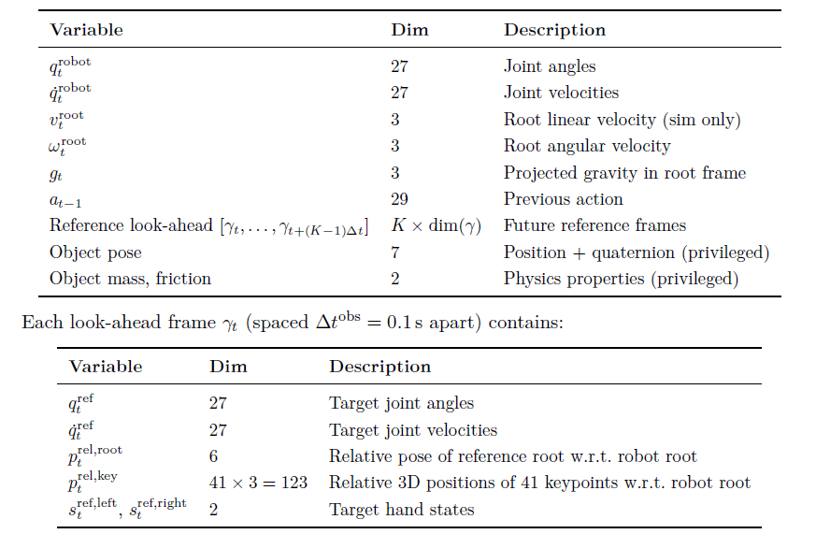
Stage 2: RL with Reference Trajectory
PPO learns to track the reference while completing the task
Observations:
Notes:
(~1.5 min)
Stage 2 is where the actual robot learning happens.
SCENE SYNTHESIS: For each reference trajectory αᵢ (which was generated with the wrist reaching position p at time tg), they place the physical object at that location in the simulator. So the reference trajectory and the scene are perfectly matched. then randomise positions, masses, and friction for robustness.

Slide 13
Stage 2: RL with Reference Trajectory
PPO learns to track the reference while completing the task
Action Space & Training:
Action: target joint angles aₜ ∈ ℝ²⁹ (27 body + 2 hand states)
Hands: binary open/close per task (no individual finger control)
Policy architecture: MLP trained with PPO
2,000 iterations × 8,192 parallel envs on one A6000 GPU
Notes:
OBSERVATIONS: The policy sees its own state (joint angles, velocities) plus a look-ahead window into the reference trajectory — the next K future frames. This is like telling the policy "here's where you should be in 0.1s, 0.2s, ...". Combined with the robot's current state, it can compute the error and act to correct it.

Slide 14
Stage 2: RL with Reference Trajectory
PPO learns to track the reference while completing the task
Reward Terms:
① Joint angle tracking
② Keypoint position tracking
③ Root position tracking
④ Root orientation tracking
⑤ Hand state tracking
⑥ Torque penalty
⑦ High acceleration penalty
⑧ Action rate smoothness
⑨ Foot slide penalty
⑩ Foot orientation
+ Task-specific sparse reward (e.g., object lifted above height h)
Notes:
REWARD: 10 tracking reward terms (joint angles, keypoints, root pose, smoothness, foot behaviour) plus a task-specific sparse reward. The tracking rewards provide dense gradient signal everywhere; the task reward confirms success.
Total reward = weighted sum of all terms. Weights are tuned per task.

Slide 15
Results & Evaluation
11 tasks · simulation · real-world deployment
Notes:
(~10 sec) Let's look at the results.

Slide 16
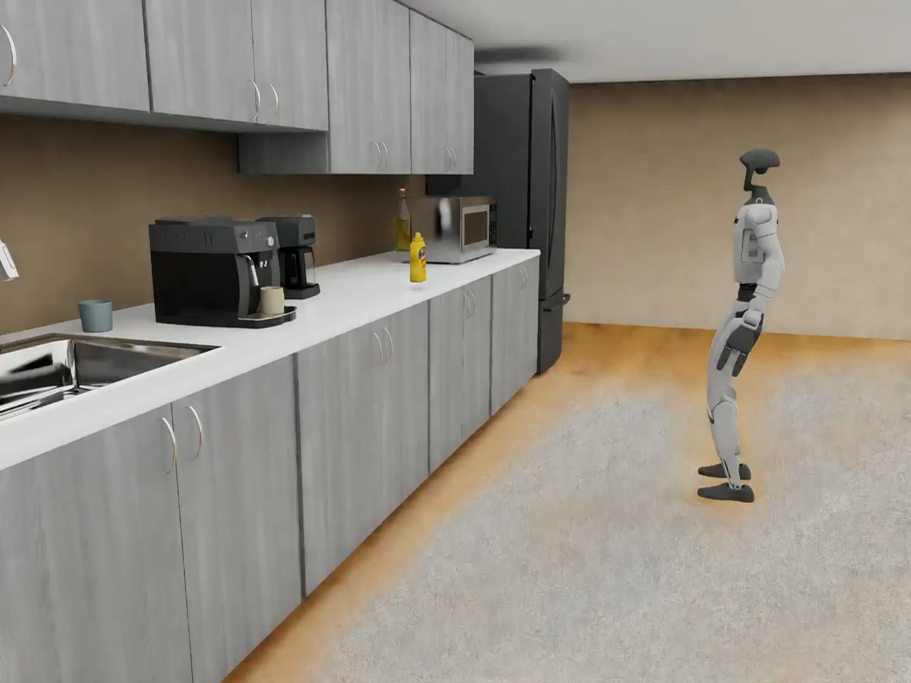
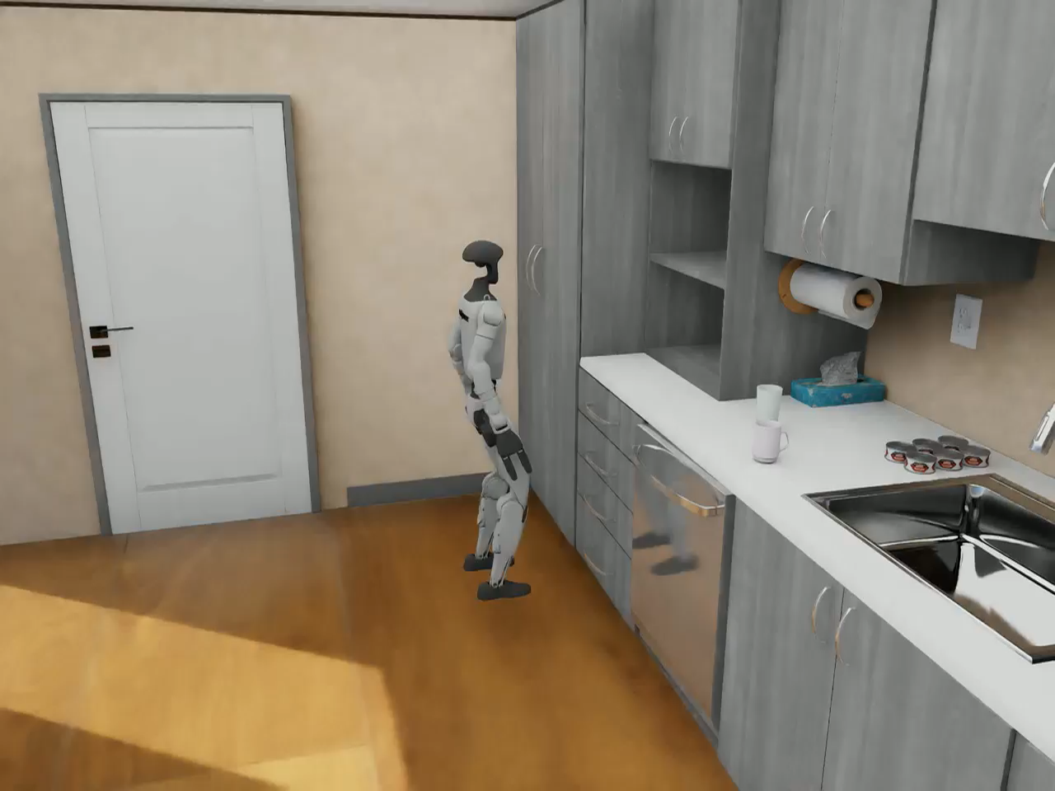
Simulation Demos
Diverse whole-body skills learned in IsaacSim
Pick (standing)
Open Drawer
human-like motions in all tasks
Stable balance maintained during manipulation
Generalises to randomised object positions & masses
Notes:
(~1 min)
Here you can see two simulation demos. Play both videos.
LEFT — Pick task: The G1 robot reaches out with its right arm, grasps the object, and lifts it. Notice how the whole body coordinates — the torso leans slightly, the legs maintain balance throughout.
RIGHT — Open Drawer task: The robot approaches, reaches down to the drawer handle, pulls it open. A challenging task because pulling requires the body to brace against the force.
The motions are natural-looking — this is what the diffusion prior gives us. Compare this to what you'd get from pure RL: typically jerky, unstable, or strange-looking motions that often don't transfer to the real robot.
Both policies generalised to 1,000 random environments (different object positions, masses, frictions) and maintained high success rates.

Slide 17
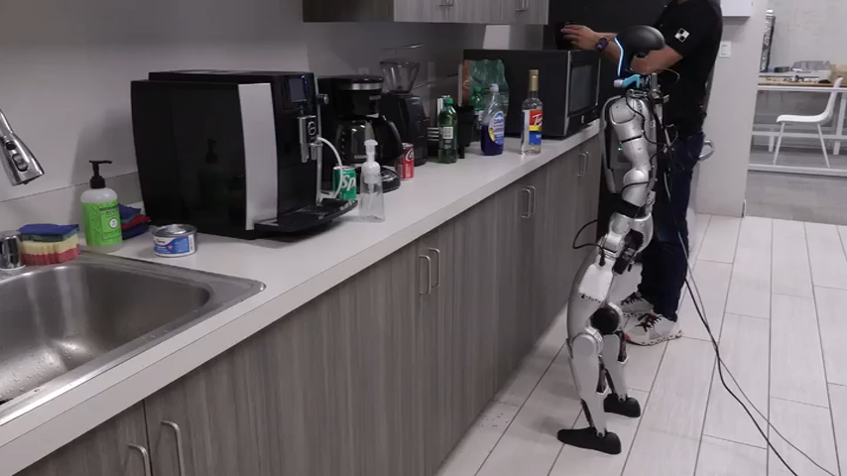
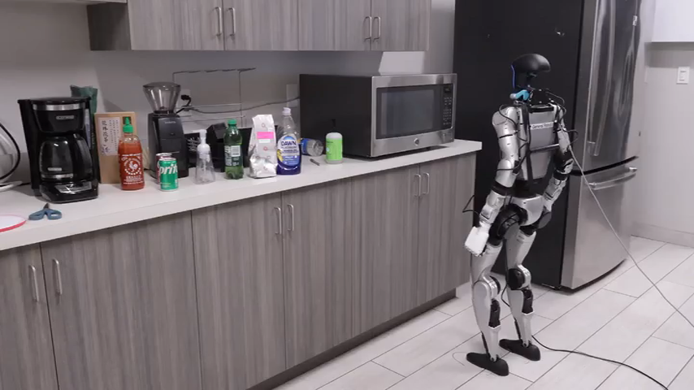
Hardware Demo: Pick & Button Press
Real Unitree G1 robot — autonomous execution
Pick — Standing
Button Press — Microwave
Object detected with OWLv2 + depth in first frame → policy runs autonomously
Notes:
(~1 min)
Two hardware demos.
LEFT — Pick task: The robot detects the object in the first camera frame, then executes the pick policy. Notice the natural reaching motion, the arm trajectory, and the stable base. The robot grasps the object and lifts it.
RIGHT — Button press on a microwave: Much more precise — the robot needs to reach a specific small target (the microwave button) at a specific height. The spatiotemporal guidance in Stage 1 specified where the finger should reach; the RL policy learned to consistently hit that target.
In both cases: fully autonomous from object detection to task completion. No human is teleopering. No additional fine-tuning on real data.

Slide 18
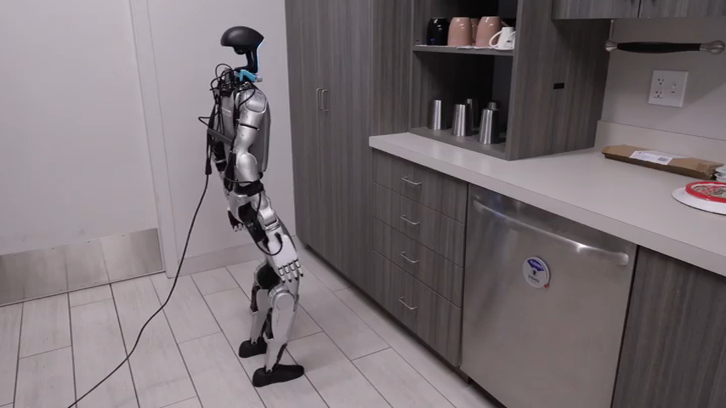
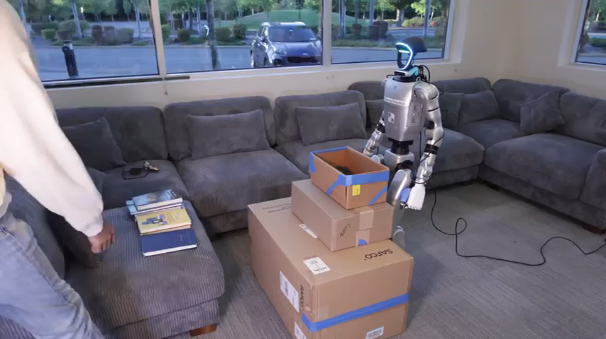
Hardware Demo: Drawer Opening & Bimanual Pick
Coordinated whole-body control on real hardware
Open Drawer
Bimanual Pick
Bimanual pick tested with 1, 2 and 4 books (varying weight) — same policy, no retraining
Notes:
(~1 min)
Two more hardware demos.
LEFT — Drawer opening: The robot bends down slightly, grasps the drawer handle, and pulls. This is hard because: (1) the robot must maintain balance while pulling against resistance, and (2) the motion requires the whole body to work as a unit — not just the arm. The diffusion prior gave the RL a template of how a human opens a drawer, which the RL then refined to be robust in simulation.
RIGHT — Bimanual pick: Both arms simultaneously lift a box. This is particularly challenging because:
- Both arms need to cooperate in synchrony
- The box weight varies (1 book, 2 books, 4 books in other demos)
- The robot must balance while lifting an uneven load
Same policy, no retraining for different weights — the domain randomisation during training (randomised object mass) gives the policy implicit robustness.

Slide 19
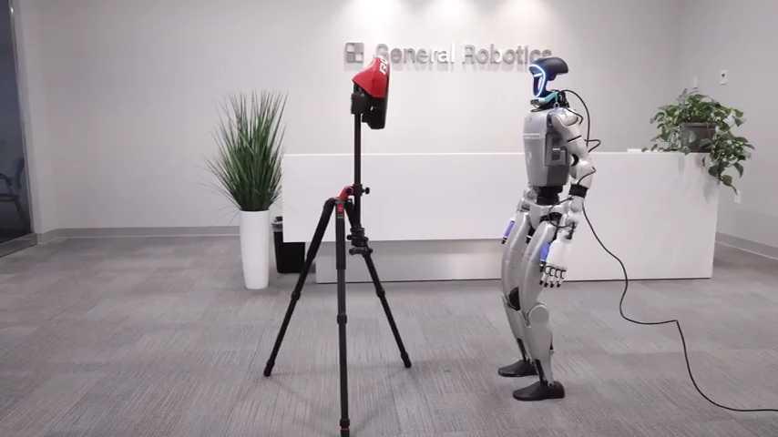
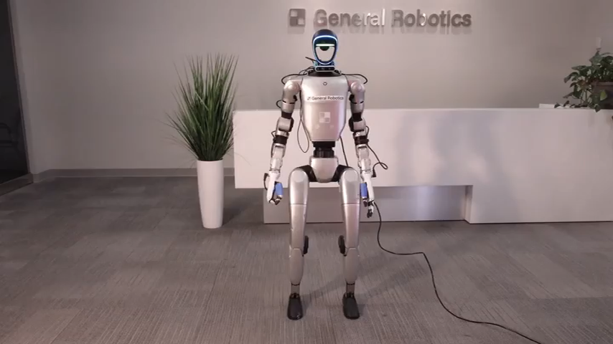
Hardware Demo: Precise Punch & Squat
Dynamic whole-body tasks requiring power and balance
Precise Punch
Squat
Squat depth randomised during training → works at varying depths on real robot
Notes:
(~1 min)
Two final demos.
LEFT — Precise punch: Requires fast, accurate arm motion to hit a small target. The robot generates power from the shoulder while maintaining balance. The "precise" in the name means it hits a specific spatial target — not just flailing.
RIGHT — Squat: This is a lower-body only demo, showing the robot squats to different depths. Trained with randomised squat depth → generalises at test time. Notice the controlled, stable descent and return.
Both tasks demonstrate that the same DreamControl framework — diffusion prior + RL — works for very different motion types: dynamic arm strikes, slow controlled squats, everything in between.
By now you've seen 6 tasks on real hardware and multiple simulation tasks — all from the same training recipe.

Slide 20
Thank You!
Questions?
Notes:
Q&A prep — common questions:
Q: Why use OmniControl and not train your own diffusion model?
A: They use it zero-shot (no fine-tuning) because OmniControl is already trained on HumanML3D which covers a huge variety of human motions. The IK fallback handles out-of-distribution tasks.
Q: Does the reference trajectory need to be exactly right?
A: No — the RL policy learns to TRACK the trajectory, not replicate it exactly. Small errors are tolerated. The diversity of trajectories (generated with different target positions) gives robustness.
Q: How does this compare to motion retargeting + trajectory tracking without RL?
A: Pure trajectory tracking (kinematic control) doesn't handle perturbations or contact dynamics. RL provides robustness to the real-world messiness.
Q: Why not use video-based motion priors instead of MoCap?
A: OmniControl is trained on MoCap but can incorporate video data via implicit video diffusion — future work direction.
Q: Can this scale to humanoid-robot dexterous manipulation?
A: Currently limited to binary hand control. The authors acknowledge this as a key limitation.

