Slide 1
Advanced Scalable Transformers in
Spatial / Temporal Generation
260407
Yilin Wang

Slide 2

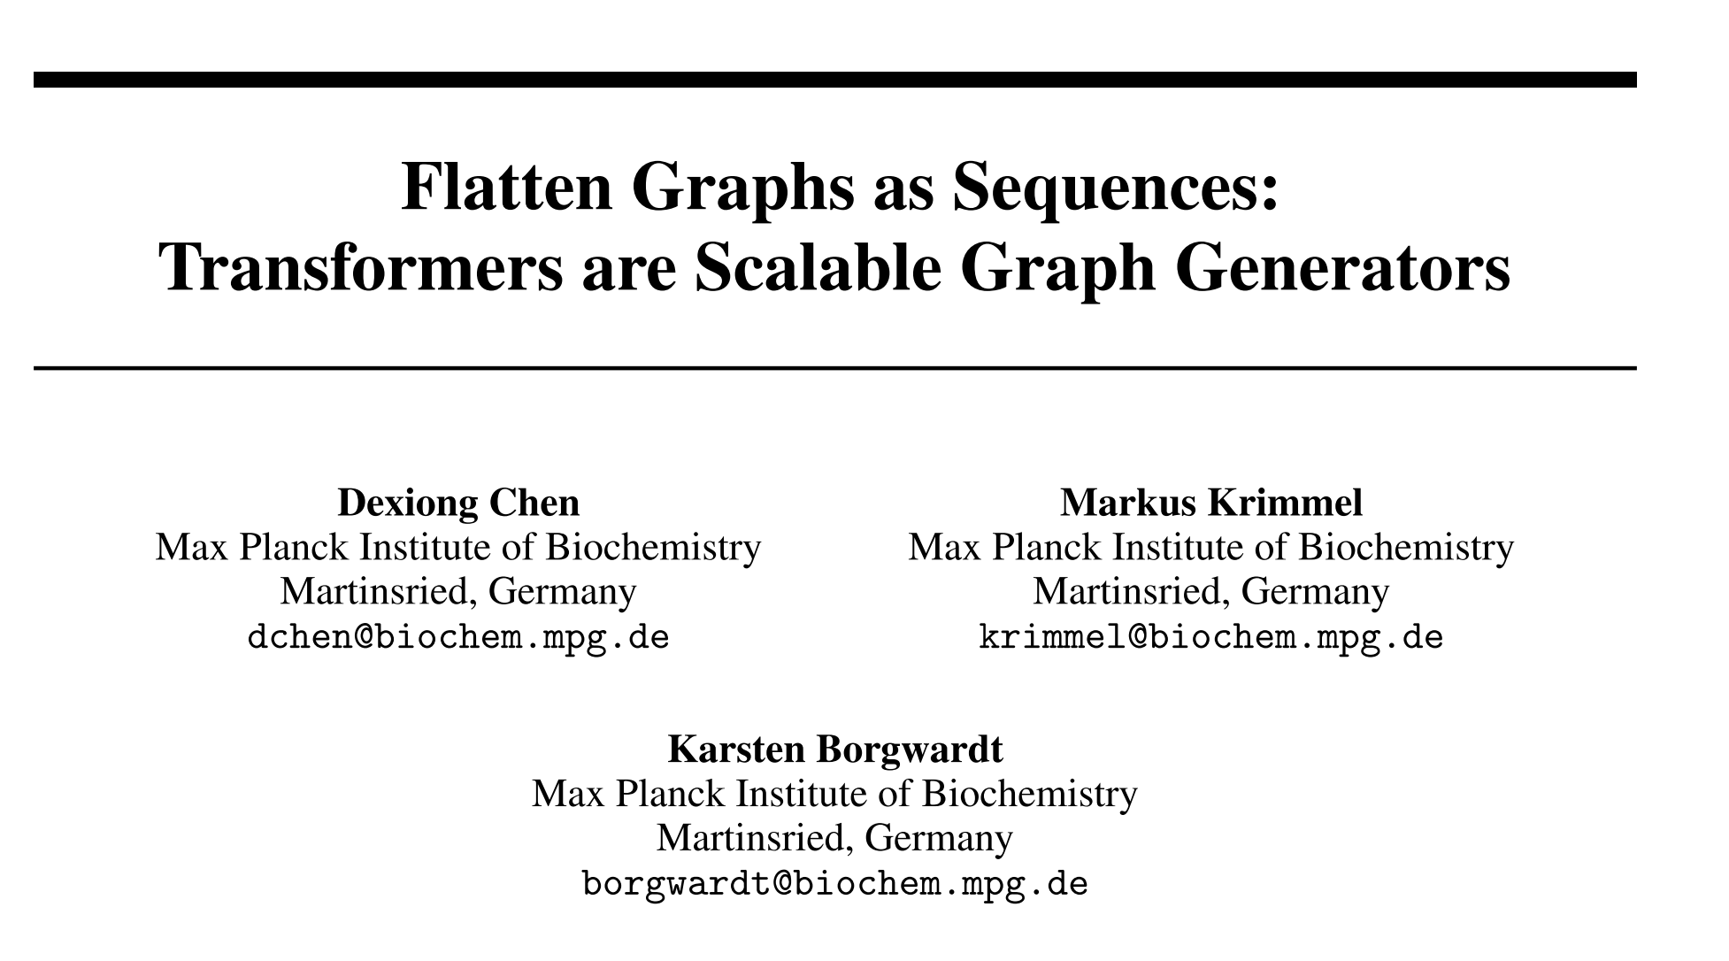
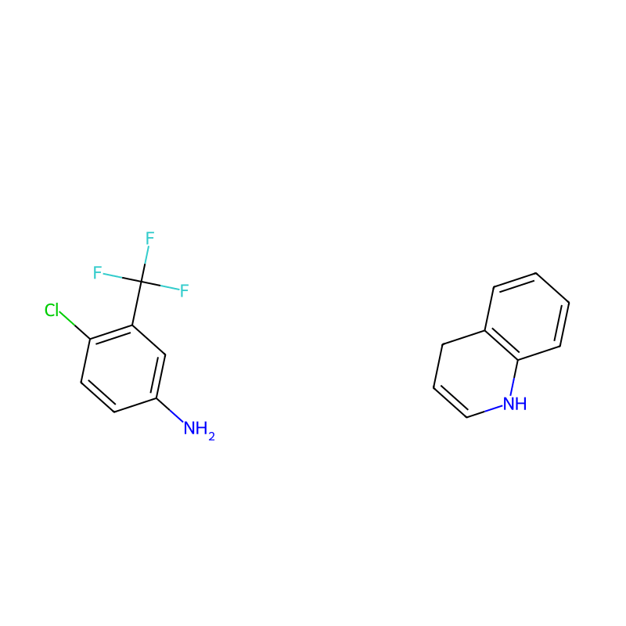
NeurIPS 2025

Slide 3
Motivation
Bottleneck of Graph Generation Paradigms
  Diffusion Models vs. Autoregressive Models
  Complexity explosion
    Adjacency matrices → O(V^2)
  Slow Sampling
Limitation of Transformer
  1D sequence tasks are naturally ordered (e.g. time)
  Graphs ➔ lie in non-Educlidean space ➔ lack a natural ordering
  Previous serialization attempts (e.g. DFS / BFS) ignores local topology
  ➔ Difficult to learn long-range spatial dependencies

Slide 4
Key Idea
Design a lossless, reversible transformation to flatten a graph into a 1D sequence
The length of the sequence scales linearly with number of edges
Utilize a pure decoder-only transformer → LLaMA architecture

Slide 5
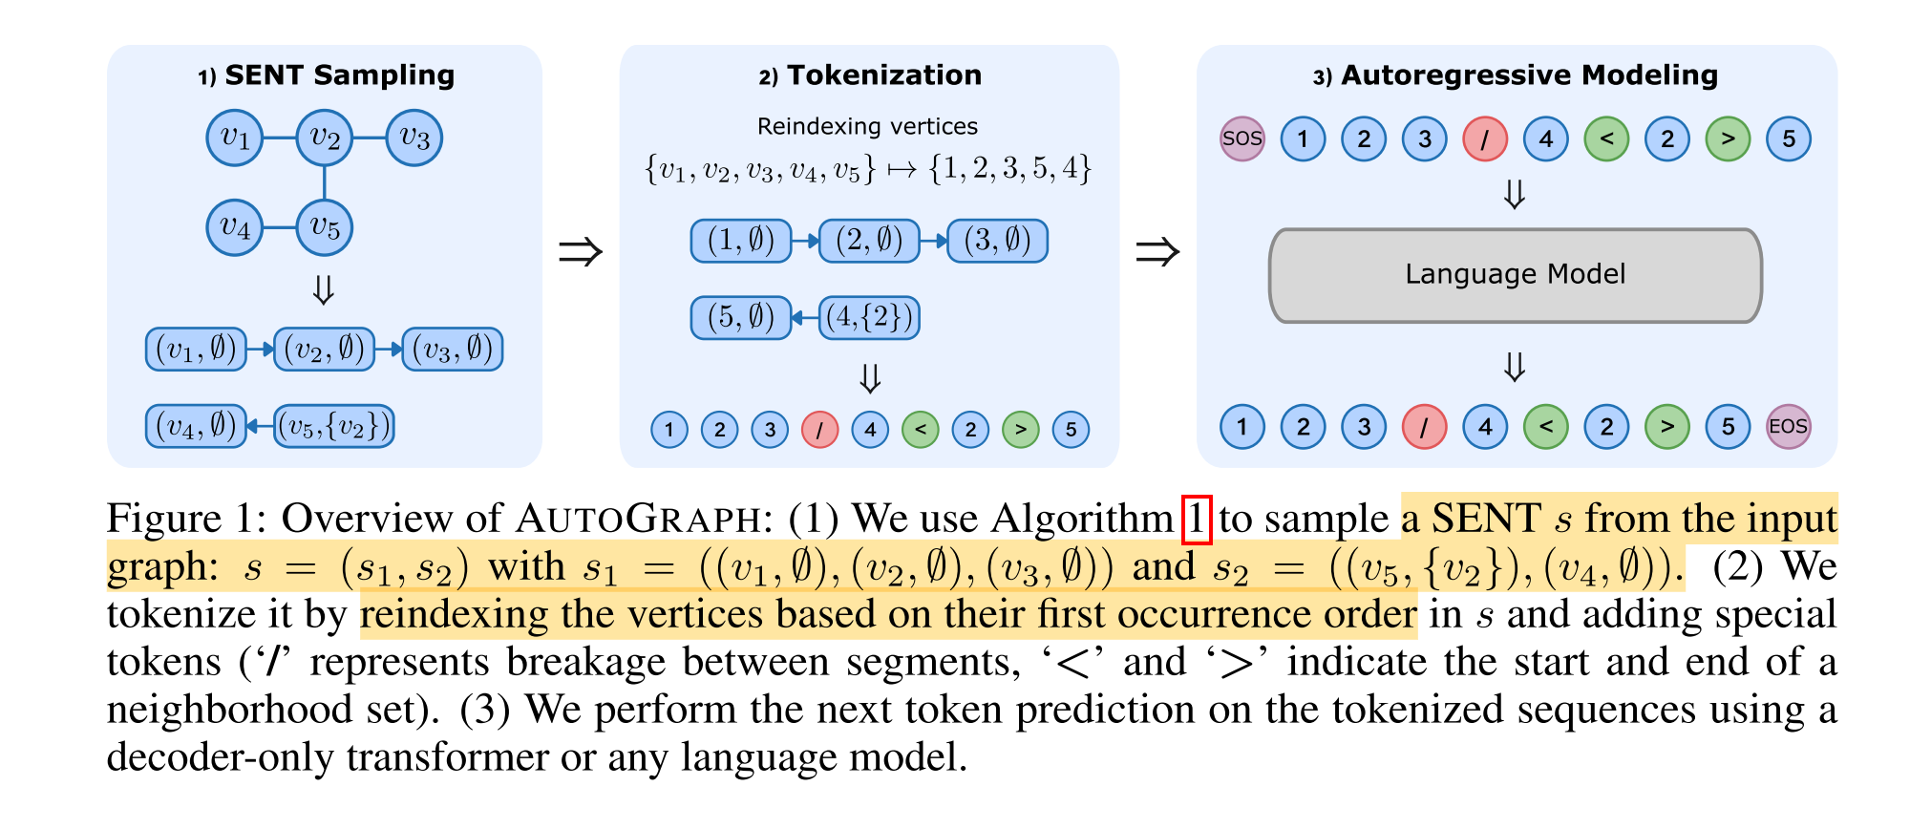
General Paradigm
SENT = Segmented Eulerian Neighborhood Trail
LLaMA

Slide 6
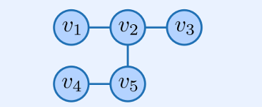
Segmented Eulerian Neighborhood Trail (SENT)
Walk
Trail
Segmented Eulerian Trail (SET)
(v1, v2, v3, v2, v5)
(v1, v2, v3)
SET S = (s1, s2, s3)
s1 = (v1, v2, v3)
s2 = (v2, v5, v4)
s3 = (v5, v1)
⚠️ v1, v2, v5 are topological close and connected, but if sequantialize the SET (s1, s2, s3), they would be far away from each other

Slide 7
Segmented Eulerian Neighborhood Trail (SENT)
Walk
Trail
Segmented Eulerian Trail (SET)
Segmented Eulerian Neighborhood Trail (SENT)
(v1, v2, v3, v2, v5)
(v1, v2, v3)
SET S = (s1, s2, s3)
s1 = (v1, v2, v3)
s2 = (v2, v5, v4)
s3 = (v5, v1)

Slide 8
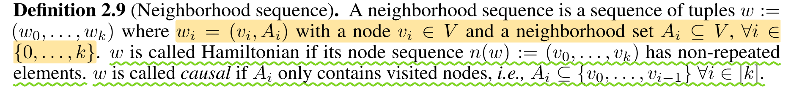
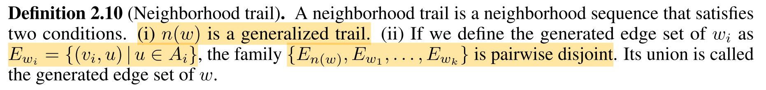
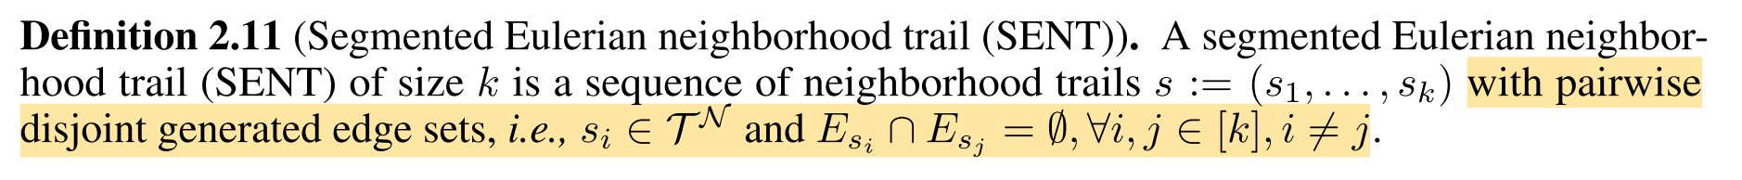
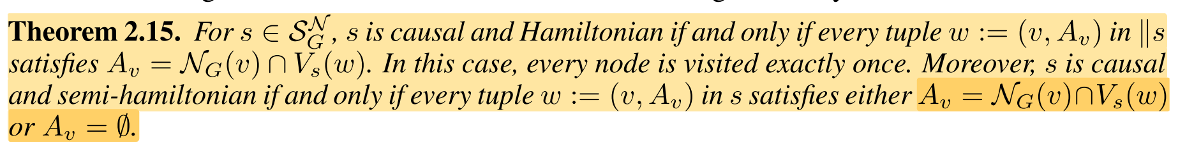
Segmented Eulerian Neighborhood Trail (SENT)
Neighborhood sequence
Neighborhood trail
Segmented Eulerian Neighborhood Trail
The set of visited nodes in the visited trails
The set of neighborhood nodes in the graph

Slide 9
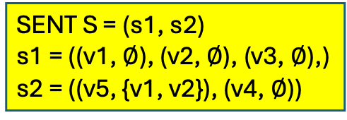
Segmented Eulerian Neighborhood Trail (SENT)
Walk
Trail
Segmented Eulerian Trail (SET)
Segmented Eulerian Neighborhood Trail (SENT)
(v1, v2, v3, v2, v5)
(v1, v2, v3)
SET S = (s1, s2, s3)
s1 = (v1, v2, v3)
s2 = (v2, v5, v4)
s3 = (v5, v1)
SENT S = (s1, s2)
s1 = ((v1, $∅$), (v2, $∅$), (v3, $∅$),)
s2 = ((v5, {v1, v2}), (v4, $∅$))

Slide 10
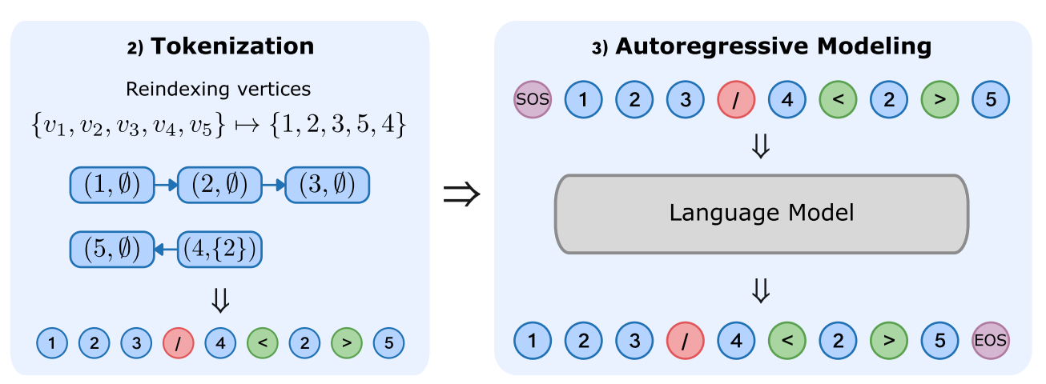
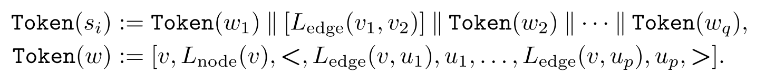
Tokenization
Handling Isomorphism
  Isomorphism ➔ permutation invariance
  Reindexing nodes based on first appearance order
Control Tokens
  Breaks between trail segments; Enclose neighborhood sets
Interleaved Tokenization of Attributed Graphs
  Seamlessly embed node features and edge features

Slide 11
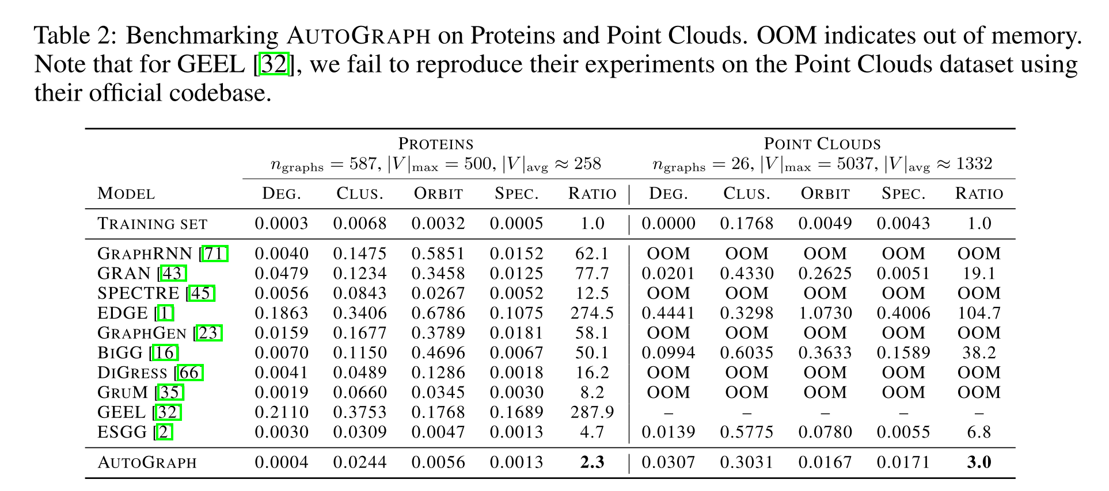
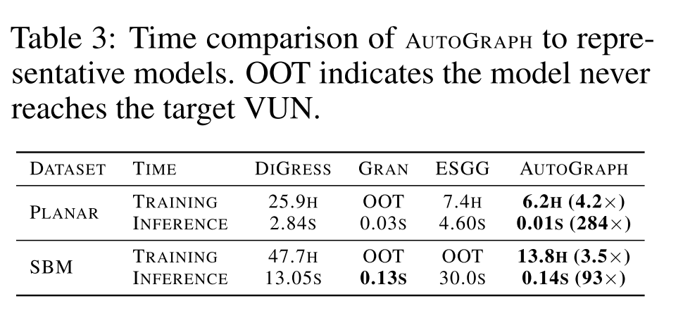
Experimental Results
Dimensionality Reduction & Large-Scale Generation

Slide 12
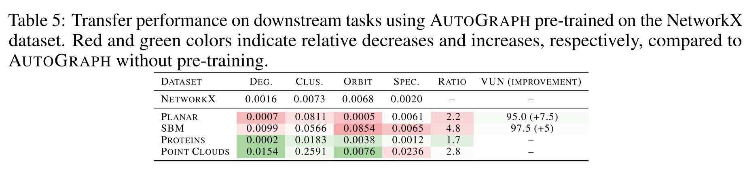
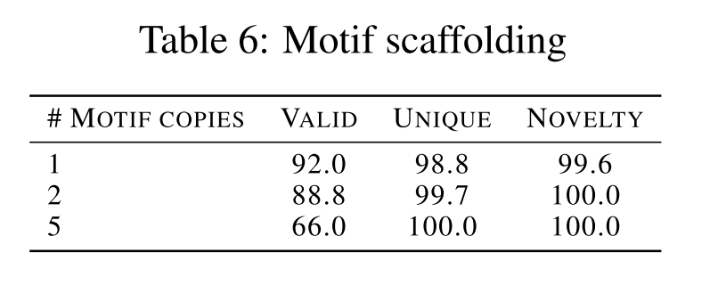
Experimental Results
Emergent Abilities
  Pre-training transferability
  Zero-shot motif (= subgraph) conditioning

Slide 13
Takeaways
SENT as a topological tokenizer of spatial interactions
  E.g. quantify / annotate the importance of physical spatial interactions between multiple dancers ➔ filter a sparse connected graph
Spatiotemporal Extensions of heterogeneous features?
  E.g. how can we introduce the time-axis tokens to extend this static graph flattening strategy into dynamic scenario like motion?

Slide 14
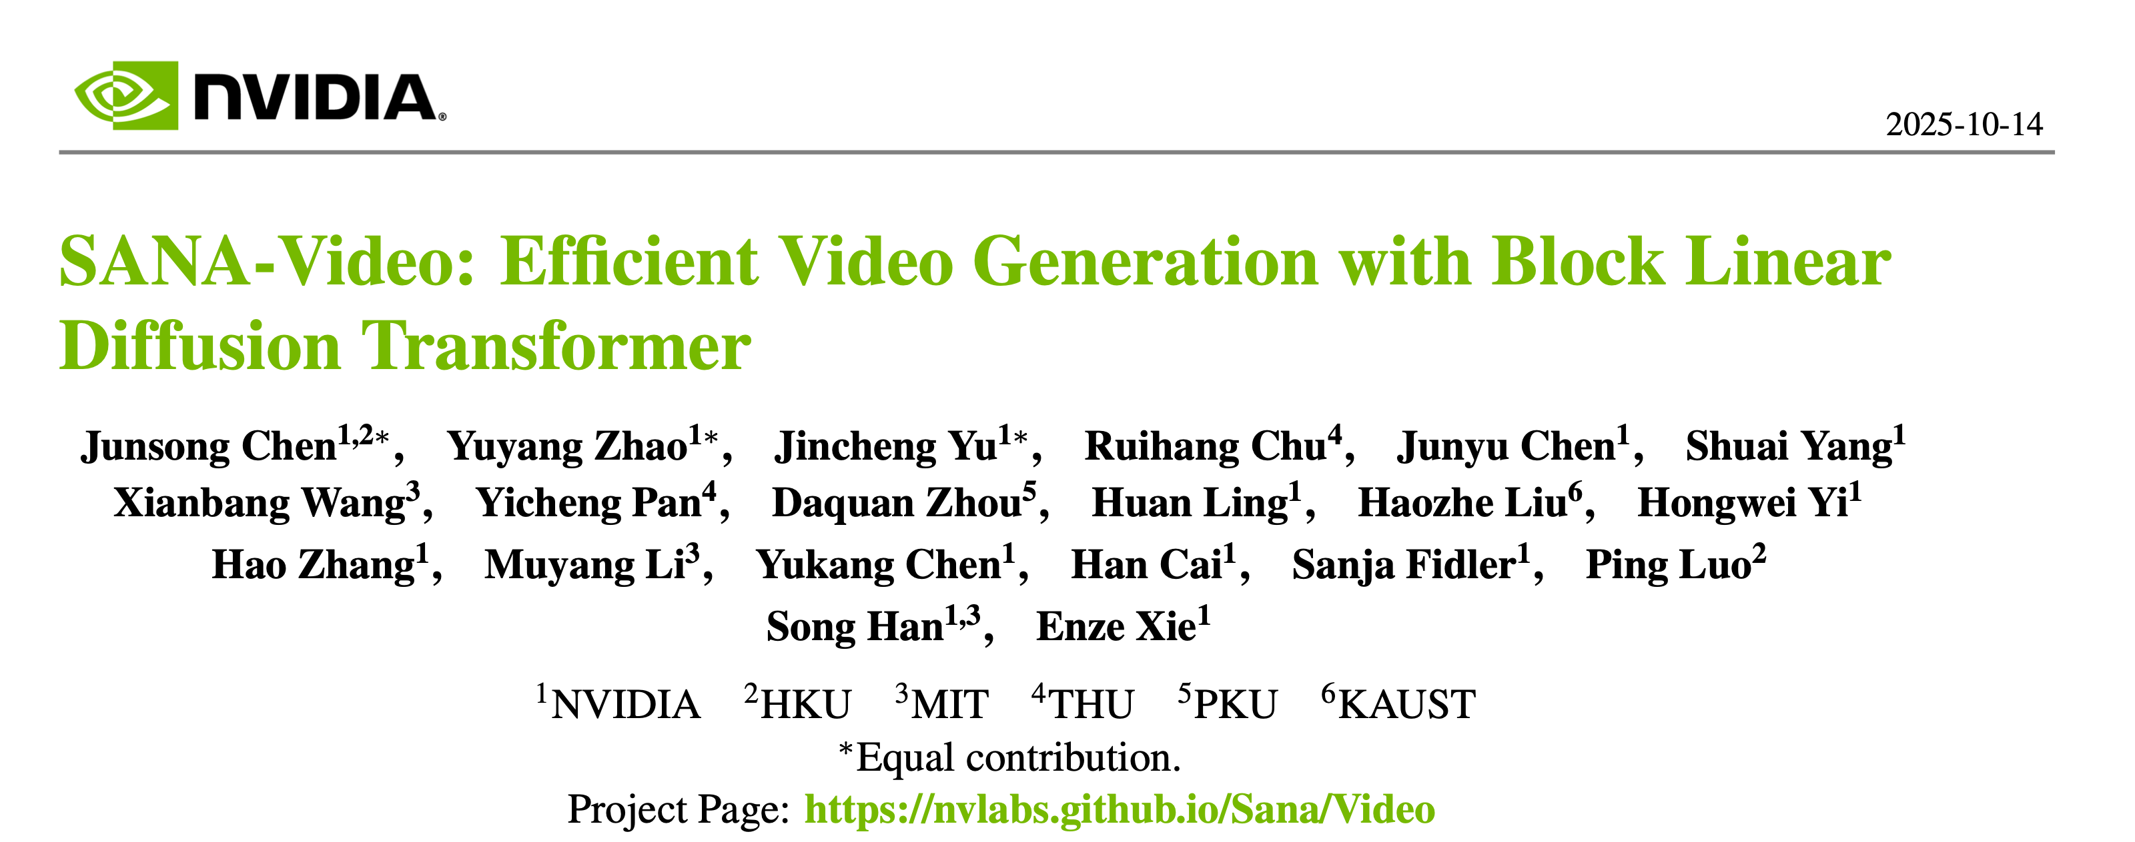
ICLR 2026 Oral

Slide 15
Motivation
Computation Bottleneck
  Softmax Attention scales quadratically ➔ Immense token counts for high-res videos
Memory Dilemma
  Standard autoregressive generation requires caching all historical keys/values ➔ scales linearly / quadratically ➔ OOM for long videos

Slide 16
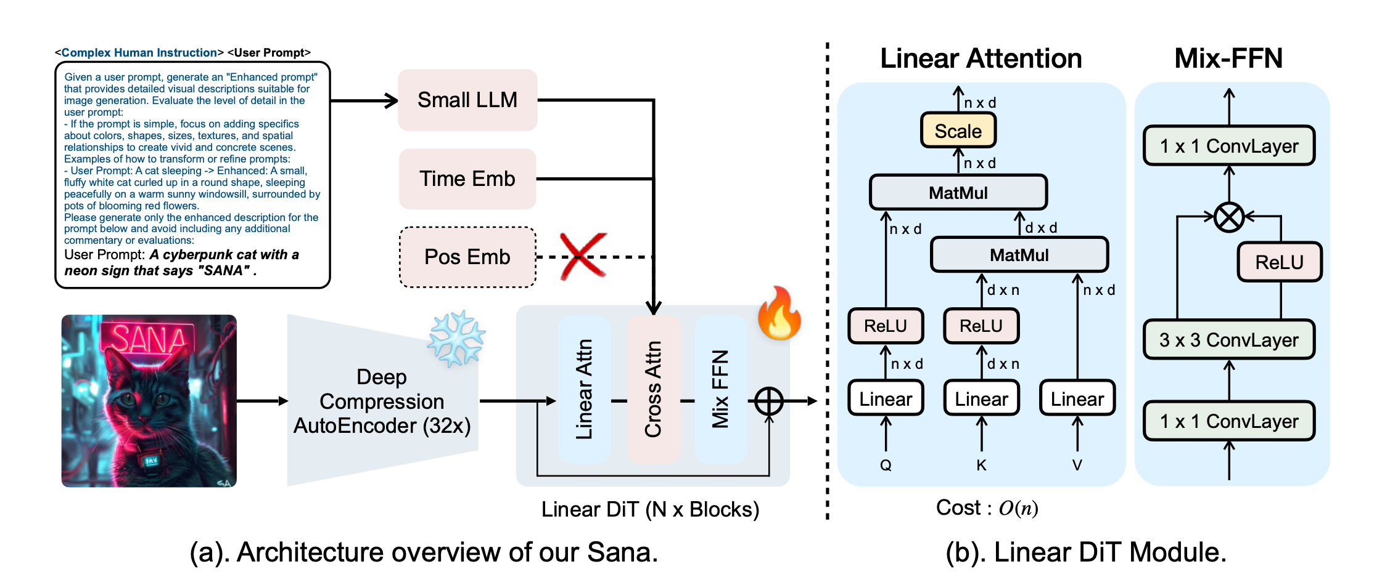
Background
Linear Attention
  Replace softmax with a linear kernel
Mix-FFN
* Sana: Efficient High-Resolution Image Synthesis with Linear Diffusion Transformer, ICLR 2025 Oral

Slide 17
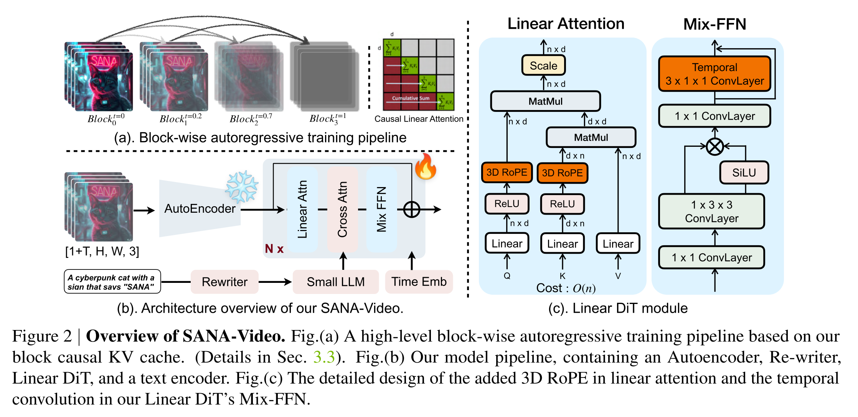
SANA-Video
SANA-Video synthesizes high-resolution, high-quality and long videos with
strong text-video alignment at a remarkably fast speed, deployable on RTX 5090 GPU.

Slide 18
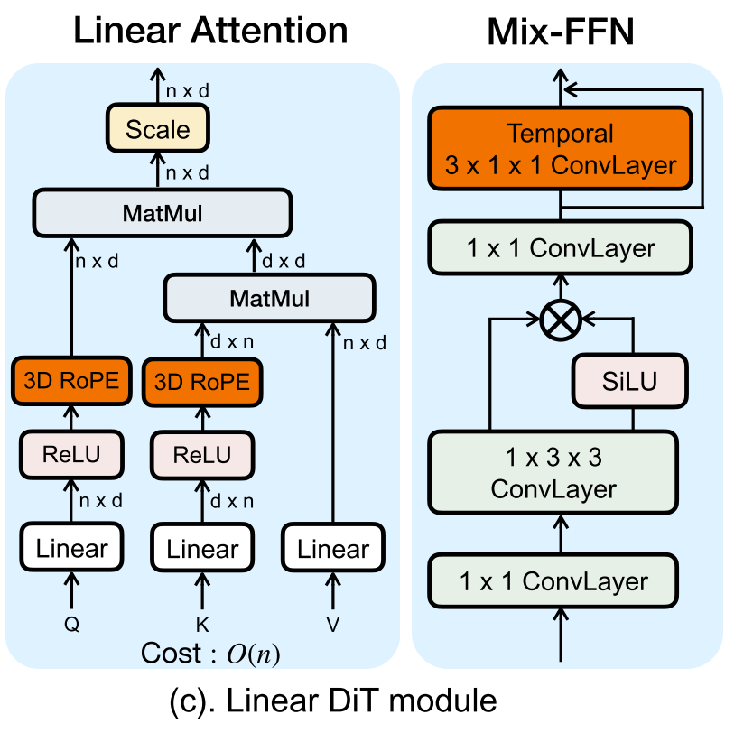
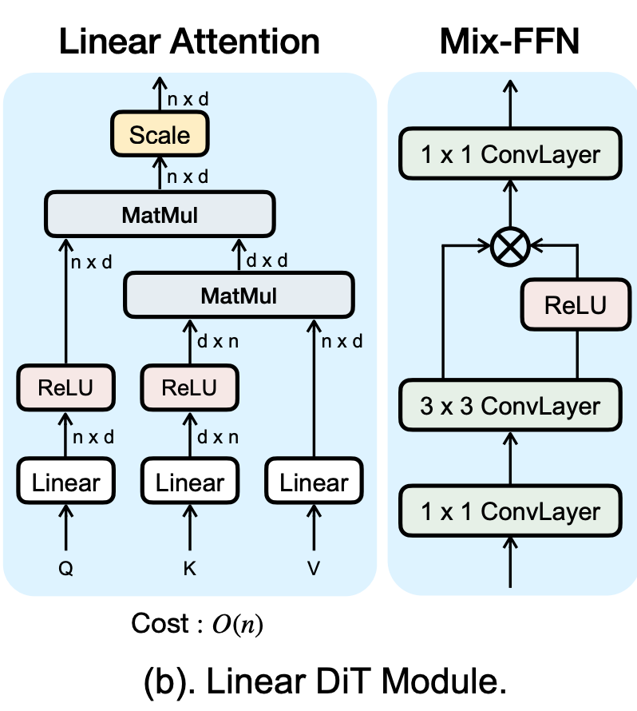
SANA-Video Linear DiT
Post-ReLU 3D RoPE
Temporal 1D Conv

Slide 19
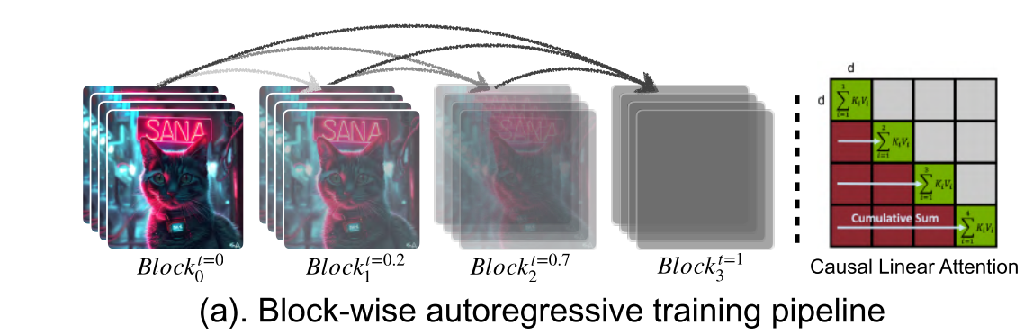
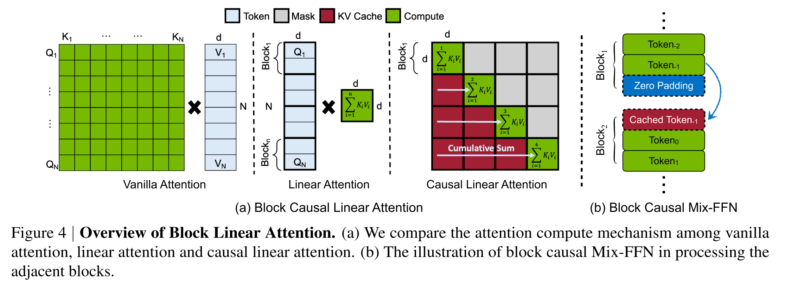
Block Linear Attention
Videos in temporal blocks
Instead of standard KV caching, the model passes the D x D cumulative state to the next block

Slide 20
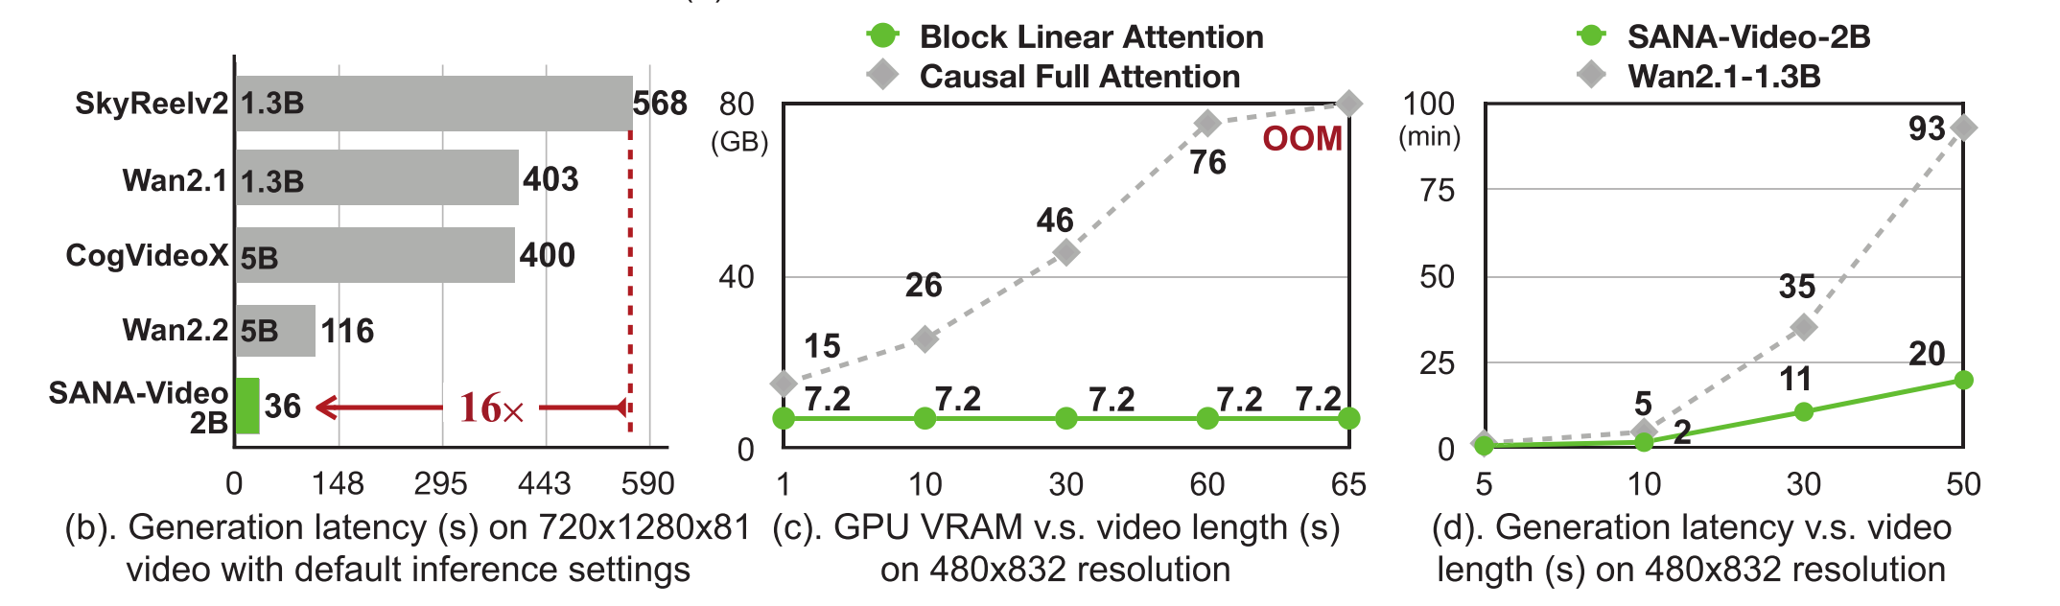
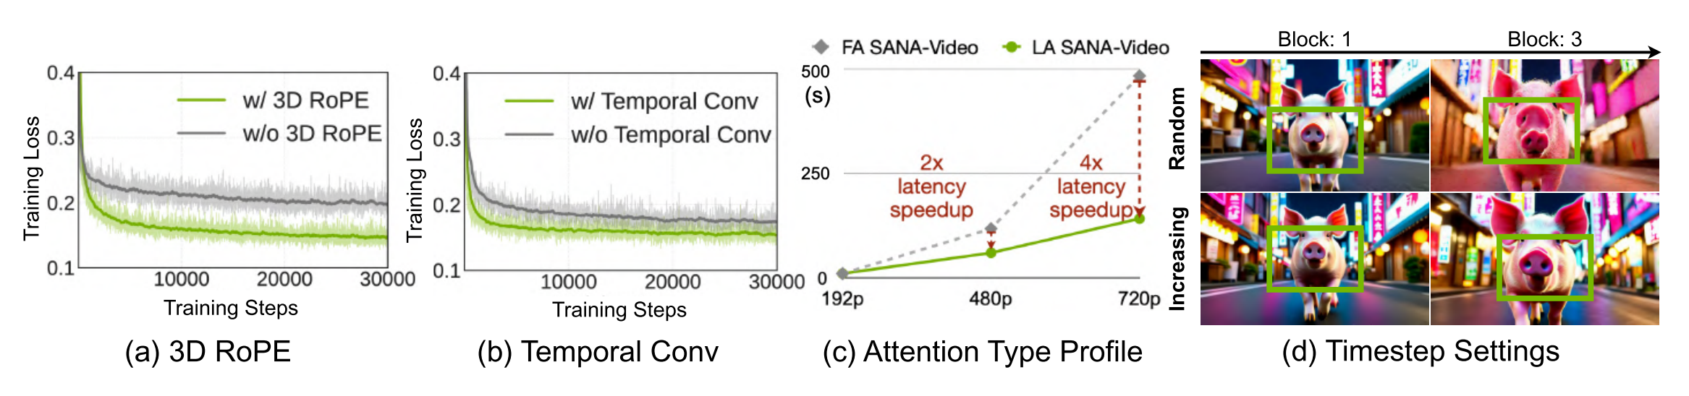
Experimental Results

Slide 21
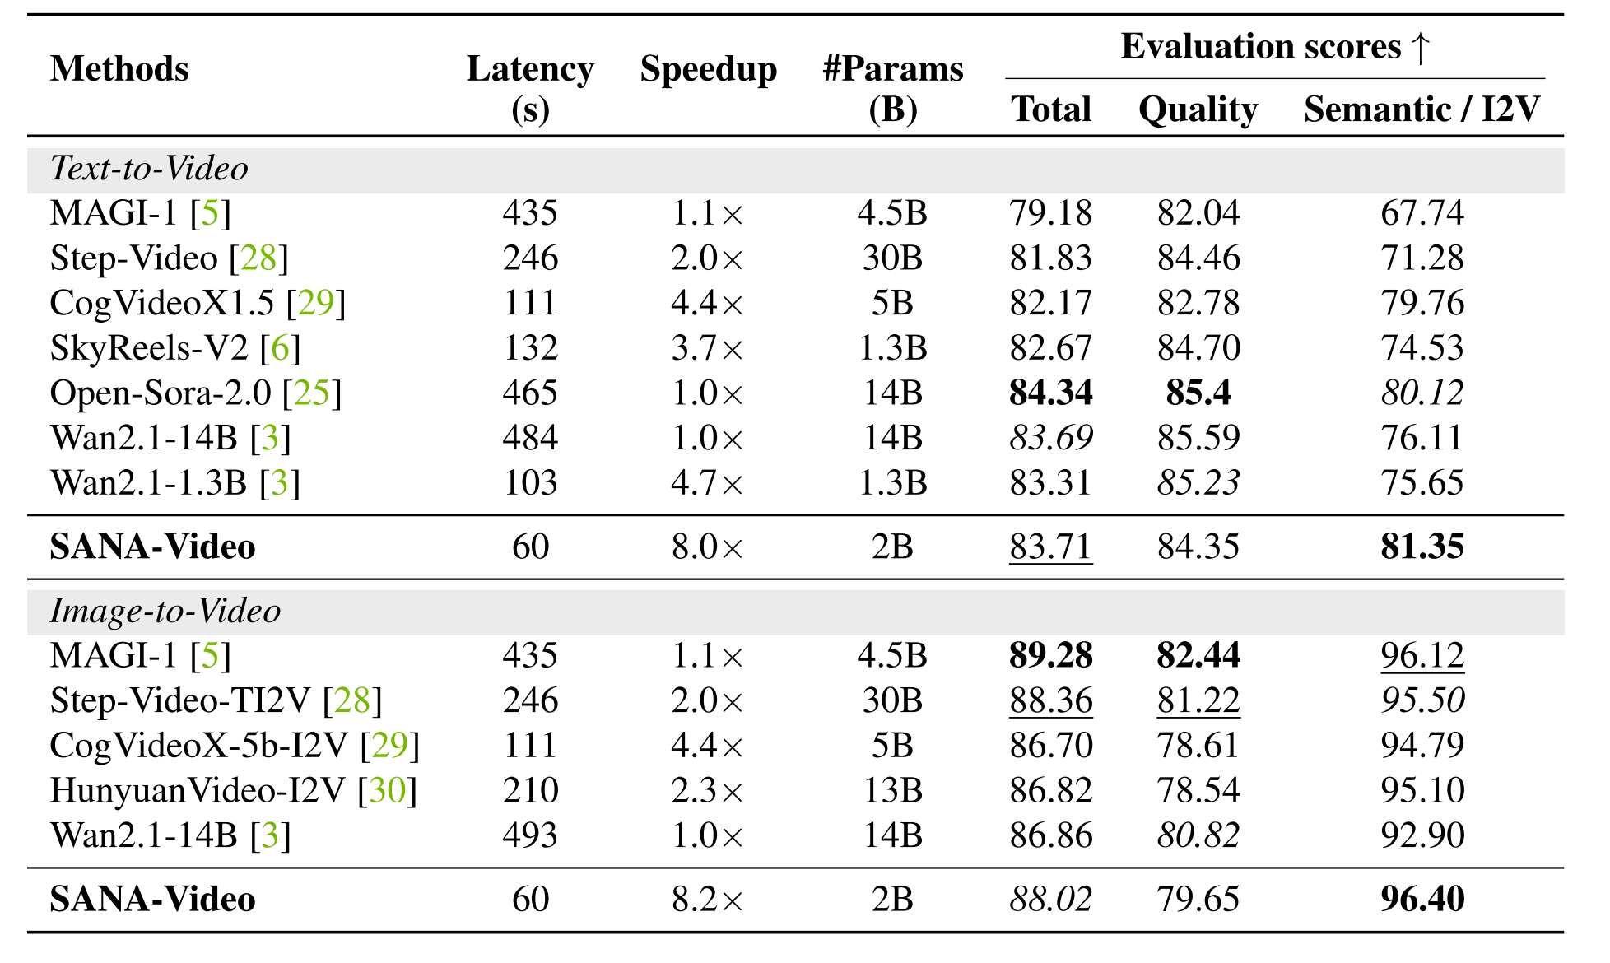
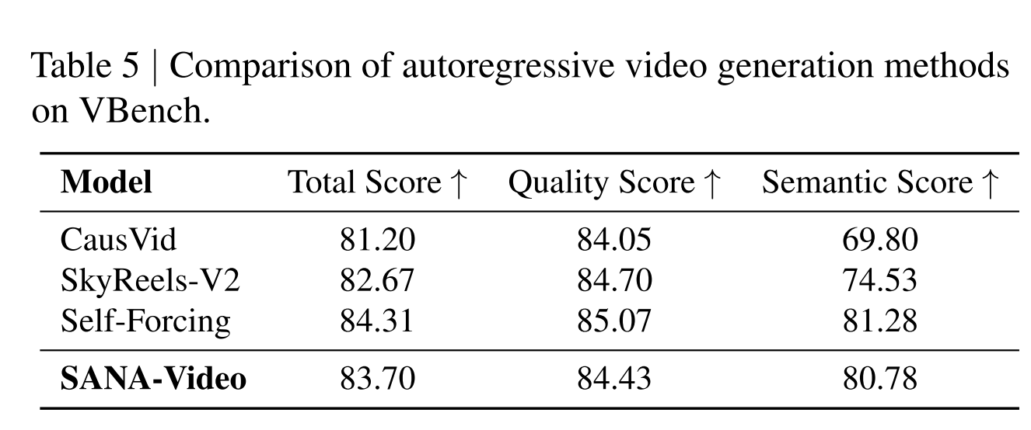
Experimental Results

Slide 22
Takeaways
Block Linear Attention maintains a constant-memory scaling that enables 16x faster generation and consumer-grade deployment
Speed vs. Fidelity Trade-off ➔ SANA-Video prioritizes latency via a highly compressed latent space (128x)
Adding 1D temporal convolutions effectively injects the necessary local inductive bias to compensate the over-smoothness introduced by linear attention

