Slide 1
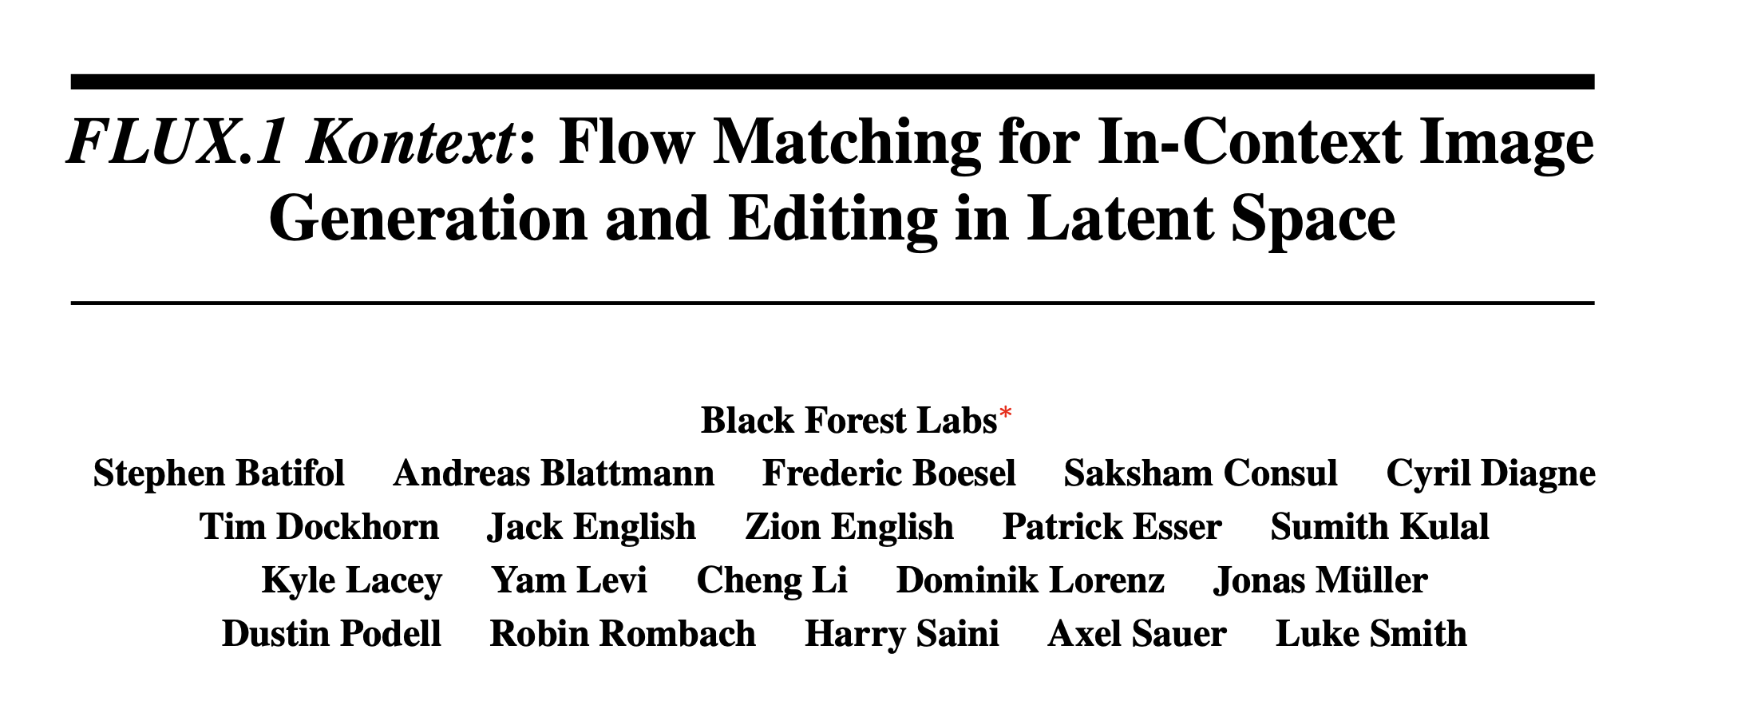

Slide 2
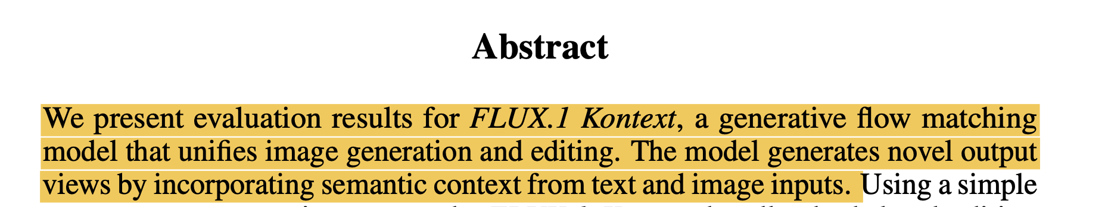
Flow Matching for Generative Modeling:
https://arxiv.org/pdf/2210.02747

Slide 3
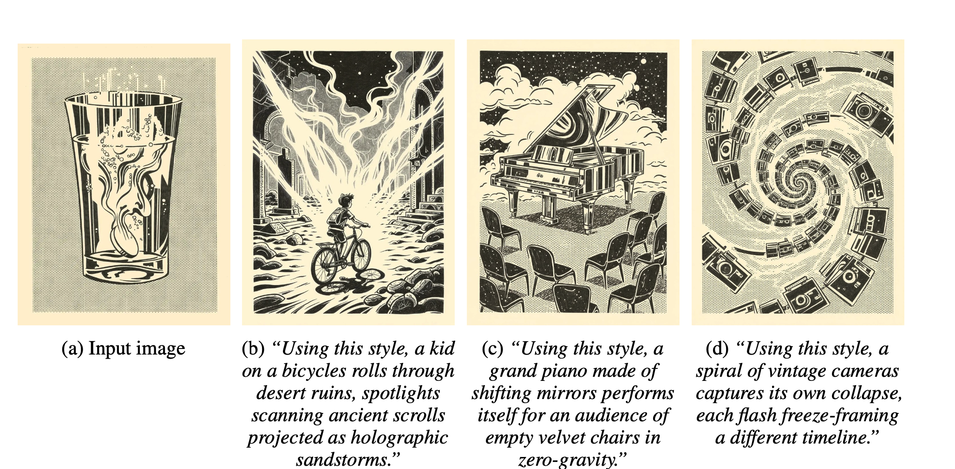
Style Reference

Slide 4
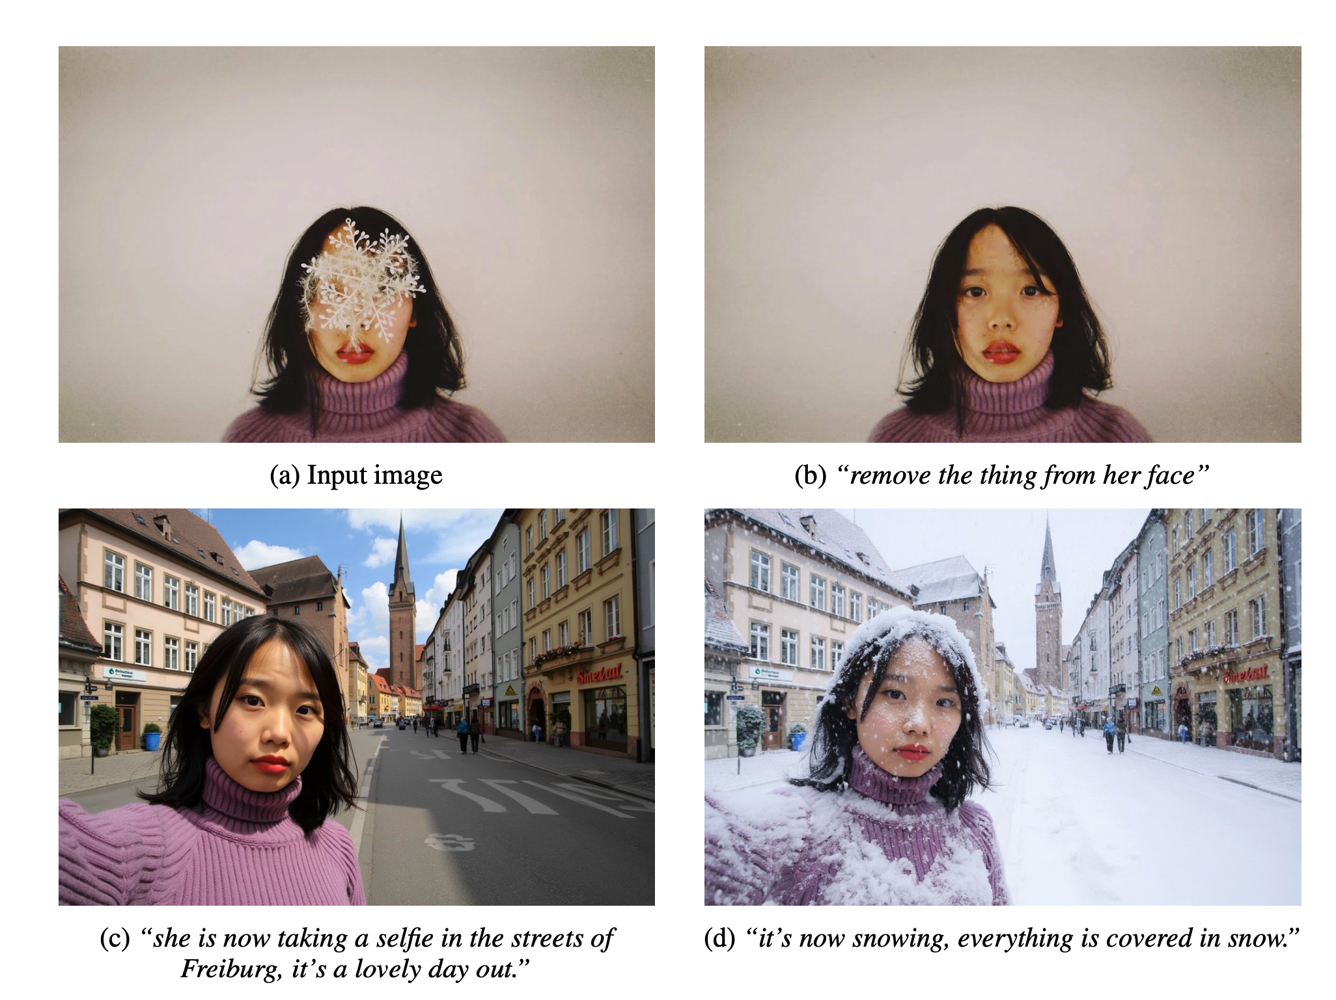
Iterative, instruction-driven editing

Slide 5
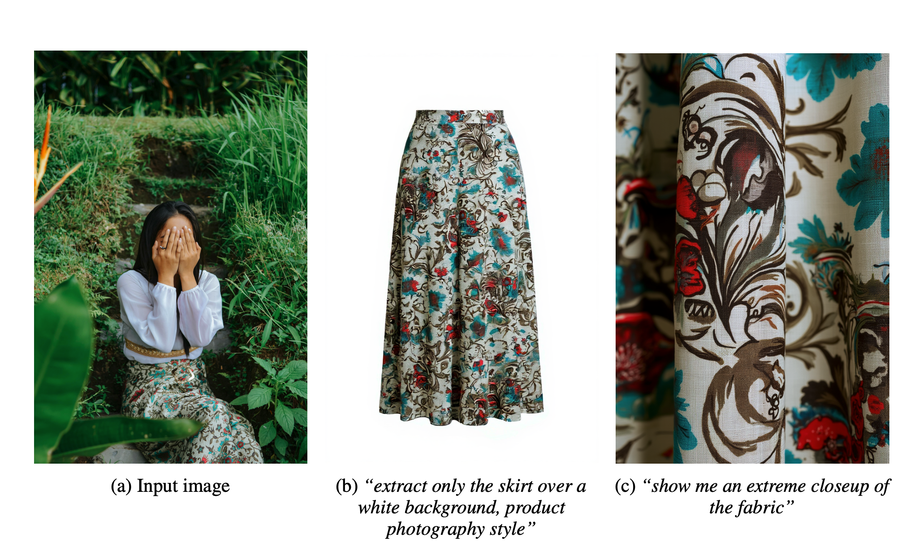
Product Photography

Slide 6
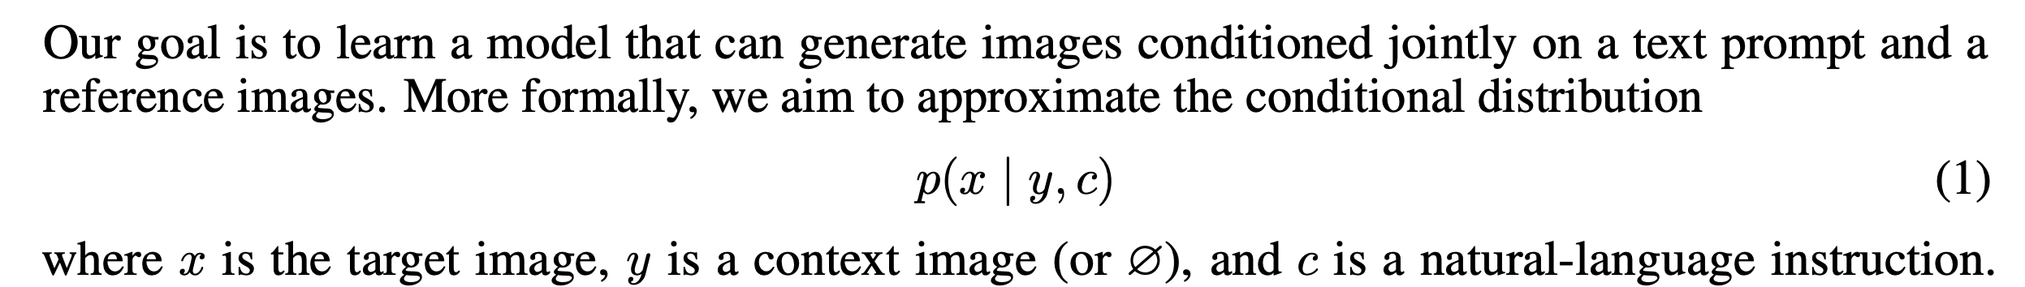
FLUX.1 Kontext

Slide 7
FLUX.1 Kontext

Slide 8
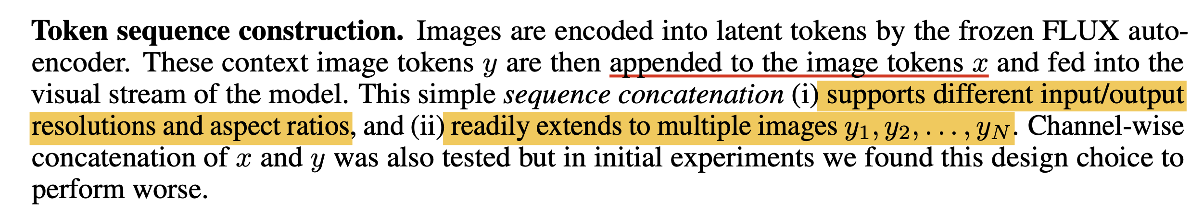
FLUX.1 Kontext

Slide 9
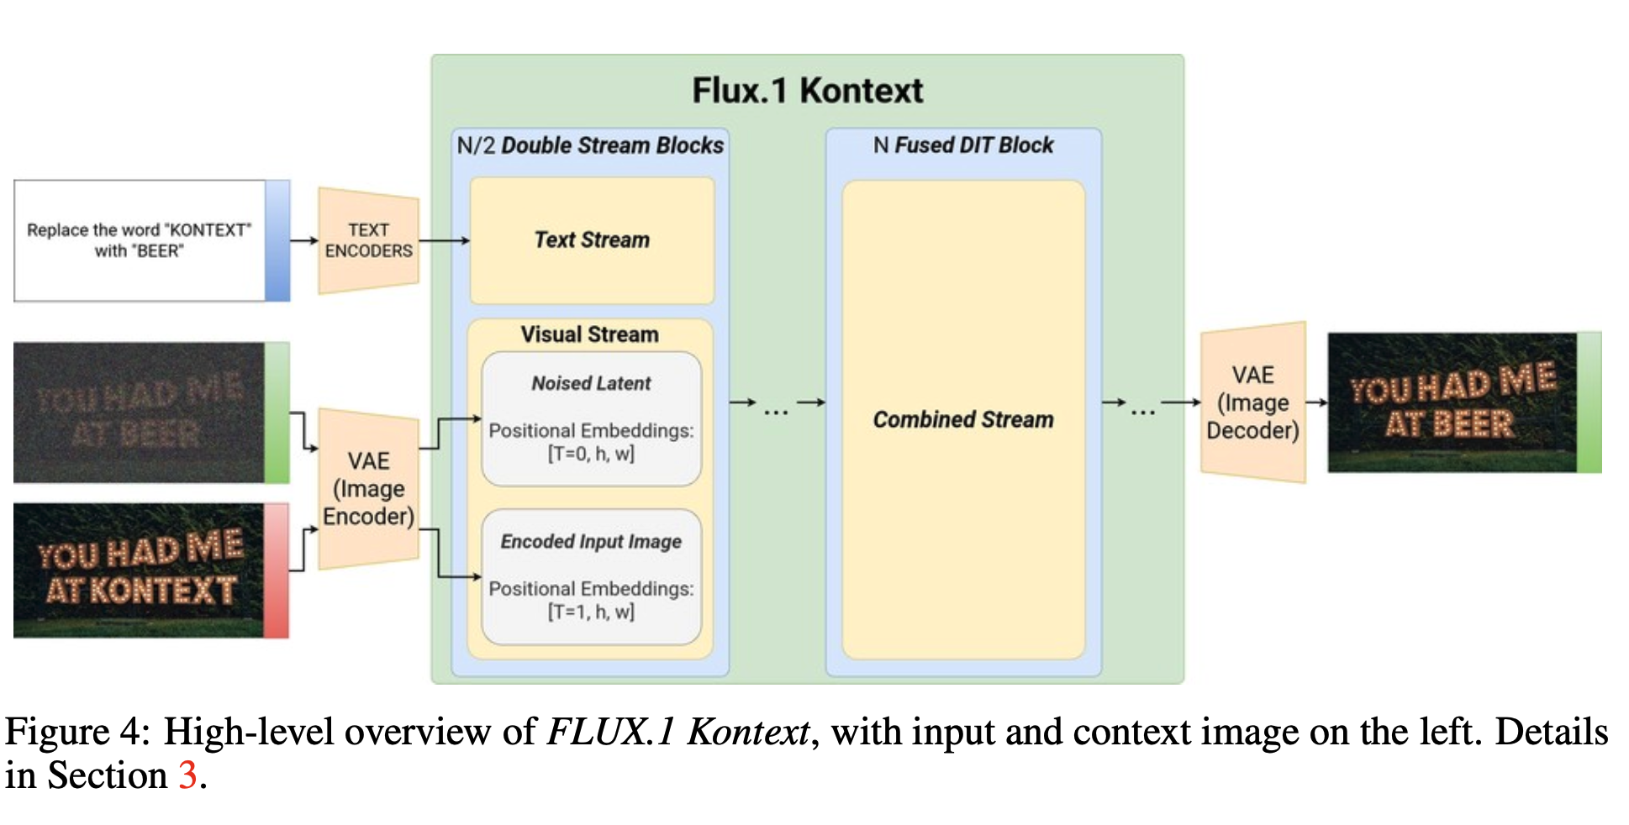
FLUX.1 Kontext

Slide 10
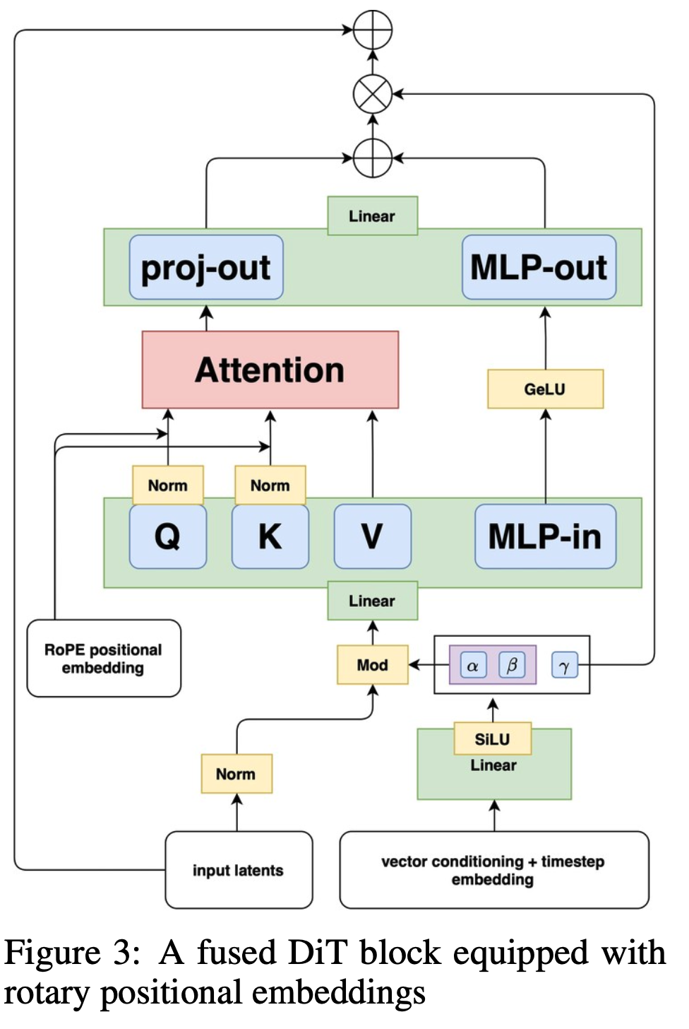
FLUX.1
FLUX.1 Kontext
RoPE:
https://arxiv.org/pdf/2104.09864

Slide 11
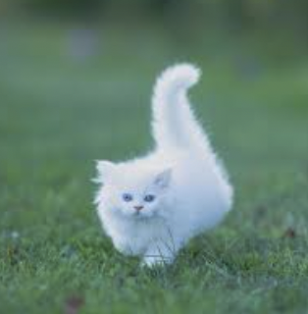
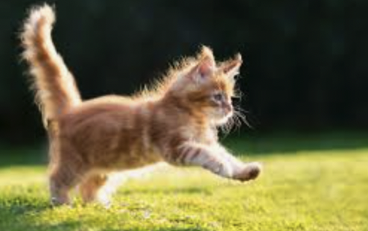
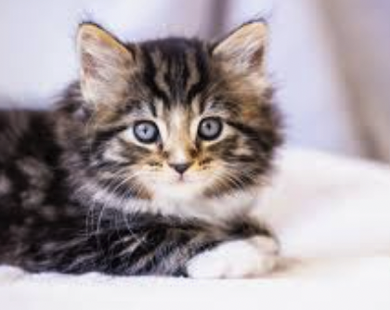
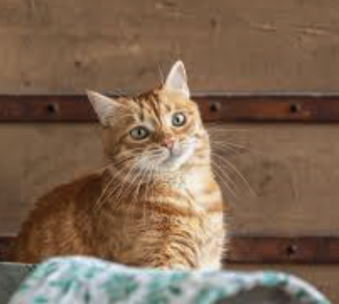
Flow-matching Diffusion Model
Training Data

Slide 12
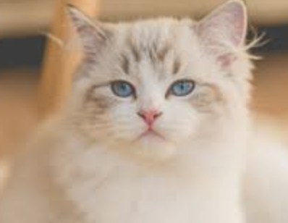
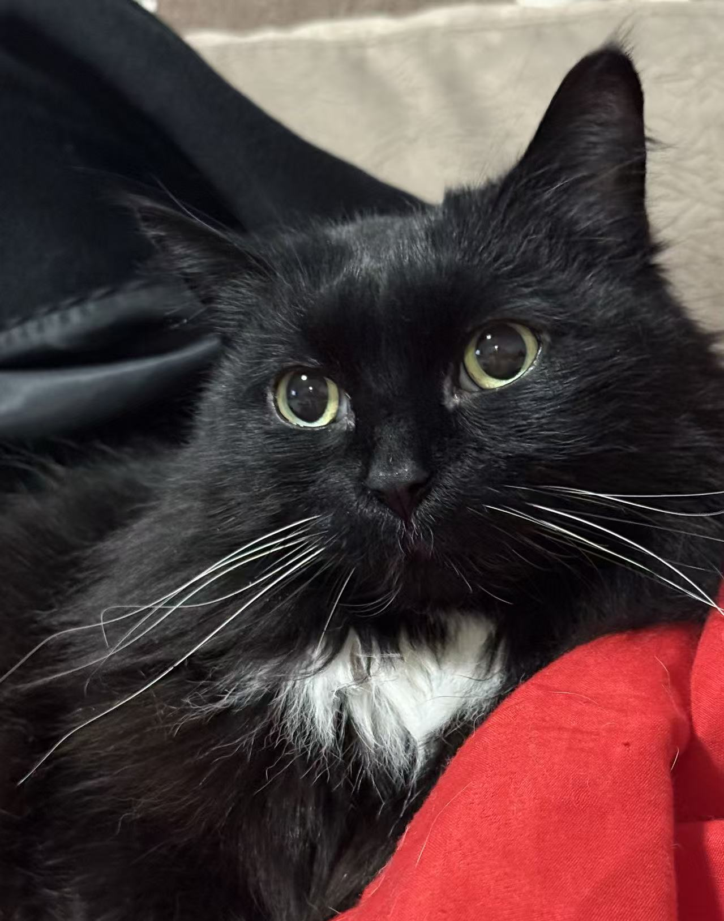
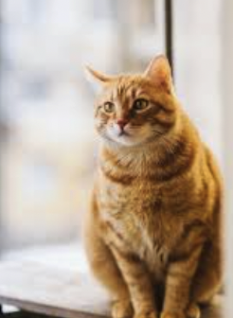
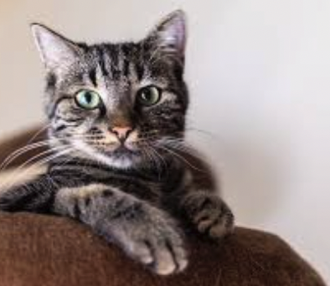
Flow-matching Diffusion Model
Images we want to generate

Slide 13
Flow-matching Diffusion Model
$$p_{1}(x_{1})$$
Images we want to generate

Slide 14
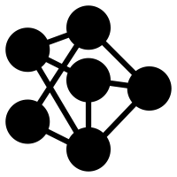
Flow-matching Diffusion Model
$$p_{1}(x_{1})$$
Data Distribution

Slide 15
Flow-matching Diffusion Model
$$p_{0}(x_{0})$$
$$p_{1}(x_{1})$$
Noise Distribution
Data Distribution

Slide 16
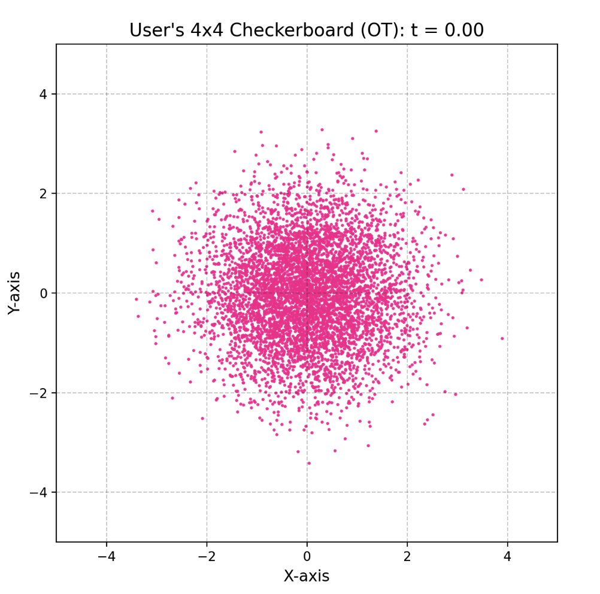
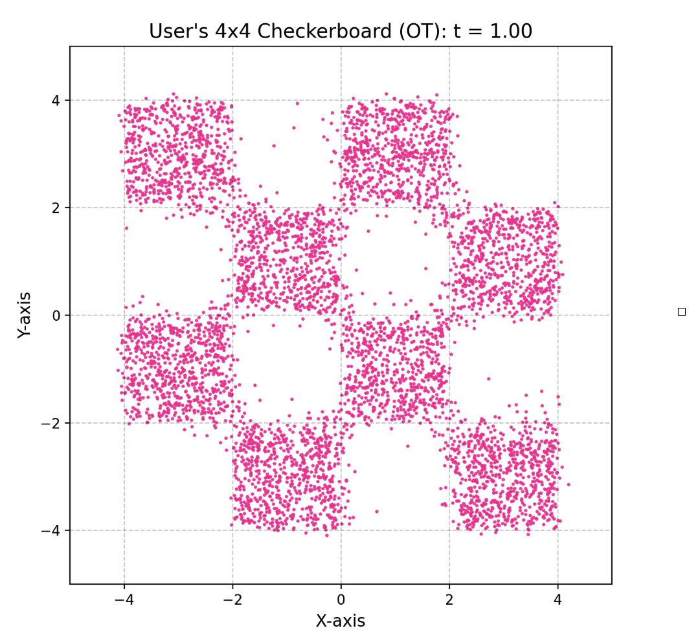
Flow-matching Diffusion Model
$$p_{0}(x_{0})$$
$$p_{1}(x_{1})$$
Noise Distribution
Data Distribution

Slide 17
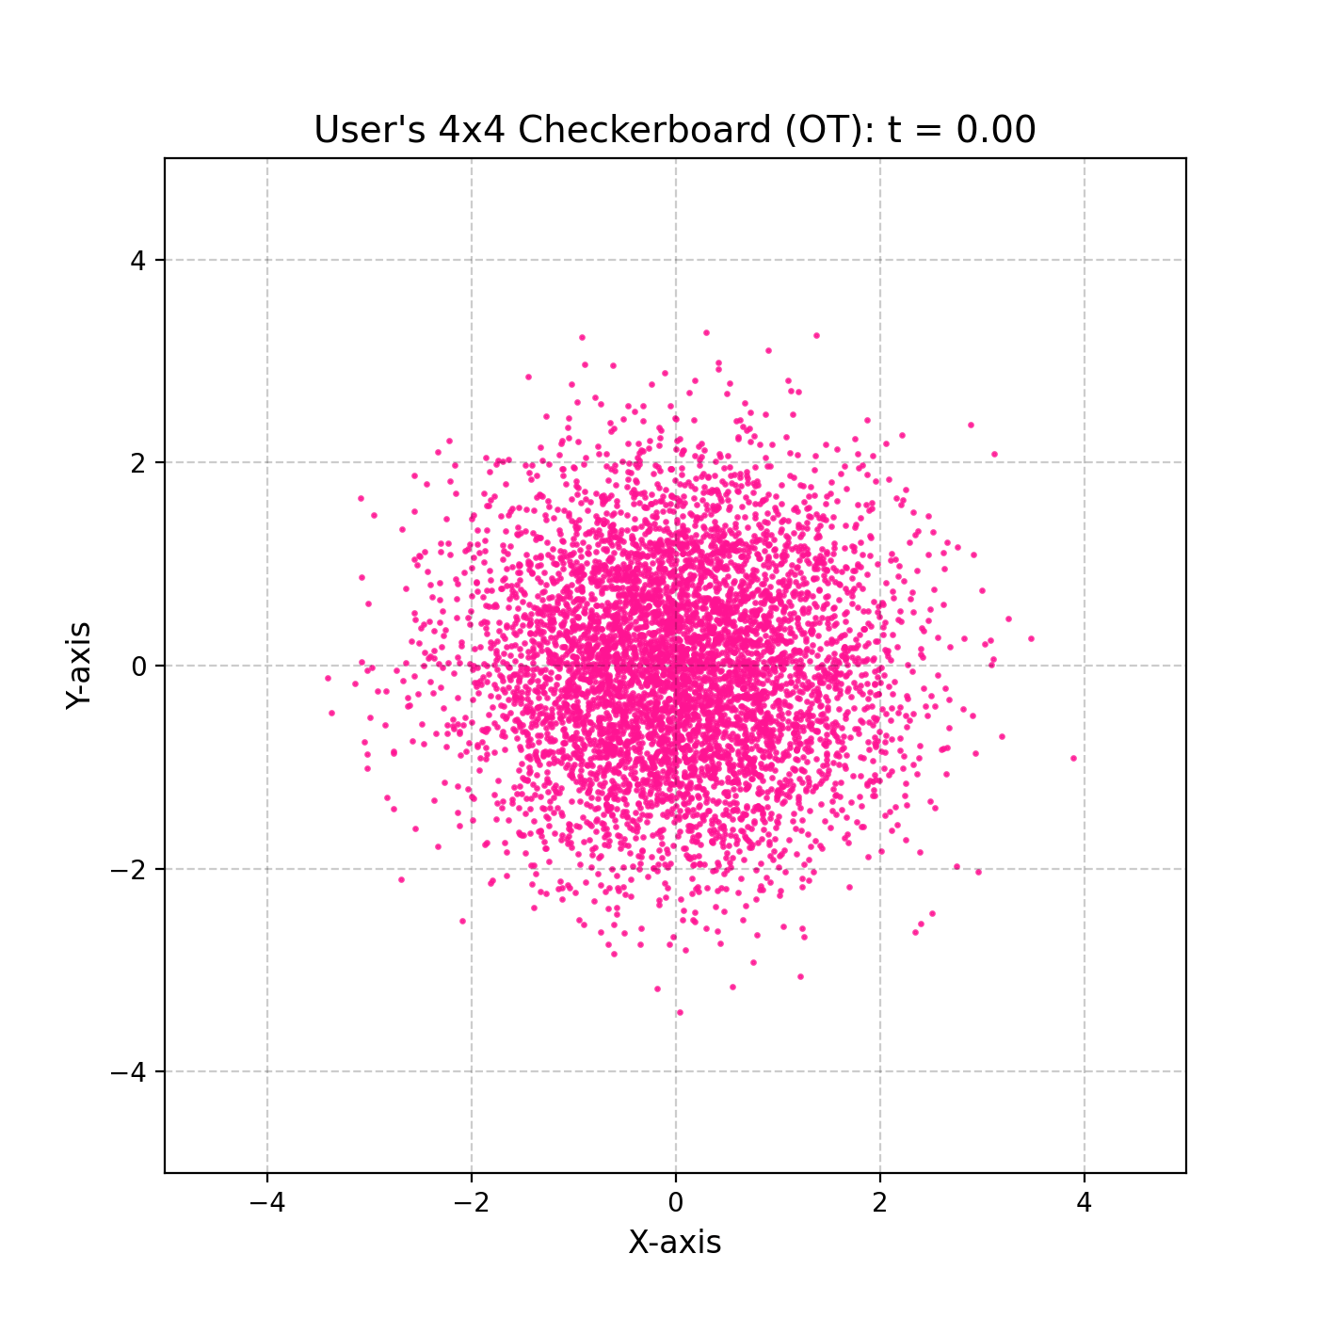

Slide 18
Flow-matching Diffusion Model
$$p_{0}(x_{0})$$
$$p_{1}(x_{1})$$
Noise Distribution
Data Distribution
$$p_{t}(x_{t})$$

Slide 19
Flow-matching Diffusion Model
Flow Matching
$$p_{t}(x_{t})$$
$$x_{t}=ψ_{t}(x)$$
Flow

Slide 20
Flow-matching Diffusion Model
Flow Matching
$$\frac{d}{dt}ψ_{t}(x)=u_{t}(ψ_{t}(x))$$
$$p_{t}(x_{t})$$
$$\frac{d}{dt}x_{t}=u_{t}(x_{t})$$
$$x_{t}=ψ_{t}(x)$$

Slide 21
Flow-matching Diffusion Model
Flow Matching
$$\frac{d}{dt}ψ_{t}(x)=u_{t}(ψ_{t}(x))$$
$$p_{t}(x_{t})$$
$$\frac{d}{dt}x_{t}=u_{t}(x_{t})$$
????
$$x_{t}=ψ_{t}(x)$$

Slide 22
Flow-matching Diffusion Model
Flow Matching
$$\frac{d}{dt}ψ_{t}(x)=u_{t}(ψ_{t}(x))$$
$$p_{t}(x_{t})$$
$$\frac{d}{dt}x_{t}=u_{t}(x_{t})$$
????
$$x_{t}=ψ_{t}(x)$$
Flow matching uses a neural network
$$v_{t}$$
to approximate
$$u_{t}$$

Slide 23
Flow-matching Diffusion Model
Flow matching uses a neural network
$$v_{t}$$
to approximate
$$u_{t}$$
$$E_{x_{t}∼p_{t}(x_{t})}[∥v_{t}(x_{t})-u_{t}(x_{t})∥^{2}]$$

Slide 24
Flow-matching Diffusion Model
Flow matching uses a neural network
$$v_{t}$$
to approximate
$$u_{t}$$
$$E_{x_{t}∼p_{t}(x_{t})}[∥v_{t}(x_{t})-u_{t}(x_{t})∥^{2}]$$

Slide 25


Flow-matching Diffusion Model
$$E_{x_{t}∼p_{t}(x_{t})}[∥v_{t}(x_{t})-u_{t}(x_{t})∥^{2}]$$
$$=E_{x_{t}∼p_{t}(x_{t})}[∥v_{t}(x_{t})∥^{2}-2⋅v_{t}(x_{t})⋅u_{t}(x_{t})+∥u_{t}(x_{t})∥^{2}]$$
$$E_{x_{0}∼p_{0}(x_{0}),x_{1}∼q(x_{1})}\left[{∥v_{t}(ψ_{t}(x_{0}))-\frac{d}{dt}ψ_{t}(x_{0})∥}^{2}\right]$$

Slide 26
Flow-matching Diffusion Model
$$E_{x_{0}∼p_{0}(x_{0}),x_{1}∼q(x_{1})}\left[{∥v_{t}(ψ_{t}(x_{0}))-\frac{d}{dt}ψ_{t}(x_{0})∥}^{2}\right]$$
Def: Canonical Transformation of Gaussian distribution
$$ψ_{t}(x_{0})=σ_{t}(x_{1})x_{0}+μ_{t}(x_{1})$$
$$\frac{d}{dt}ψ_{t}(x_{0})=\frac{d}{dt}\left((1-t)x_{0}+tx_{1}\right)$$
$$σ_{t}(x_{1})=1-t$$
$$=\frac{d}{dt}\left(x_{0}-tx_{0}+tx_{1}\right)$$
$$μ_{t}(x_{1})=tx_{1}$$
$$ψ_{t}(x_{0})=(1-t)x_{0}+tx_{1}$$
$$=x_{1}-x_{0}$$

Slide 27
Flow-matching Diffusion Model
$$E_{x_{0}∼p_{0}(x_{0}),x_{1}∼q(x_{1})}\left[{∥v_{t}(ψ_{t}(x_{0}))-\frac{d}{dt}ψ_{t}(x_{0})∥}^{2}\right]$$
Def: Canonical Transformation of Gaussian distribution
$$ψ_{t}(x_{0})=σ_{t}(x_{1})x_{0}+μ_{t}(x_{1})$$
$$\frac{d}{dt}ψ_{t}(x_{0})=\frac{d}{dt}\left((1-t)x_{0}+tx_{1}\right)$$
$$σ_{t}(x_{1})=1-t$$
$$=\frac{d}{dt}\left(x_{0}-tx_{0}+tx_{1}\right)$$
$$μ_{t}(x_{1})=tx_{1}$$
$$=x_{1}-x_{0}$$
$$ψ_{t}(x_{0})=(1-t)x_{0}+tx_{1}$$
$$\text{Final Objective:}E_{x_{0}∼P_{0}(x_{0}),x_{1}∼q(x_{1})}\left[∥v_{t}((1-t)x_{0}+tx_{1})-(x_{1}-x_{0})∥^{2}\right]$$

Slide 28
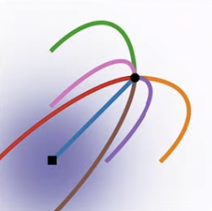
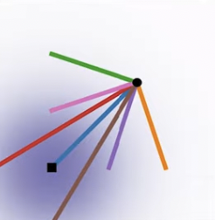
Flow-matching Diffusion Model
DDPM
&
Score Based Approach
Flow Matching

Slide 29
Flux Model
Rectified flow-matching loss
$$L_{θ}=E_{t∼p(t),x,y,c}\left[∥v_{θ}((1-t)x+tε,t,y,c)-(ε-x)∥_{2}^{2}\right]$$

Slide 30
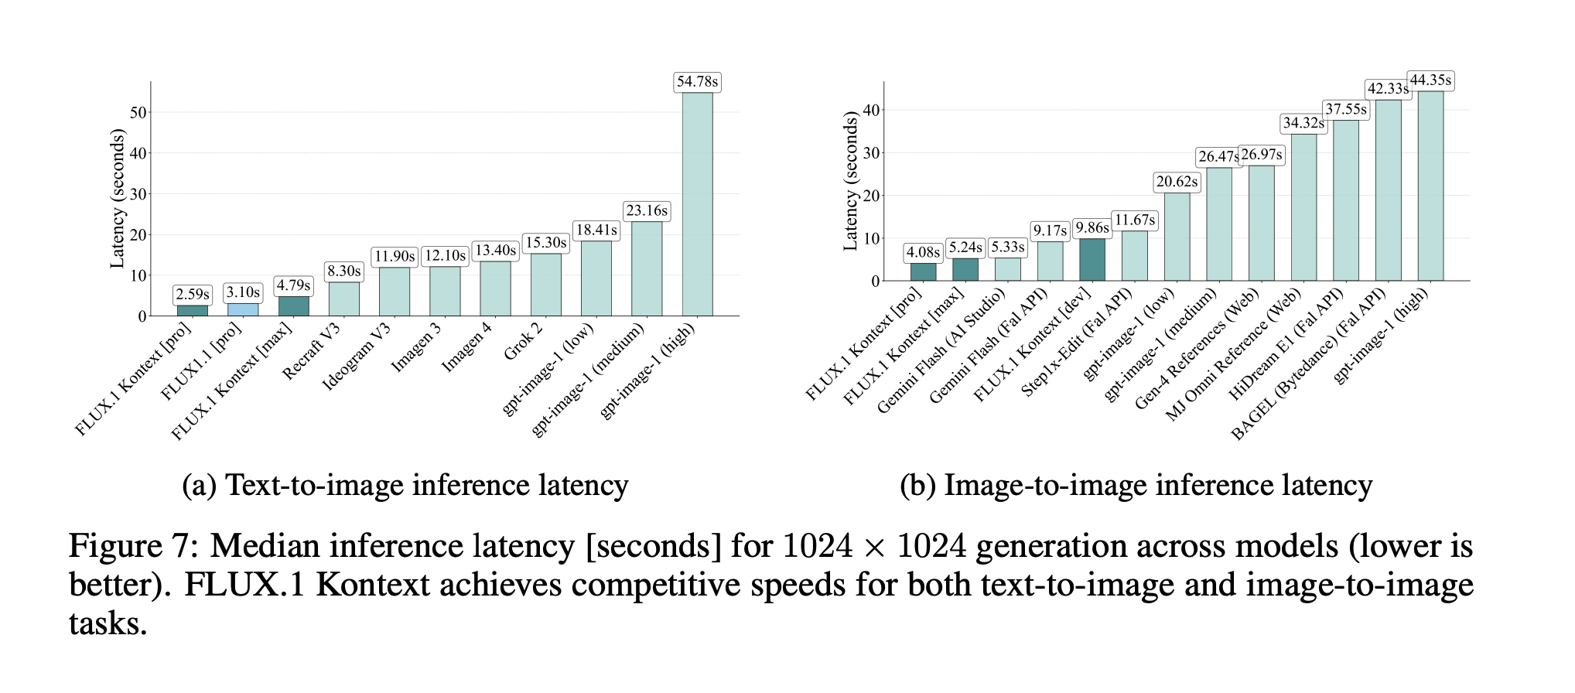
Evaluations & Applications

Slide 31
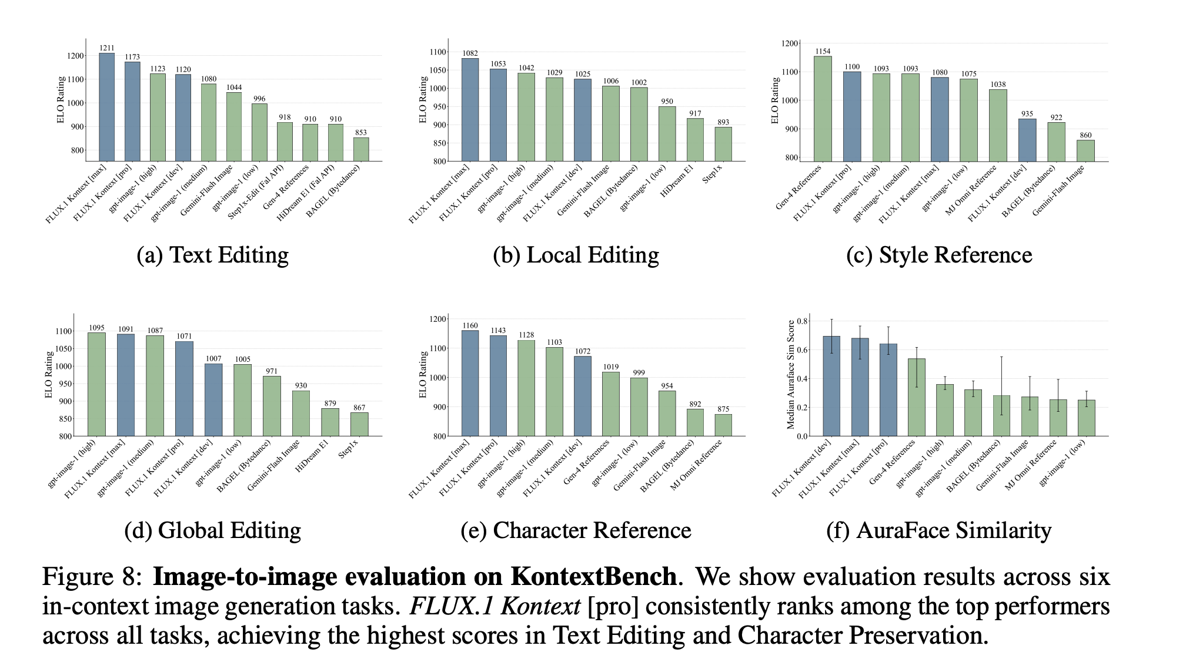
Evaluations & Applications

Slide 32
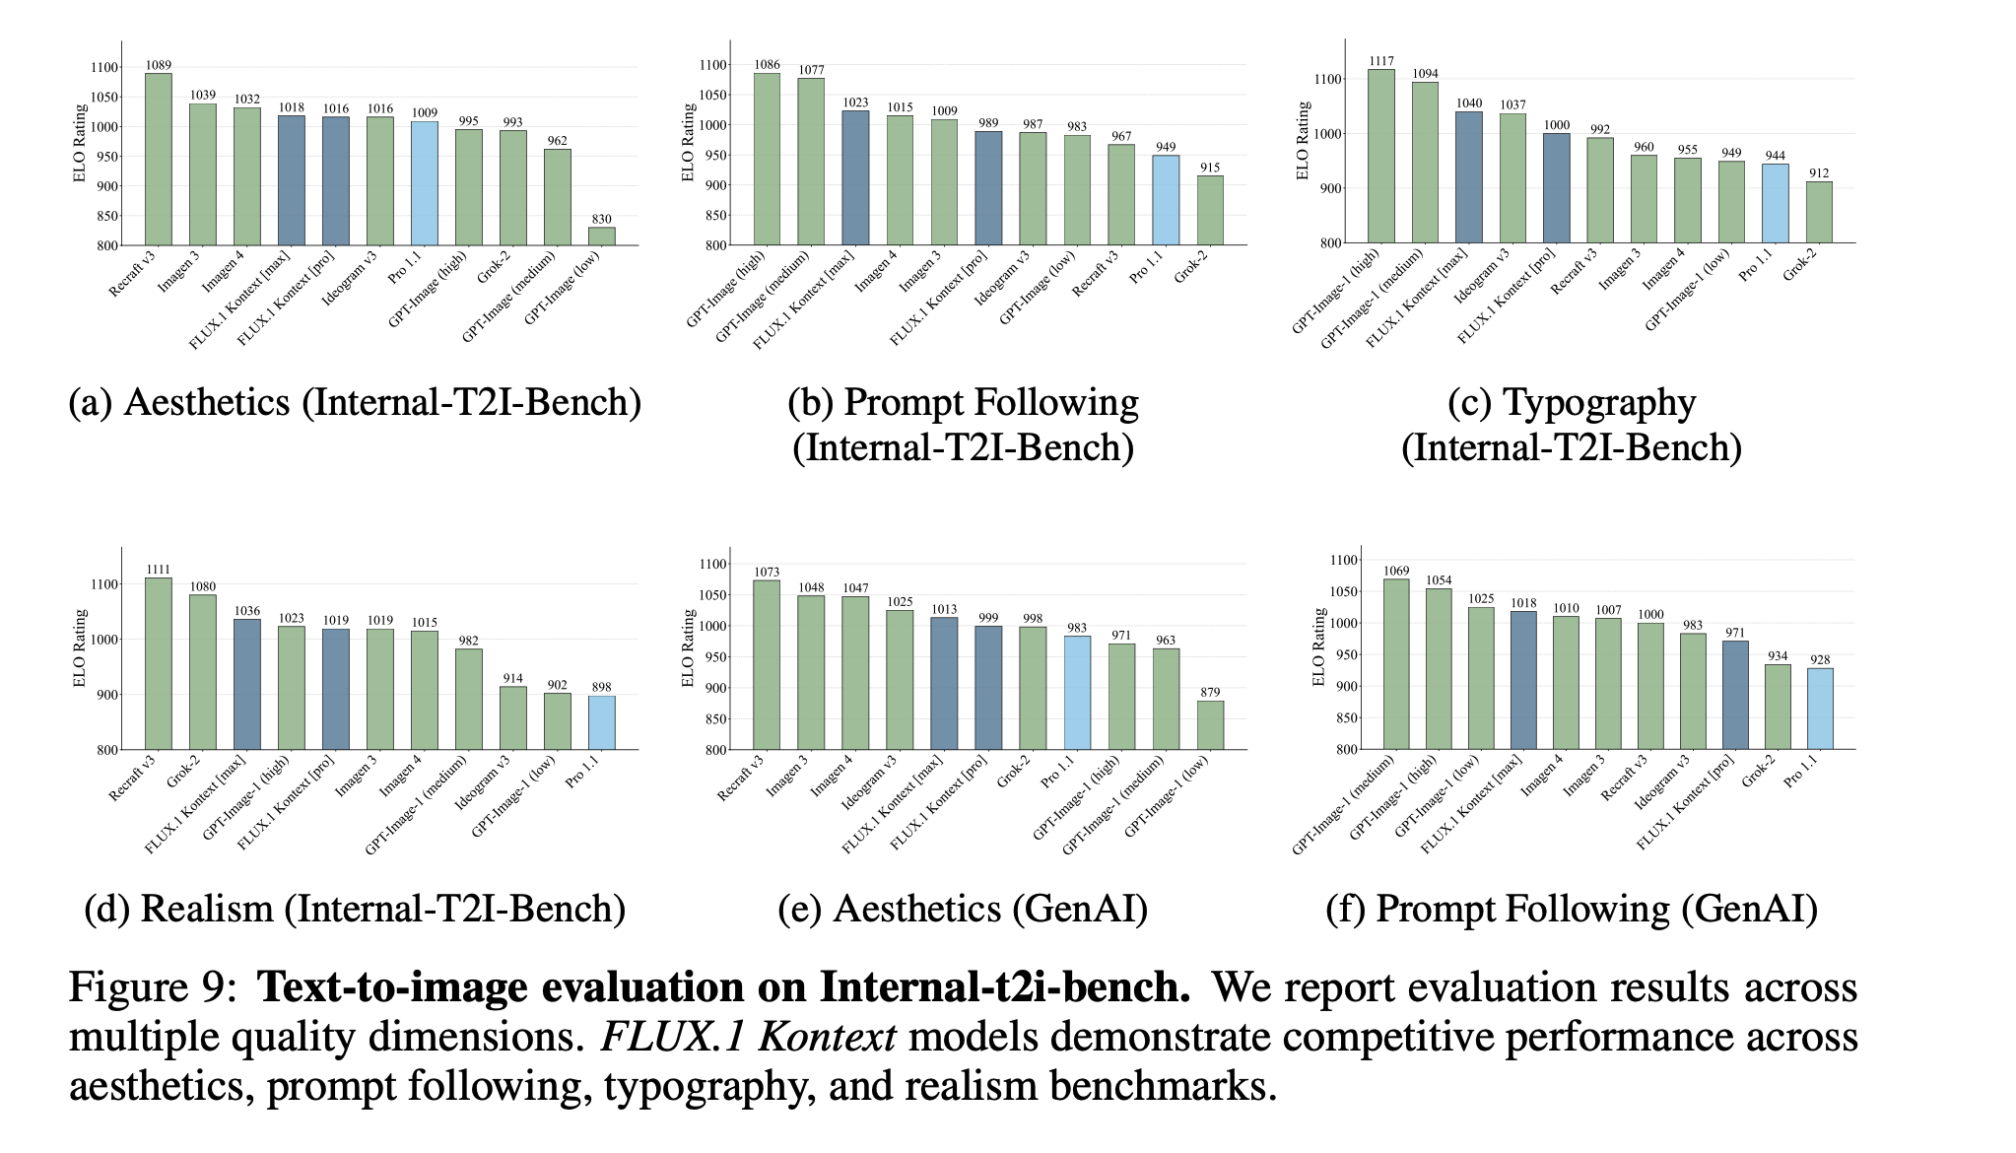
Evaluations & Applications

Slide 33
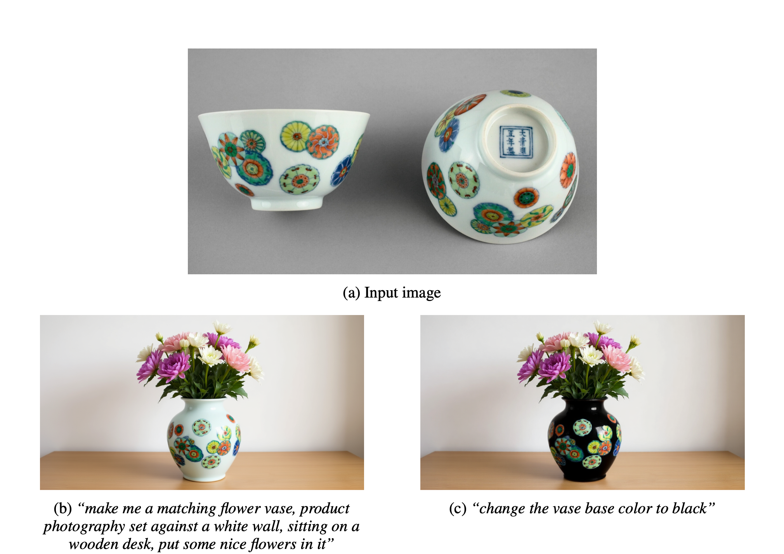
Evaluations & Applications
Iterative, product-style editing

Slide 34
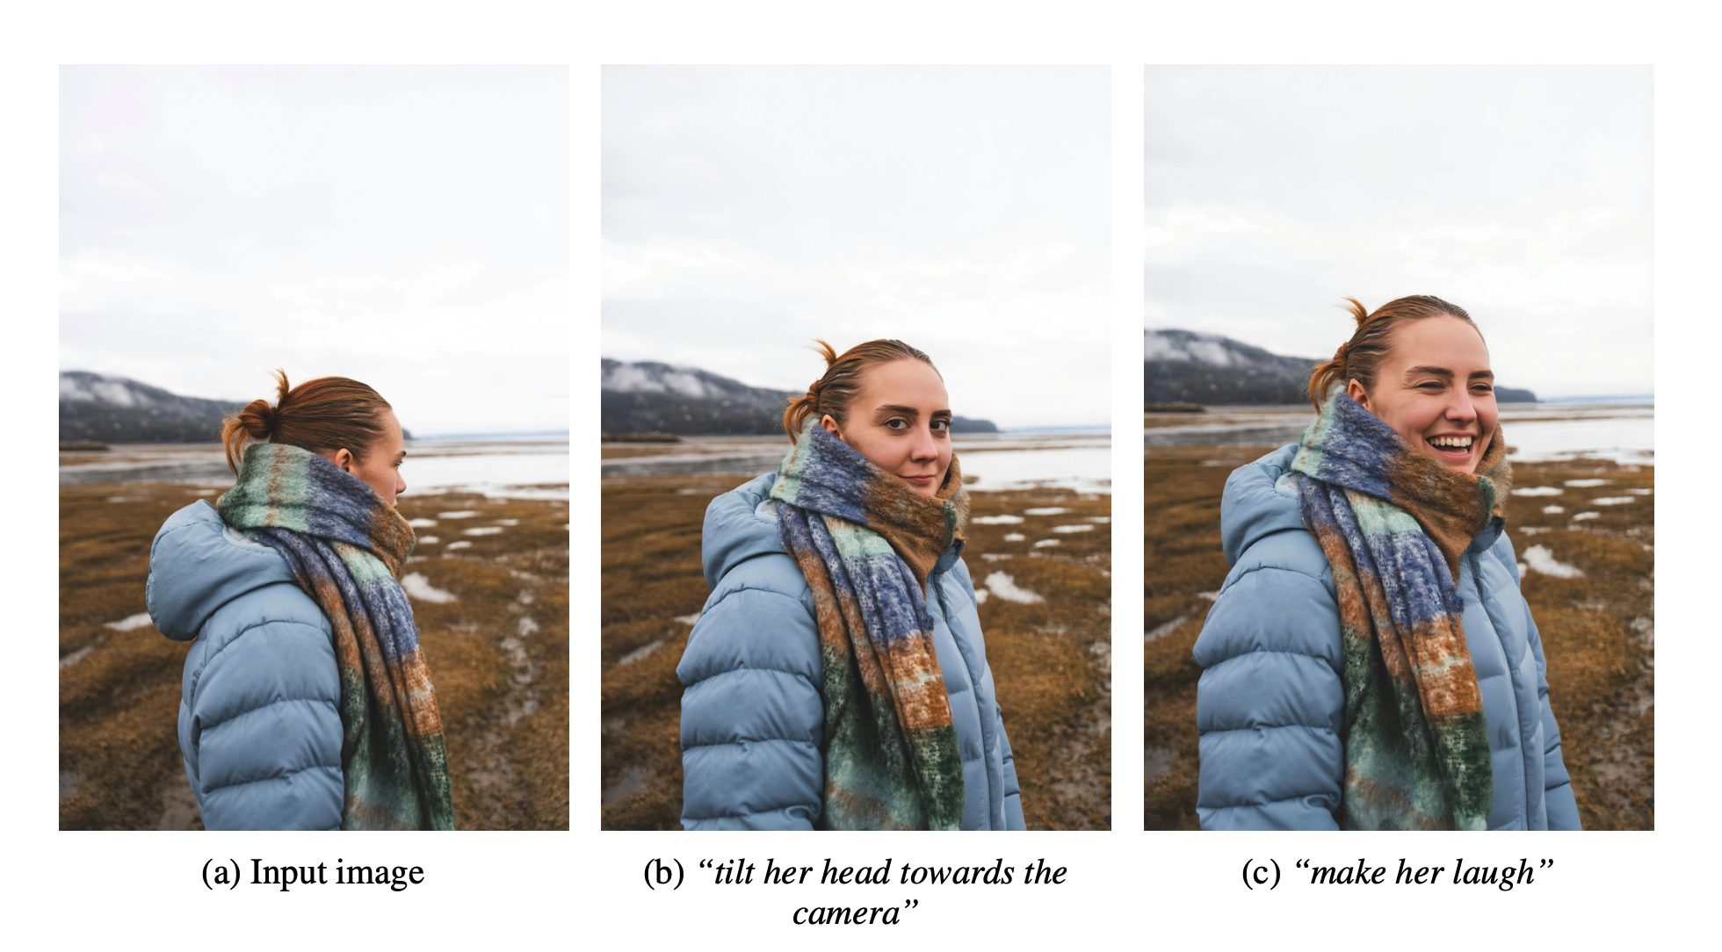
Evaluations & Applications
Sequential, facial-expression editing

