Slide 1
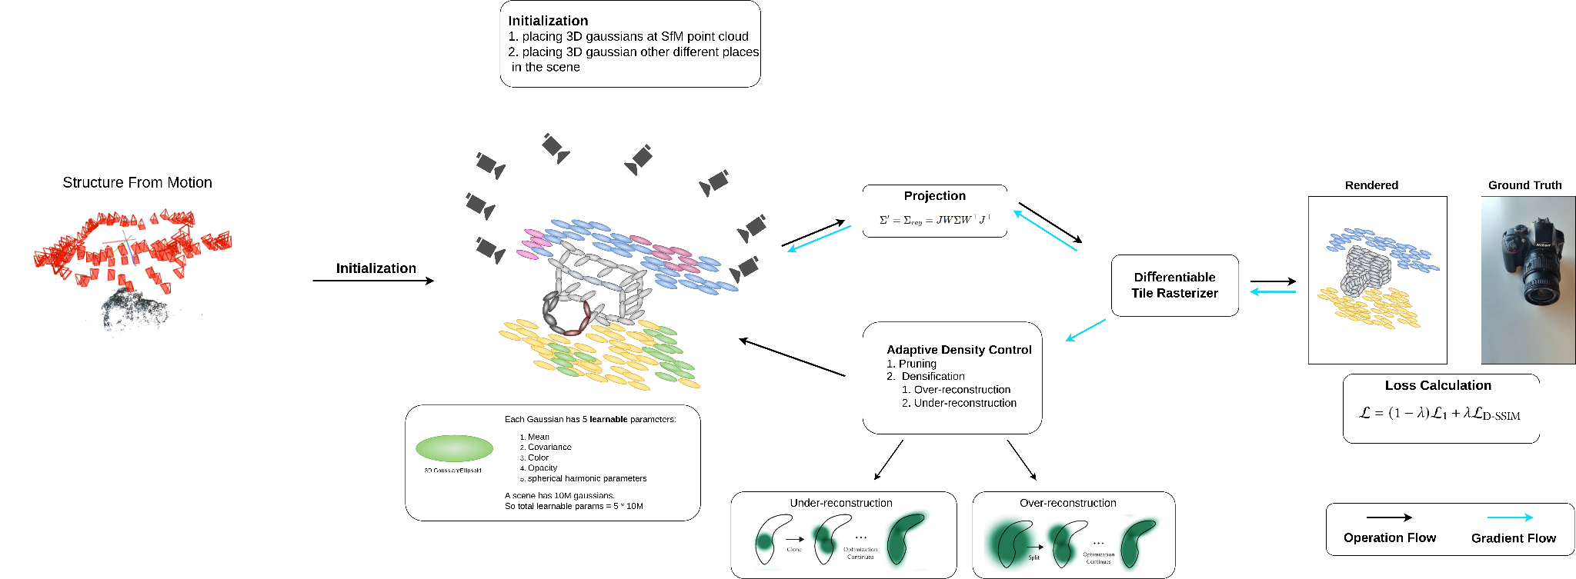
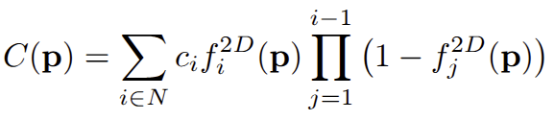
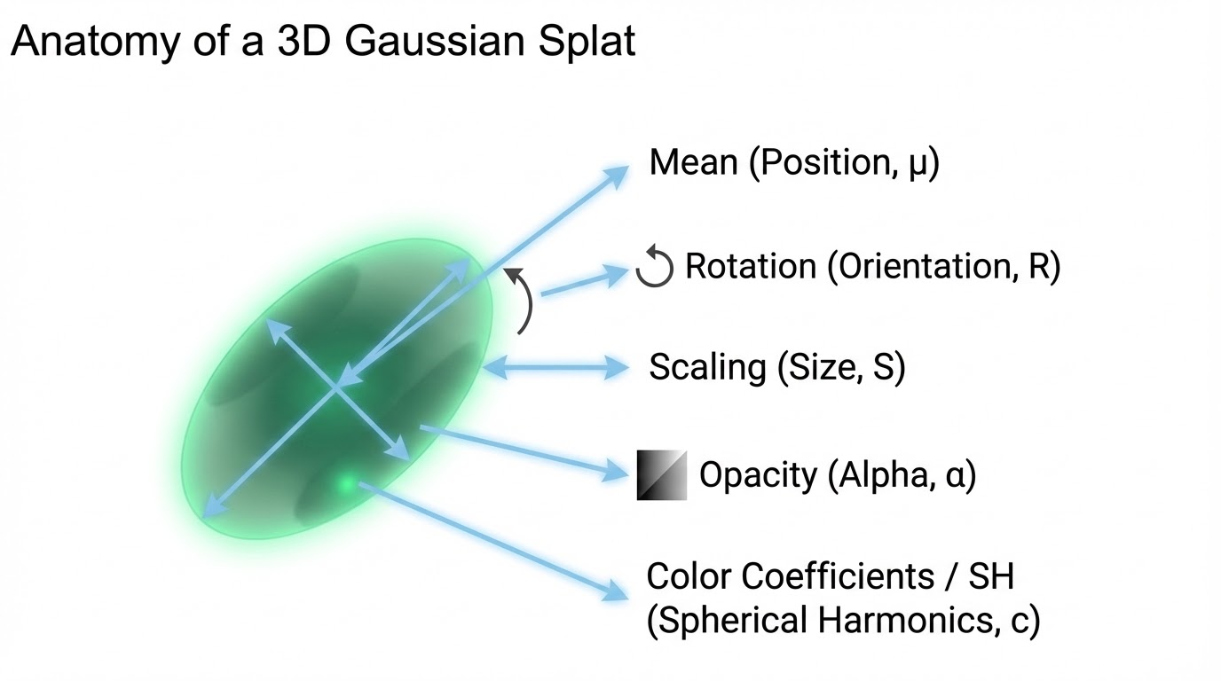
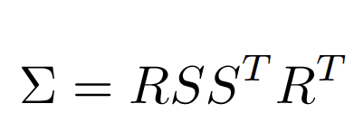
Prerequisite: 3D Gaussian Splat

Slide 2
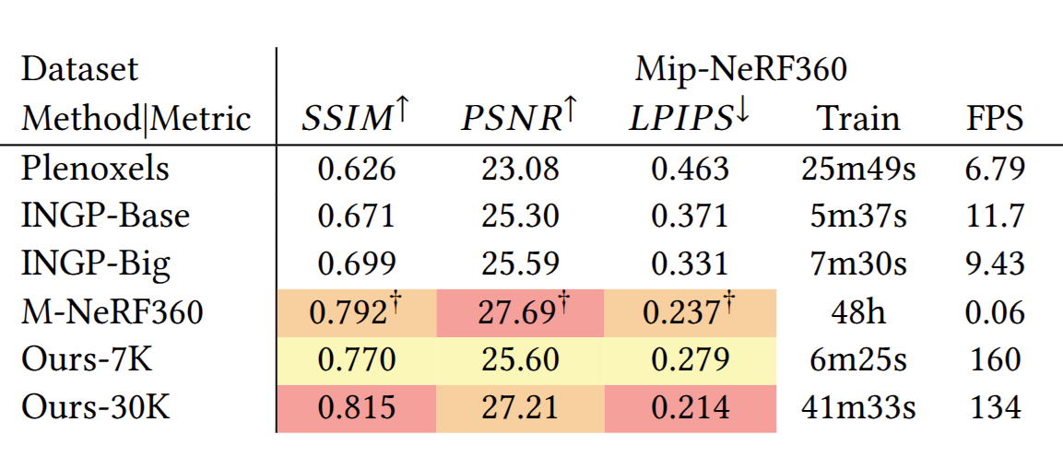
Prerequisite: What makes 3DGS so great?
3DGS is extremely fast
Much faster to train
Real time rendering performance

Slide 3
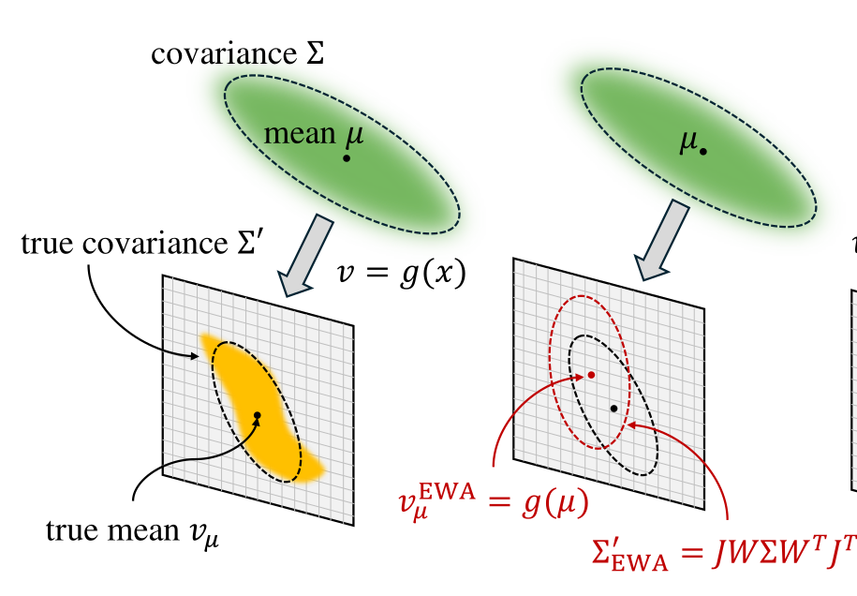
Limitation of 3DGS: Assumes Linear Projection
Most Accurate way of projecting 3D covariance to 2D covariance is using monte-carlo sampling.
3DGS scenes contains 100 of thousands to millions of 3D Gaussian.
Using monte-carlo sampling on huge numbers of 3d gaussian will be extremely slow.
3DGS Paper Solution
EWA Splatting: Approximates the projection using first-order Taylor expansion
EWA Splatting is linear Approximation, however, projection matrix is non-linear in nature.
3DGS by nature assumes linear projection (Pinhole setting)

Slide 4
Limitation of 3DGS: Assumes Linear Projection
Most Accurate way of projecting 3D covariance to 2D covariance is using monte-carlo sampling.
3DGS scenes contains 100 of thousands to millions of 3D Gaussian.
Using monte-carlo sampling on huge numbers of 3d gaussian will be extremely slow.
3DGS Paper Solution
EWA Splatting: Approximates the projection using first-order Taylor expansion
EWA Splatting is linear Approximation, however, projection matrix is non-linear in nature.
3DGS by nature assumes linear projection (Pinhole setting)
Does not show good result for uncalibrated cameras, fisheye cameras

Slide 5
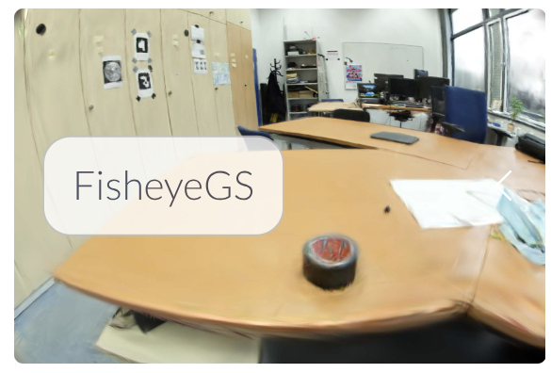
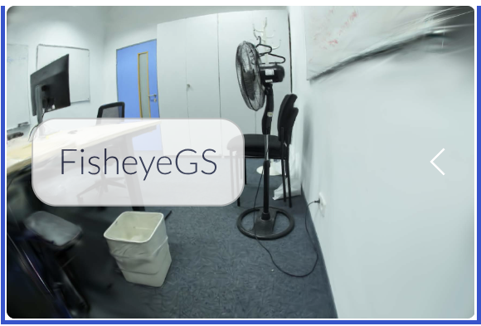
Limitation of 3DGS: Assumes Linear Projection

Slide 6
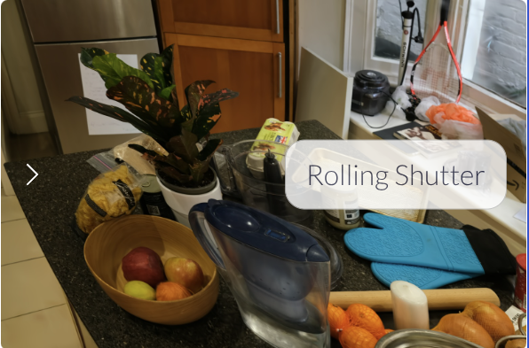
Limitation of 3DGS: Can’t Handle Rolling Shutter
3DGS assumes one fixed camera pose per image
EWA linearizes the projection around that pose
Rolling shutter requires pose to vary per pixel (time-dependent)

Slide 7
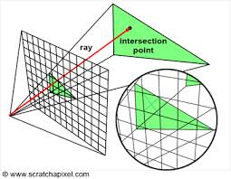
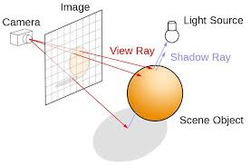
Limitation of 3DGS: Rasterization fails to capture true secondary effect
Rasterization
Rasterization
3DGS uses rasterization (left), and it only capture rays from 3d points to camera ray.
Rasterization does not capture secondary effect like true reflection, shadow because it does not handle secondary rays as in ray tracing.

Slide 8

CVPR 25 (Oral)

Slide 9
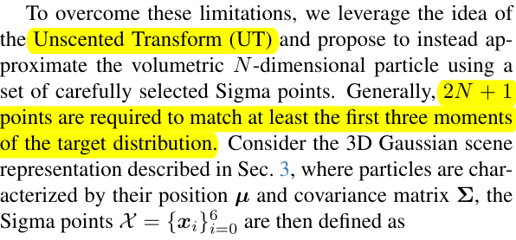
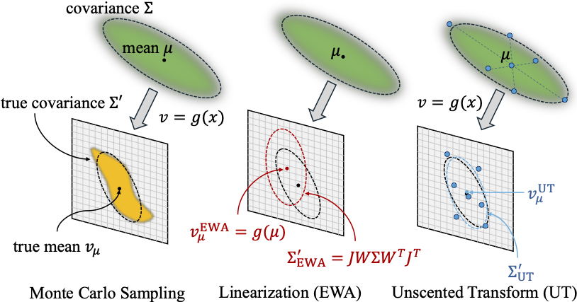
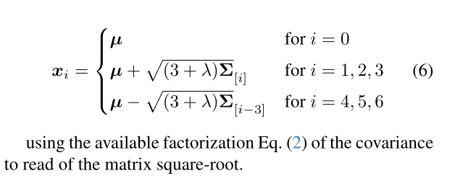
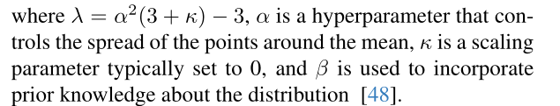
3DGUT: Introduce Unscented transform (Non-Linear Projection of Gaussians)

Slide 10
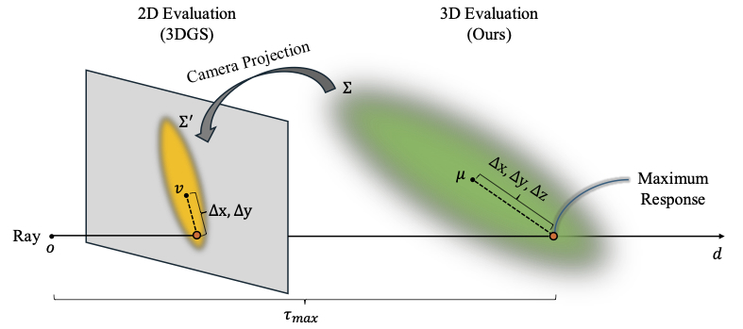
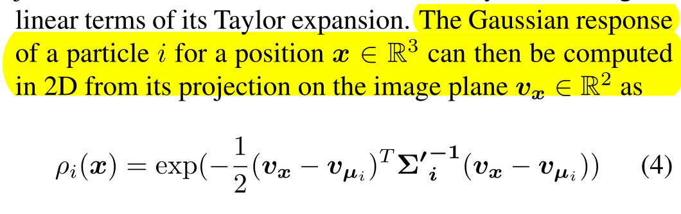
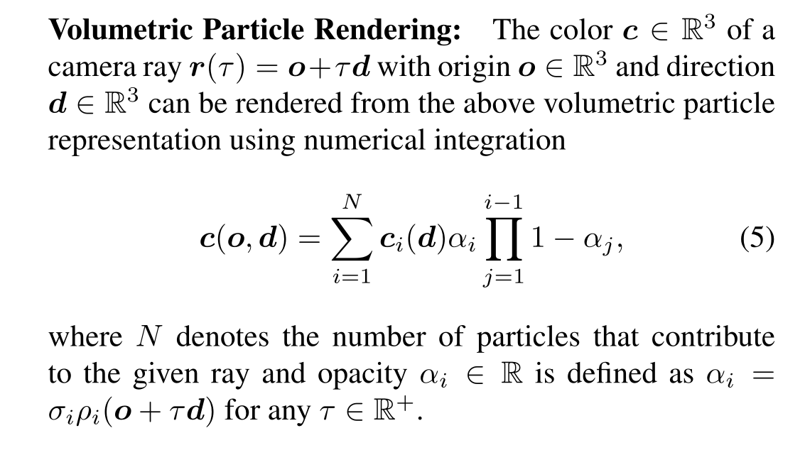
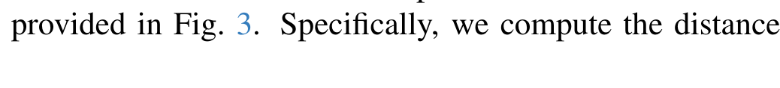
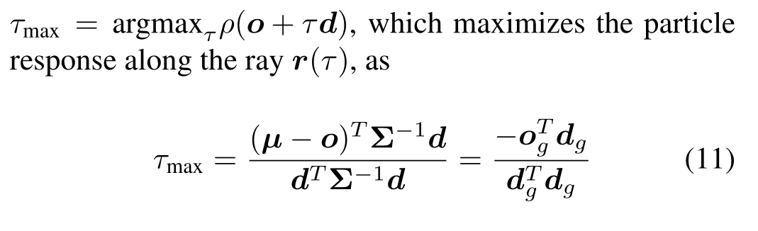
3DGUT: Primary Ray Tracing

Slide 11
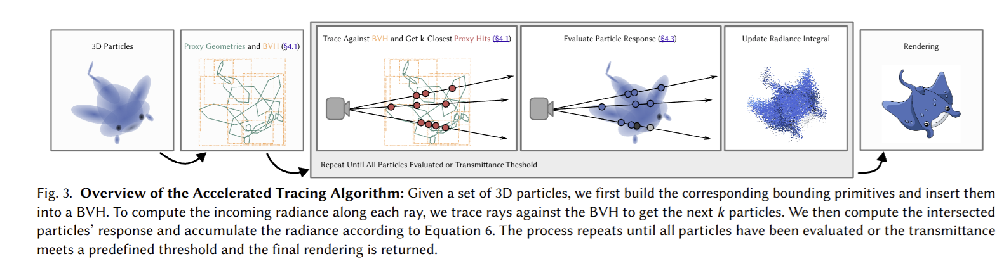
3DGUT: Secondary Ray Tracing
• Build BVH to group nearby Gaussians into bounding boxes
• Cast a ray from the camera
• Intersect the ray with BVH boxes (fast rejection of empty space)
• Test only Gaussians inside intersected boxes
• For each hit Gaussian:
Compute its maximum response along the ray (τ_max)
• Sort hits front-to-back (by τ_max)
• Keep the k closest hits along the ray (limit computation)
• Accumulate opacity and color
• Stop when transmittance becomes small

Slide 12
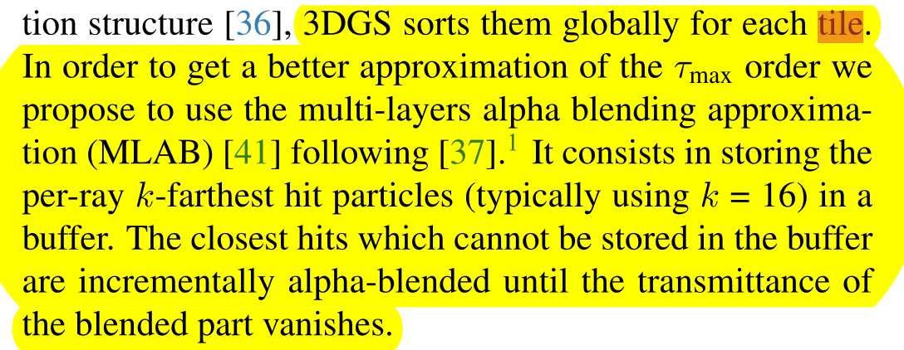
3DGUT: Tile Based Ray Tracing (Hybrid Rasterization + Tracing)

Slide 13
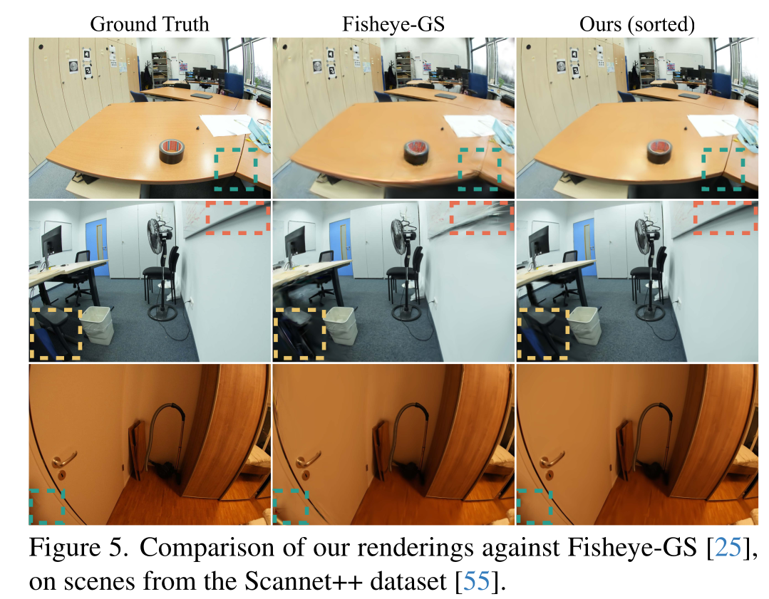
Qualitative Comparison

Slide 14
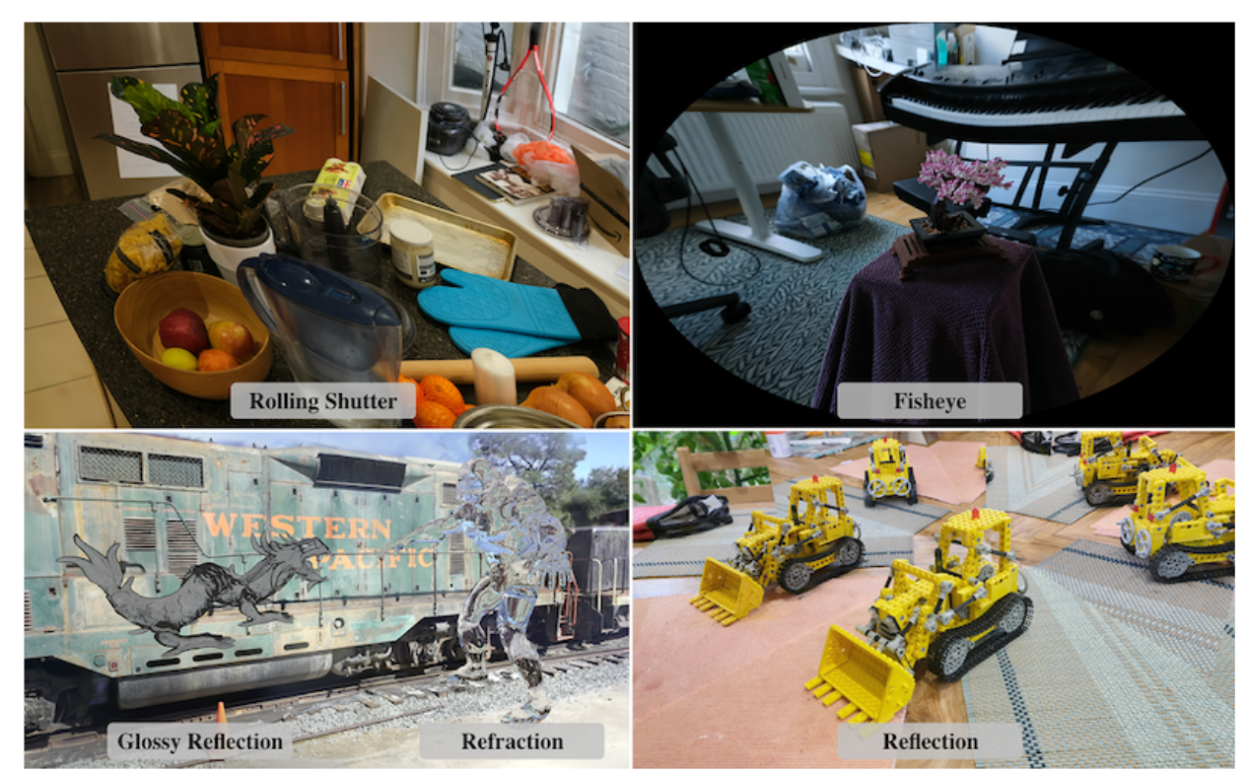
Qualitative Comparison

Slide 15
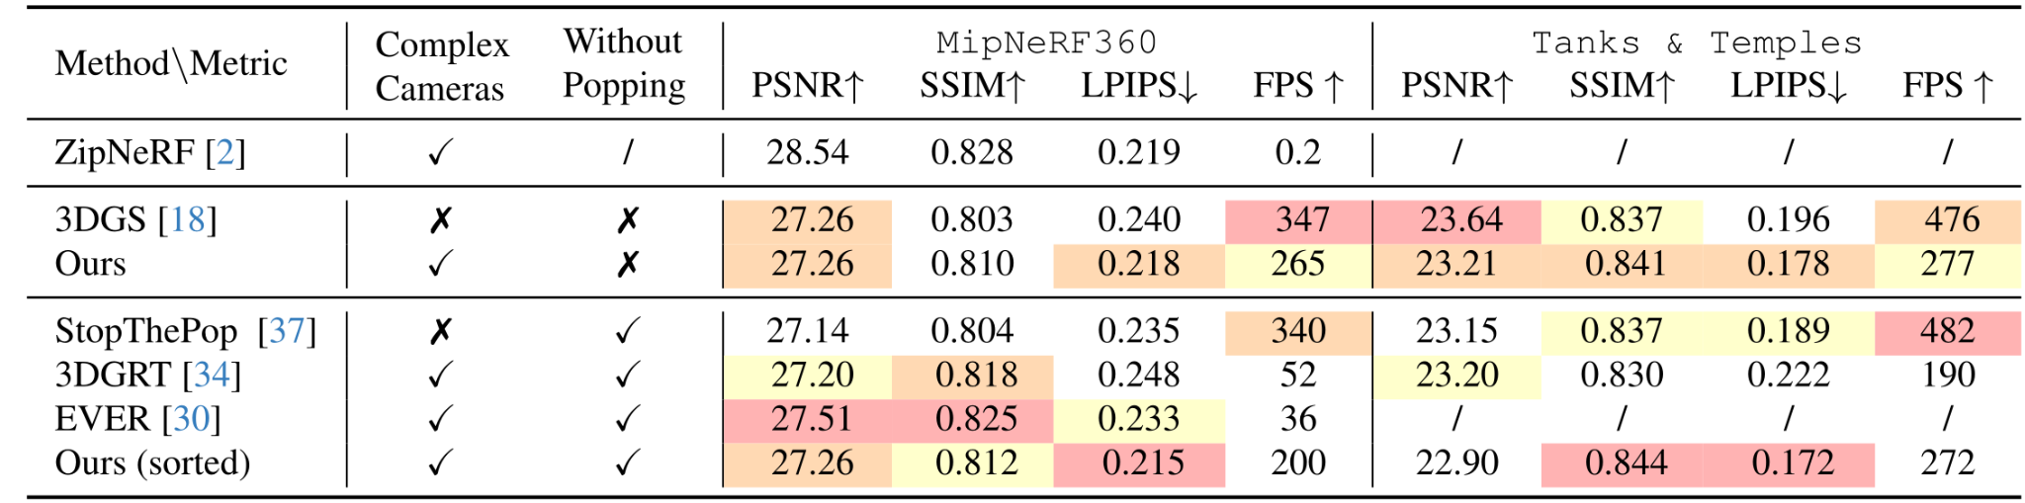
3D GUT Still Achieve Real time Inference Speed

Slide 16
Thank You

