Slide 1
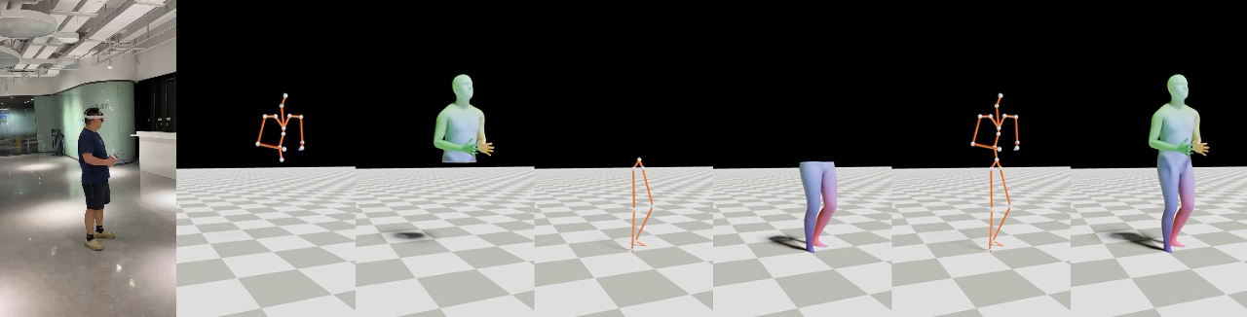
Stratified Avatar Generation from Sparse Observations
CVPR 2024 (Oral)
Han Feng^{1*}, Wenchao Ma^{2*}, Quankai Gao³, Xianwei Zheng¹ , Nan Xue ^{4†} , Huijuan Xu ²
* Equal contribution, ordered by alphabet.
† Corresponding author
¹ Wuhan University ² Pennsylvania State University ³ University of Southern California ⁴ Ant Group
Notes:
Estimating 3D full-body avatars from AR/VR devices is essential for creating immersive experiences in AR/VR applications. This task is challenging due to the limited input from Head Mounted Devices, which capture only sparse observations from the head and hands. Predicting the full-body avatars, particularly the lower body, from these sparse observations presents significant difficulties.

Slide 2
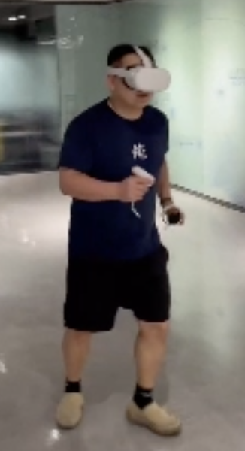
Motivation
Generating 3D full-body avatars from observations (IMUs) of Head Mounted Devices (HMDs) is crucial for enhancing immersive AR/VR experiences.
HMDs primarily track the head and hands, while leaving the rest of the body unmonitored.

Slide 3
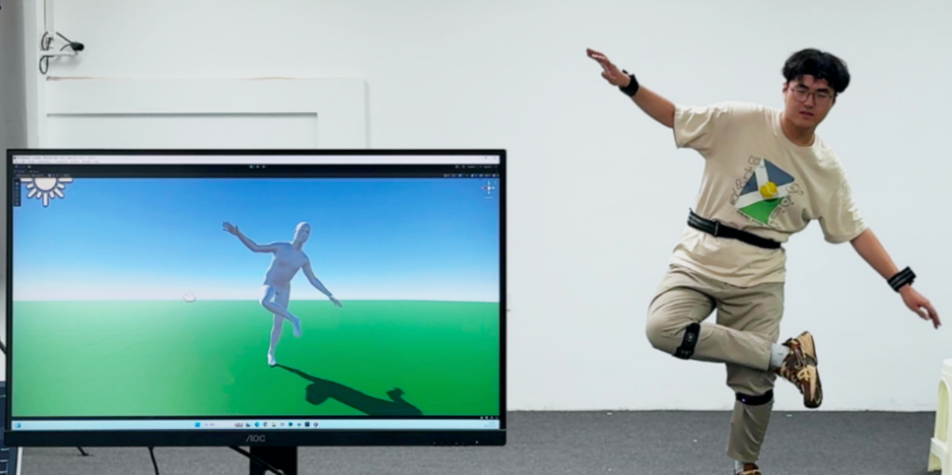
Motivation
Incorporating more sensors (at the pelvis and leg) diminish the user experience.
For instance, recent works focus on reconstructing full body motion from six inertial measurement units (IMUs).

Slide 4
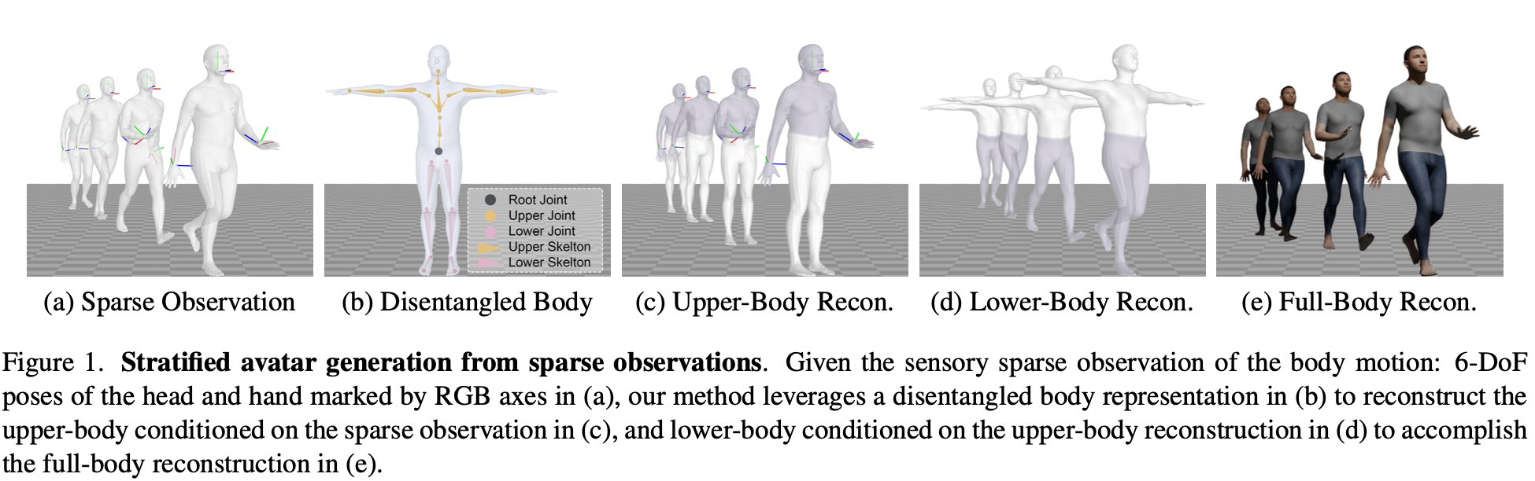
Method

Slide 5
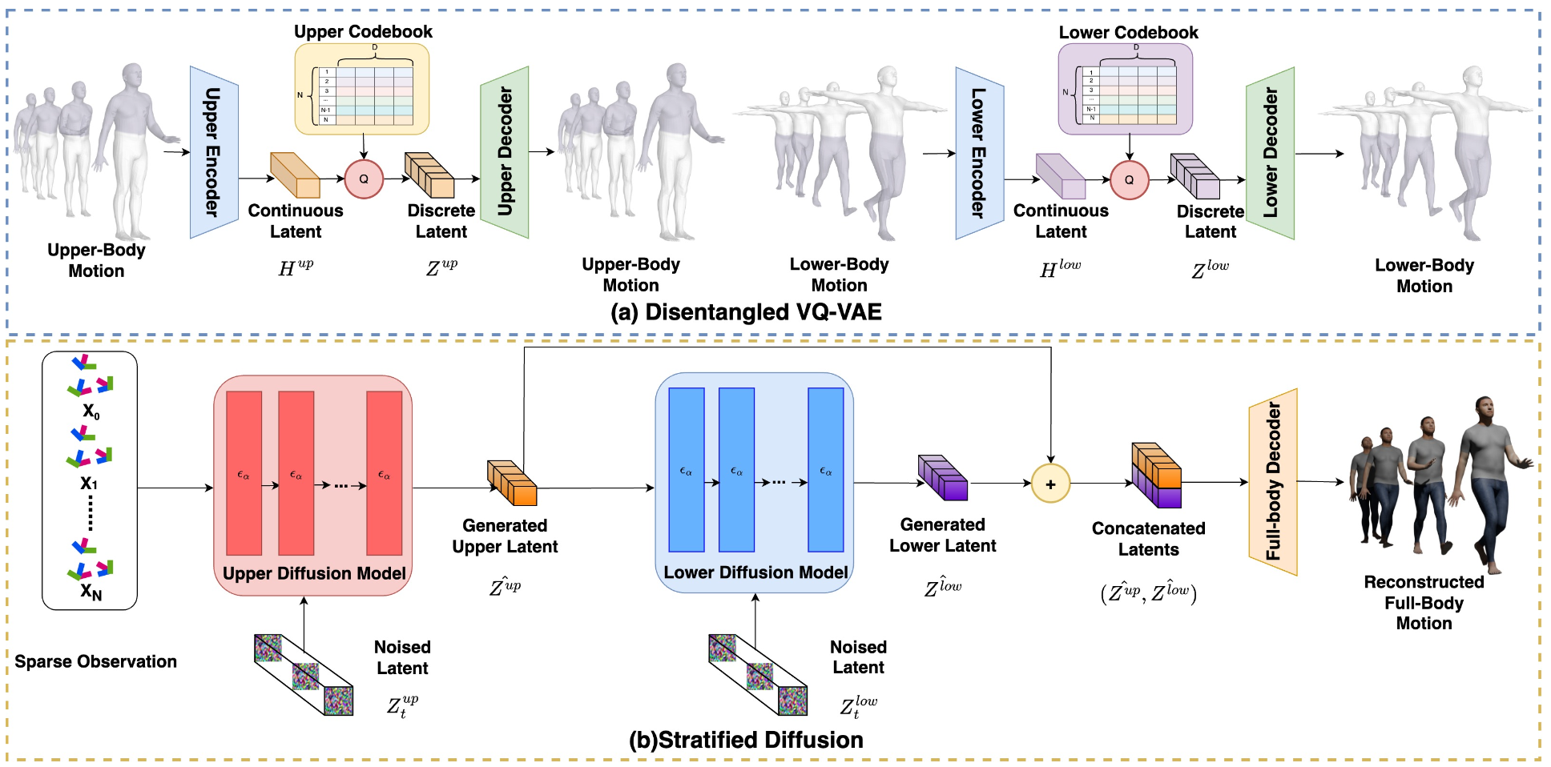
Architecture

Slide 6
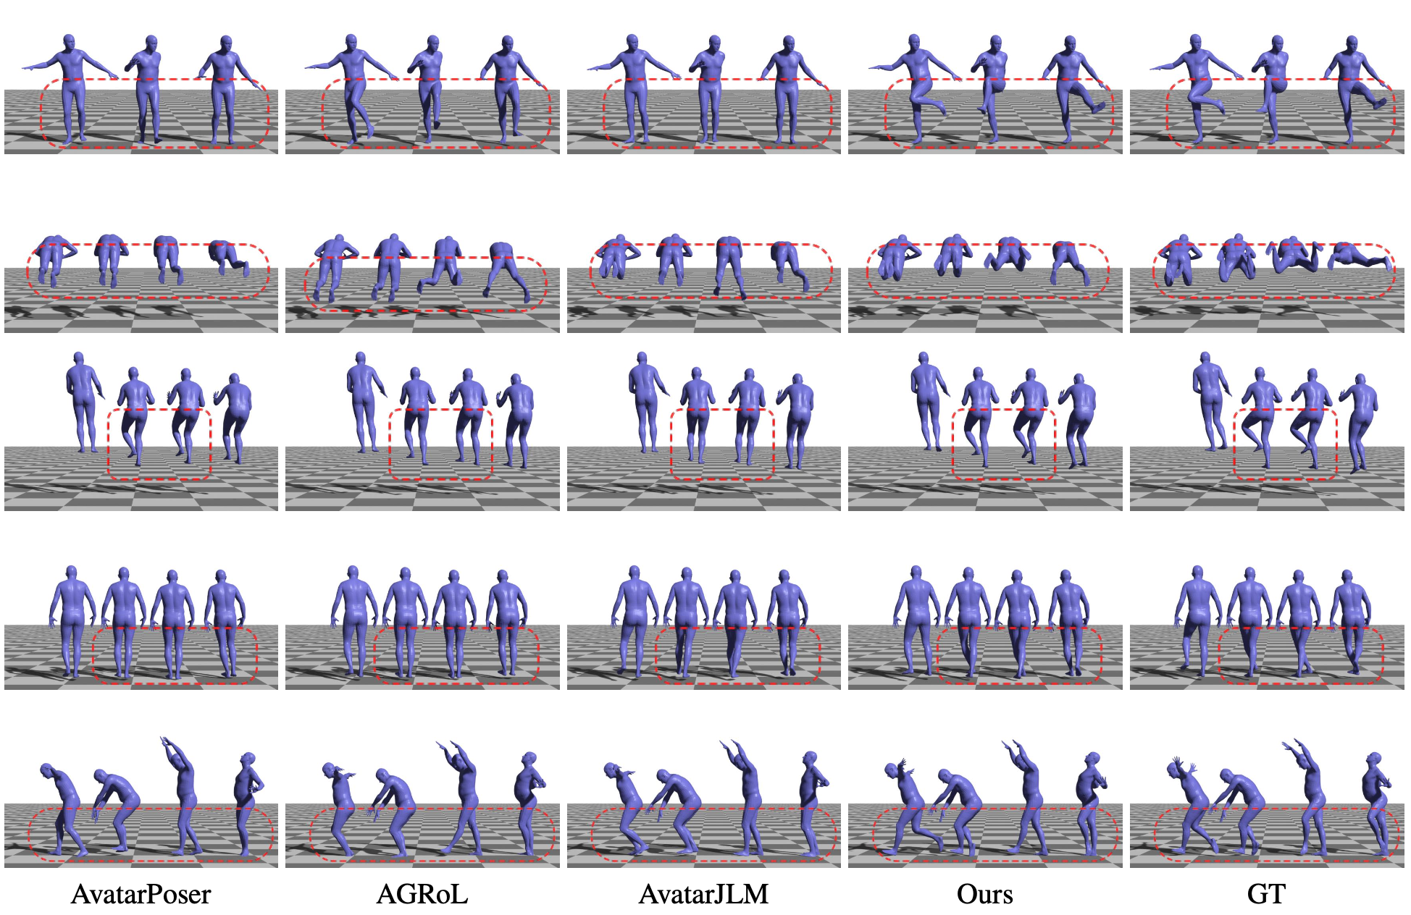
Results on AMASS Dataset

Slide 7


Slide 8
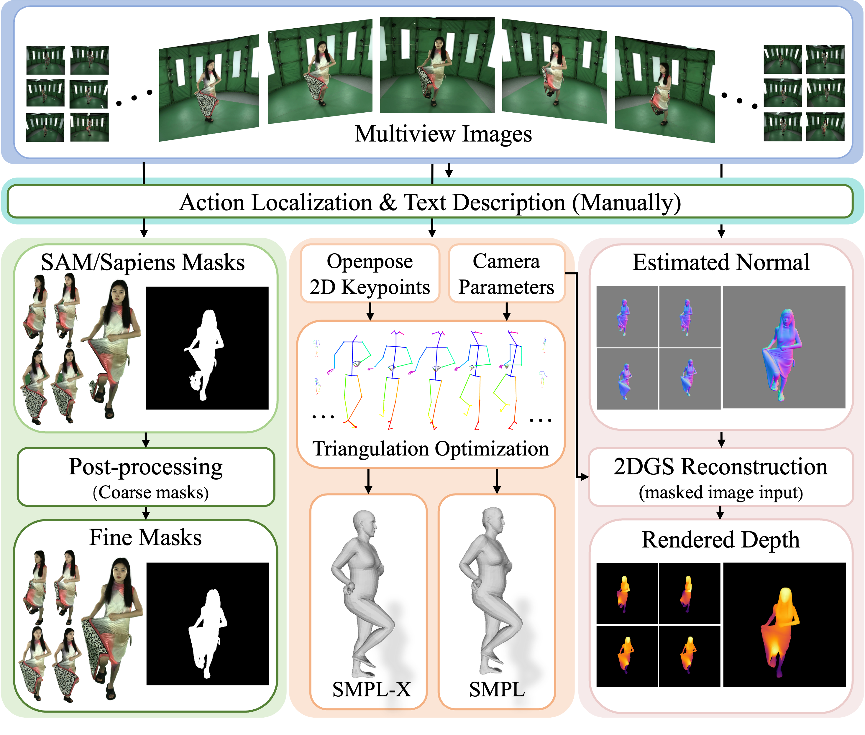
Overview

Slide 9
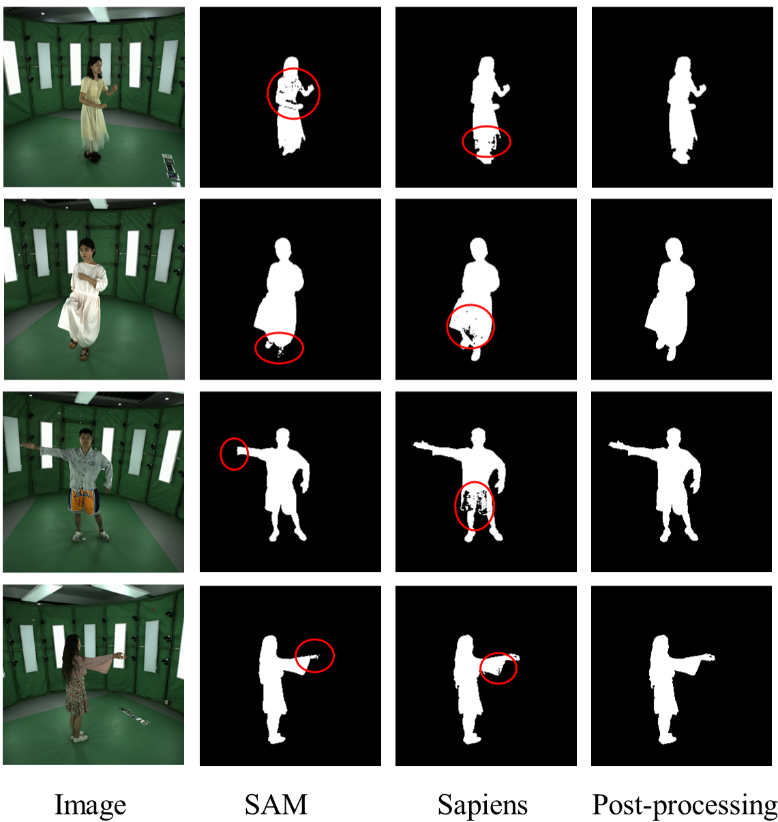
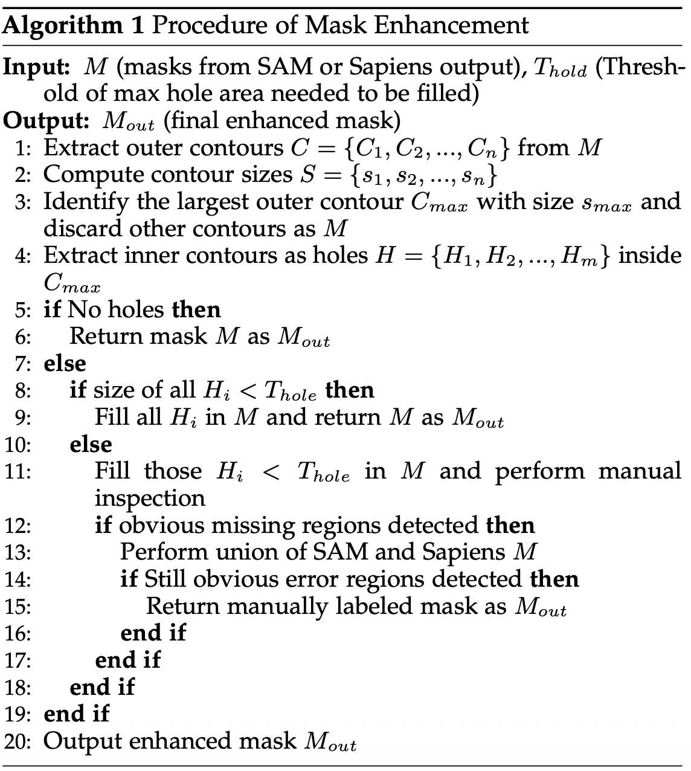
New Masks

Slide 10
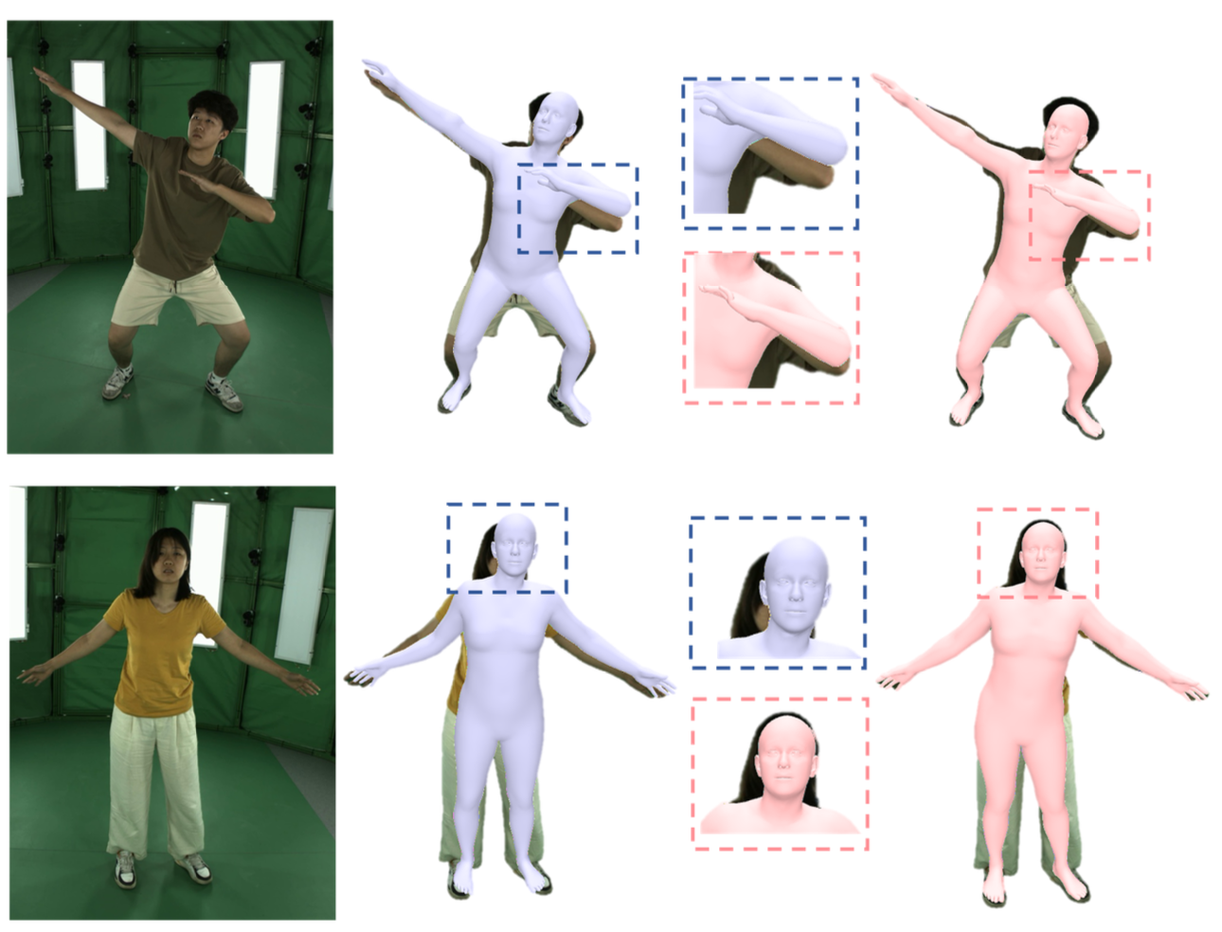
SMPLX comparison results
Incorporate the body pose prior to refine the human pose in the latent space of VPoser, a variational human pose prior trained on the AMASS dataset

Slide 11
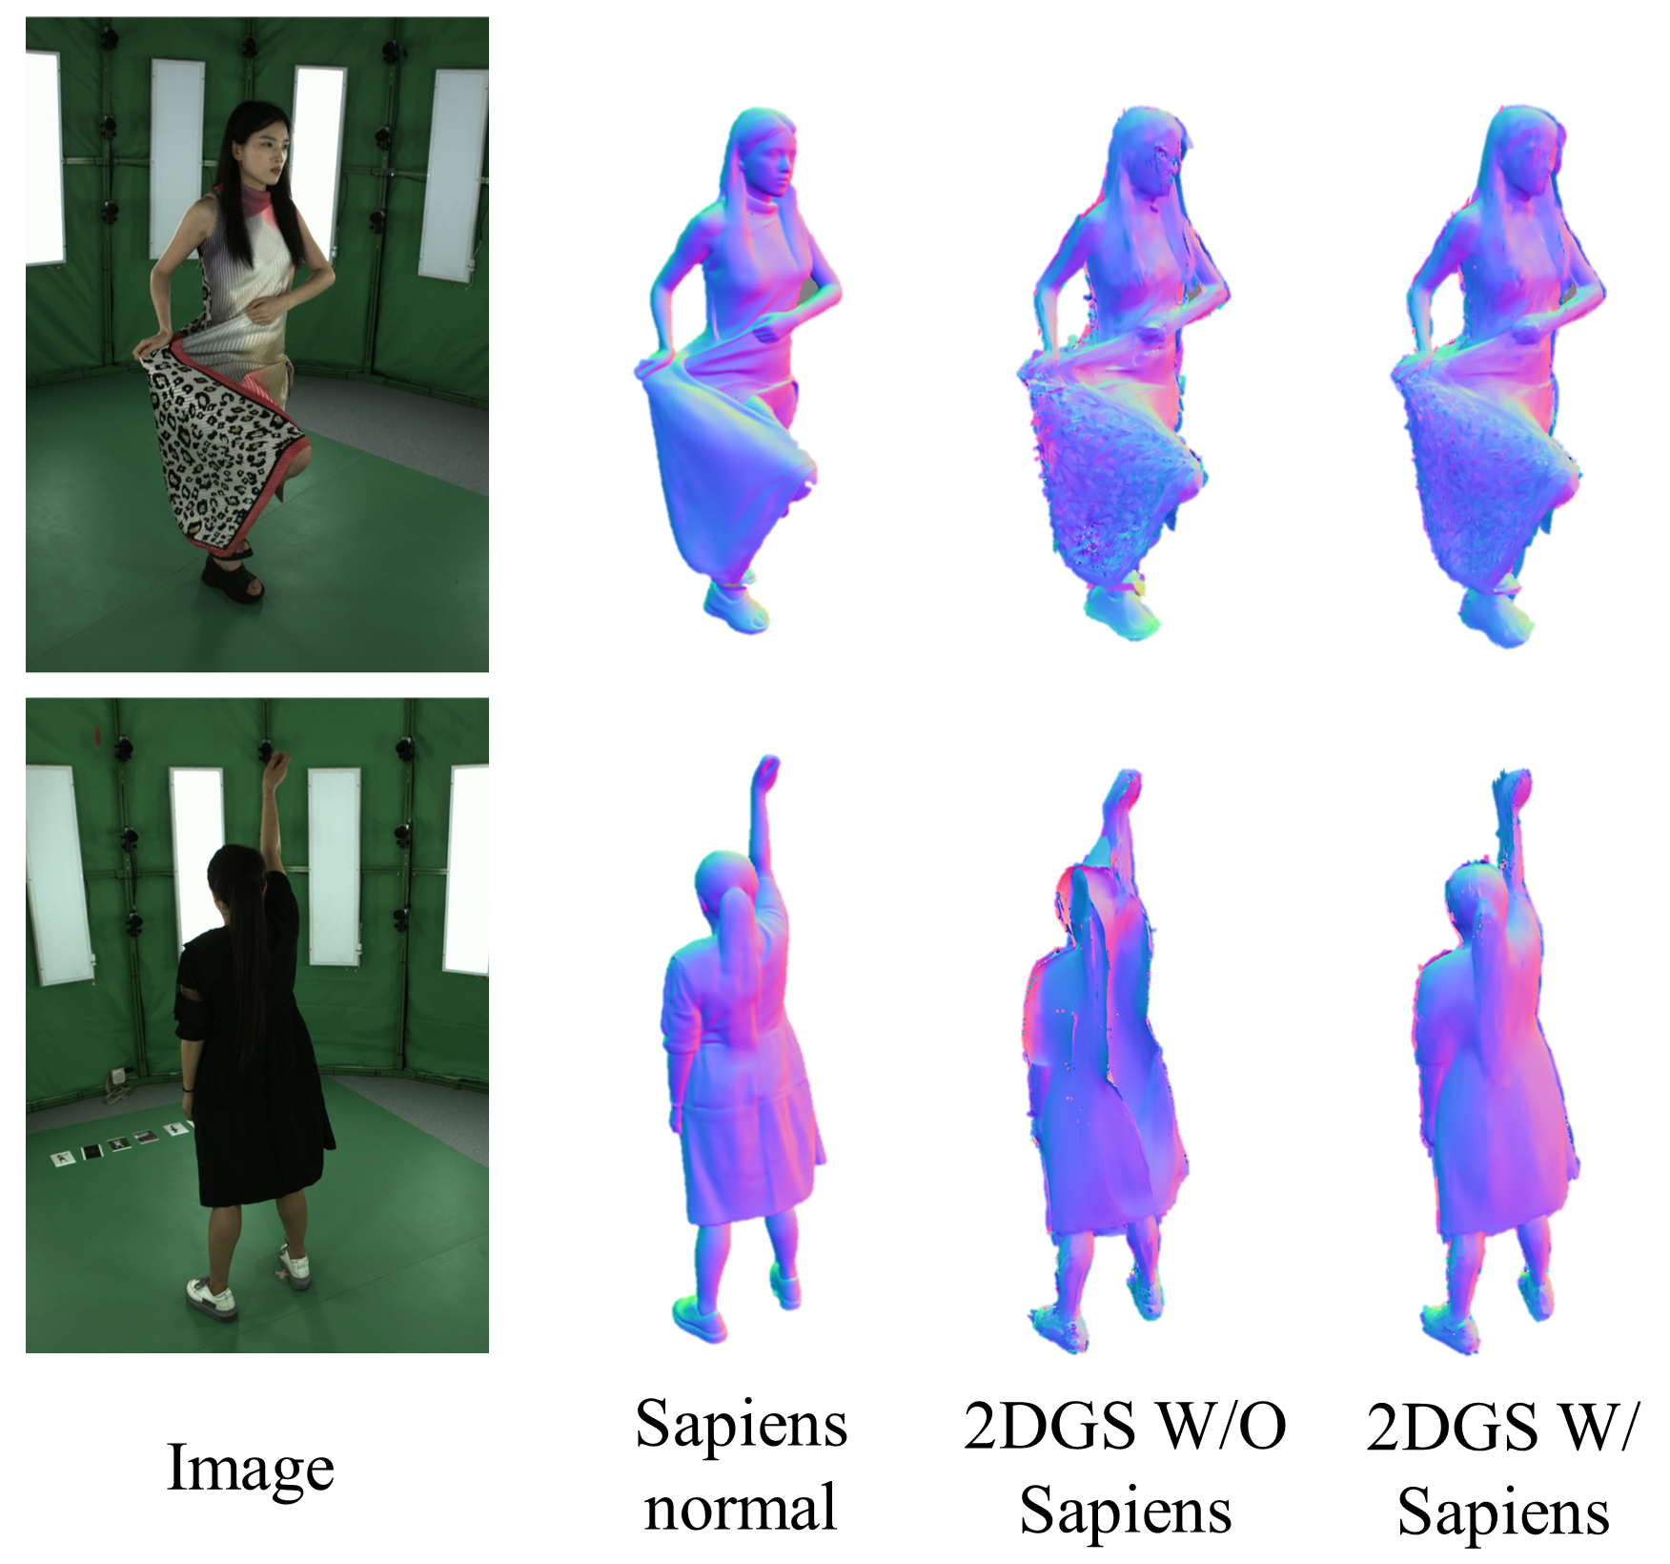
Normal Map
Use the 2D human normal foundation model Sapiens to generate pseudo labels for normal maps.
Leverage the generated normal maps to regularize the human surface reconstruction method following 2DGS.

Slide 12
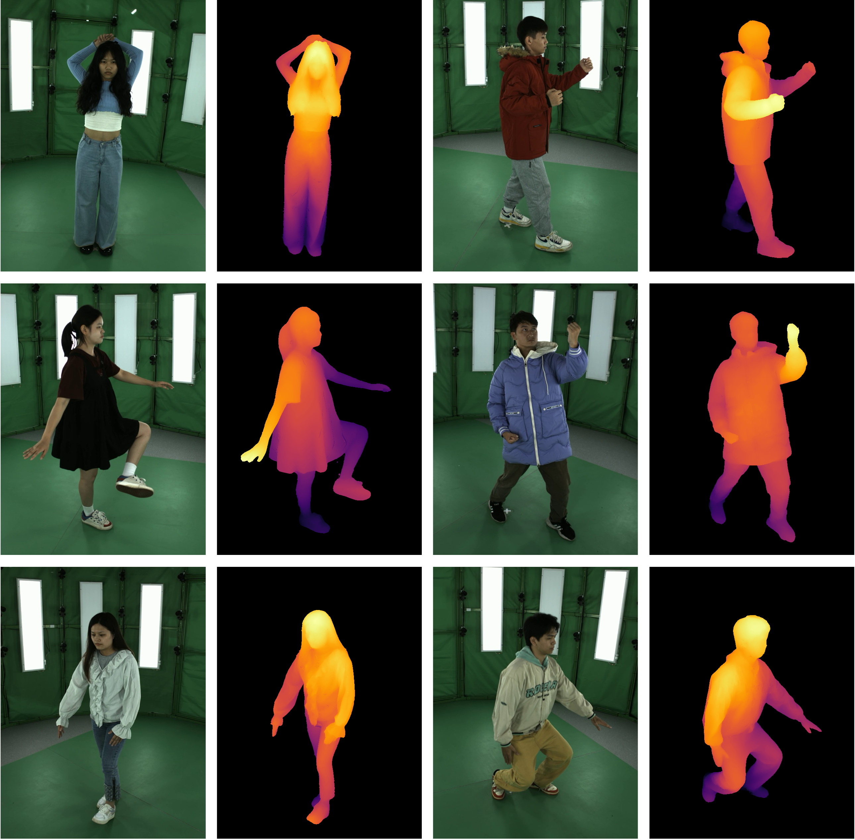
Depth Map
Depth map provides reliable geometric input for neural networks to infer accurate 3D shapes
Depth information can capture fine details such as cloth wrinkles, which can serve as a supervisory signal to constrain the 3D human geometry, and further improve the quality of reconstruction.
Use 2D Gaussian primitives and multi-view camera parameters to render human depth maps for each view

Slide 13
Thank You !

