Slide 1
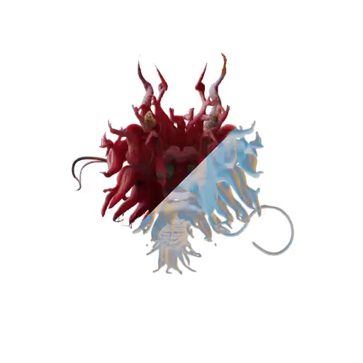
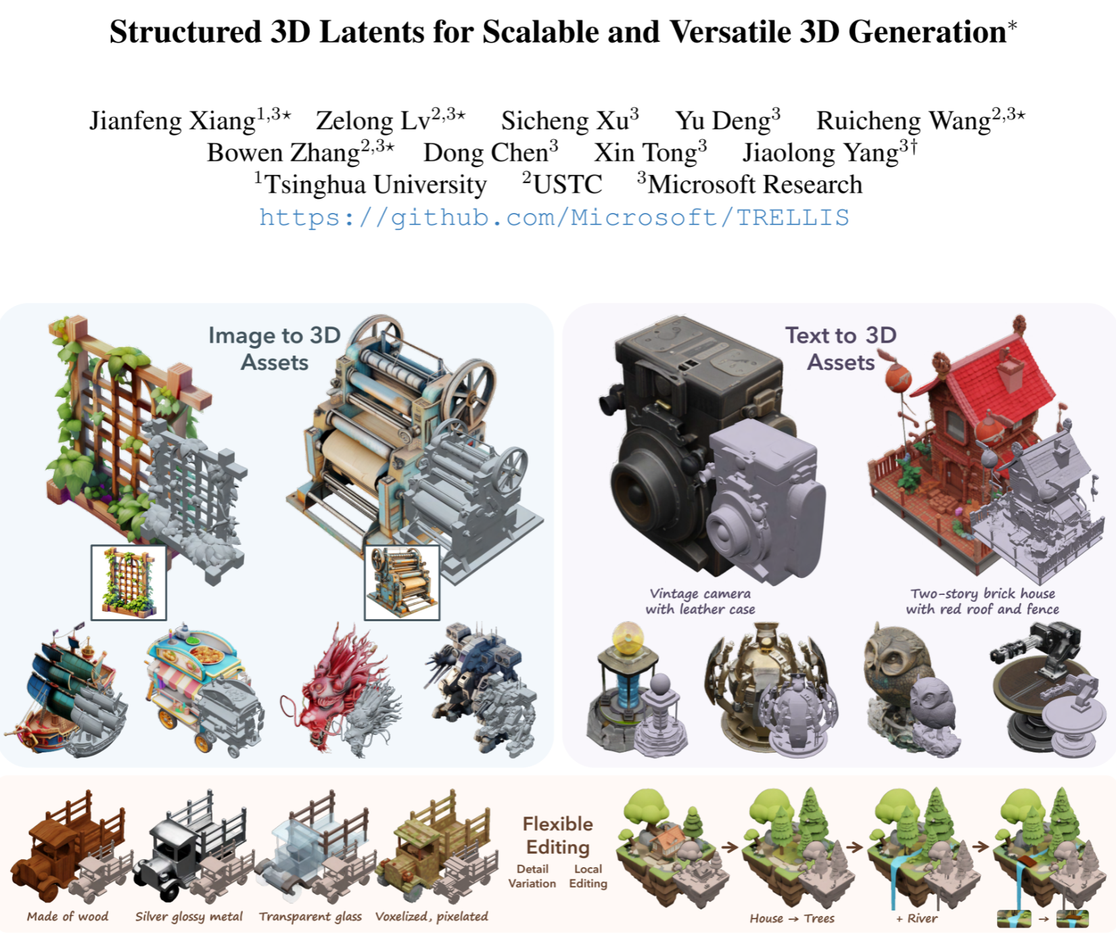

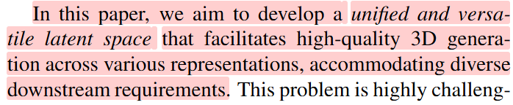
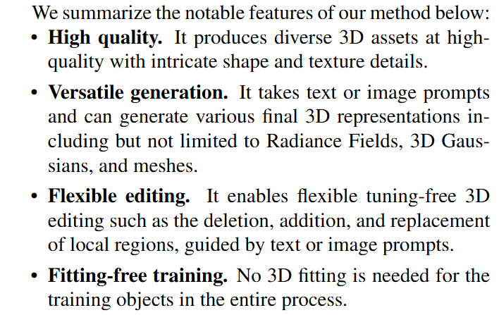

Slide 2
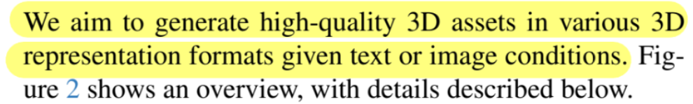
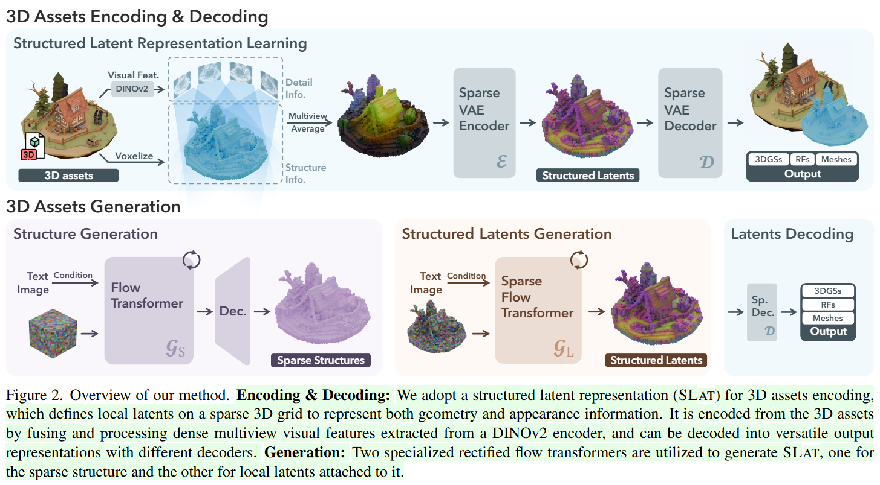
Methodology

Slide 3
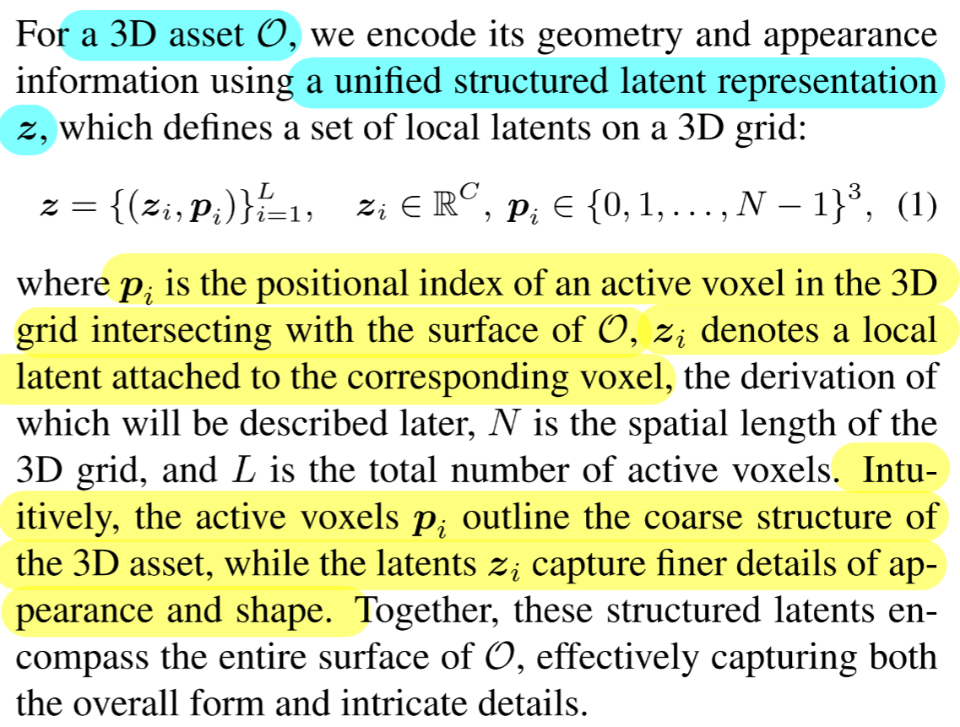


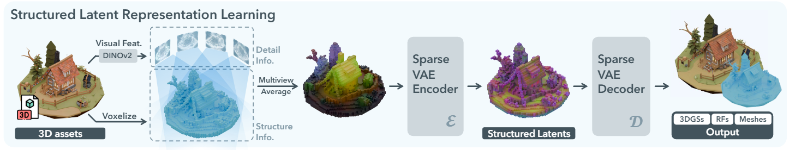
Methodology
Structured LATents (SLAT)
a unified 3D latent representation for high-quality, versatile 3D generation. SLAT marries sparse structures with powerful visual representations.
By default, we set N = 64 which leads to an average value of L = 20K

Slide 4
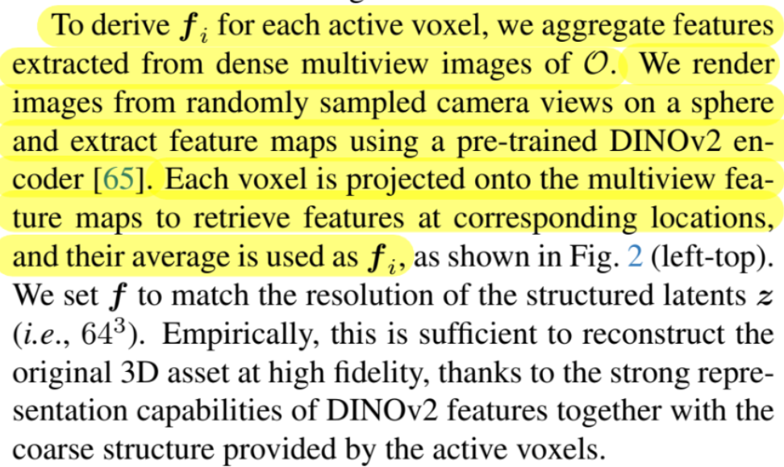






Methodology
Visual feature aggregation
Avg of Multi- view DINOv2 feature
Voxelize

Slide 5
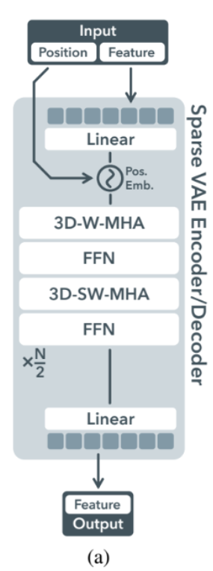
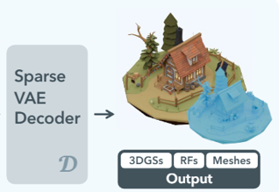
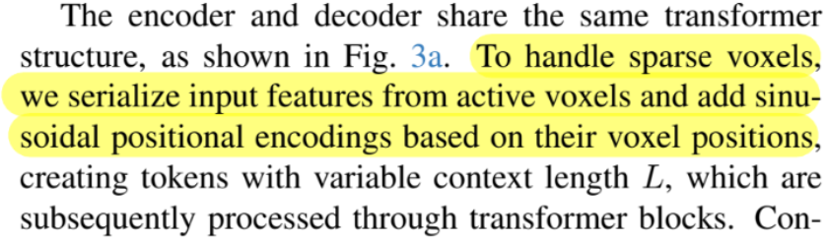
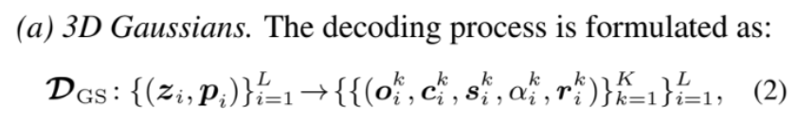
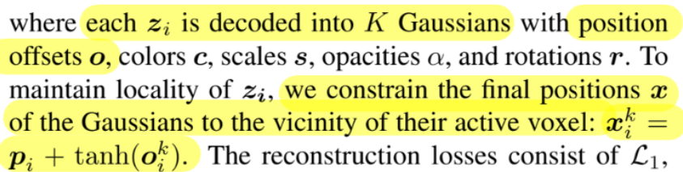
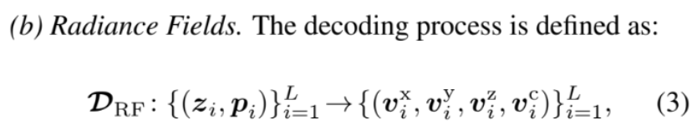
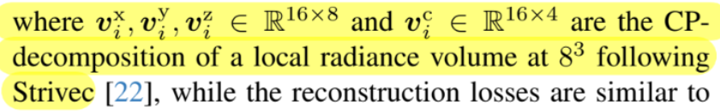
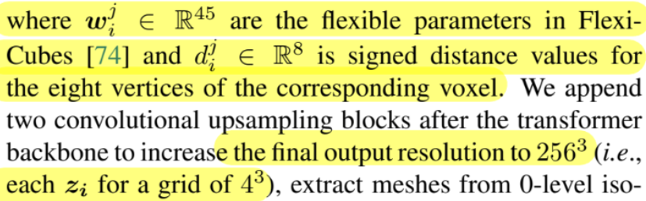
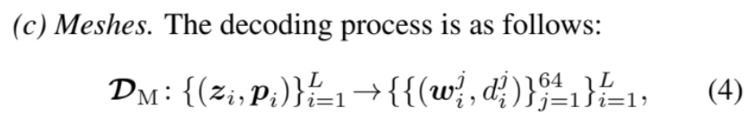
Methodology
Structured Latent VAE Design
Decoding into versatile formats
K=32

Slide 6
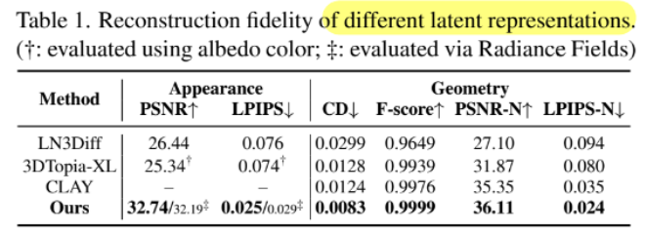
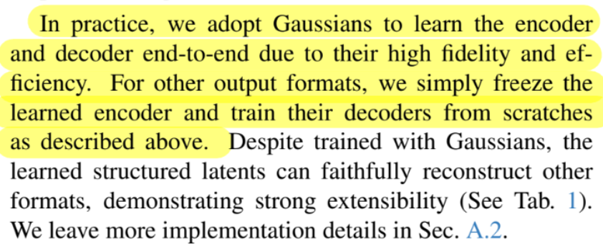

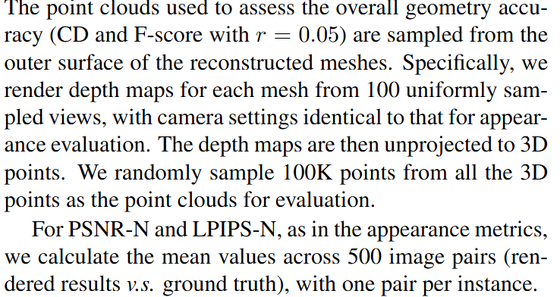
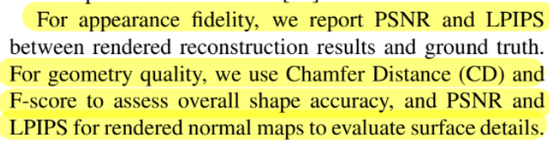
Methodology

Slide 7
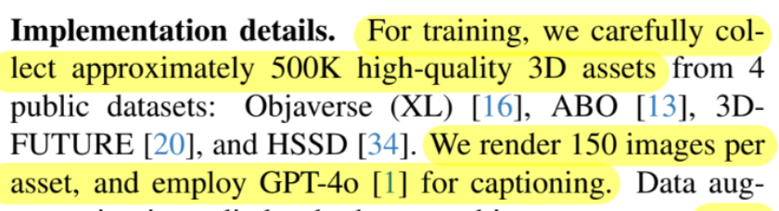
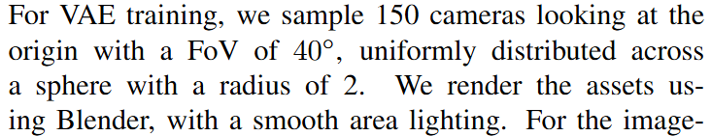


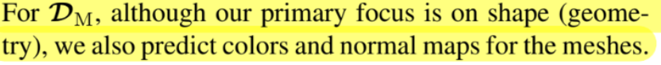

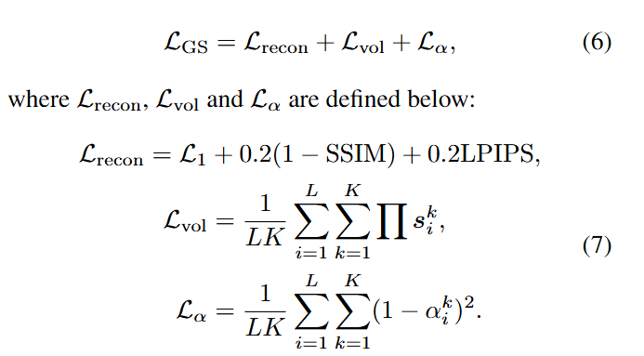
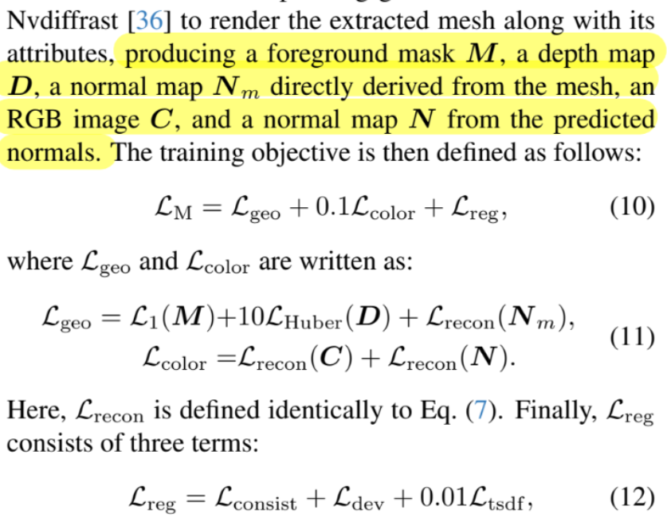

Methodology
Use specific losses for different 3D decoders.
Reconstruction losses are applied between the decoded 3D assets and the ground truth to train the encoder and decoder in an end-to-end manner, along with a KL-penalty on zi to encourage normal distribution regularization.
Structured Latent VAE Training
The training objective is L_recon as defined in Eq. (7).
penalizes the variance of attributes associ-ated with the same voxel vertex
A term in FlexiCube

Slide 8
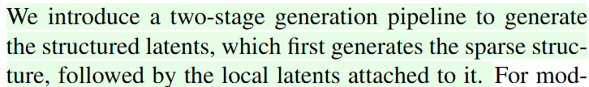
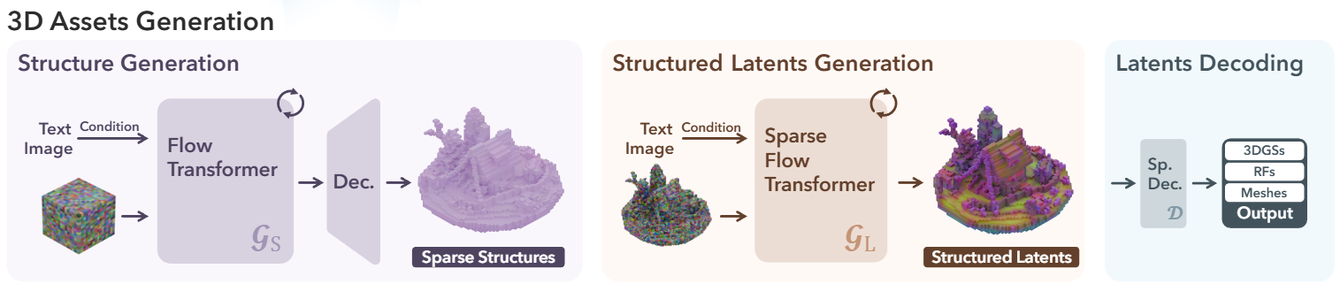


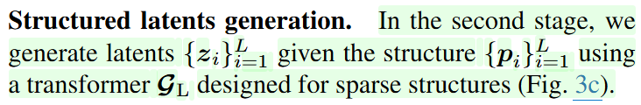

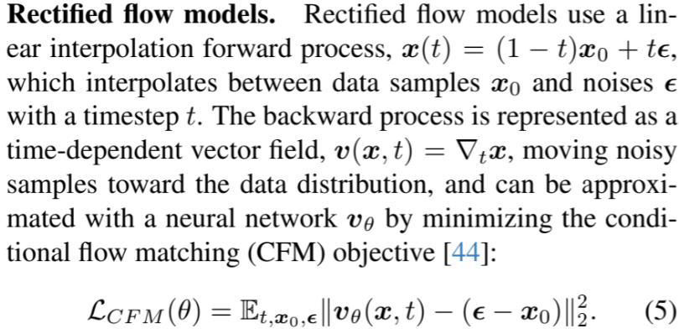
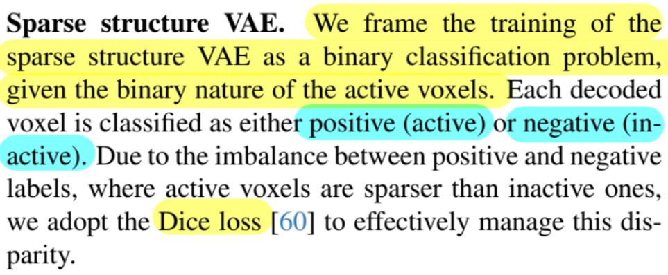
Methodology
Stage 1
Stage 2
Introduce a simple VAE

Slide 9
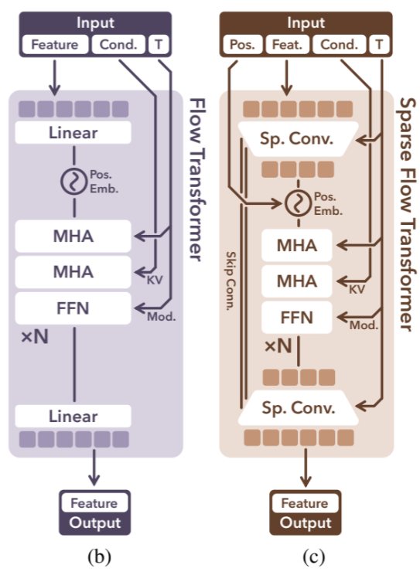
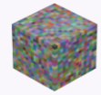


Methodology
Due to our sparse structure, we apply a downsampling block with sparse convolutions to pack latents within a 2^3 local region
Input
An input dense noisy grid is serialized, combined with positional encodings
A convolutional upsampling block is appended at the end of the transformer, with skip connections to the downsampling block that facilitates spatial information flow.
Conditions
Text: pre-trained CLIP
Image: DINOv2
Conditions are injected through cross attention layers as keys and values.
Data augmentation is applied to both text and image prompts: texts are summarized to varying lengths, and images are rendered with different FoVs (ranging from 10◦ to 70◦).
We train three models with total parameters of 342M (Basic), 1.1B (Large), and 2B (X-Large). The XL model is trained with 64 A100 GPUs(40G) for 400K steps with a batchsize of 256
Timestep information is incorporated using adaptive layer normalization (adaLN) and a gating mechanism

Slide 10
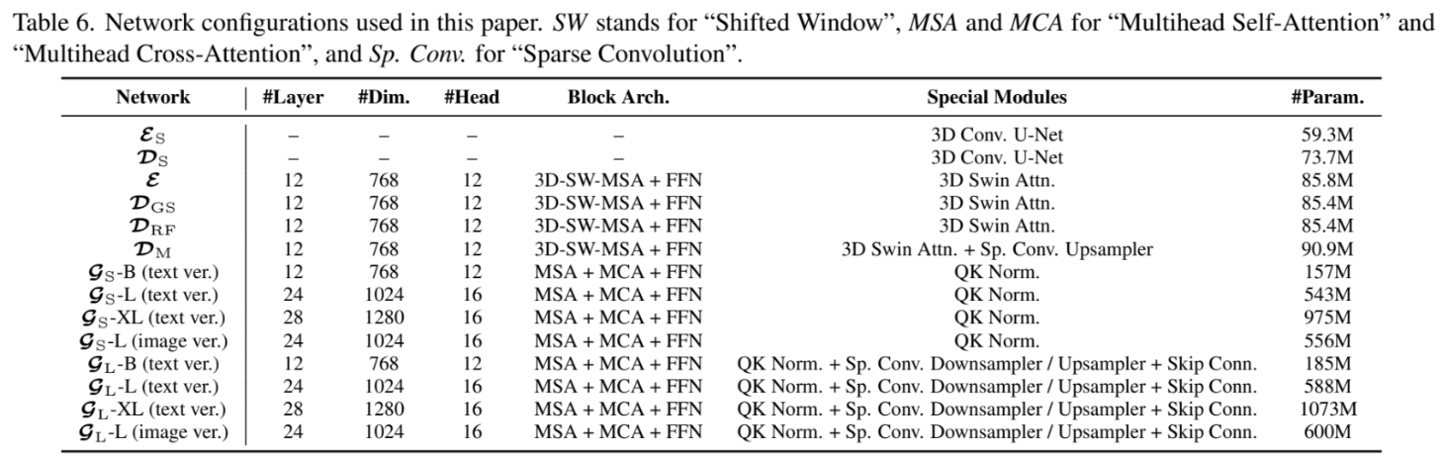
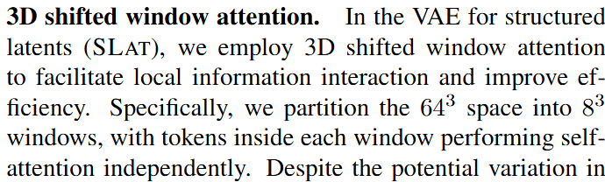
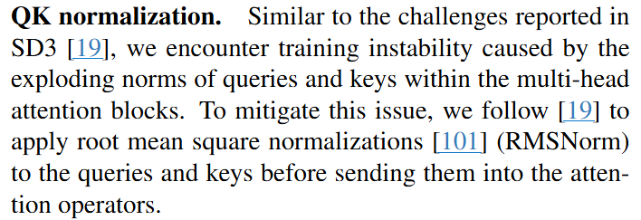
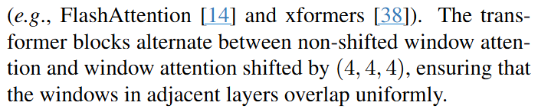
Methodology

Slide 11
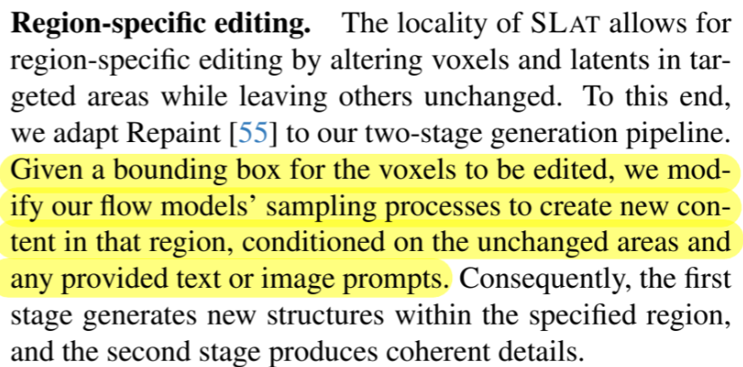
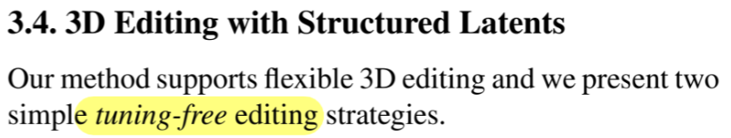
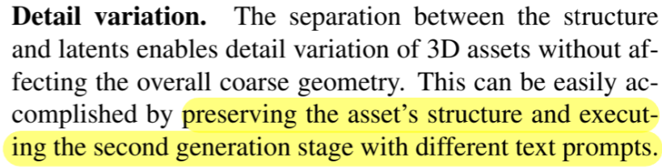
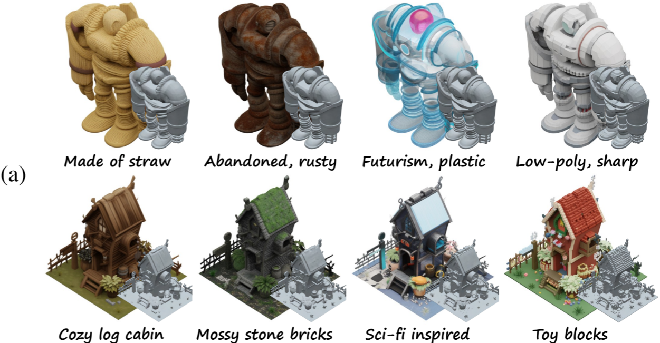
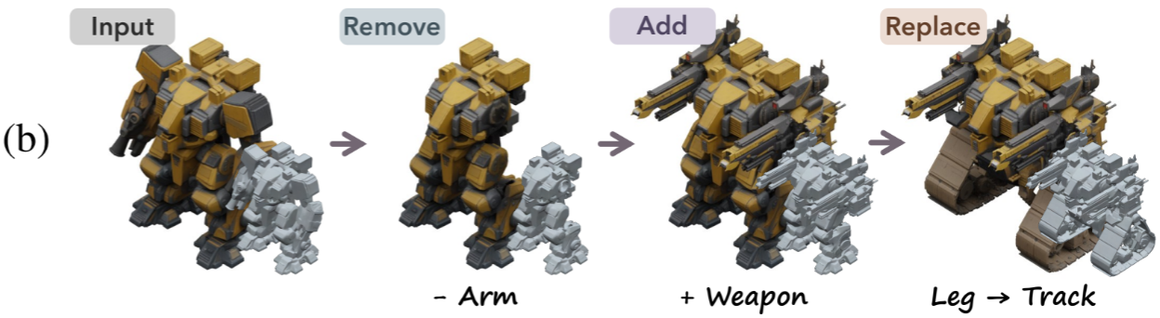
Methodology

Slide 12
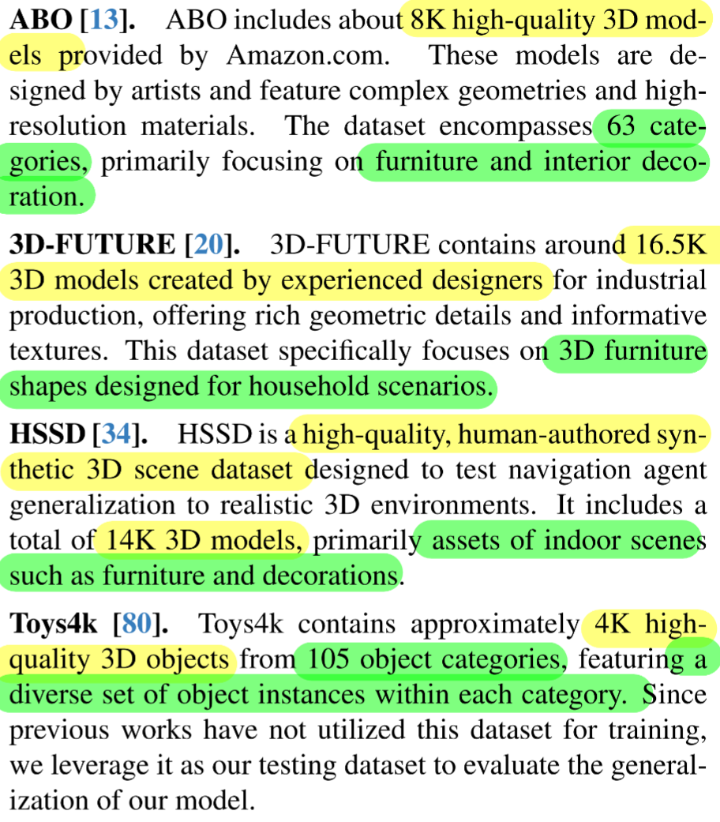
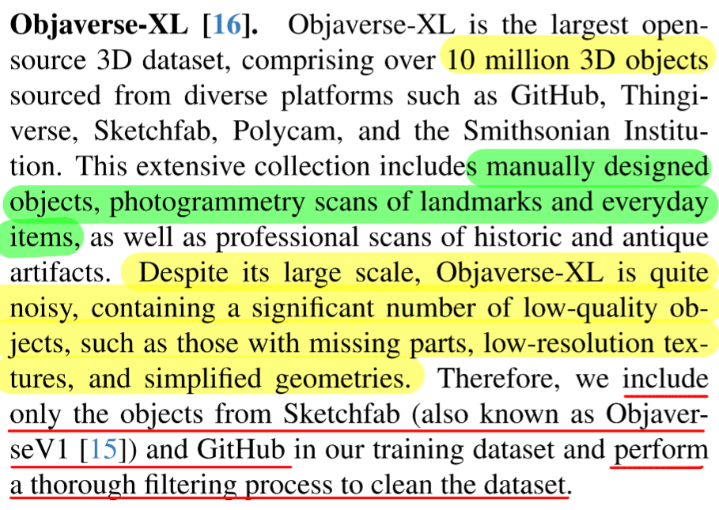
Data Preparation - Source

Slide 13
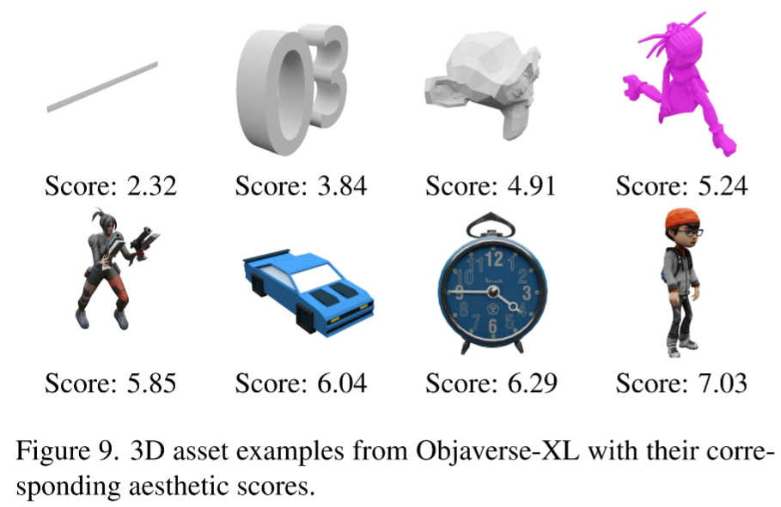
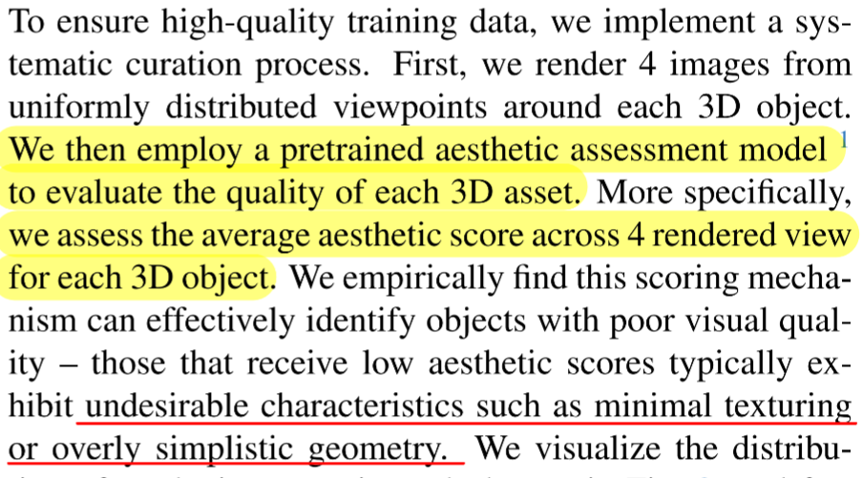
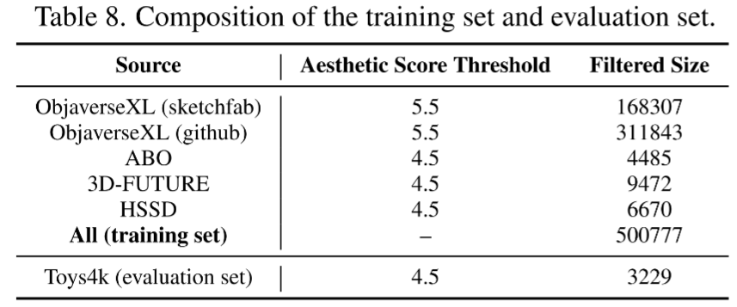
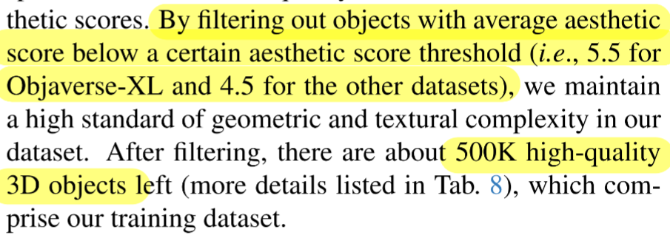
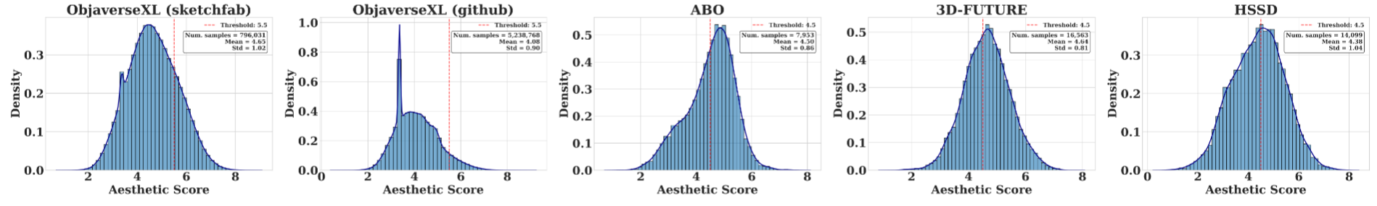
Data Preparation - Curation

Slide 14



Data Preparation - Captioning

Slide 15

Comparison

Slide 16





Comparison

Slide 17




