Slide 1
Navigating High-Dimensionality in Diffusion Models
Presenter: Yilin Wang

Slide 2

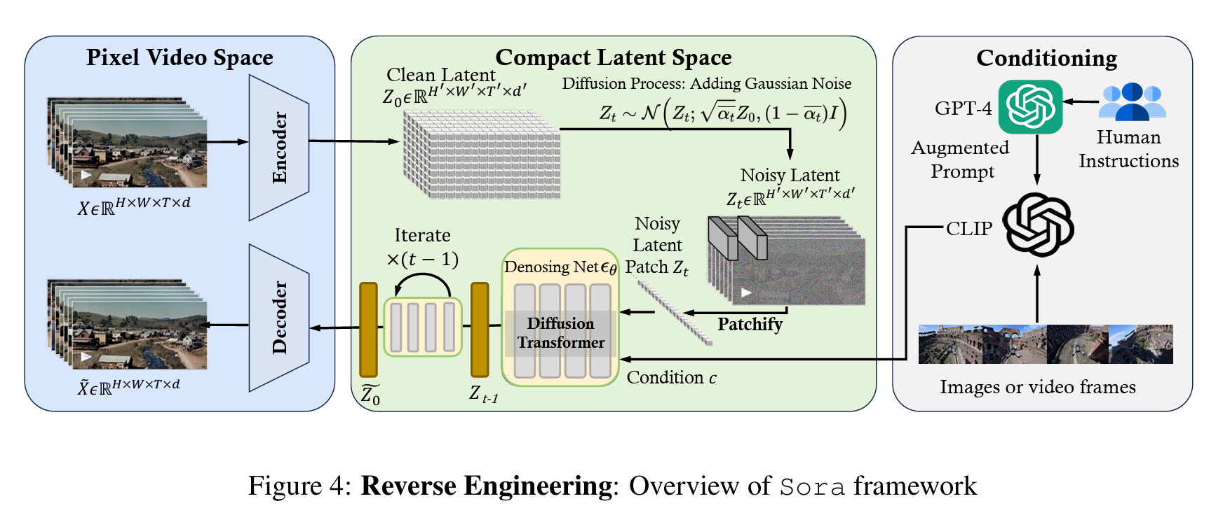
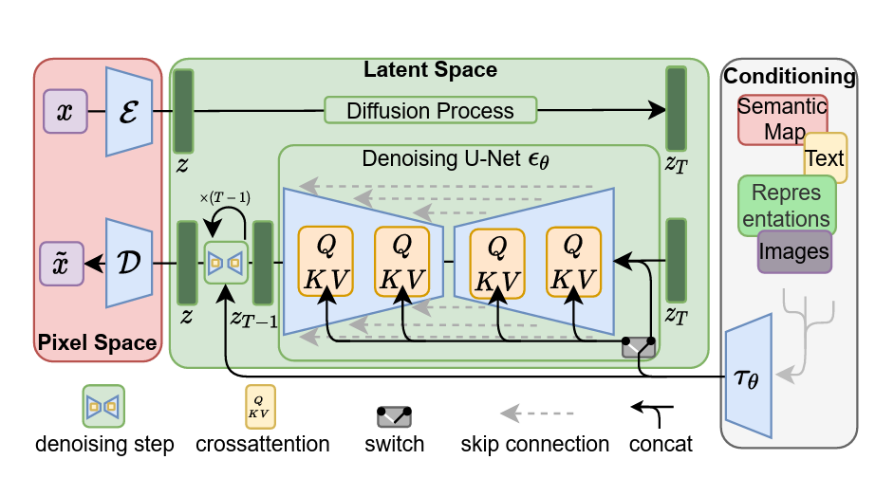
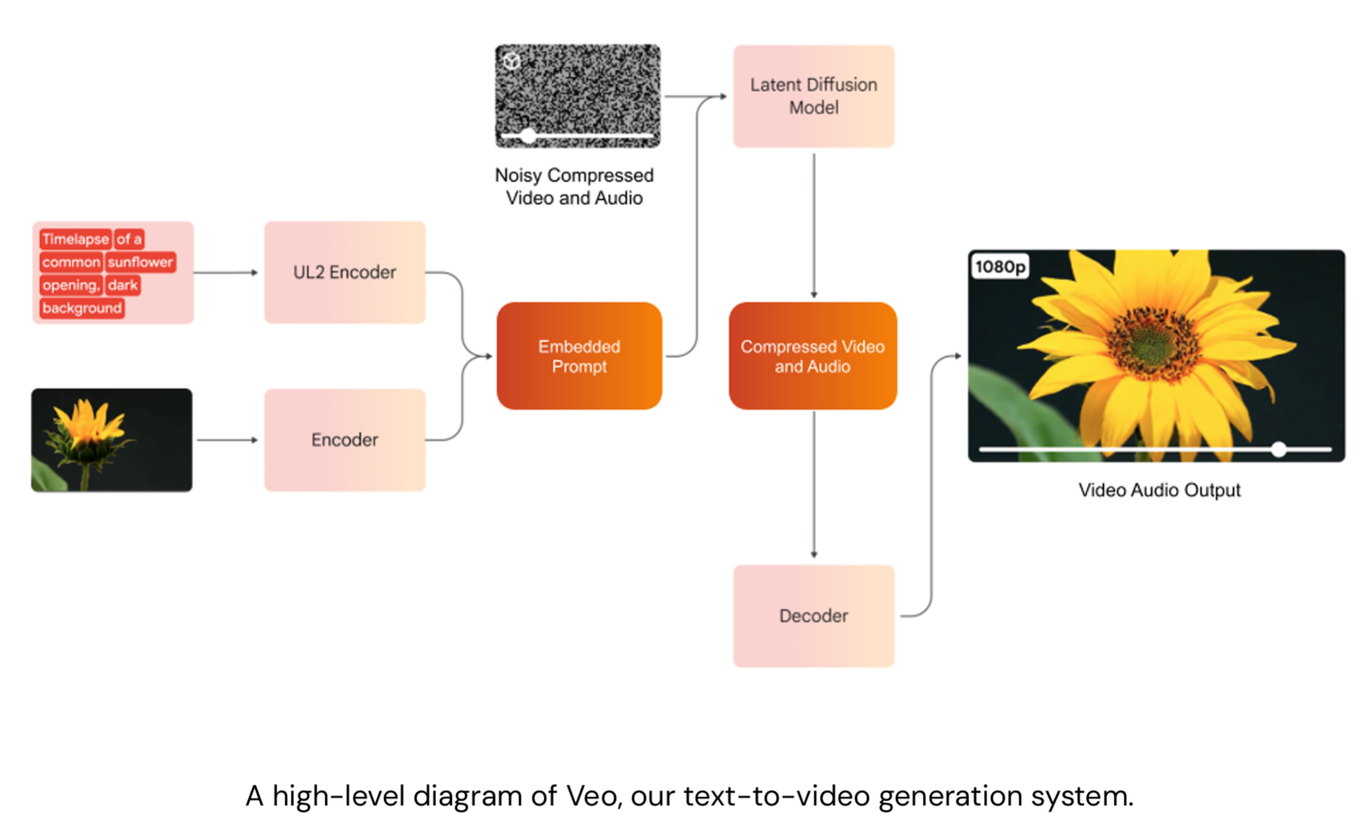
Background
DiT (Diffusion Transformer) + VAE is the current “standard”
Notes:
Sora review: https://arxiv.org/pdf/2402.17177
veo technical report: https://openai.com/index/video-generation-models-as-world-simulators/

Slide 3
Background
DiT (Diffusion Transformer) + VAE is the current “standard”
Pixel Space
  Historically hard to scale due to high dimensionality
Latent Space
  Relying on VAEs (SD-VAE) which are now becoming the bottleneck
How do we handle High Dimensionality effectively

Slide 4
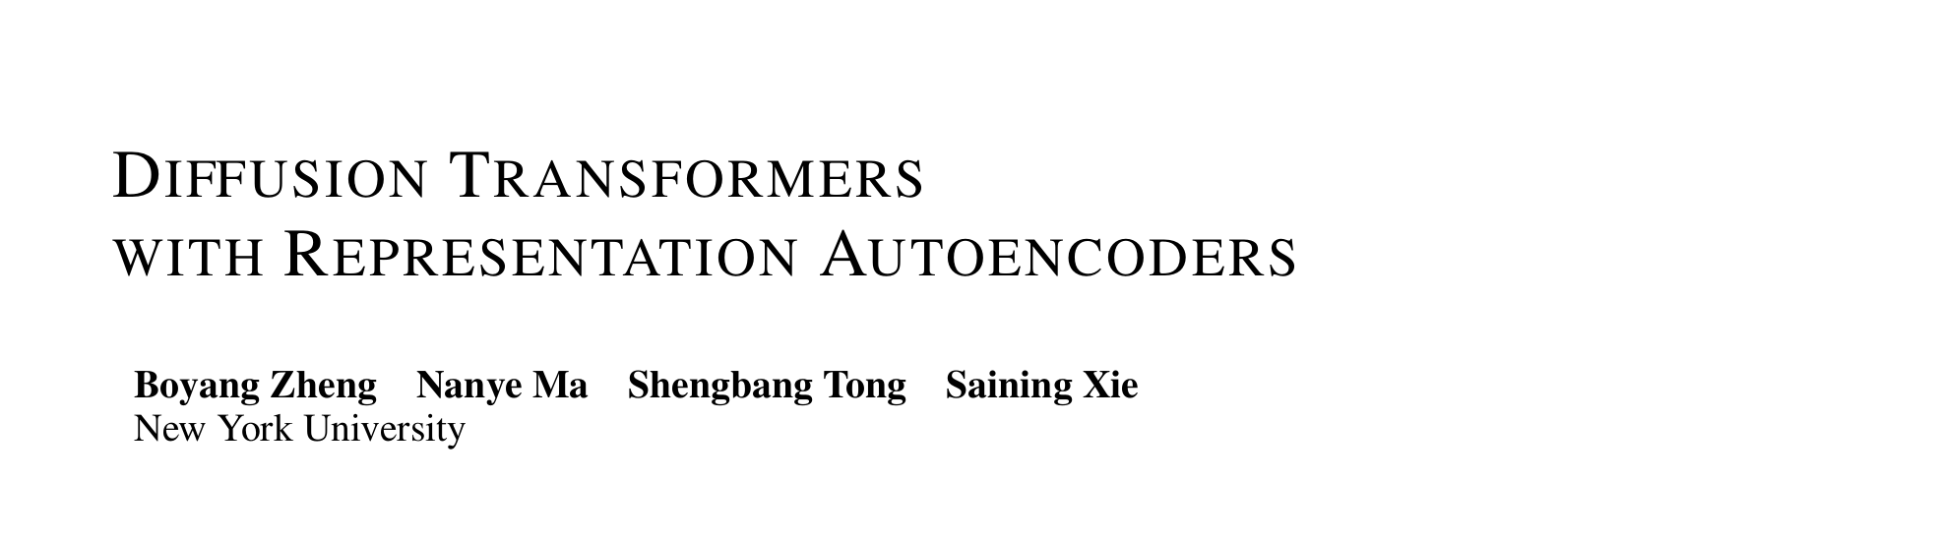
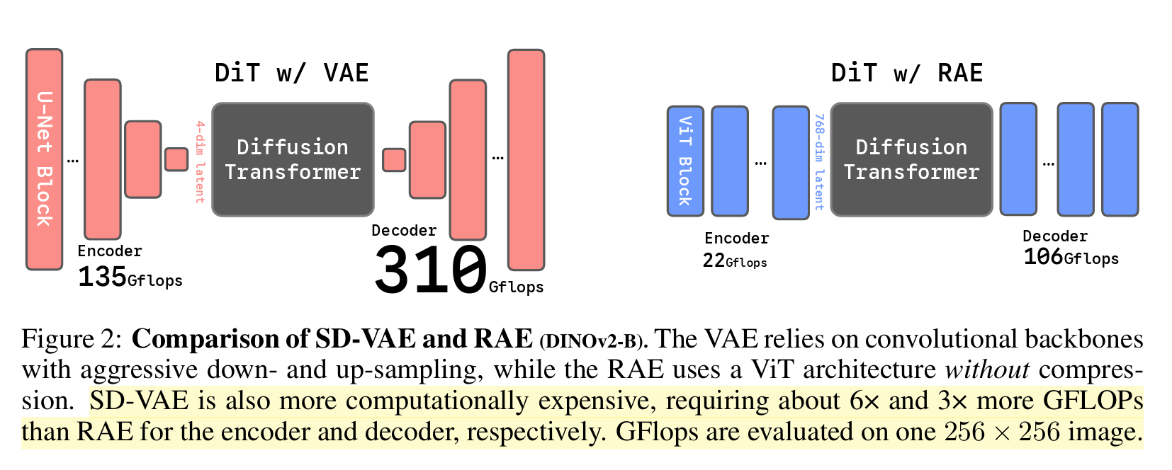

Slide 5
Motivation
Problem with VAE: SD-VAE is old, slow, and has a low-dimensional latent space (64 x 64 x 4) that loses semantic detail.
Key Insight: Self-supervised encoders (DINOv2, MAE) are powerful and semantically rich.
Key Challenge: These encoders produce high-dimensional latents (e.g., DINOv2 is 768-dim or 1024-dim per token). Traditional DiTs fail to converge on such high-dim tokens.

Slide 6
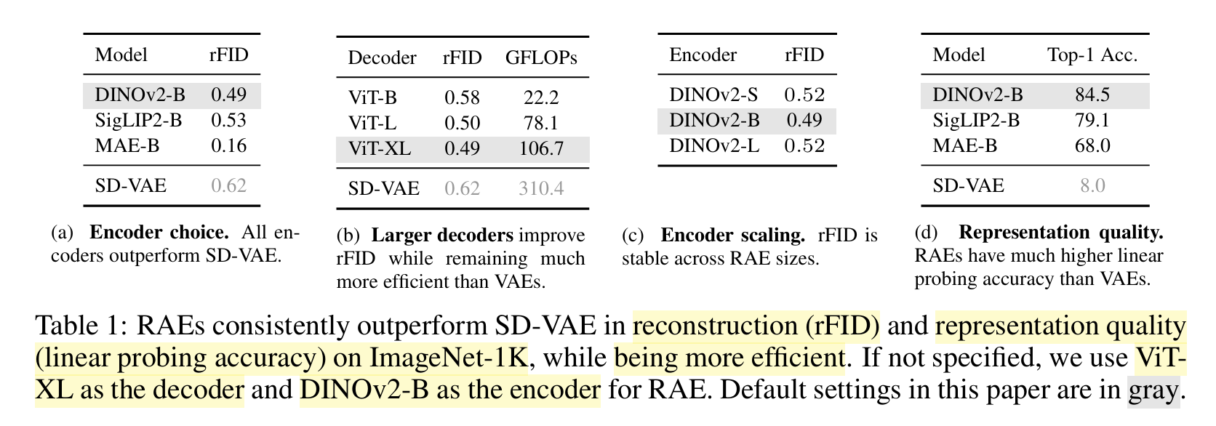
Method – Representation Autoencoder (RAE)
RAE Design:
  Encoder: Frozen Pre-trained model (e.g., DINOv2-B).
  Decoder: Lightweight Transformer trained to reconstruct pixels from DINO tokens.
Notes:
RAE achieves much lower reconstruction FID (rFID) than SD-VAE (0.49 vs 0.62) while being faster. It breaks the myth that semantic encoders can't reconstruct details.

Slide 7
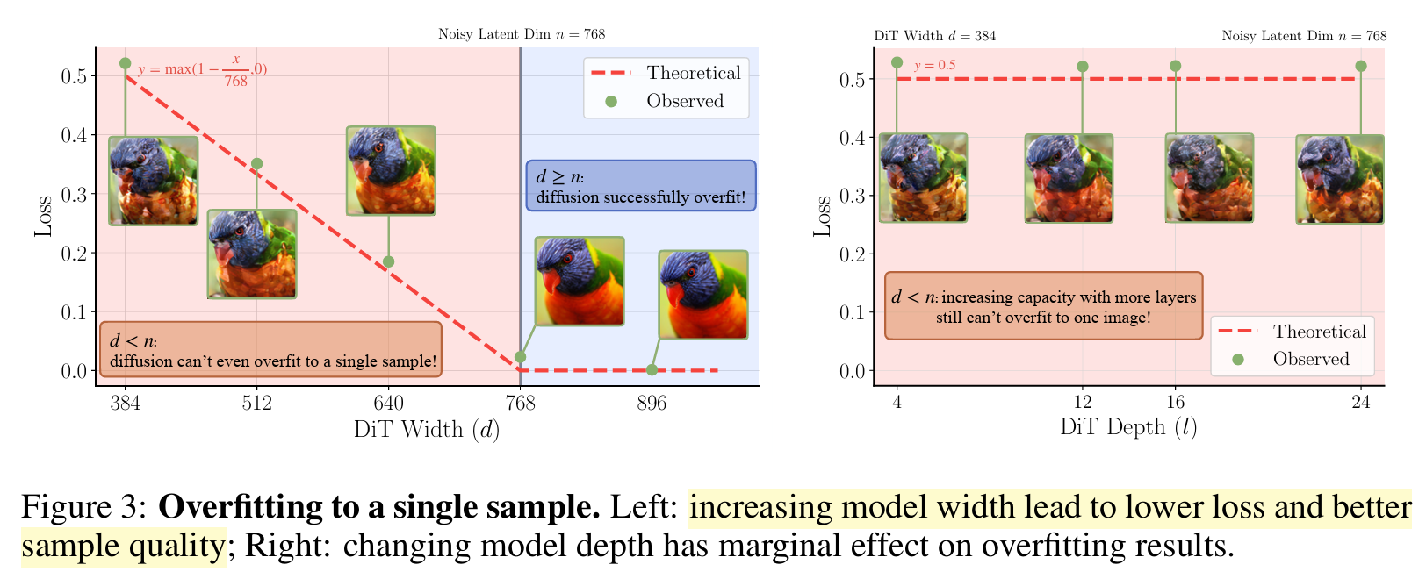
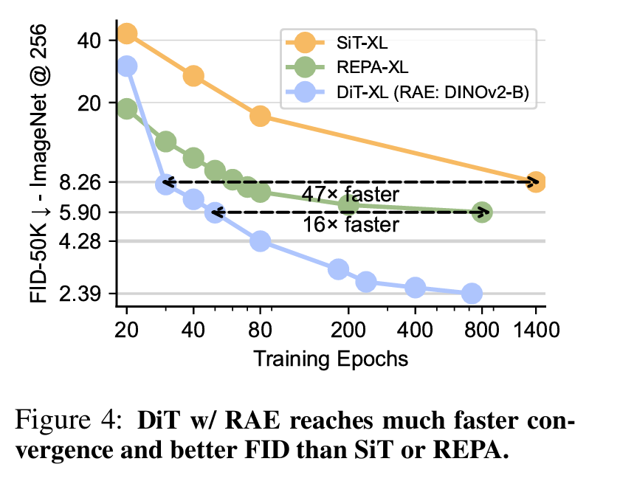
Method – Taming DiT for RAE
Why did DiT fail on DINO latents?
  Hypothesis: The “Width” of the DiT (d) must match or exceed the input token dimension (n).
Theorem/Empirical: If DiT width < Token dim (d < n), the model cannot even overfit a single batch. Diffusion effectively "expands" the manifold to full space due to noise injection.
Fix 1: Scale DiT width so d >= n.
Fix 2: Dimension-Dependent Schedule Shift (Adjust noise schedule for high-dim data).

Slide 8
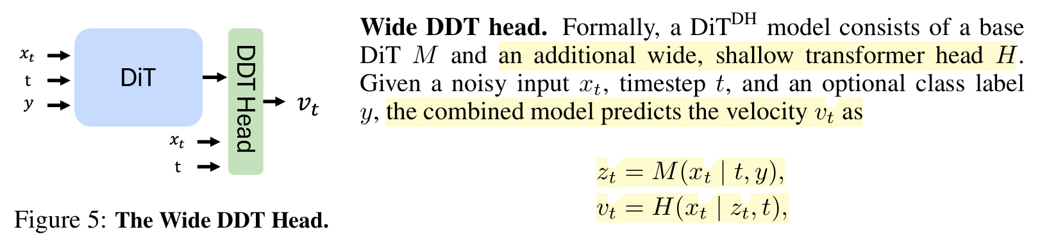
Method – The DiT^{DH} Architecture
The Cost Problem: Making the whole DiT “wide” (e.g., hidden dim 1024+) is too expensive (O(d²))
Solution (DiT^{DH}):
  Backbone: Standard width (efficient).
  Head (DDT Head): A shallow but wide transformer block at the end specifically for denoising.
Impact: Achieves the necessary capacity for high-dim latents without the massive compute cost.

Slide 9
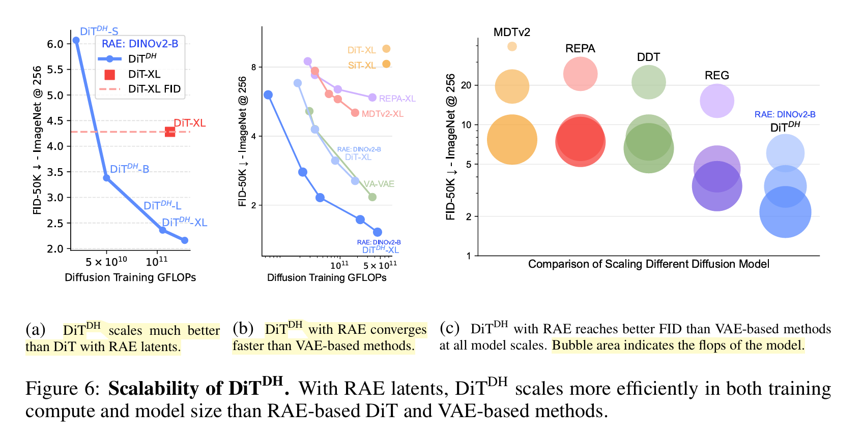
Method – The DiT^{DH} Architecture

Slide 10
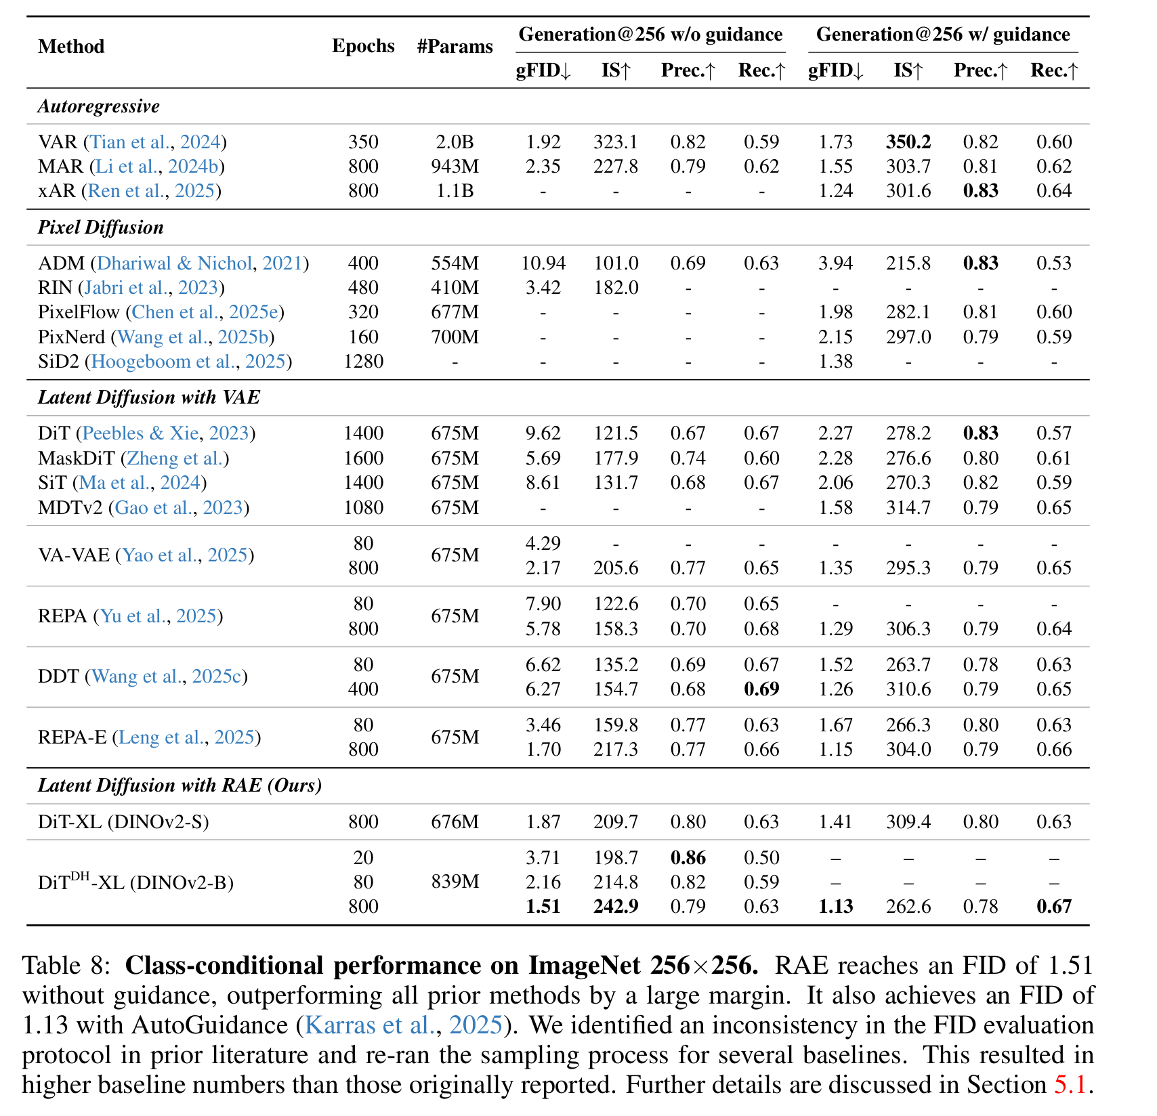
Quantitative
Comparison

Slide 11
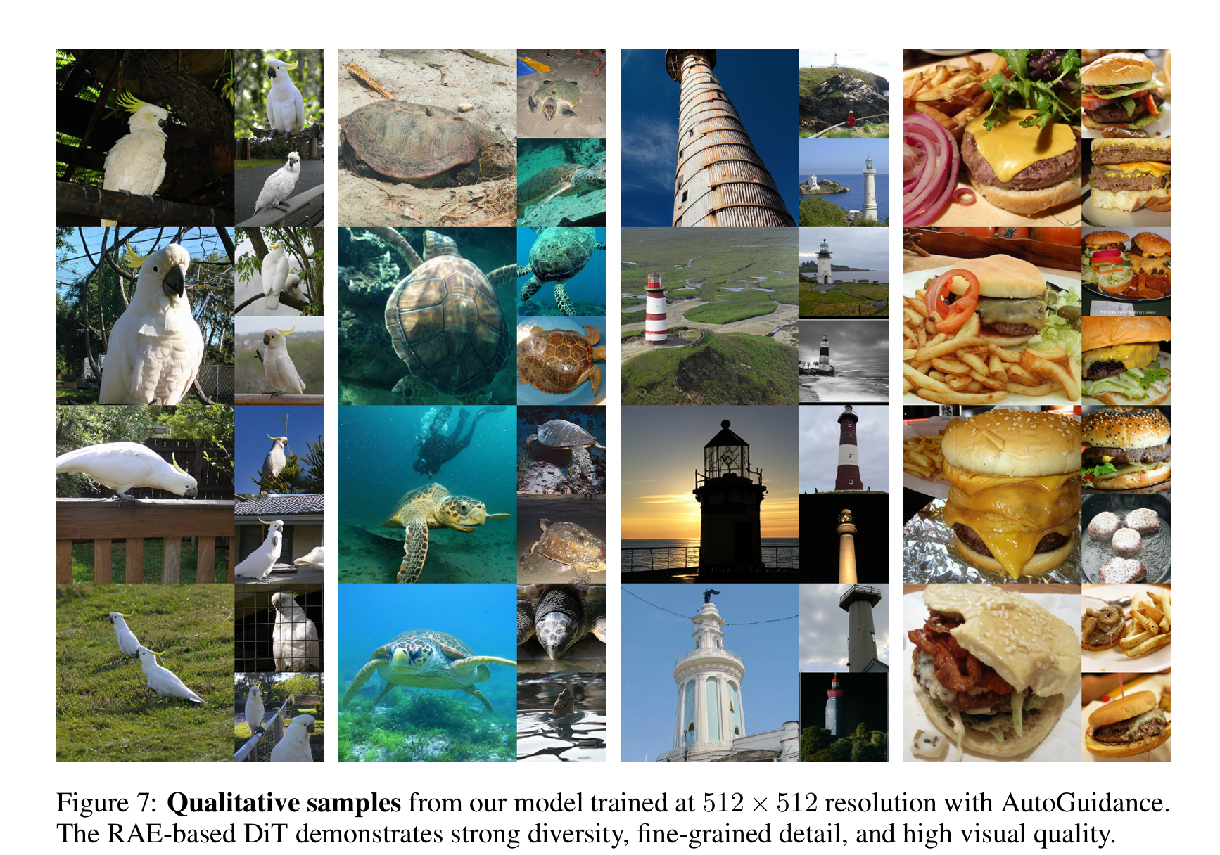
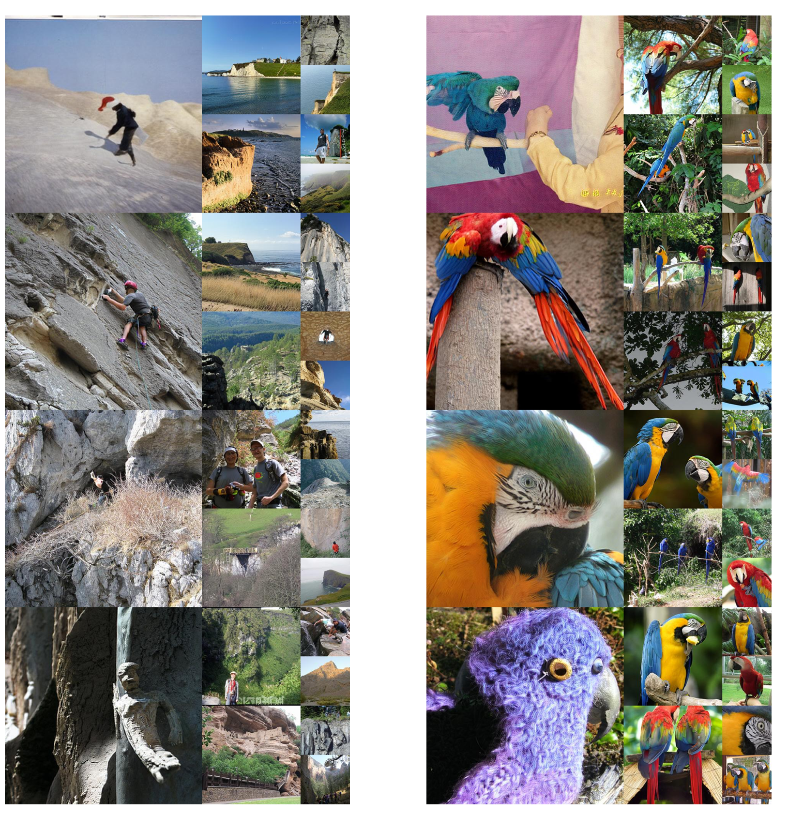
Qualitative Result

Slide 12
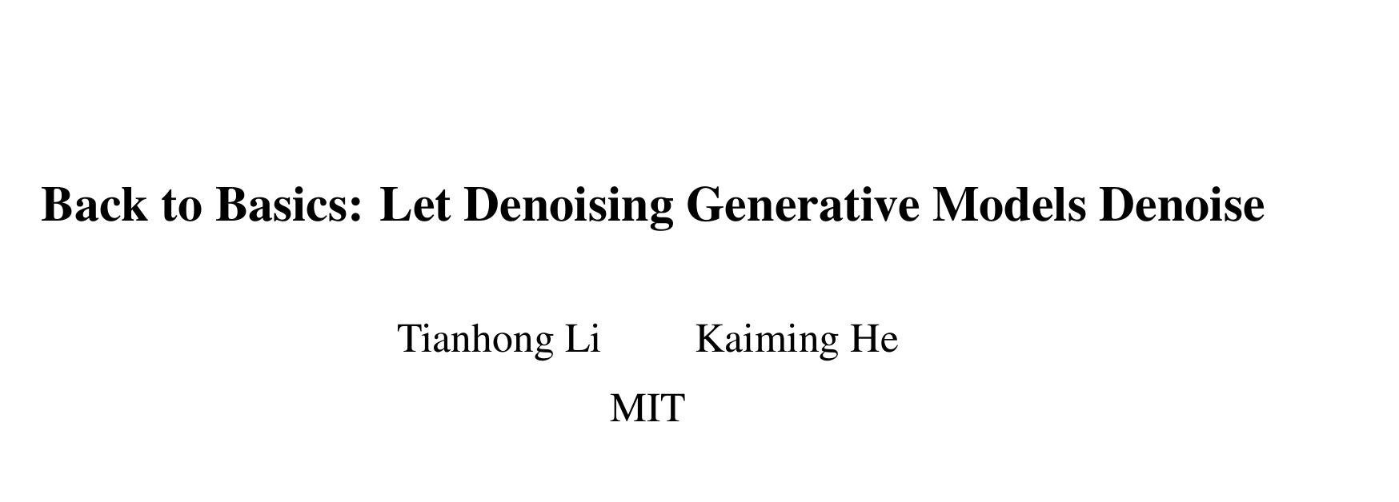

Slide 13
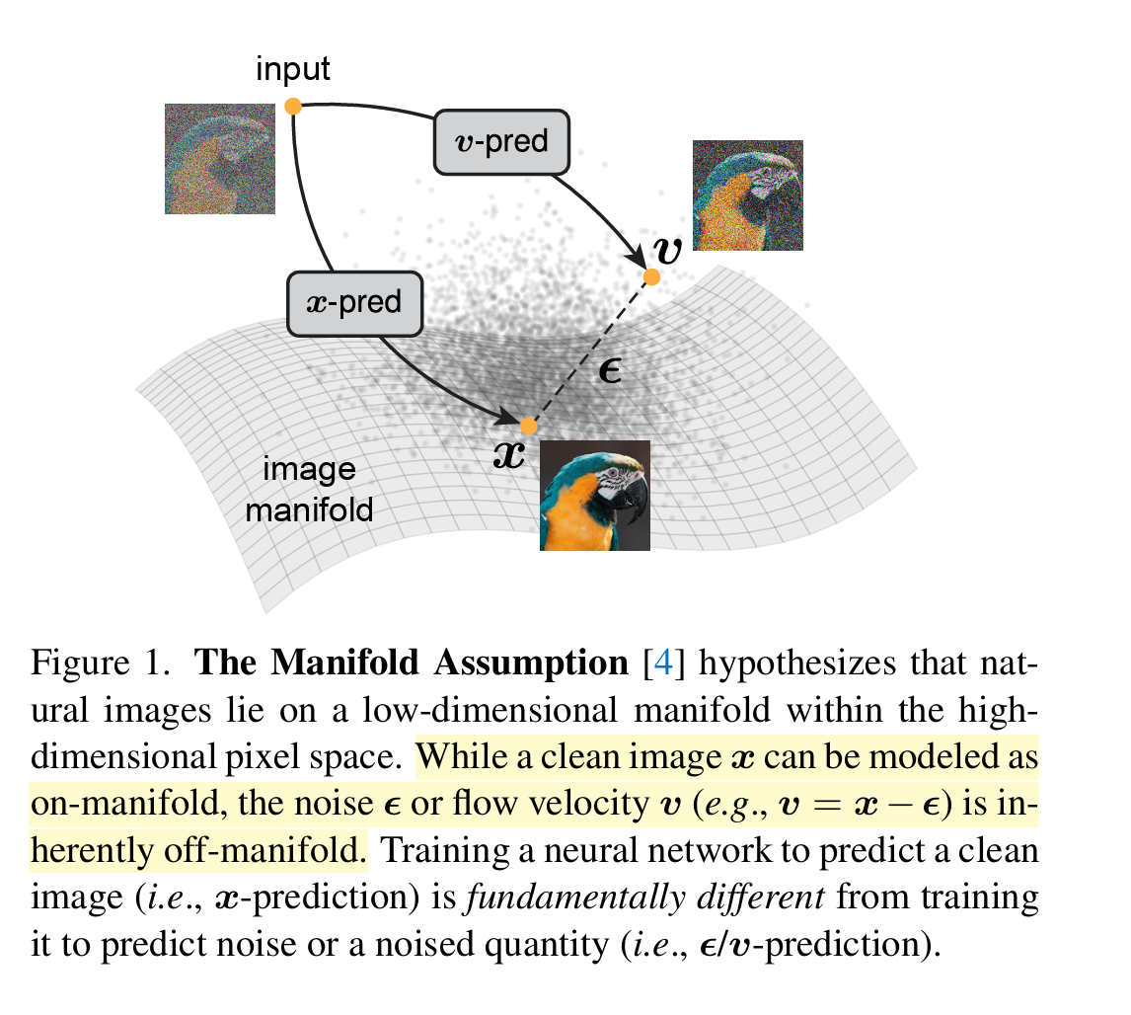
Manifold Assumption
Natural images lie on a low-dimensional manifold embedded in a high-dimensional pixel space
  Clean Data: On-manifold → Low intrinsic dimension
  Noise or Velocity: Off-manifold → High intrinsic dimension
➔➔➔
Key Insight:
Predicting noise or velocity in high-dim pixel space requires the network to model the full high-dim distribution, which is extremely hard.
Predicting x implies a projection back to the manifold, which is easier.
Notes:
On-manifold (Low intrinsic dimension).

Slide 14
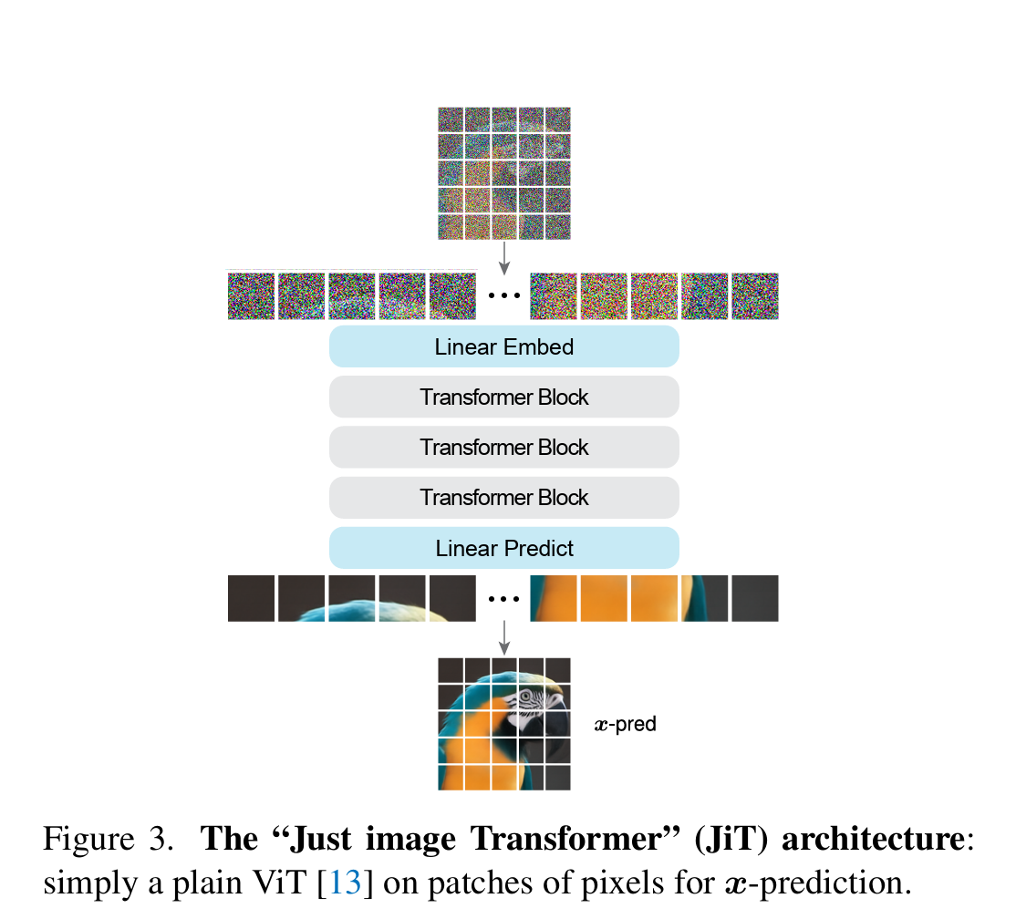
Methodology
Architecture: Plain Vision Transformer (ViT)
Input: Raw image patches (e.g., 16 x 16 or 32 x 32)
Formulation:
  Target: Directly predict x
  Loss: v-loss ➔ re-weighted x-loss
Key Differentiator: No VAE, no pre-training, no extra losses (perceptual/adversarial). Just pixels.

Slide 15
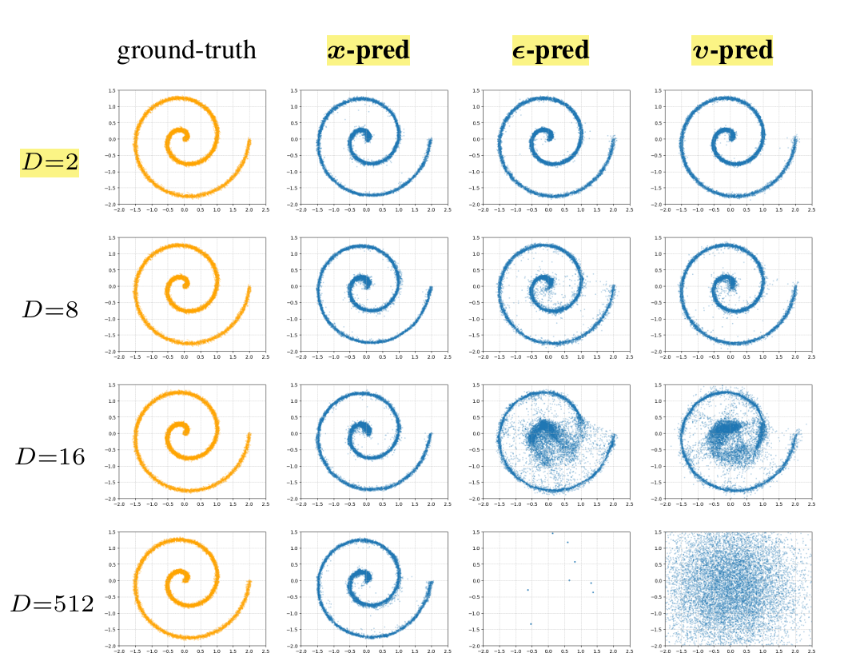
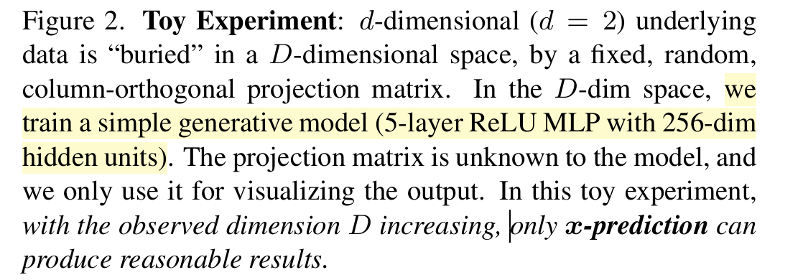
The Toy Experiment
Setup: Embed 2D data (spirals) into high-dim space (D=512).
Notes:
Observation:
$x$-prediction: Successfully recovers the spiral (learns the manifold).
$\epsilon$-prediction / $v$-prediction: Catastrophic failure at high $D$.
Why? $\epsilon$-pred tries to learn the high-freq noise pattern which requires massive capacity; $x$-pred learns the low-freq manifold structure.

Slide 16
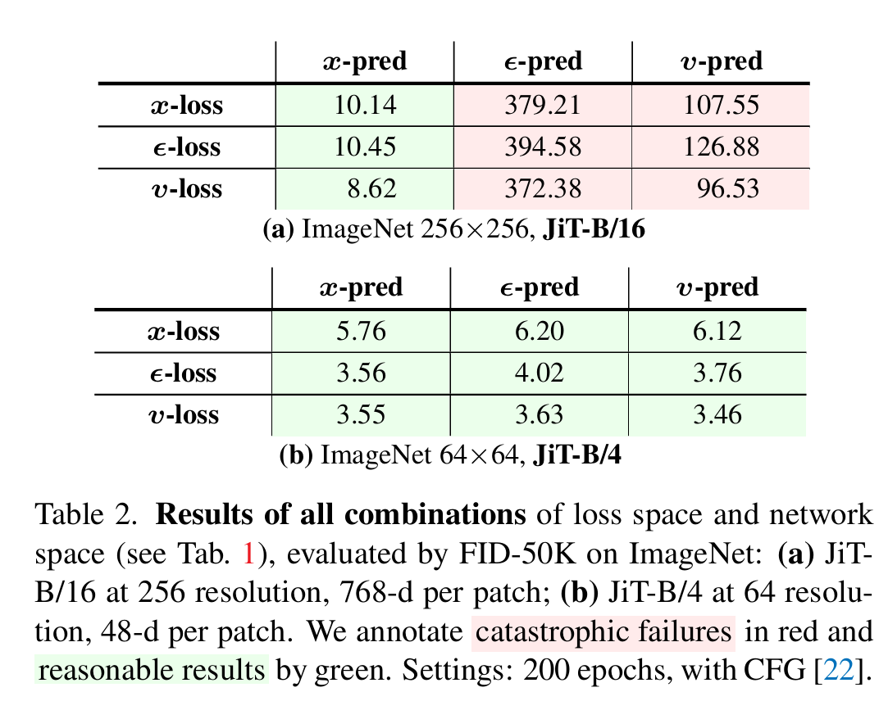
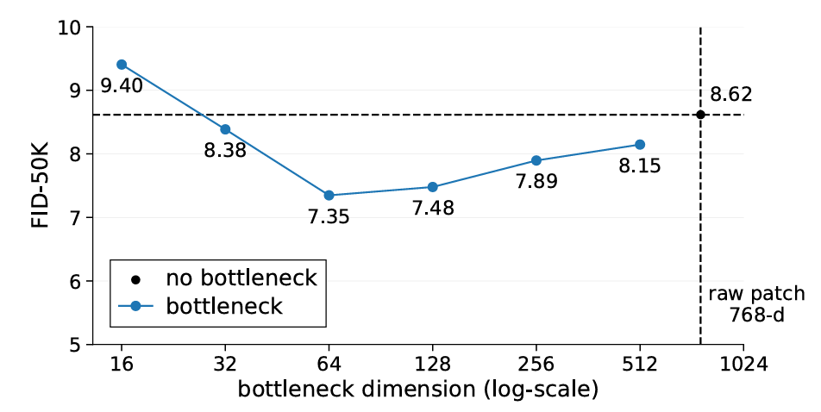
ImageNet Experiments & Scaling
Performance: Competitive with LDM baselines w/o. any tokenizer
Surprising Find - Bottleneck: Adding a low-rank bottleneck in the patch embedder improves performance
Notes:
This confirms the manifold hypothesis (forcing low-dim representation is good).

Slide 17
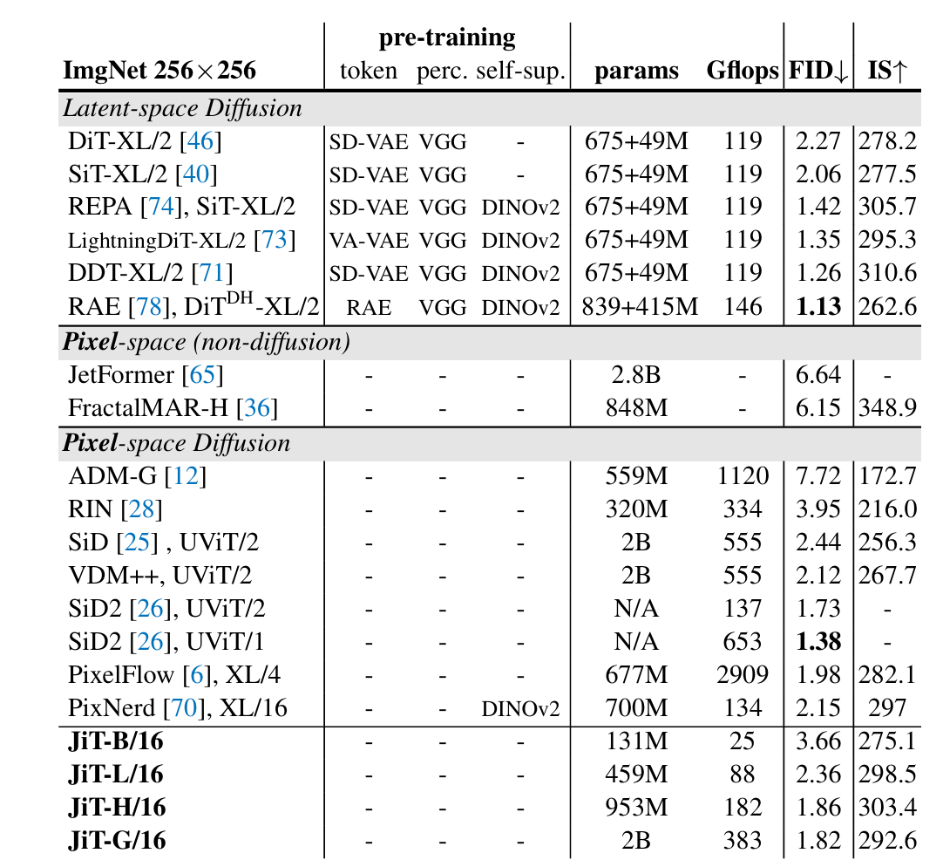
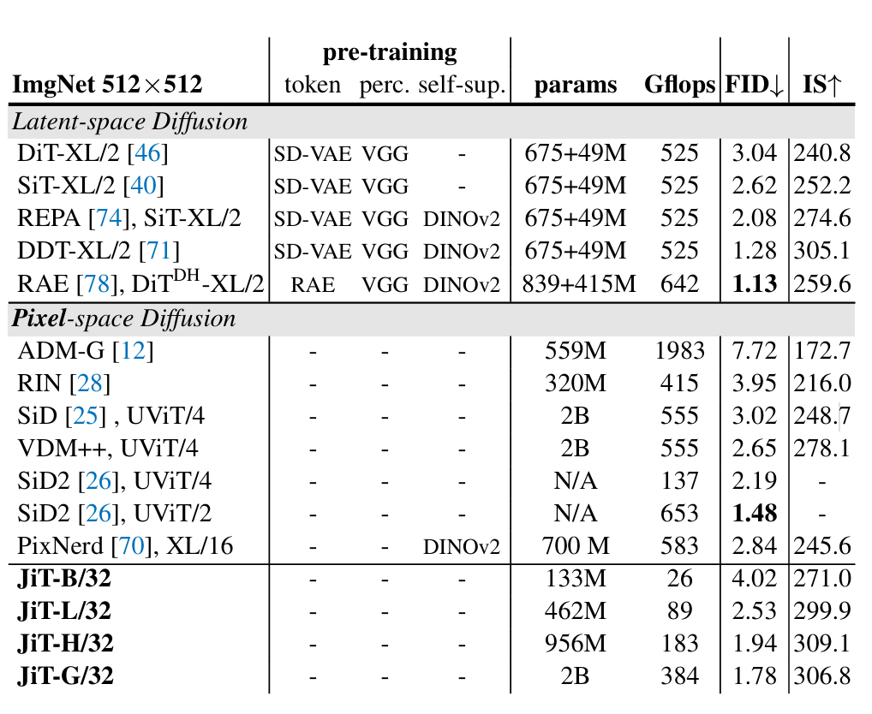
Comparison Results

Slide 18
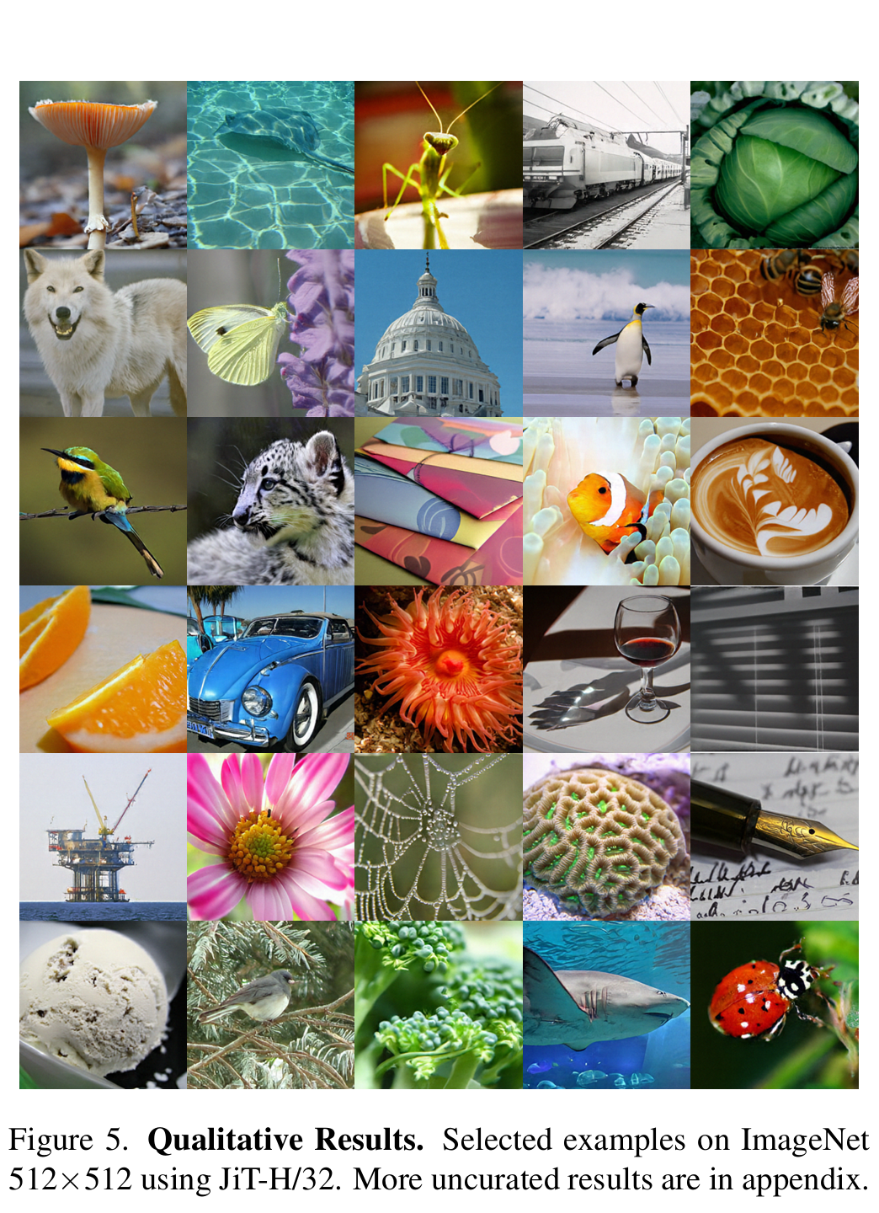
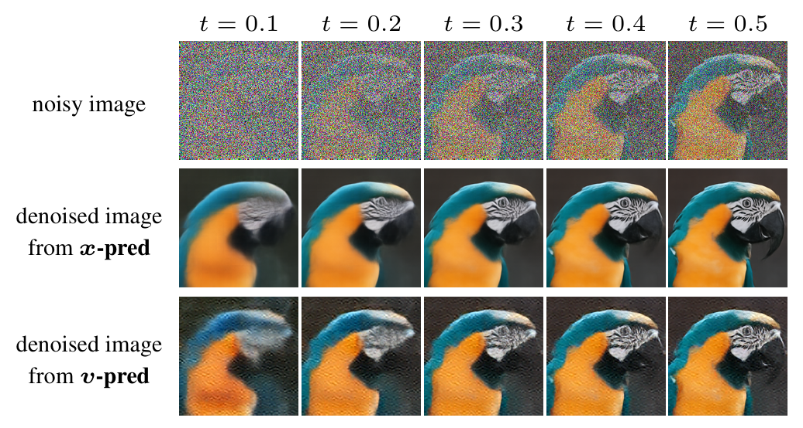
Quantitative Result

Slide 19
Takeaway
High-dim noise regression in diffusion is mathematically Full-Rank
RAE ➔ Capacity Matching utilizing high-dim semantic latents, model width need to scale up with token dim
JiT ➔ Manifold Projection bypass the need to model full noise field by learning a projection back to sparse data manifold

Slide 20
Takeaway
Implication for 3D generation
Sparse Data (e.g., 3D Motion)
  Problem: High-frequency artifacts (jitter/foot-sliding) from noise prediction diffusion.
  Insight: Motion data has extremely Low Intrinsic Dimension.
  ➔ try x-prediction(JiT)-style diffusion?
Dense Data (e.g., 3DGS)
  Problem: Parameter spaces (SH coefficients, Covariance) are high-dimensional
  Insight: Standard Transformers are Rank-Deficient for fitting these dense distributions.
  ➔ try adopt wide & shallow heads?

