Slide 1
SAM3: Segment Anything with Concepts
ICLR Submission
（Code and Demo are not available now）

Slide 2
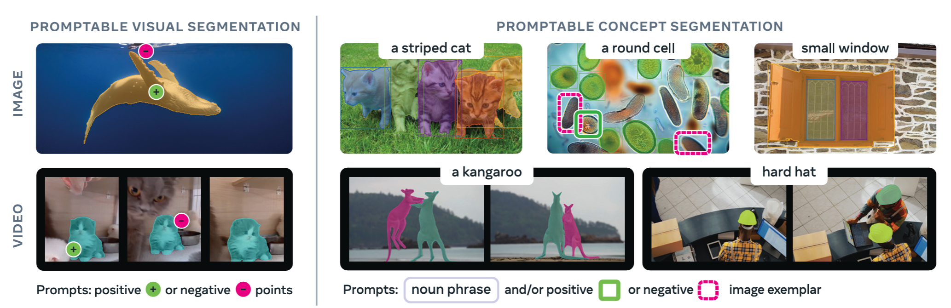
Overview
Present Segment Anything Model 3, which supports object detection, tracking and segmentation with text, referring image or both (term as Promptable Concept Segmentation, PCS).
Build a large-scale benchmark (SA-Co) to support PCS task.

Slide 3
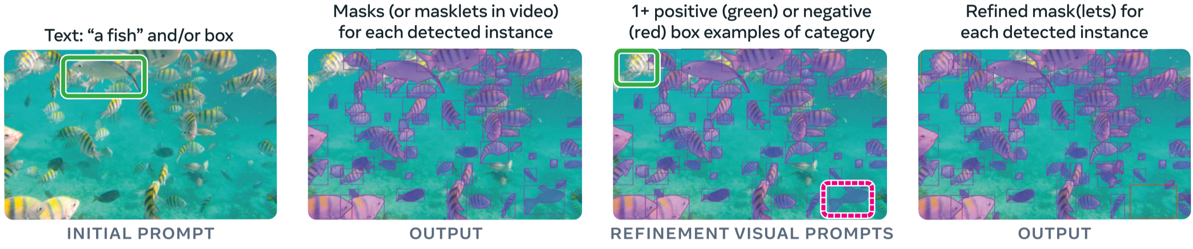
Promptable Concept Segmentation (PCS)
Input: Image or short video (≤30 secs, ~900 frame)
Prompt: Phrase (global) or image examplar(to specific frame) or both
Task: Detection, tracking and segmentation
Text prompt is responsible for concept definition and image template is complement to the text prompt when object is missing or the concept is hard to recognize.

Slide 4
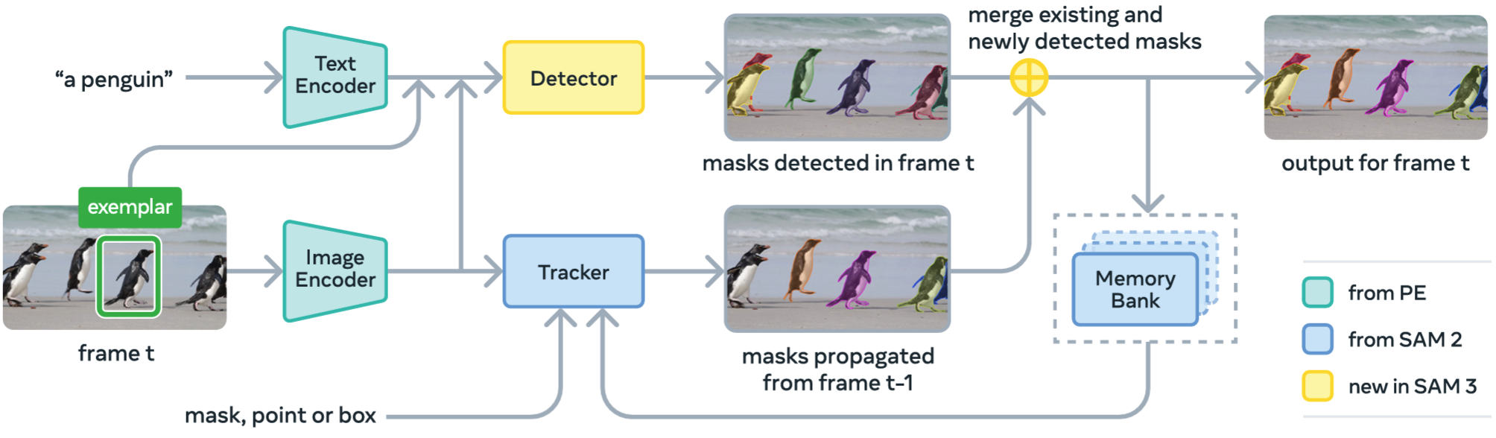
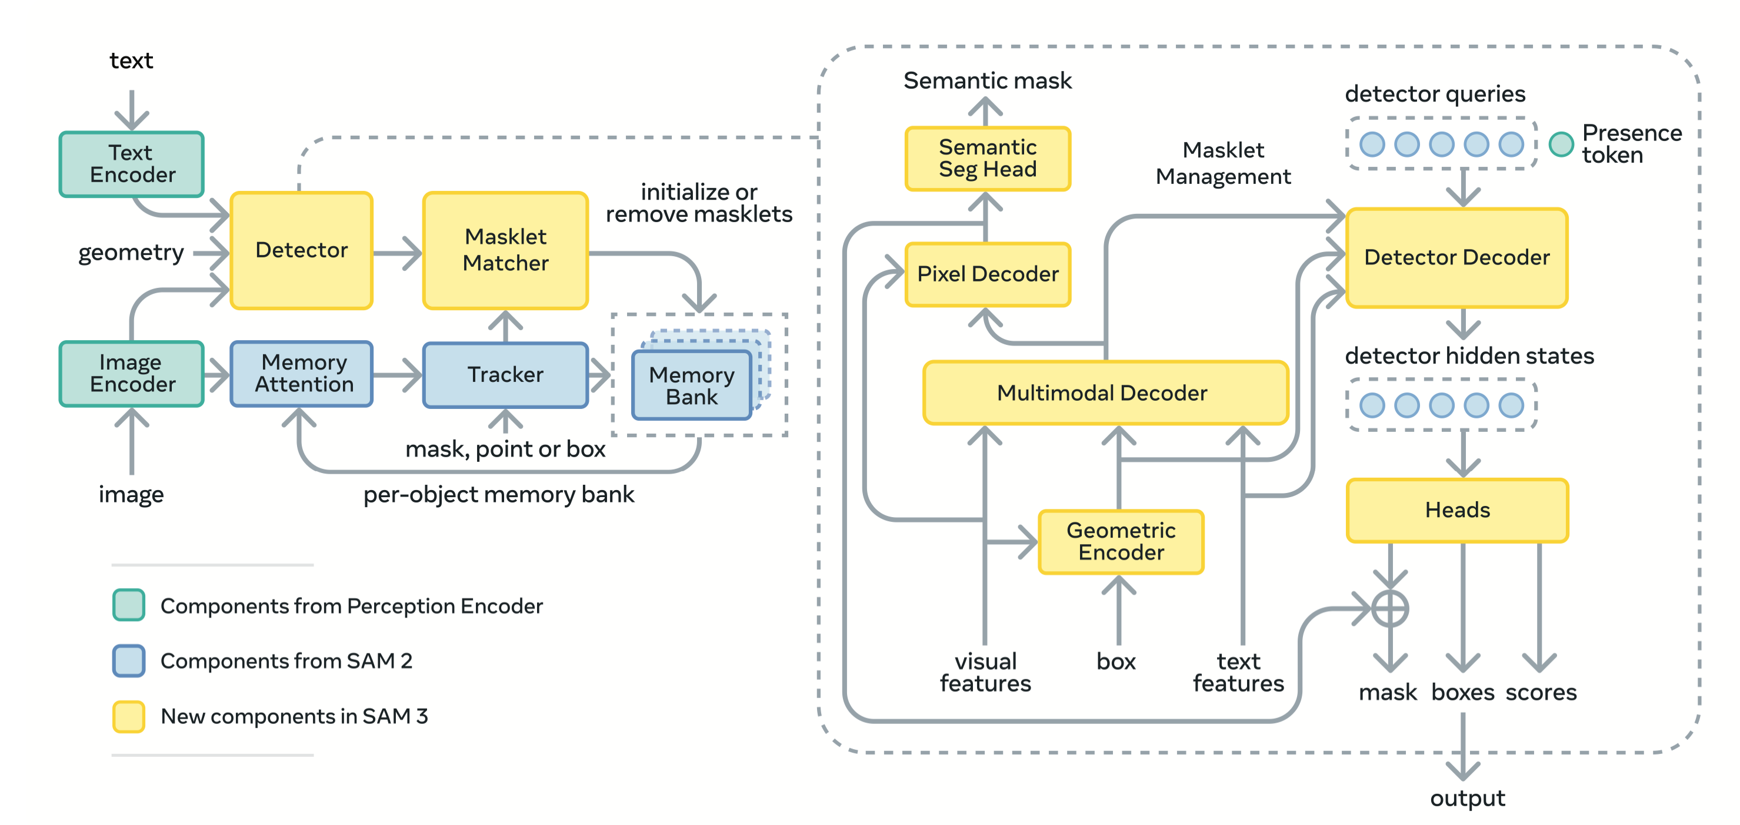
SAM3
SAM3 also follow a tracking-by-detection paradigm.
Detect in current frame: The detector follows DETR framework.
Multi-modal decoder receives all the features from encoders and used for generate both instance mask and semantic mask.
Semantic mask is used for pixel-level classification results.

Slide 5
SAM3
SAM3 also follow a tracking-by-detection paradigm.
Detect in current frame: The detector follows DETR framework.
Presence Token is to detect if the concept is present in the current frame.

Slide 6
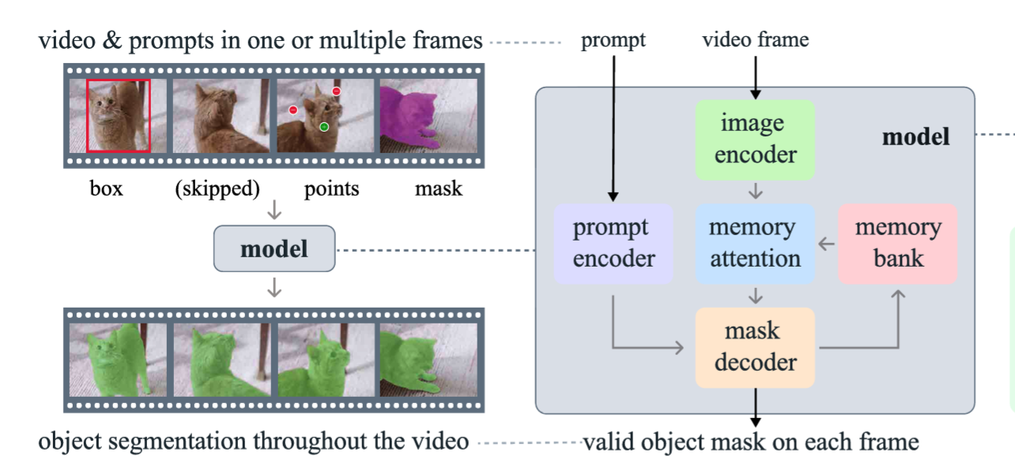
SAM3
SAM3 also follow a tracking-by-detection paradigm.
Detect in current frame
Mask association: It utilizes a SAM2-like model to perform promptable visual segmentation.

Slide 7
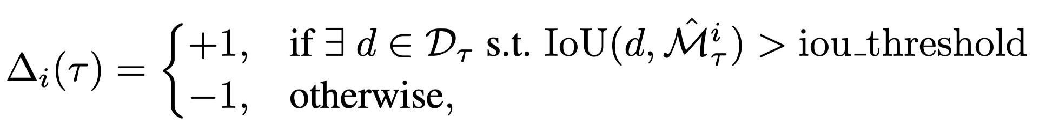
SAM3
SAM3 also follow a tracking-by-detection paradigm.
Detect in current frame
Mask association
Mask refinement: The current mask and previous masklet are matched via IoU.
Once matched, current mask prompted by phrase or examplar are used to refine the results from tracker.

Slide 8
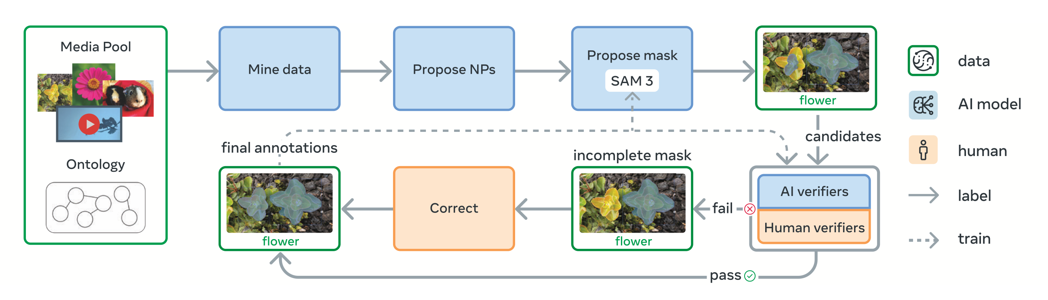
SA-Co Dataset
Human/model-in-loop data engine:
AI model is used to select the video and exploit the existing noun phrase (category) in the data.
SAM3 model is used to generate the mask, which belongs to the noun phrase.
Human is involved to verify and correct the mask.
Image Training set: 5.2M image and 4M unique NPs
Video Training set: 52.5K video and 24.8K unique NPs
Evaluation set:126K images and videos, 214K unique phrases.
Providing massive image/video-mask pairs for training

Slide 9
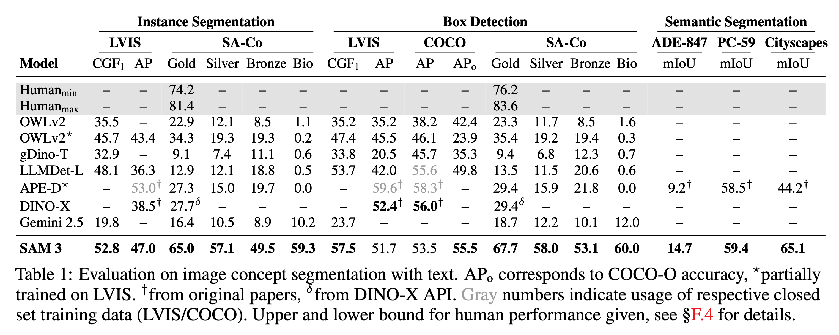
Experimental results
Results on various tasks with text prompt
With only a text prompt, SAM3 can achieve near human performance on Instance segmentation, Semantic segmentation and open-vocabulary detection.

Slide 10
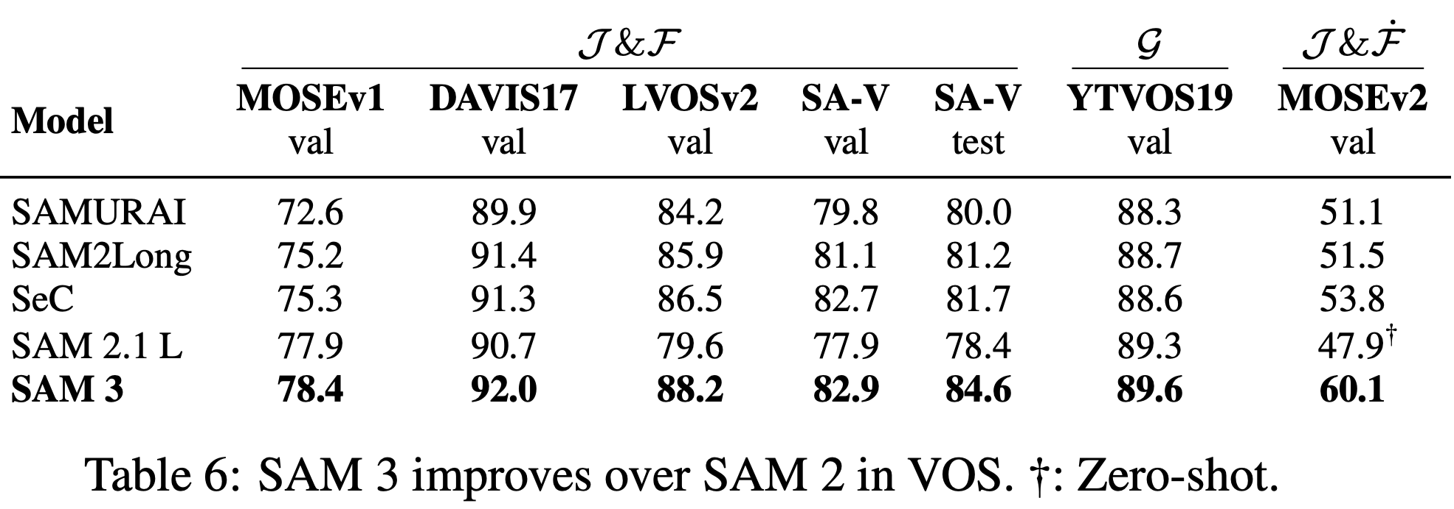
Experimental results
Compared with SAM2, SAM3 also obtains better performance on VOS, achieving better segmentation ability.
(which could be a great tool for generating ground truth.)
[Not friendly for laboratory usage]: generating mask for 10 objects needs 2 H200s (282G memory!)

Slide 11
Conclusion
SAM3 = SAM2 + Open-vocabulary detector (general encoder + detector decoder)
The mask association process can be optimized by replacing the huge SAM2 model.
(In the future, I may check why SAM3 utilize SAM2 as tracker.)
Serve as a strong annotator for downstream tasks.

