Slide 1
Journal Club
Yilin Wang
25/10/08

Slide 2
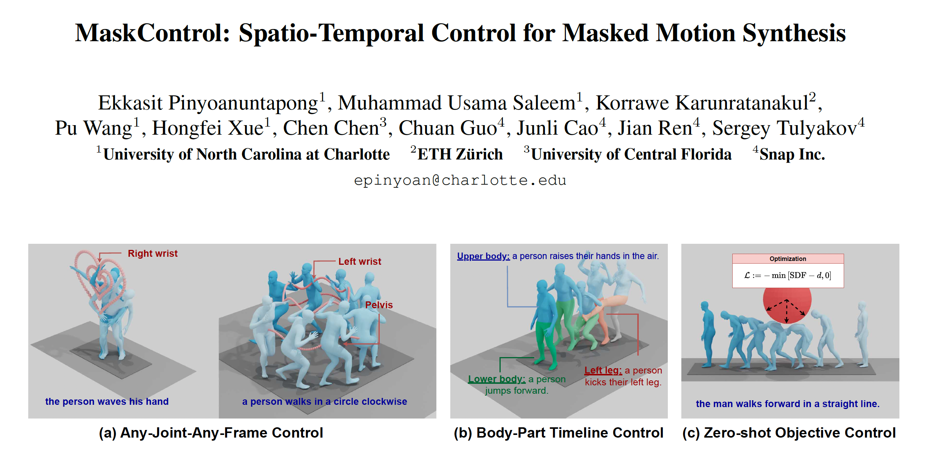

Slide 3


Task Definition
Control Signal
Text Prompt W
Joint Control Signal S
si specifies the targeted 3D coordinates of the joints to be controlled, among the total j joints, while joints that are not controlled are zeroed out.
Output
Motion sequence
Following the instruction from text prompt, while joint positions aligning with the joint control signal at each frame

Slide 4
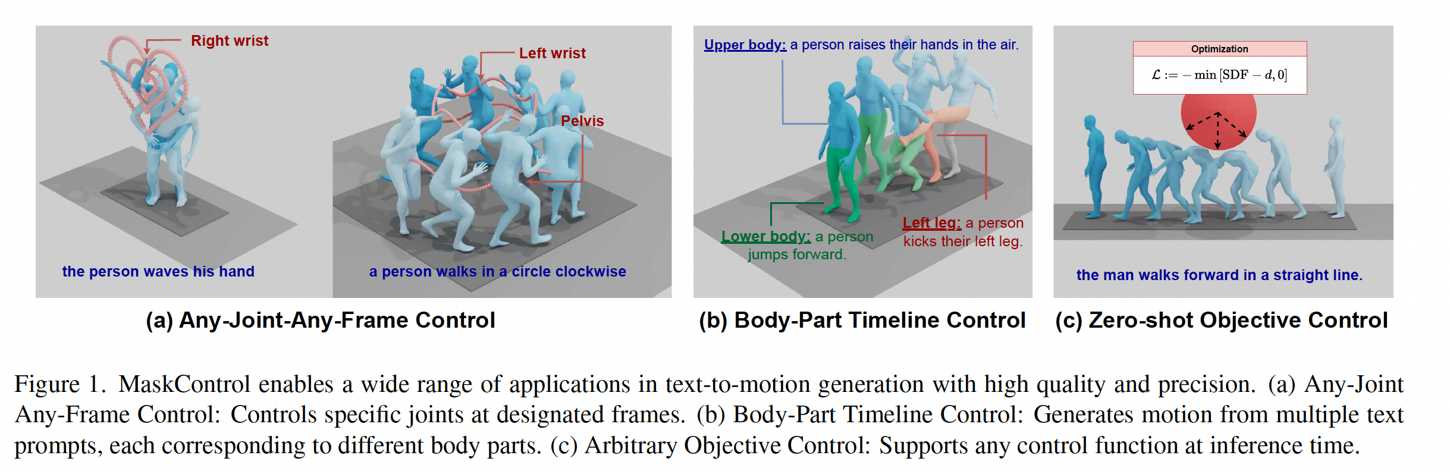
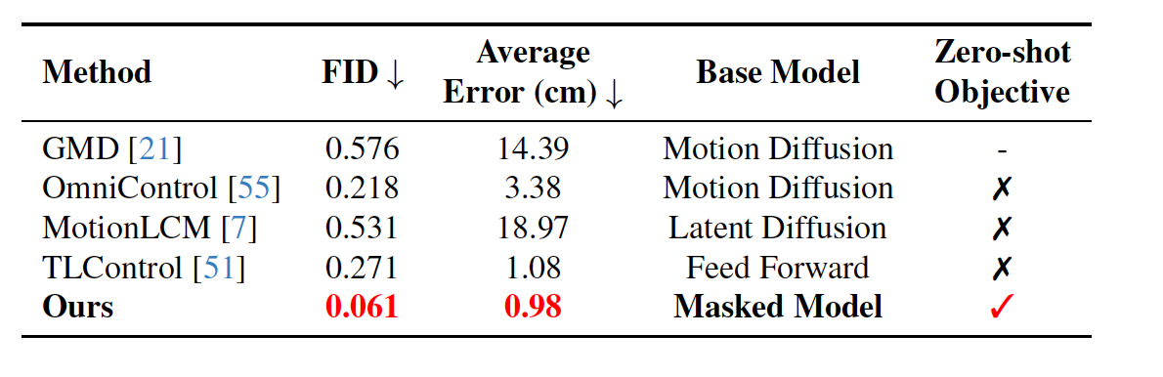
Motivation
High precision control while maintaining high quality motion generation
“Differentiablize” masked motion model
Directly correlate the discrete motion token distribution in latent space with continuous spatial-temporal control signals in motion space

Slide 5
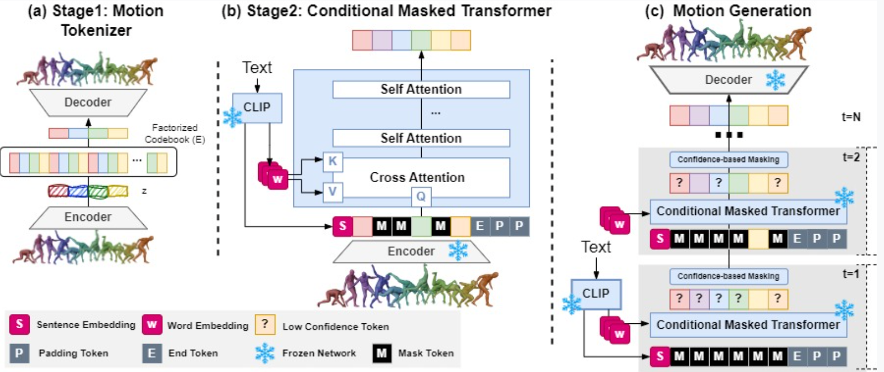

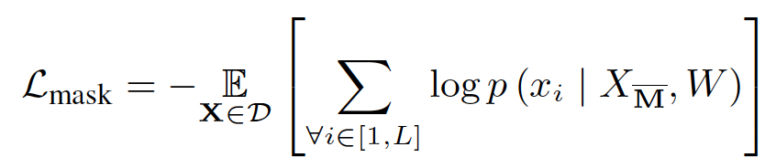
Preliminary
Masked Text-to-Motion Model
First stage: Motion Tokenizer
Learn a discrete representation of motion by quantizing the encoder’s output embedding to a codebook, typically through VQ-VAE
Second stage: Text-conditioned Masked Transformer
The quantized motion token sequence is updated with [MASK] tokens to form the corrupted motion token sequence
[MASK] tokens are predicted by a motion token classifier, typically based on the Transformer backbone

Slide 6
Preliminary
Why high precision control fails when naively applying current masked motion model ?
Mask transformer trained on predicting motion tokens directly, which limits fine-grained spatial-temporal controllability
Mapping motion tokens back to motion sequences is non-differentiable

Slide 7
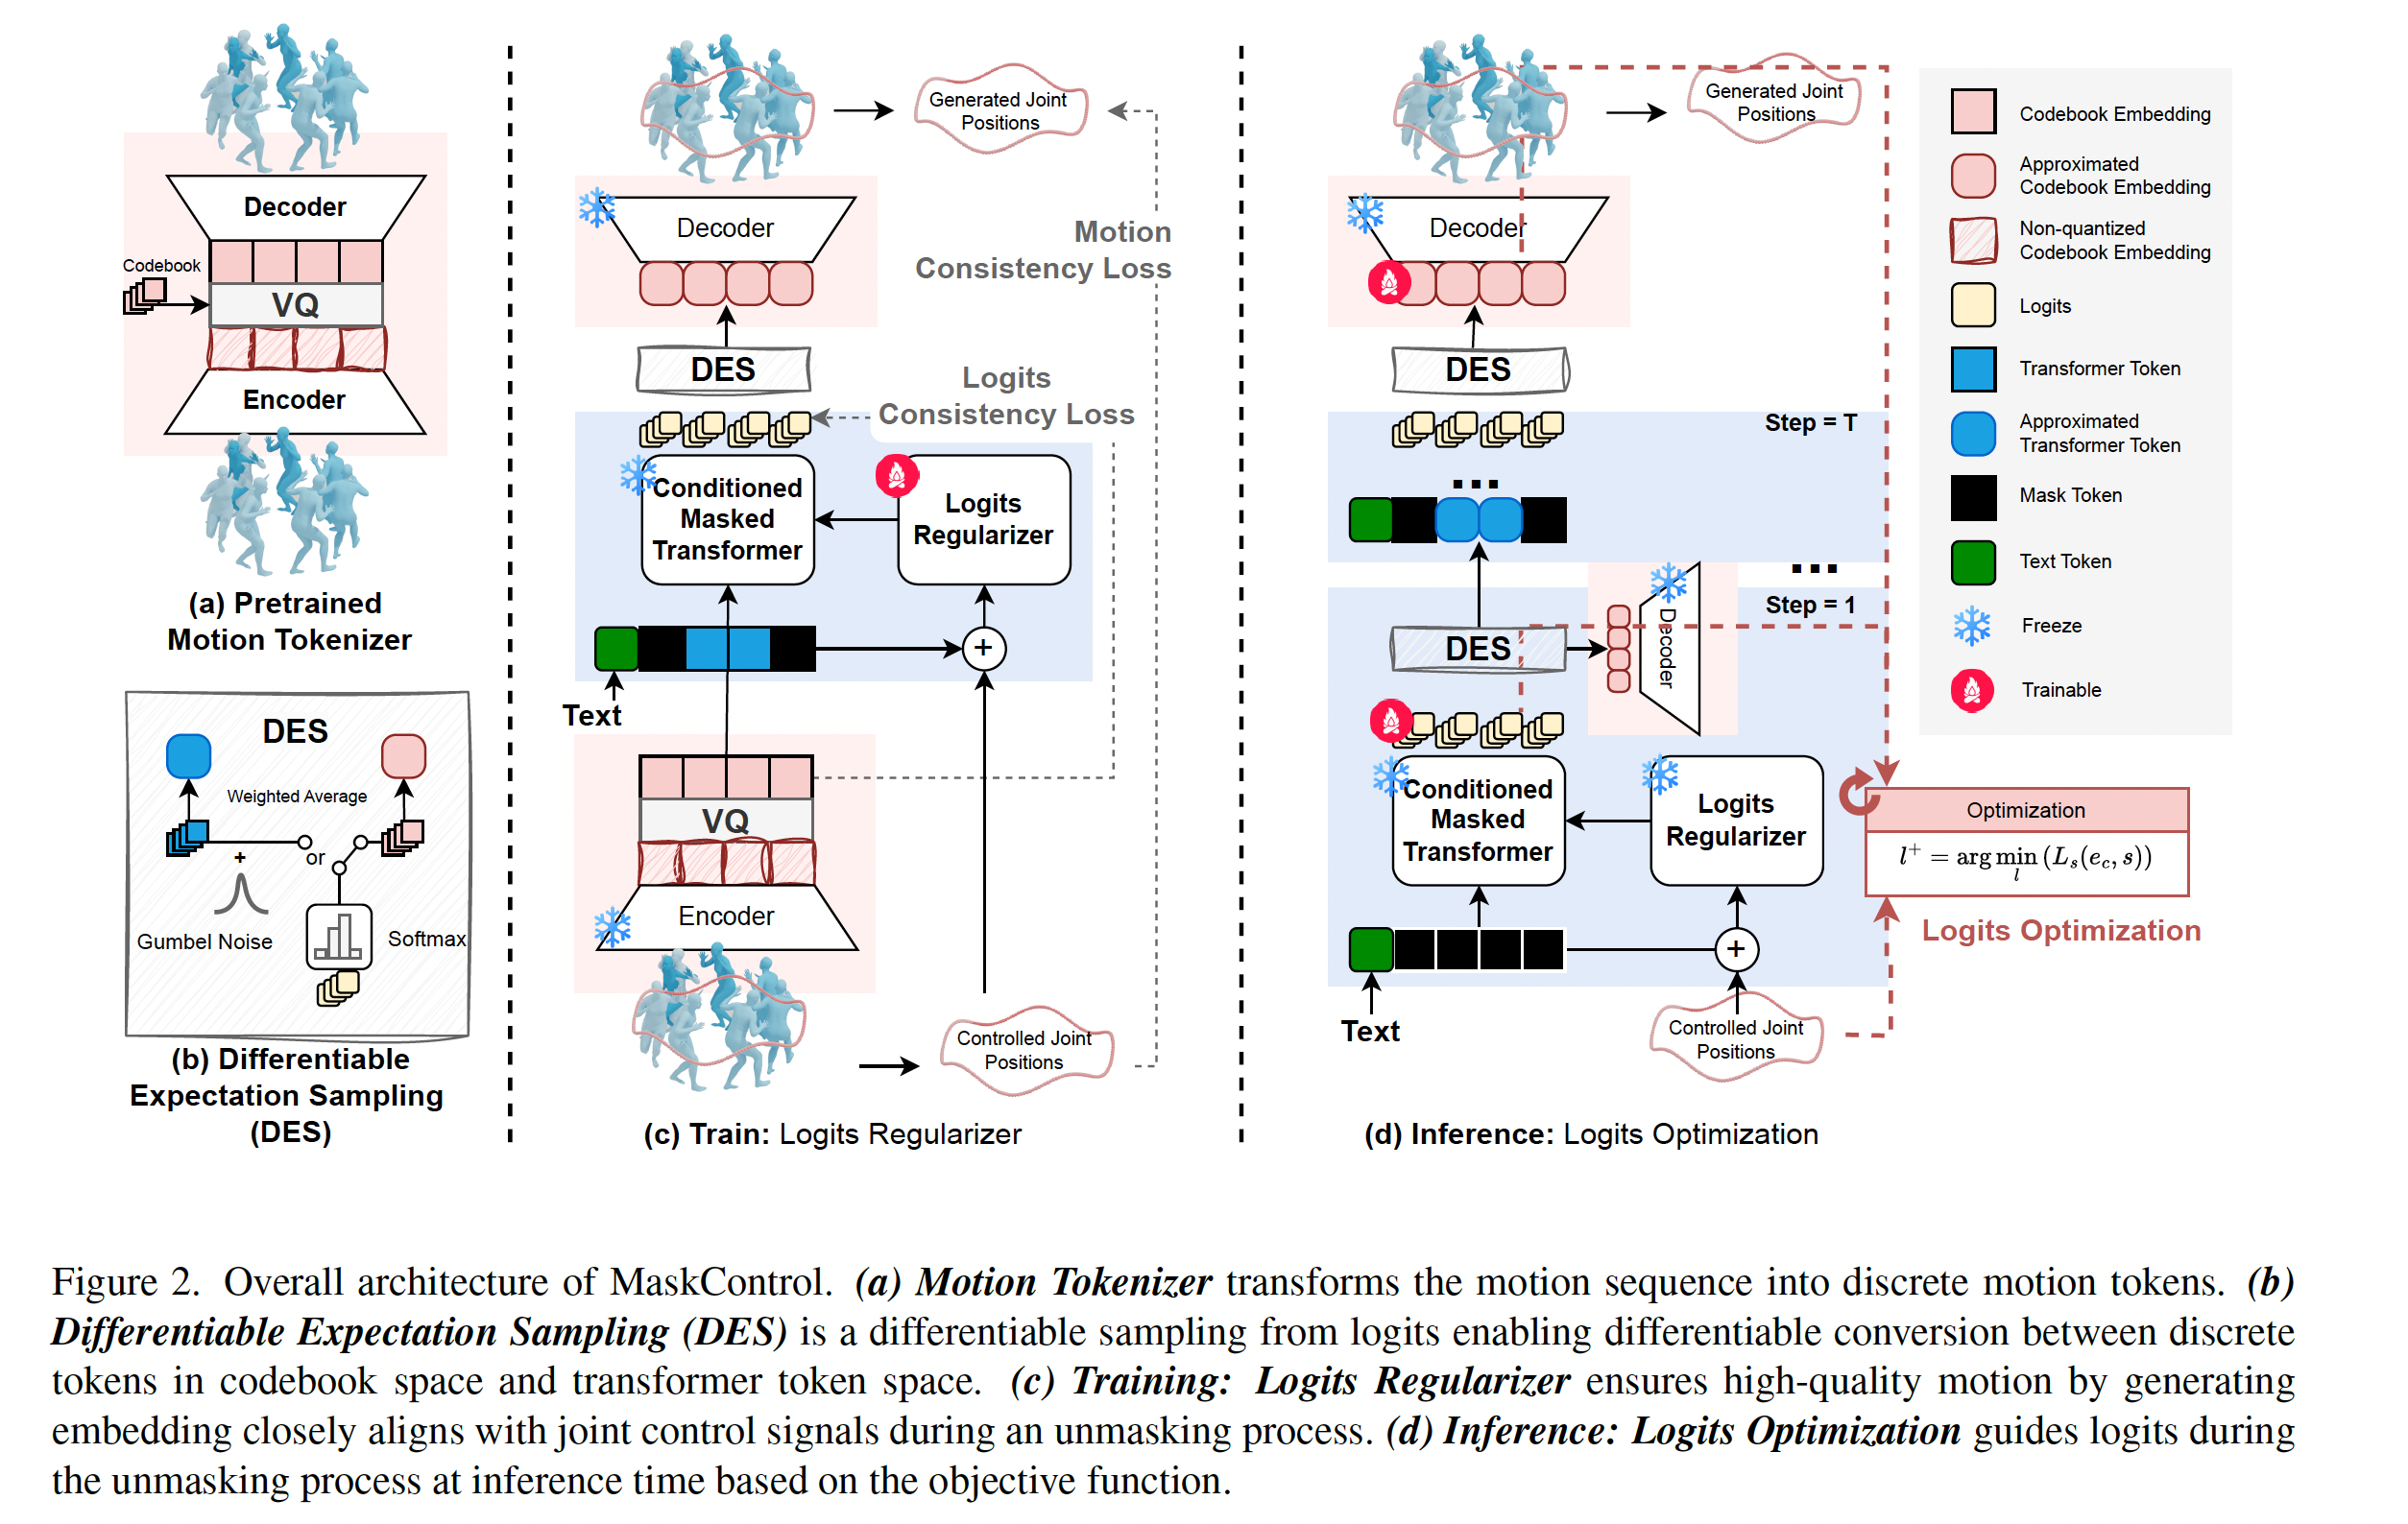
Method

Slide 8
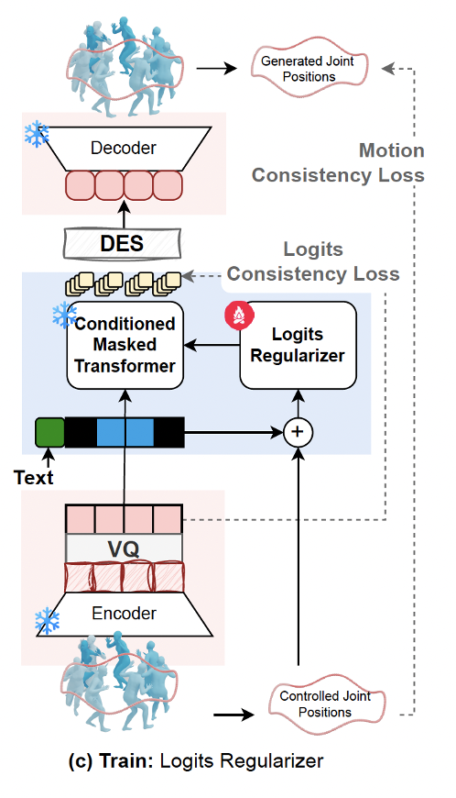
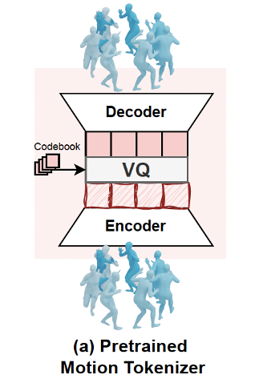
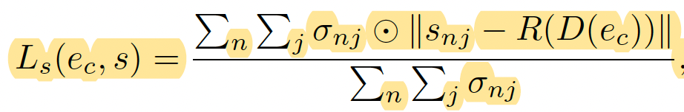
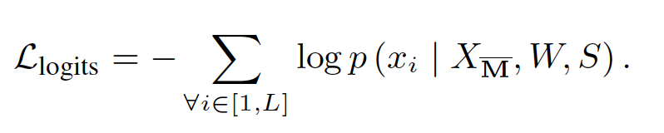
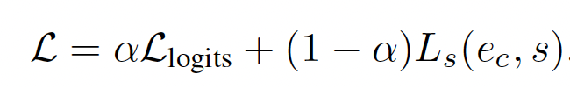
Method
Training Phase
A Strong Pretrained T2M Prior
Logits Regularizer
Trainable copy of pretrained prior, zero-initialized
Motion Consistency Loss
Logits Consistency Loss

Slide 9
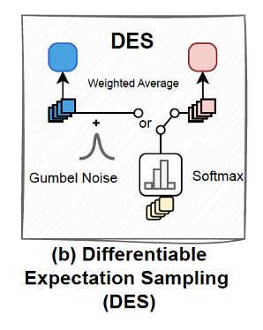
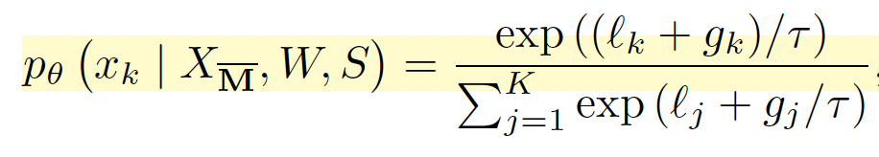
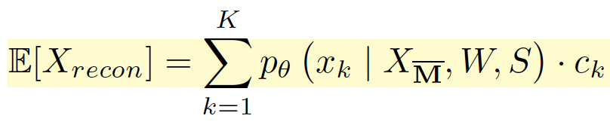
Method
Training Phase
A Strong Pretrained T2M Prior
Logits Regularizer
DES
Relaxing constraints of argmax() selection through:
Gumbel-Softmax
Weighted average of codebook embeddings

Slide 10
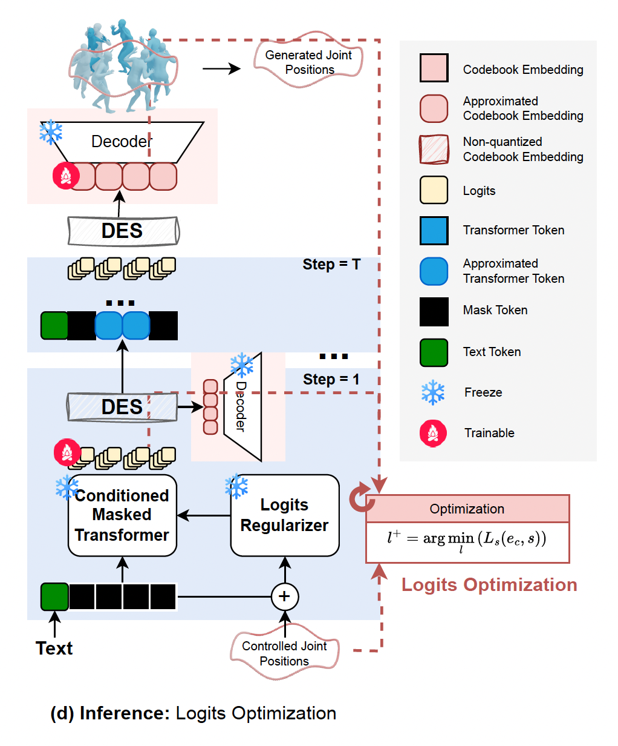
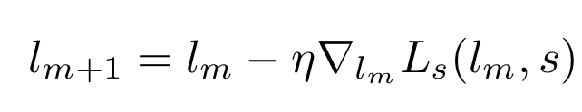

Method
Inference Phase
Logits Optimization
Logits are updated iteratively by optimizing motion consistency loss
For zero-shot objective control, the Ls can be arbitrary function

Slide 11
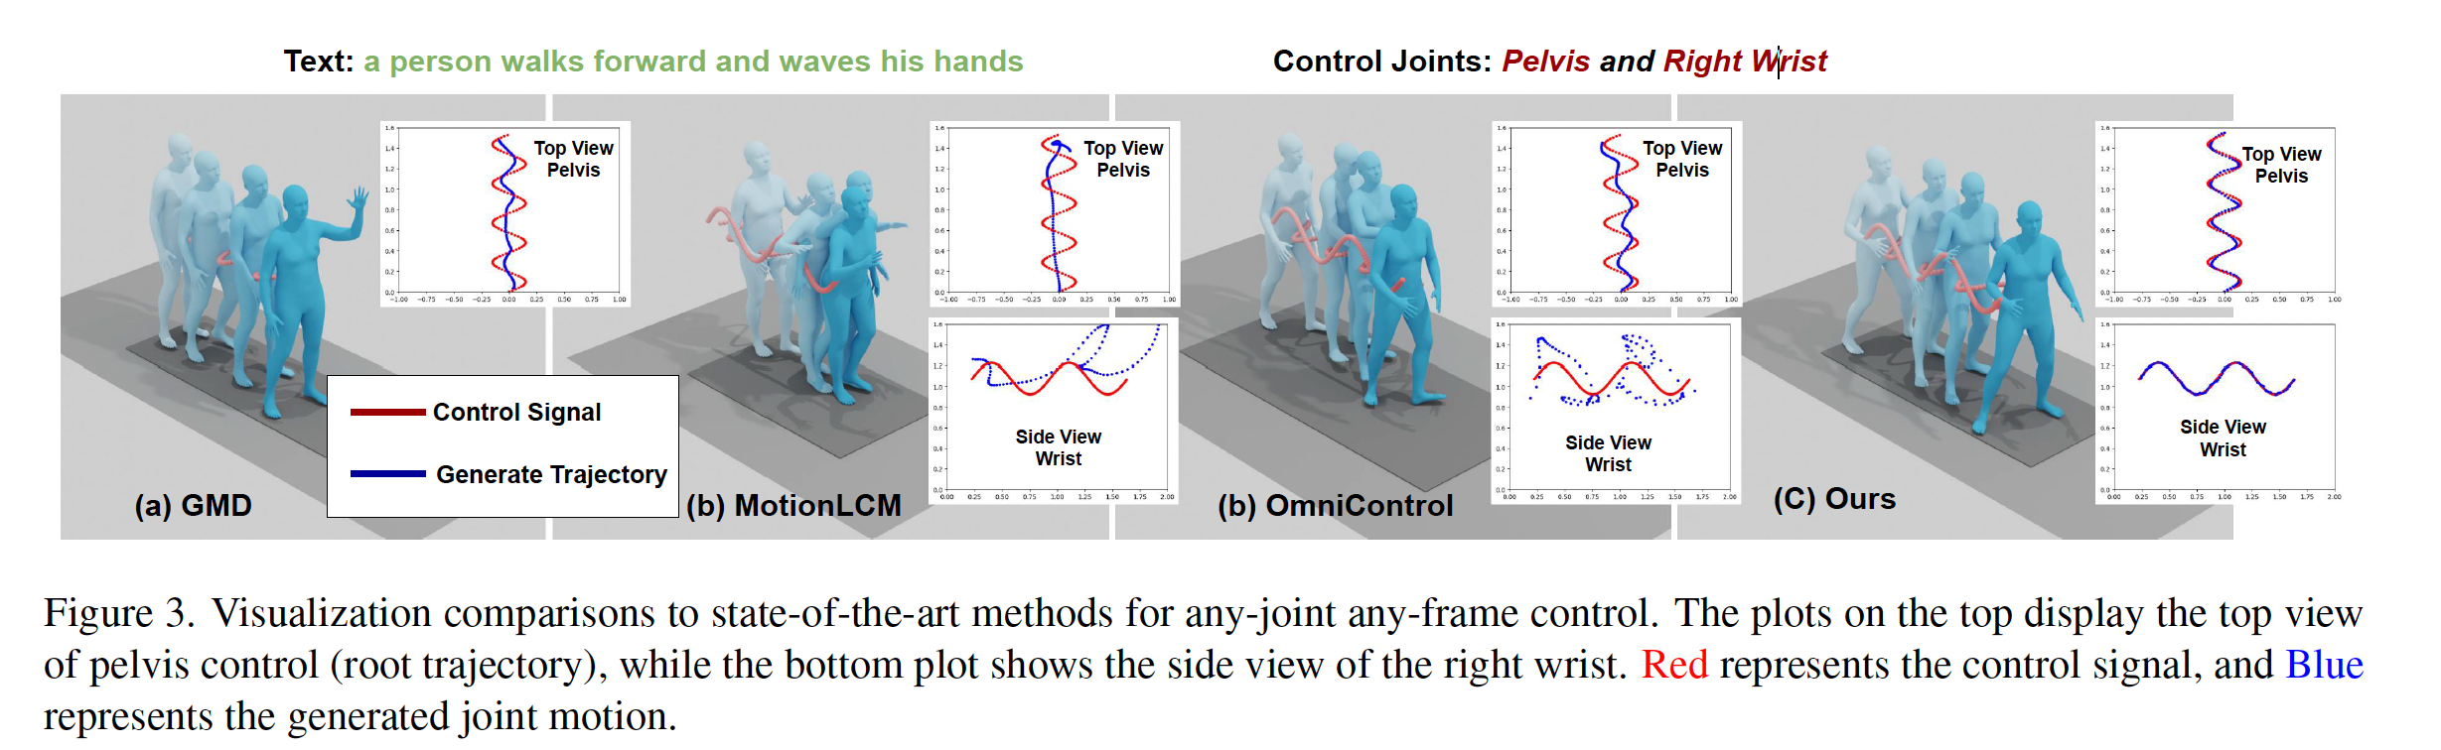
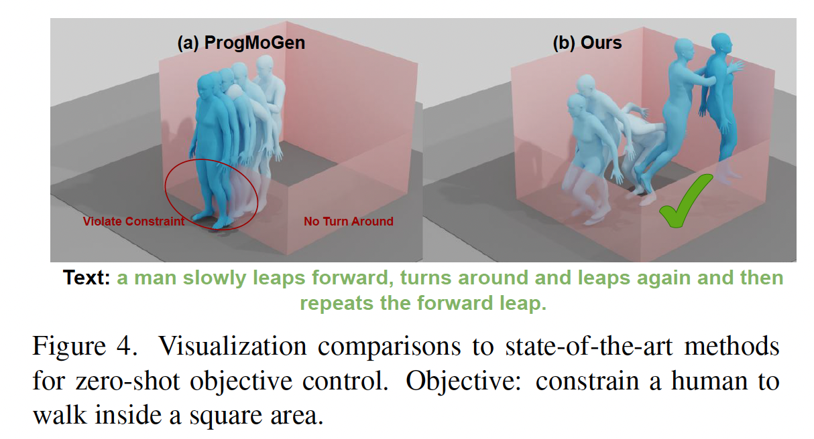
Evaluation
Demo website:
https://www.ekkasit.com/ControlMM-page/

Slide 12
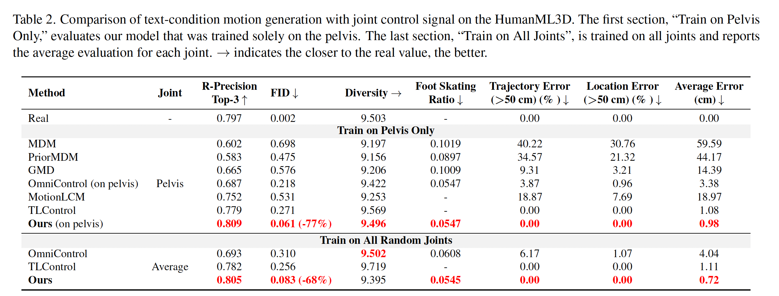
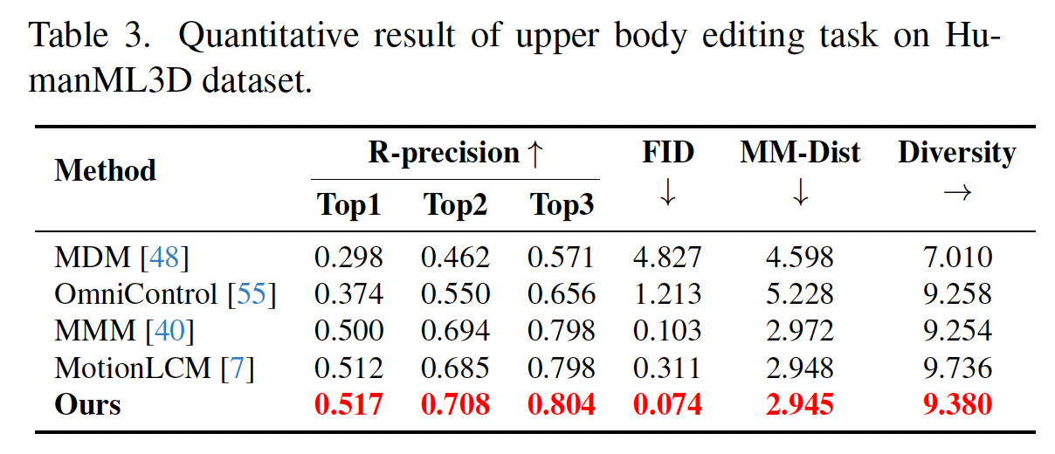
Evaluation

Slide 13
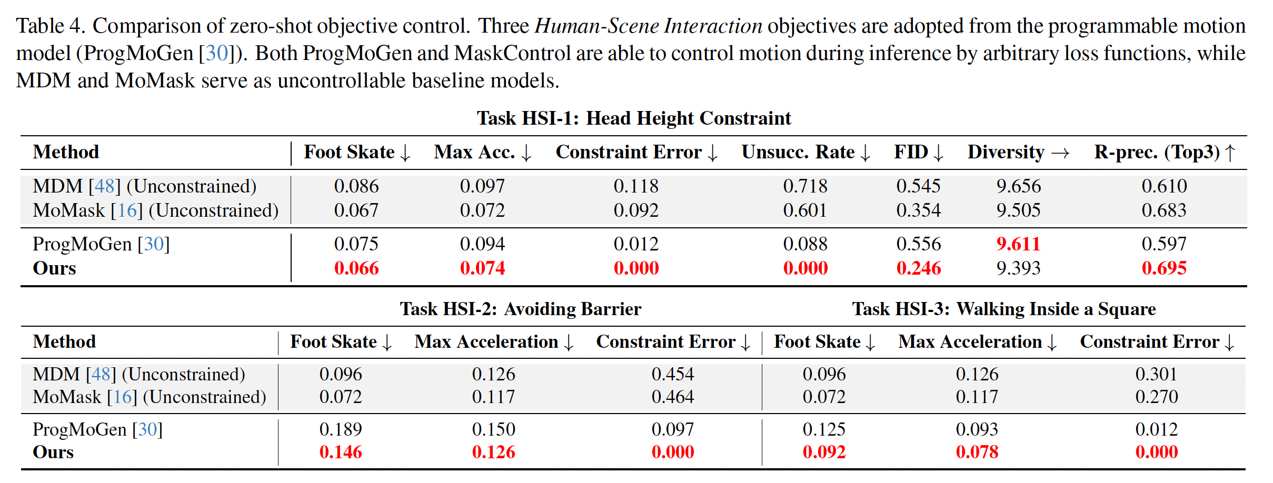
Evaluation

Slide 14
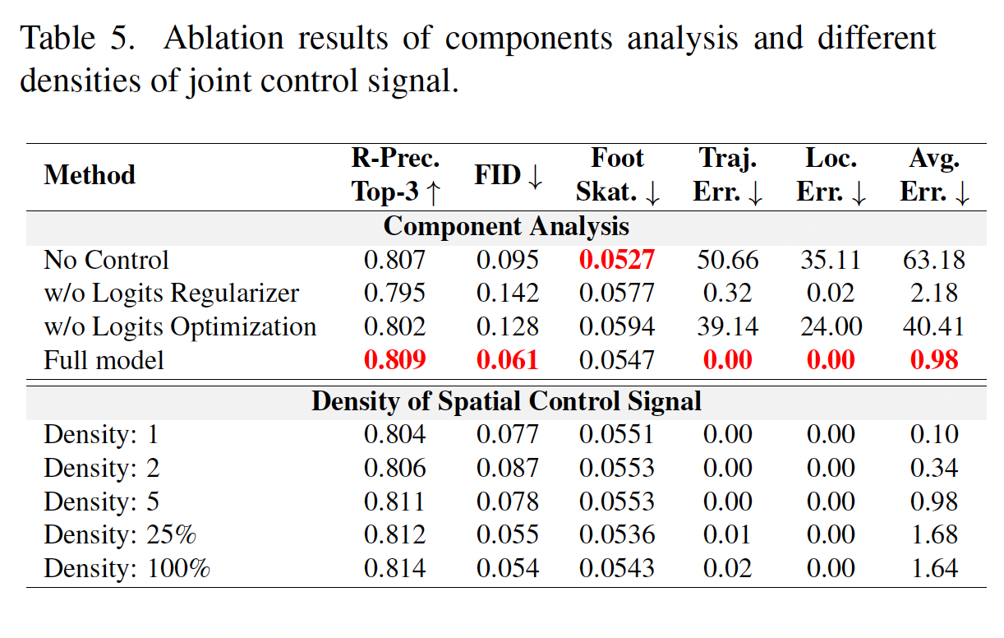
Evaluation
Without Logits Regularizer
FID drops dramatically
Without Logits Optimization
Average Joint Error significantly worsens

Slide 15
Takeaway
Spatial-Temporal control for motion gains most benefit from optimizing constraint loss directly on motion space
Differentiable querying of the codebook embeddings enhances the controllabiliy of mask motion models

