Slide 1
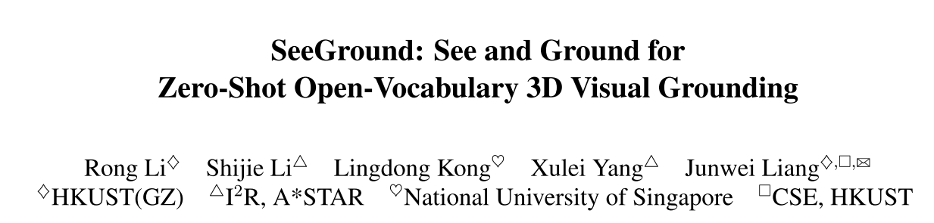
CVPR 25

Slide 2
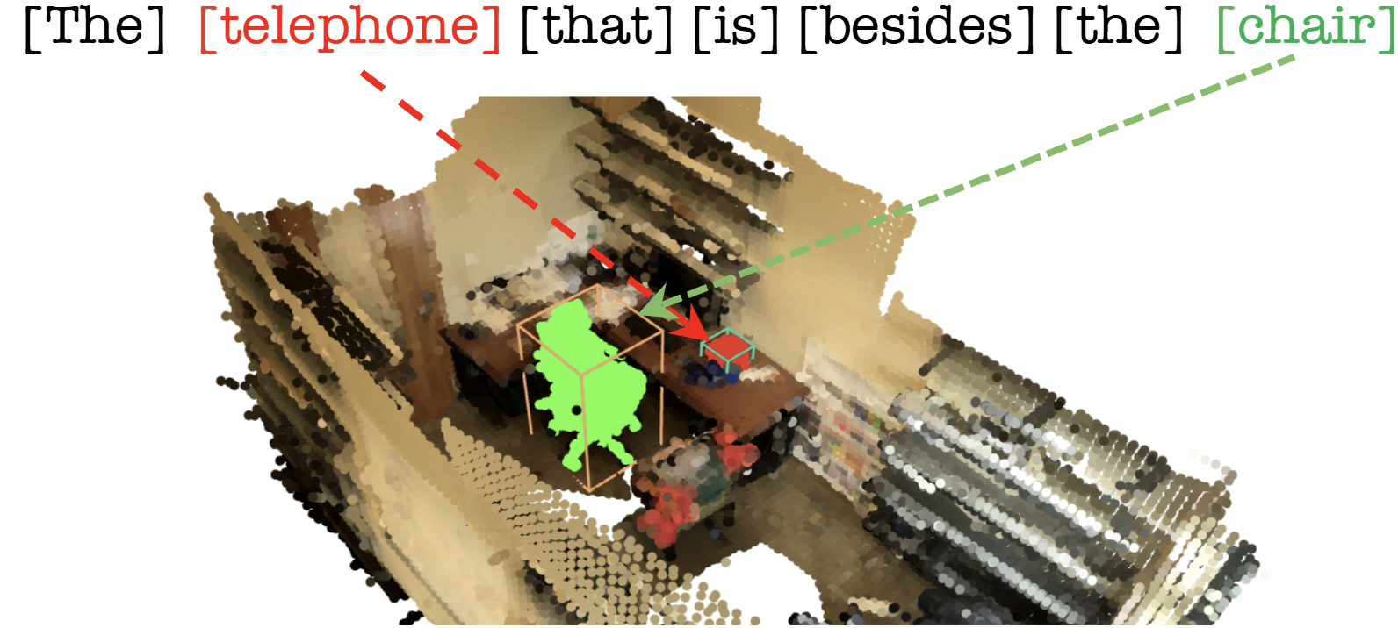
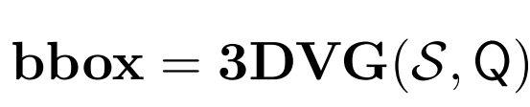
Preliminary: 3D Visual Grounding
3D Visual Grounding: Find the target object in a 3D scene using a natural-language description.
Applications: Robotics, autonomous navigation, augmented reality, and scene understanding.

Slide 3
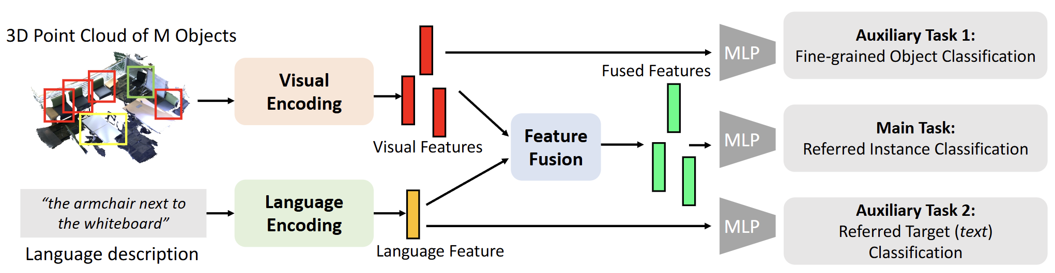
Limitations of Previous 3DVG Methods
Referit3d ECCV 2020
Previous Works: Treat 3DVG as a supervised task on limited datasets.
Problem: Poor generalization to real-world scenes.
.

Slide 4
2D Visual Grounding Models
2D models like Grounding-SAM and Qwen-VL have achieved strong results in open-vocabulary object detection.
Problem: These models struggle with full 3D scenes or multi-object spatial reasoning.
Question: How can we extend powerful 2D VLMs to understand and ground objects in 3D environments?

Slide 5
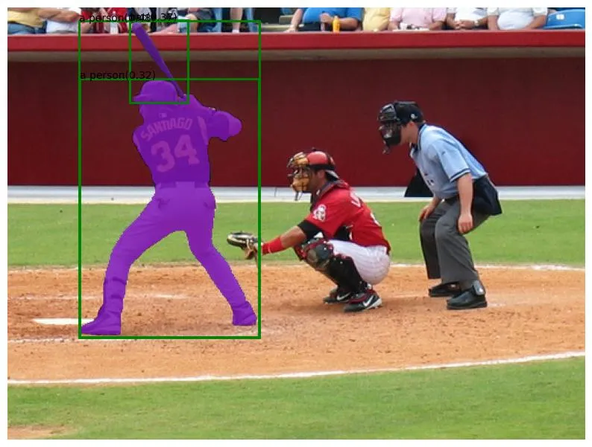
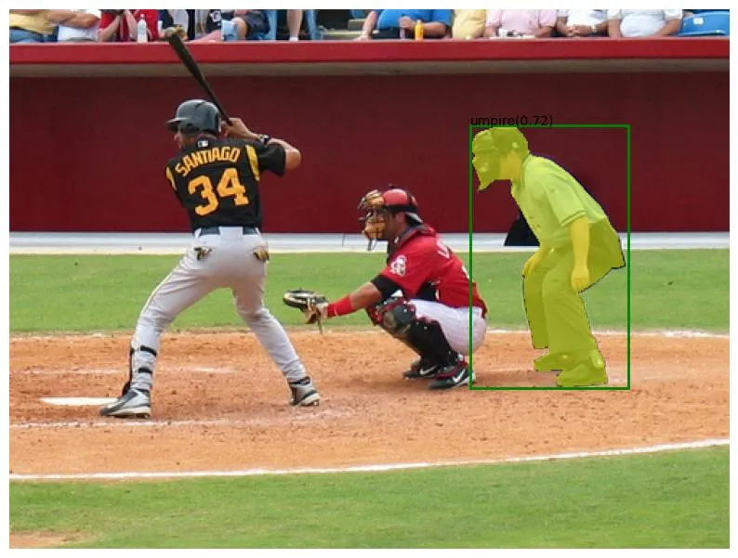
2D Visual Grounding Models
Prompt: A person holding a bat.
Prompt: A person behind the catcher.
2D models like Grounding-SAM and Qwen-VL have achieved strong results in open-vocabulary object detection.
Problem: These models struggle with full 3D scenes or multi-object spatial reasoning.
Question: How can we extend powerful 2D VLMs to understand and ground objects in 3D environments?

Slide 6
SeeGround
A training-free zero shot 3DVG method leveraging 2D VLMs.
Zero- Shot Methodology
  Build an object lookup table using open-vocabulary 3D detection.
  Use the 3D spatial query to render a suitable 2D view.
  Ground the target object in the rendered frame.
  Map the grounded 2D object back to its 3D match in the lookup table.

Slide 7
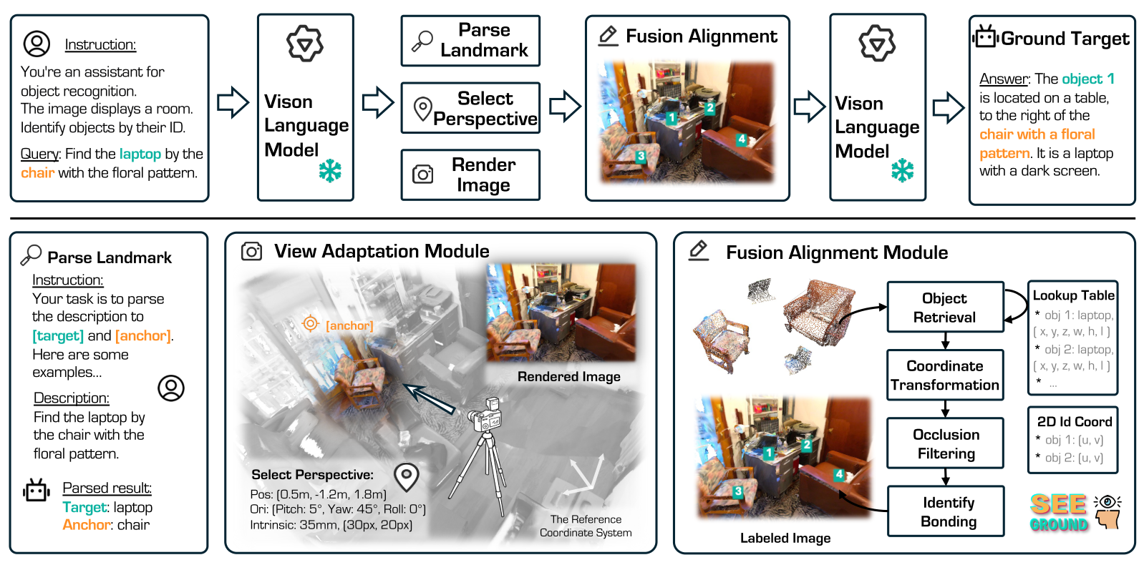
SeeGrounder Pipeline: Big Picture

Slide 8
Methodology

Slide 9


Building “Spatial Rich” 3D look up table
Build Object Lookup Table (OLT):
  Use an open-vocabulary 3D detector on scene S to get bounding boxes and semantic labels.
  Store objects with spatial attributes like position and size for later reference.
Enhance with Visual Information:
  Render 2D views of the scene to capture texture, color, and geometry.
  Combine visual and spatial data for a richer 3D representation.

Slide 10
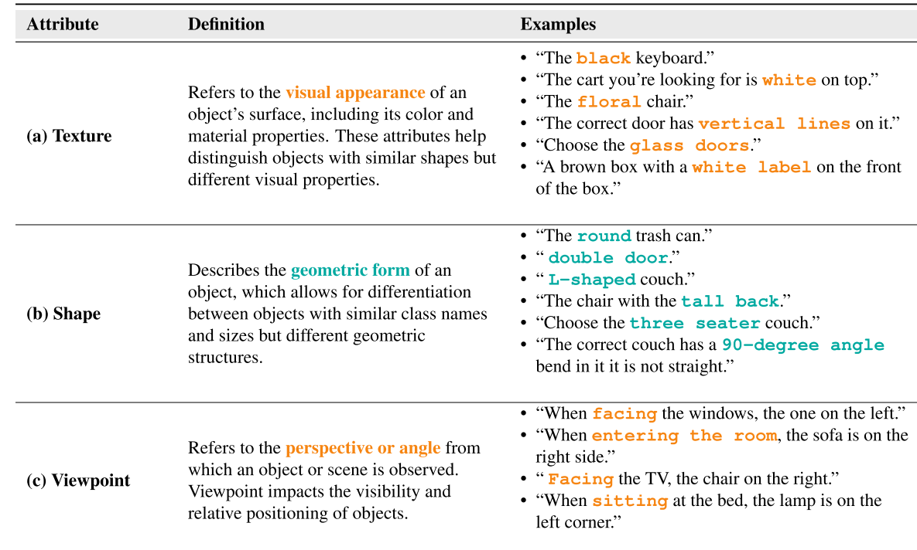
Semantic features Example

Slide 11
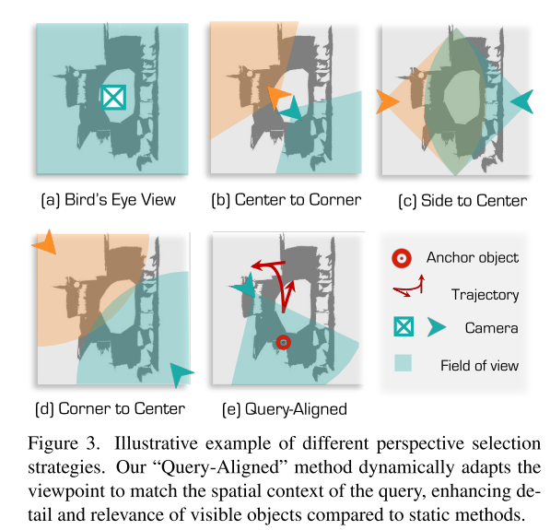
Query-Aligned Image Rendering
Different fixed viewpoints (bird’s-eye, corner, or object-centered) capture only parts of the scene.
Bird’s-eye view shows layout but lacks object details and depth.
Corner or object-centered views miss global spatial context.

Slide 12
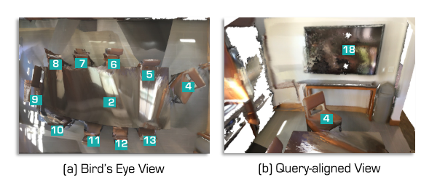
Query-Aligned Image Rendering
Query: “Find the chair in front of the TV.”
First, use the VLM to identify the Anchor object (A) = table and Target object (O) = chair. (Example prompt shown next slide)
Use the anchor object to select a query-aligned viewpoint, positioning the camera to capture both objects clearly.
Render a 2D image from this view for accurate grounding aligned with the query’s spatial description.

Slide 13
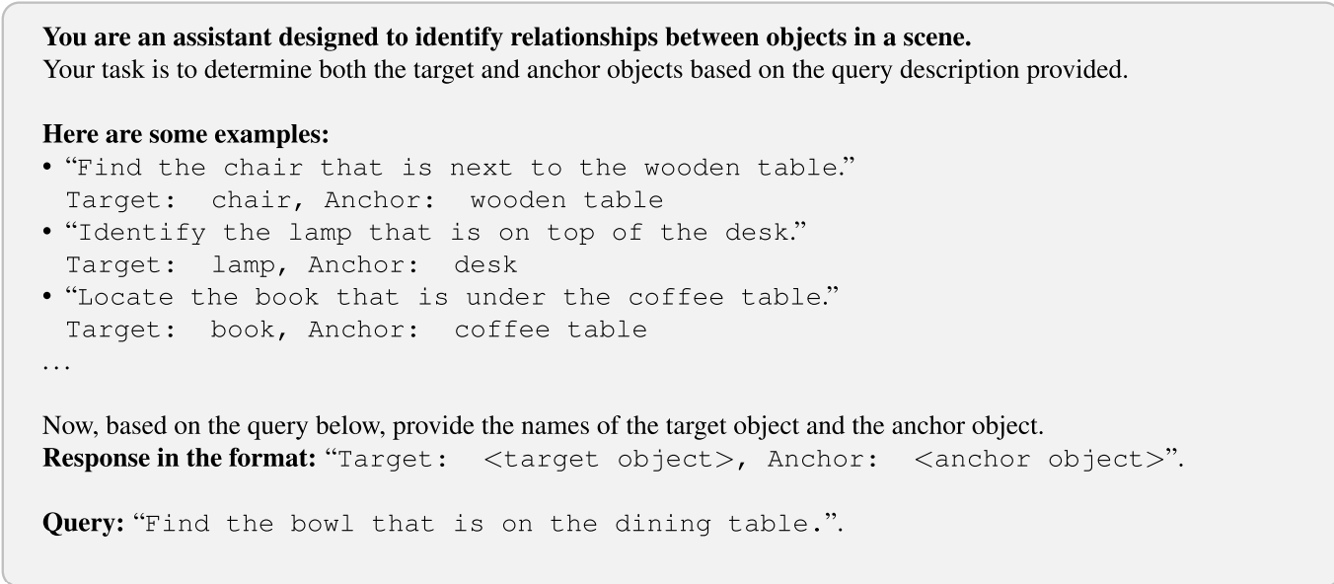
VLM to select Anchor and Target Object using VLM

Slide 14
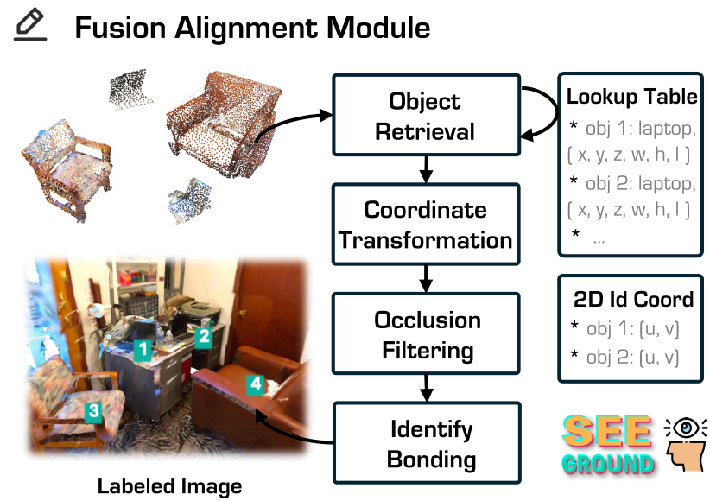
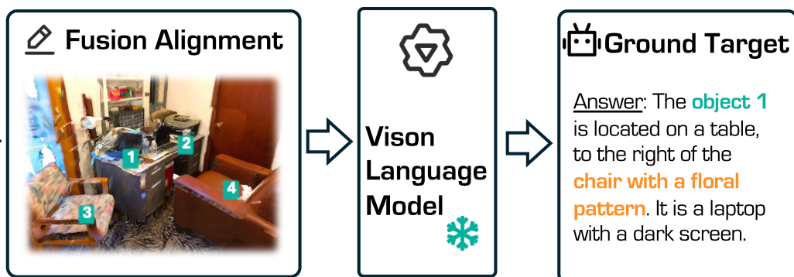
Fusion Alignment Model

Slide 15
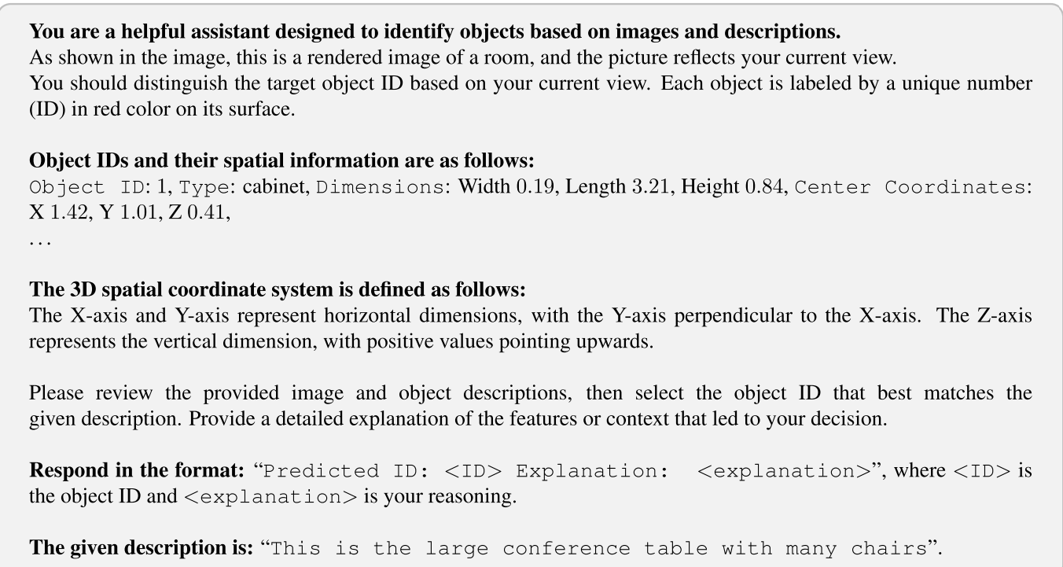
VLM Prompt for 3D Visual Grounding

Slide 16
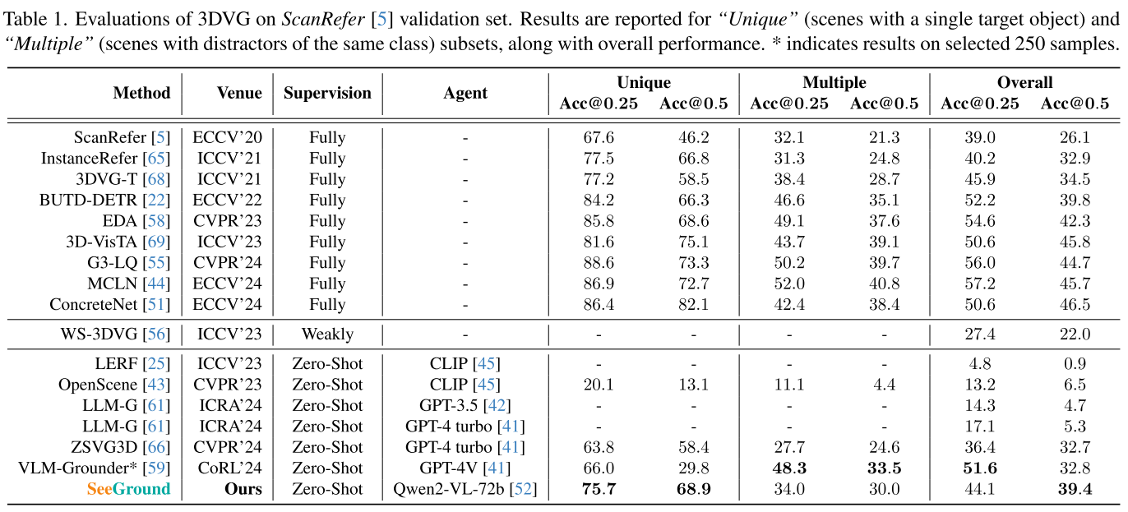
Quantitative Analysis

Slide 17
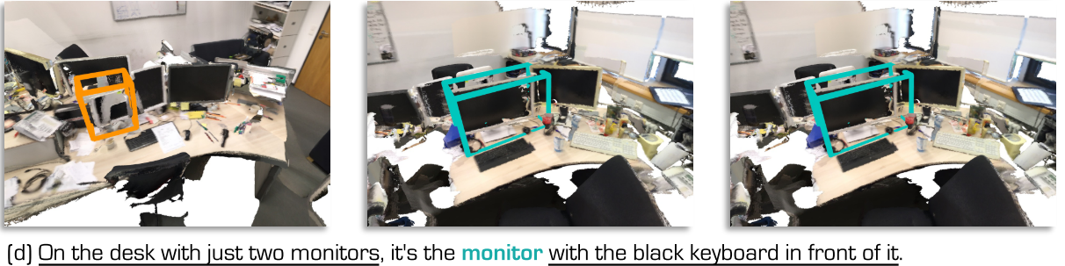
Qualitative Analysis

Slide 18
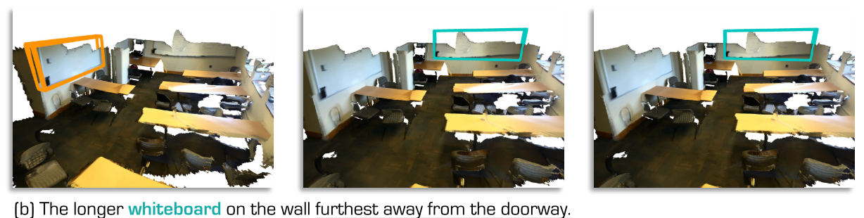
Qualitative Analysis

Slide 19
Conclusion
The paper shows that zero-shot 3D visual grounding is feasible and achieves results comparable to fully supervised approaches.
However, it still relies on region detection models trained on scene-specific data, which questions whether the method is truly zero-shot.

Slide 20
TakeAways
Zero-shot 3DVG can be adapted to Gaussian Splatting representations for efficient scene understanding.
Rendered masks in 3DGS remove the need for external region detectors, enabling a more direct and scalable approach.

Slide 21
Thank you for listening.

Slide 22
Methodology:

