Slide 1
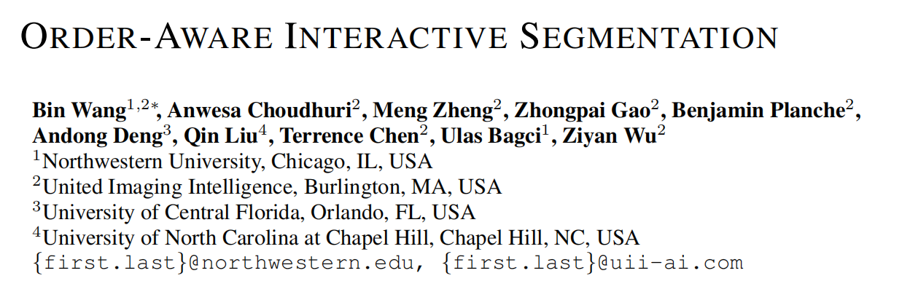
ORDER-AWARE INTERACTIVE SEGMENTATION
ICLR 2025

Slide 2
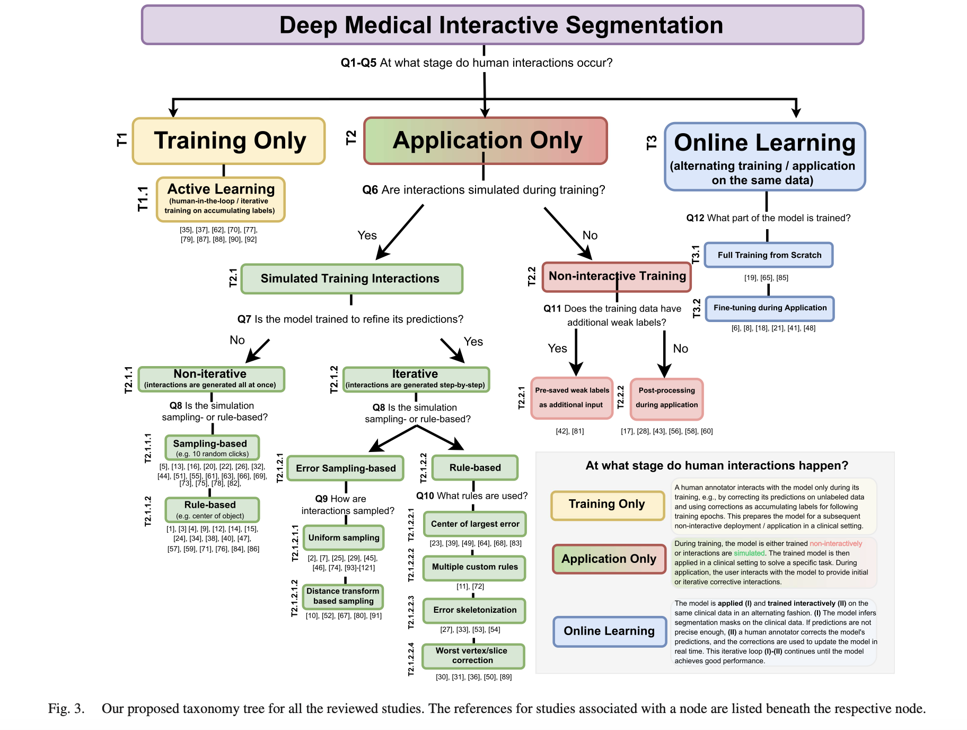
Interactive Segmentation in Medical Image
【1】Marinov, Z., Jäger, P. F., Egger, J., Kleesiek, J., & Stiefelhagen, R. (2024). Deep interactive segmentation of medical images: A systematic review and taxonomy. IEEE transactions on pattern analysis and machine intelligence.

Slide 3
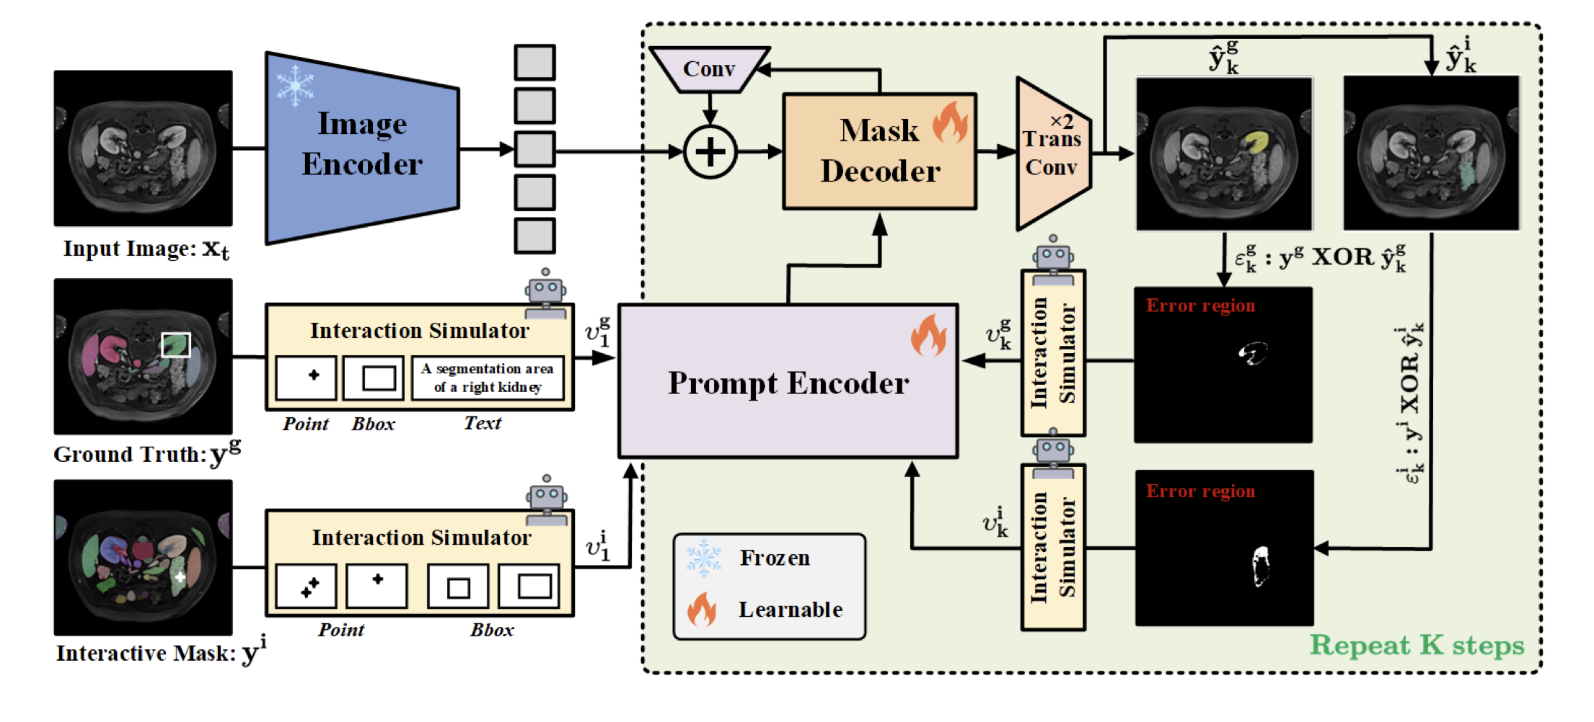
A typical net for Medical Image Interactive Segmentation (w text)
【1】Cheng, J., Fu, B., Ye, J., Wang, G., Li, T., Wang, H., ... & He, J. (2025). Interactive medical image segmentation: A benchmark dataset and baseline. In Proceedings of the Computer Vision and Pattern Recognition Conference (pp. 20841-20851).

Slide 4
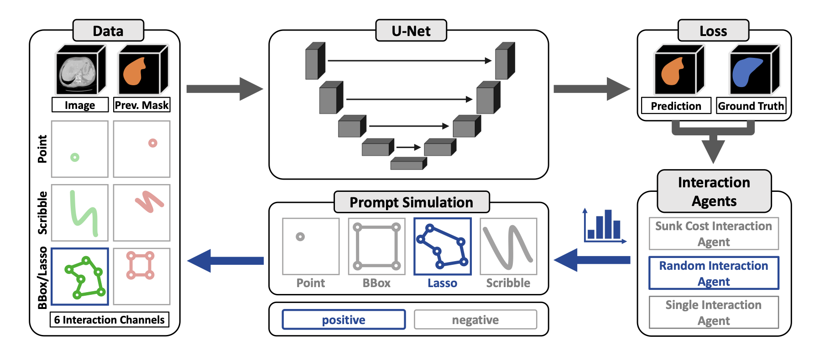
A typical net for Medical Image Interactive Segmentation (w/o text)
【1】Isensee, F., Rokuss, M., Krämer, L., Dinkelacker, S., Ravindran, A., Stritzke, F., ... & Maier-Hein, K. (2025). nninteractive: Redefining 3d promptable segmentation. arXiv preprint arXiv:2503.08373.

Slide 5
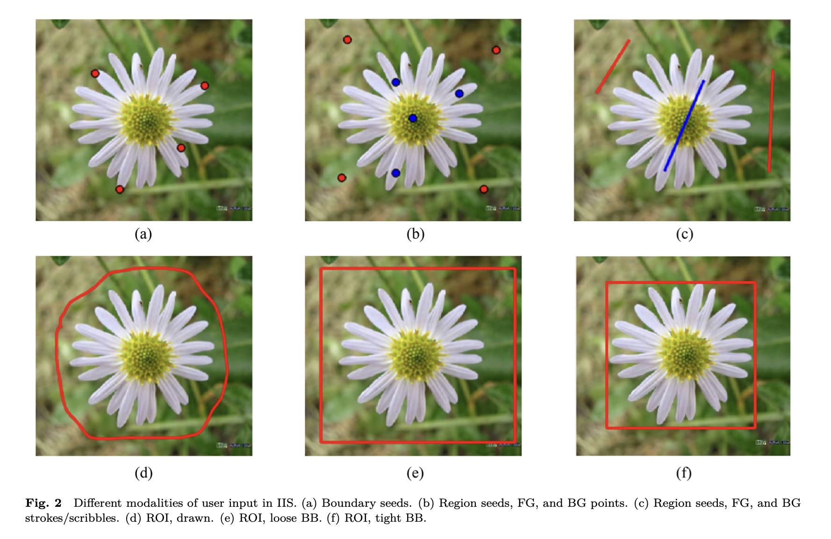
Typical interaction methods in natural images
【1】Ramadan, H., Lachqar, C., & Tairi, H. (2020). A survey of recent interactive image segmentation methods. Computational visual media, 6(4), 355-384.

Slide 6
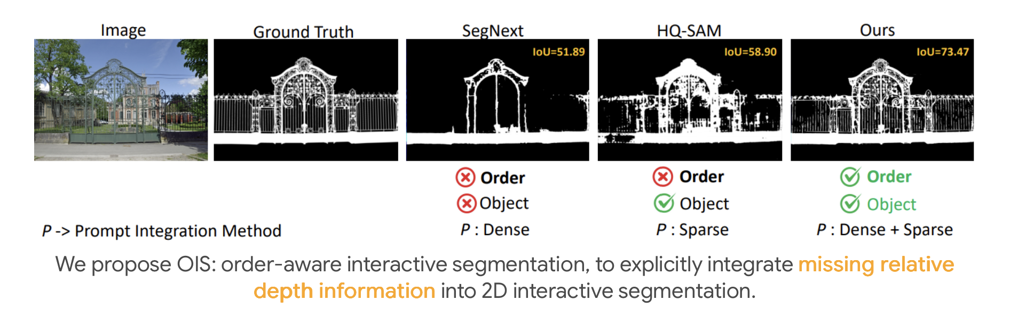
Challenges:
1. Lack of relative depth perception
difficult for them to distinguish objects accurately
2. Confused foreground-background interaction
negative clicks should attend only to the background regions, and positive clicks should only interact with the fore- ground regions
Link
3. Imbalanced efficiency and alignment
Link

Slide 7
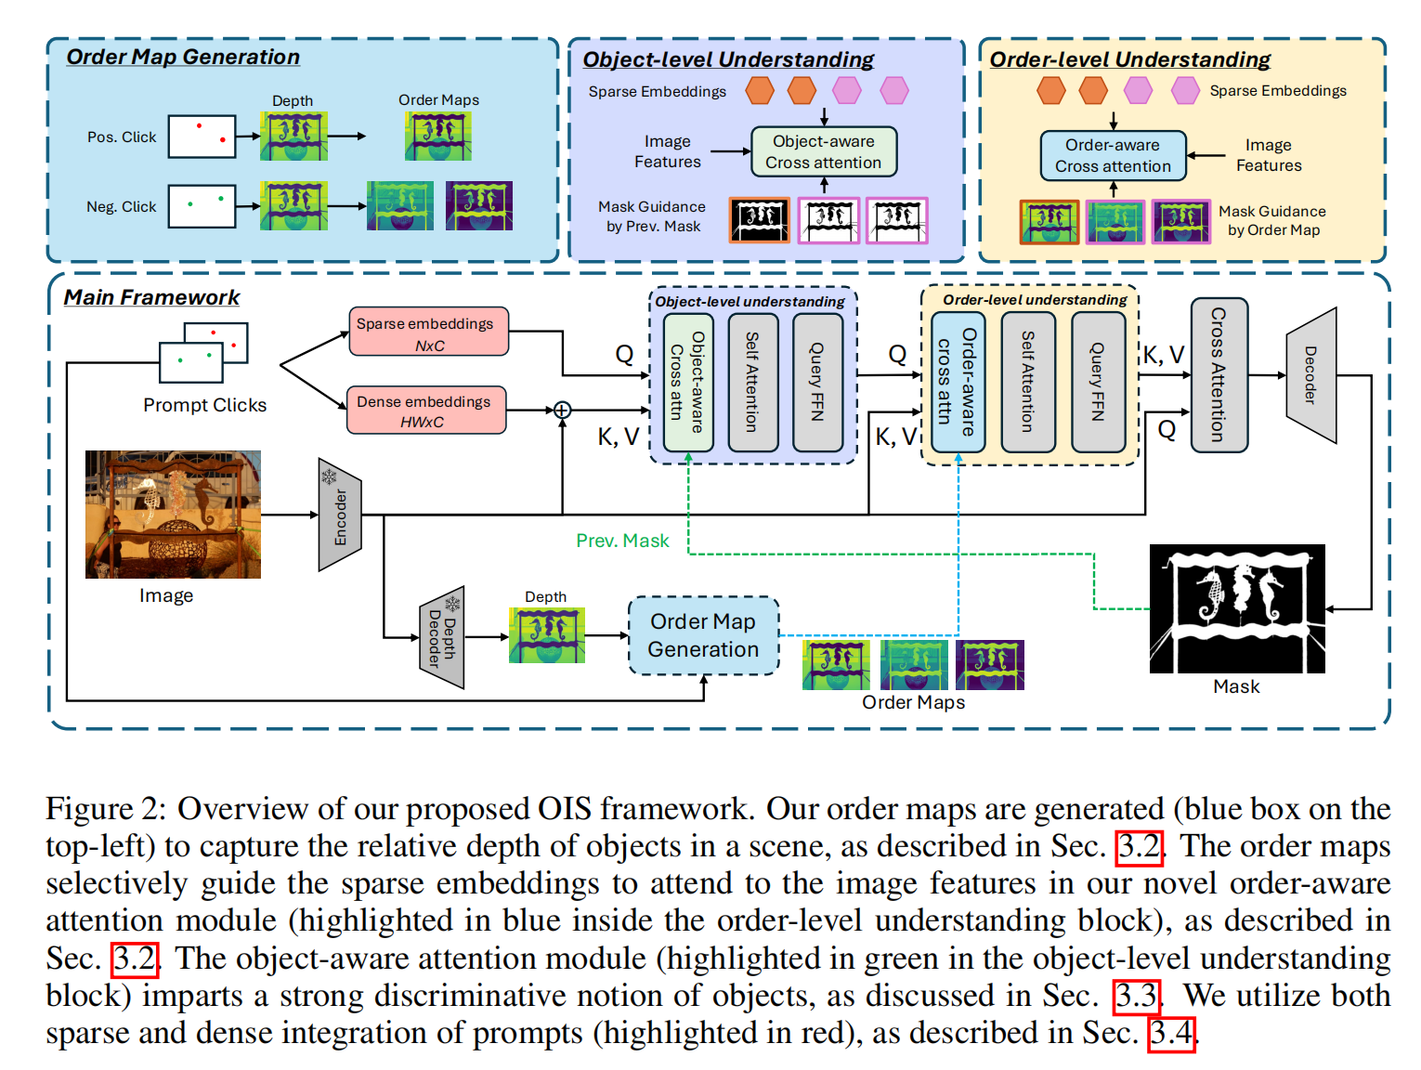

Slide 8
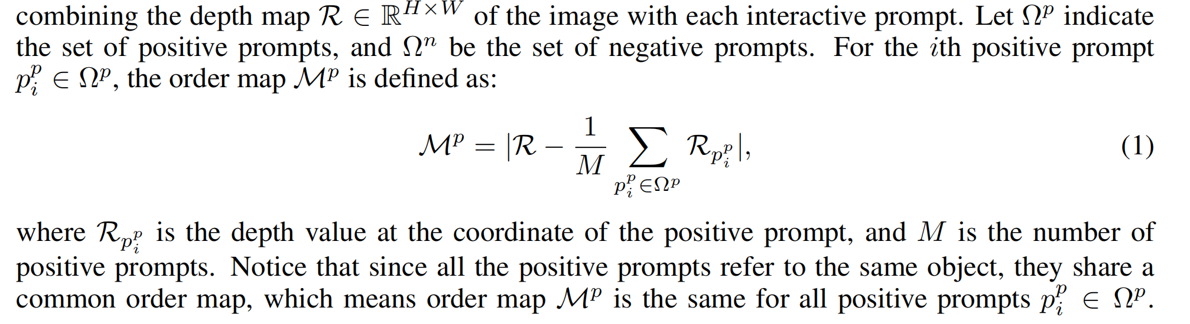
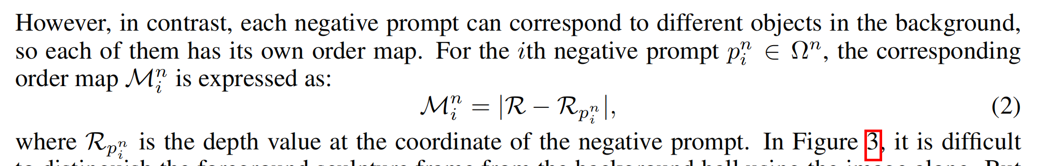
Order map.
we first introduce the concept of order, which represents the relative depth between objects in a scene

Slide 9
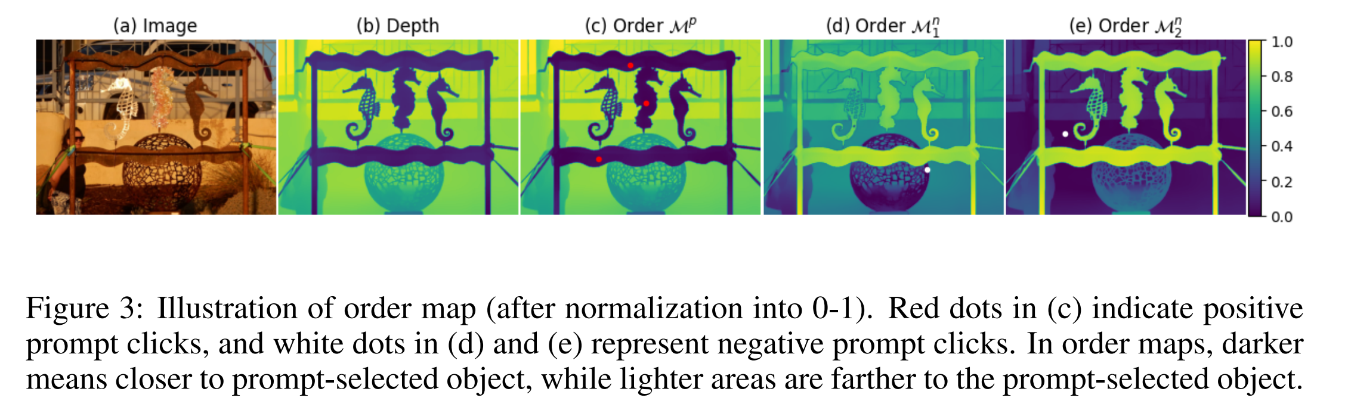
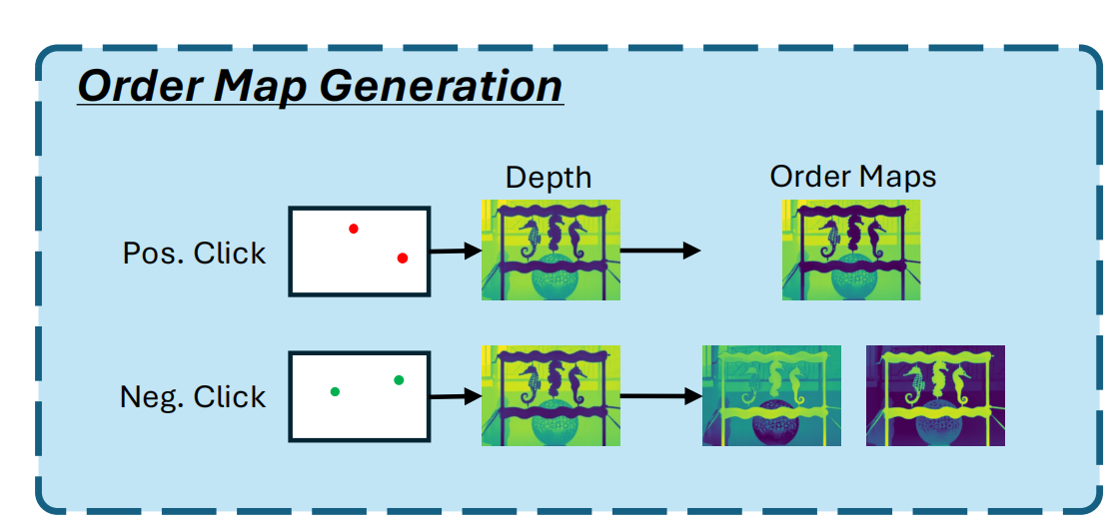
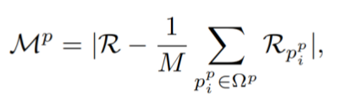

Order map.

Slide 10
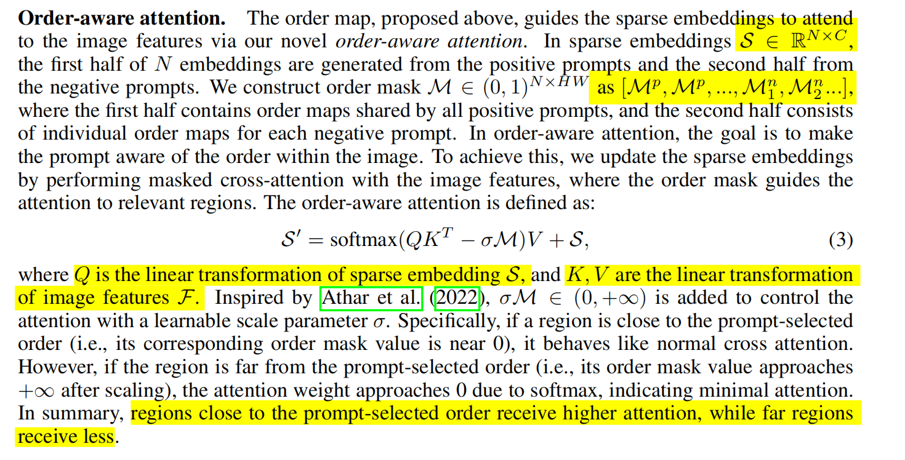

Slide 11
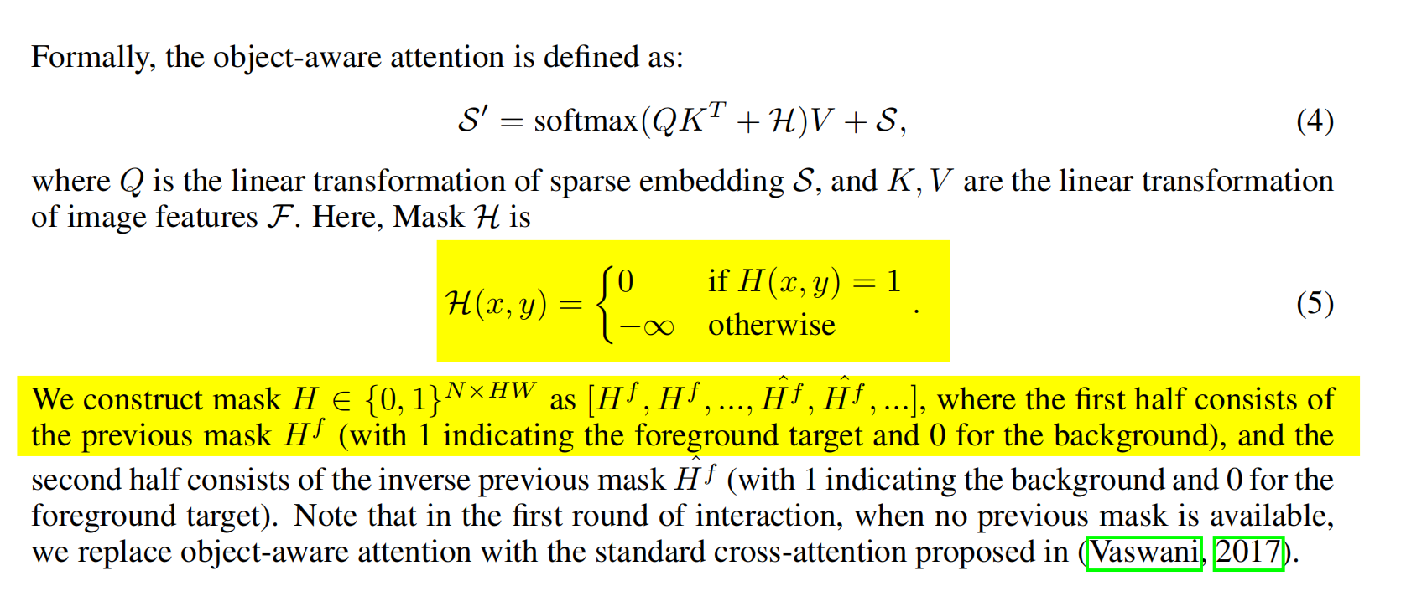
faces the limitation of differentiating between objects within the same order.
Object-aware attention.

Slide 12
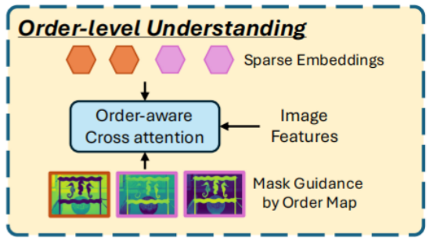

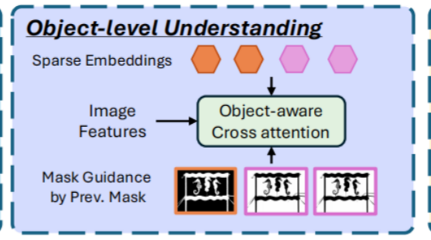

Order-aware attention.
Object-aware attention.

Slide 13
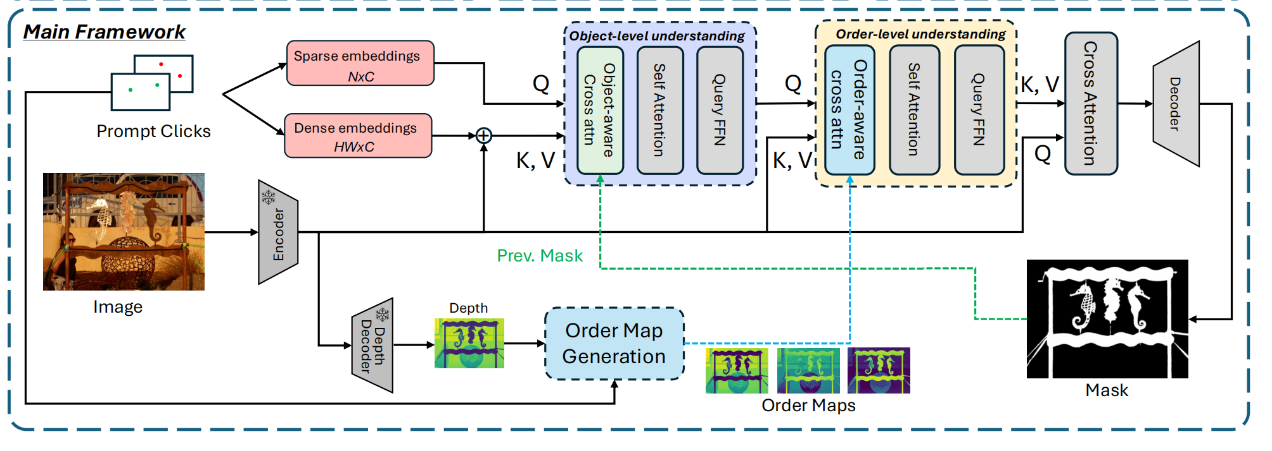
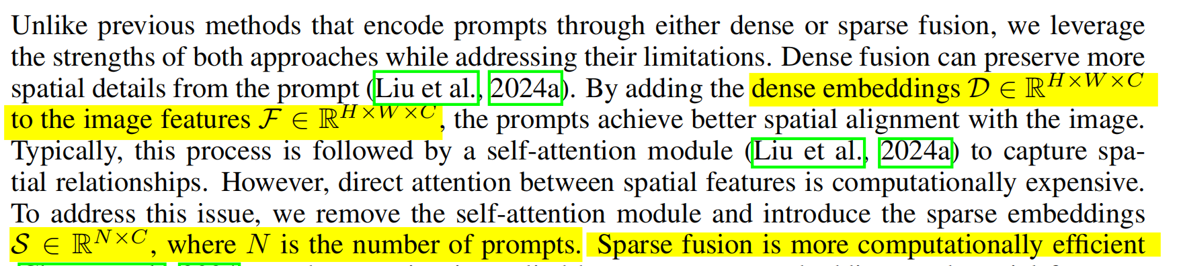

Slide 14
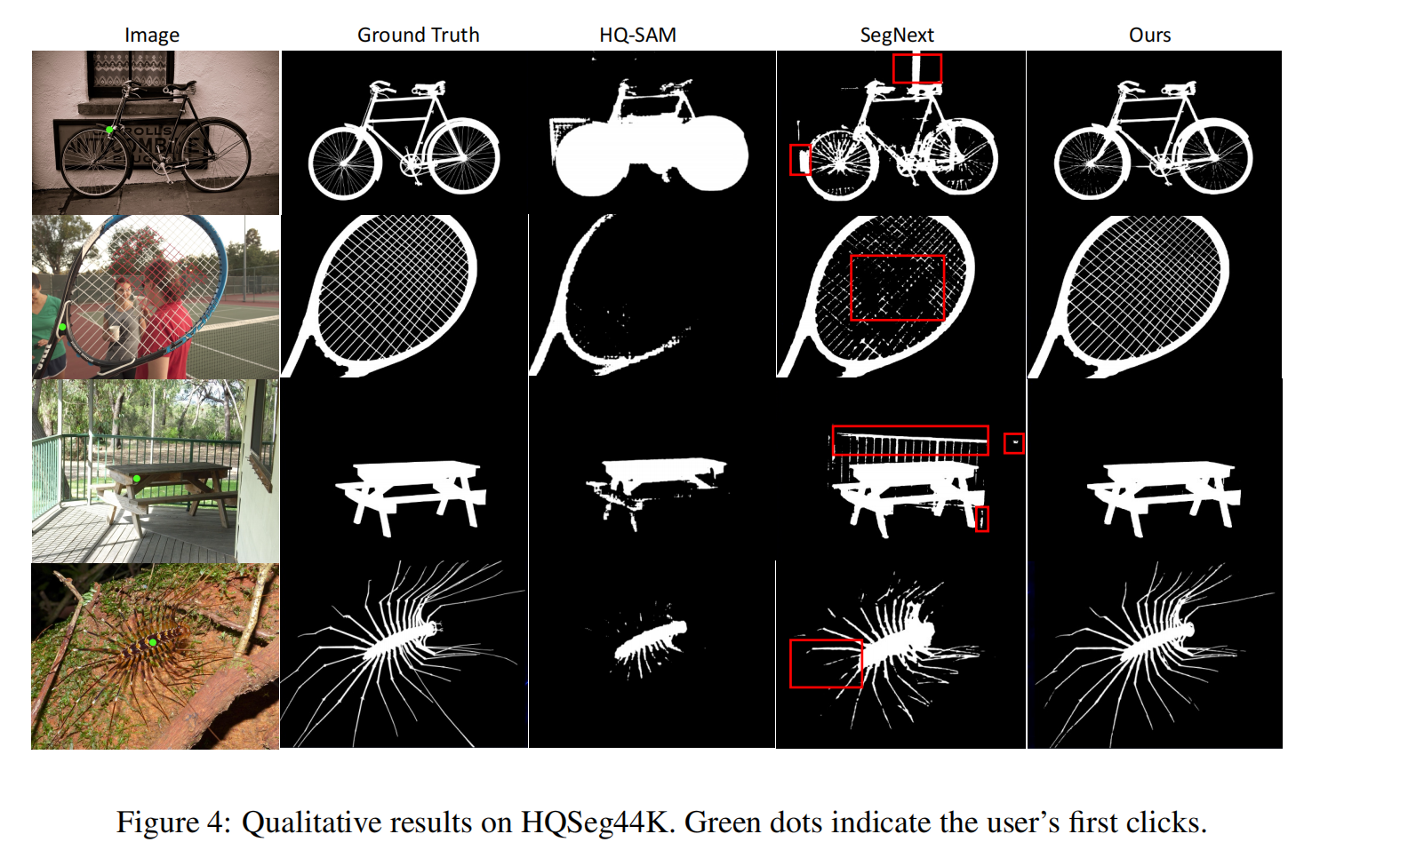

Slide 15
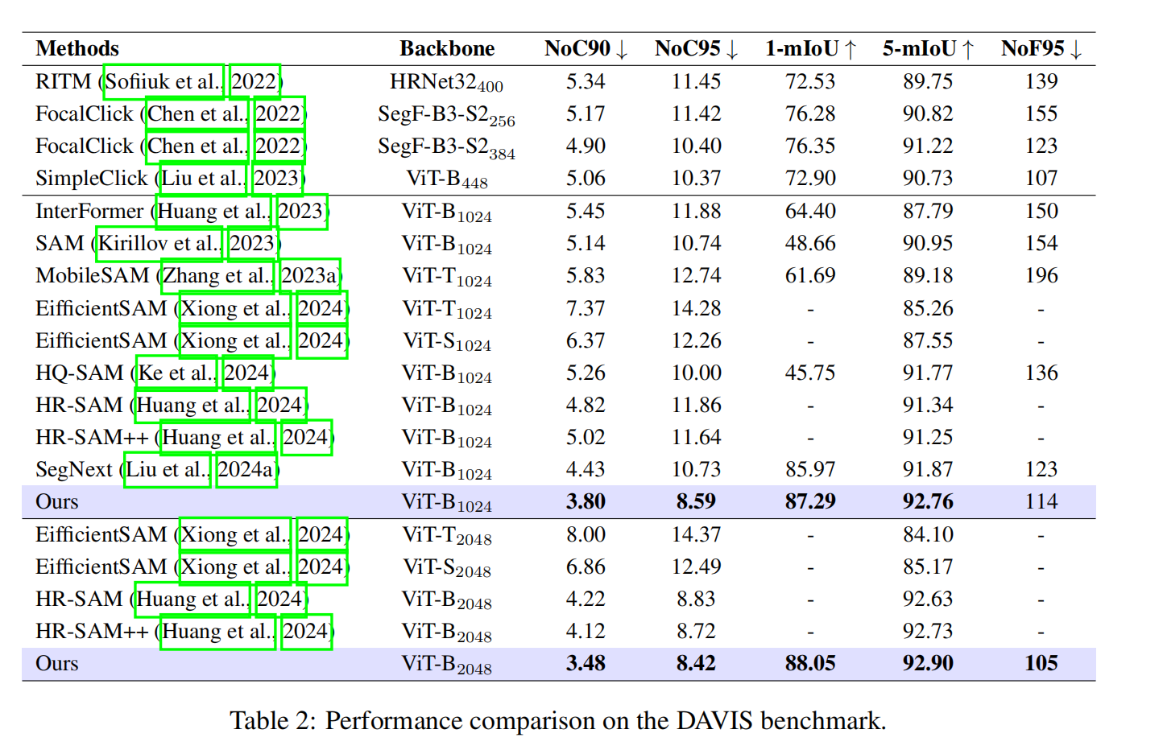

Slide 16
