Slide 1
ICLR 2025 Paper Sharing
Yilin Wang
2025/06/03

Slide 2
Motion Generation Related
DartControl: A Diffusion-Based Autoregressive Motion Model for Real-Time Text-Driven Motion Control
CLoSD: Closing the Loop between Simulation and Diffusion for multi-task character control
Real time
Diffusion
In
Autoregressive
Framework
Motion Control

Slide 3
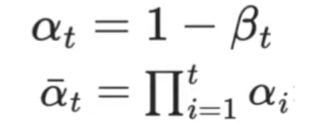
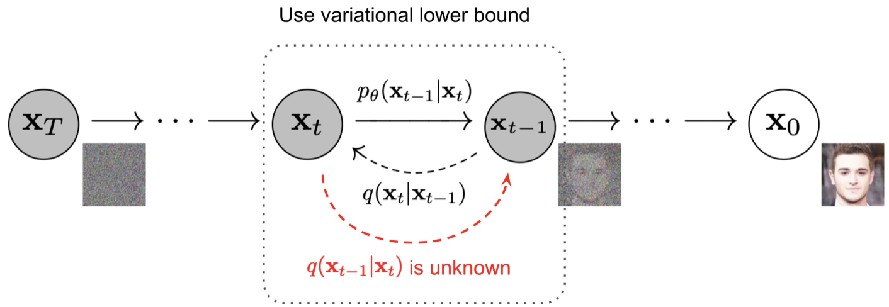
Preliminary
Denoising Diffusion Models
Forward: a Markov noising process that gradually destroys an observed datapoint x over time t, by mixing the data with Gaussian noise.
Denoising: predict what the clean sample might look like with a NN, and then project it back to a lower noise level with the same forward.
Notes:
We keep alternating between predicting the clean data, and projecting it back to a lower noise level until we get the clean sample.
Connection between DDIM and DDPM
- the path integral of the score function is preserved, we can take larger steps while maintaining generation quality

Slide 4
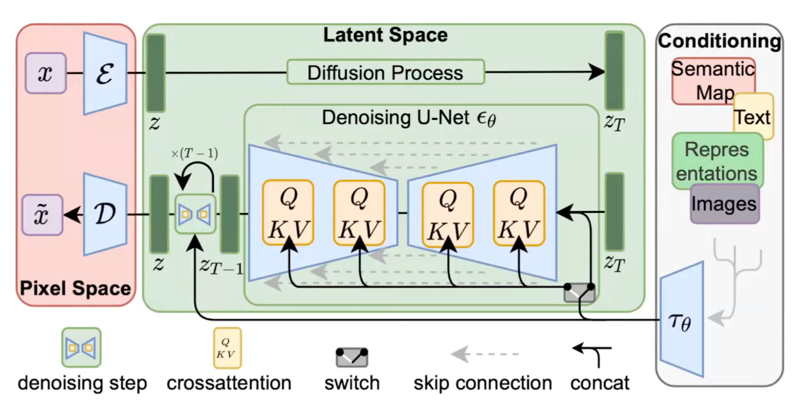
Preliminary
Denoising Diffusion Models
Latent Diffusion Model

Slide 5
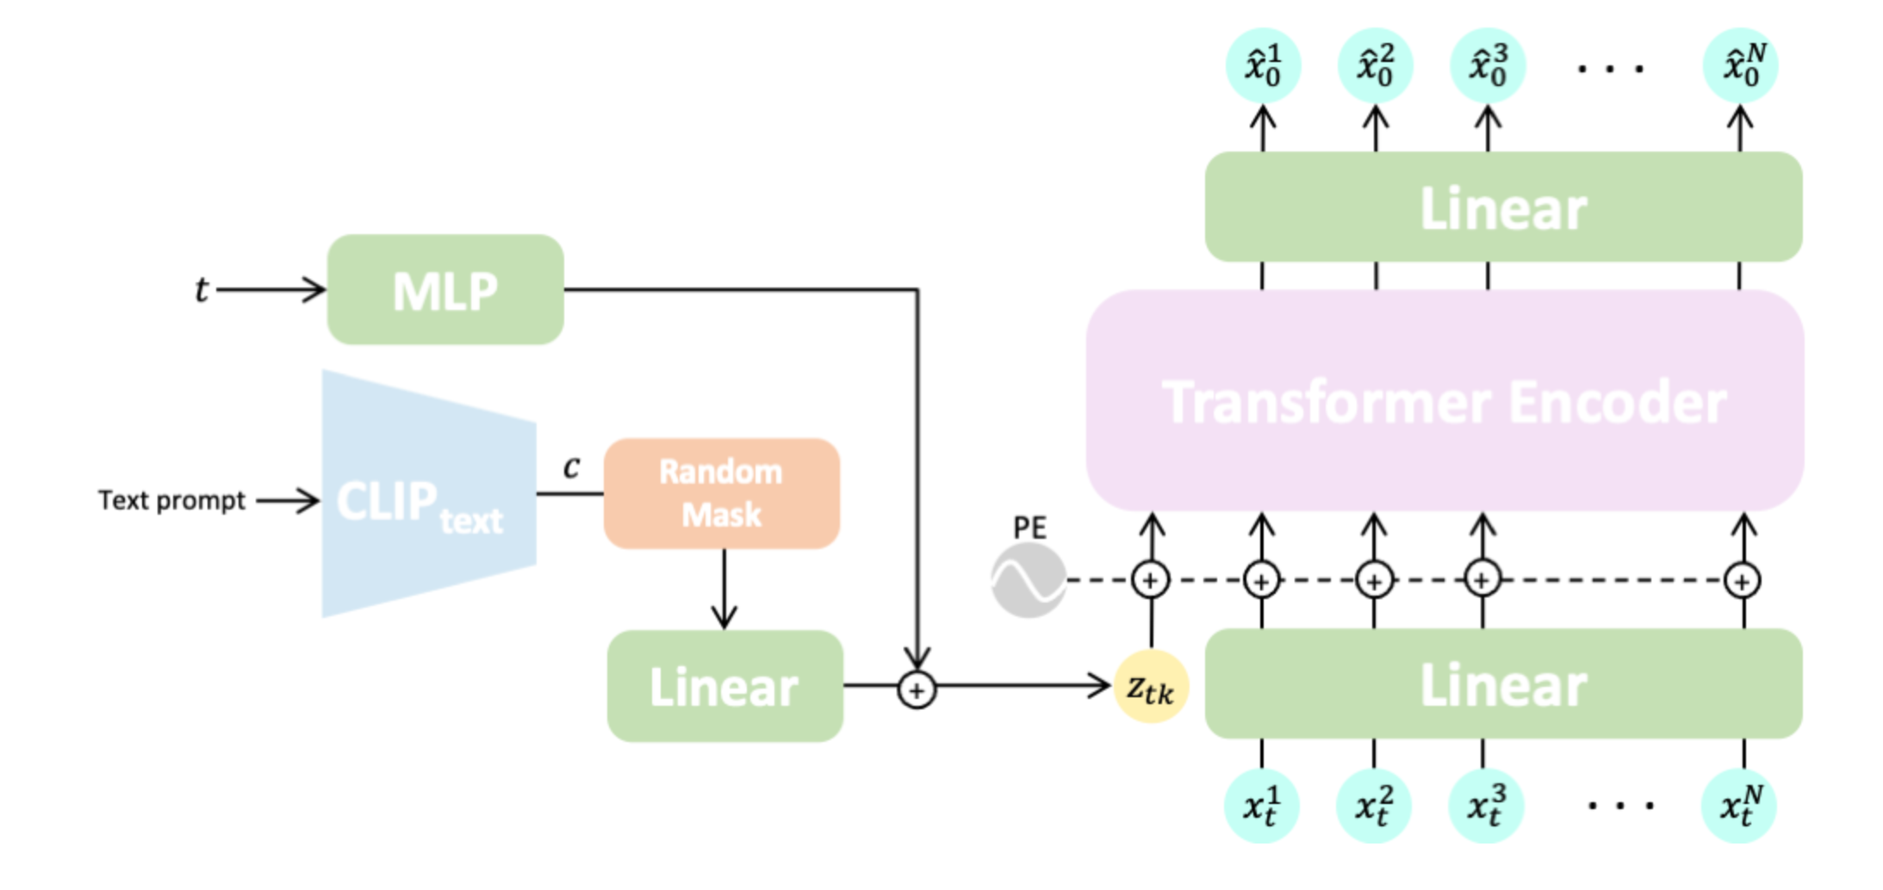
Preliminary
Denoising Diffusion Models for Human Motion Generation
*MDM: Human Motion Diffusion Model

Slide 6
Preliminary
Reinforcement Learning
Key Components
Agent: Decision-maker (e.g., virtual character)
Environment: World the agent operates in
State (s): Current situation/observation
Action (a): Choice made by agent
Reward (r): Feedback signal
Policy (π): Strategy for action selection
RL problems are formalized as Markov Decision Process(MDPs) with the tuple
(S, A, P, R, γ)
Policy function
Value function
Policy Gradient Optimization
Notes:
Policy gradient methods directly optimize the policy function π(a|s) by using gradient ascent on the expected reward.
Actor-arctic: Combine policy gradients with value function approximation

Slide 7
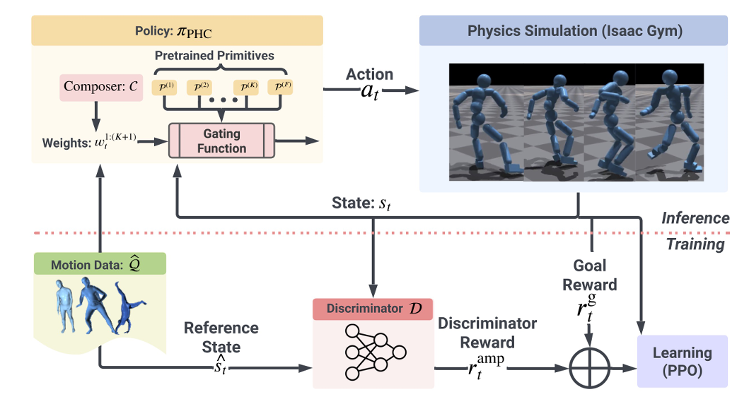
Preliminary
Reinforcement Learning for motion control
Formulation
State: Current pose, goal pose, environment context
Action: Joint torques, target poses, latent vectors
Reward: Distance to goal, physical constraints
Policy: Neural network mapping states to actions
Typical Techniques
PPO (Proximal Policy Optimization)
Actor-Critic Method:
Actor: π_θ(a|s) (policy network)
Critic: V_φ(s) (value network)
Often integrated with physics simulators
Issac gym
Notes:
PPO is a policy gradient reinforcement learning algorithm designed to improve training stability by preventing large policy updates that could destabilize learning.

Slide 8
DartControl: A Diffusion-Based Autoregressive Motion Model for Real-Time Text-Driven Motion Control

Slide 9
DartControl - Motivation
“Infinite” long motion generation
Previous methods are offline and require prior knowledges of action timeline

Slide 10
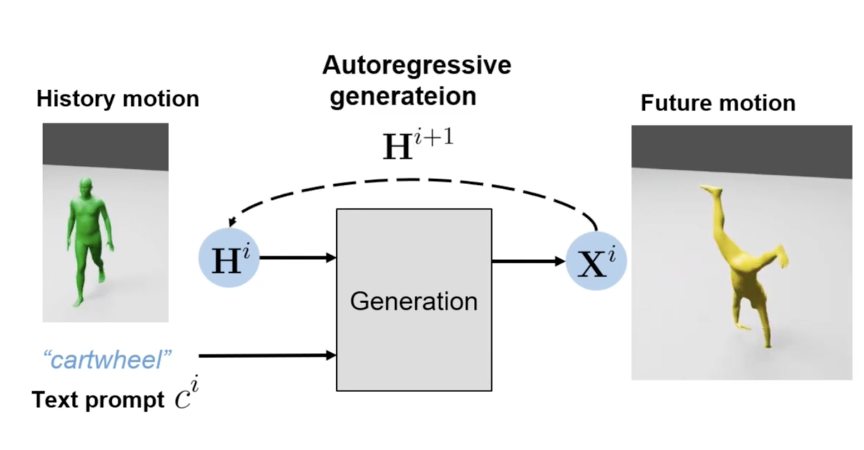
DartControl - Methodology
Input
Preceding motion sequence
A sequence of N text prompt
Output
Continuous and realistic motion sequence aligned with the corresponding text semantics

Slide 11
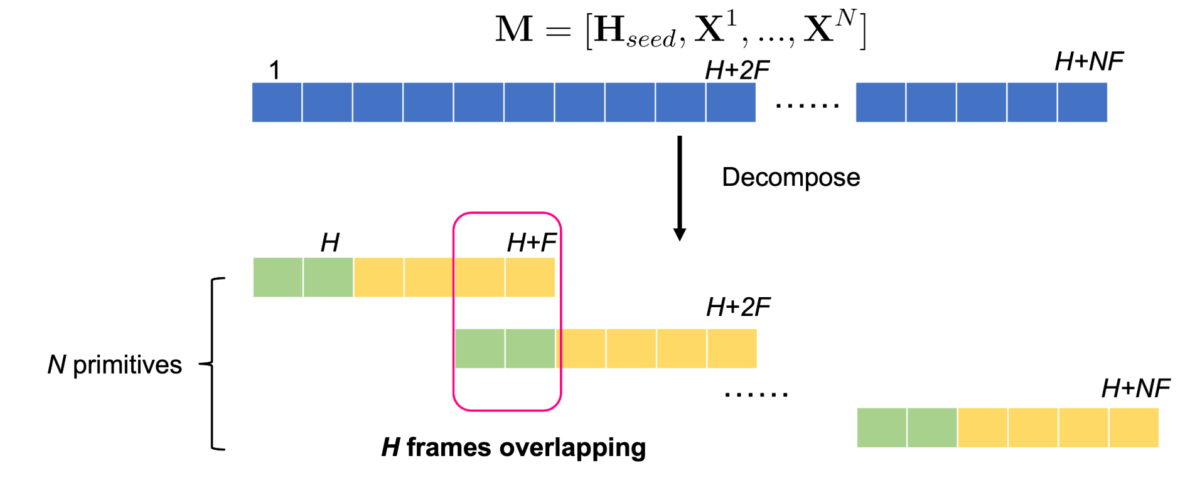
DartControl - Methodology
Autoregressive Motion Primitive Representation

Slide 12
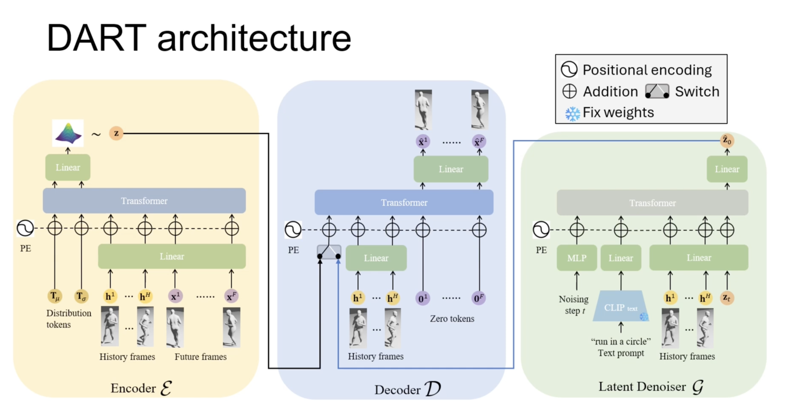
DartControl - Methodology
Motion Primitive VAE
Latent Denoiser

Slide 13
DartControl - Methodology
Motion Control in latent space → an optimization problem
closest to the spatial objectives
adhering to regularization terms derived from scene and physical constraints

Slide 14
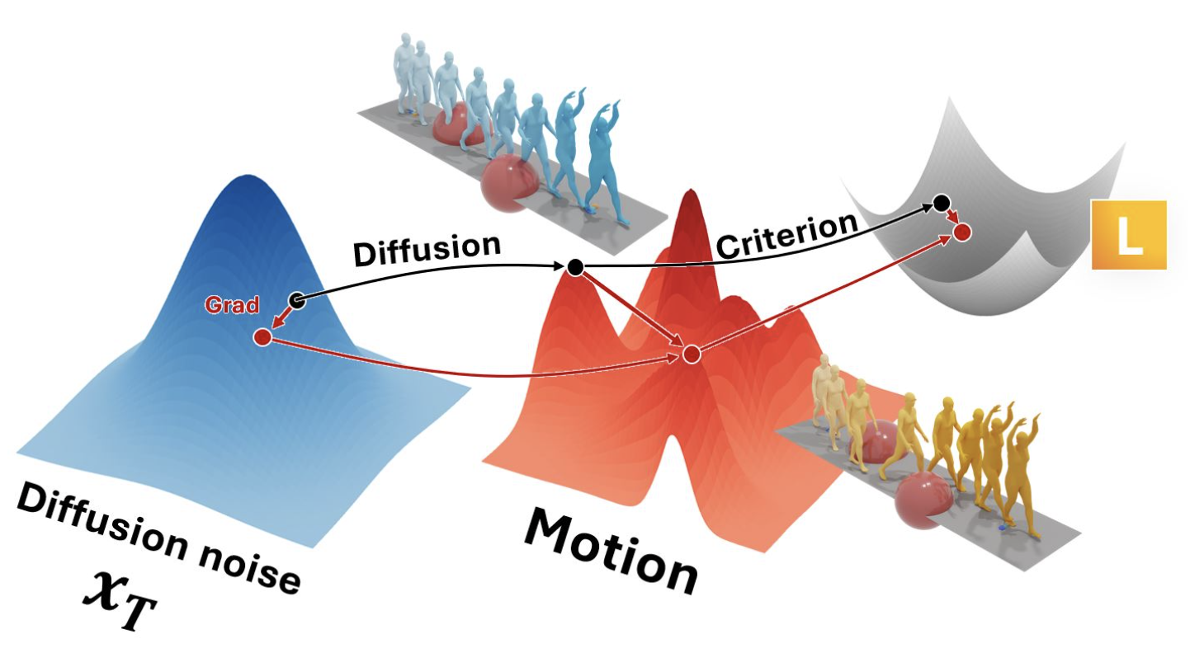
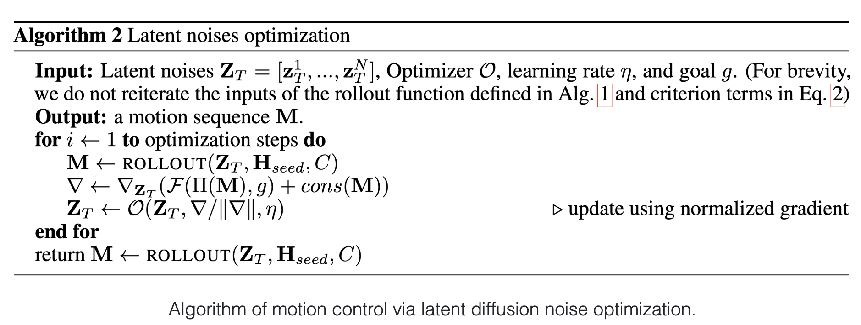
DartControl - Methodology
Motion Control in latent space → an optimization problem
Motion Control via Latent Noise Optimization
*DNO: Optimizing Diffusion Noise Can Serve As Universal Motion Priors
in-between motion generation
human-scene interaction generation
Notes:
latent noise (x_{T}) can be optimized using critertion function defined on the motion space (x₀) to serve as universal motion priors for a wide range of motion-related tasks.

Slide 15
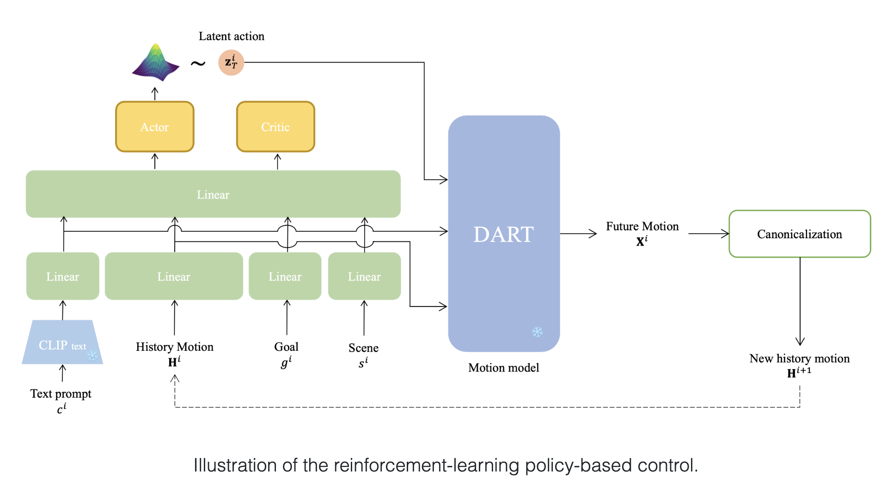
DartControl - Methodology
Motion Control in latent space → an optimization problem
Motion Control via Reinforcement Learning
text-conditioned goal-reaching task

Slide 16
DartControl - Results
Online text-to-motion
Text-conditioned in-betweening
Text-conditioned goal reaching
Human-scene interaction
(video demo)
Notes:
Show video demo https://zkf1997.github.io/DART/

Slide 17
DartControl - Results

Slide 18
DartControl - Results
Integrated with PHC

Slide 19
CLoSD: Closing the Loop between Simulation and Diffusion for multi-task character control

Slide 20
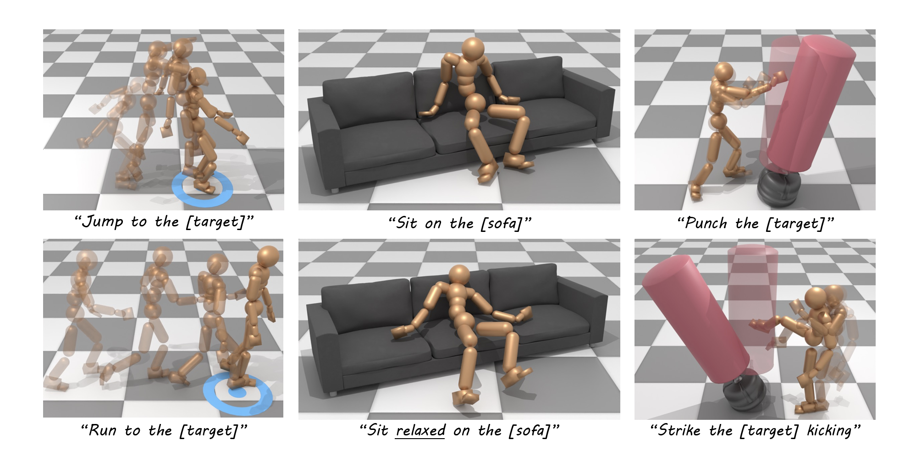
CLoSD – Motivation
Previous RL methods for physics-based motion control fail to be scaled to:
Large human motion datasets
Multiple tasks including object interactions
Key insight: motion diffusion can serve as an on-the-fly universal planner for a robust RL controller to scale the diversity and versatility
Diffusion motion planner
Physics-based motion tracker

Slide 21
CLoSD - Challenges
Diffusion models are commonly used for offline generation, but to interact with the physics simulator, it should be a real-time planner
Mismatch of the original motion tracker as it was trained without object interaction nor interaction with an online planner

Slide 22
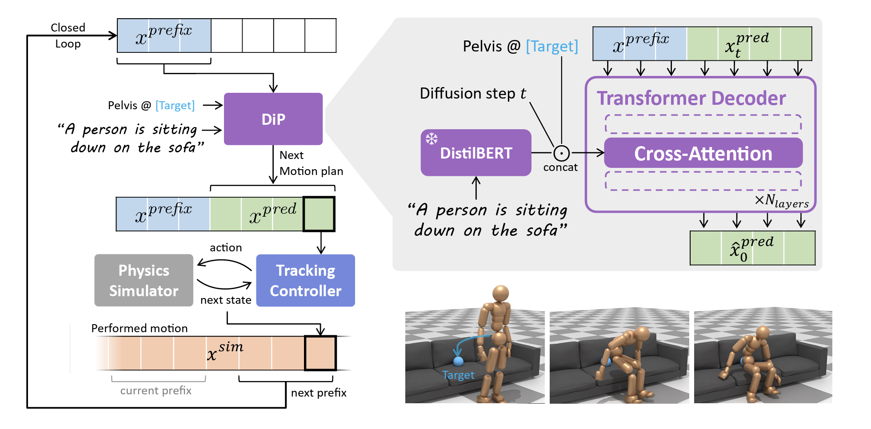
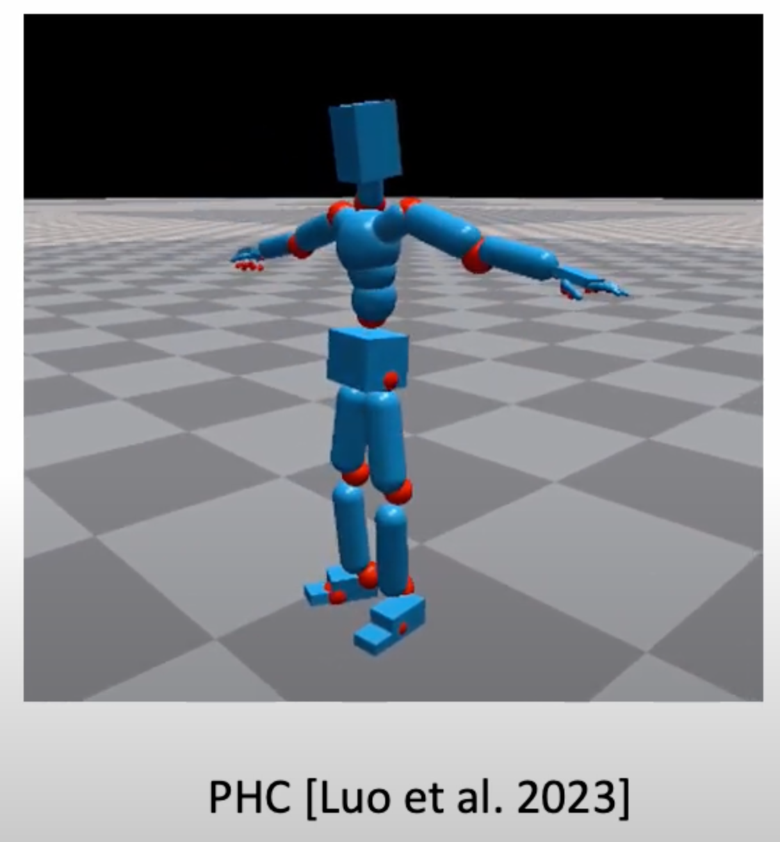
CLoSD - Methodology
Overview
Boolean signal vj per joint: indicating if it is currently used in the task
Notes:
Advantages of DistilBERT: a text encoder that is not biased to the global description of pictures (as CLIP does)

Slide 23
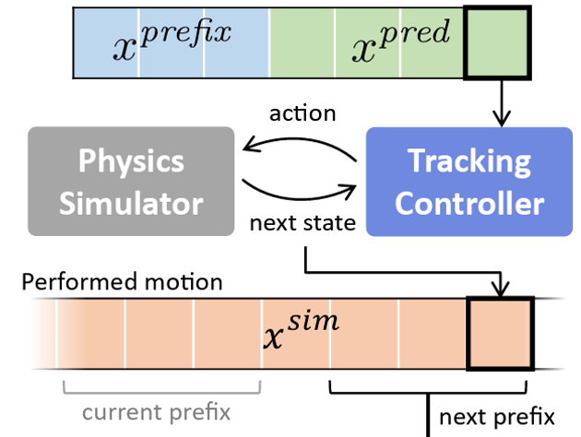
CLoSD - Methodology
Motion Representation
Kinematic motion
→ HumanML3D representation
RL motion states
→ global positions and velocities
SMPL compatible simulator
State Machine
Finetuning Motion Tracker

Slide 24
CLoSD - Results
Tasks demonstrated
Goal Reaching
→ specifying a random target for the pelvis joint on the XY plane (without forcing a specific height) while specifying a text prompt defining the desired locomotion type (e.g. running, walking, jumping, dancing waltz, etc.) and its style (e.g. “rapidly”, “like a zombie”, “slalom”,)
Object Striking
→ In this task, the character needs to strike down a standing kickboxing bag.
Sitting Down
→ In this task, the character needs to sit down on a sofa.
Getting up
→ In this task, the initial pose is sitting down on a sofa object and the goal is to get up to a standing position.

Slide 25
CLoSD - Results

Slide 26
CLoSD - Results

Slide 27
CLoSD - Results

Slide 28
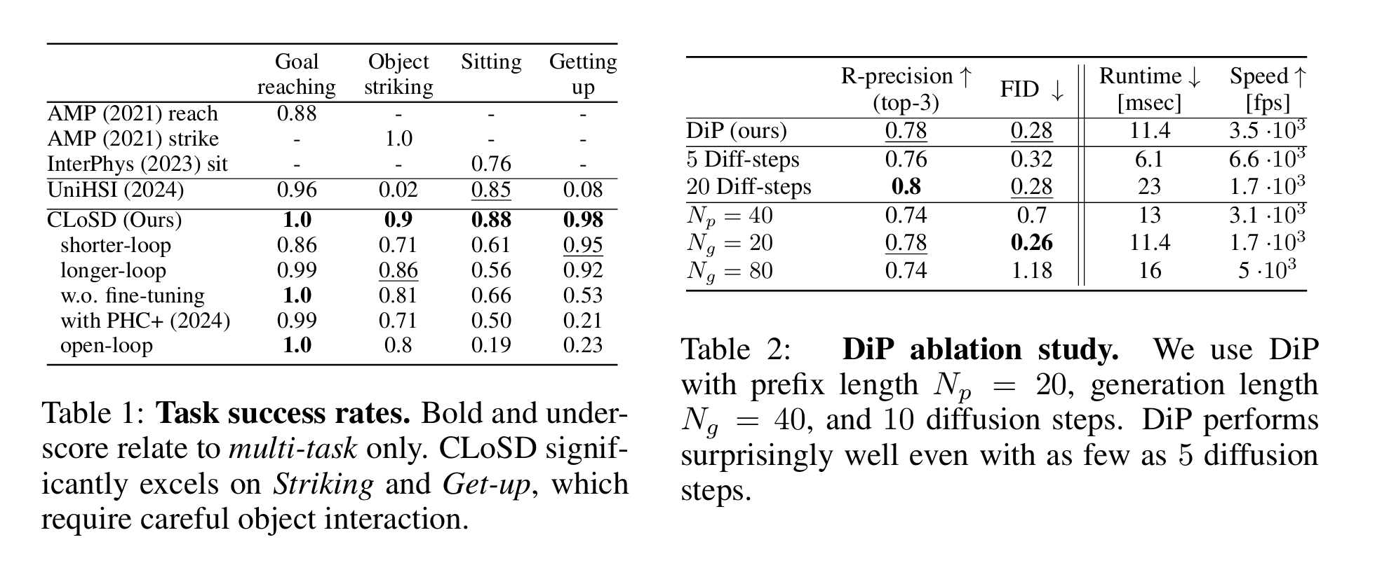
CLoSD - Results
Quantitative

Slide 29
Insight
From offline to real time
Combining kinematic motion generation with physic simulator for more realistic generation
Autoregressive diffusion models?
Extend to multiple characters?

Slide 30
Generative Model Related
HART: Efficient Visual Generation with Hybrid Autoregressive Transformer
FreqPrior: Improving Video Diffusion Models with Frequency Filtering Gaussian Noise
AlphaEdit: Null-Space Constrained Knowledge Editing for Language Models

