Slide 1
EasyHOI: Unleashing the Power of Large Models for Reconstructing Hand-Object Interactions in the Wild
CVPR 2025
Presenter: Jun Zhou

Slide 2
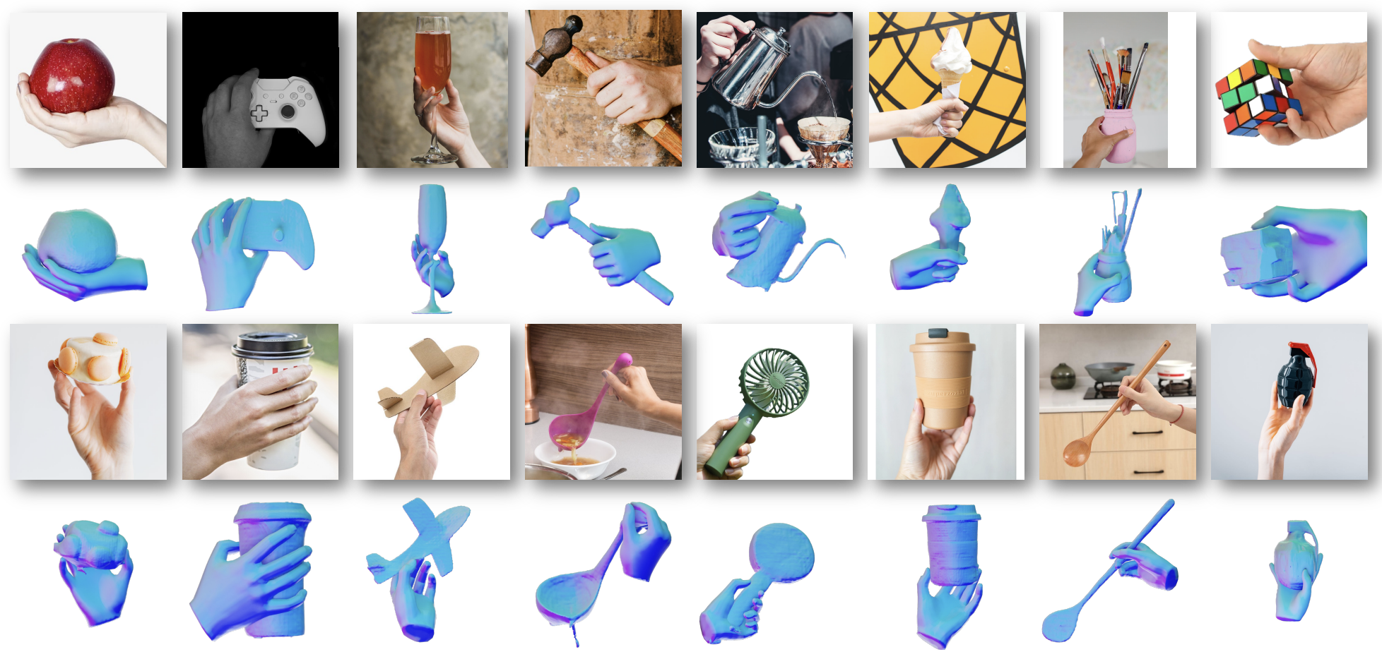
Reconstruction Results
Notes:
Existing works simplify the HOI task by assuming the object is known. However, such 3D template assumption is too strong and prevents these systems from generalizing to unknown objects.
This work leverages large models and prior-guided optimization to reconstruct physically plausible hand-object interactions from singleview images. The author claims to be capable of handling occlusions even in wild images.

Slide 3
Challenge
Inconsistent Coordinate Systems: Object reconstruction relys on a canonical coordinate system, while hand reconstruction often adopts a camera-based system.
Impact of Occlusions: The inability to effectively reconstruct these unobserved areas leads to physically implausible results and unrealistic interaction estimates.

Slide 4
Pipeline
The pipeline mainly consists of two stages:
Initial Reconstruction of Hand and Object;
) Hand-Object Interaction Optimization
Notes:
The pipeline mainly consists of two stages: 1) Initial Reconstruction of Hand and Object: We first employ LISA [32] to segment hand and object masks. A diffusion model [70] then removes and inpaints the hand region, followed by SAM [31] segmenting the complete object. Finally, InstantMesh [65] reconstructs the object mesh while HaMeR [46] simultaneously reconstructs the hand mesh. 2) Hand-Object Interaction Optimization: the initial hand and object reconstructions are obtained separately, they may be inconsistent with the input image. To overcome this challenge, we formulate a prior-guided optimization framework for HOI tasks that progressively refines the reconstruction in a coarse-to-fine manner.

Slide 5
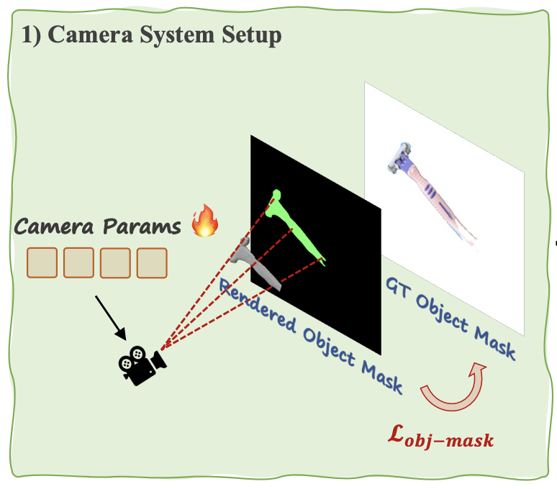
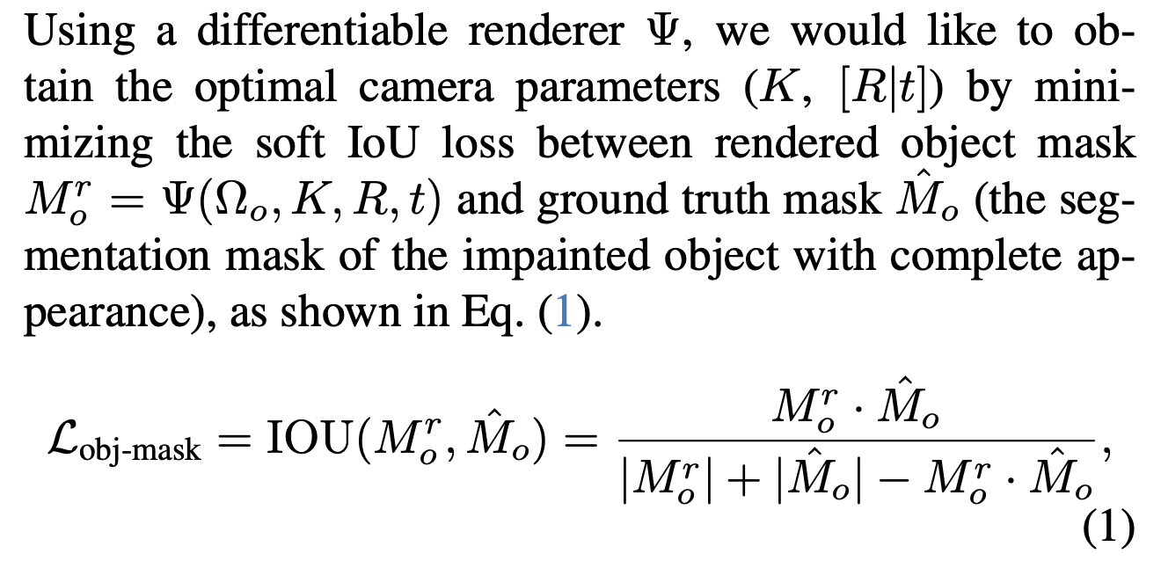
Camera System
When initial and ground truth masks don’t overlap, the IoU loss becomes ineffective since its gradient is zero.

Slide 6
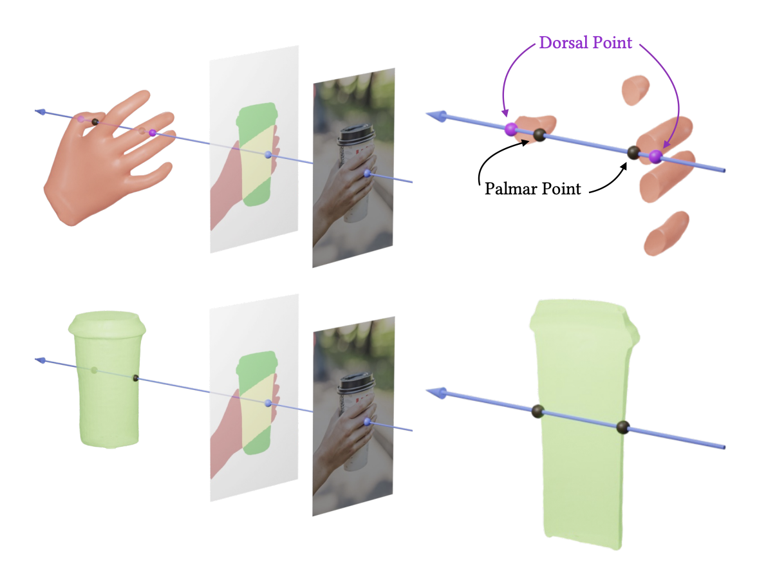
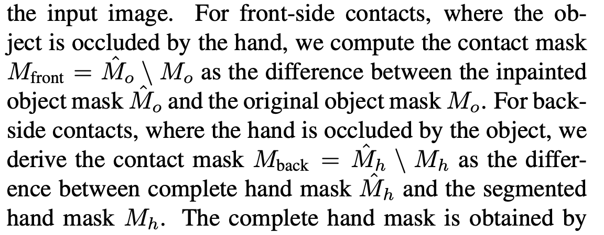
HOI Contact Alignment
Definition of contact
Once all potential contact points on both the hand and the object are identified, the Iterative Closest Point (ICP) method is applied to compute the optimal hand translation, aligning the contact.

Slide 7
Hand Parameter Refinement

Slide 8
Results

Slide 9
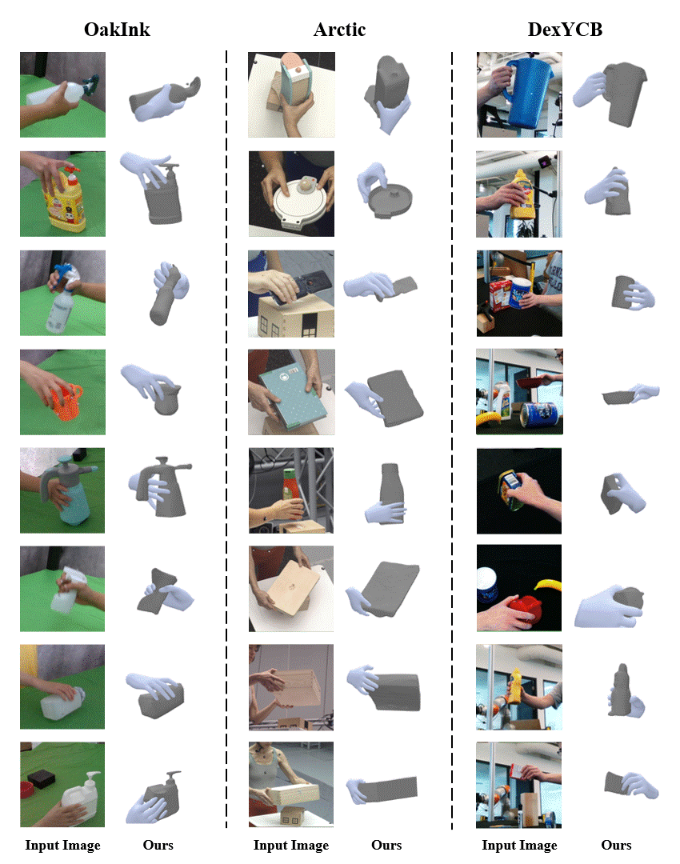
In-the-wild

Slide 10
HaWoR: World-Space Hand Motion Reconstruction from Egocentric Videos
CVPR 2025

Slide 11
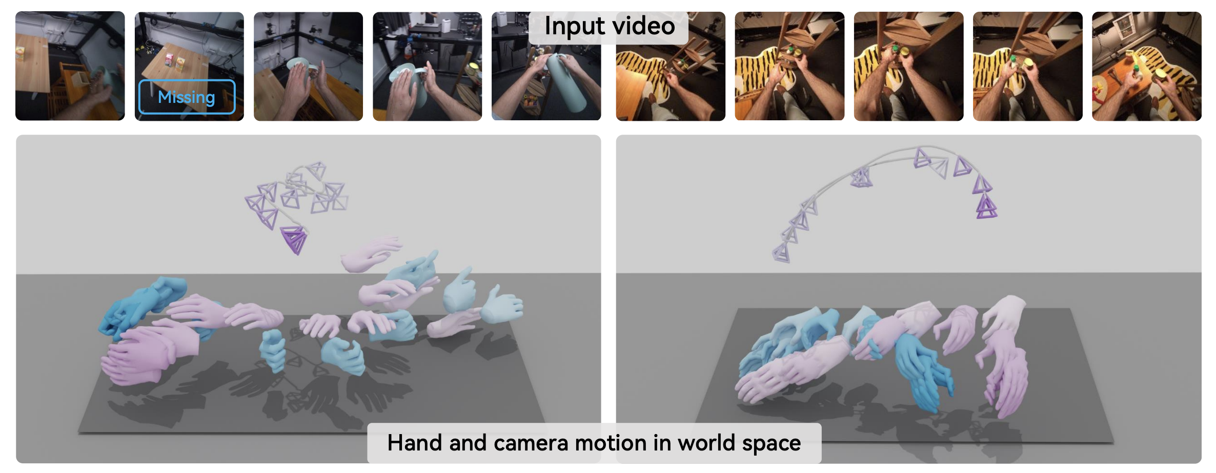
World-space 3D hand motion estimation
Decompose the problem into two simpler tasks:
the 3D hand motion reconstruction in the camera space
the camera trajectory estimation in the world space.
Notes:
HaWoR is a world-space 3D hand motion estimation method for egocentric videos

Slide 12
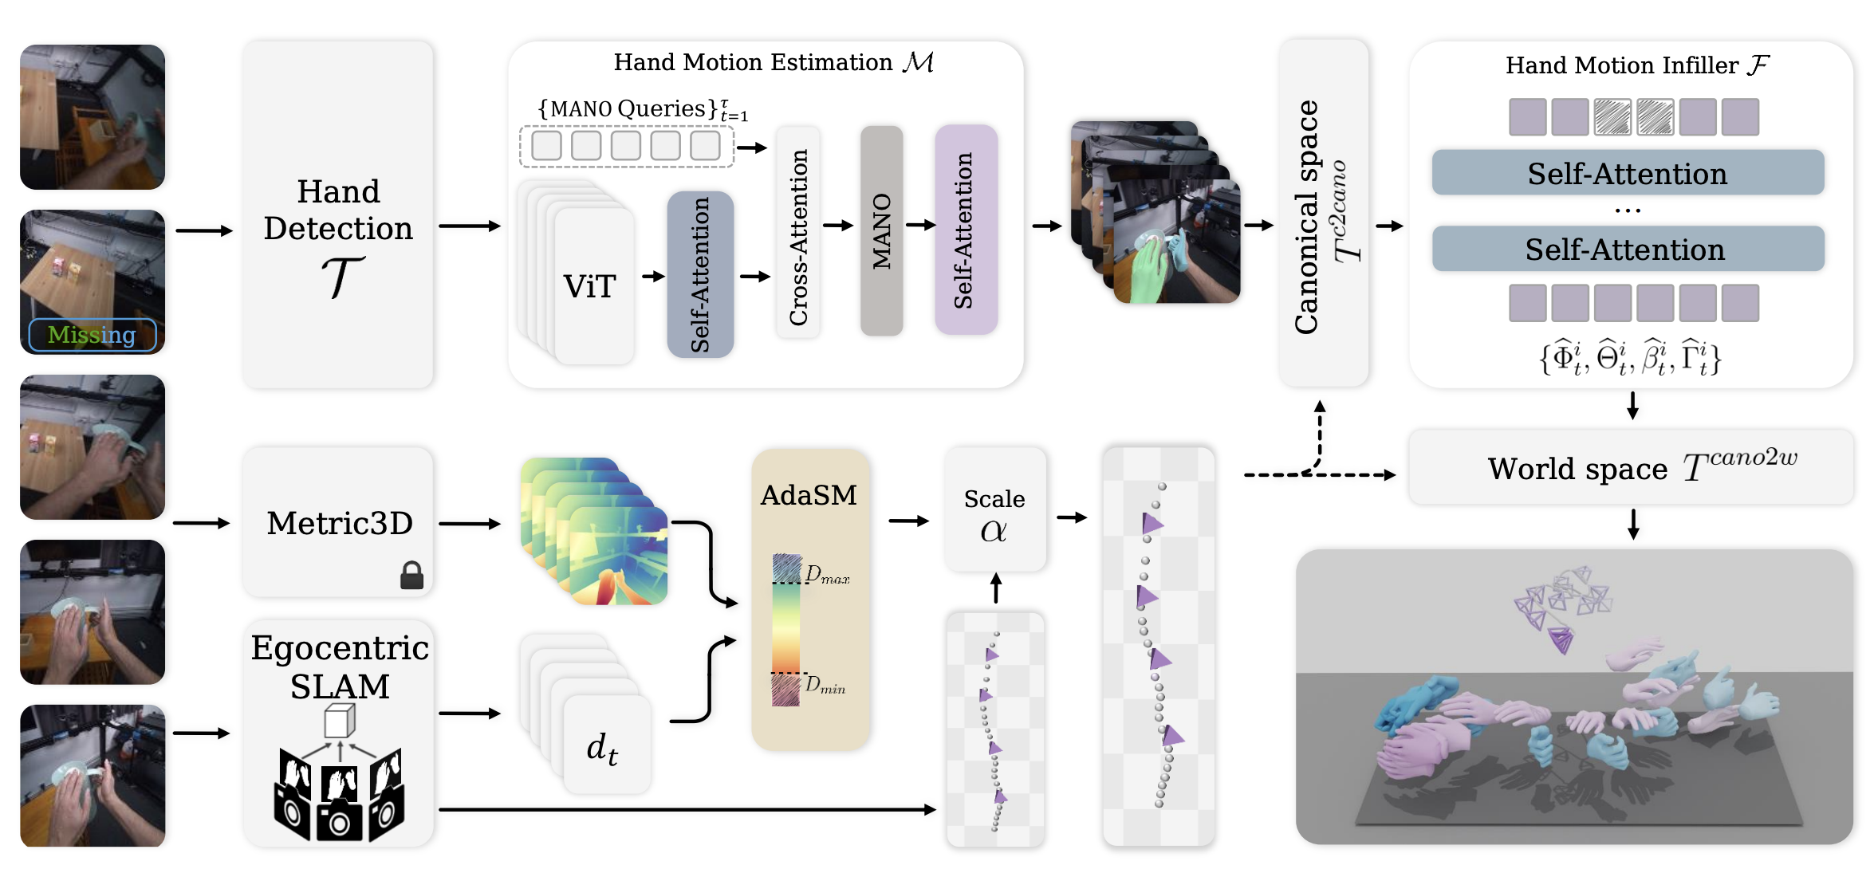
Pipeline
Reconstructs robust hand motions in the camera-frame
Predicts the camera pose in the world-coordinates
Restores non-visible and occluded hands and reinforces the temporal coherence of the reconstructed 3D hand motion

Slide 13
Method
Hand Motion Estimation
Based on single frame method
Use temporal self-attention on image feature and hand meshes to improve the temporal coherence of motion
Camera Trajectory Estimation
Based on a SLAM method which can against subtle dynamic objects
mask out hand region to eliminate the influence of large hand movements
Use estimated depth to calculate the world-scale reference
Hand Motion Infilling
Transform hand motions to canonical coordinate system
A infiller network predicts the missing pose

Slide 14
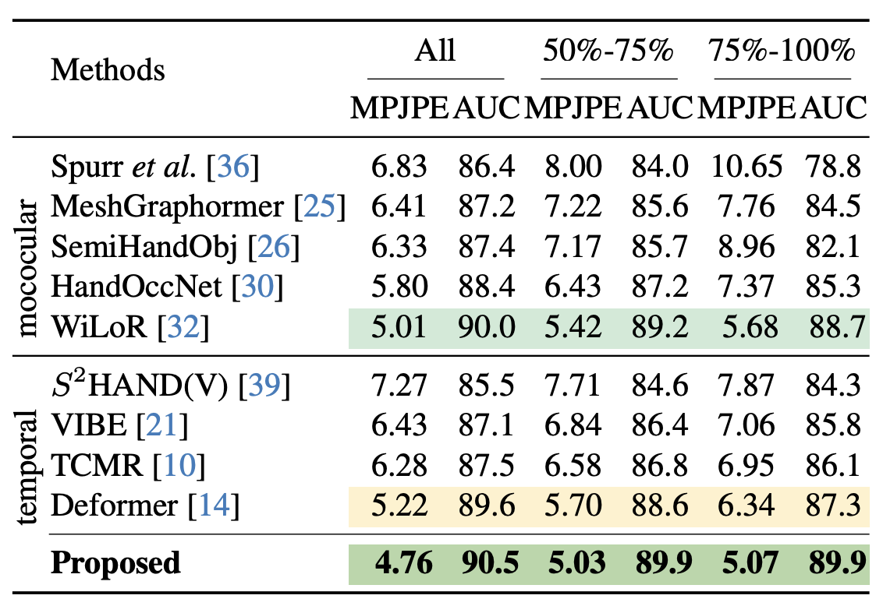
Result
Occlusion rate
Comparison of Camera-frame 3D Hand Motion on DexYCB Dataset

Slide 15
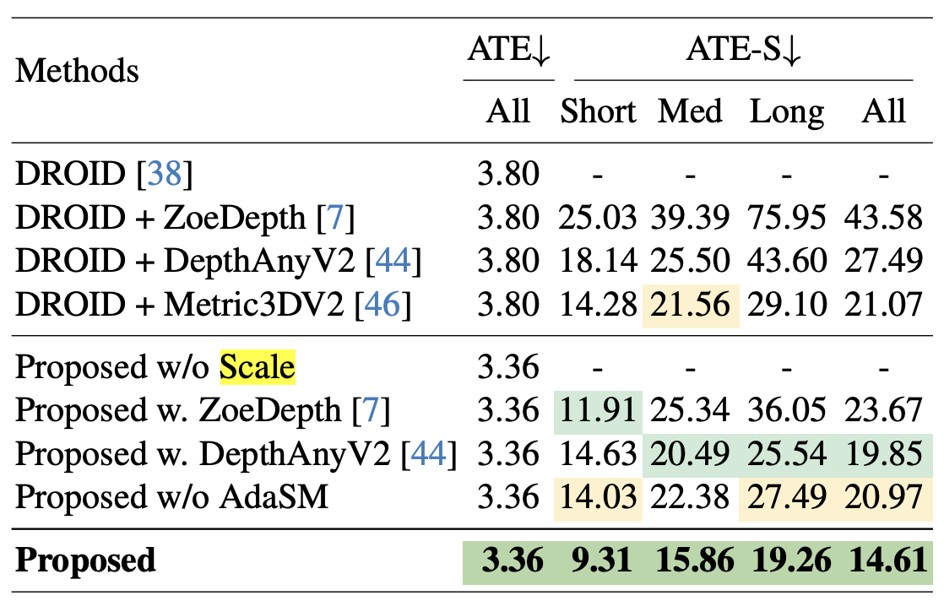
Result
Average Trajectory Error
Aligned
Comparison of World-frame 3D Hand Motion on HOT3D Dataset
Displacement: short (< 5m), medium (3m−5m) and long (> 5m)

