Slide 1
Zero-1-to-3: Zero-shot One Image to 3D Object
ICCV 2023
Ruoshi Liu, Rundi Wu, Basile Van Hoorick, Pavel Tokmakov, Sergey Zakharov, Carl Vondrick
Columbia University, Toyota Research Institute

Slide 2
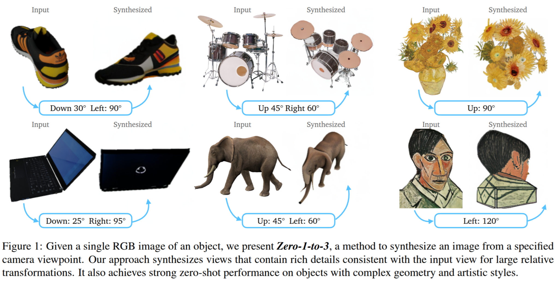
Introduction to Zero-1-to-3
Problem: Single-image 3D reconstruction is ill-posed and under-constrained.
Existing Approaches: Require multi-view datasets, 3D supervision, or category priors.
Key Idea: Use a viewpoint-conditioned diffusion model to synthesize novel views zero-shot.

Slide 3
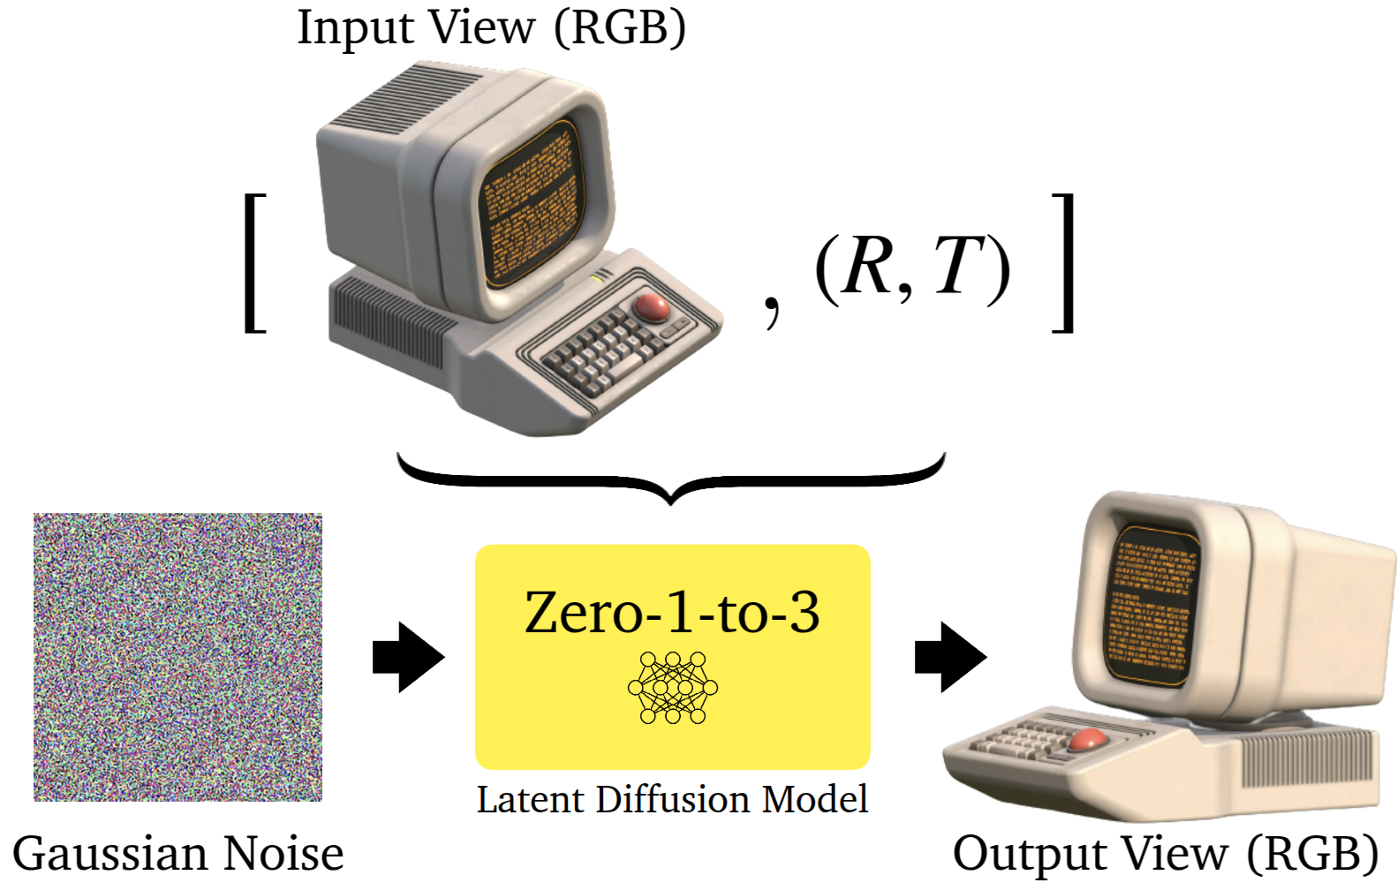
Method Overview
Diffusion model-based view synthesis trained on synthetic data.
Learns viewpoint transformations in image space via Stable Diffusion fine-tuning.
Zero-shot generalization: Works on in-the-wild objects without explicit 3D priors.

Slide 4
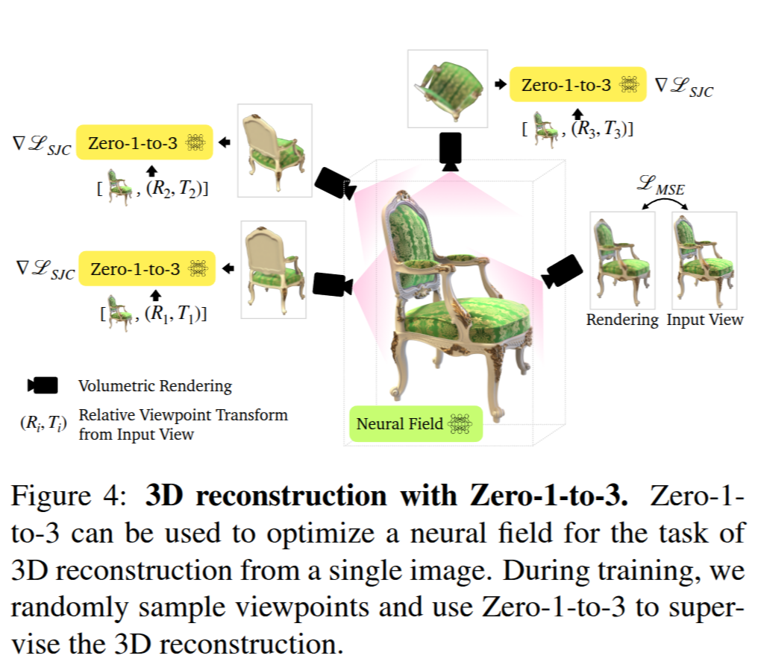
Model Architecture
Conditional latent diffusion model with viewpoint encoding.
Input: Single RGB image + target camera extrinsics (R,T)(R, T)(R,T).
Output: Synthesized novel view, conditioned on relative camera pose.
Uses pre-trained 2D generative models (Stable Diffusion) to infer 3D priors.

Slide 5
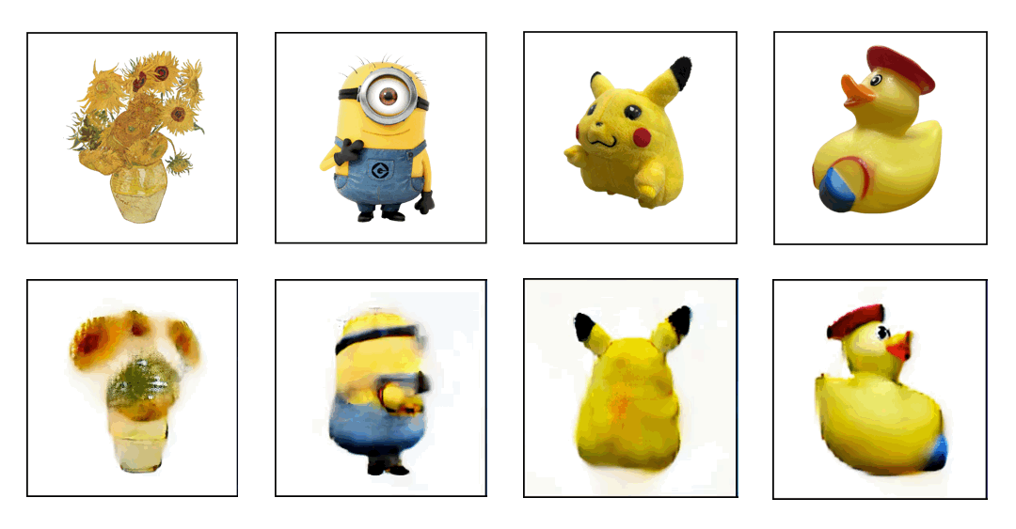
Experimental Results
Datasets:
Google Scanned Objects (GSO) – high-quality 3D scans of household items.
RTMV – complex multi-object scenes.
In-the-Wild Images – real-world photos taken with iPhone and artistic images.

Slide 6
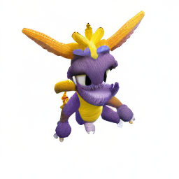
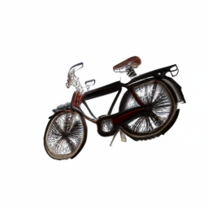
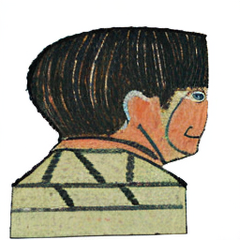
Limitations
Limitations:
Lacks explicit 3D representation (purely image-based).
Challenged by complex scenes (multiple objects, occlusion).
Viewpoint bias inherited from training data distribution.

Slide 7
Dreamfusion: Text-to-3d Using 2d Diffusion
Arxiv 2022
Ben Poole, Ajay Jain, Jonathan T. Barron, Ben Mildenhall
Google Research, UC Berkeley

Slide 8
Introduction to DreamFusion
Objective: Generate 3D models from text without explicit 3D supervision.
Challenge: 3D training data is scarce; 2D diffusion models lack 3D consistency.
Solution: Score Distillation Sampling (SDS) for NeRF optimization.

Slide 9
Method Overview
Uses pre-trained 2D diffusion model (Imagen) to generate view-consistent renders.
Optimizes a NeRF representation via SDS loss.
No explicit 3D supervision required.
Noise Residual: The difference between the predicted noise and the actual noise added during training. It measures how accurately the model removes noise from the input.
U-Net Jacobian: Represents how changes in the noisy input affect the predicted noise. It determines how sensitive the diffusion model is to variations in the input. Generator Jacobian: Describes how updates to the model parameters influence the generated image. It helps guide optimization when training a 3D representation using diffusion models.
SDS optimizes a 3D representation by distilling knowledge from a pretrained 2D diffusion model. It guides a NeRF to produce 3D objects whose 2D renderings align with the diffusion model’s learned image distribution. This enables text-to-3D generation without explicit 3D supervision while enforcing multi-view consistency.

Slide 10
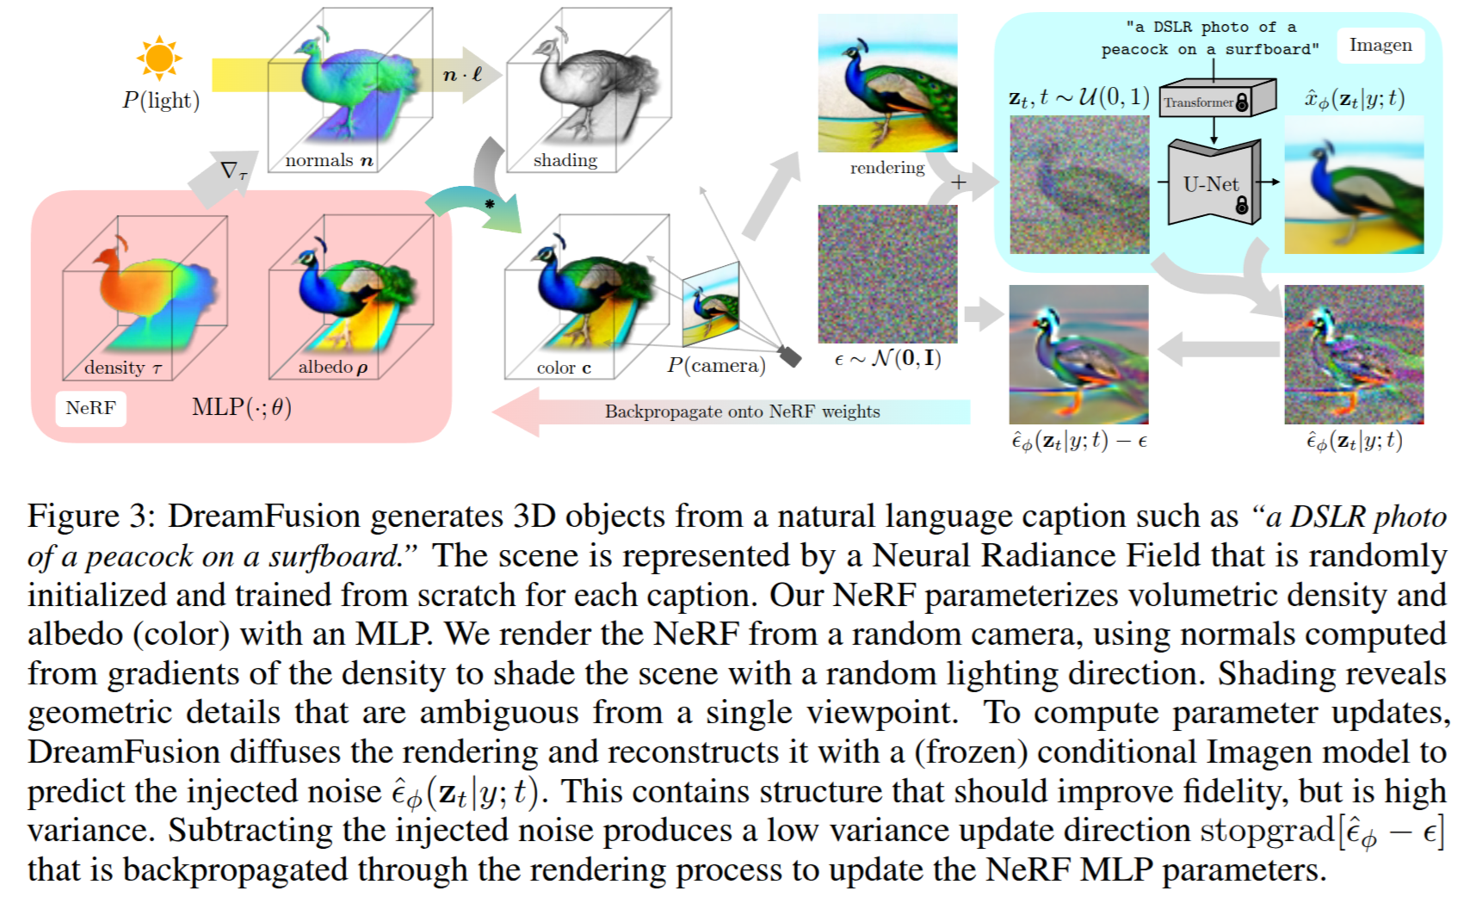
Model Architecture

Slide 11
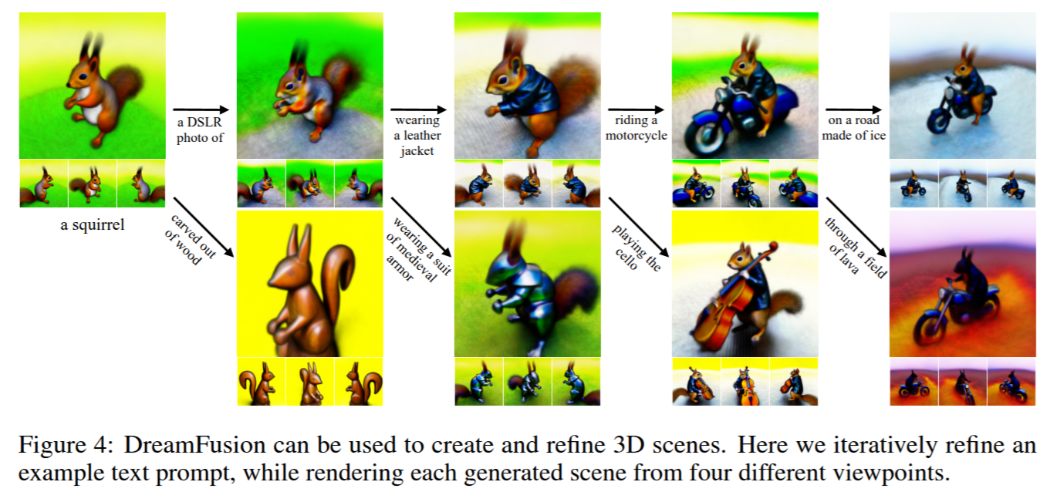
Key Contributions
Input: Text prompt → 2D diffusion model generates plausible views.
Optimization: NeRF iteratively updates to align with multi-view priors.
Output: A renderable 3D model, viewable from any angle.

Slide 12
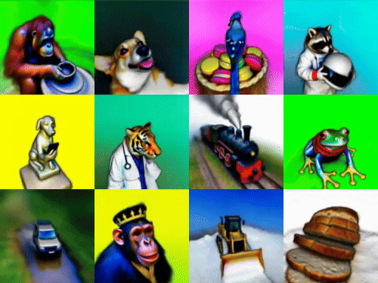
Experimental Results
Datasets:
Text-to-3D generation benchmark – diverse text prompts.
Synthetic datasets for evaluation of multi-view consistency.
Comparison with CLIP-based models (Dream Fields, Point-E).

Slide 13
Limitations & Future Work
Current Limitations:
No explicit mesh control (NeRF-based).
Computationally expensive optimization.
Struggles with intricate object structures.

