Slide 1
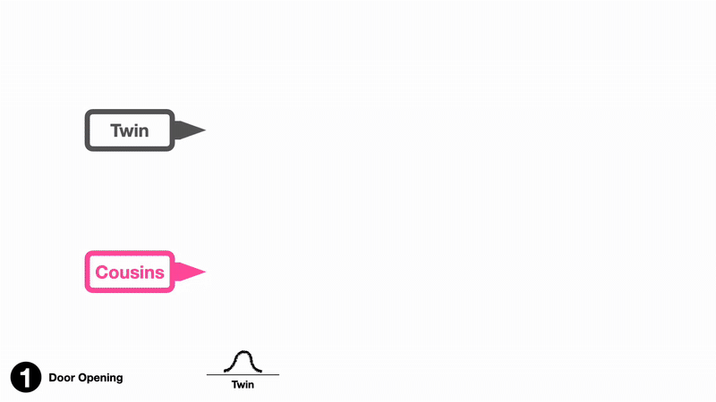
ACDC: Automated Creation of Digital Cousins for Robust Policy Learning
CoRL 2024
Tianyuan Dai,, Josiah Wong, Yunfan Jiang, Chen Wang, Cem Gokmen, Ruohan Zhang, Jiajun Wu, Li Fei-Fei
Stanford University
Presenter: Jing Wang

Slide 2
Motivation
Challenge in Robotics:
• Training policies directly on real robots is unsafe, expensive, and hard to scale.
• Simulation is an attractive alternative, but suffers from the Sim-to-Real gap due to differences in semantics and physics.
Traditional Method:
• Digital Twins: Full replicas of a real-world scene, which is high fidel but expensive and limited to one instance.
• Procedural/Randomized Simulations: Can cover wide distributions but may lack critical affordances.
Key Question: How to generate simulation data that is both inexpensive and robust enough to ensure successful sim-to-real transfer?

Slide 3
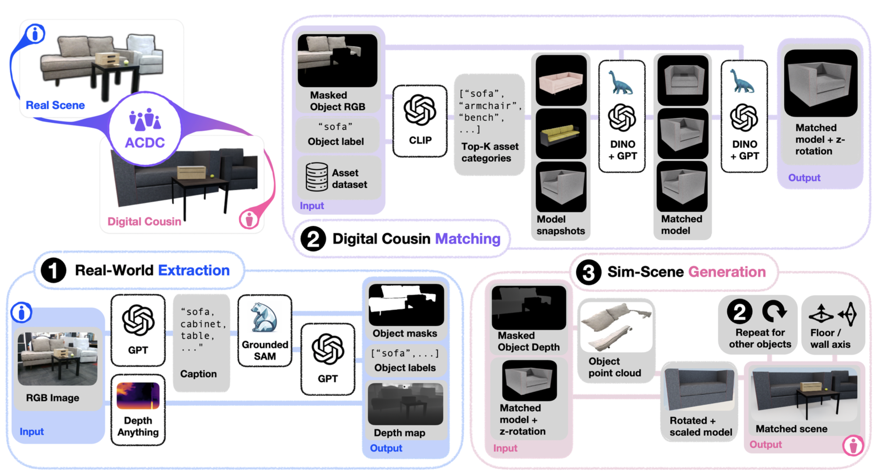
Digital Cousins
Definition: A digital cousin is a virtual scene or asset that does not exactly replicate a real-world scene (unlike a digital twin) but maintains similar high-level spatial and semantic affordances.
Advantages:
Cost-Efficiency: No need for reconstructing every detail.
Robustness: Training on a distribution of similar scenes (cousins) leads to policies that generalize better, especially when transferring to the real world.
Visual Example: Compare a digital twin (exact replica) with multiple digital cousins that vary in details but preserve critical features (e.g., cabinet layout, handle positions).

Slide 4
Overview
Three sequential stages:
1. Real-World Extraction:
Input: A single RGB image captured by a calibrated camera.
GPT-4: Generates descriptive captions for objects in the scene.
GroundedSAM-v2: Extracts object masks based on the captions.
Depth-Anything-v2: Estimates a depth map to extract 3D point clouds.
Output: Object representations that include semantic labels, masks, depth information, and point clouds.

Slide 5
Overview
Three sequential stages:
2. Digital Cousin Matching:
Dataset: Uses a large asset dataset (e.g., BEHAVIOR-1K).
Matching Process:
CLIP Similarity: Identifies top candidate asset categories based on object captions.
DINOv2 Embeddings: Compares masked RGB images to asset snapshots to choose the closest “digital cousin” candidates.
Output: For each object, select one or more digital cousins with an optimal asset and orientation.

Slide 6
Overview
Three sequential stages:
3. Simulated Scene Generation:
Assembly: Assets are positioned based on the object point clouds.
Post-Processing:
Rescaling, orientation adjustments, and de-penetration (collision resolution) are performed.
Special handling for wall-mounted objects via GPT-4 prompts.
Result: A fully interactive and physically plausible simulated scene that preserves high-level layout and affordances.

Slide 7
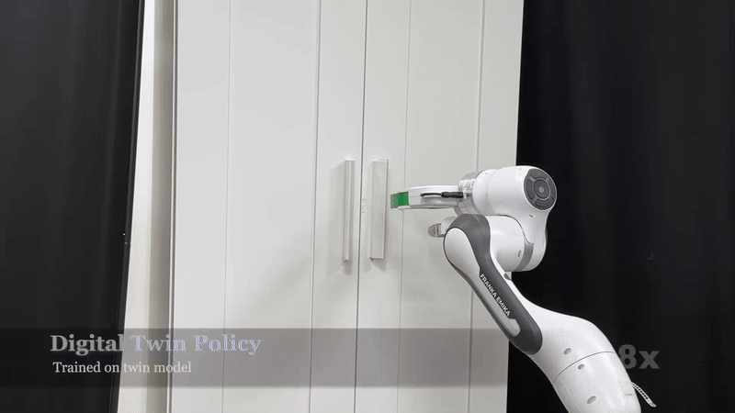
Policy Learning on Digital Cousins
Methodology:
Imitation Learning: Train robot policies using scripted, programmatically generated demonstrations.
Skill Primitives: Define basic skills such as:
Open/Close: For articulated objects like doors or drawers.
Pick/Place: For object manipulation tasks.
Data Collection: Automated demonstration collection in simulation using motion planning and ground-truth information.
Domain randomization is applied to enhance robustness.
Result: Policies trained on digital cousins achieve comparable performance to those trained on exact digital twins in-simulation and show significant improvements in robustness and sim-to-real transfer.

Slide 8
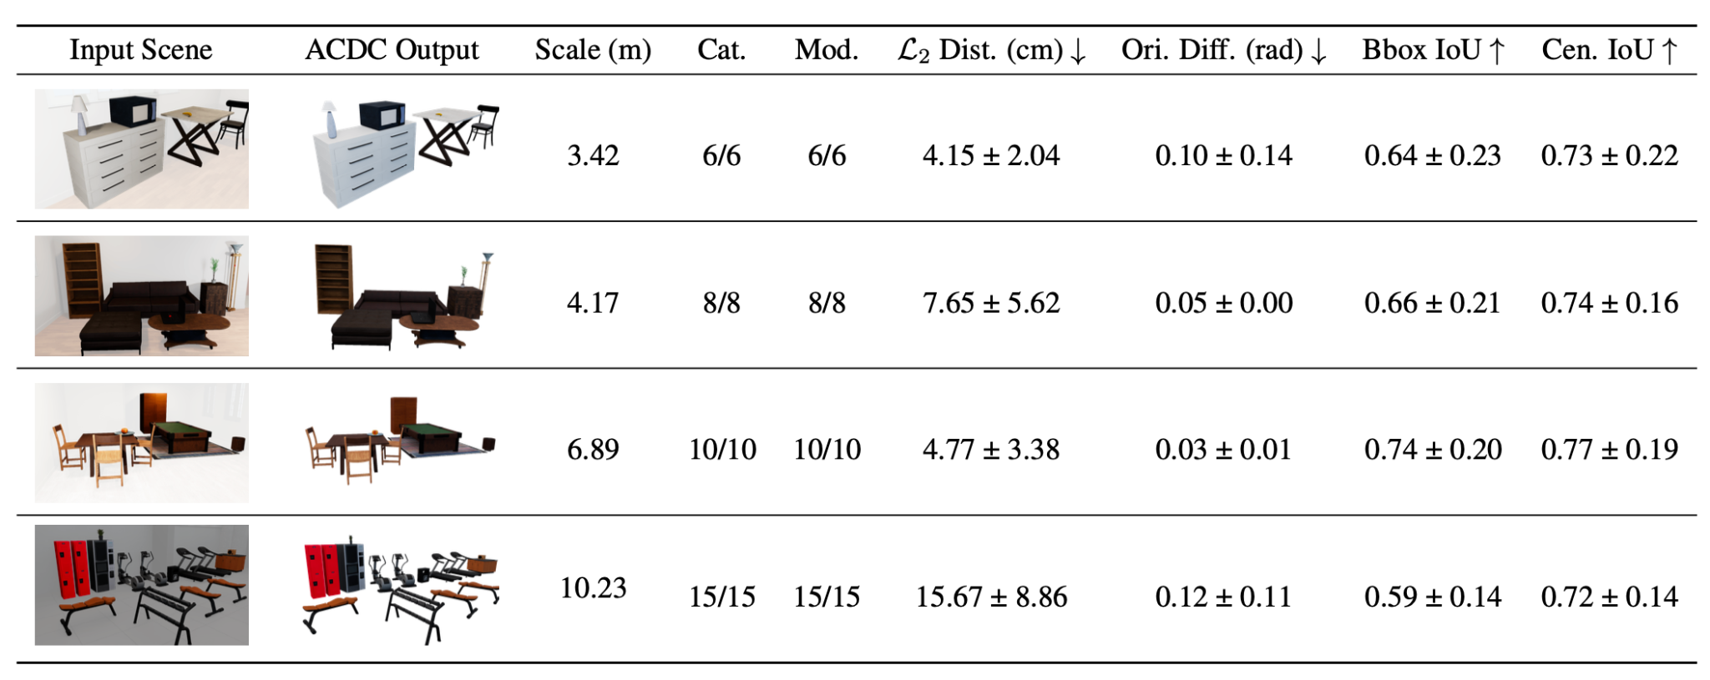
Experimental Results

Slide 9
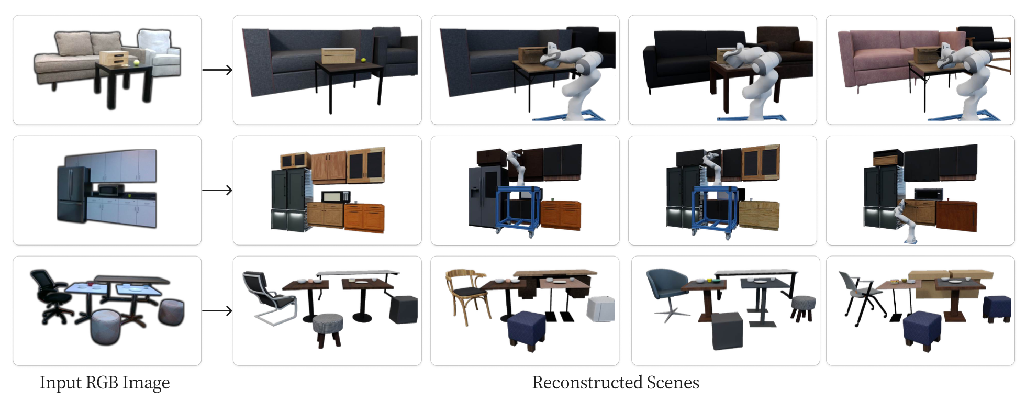
Experimental Results

Slide 10
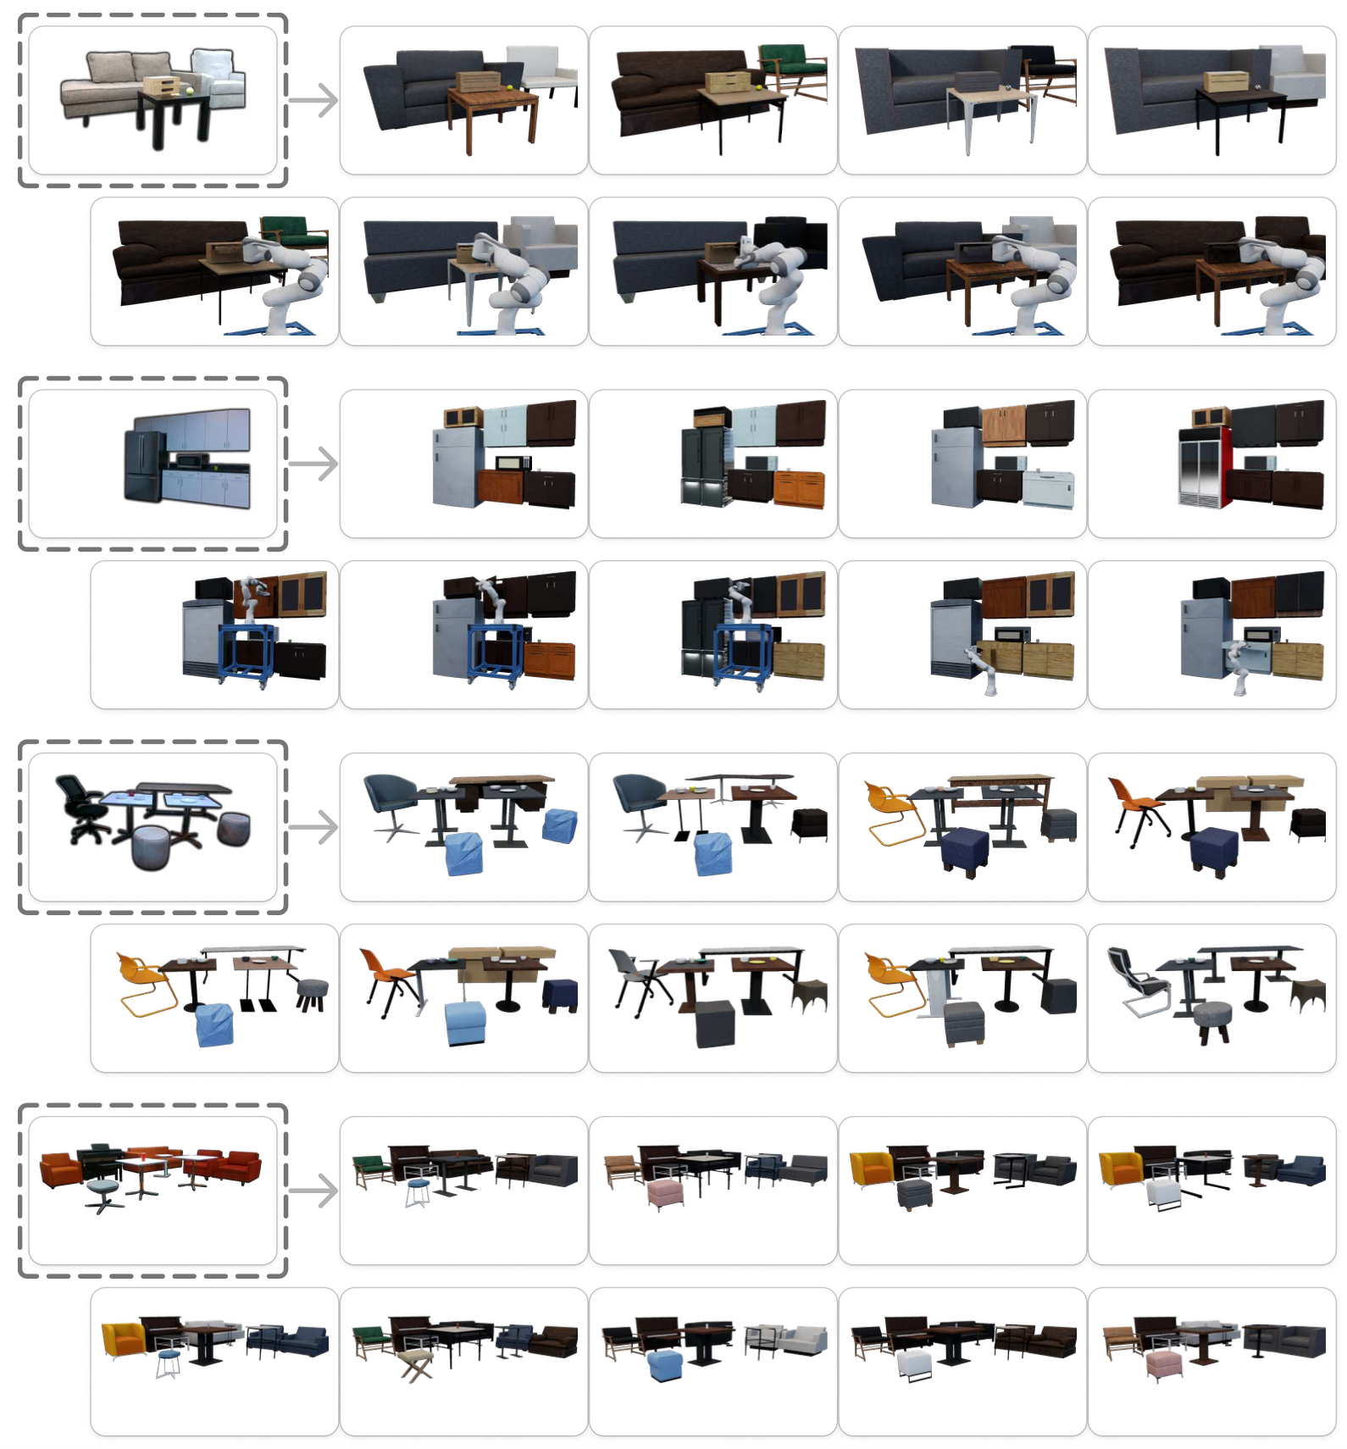
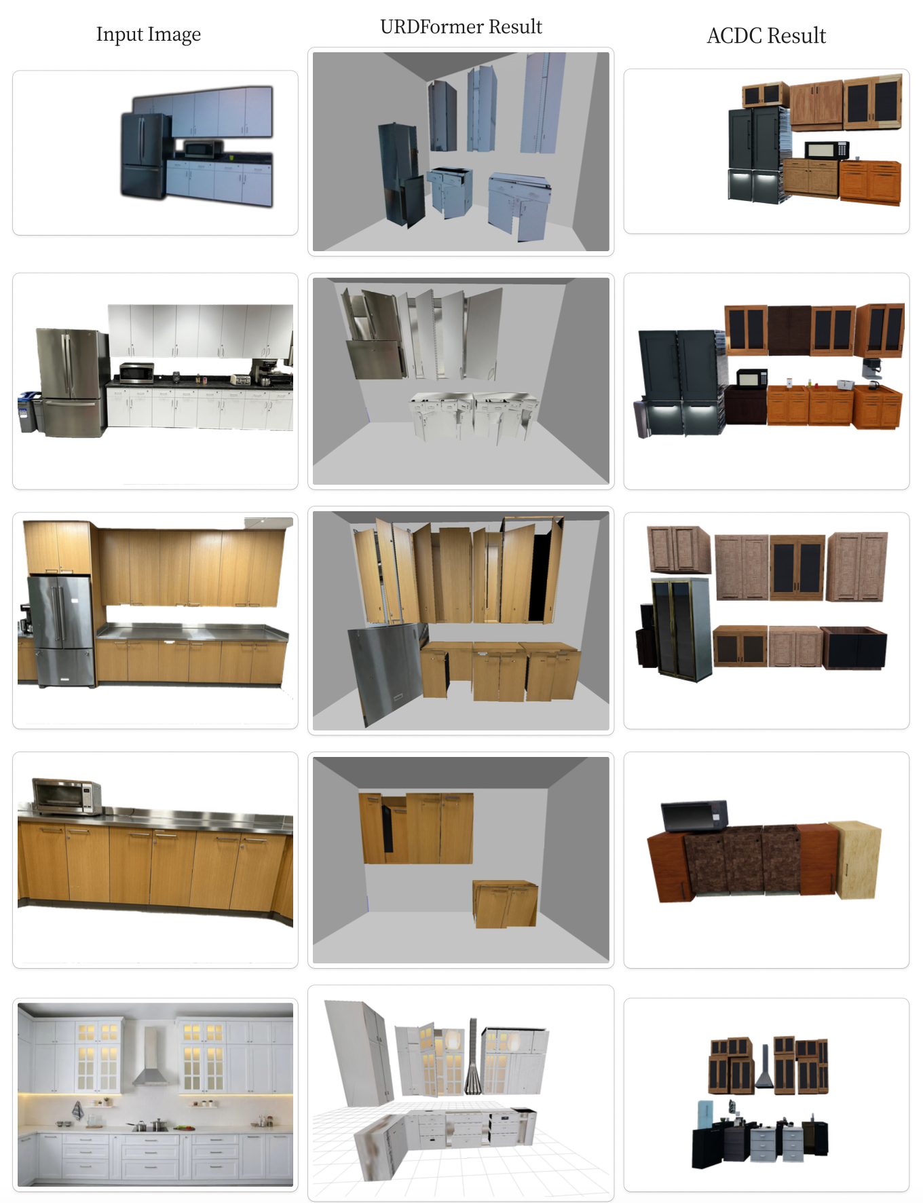
Experimental Results

Slide 11
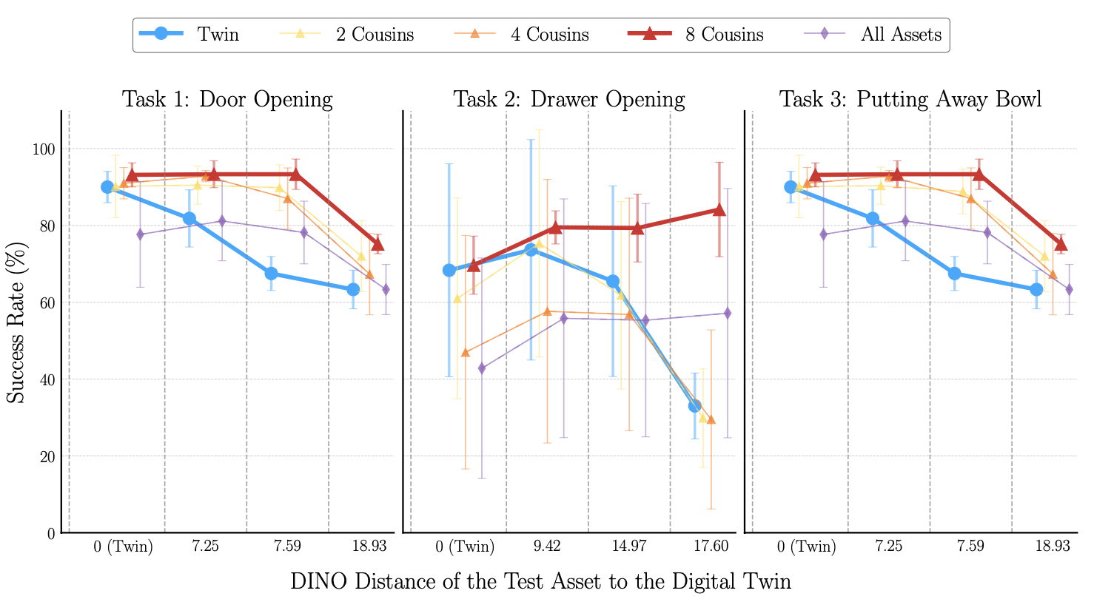
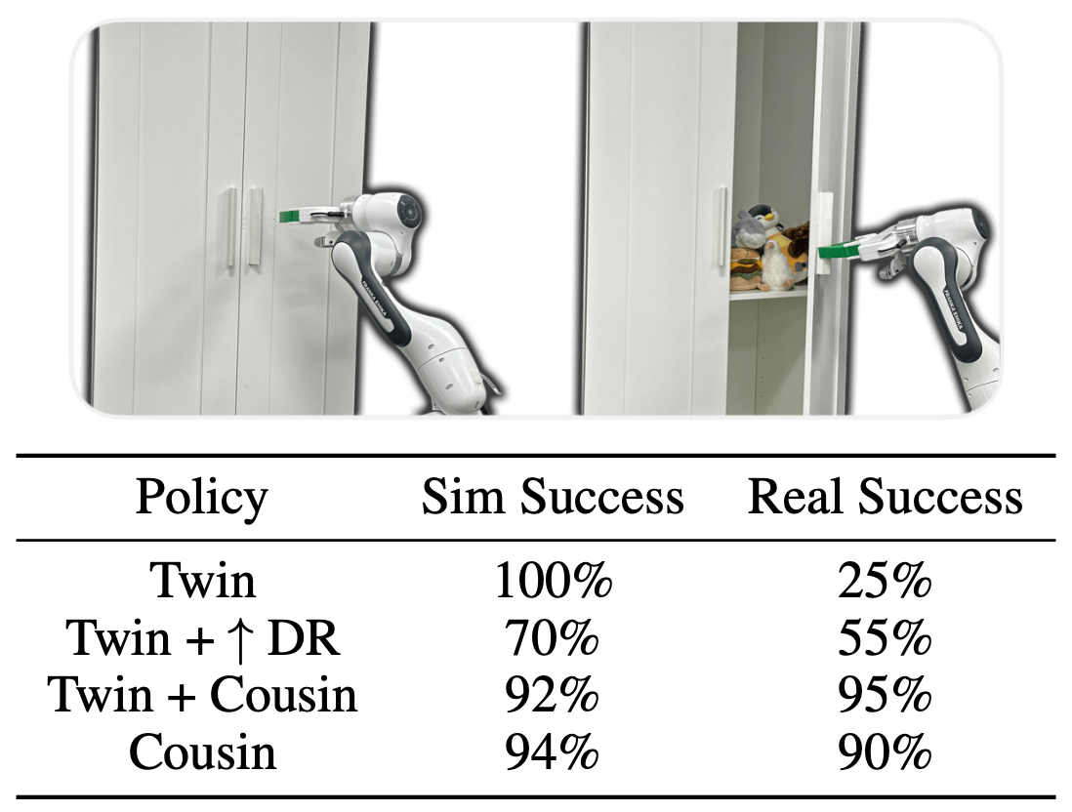
Experimental Results

