Slide 1
Single View Reconstruction

Slide 2
Single View Reconstruction and Its Problems
What is Single View Reconstruction?
Recovering 3D structure from a single 2D image.
Limitation of Scene Reconstruction with a Single Image
Ill-posed Problem – Multiple 3D structures can produce the same 2D image.
Difficult to Reconstruct Occluded Regions – Missing information due to occlusion.
Novel View Synthesis – Objects look different from different viewpoints.

Slide 3
Flash3D

Slide 4
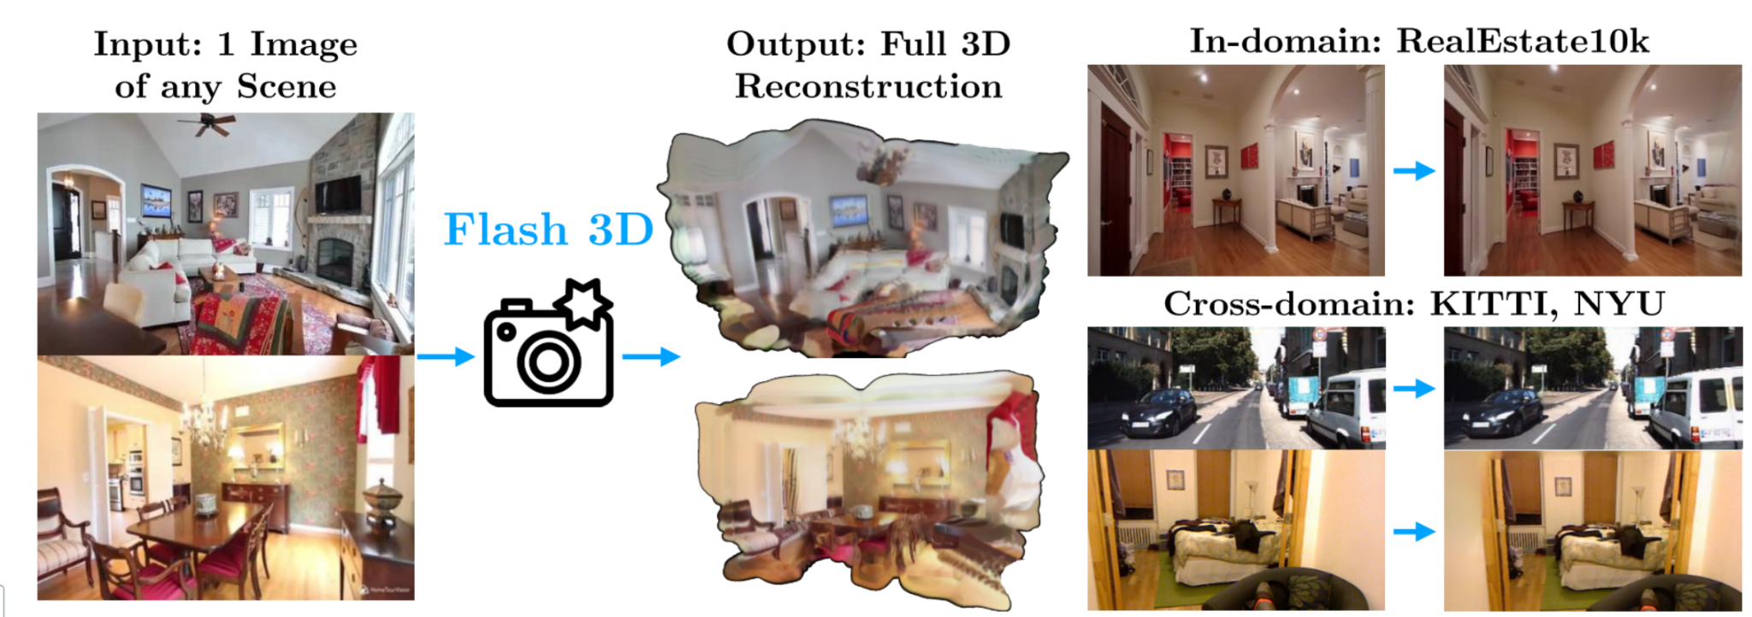
About Flash3D
Flash3D reconstructs the 3D (not 2.5D) scene structure and appearance from just a single image
Trained on just RealEstate10k dataset, and also generalises in cross-domain datasets like KITTI, NYU.
Trained on single A6000 GPU in 16 hours

Slide 5
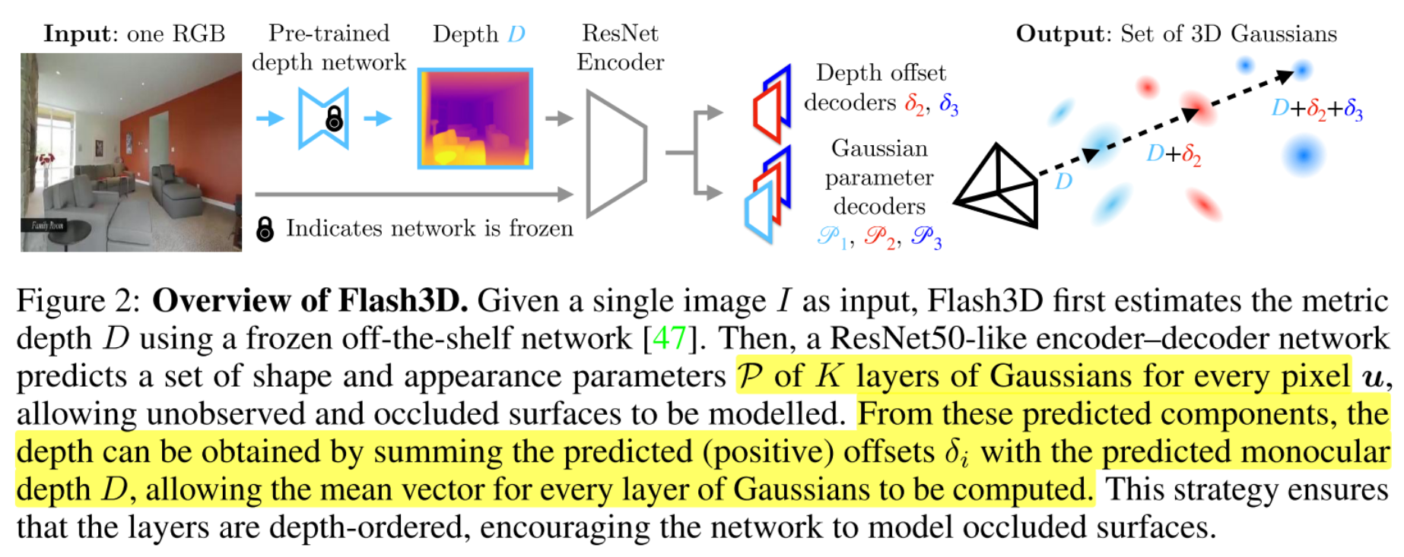
Flash3D: Model Architecture

Slide 6
Flash3D: Baseline Architecture

Slide 7
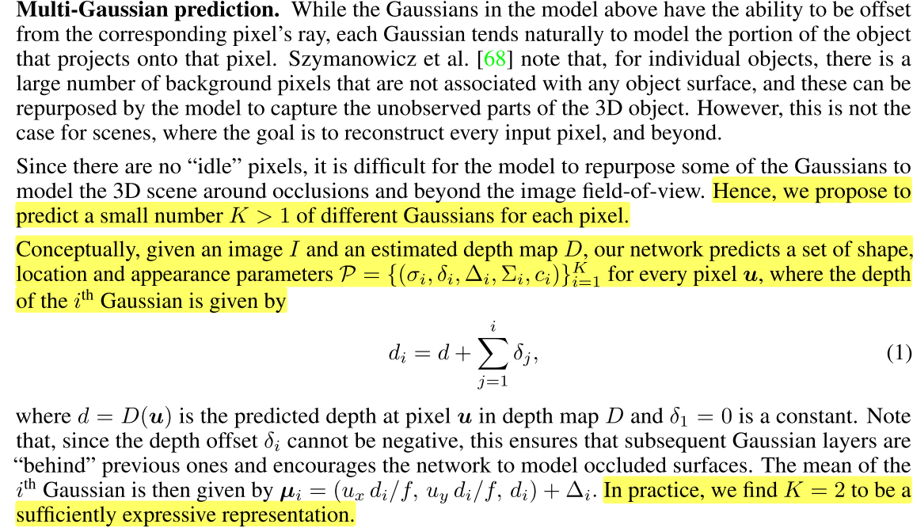
Flash3D: Multi-Gaussian Prediction

Slide 8
Experimental Results

Slide 9
Cross-Domain Novel View Synthesis in KITTI Dataset
Notation:
CD ✓: Trained on one dataset (RealEstate10K) and Tested in KITTI
CD ✗: Trained and Tested on same dataset (KITTI dataset)

Slide 10
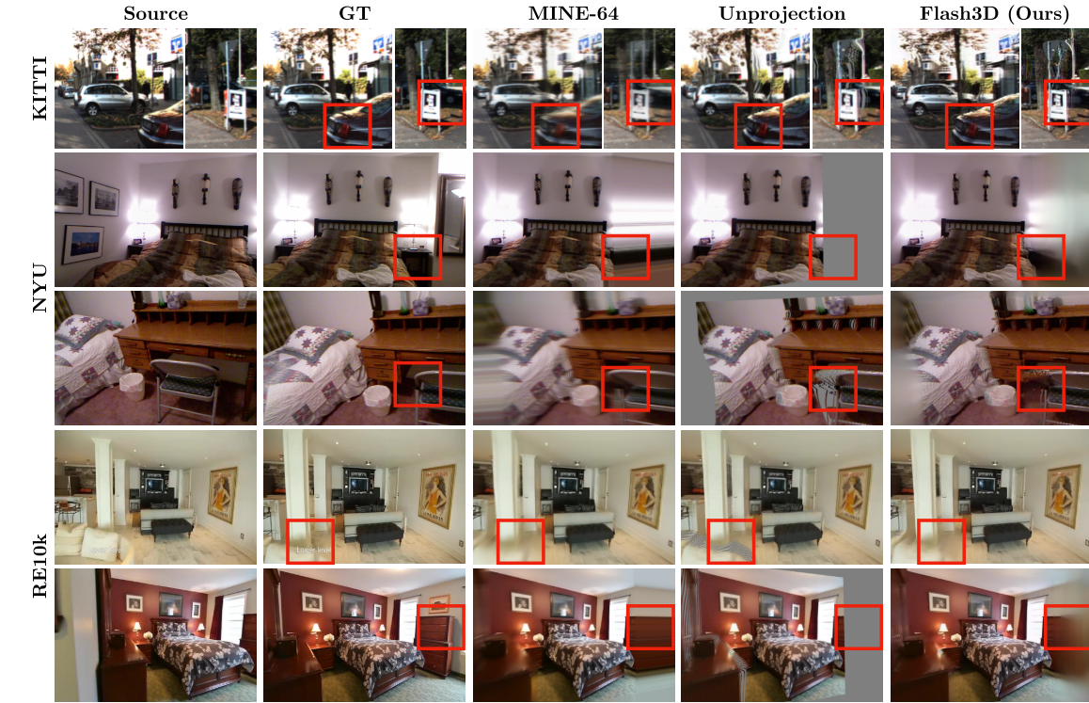
Qualitative Analysis of Single View Scene Reconstruction

Slide 11
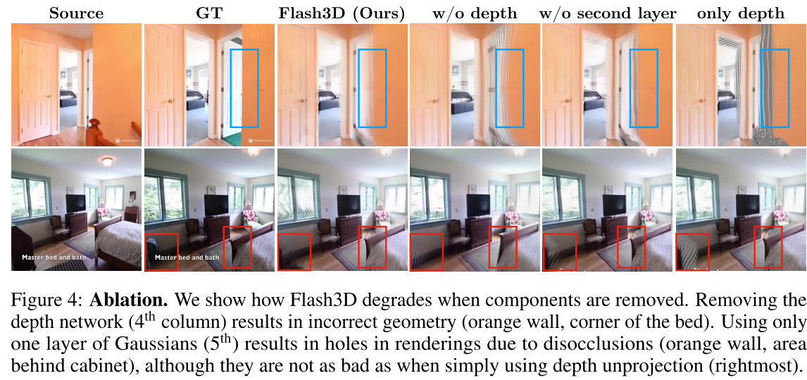
Ablation Study: Effect of each layers

Slide 12
Demo: Scene Reconstruction using single Image

Slide 13
Dream Gaussian

Slide 14
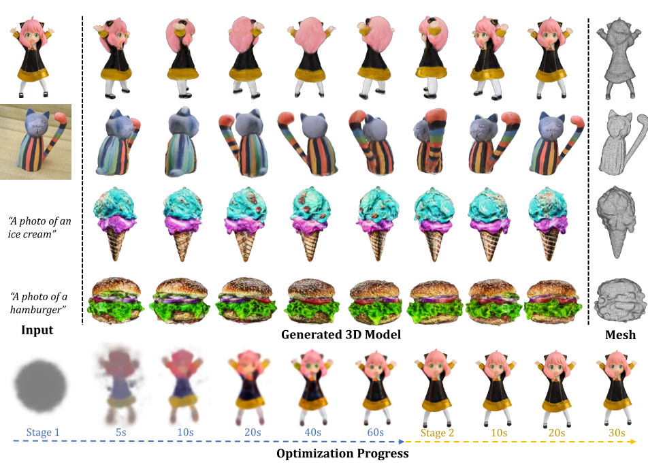
DREAM GAUSSIAN adapted 3D Gaussian splatting into generative settings for 3D content creation (Text to 3D, and Image to 3D)
Designed an efficient mesh extraction algorithm from 3D Gaussians and a UV-space texture refinement stage to further enhance the generation quality

Slide 15
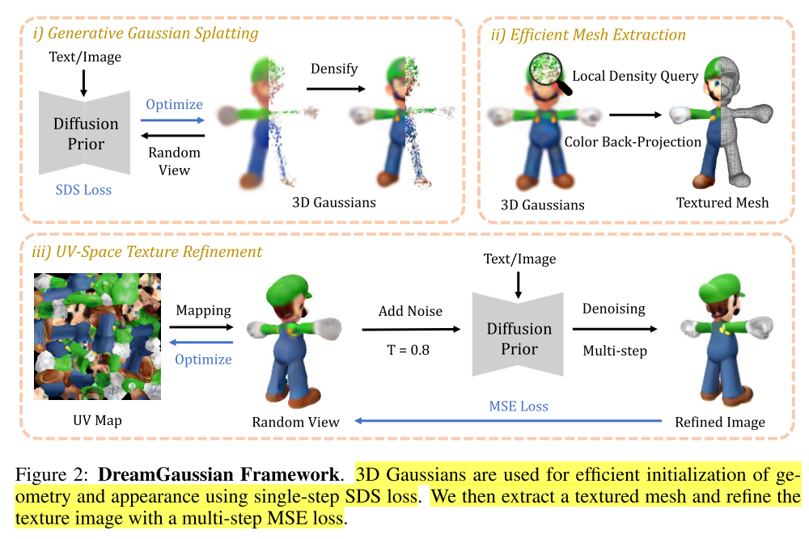
DREAM GAUSSIAN: Model Architecture

Slide 16
Initializing Gaussian Splats

Slide 17
Image to 3D: Single Image Reconstruction

Slide 18
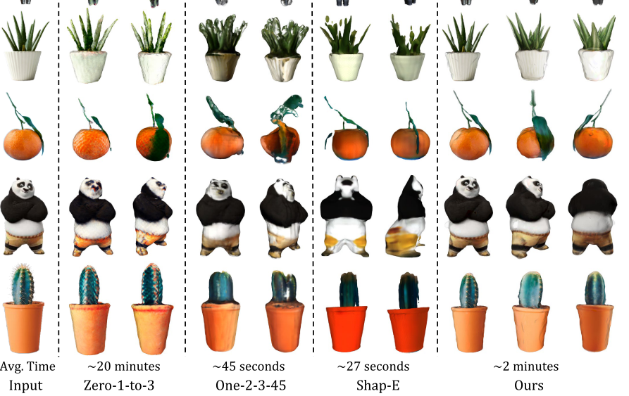
Qualitative Analysis: Single View Reconstruction

Slide 19
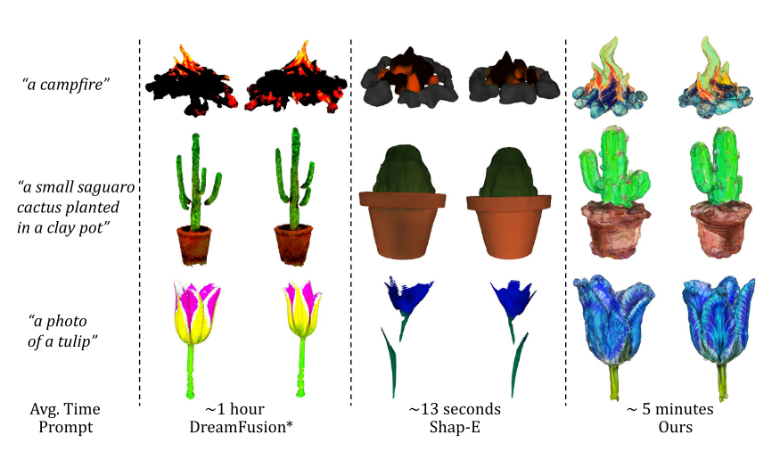
Qualitative Analysis: Text-to-3D Reconstruction

Slide 20
Ablation Study: Model Architecture

Slide 21
Thank You

