Slide 1
Splatter Image: Ultra-Fast Single-View 3D Reconstruction
Stanislaw Szymanowicz Christian Rupprecht Andrea Vedaldi
Visual Geometry Group - University of Oxford

Slide 2
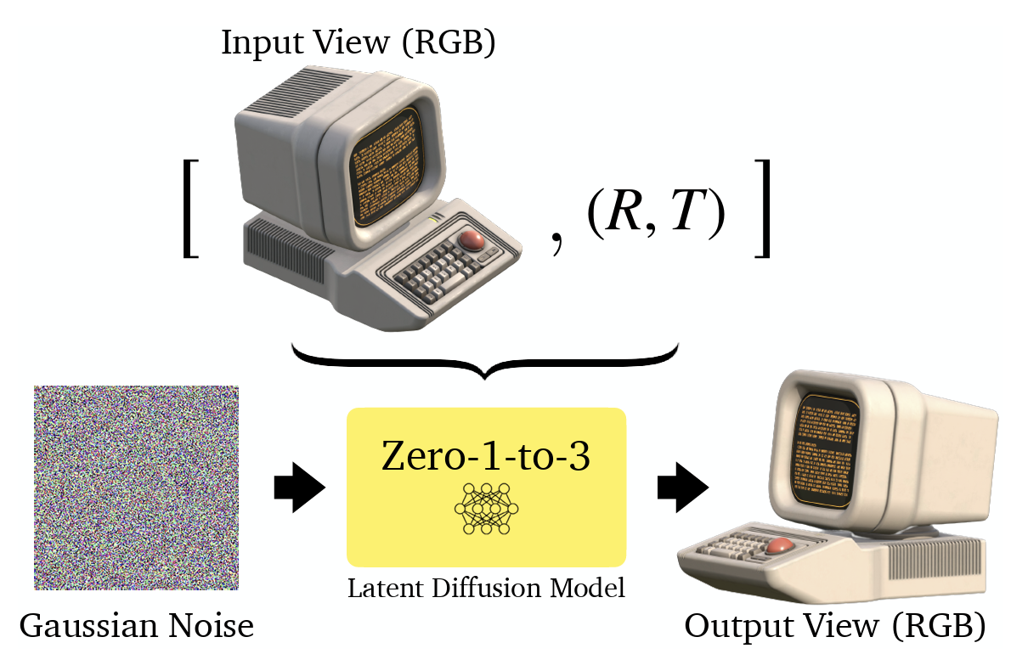
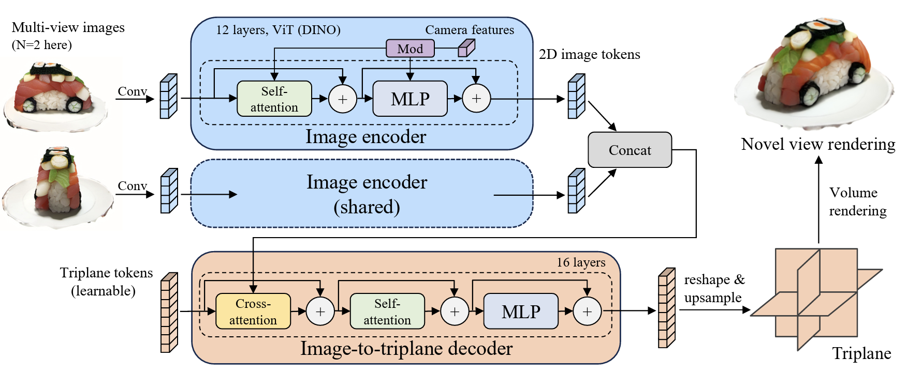
Related work
Representations for single-view 3D reconstruction
NeRF, voxel grid, triplane
Probabilistic 3D Reconstruction
Image space: Zero-1-to-3 (ICCV23), Instant3D (ICLR24), ViewsetDiffusion (ICCV23)
NeRF: pixelNeRF (CVPR21), GeNVS (ICCV23), DMV3D (ICLR24)
Zero-1-to-3
Instant3D
pixelNeRF
Notes:
NeRF: slow in inference
Voxel grid: scale pooly in with resolution
Triplane: a compromise between rendering speed and memory consumption, require hundreds of GPUs to train for multiple days
Ours: predict a mixture of 3D Gaussians, cheap to train (1-2 GPUs)

Slide 3
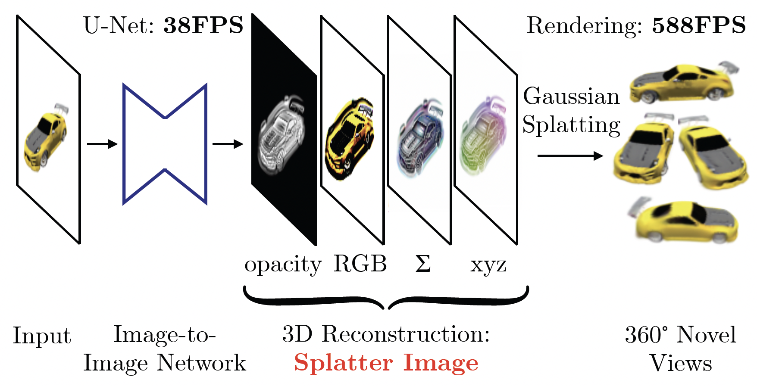
Deterministic reconstruction
Previous methods tackled 3D reconstruction as a conditional generation task.
Deterministic reconstruction:

Slide 4
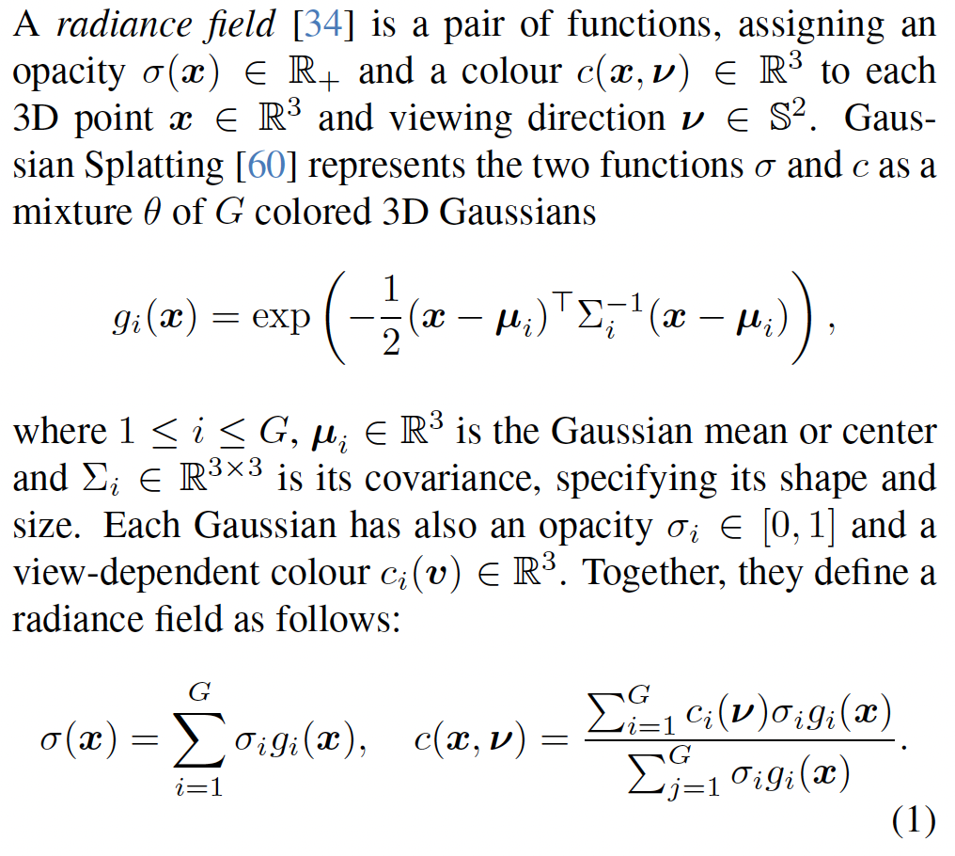
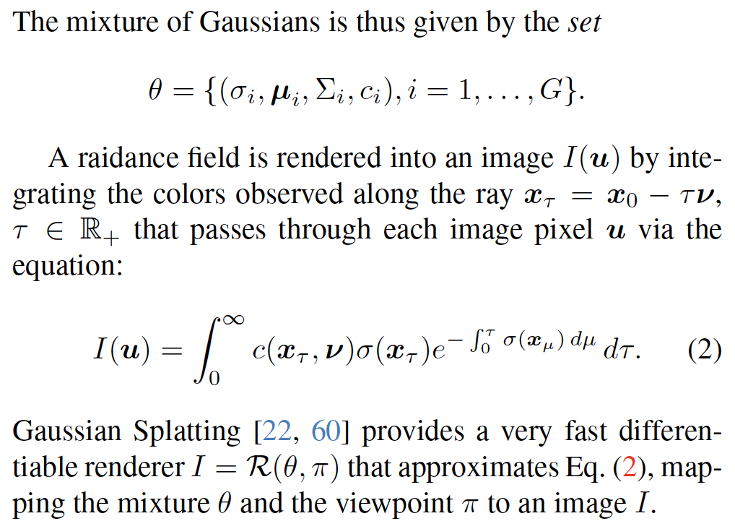
Overview of Gaussian splatting

Slide 5
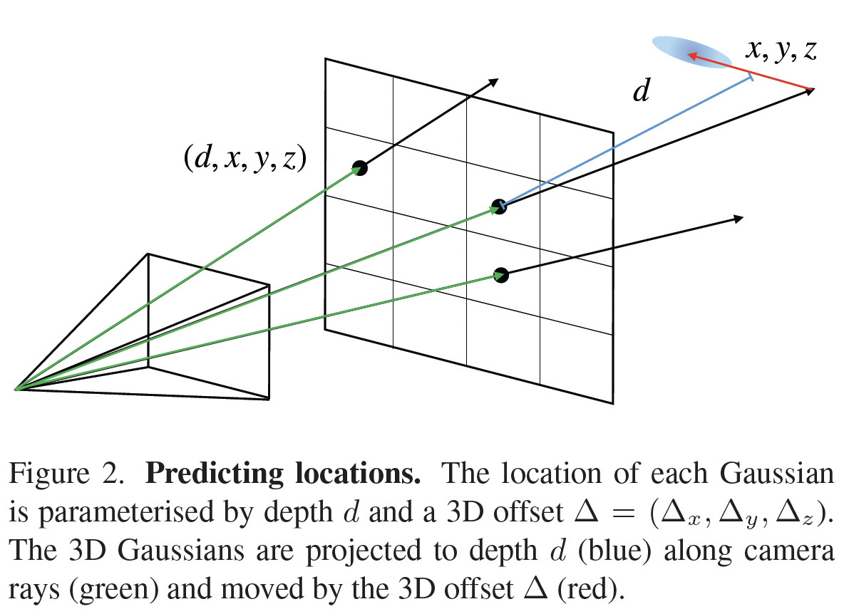
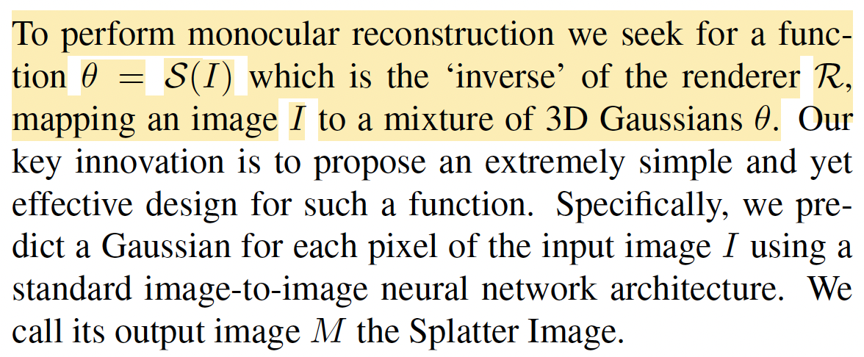
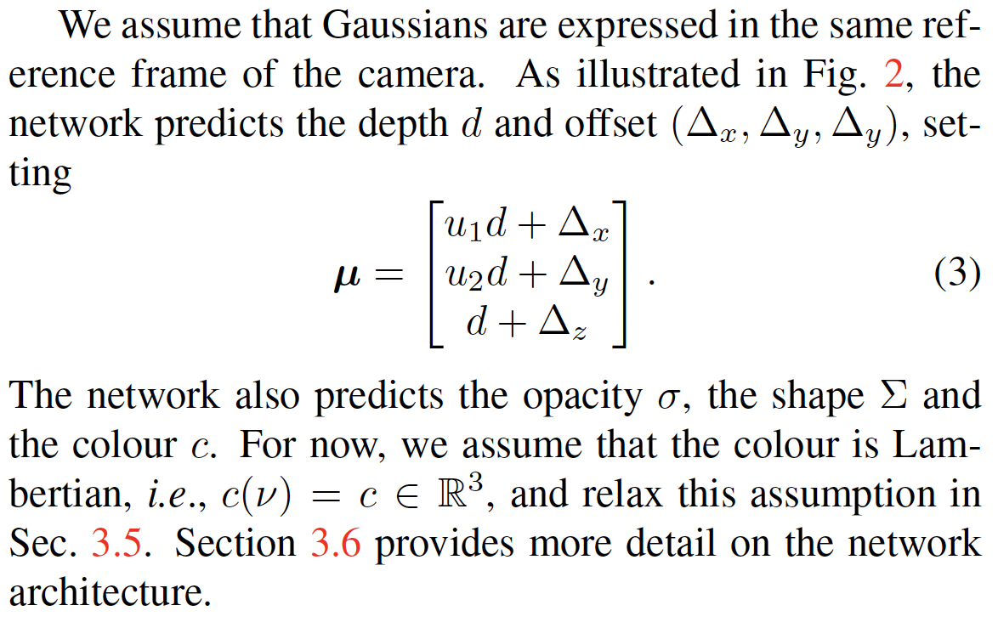
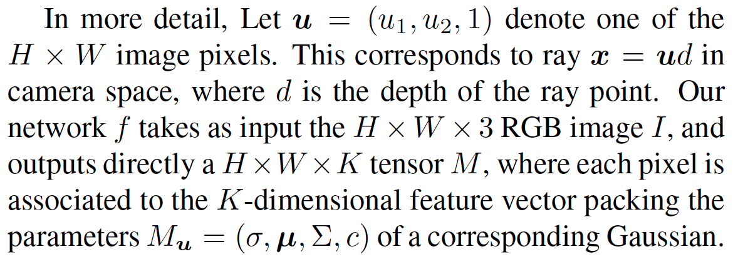
The splatter image

Slide 6
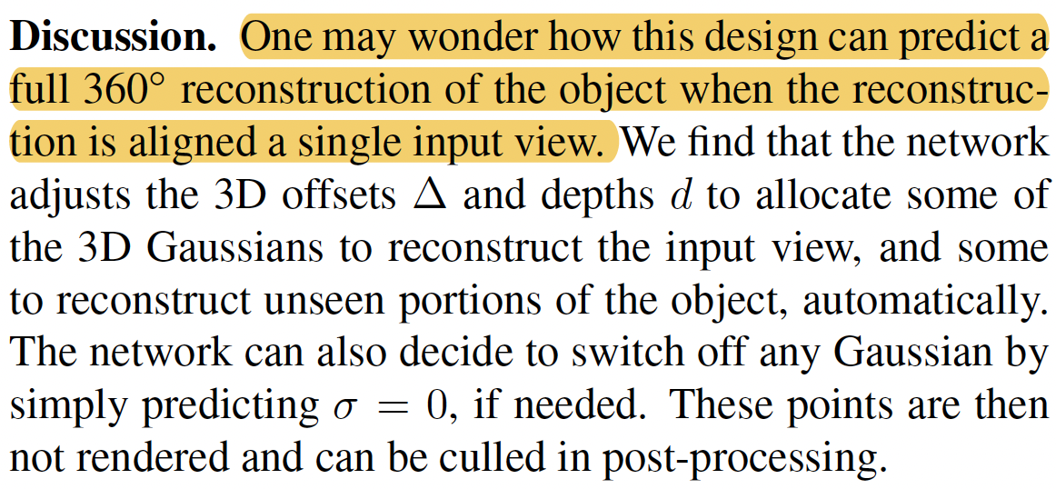
The splatter image

Slide 7
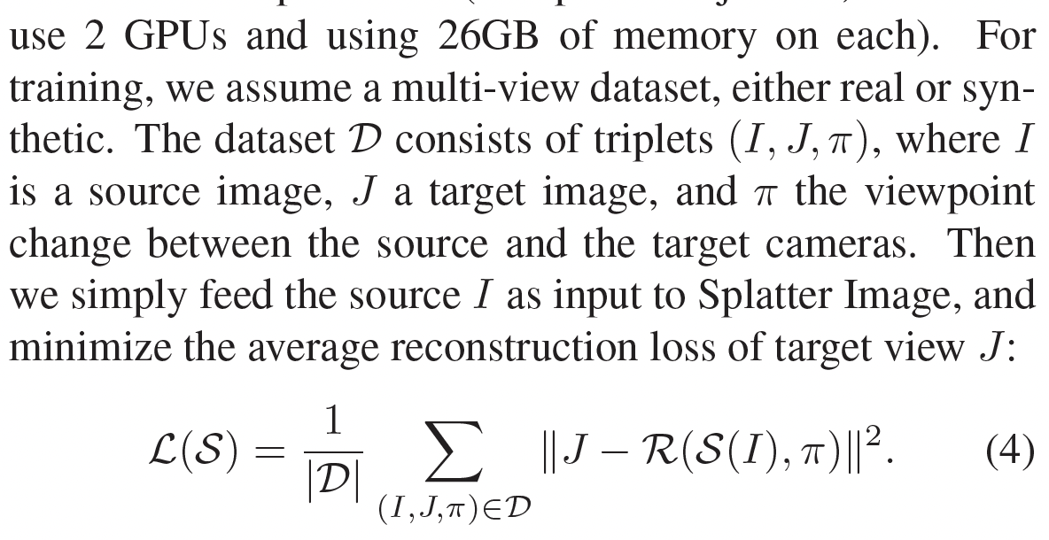
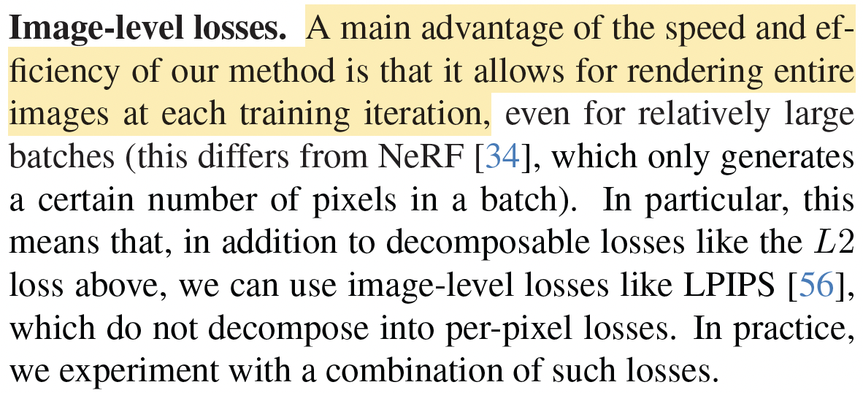
Learning formulation

Slide 8
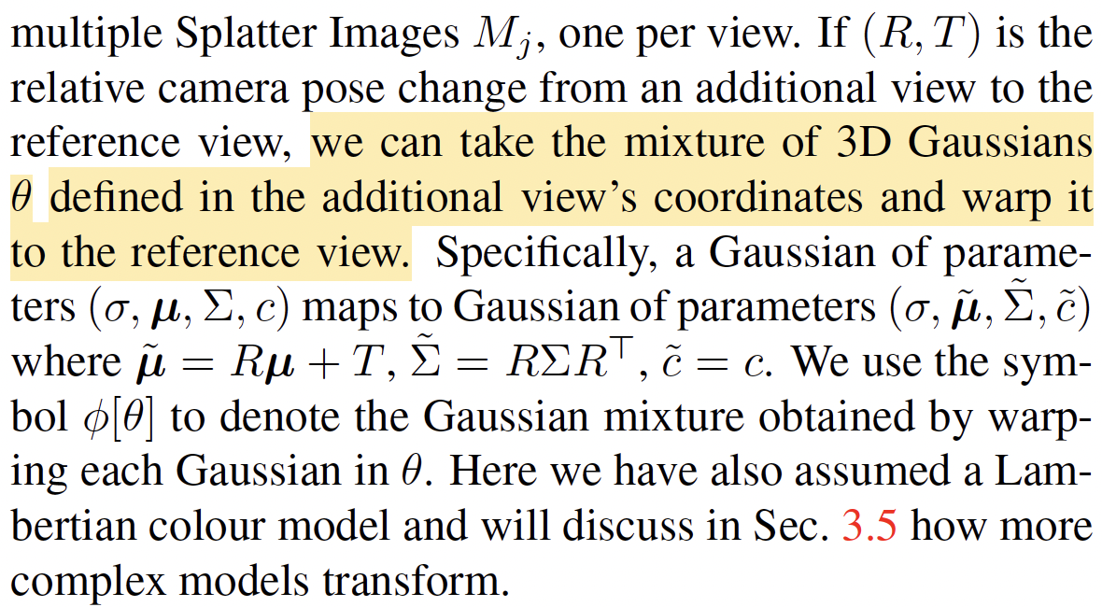
Extension to multiple input viewpoints

Slide 9
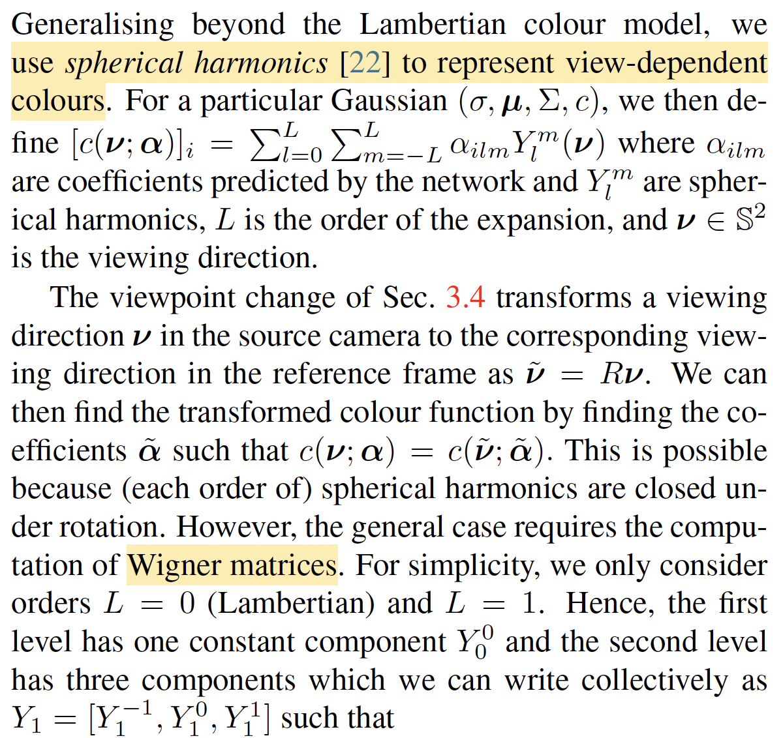
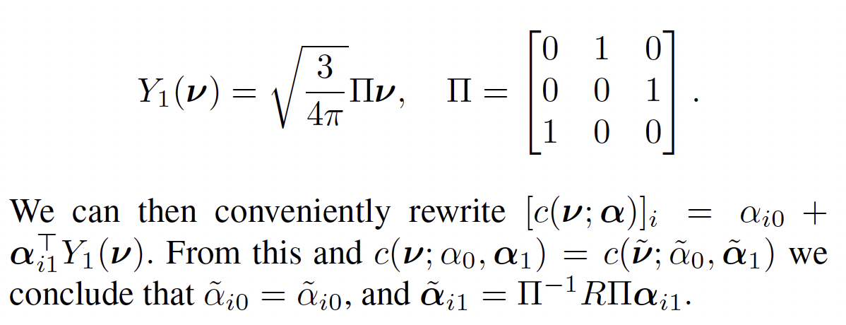
View-dependent colour
Notes:
颜色的 0 阶系数保持不变，而 1 阶系数受到旋转矩阵影响，但可以用 Π−1RΠ\Pi^{-1} R \PiΠ−1RΠ 进行变换。

Slide 10
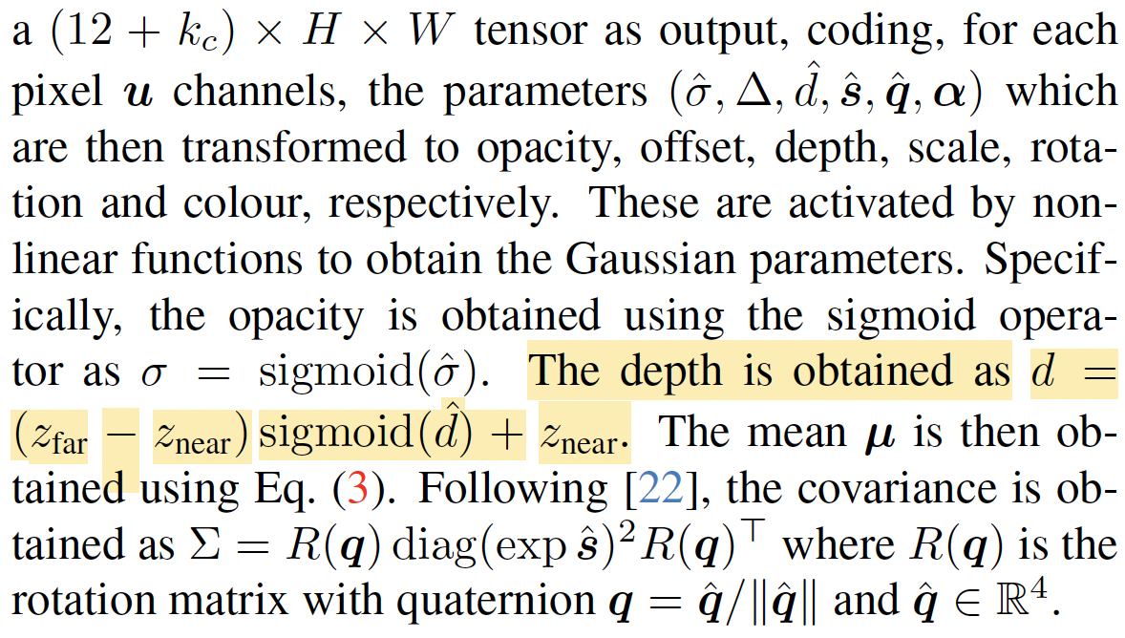
Network architecture

Slide 11
Experiments
Datasets
ShapeNet-SRN, car and chair classes (single-view reconstruction)
CO3D (real objects), Hydrants and Teddybears
Multi-category datasets: ShapeNet and Objaverse-LVIS
Baselines
For ShapeNet, implicit (pixelNeRF), hydrid implicit-explicit and explicit methods
For CO3D, pixelNeRF
Objaverse-LVIS, OpenLRM
do not compare to methods that employ Score Distillation or feedforward diffusion models

Slide 12
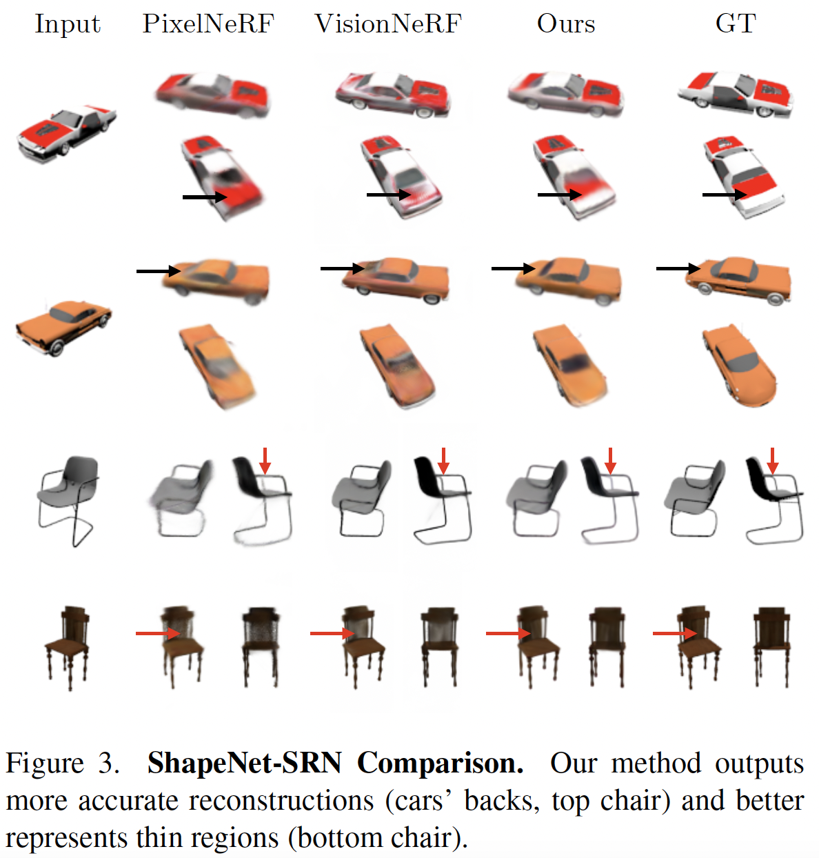
Single-view 3D reconstruction (ShapeNet)

Slide 13
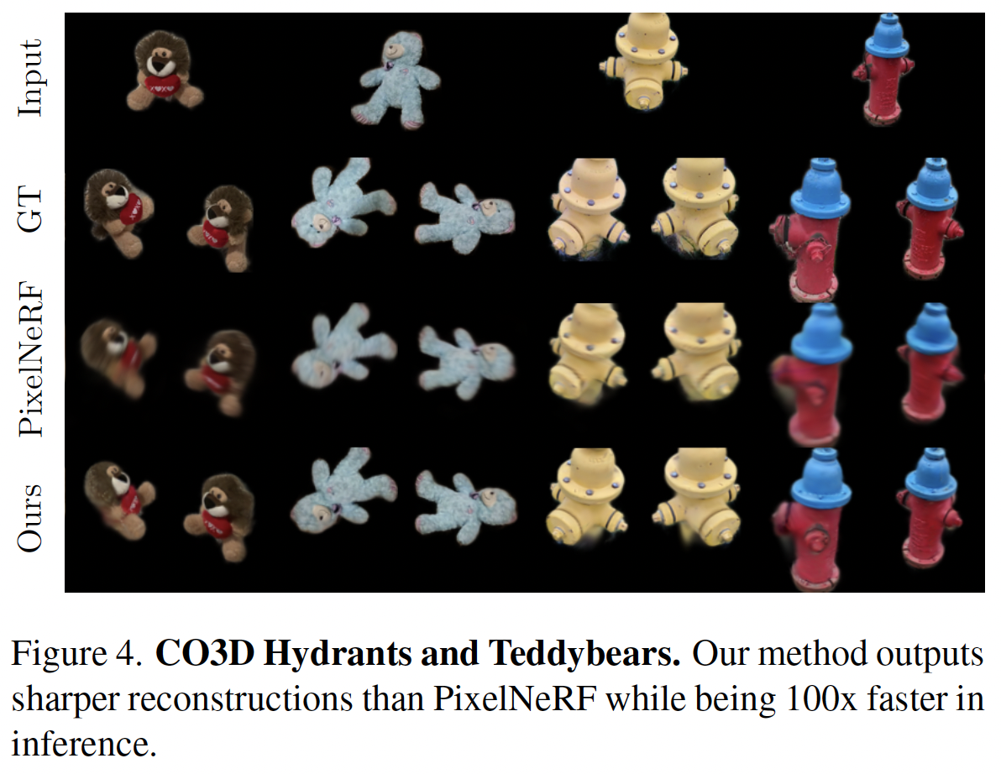
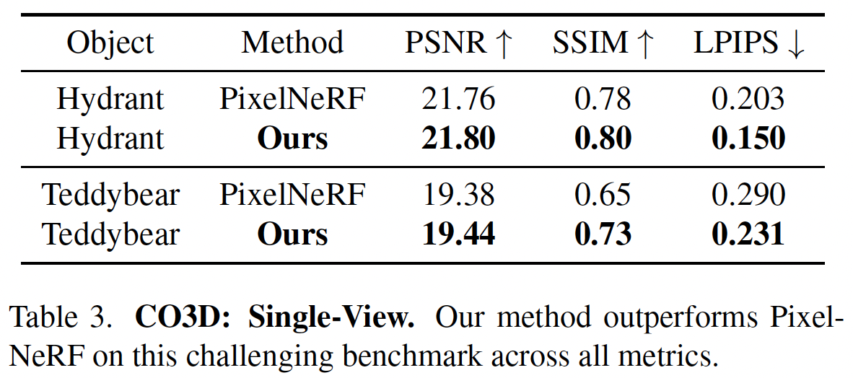
Single-view 3D reconstruction (CO3D)
Produces sharper images while being 1,000 faster.

Slide 14
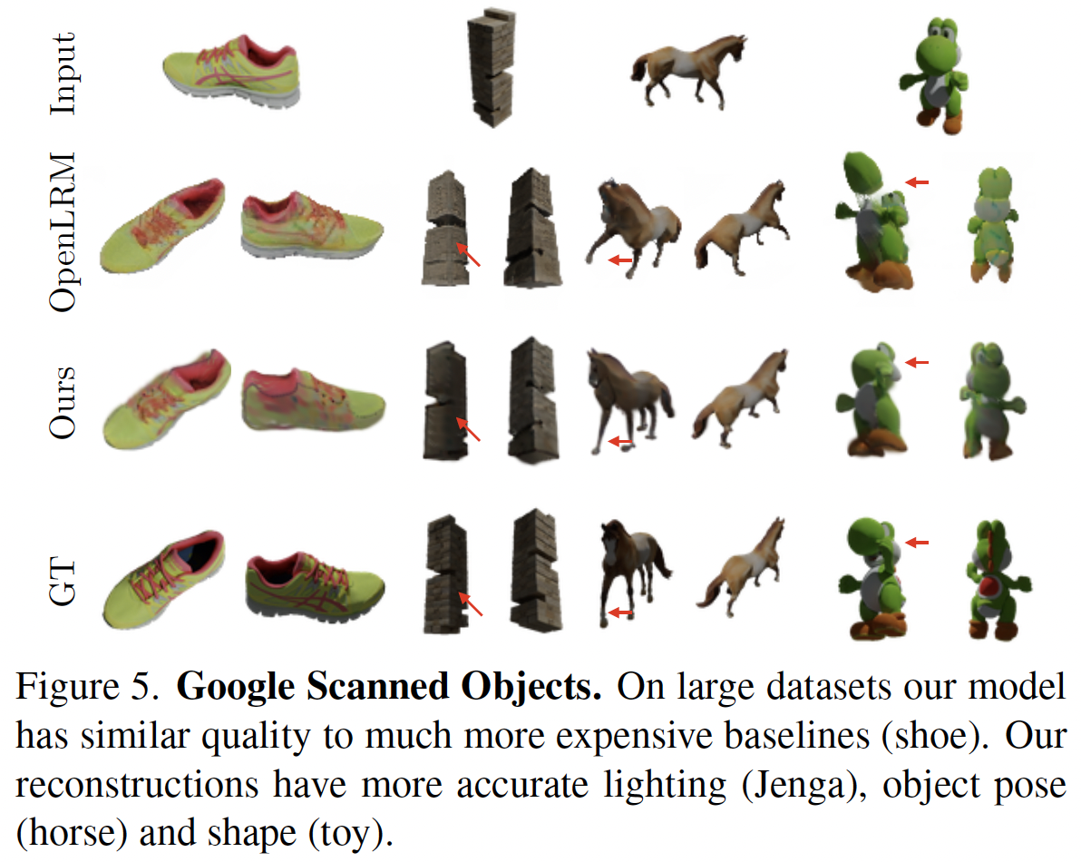
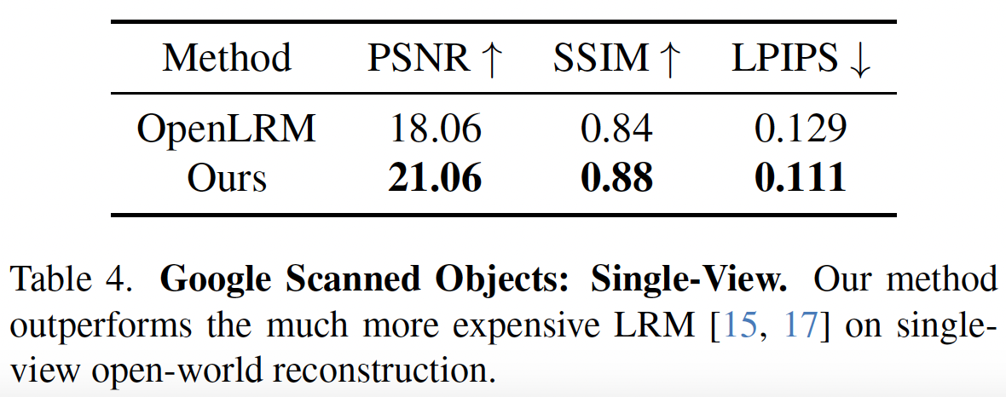
Single-view 3D reconstruction (Google Scanned Objects)

Slide 15
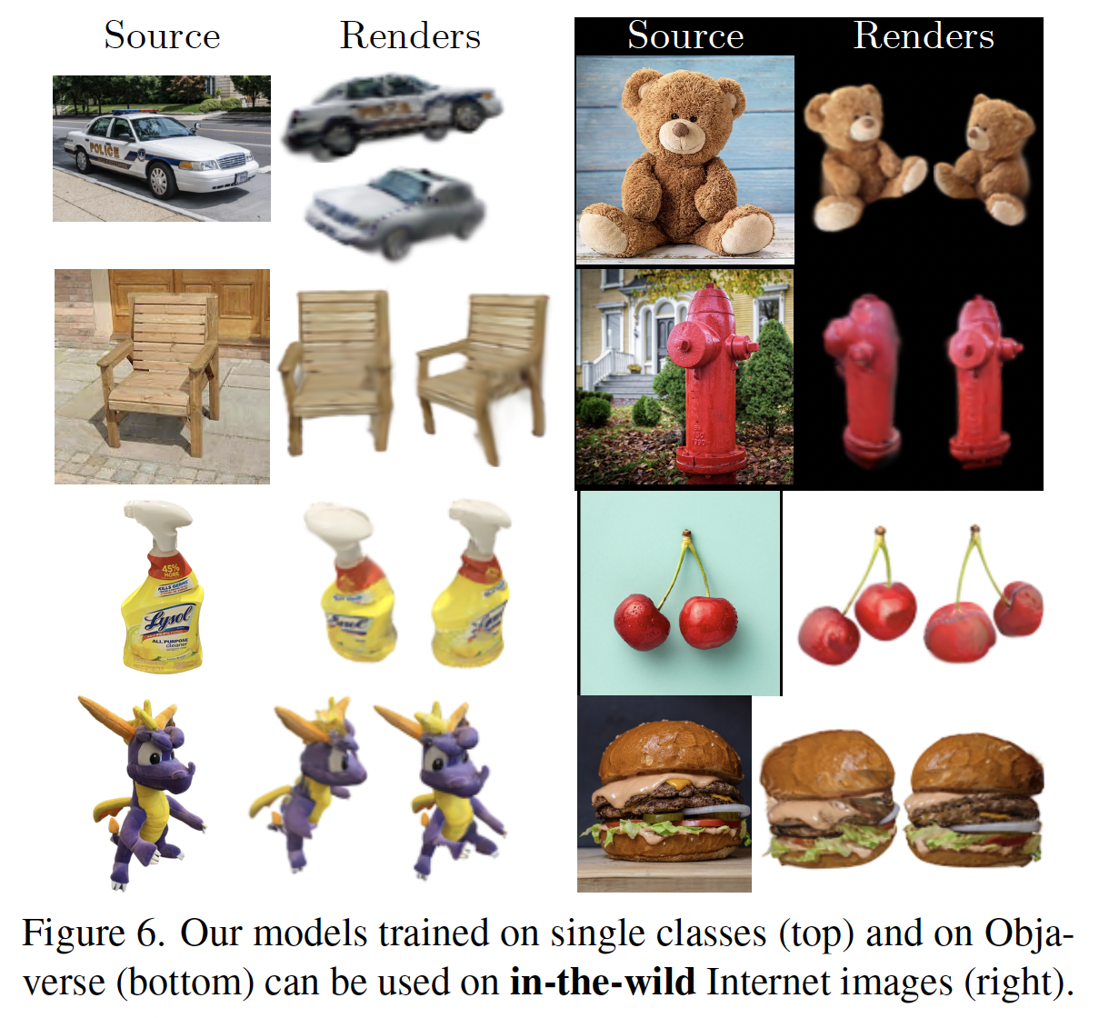
Single-view 3D reconstruction (in-the-wild images)

Slide 16
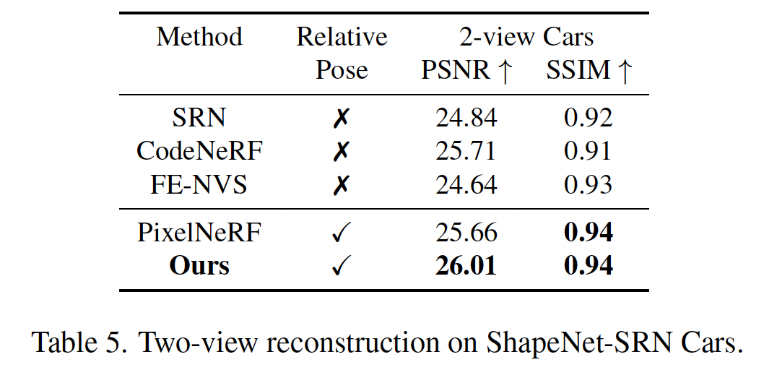
Two-view 3D reconstruction

Slide 17
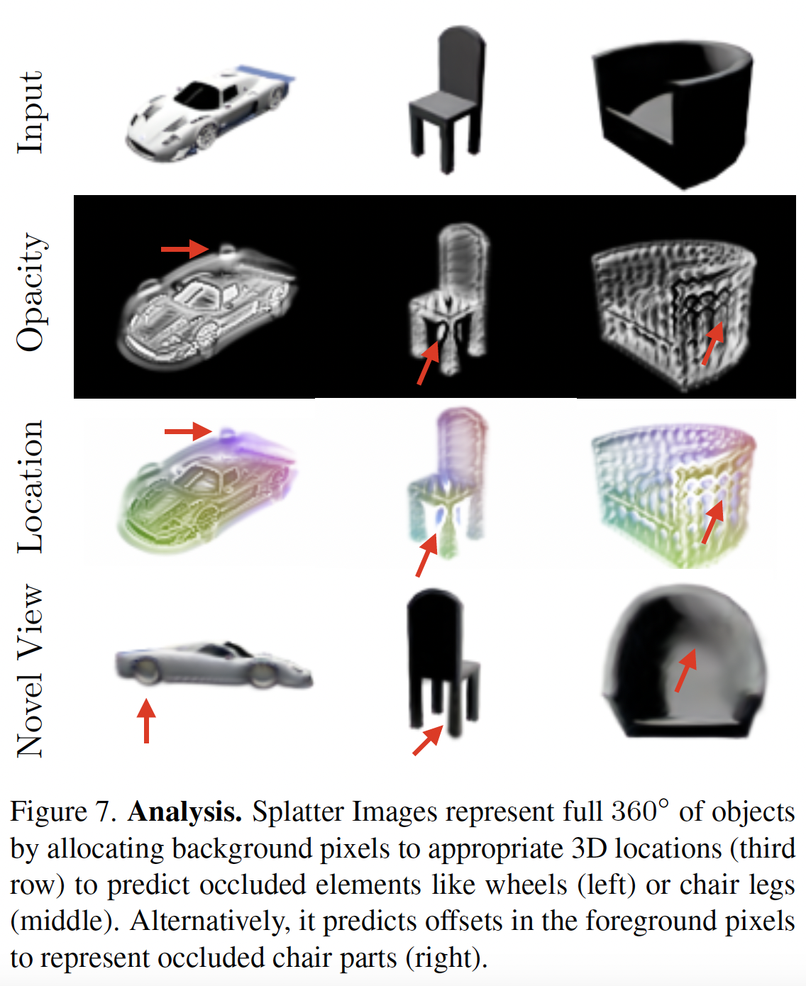
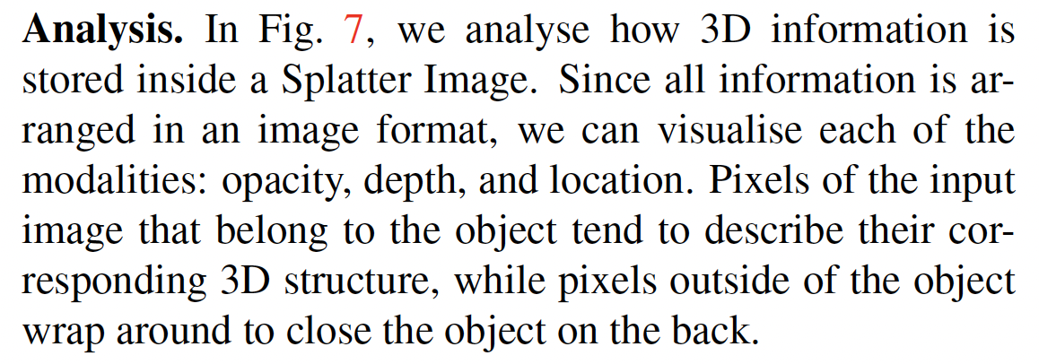
Analysis

Slide 18
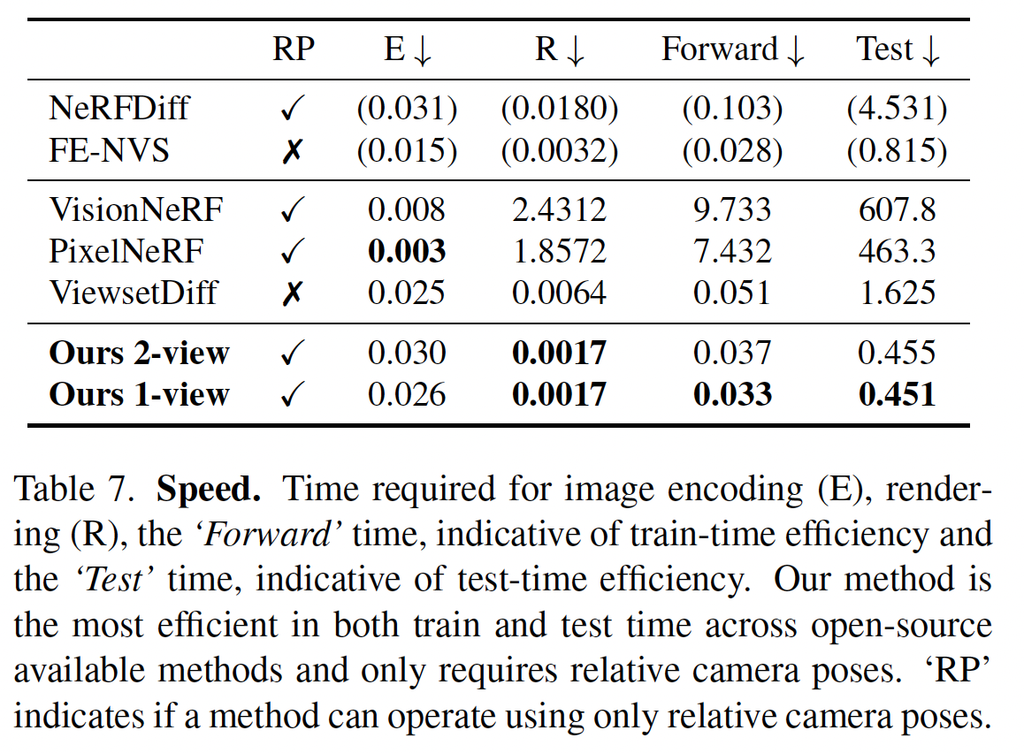
Evaluation of reconstruction efficiency

Slide 19
Takeaways
Deterministic vs probabilistic?
e.g. GSD, A Lesson in Splats
Data: multiview images vs video images?

