Slide 1
One Step Diffusion via Shortcut Models
Kevin Frans, Danijar Hafner, Sergey Levine, Pieter Abbeel
UC Berkeley
ICLR 2025 Oral
Presenter: Yilin Wang 25/02/11

Slide 2
Background
Diffusion Models
Forward: gradually destroys an observed datapoint x over time t, by mixing the data with Gaussian noise.
Denoising: predict what the clean sample might look like with a NN, and then project it back to a lower noise level with the same forward.
In DDIM, the entire reverse process is deterministic, while randomness only comes from the initial Gaussian sample.
Notes:
We keep alternating between predicting the clean data, and projecting it back to a lower noise level until we get the clean sample.

Slide 3
Background
Flow-matching Models
Forward: a linear interpolation between the data and a noise term :
Denosing: reverse time to any previsous timestep s by predicting the “velocity” from noise to data point at time t

Slide 4
Background
Diffusion Models
Forward: a stochastic differential equation (SDE)
Denosing: predict what the clean sample might look like with a NN, and then project it back to a lower noise level with the same forward.
In DDIM, SDE ➔ ODE with
Notes:
where is an infinitesimal Gaussian (formally, a Brownian motion).ftft​ and gtgt​ decide the noise schedule.

Slide 5
Background
Flow-matching Models
Forward: an ordinary differential equation (ODE)
Denosing: The generative process is simply reversing the ODE in time, and replacing ut by its conditional expectation with respect to zt
Generalized to SDE:
Flow Matching sampler equivalent to DDIM sampler

Slide 6
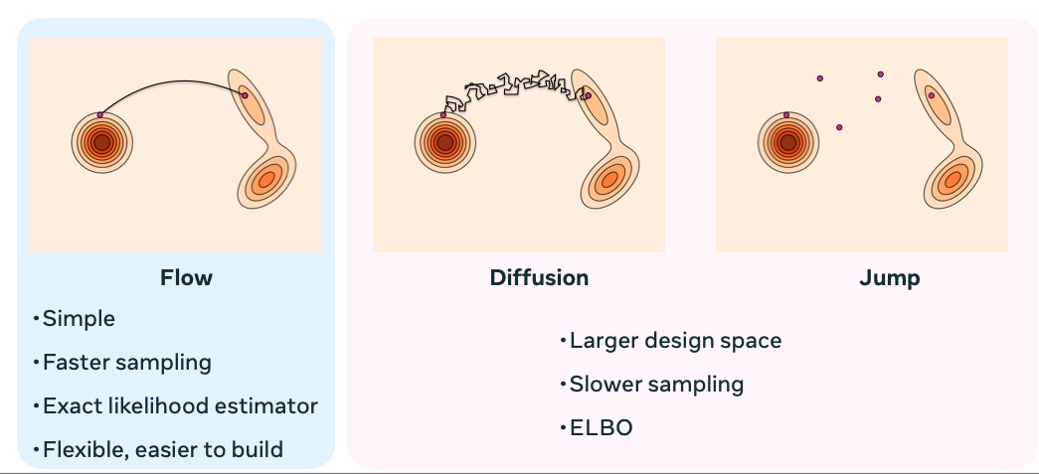
Background
Diffusion models & Flow Matching models approach the generative modelling problem by learning an ordinary differential equation (ODE) that transforms noise into data

Slide 7
Background
Flow-matching Models
Notes:
Flow models learn a neural network to estimate the expected value v ̄t = E[vt | xt]. The flow model can be optimized by regressing the empirical velocity of randomly sampled pairings of noise x0 and data x1 pairs To sample from a flow model, a noise point x0 is first sampled from the normal distribution. This point is then iteratively updated from x0 to x1 following the the denoising ODE defined as following the learned flow model v ̄θ (xt , t). In practice, this process is approximated using Euler sampling over small discrete time intervals.

Slide 8
Background
Few-step Ambiguity
Under finite step sizes, the guarantee of accurate mapping is lost
The fewer steps, the more the generations are biased towards the dataset mean
At the first sampling step, the model points towards the dataset mean and thus cannot generate multi-modal data in a single step
Notes:
Training paths are created by randomly pairing data and noise. Note that the paths overlap; there is inherent uncertainty about the direction vt to the data point

Slide 9
Shortcut Models
Train a single model that supports different sampling budgets
by conditioning the model on a desired step size d in addition to timestep t
Shortcut
the normalized direction from xt towards the correct next point x′t+d

Slide 10
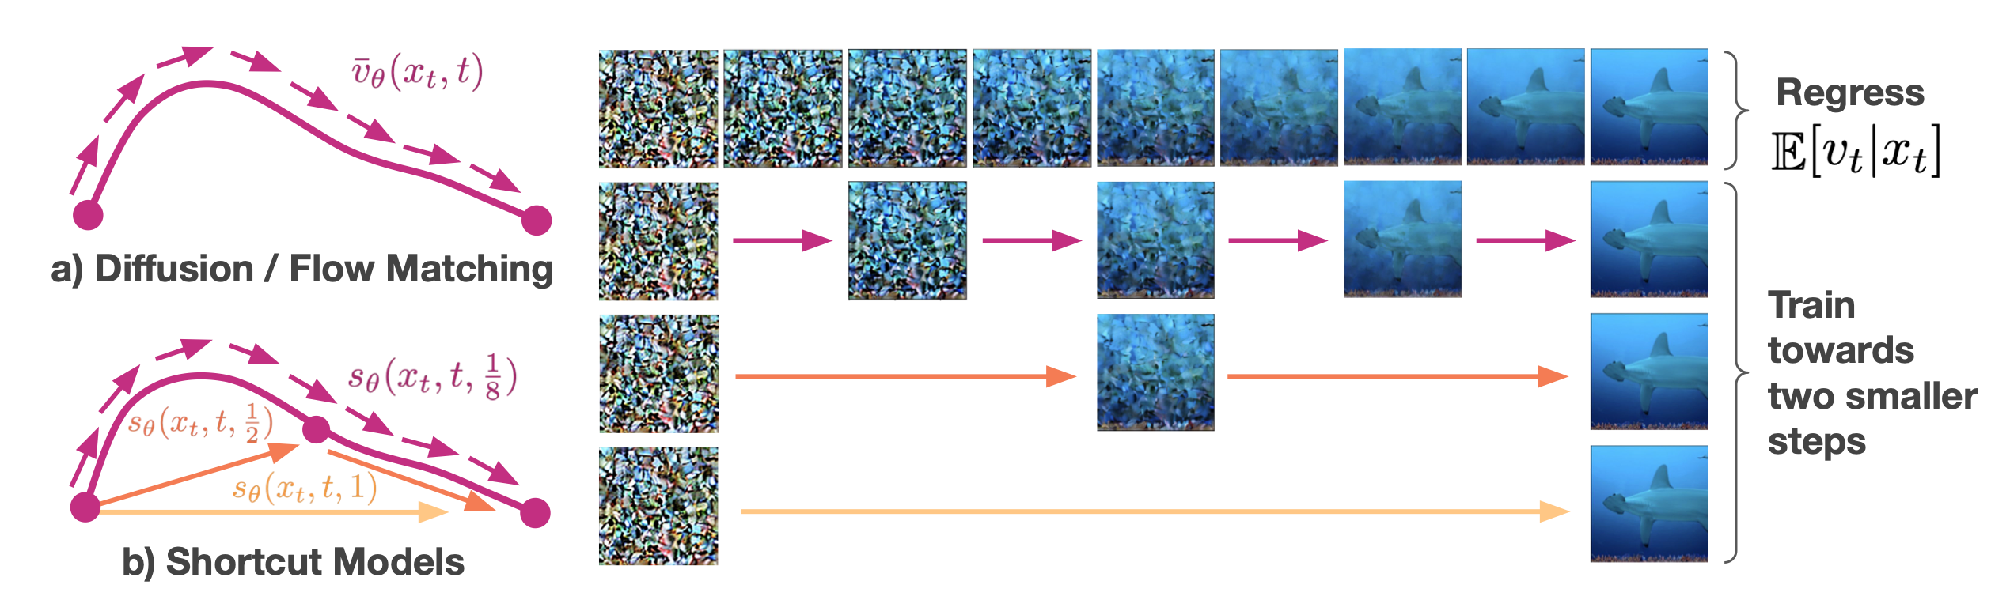
Shortcut Models
Generalization of flow-matching models to larger step sizes:
shortcut models additionally learn to make larger jumps.
At d → 0, the shortcut is equivalent to the flow.
Self-consistency property
One shortcut step equals two consecutive shortcut steps of half the size

Slide 11
Shortcut Models
Objective
A consistent noise-data mapping when queried under any sequence of step sizes, including directly in a single step.
Flow-matching term:
grounds the shortcut model at small step size to match empirical velocity samples
Self-consistency term:
appropriate targets for larger step sizes
Notes:
In practice, we split the batch into a fraction that is trained with d = 0 and another fraction with randomly sampled d > 0 targets.

Slide 12
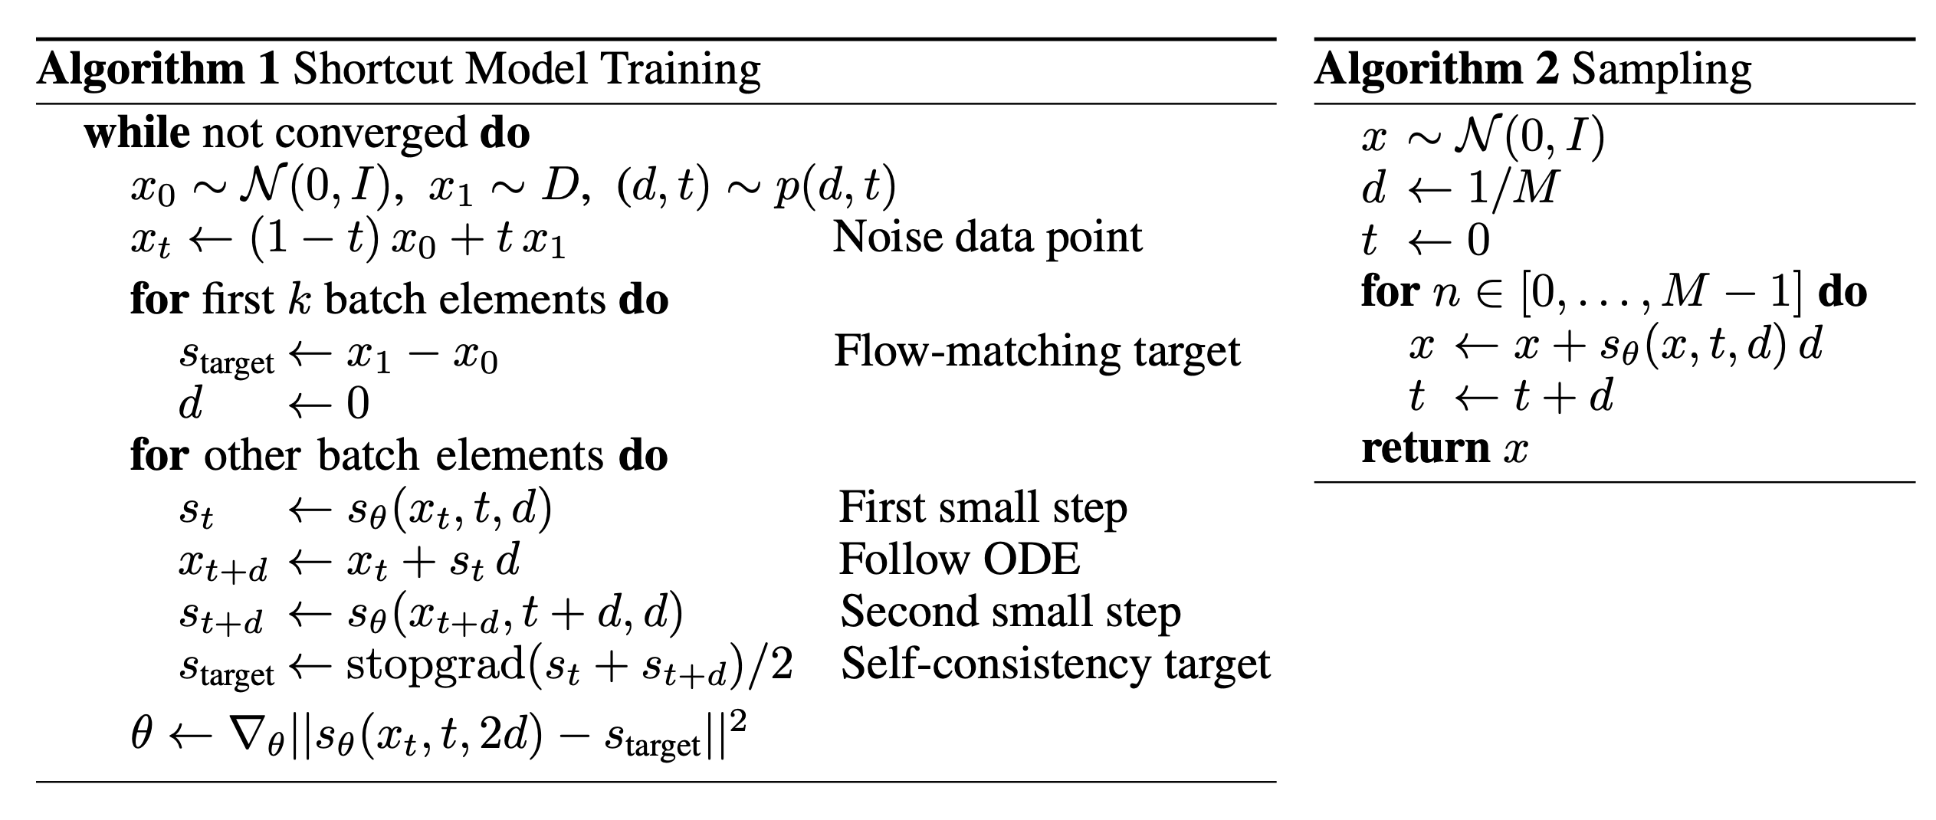
Shortcut Models
Algorithm

Slide 13
Shortcut Models
Training Details
Regressing onto empirical samples
Enforcing self-consistency
Joint optimization
Guidance
Exponential moving average weights
Weight decay
Discrete time sampling

Slide 14
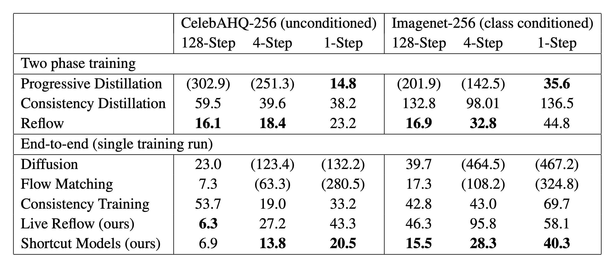
Experiments
How do shortcut models compare to prior one-step generation methods?

Slide 15
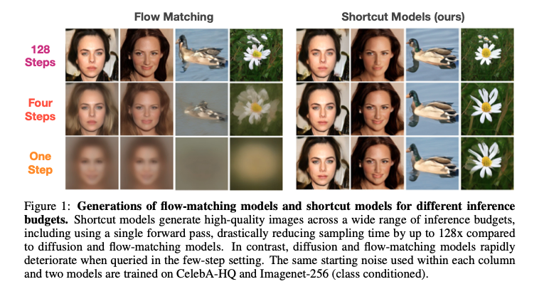
Experiments
What is the behavior of the shortcut models when images are generated with varying inference budgets?

Slide 16
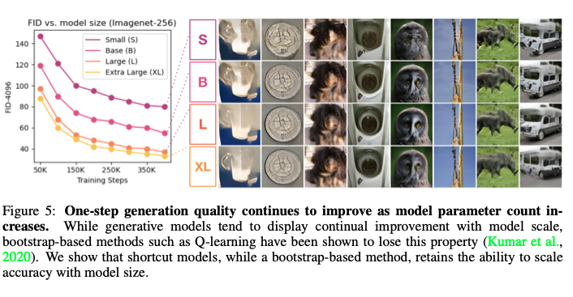
Experiments
How does shortcut model performance increase with model scale?

Slide 17
Experiments
Can shortcut models give us an interpolatable latent space?
A pair of noise points (x0, x10) are sampled, then interpolated in a variance-preserving manner:

Slide 18
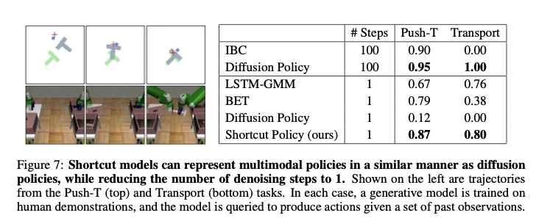
Experiments
In non-image domain?

Slide 19
Key Takeaways
The key idea behind shortcut models is to learn a step-size conditioned model that is grounded to the data at a small step-size, and trained via self-bootstrapping at larger step-sizes.
A simple recipe that requires no scheduling and can be trained end-to-end in a single run.
A distillation strategy that requires no separate pretraining
Best practice:
Standard diffusion model practice should be followed
A non-zero weight decay is highly recommended.
EMA parameters provides a consistent improvement

Slide 20
Useful links
For understanding the general unified framework of diffusion & flow-matching models:
https://diffusionflow.github.io
https://www.youtube.com/watch?v=wMmqCMwuM2Q

