Slide 1
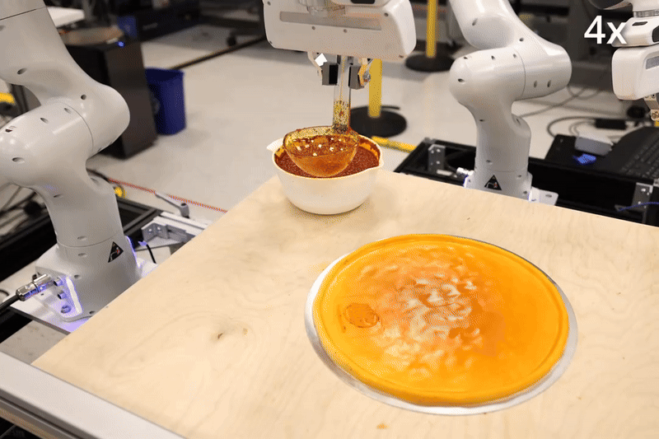
Diffusion Policy: Visuomotor Policy Learning via Action Diffusion
Proceedings of Robotics: Science and Systems (RSS 2023)
Cheng Chi, Zhenjia Xu, Siyuan Feng, Eric Cousineau, Yilun Du, Benjamin Burchfiel, Russ Tedrake, Shuran Song
MIT, Columbia University, and Toyota Research
Presenter: Jing Wang

Slide 2
Preliminary
Expert Dataset:
Policy learning and RL.
Observations (O): Represent the state or sensory input of the environment at time t.
Actions (A): Represent the decision or control signal generated by the policy at time t.
Policy ( ): A function or stochastic mapping from observations to actions:
Environment Dynamics (P): Defines how the environment transitions between states:
Reward Function (R): A scalar feedback signal provided by the environment based on the action taken:

Slide 3
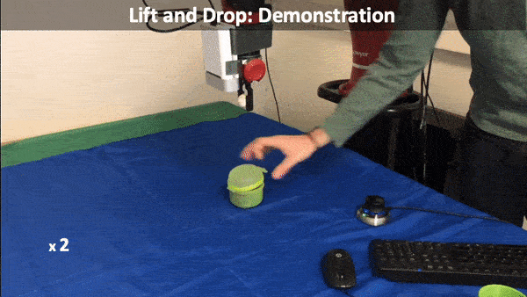
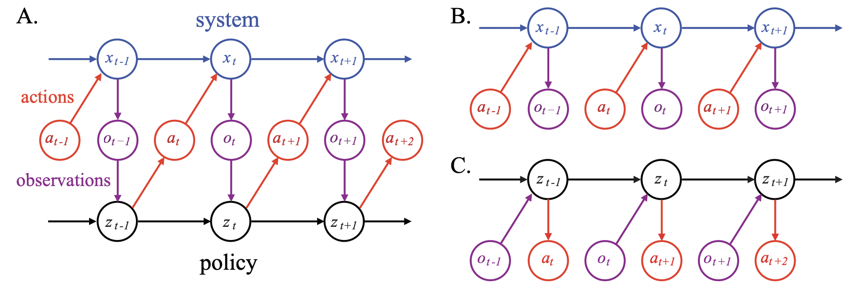
Preliminary
Expert Dataset:
For learning from demonstrations (behavior cloning), the problem is simplified.
Observations (O): Represent the state or sensory input of the environment at time t.
Actions (A): Represent the decision or control signal generated by the policy at time t.
Policy ( ): A function or stochastic mapping from observations to actions:

Slide 4
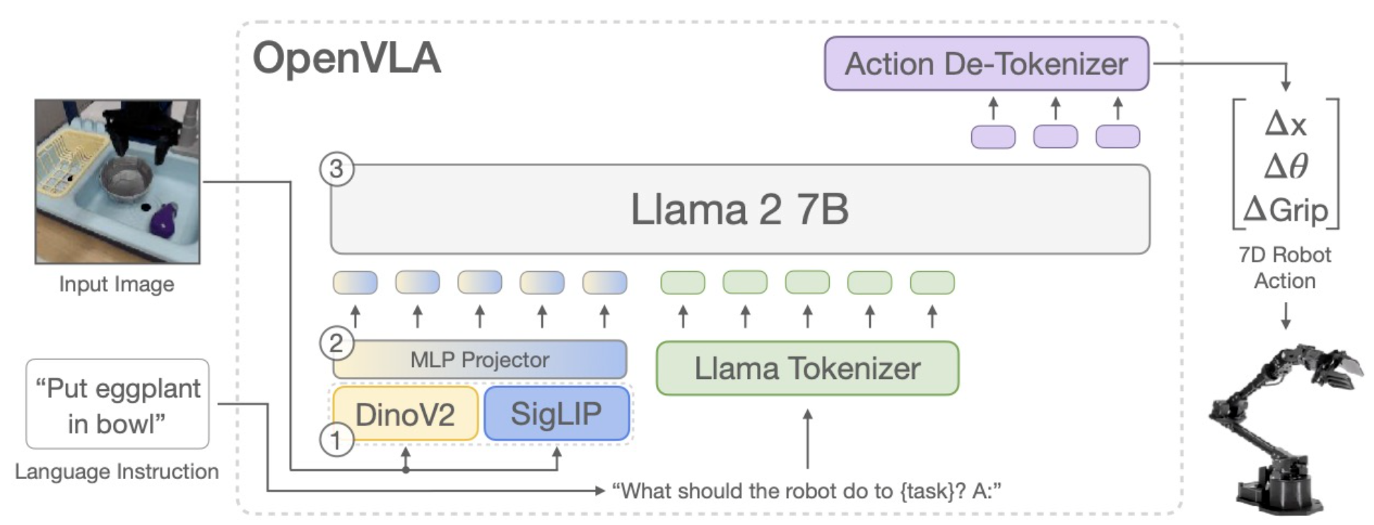
Existing Methods
Expert Dataset:
Regression:
(continuous)
Classification:
(discrete)

Slide 5
Existing Methods
Expert Dataset:
MoG
EBM
Sampling is challenging, either MCMC or variational inference.

Slide 6
Diffusion Policy (DDPM)
Noise adding (forward training)
Noise removing (reverse samping)

Slide 7
Evaluation Metrics
Success Rate: This metric quantifies the fraction of tasks completed successfully in %. For example, in manipulation tasks like Push-T, success is defined based on achieving a specific end-state goal.
Intersection over Union (IoU): Used in tasks like sauce pouring or spreading, where the goal is to compare the overlap between the achieved and desired coverage areas (e.g., on pizza dough).
Task-Specific Metrics: For certain real-world tasks like Mug Flipping or Sauce Spreading, additional task-specific success criteria are used, such as properly orienting a mug or achieving even sauce distribution.

Slide 8
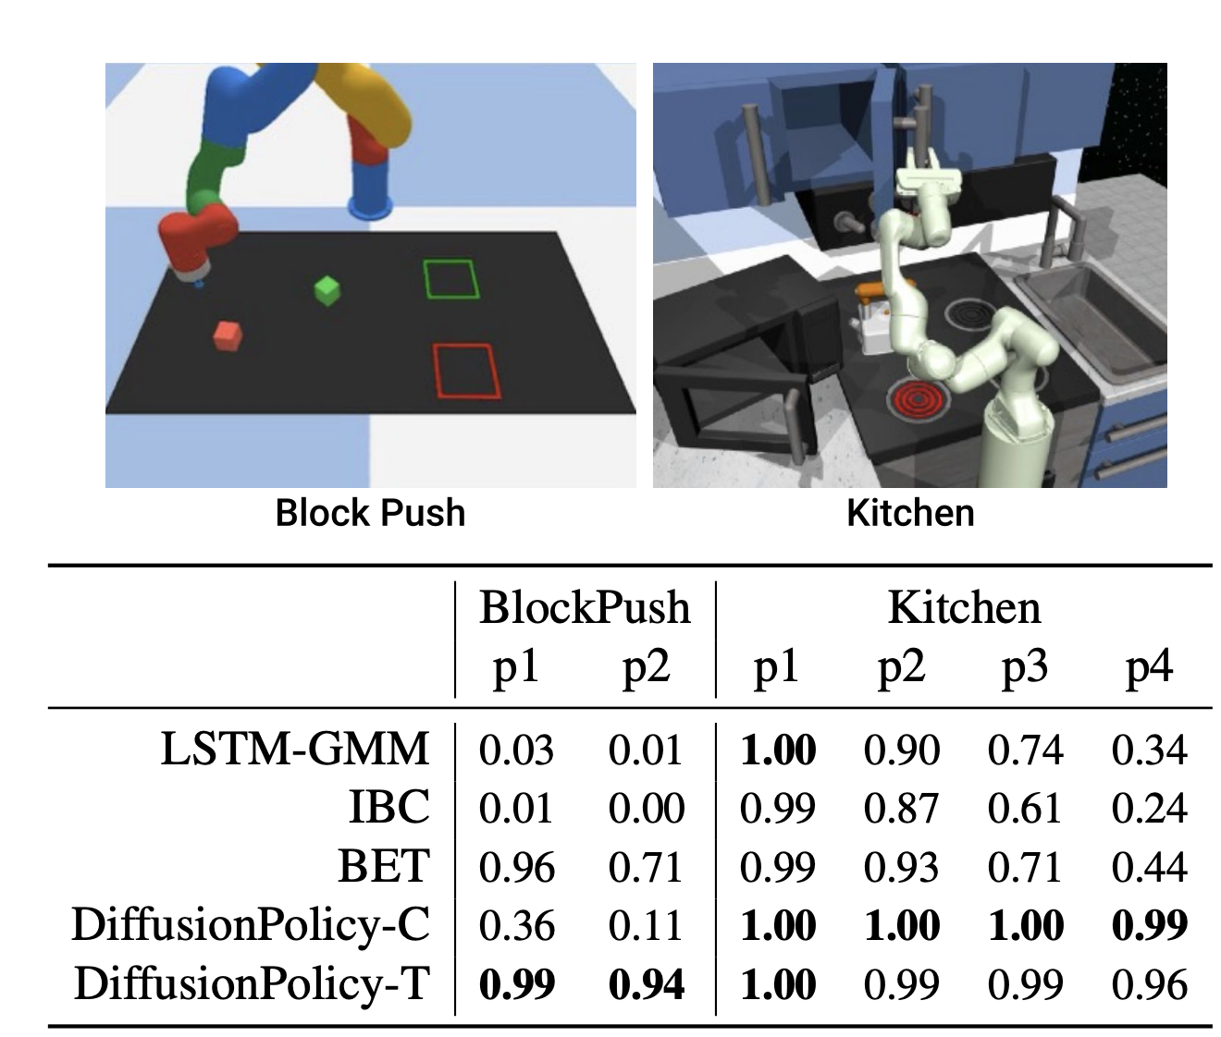
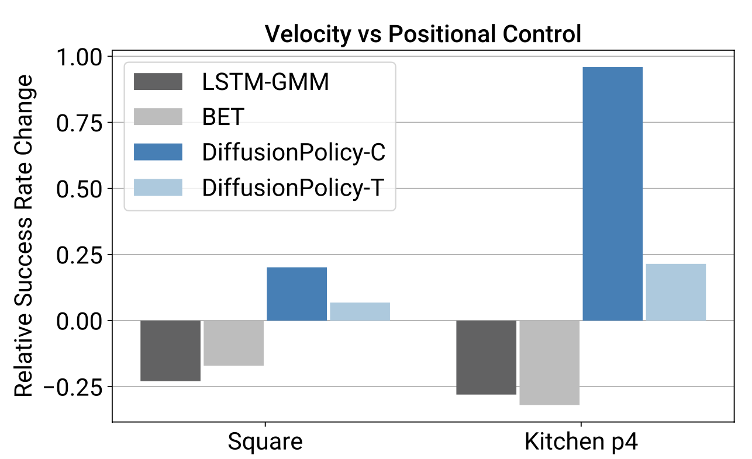
Simulation Results

Slide 9
Simulation Results

Slide 10
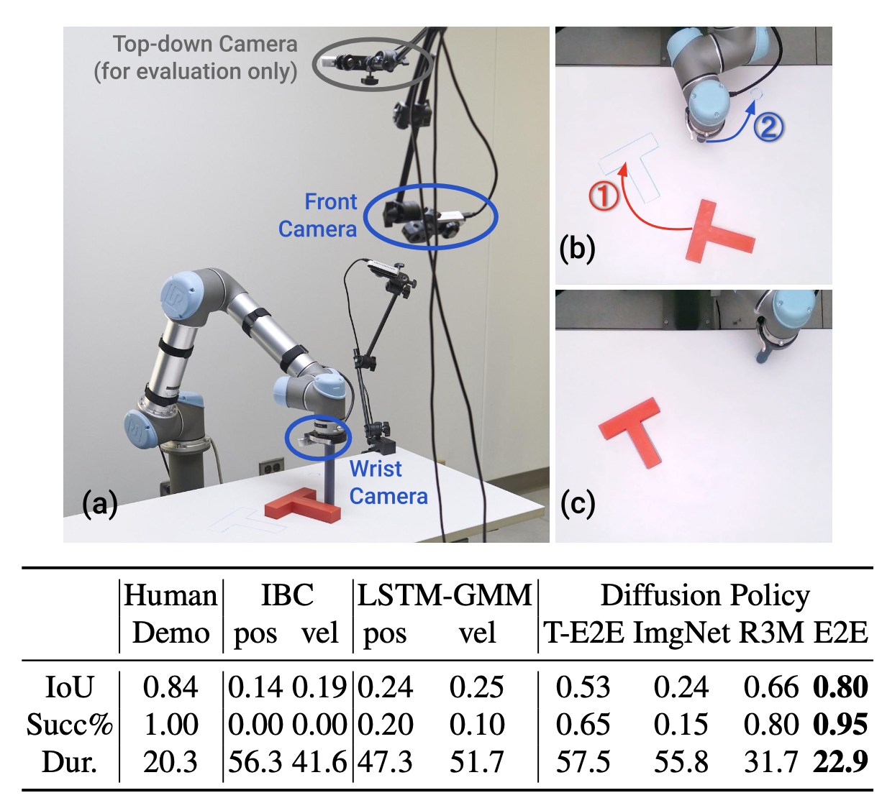
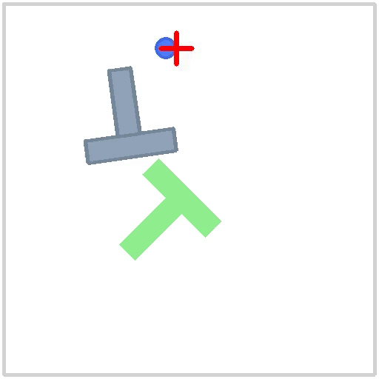
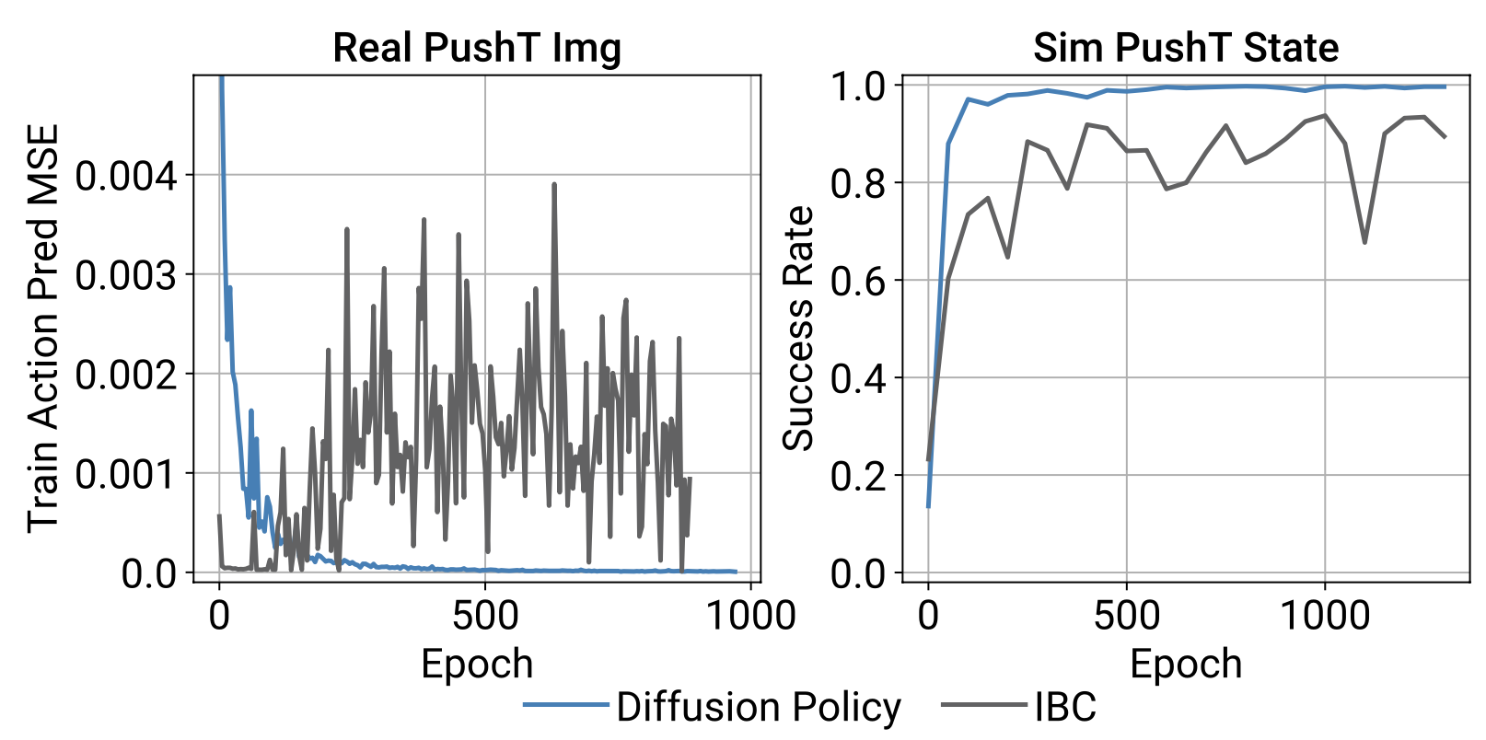
Real Experiments

Slide 11
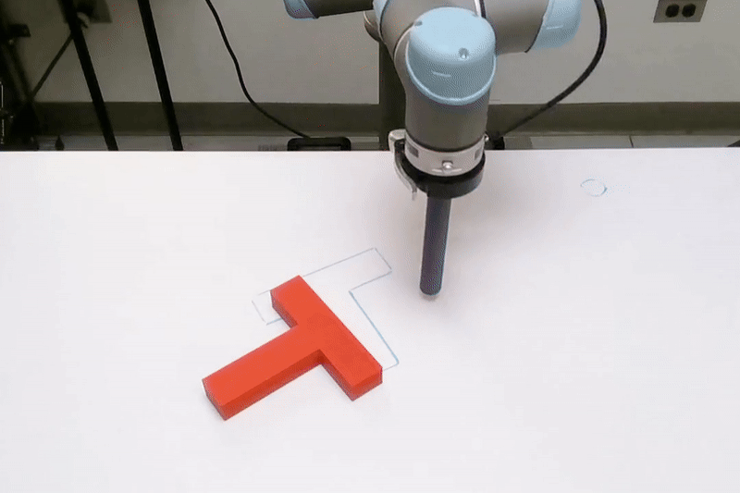
Real Experiments

Slide 12
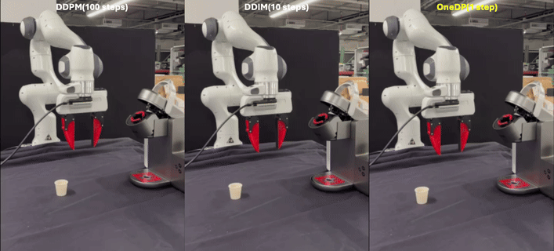
One-Step Diffusion Policy: Fast Visuomotor Policies Via Diffusion Distillation
Preprint Oct. 2024
Zhendong Wang, Zhaoshuo Li, Ajay Mandlekar, Zhenjia Xu, Jiaojiao Fan, Yashraj Narang, Linxi Fan, Yuke Zhu, Yogesh Balaji, Mingyuan Zhou, Ming-Yu Liu, Yu Zeng
NVIDIA and The University of Texas at Austin
Presenter: Jing Wang

Slide 13
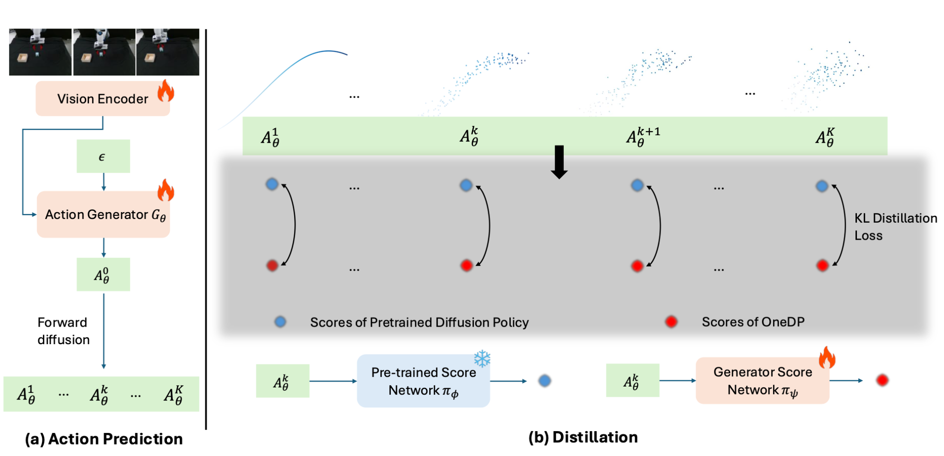
One-Step Diffusion Policy
Action Generator: The one-step implicit action generator generates actions as
Goal: To match the prediction distribution of pre-trained diffusion model with action generator

Slide 14
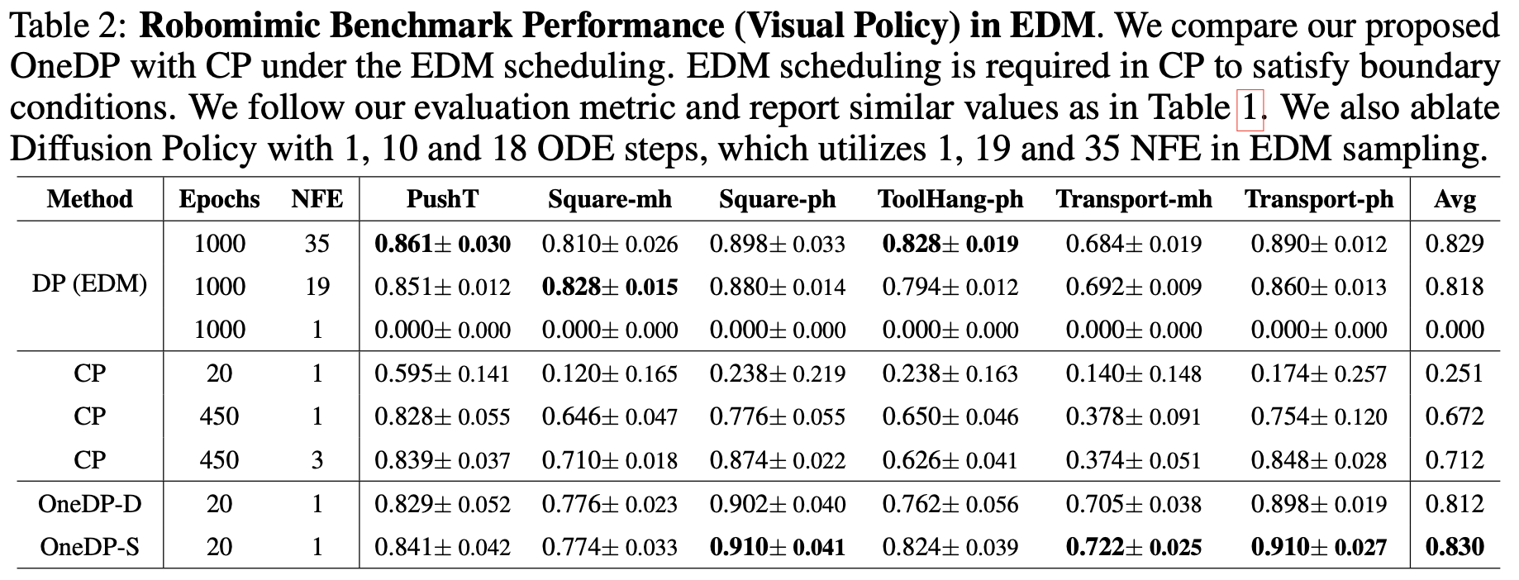
Simulation Results

Slide 15
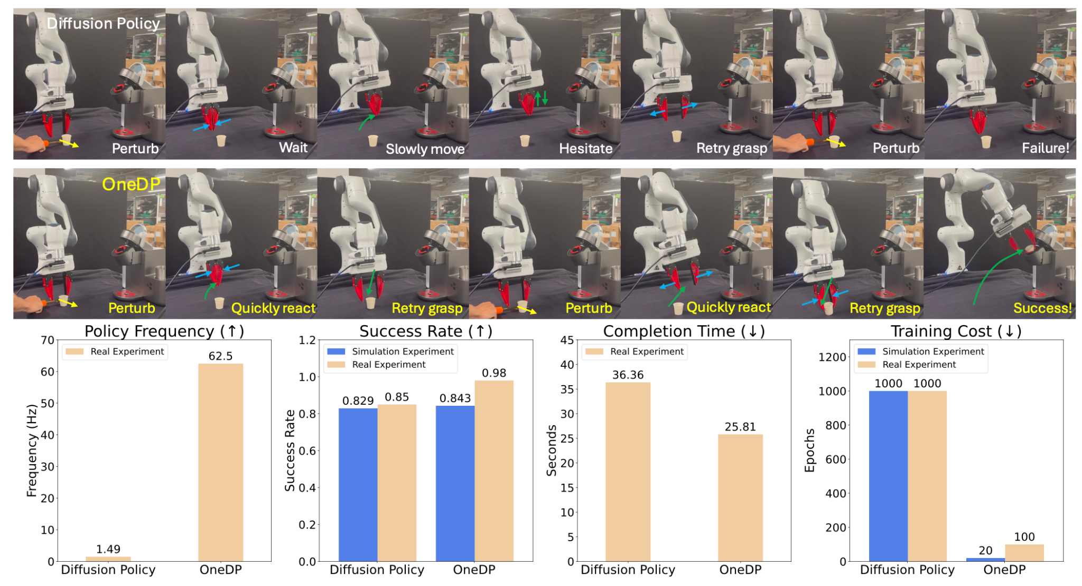
Real Experiment

Slide 16
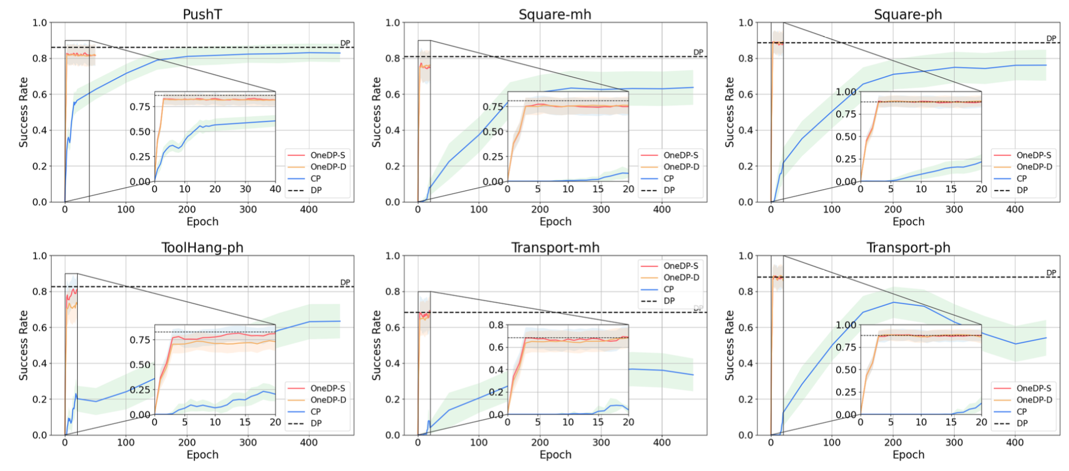
Benefits for Training Convergence and Inference Time

