Slide 1
Posture-Informed Muscular Force Learning for Robust Hand Pressure Estimation
Kyungjin Seo , Junghoon Seo , Hanseok Jeong, Sangpil Kim , Sang Ho Yoon
KAIST, Korea University
NeurIPS 2024 Presenter: Jun Zhou

Slide 2
Preliminary: Hand Pressure Estimation
Fingers display visible cues indicative of applied pressure
ECCV22-PressureVisionDB dataset collects the hand pressure using a pressure-sensitive trackpad to collect the pressure information

Slide 3
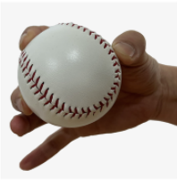
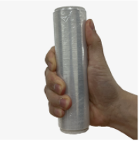
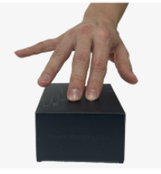
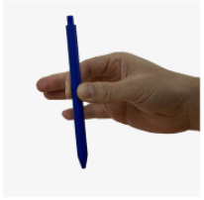
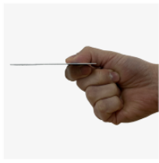
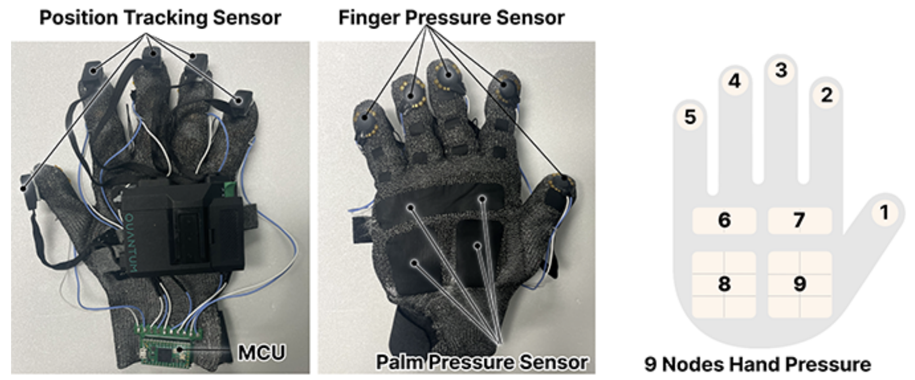
How to Extend to Diverse Surface?

Slide 4
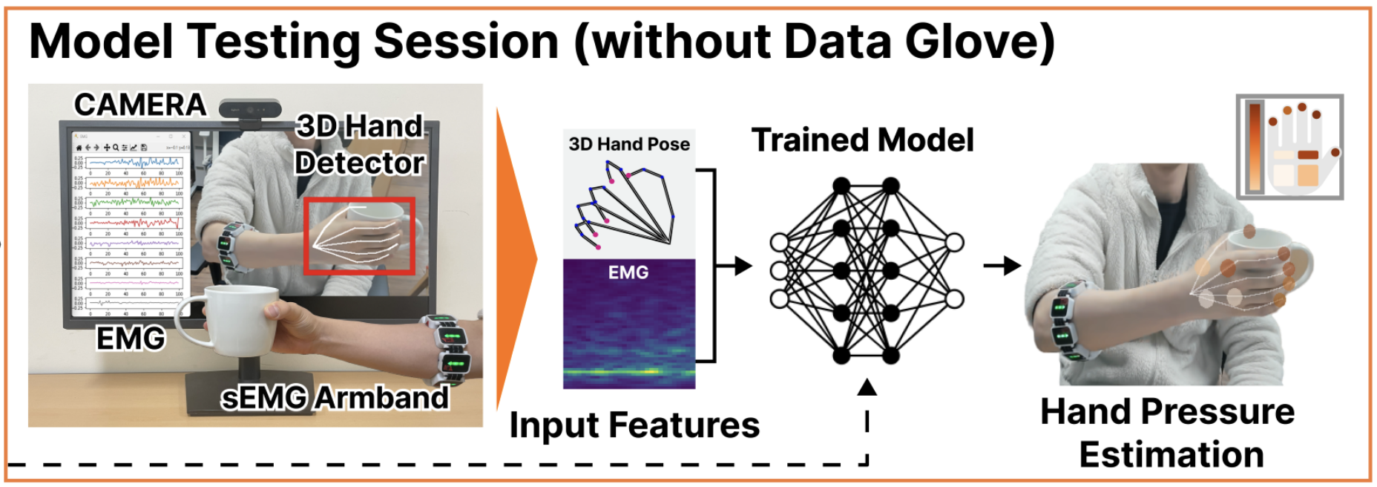
How to Generalize to Bare Hand?
Not rely on image, take hand pose & sEMG as input.

Slide 5
Pipeline

Slide 6
Metric
Normalized Root Mean Squared Error
Classification Accuracy
A prediction is considered correct only if the pressure exertion status of all hand regions (fingertips and palm areas) is accurately classified

Slide 7
Metric
Normalized Root Mean Squared Error
Mean Average Error

Slide 8
Result
Compare with sEMG-only method
Compare with SOTA

Slide 9
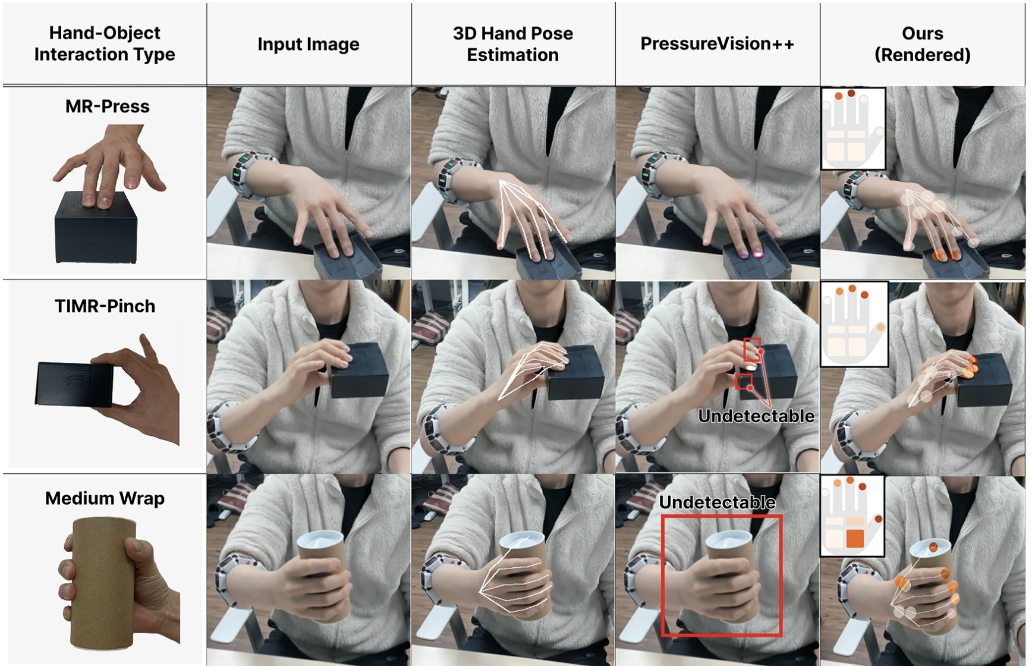
Qualitative Result

Slide 10
MMVP: A Multimodal MoCap Dataset with Vision and Pressure Sensors
He Zhang , Shenghao Ren , Haolei Yuan , Jianhui Zhao , Fan Li , Shuangpeng Sun , Zhenghao Liang , Tao Yu , Qiu Shen , Xun Cao
Beihang University, Tsinghua University, Nanjing University, Beijing Weilan Technology
CVPR 2024

Slide 11
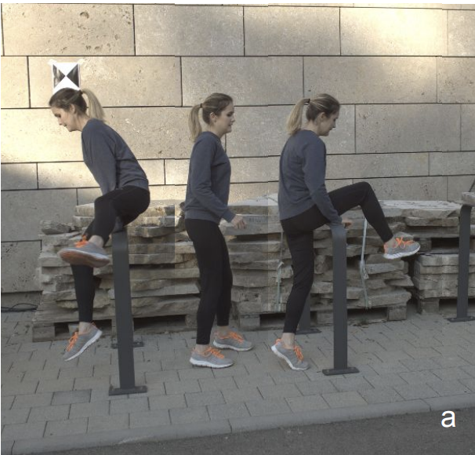
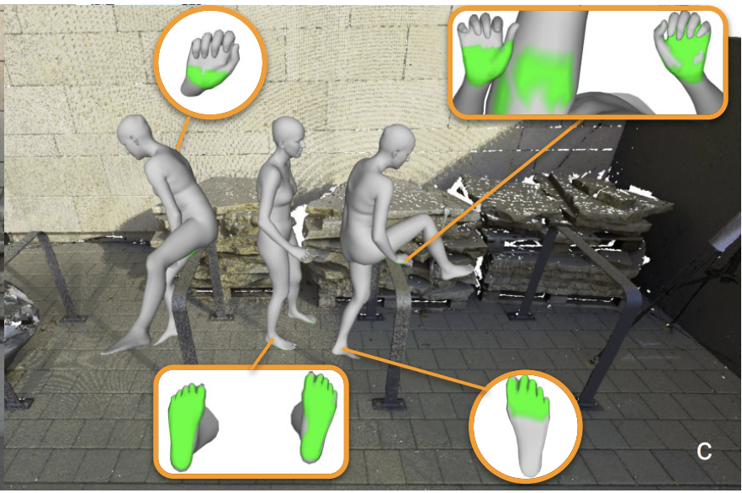
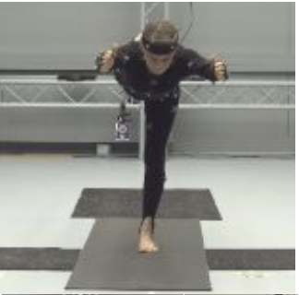
Preliminary: Human-Scene Contact Estimation

Slide 12
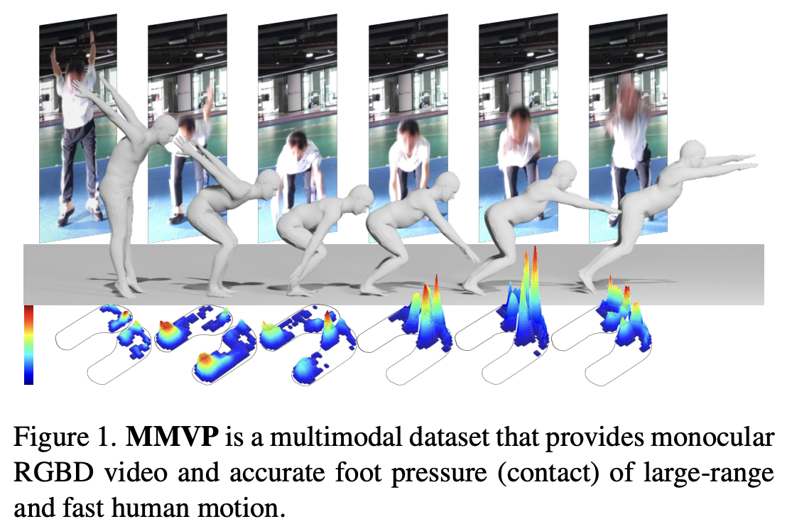
Motivation
lack of a motion capture dataset with a large range of motion, fast body movements, and visual-pressure synergistic acquisition, as well as accurate and dense foot-contact annotation.

Slide 13
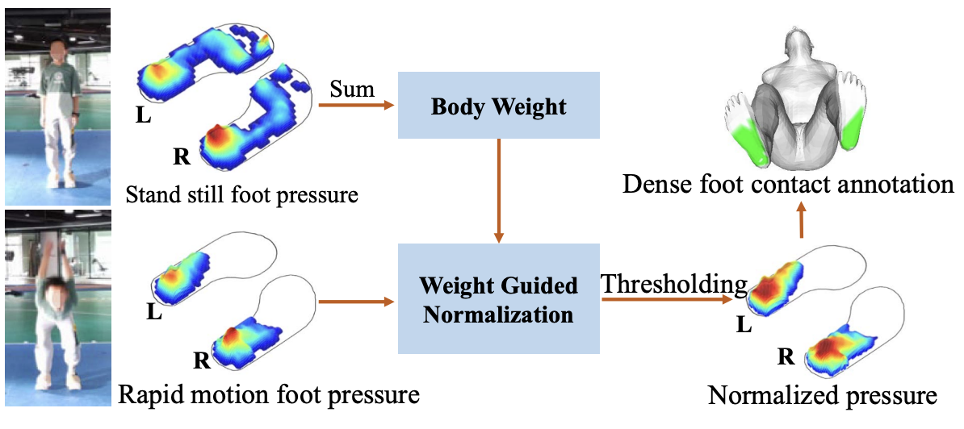
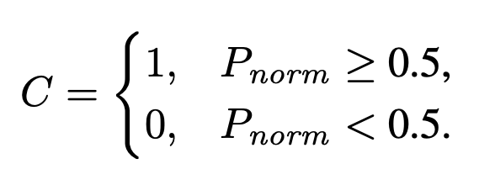
Annotation: Calculate Foot Contact
The foot pressure can vary dramatically depending on body weight and motion status.
So it’s hard to design a fixed-value threshold to annotate the dense contact.

Slide 14
Annotation: SMPL Fitting

Slide 15
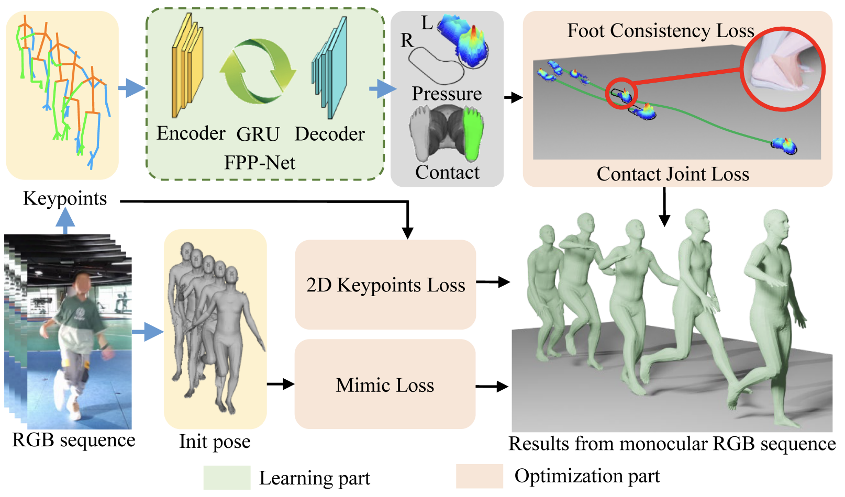
Method

Slide 16
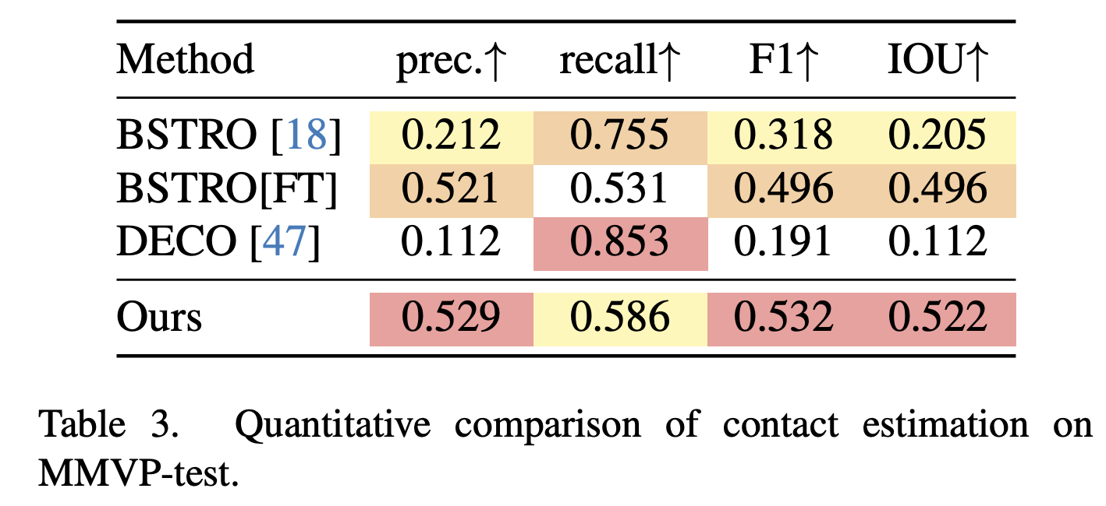
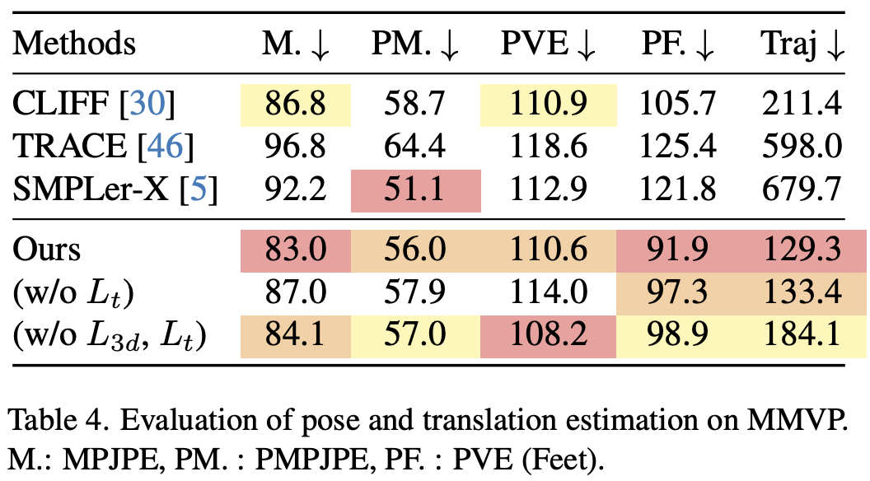
Result
Contact
Pose

Slide 17
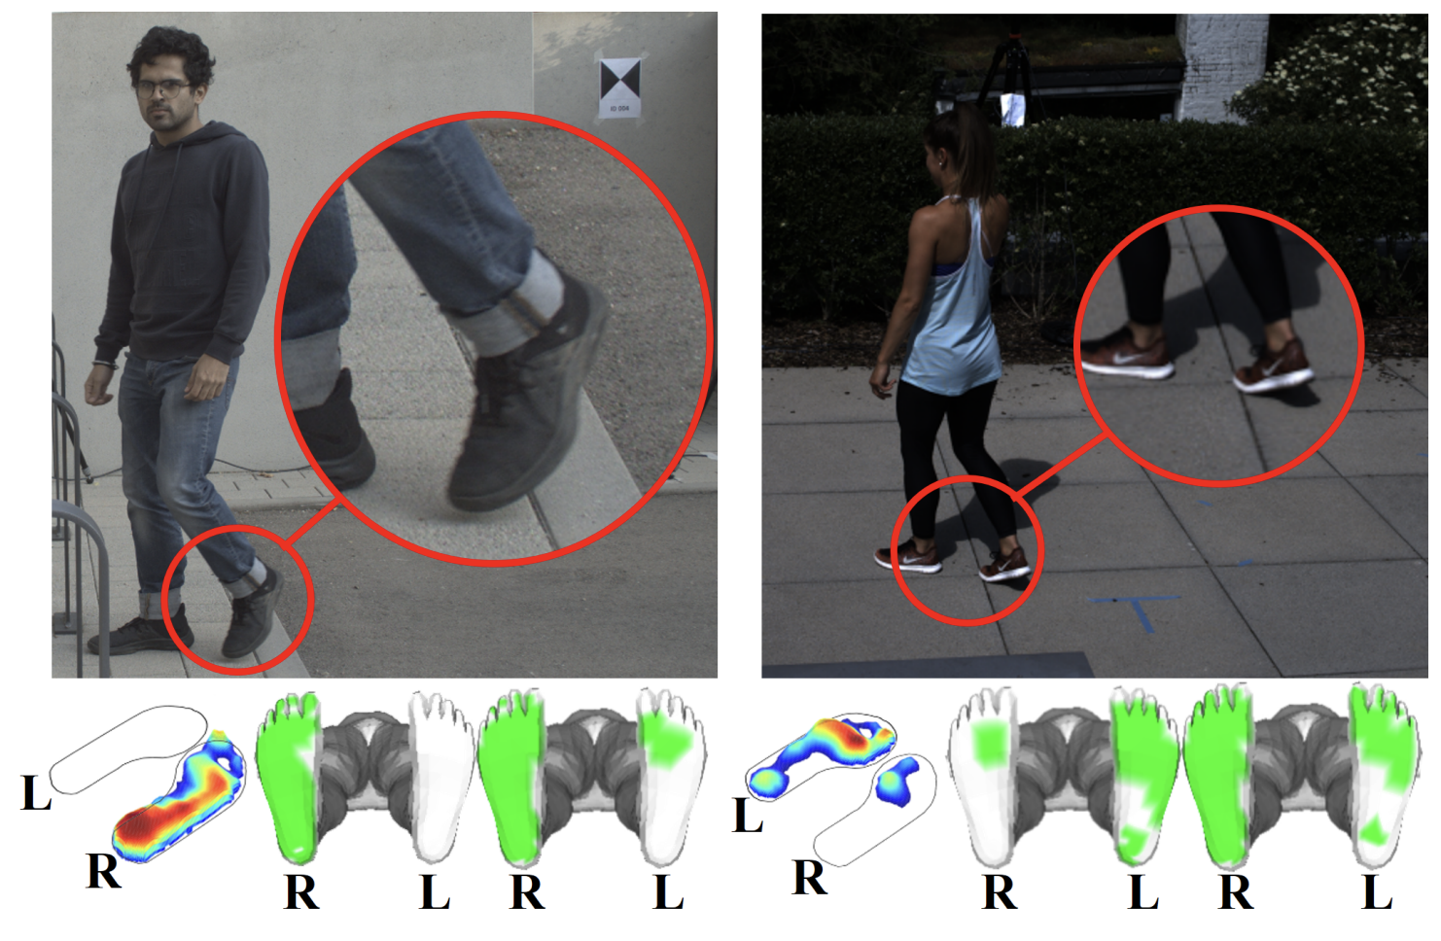
Qualitative Result: Contact

Slide 18
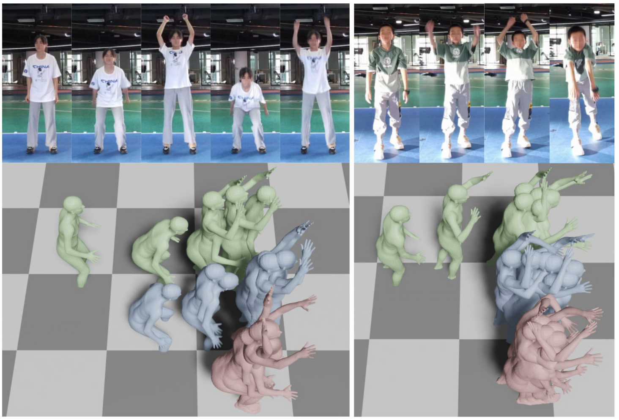
Qualitative Result: Pose

