Slide 1
Visual Grounding

Slide 2
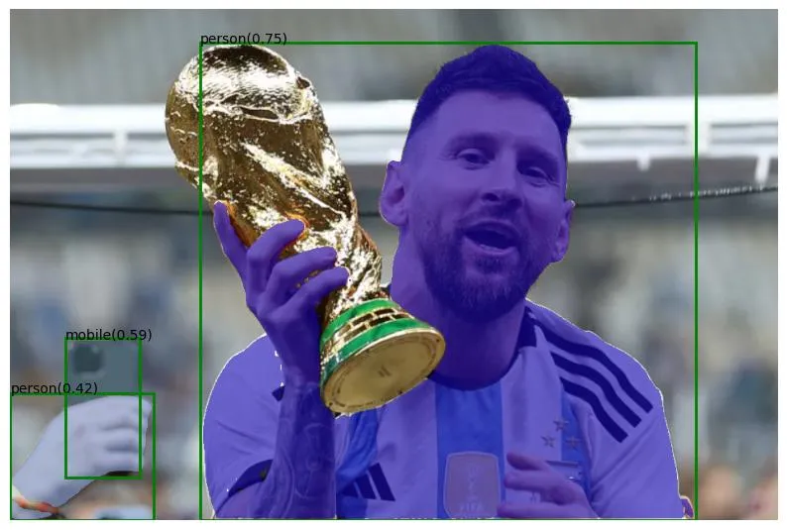
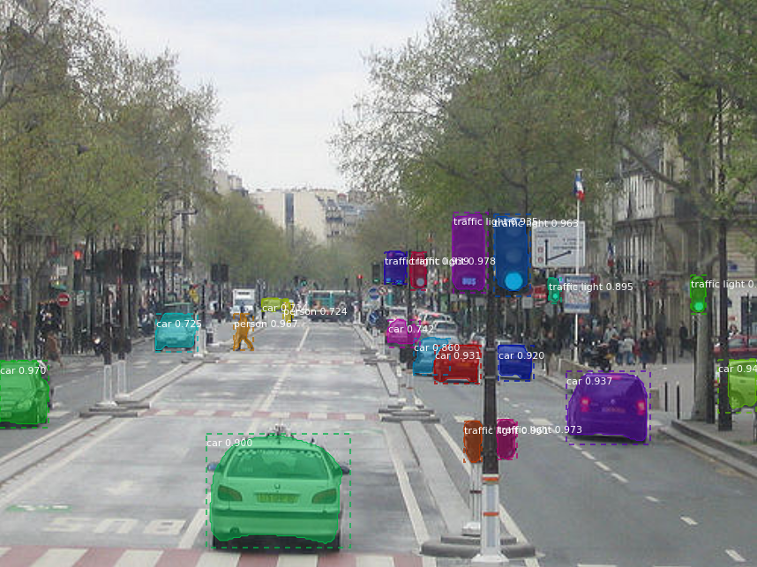
Traditional Method of Segmentation
Models are trained on a fixed set of classes (e.g., COCO dataset classes).
Models can only segment classes which they are trained on.
Limitation: Can’t generalise to the real world environment.

Slide 3
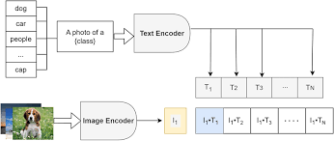
Zero-Shot Segmentation/ Open Vocabulary Segmentation
Some Background on Zero-Shot Image Classification
Large foundational Vision-Language like CLIP model have shown exceptional image classification result in unseen classes.
How they do this:
Text Embedding for all possible classes
Image Embedding of a given image
Calculate the similarity of image with all possible classes.

Slide 4
Zero-Shot Segmentation/ Open Vocabulary Segmentation
Some Background on Zero-Shot Image Classification
Large foundational Vision-Language like CLIP model have shown exceptional image classification result in unseen classes.
How they do this:
Text Embedding for all possible classes
Image Embedding of a given image
Calculate the similarity of image with all possible classes.

Slide 5
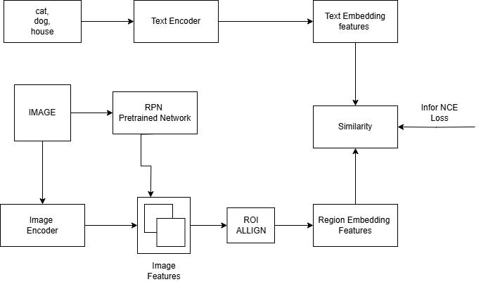
OVS Architecture Simplified
Similar to zero-shot image classification, we first extract text and image features.
Using a pre-trained class-agnostic model (usually RPN), objects of interest are localized.
The localized regions are mapped from RGB to feature space, and regional features are pooled using ROI Align.
Regional features are compared with text features to compute similarity and determine the class of the segmented patches.

Slide 6
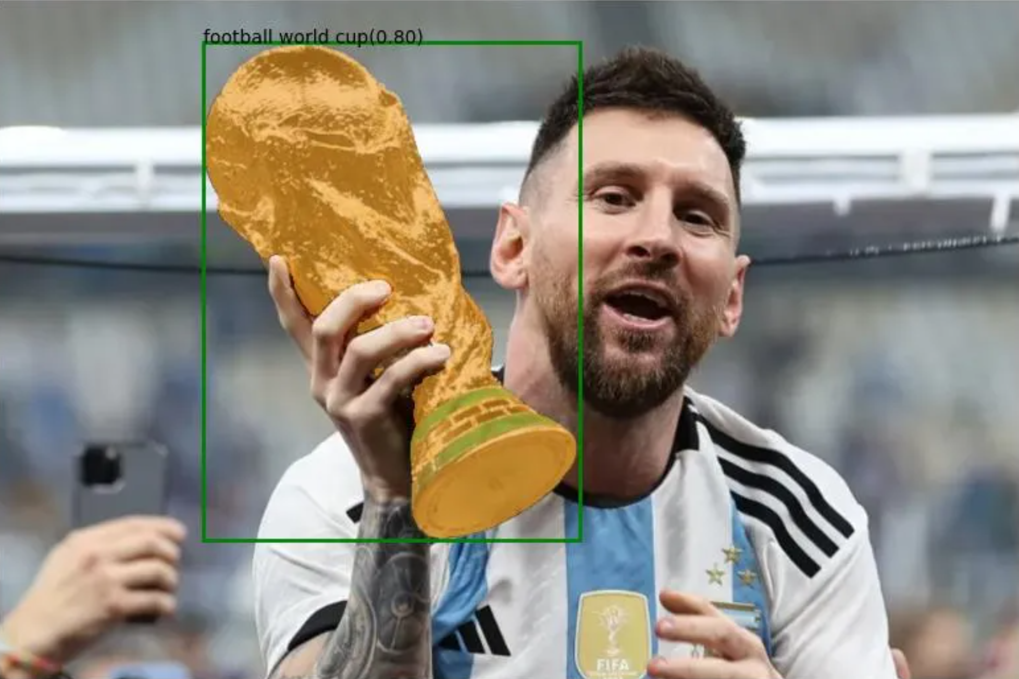
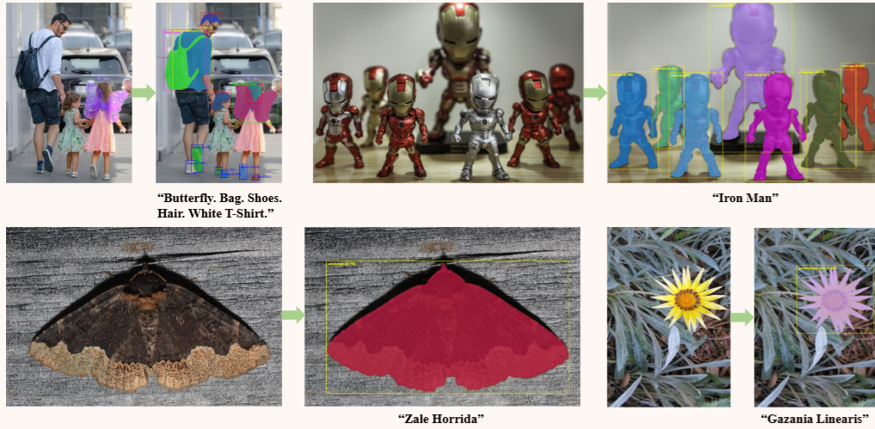
Zero-Shot Segmentation/ Open Vocabulary Segmentation

Slide 7
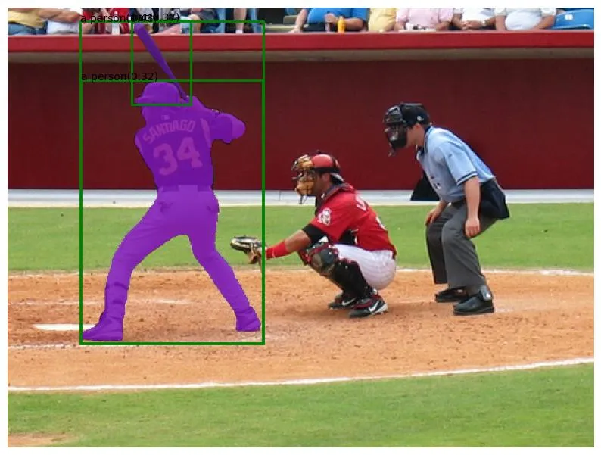
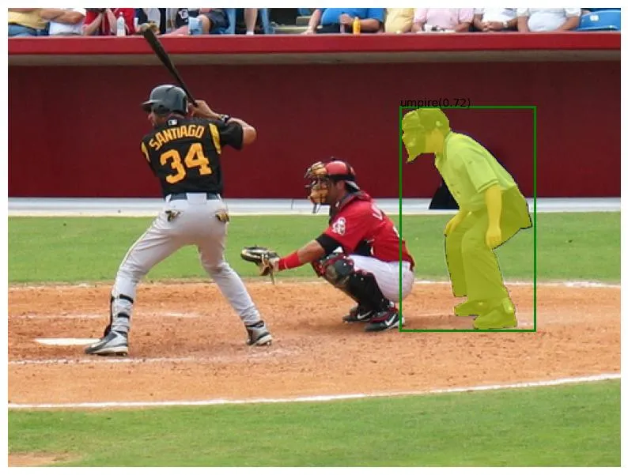
Visual Grounding
Prompt: A person holding a bat.
Grounding w.r.t to Attributes
Prompt: A person behind the catcher.
Grounding with respect to spatial relationships.
What is Visual Grounding?
Localization (Segmentation/Detection) of the object from the given contextual information like natural language.
For example, we want to localize image w.r.t to its ‘attribute features’ as shown in the left image; Or, we want to localize the image w.r.t to its spatial positioning as shown in the right image.
In some ML papers, this is also referred as “Referring Expression Comprehension (REC)” task .

Slide 8
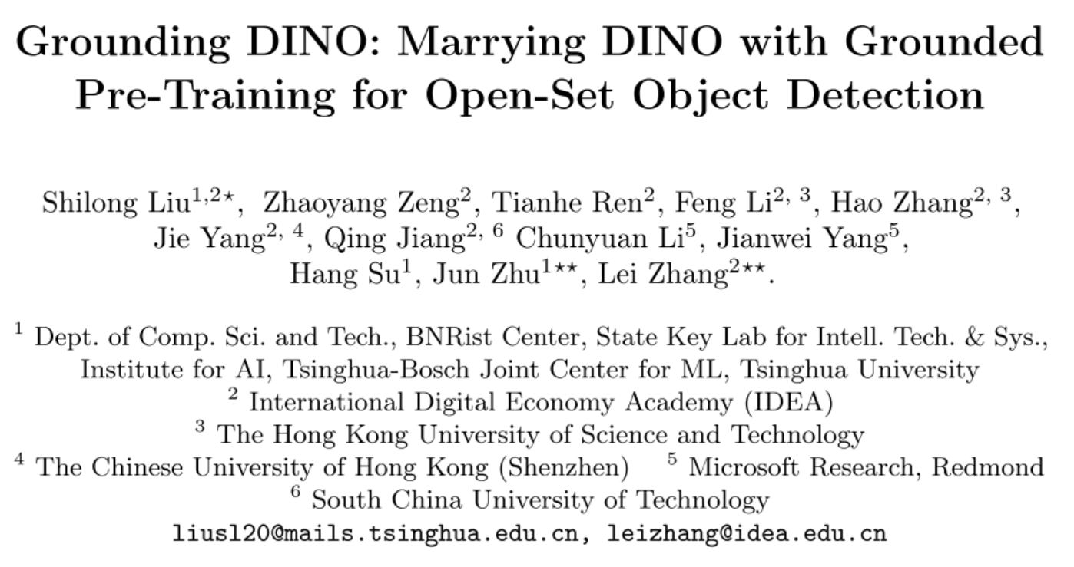
ECCV 2024

Slide 9
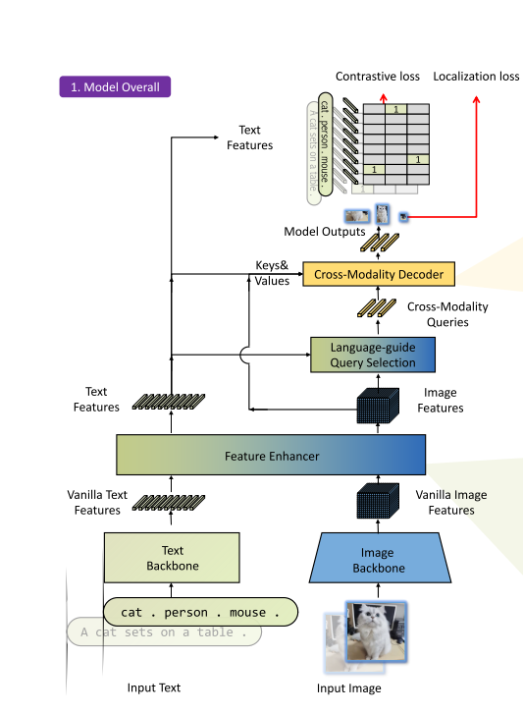
Grounding DINO: Model Architecture
Vanilla image features and vanilla text features are extracted using an image backbone and a text backbone, respectively.
These features are fused in a feature enhancer module for cross-modality feature fusion.
The resulting cross-modality text and image features are passed to a language-guided query selection module, which selects cross-modality queries from the image features.
These queries, similar to object queries in DETR-like models, are fed into a cross-modality decoder to extract relevant features from both modalities and update the queries.
The final decoder layer outputs are used to predict object boxes and align the object boxes with the respective text features.

Slide 10
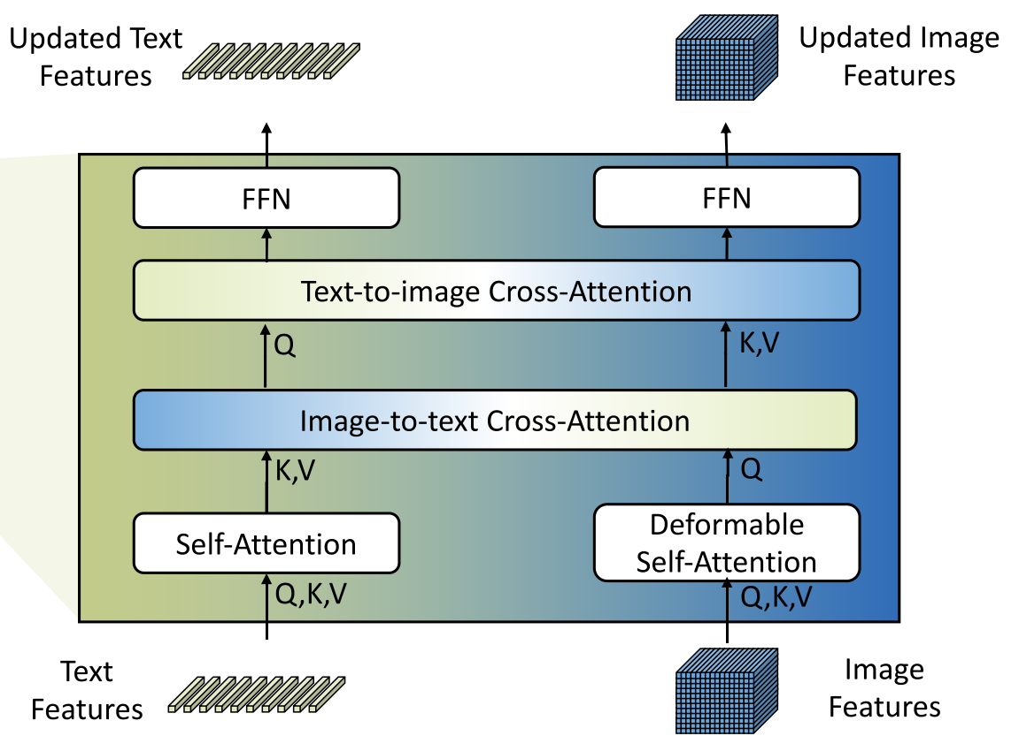
Feature Extractor & Enhancer
Multi-scale image features are extracted using an image backbone like Swin Transformer.
Text features are extracted using a text backbone like BERT.
Feature Enhancer:
Includes Deformable self-attention for enhancing image features.
Uses Vanilla self-attention for enhancing text features.
Incorporates cross-attention modules (image-to-text and text-to-image) inspired by GLIP for aligning features of different modalities.

Slide 11
Language-Guided Query Selection
Background:
Image features (X_I) are high-dimensional (N_I > 10,000, from Swin Transformer).
Text features (X_T) are compact (N_T < 256, from BERT).
Objective:
Select N_q = 900 most relevant image tokens to guide the decoder.
How We Do It:
Compute similarity matrix: X_I X_T^T.
Perform max operation along text tokens: Max^(-1).
Select top N_q = 900 image tokens based on similarity scores.
Use selected tokens to initialize decoder queries (content + positional).

Slide 12
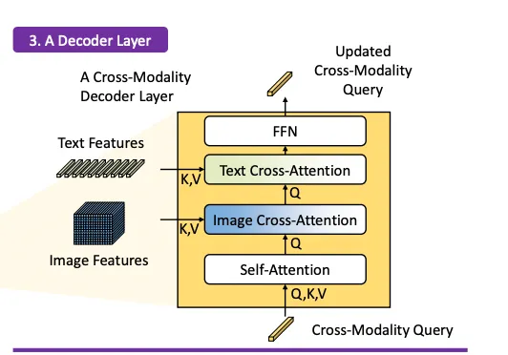
Cross-modality decoder
A cross-modality decoder integrates text and image modality features.
It processes fused features and decoder queries through attention layers and feed-forward networks.
These layers capture relationships between visual and textual information.
The decoder refines object detections and assigns appropriate labels.
Final steps include bounding box prediction, confidence filtering, and label assignment.

Slide 13
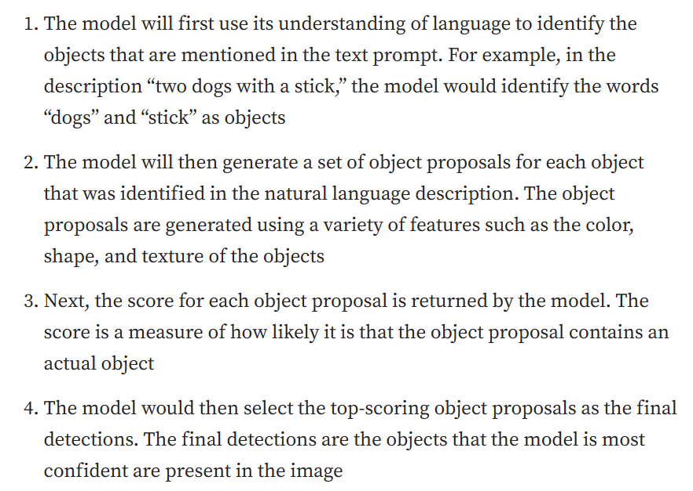
How it works?

Slide 14
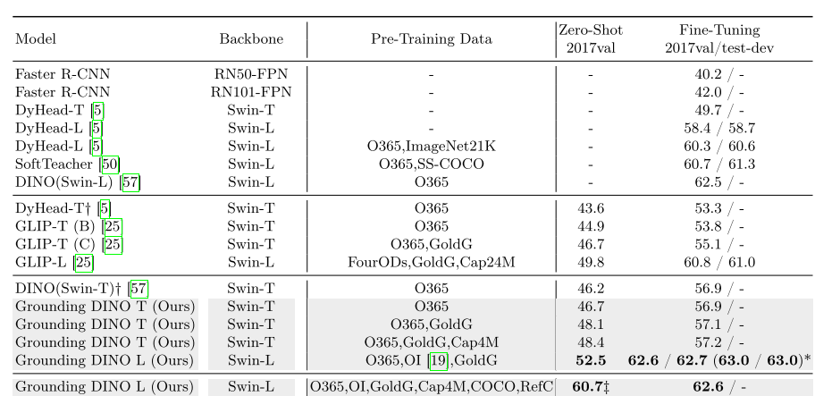
Experimental Results in COCO Object Detection Datasets

Slide 15
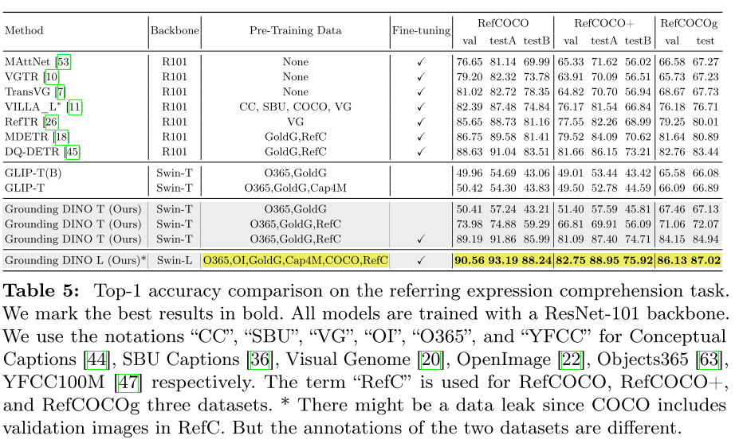
Experimental Results in Visual Grounding Datasets

Slide 16
Thank You

