Slide 1
EgoAvatar: Egocentric View-Driven and Photorealistic Full-body Avatars
SIGGRAPH Asia 2024
JIANCHUN CHEN, SIC & VIA, JIAN WANG, SIC & VIA, YINDA ZHANG, ROHIT PANDEY, THABO BEELER, MARC HABERMANN, CHRISTIAN THEOBALT
By Hamid Mohammadi

Slide 2
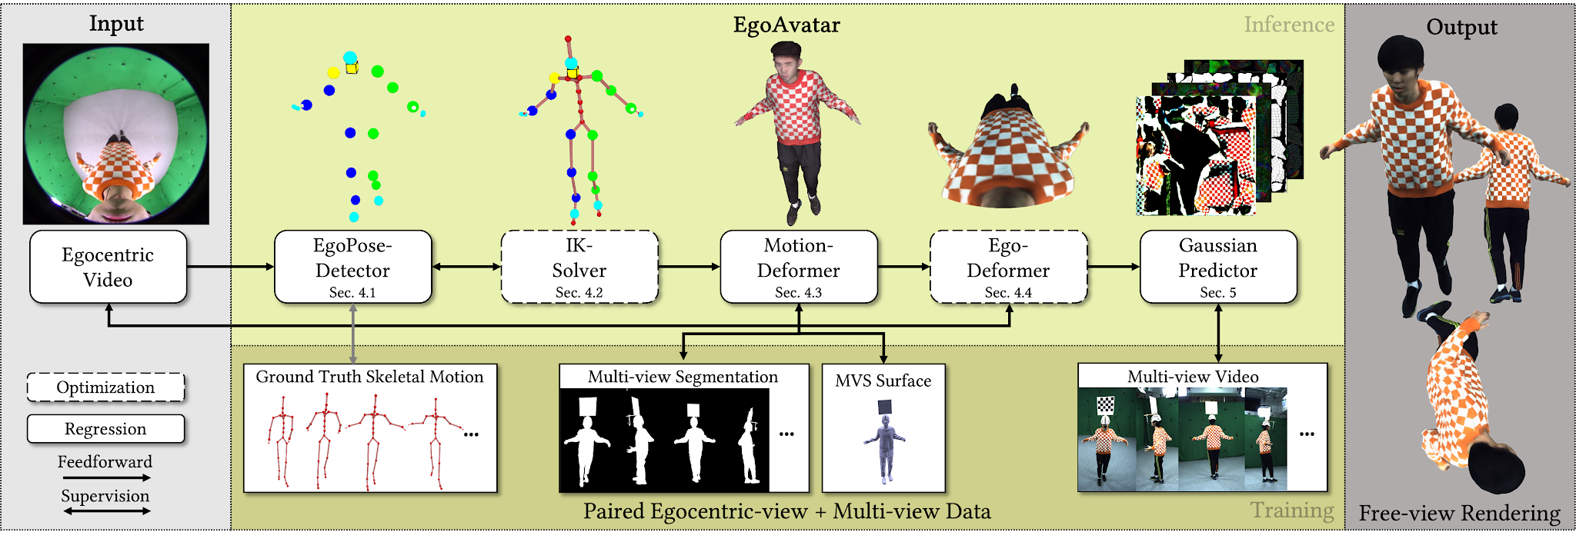
Task
3D avatar reconstruction from a single view head-mounted RGB fisheye camera

Slide 3
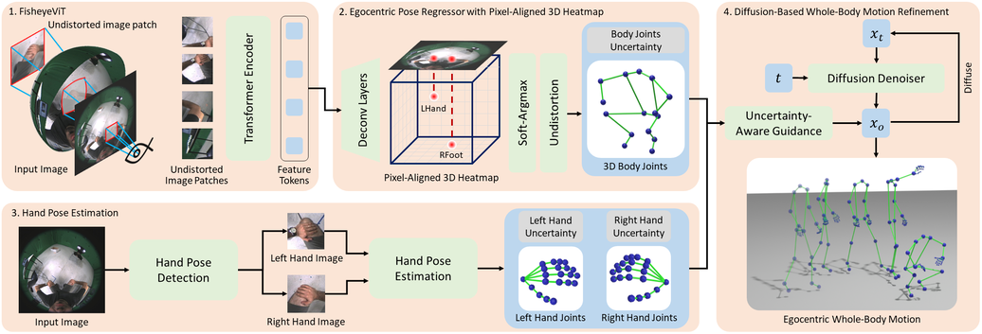
EgoPose Detector
Paper: Egocentric Whole-Body Motion Capture with FisheyeViT and Diffusion-Based Motion Refinement (CVPR2024)

Slide 4
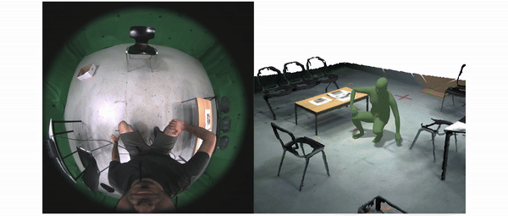
EgoPose Detector
Paper: Egocentric Whole-Body Motion Capture with FisheyeViT and Diffusion-Based Motion Refinement (CVPR2024)

Slide 5
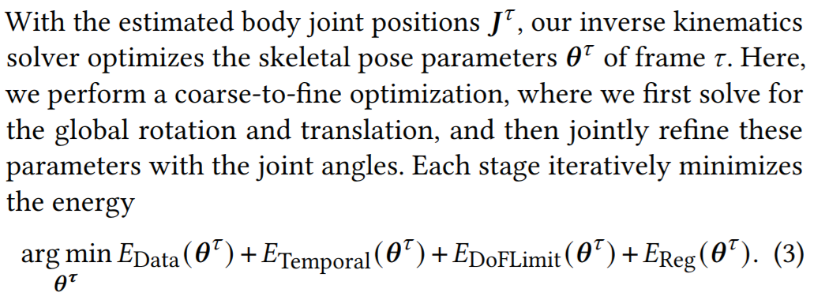
Inverse Kinematics Solver

Slide 6
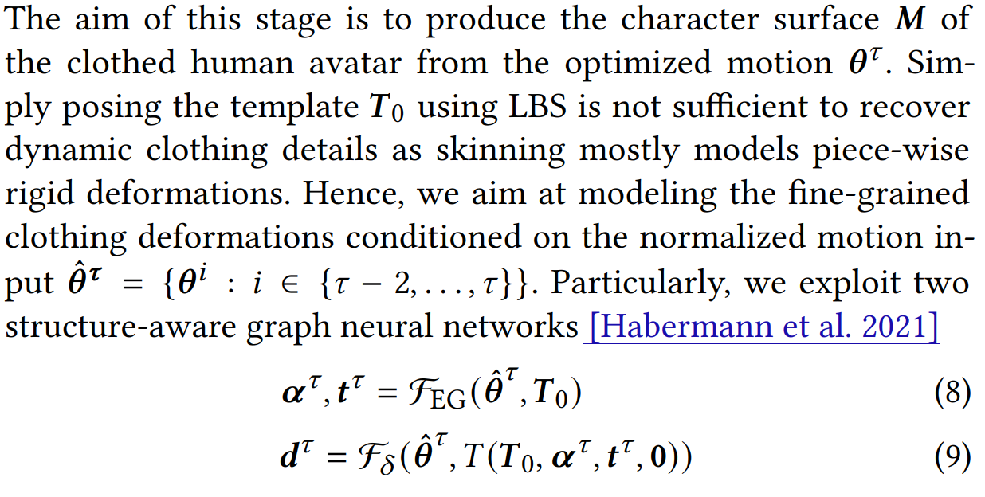
Motion Deformer

Slide 7
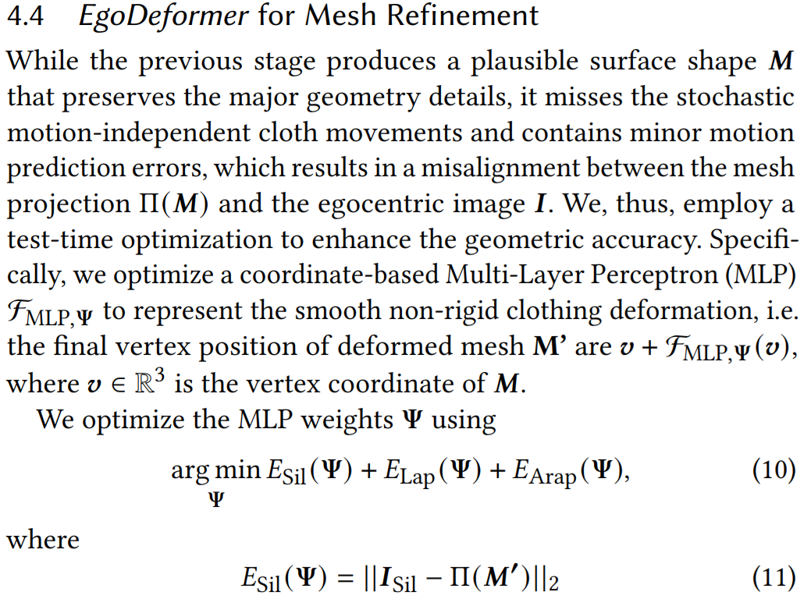
Ego Deformer

Slide 8
View-free Reconstruction

Slide 9
Expressive Whole-Body 3D Gaussian Avatar
ECCV 24
Gyeongsik Moon, Takaaki Shiratori, Shunsuke Saito
Seoul National University + META

Slide 10
Task: Animatable Whole-body Avatar
Create an animatable avatar from a monocular video of a single person
The person must rotate in the video
Support Face and Hand expressions

Slide 11
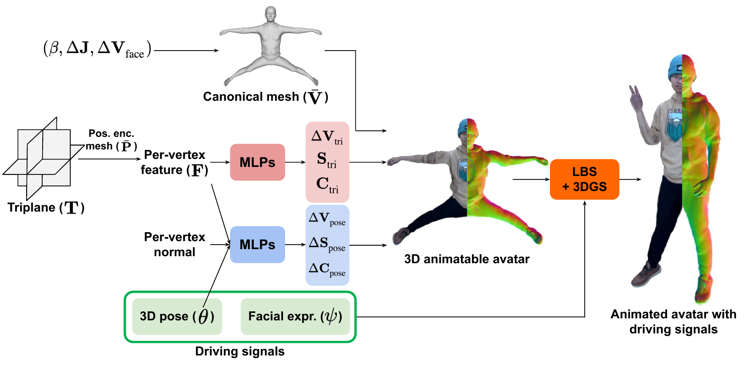
Pipelines
Key features:
Triplanes for positional encoding
Per-vortex normals: used to obtain angle-dependent shading
Pose and Facial expression for novel animations
V: Vertices
S: Scale
C: Color

Slide 12
Animation
V_{tri}: Vertex locations from the Triplane MLP
V_{pose}: Vertex locations from the Pose MLP
W: Blending weights
θ: Pose
LBS: Linear Blend Skinning function

Slide 13
Rendering
K: Camera intrinsic parameters
E: Camera extrinsic parameters
S: Scale
f: Render function
I: Image

Slide 14
Thanks!

Slide 15
GaussianBody: Clothed Human Reconstruction via 3d Gaussian Splatting
Arxiv
Mengtian Li, Shengxiang Yao, Zhifeng Xie, Keyu Chen
Shanghai University,
Tavus Inc.
Shanghai Engineering Research Center of Motion Picture Special Effects

Slide 16
Task: Realistic Human Reconstruction from a Single-view RGB Video
Single-view RGB video of one person
The person must rotate fully in the video
Camera parameters are known

Slide 17
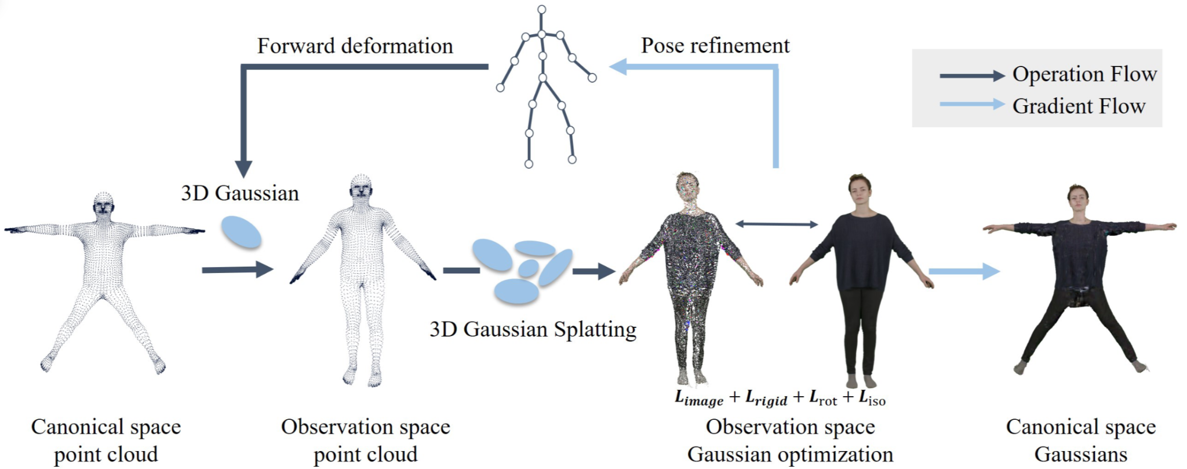
Pipeline
The Gaussians are initialized on the SMPL vertices.
Use SMPL blend skinning to deform and rotate the Gaussians.
Joint optimization of SMPL parameters and Gaussians on all video frames.

Slide 18
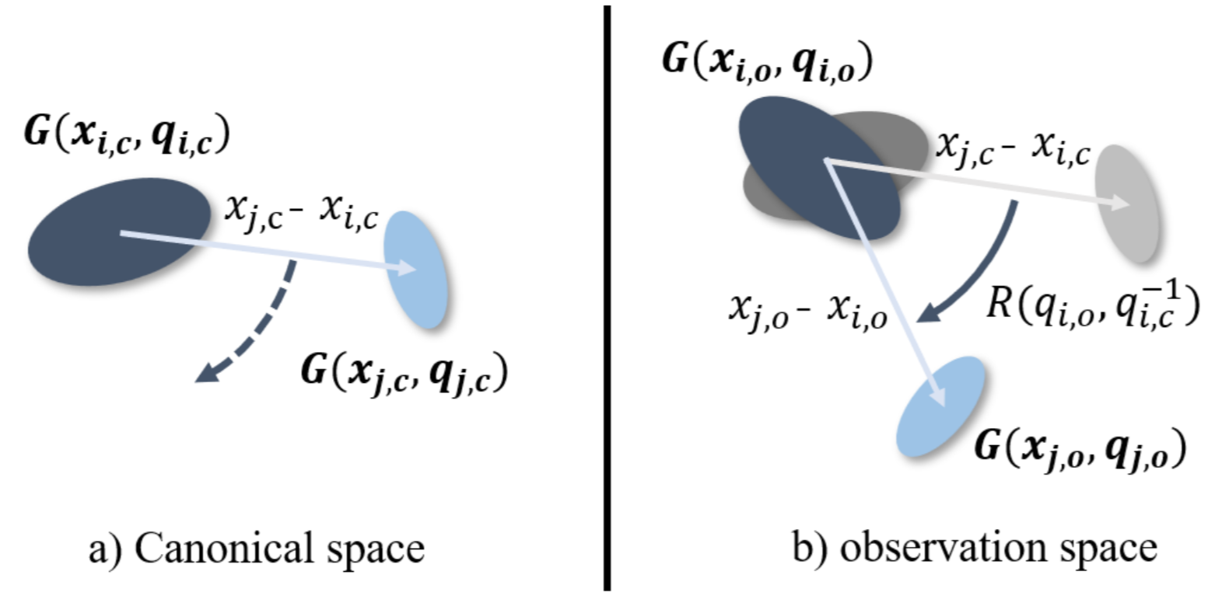
Gaussians in Observation Space
To keep the directional color values of Gaussian harmonics, the viewing direction is transformed to the relative SMPL coordinates.

Slide 19
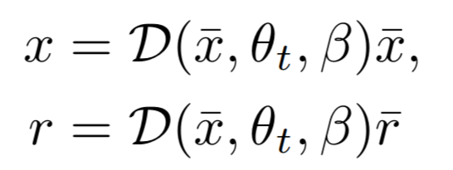
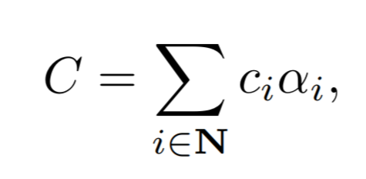
SMPL Guidance
Gaussian Splatting
SMPL Deformation Guidance

Slide 20
Optimization

Slide 21
Thanks!

