Slide 1
Autoregressive Image Generation without Vector Quantization
Tianhong Li¹ Yonglong Tian² He Li³ Mingyang Deng¹ Kaiming He¹
¹MIT CSAIL ²Google DeepMind ³Tsinghua University
NeurIPS 2024
Presenter: Hang Zhou

Slide 2
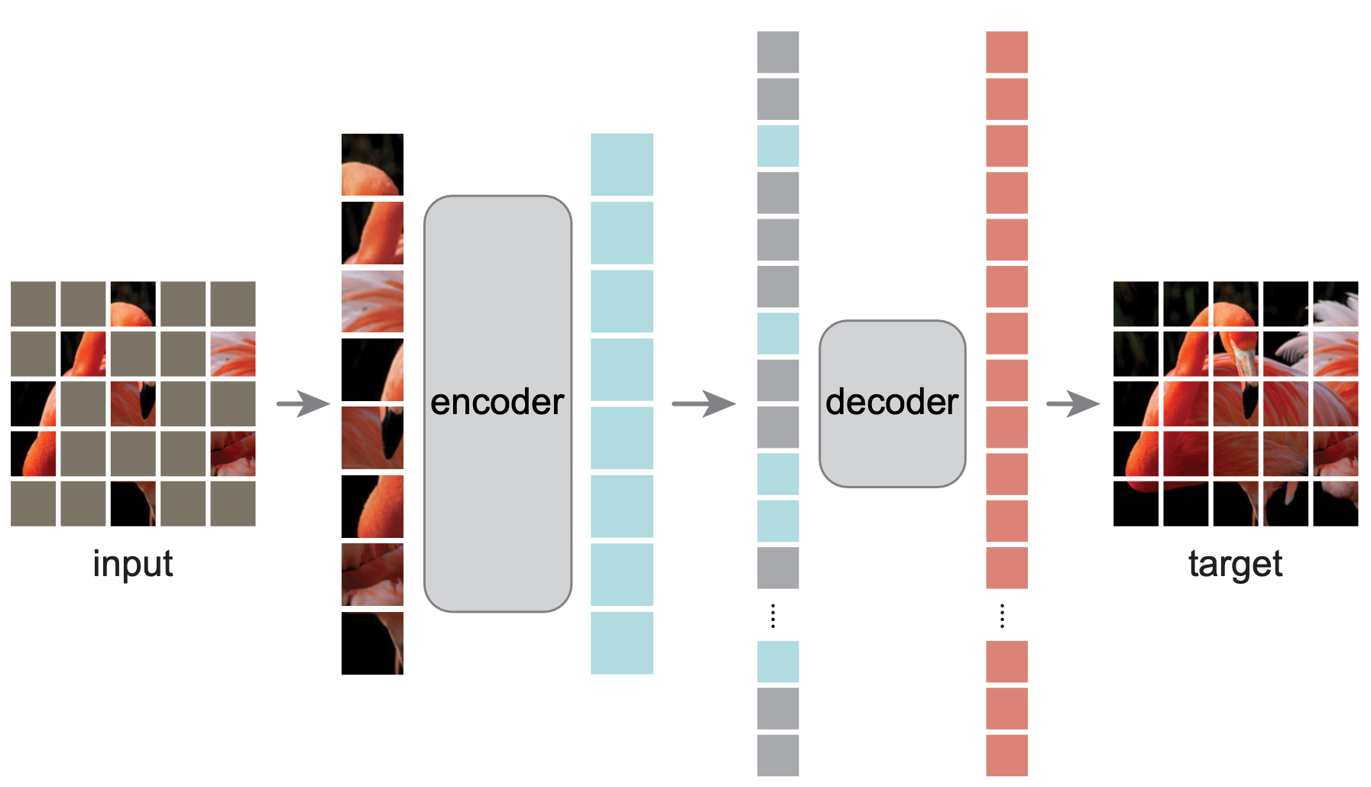
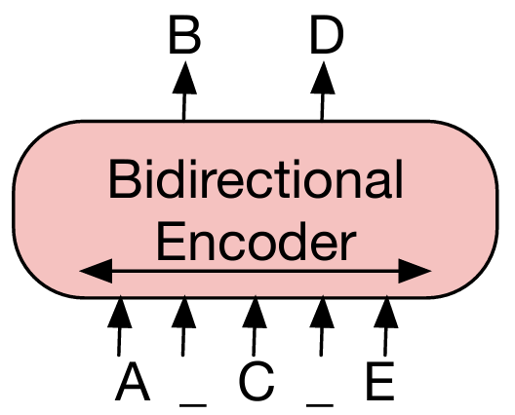
Preliminary
Representation learning
MAE (Masked AutoEncoder)
BERT (Bidirectional Encoder Representations from Transformers)
Notes:
Representation learning
MAE is a kind of denoising autoencoder
MAE encoder: similar to ViT, but only encode a fraction of image patches
MAE decoder: also transformer based, but decode all the tokens including the masked ones
In comparison, in BERT, they replace masked tokens with special tokens

Slide 3
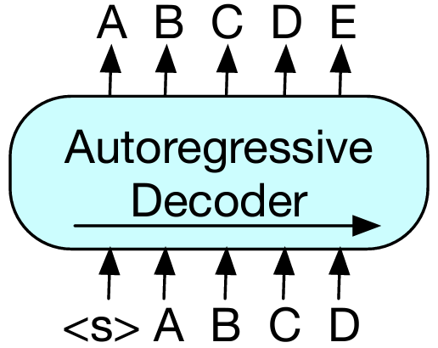
Preliminary
Autoregressive model
Generative model?
Diversity?
Autoregressive image models
Pixel Recurrent Neural Networks, ICML 2016
Conditional Image Generation with PixelCNN Decoders, NeurIPS 2016
Image Transformer, ICML 2018
PixelSNAIL: AnImproved Autoregressive Generative Model, ICML 2018
Generative Pretraining from Pixels, ICML 2020

Slide 4
Preliminary
Autoregressive image models
Autoregressive Image Generation using Residual Quantization, CVPR 2022
Notes:
Trained on ImageNet

Slide 5
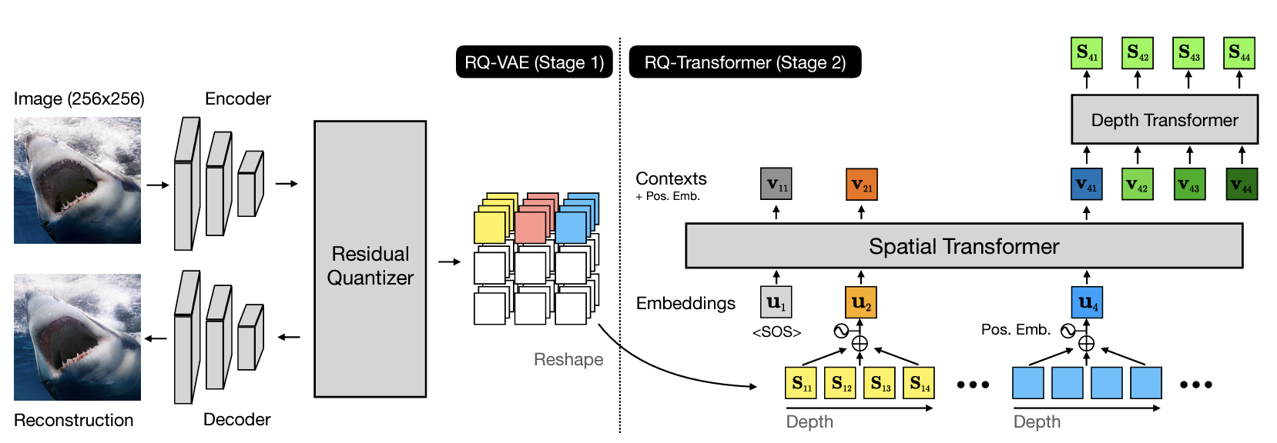
Preliminary
Autoregressive image models
Autoregressive Image Generation using Residual Quantization, CVPR 2022

Slide 6
Rethinking discrete-valued tokens
Is it necessary for autoregressive models to be coupled with vector-quantized representations?
predict next tokens based on previous ones, tokens can be discrete or continuous
How to model the per-token probability distribution?
Discrete-valued representations can be modeled by a categorical distribution:
x
z
Notes:
our image generation approach is a sequence model operated on a tokenized latent space.
But unlike previous methods that are based on vector-quantized tokenizers (e.g., variants of VQ-VAE), we aim to use continuous-valued tokenizers.
Matrix W is a K-way classifier which is learned with autoregressive model
x: continuous value
z: vector

Slide 7
Diffusion loss
How to model the per-token probability distribution?
Model with diffusion models
x

Slide 8
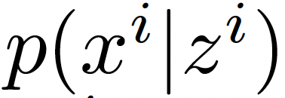
Diffusion loss for autoregressive models
Autoregressive model formulation:
Token x^{i} can be a continuous value
The formulation is decomposed into two parts:
Generate conditioning vector z^{i}
model the probability of the next token by diffusion inference step
Notes:
x^i: continuous value

Slide 9
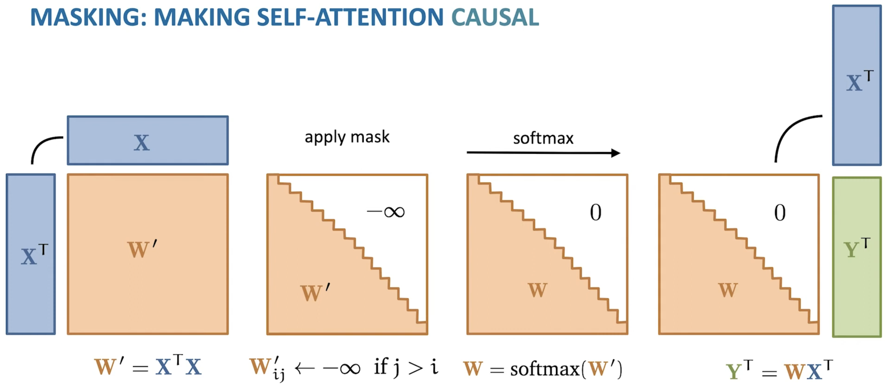
Unifying autoregressive and masked generative models
Autoregressive models are popularly implemented by causal attention
key-value (kv) cache to speed up inference

Slide 10
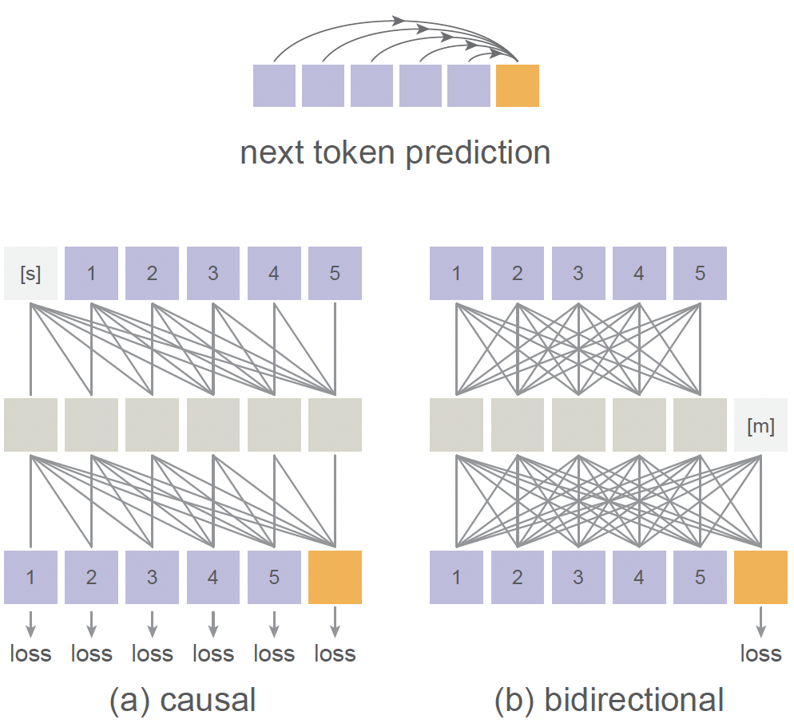
Unifying autoregressive and masked generative models
Bidirectional attention can perform autoregression
Apply an MAE-style encoder on the known tokens with positional embedding
Concatenate the encoded sequence with mask tokens with positional embedding added
Map this sequence with an MAE-style decoder
Unlike causal attention, the loss is computed only on the unknown tokens

Slide 11
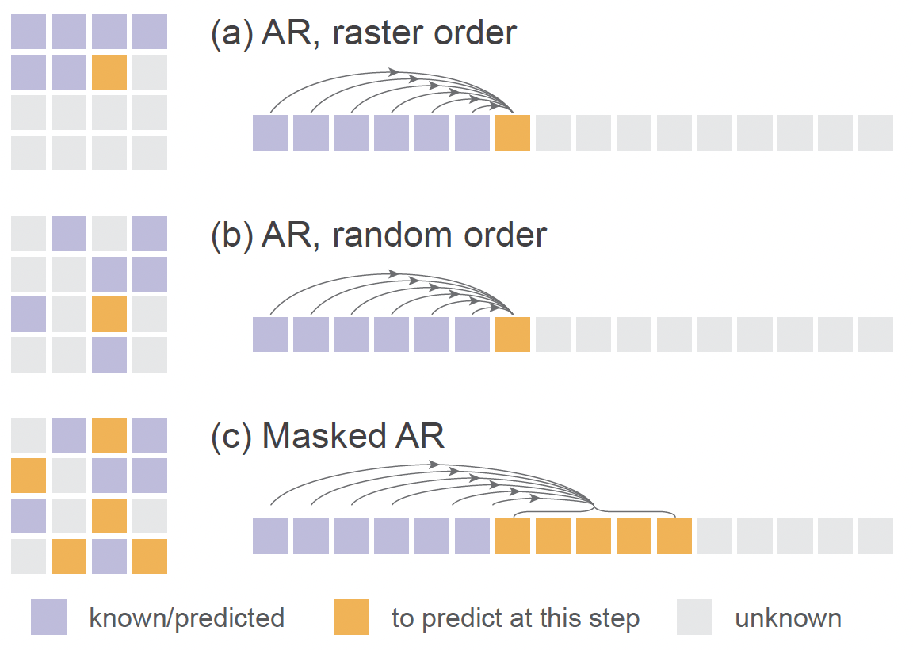
Unifying autoregressive and masked generative models
Advantage:
generate multiple tokens together, speed up inference
Full attention across tokens can improve the quality and offer a better speed/accuracy trade-off.
Autoregressive models in random orders
randomly permuted sequence
(a): standard autoregressive model
(bc): generalized autoregressive models

Slide 12
Unifying autoregressive and masked generative models
Masked autoregressive models
predict multiple tokens based on previous tokens

Slide 13
Implementations
Diffusion structure:
Same as DDIM, 1000 steps
Denoising MLP:
3residual blocks and a width of 1024 channels for denoising.
Tokenizer:
tokenizers provided by LDM
Transformer:
ViT
Autoregressive baseline:
Causal attention, GPT, kv-cache
Masked autoregressive models
70% tokens are unknown (training), progressively reduces the masking ratio from 1.0 to 0 with a cosine schedule (inference)

Slide 14
Experiments
ImageNet at a resolution of 256×256
Evaluation:
FID
IS
Inception v3, classification acc

Slide 15
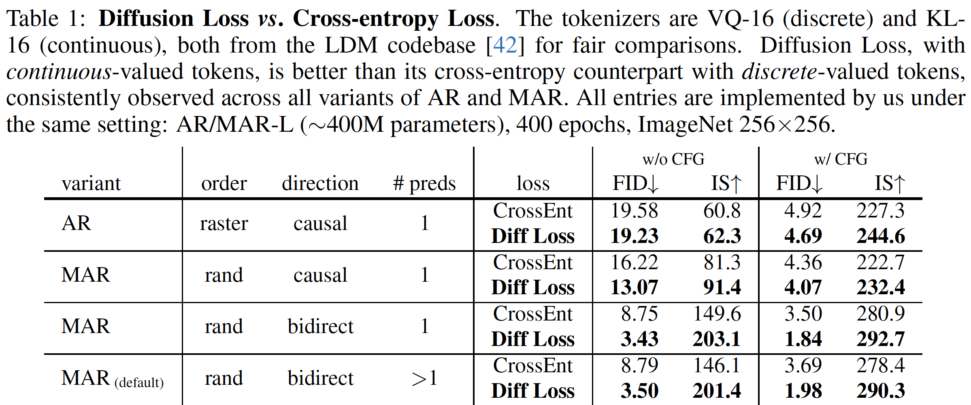
Ablation study
Diffusion loss vs cross-entropy loss

Slide 16
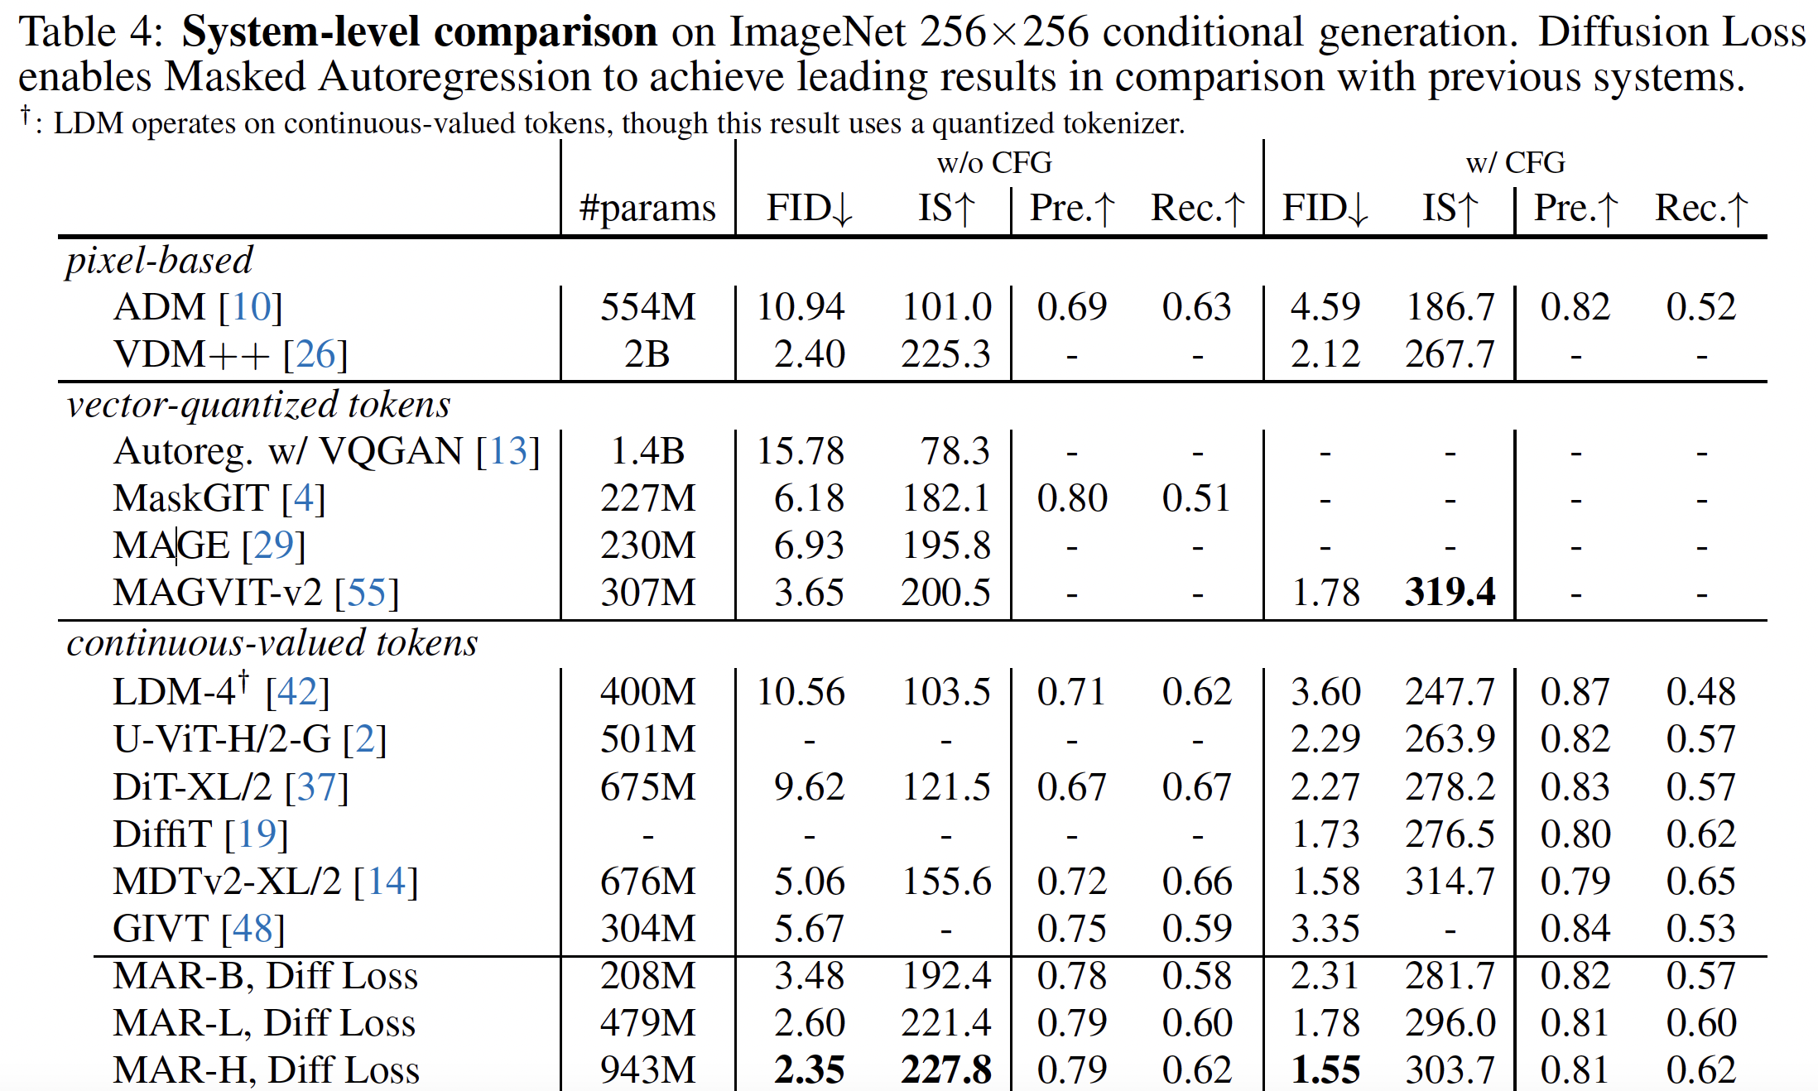
Comparisons
Notes:
Classifier-free guidance (CFG). To support CFG [23], at training time, the class condition is replaced with a dummy class token for 10% of the samples [23].

Slide 17
Comparisons

Slide 18
Visual results

Slide 19
Takeaway
Notes:
MO-Mask

