Slide 1
Multi-Person Text-to-Motion Synthesis in ECCV2024
Presenter: Yilin Wang
241018

Slide 2
FreeMotion: A Unified Framework for Number-free Text-to-Motion Synthesis

Slide 3
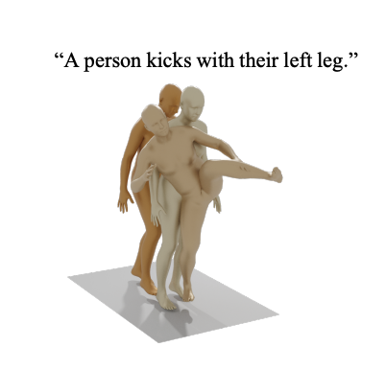
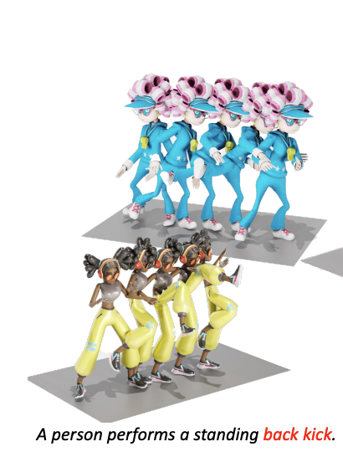
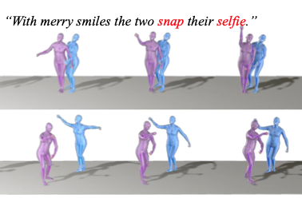
Motivation
MDM
MoMask
FreeMotion
Single
Person
N-Person
InterGen
Two
Person

Slide 4
Method
N-person
Joint distribution
1 person
Marginal distribution
Conditional Motion Distribution
Notes:
Key insight: build a bridge between the marginal and joint distribution with the conditional distribution.
As the goal is to: model the joint distribution of n-person motions
Can be decomposed to marginal x conditional motion distribution

Slide 5
Method
Generation Module → generate single-person motion for each person from text
Interaction Module → inject condition motions (other persons) to the current motion

Slide 6
Stage 1: Train Generation Module (single person)
Foot contact
Loss
Joint velocity
Loss
Bone length
Loss
Add noise to a input motion x →
Denoise the noisy motion iteratively
Notes:
The 1 → the current motion for synthesis

Slide 7
Stage 2: Train Interactive Module (Two-person) (Multi-person)
Hidden state for the current noised motion
Hidden state for the condition motions are randomly masked out
Fuse information from motion conditions to current motion
Spatial Control
Explicit Guidance
L2-distance: generated motion positions vs. goal spatial positions
Implicit Guidance
Spatial control as a part of the current motion hidden states

Slide 8
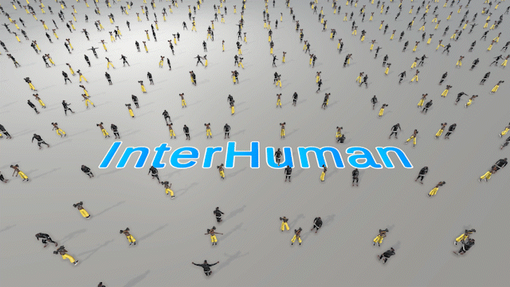
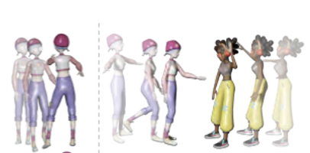
Evaluation
InterHuman Dataset
Two-person interaction text-to-motion dataset
Evaluate model capacity for single & two-person motion synthesis
Reannotating InterHuman Dataset for single-person text with LLM
Modify InterGen for single-person synthesis:
Cross-attention output muting

Slide 9
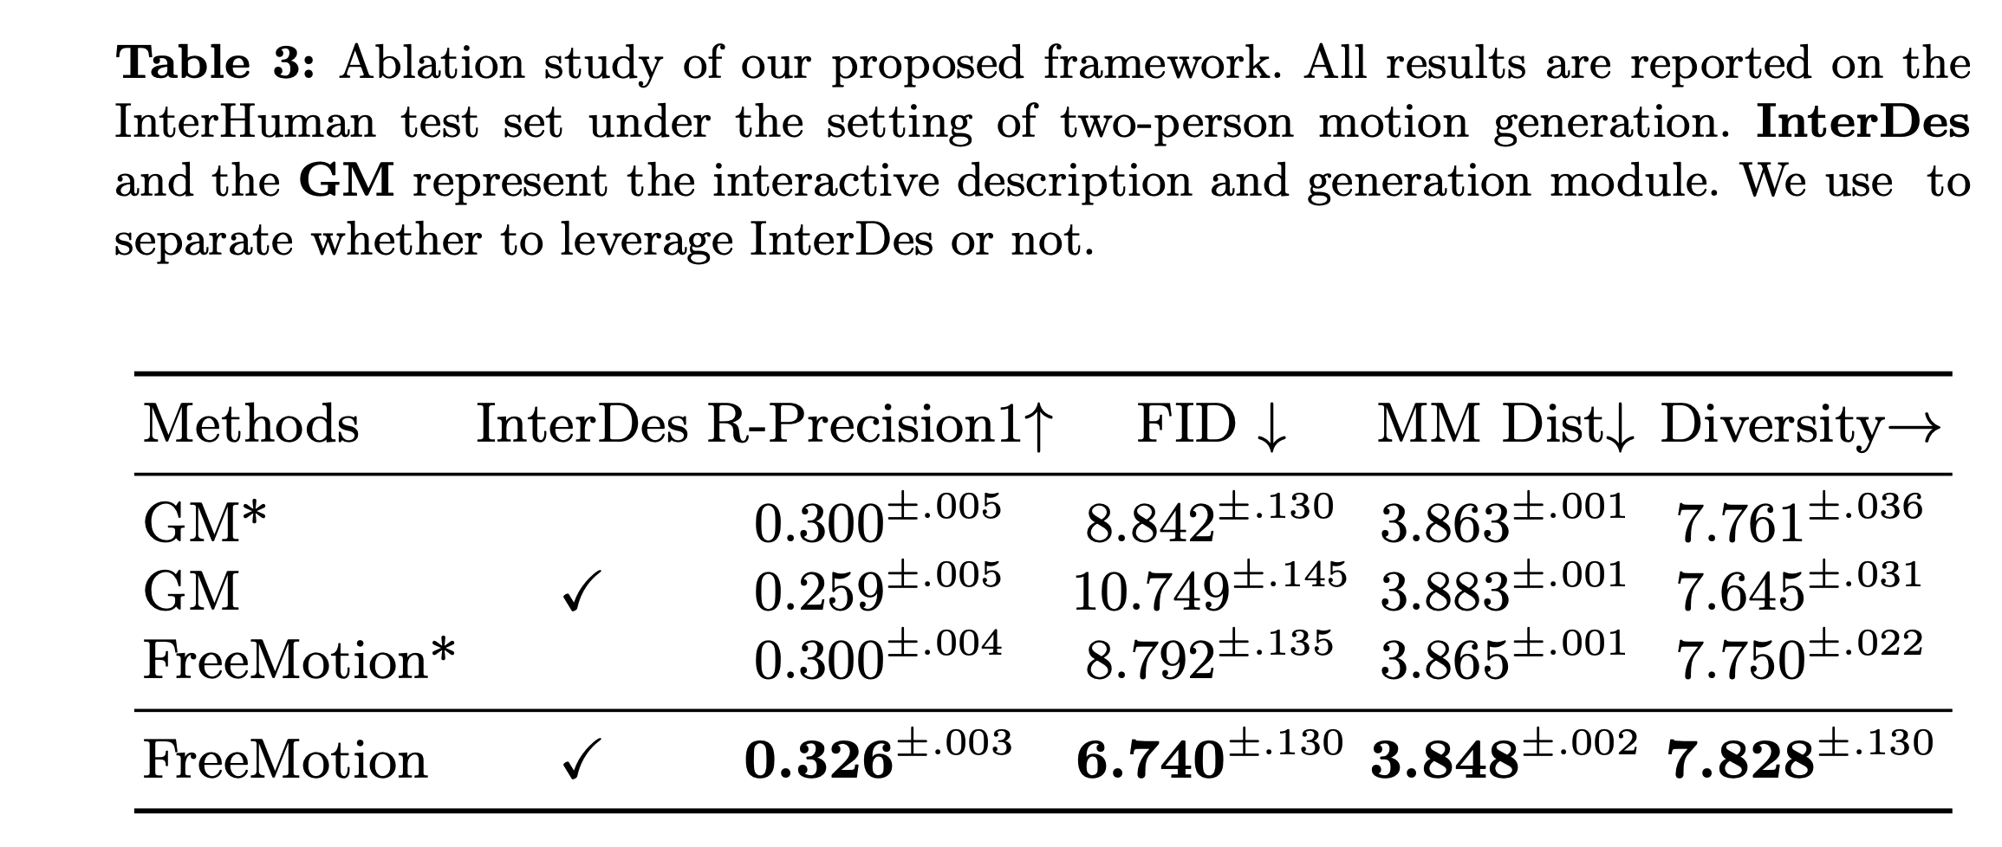
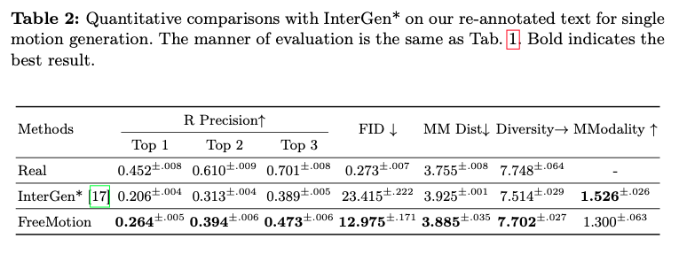
Results

Slide 10
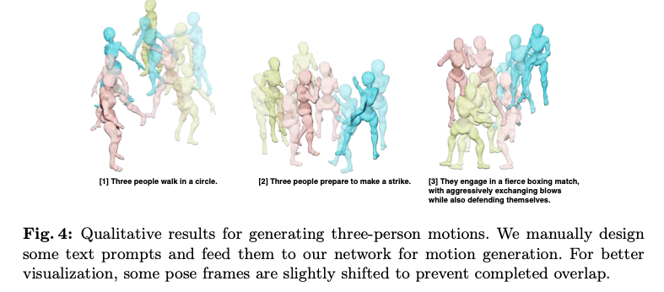
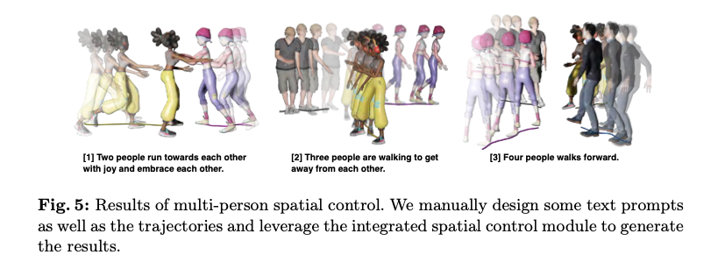
Results
project link

Slide 11
Towards Open Domain Text-Driven Synthesis of Multi-Person Motions

Slide 12
Motivation

Slide 13
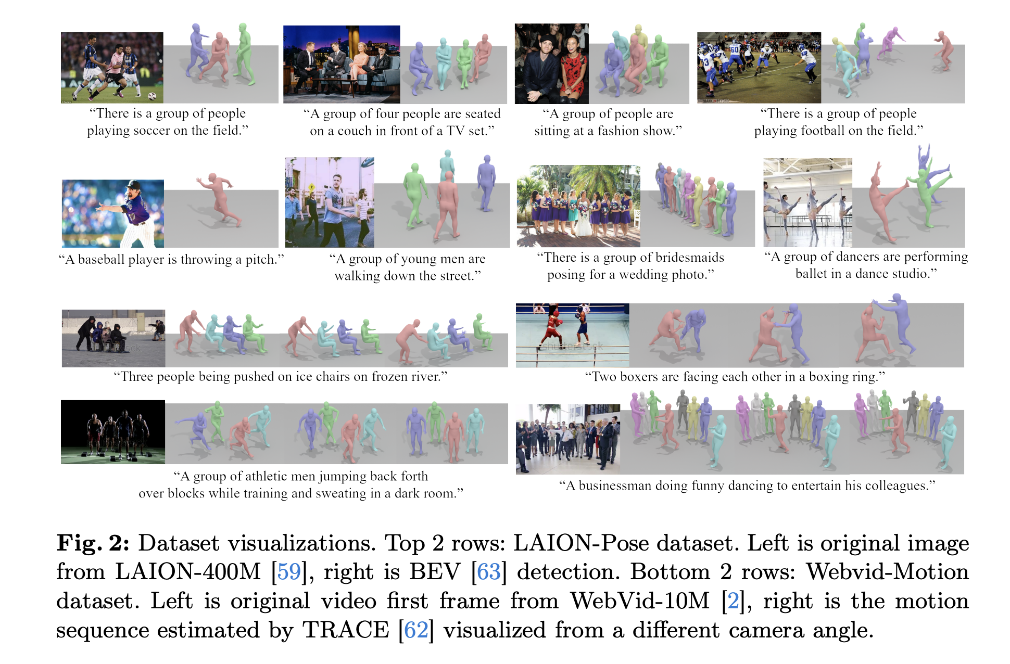
Dataset Contribution
LAION-Pose
WebVid-Motion

Slide 14
LAION-Pose
Pose estimation based on BEV* from the LAION-400M dataset:
Person detection filter
Mesh Completion filter: > 85% in the frame
Mesh De-duplication filter: < 25% IoU overlap
Prompts Filter: real human scenes

Slide 15
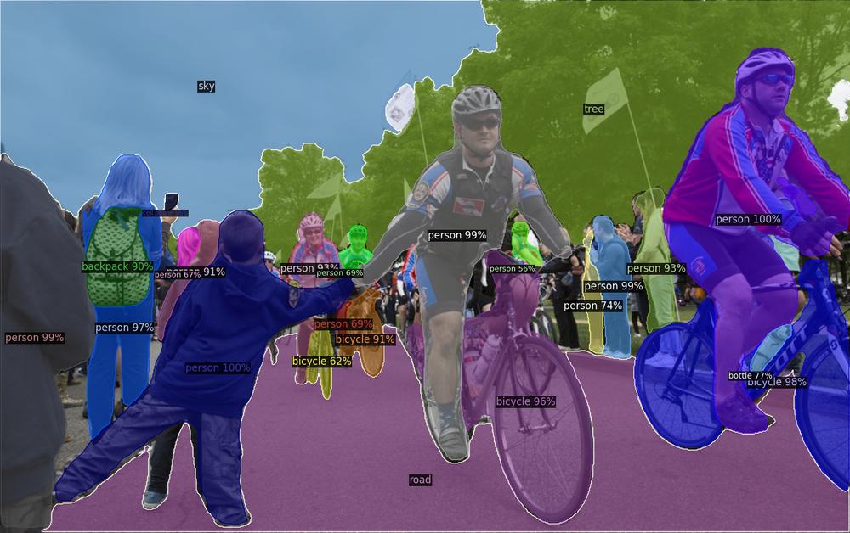
WebVid-Motion
Filter out video clips with at least two persons from WebVid-10
Person Detection Filter: Detectron-2
Middle frame of the video
Filter videos with at least two persons

Slide 16
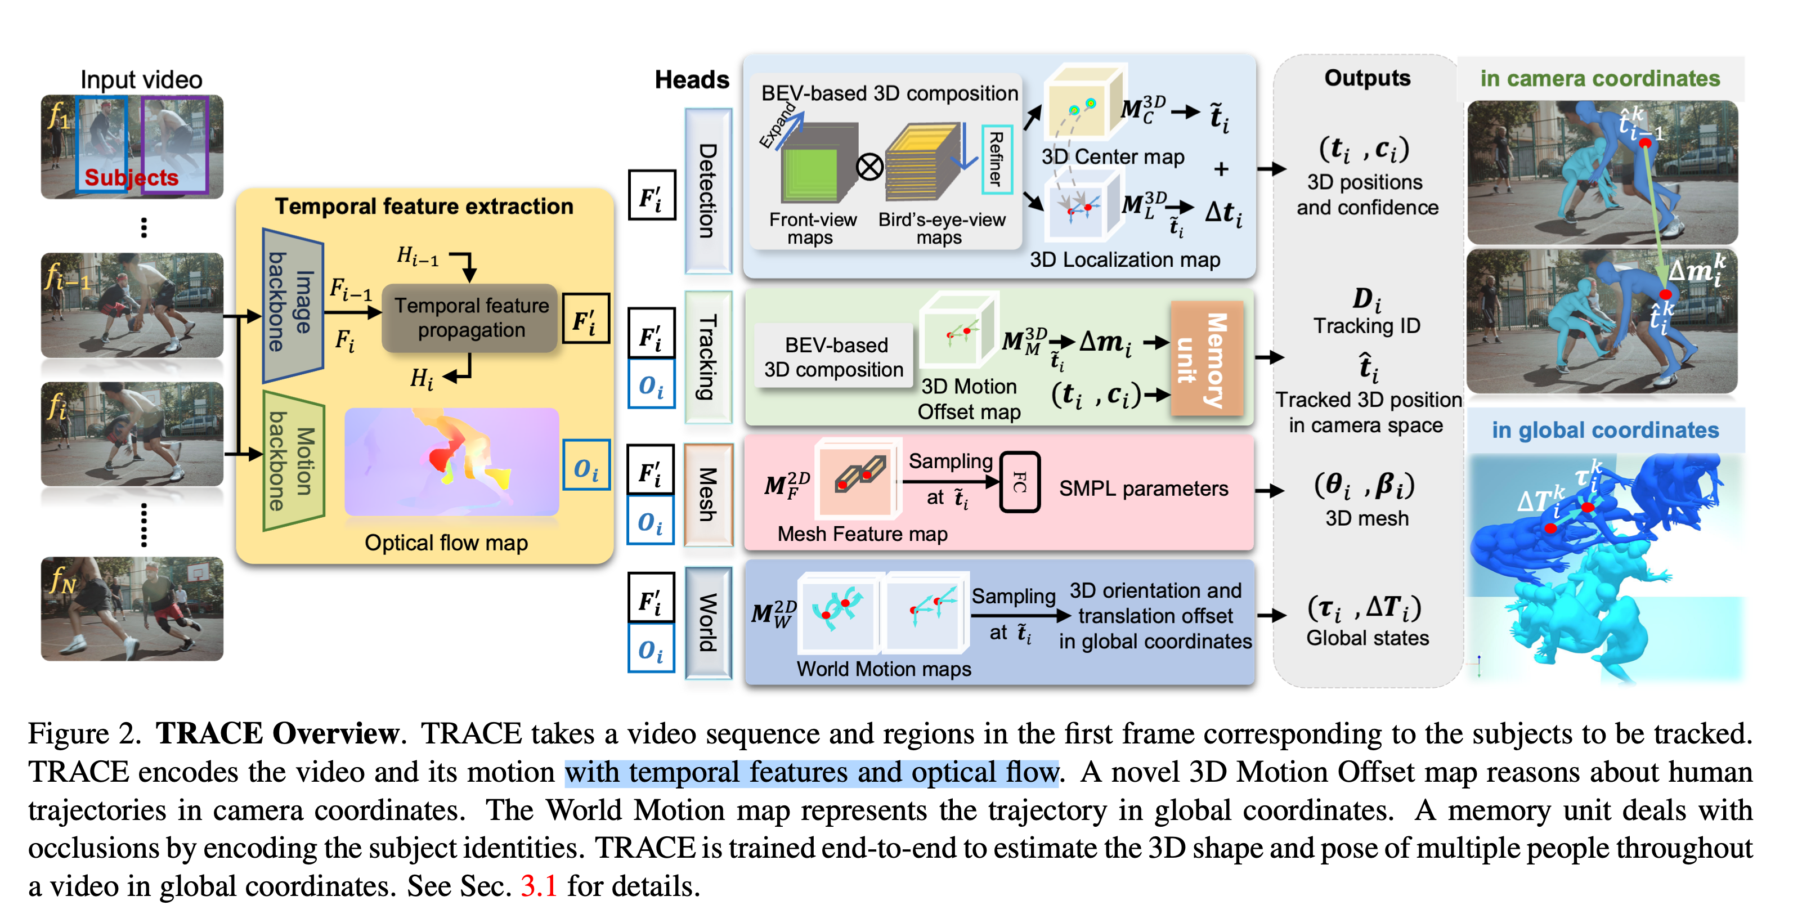
WebVid-Motion
Filter out video clips with at least two persons from WebVid-10
Person Detection Filter: Detectron-2
Motion Estimation: TRACE
3D Motion Offest Map
Per-frame Per-subject
Global translation
Per-frame Per-subject
Joint rotation
Per-frame Per-subject
Shape Information

Slide 17
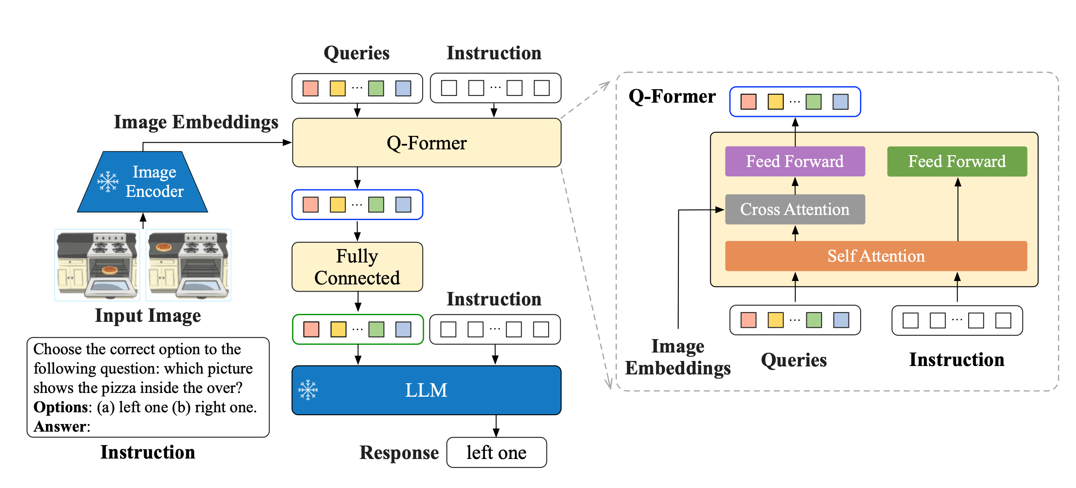
WebVid-Motion
Filter out video clips with at least two persons from WebVid-10
Person Detection Filter: Detectron-2
Motion Estimation: TRACE
Motion Captioning: InstructBLIP
Middle frame of the video
“describe the person or group of people’s action and body poses in the image”

Slide 18
Synthesis Framework
Reference Pose Frame
Text
Stage 1: text to single-frame multi-person pose
Pose layer
Stage 2: text to multi-person model
Pose layer❄️ + Motion layer
Pose layer → focus on per-frame subject interaction ➔ spatial
Motion layer → focus on per-subject movement through time ➔ temporal
Notes:
(B x F) x N x C pose layer is applied on the subject dimension
(B x N) x F x C motion layer is applied on the temporal dimension
Pose layer → focus on per-frame subject interaction
Motion layer → focus on per-subject movement through time
During stage 2, reference pose frame is also input as a condition to the motion layers
Similar idea with AnimateDiff

Slide 19
Results
Notes:
Table 1: Results present the Pose-Only and Motion-Only results as the upper bounds of perfor- mance when solely focusing on per-frame pose quality and per-subject motion quality.
Table 3:
Not freezing the pre-trained pose layers in the joint training stage (B) also does not perform as well, showing that motion data might interfere with the high-quality pose representation learned by pose layers during the first stage.
Training without WebVid-Motion data (C) shows a downgrade in text- pose alignments, indicating that multi-person motion data helps improving inter- action qualities. Removing all motion texts (D), essentially training the temporal layers unconditionally, also decreases the alignment between pose and text.

Slide 20
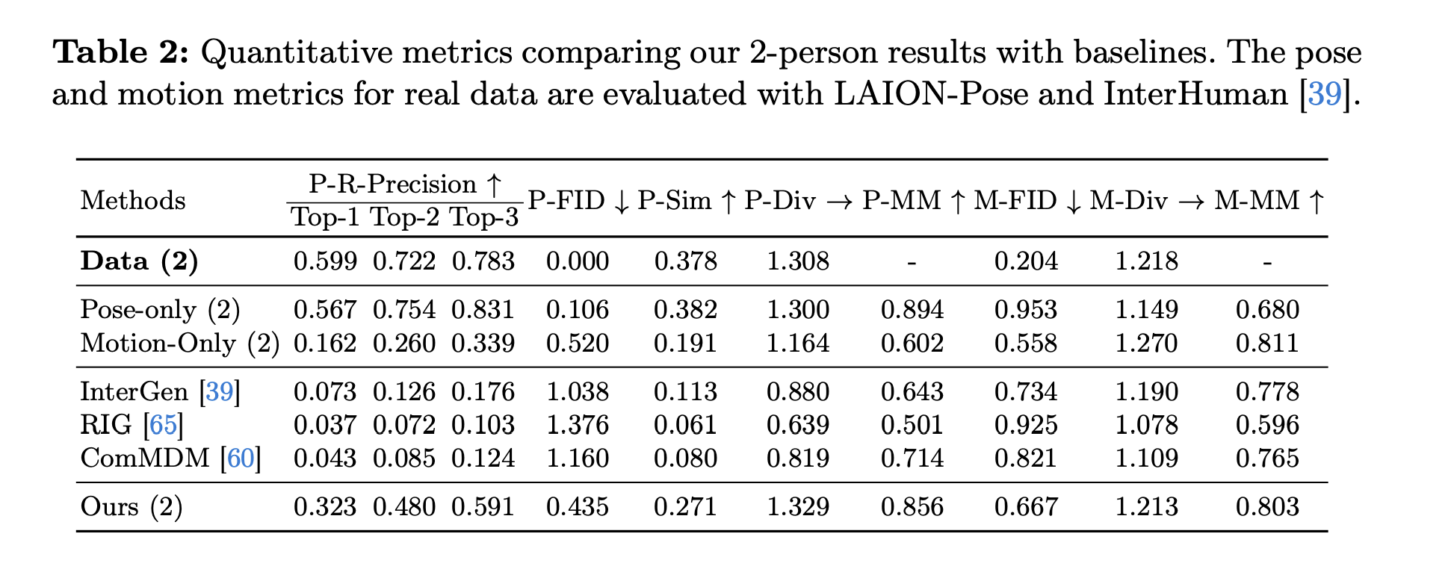
Results

Slide 21
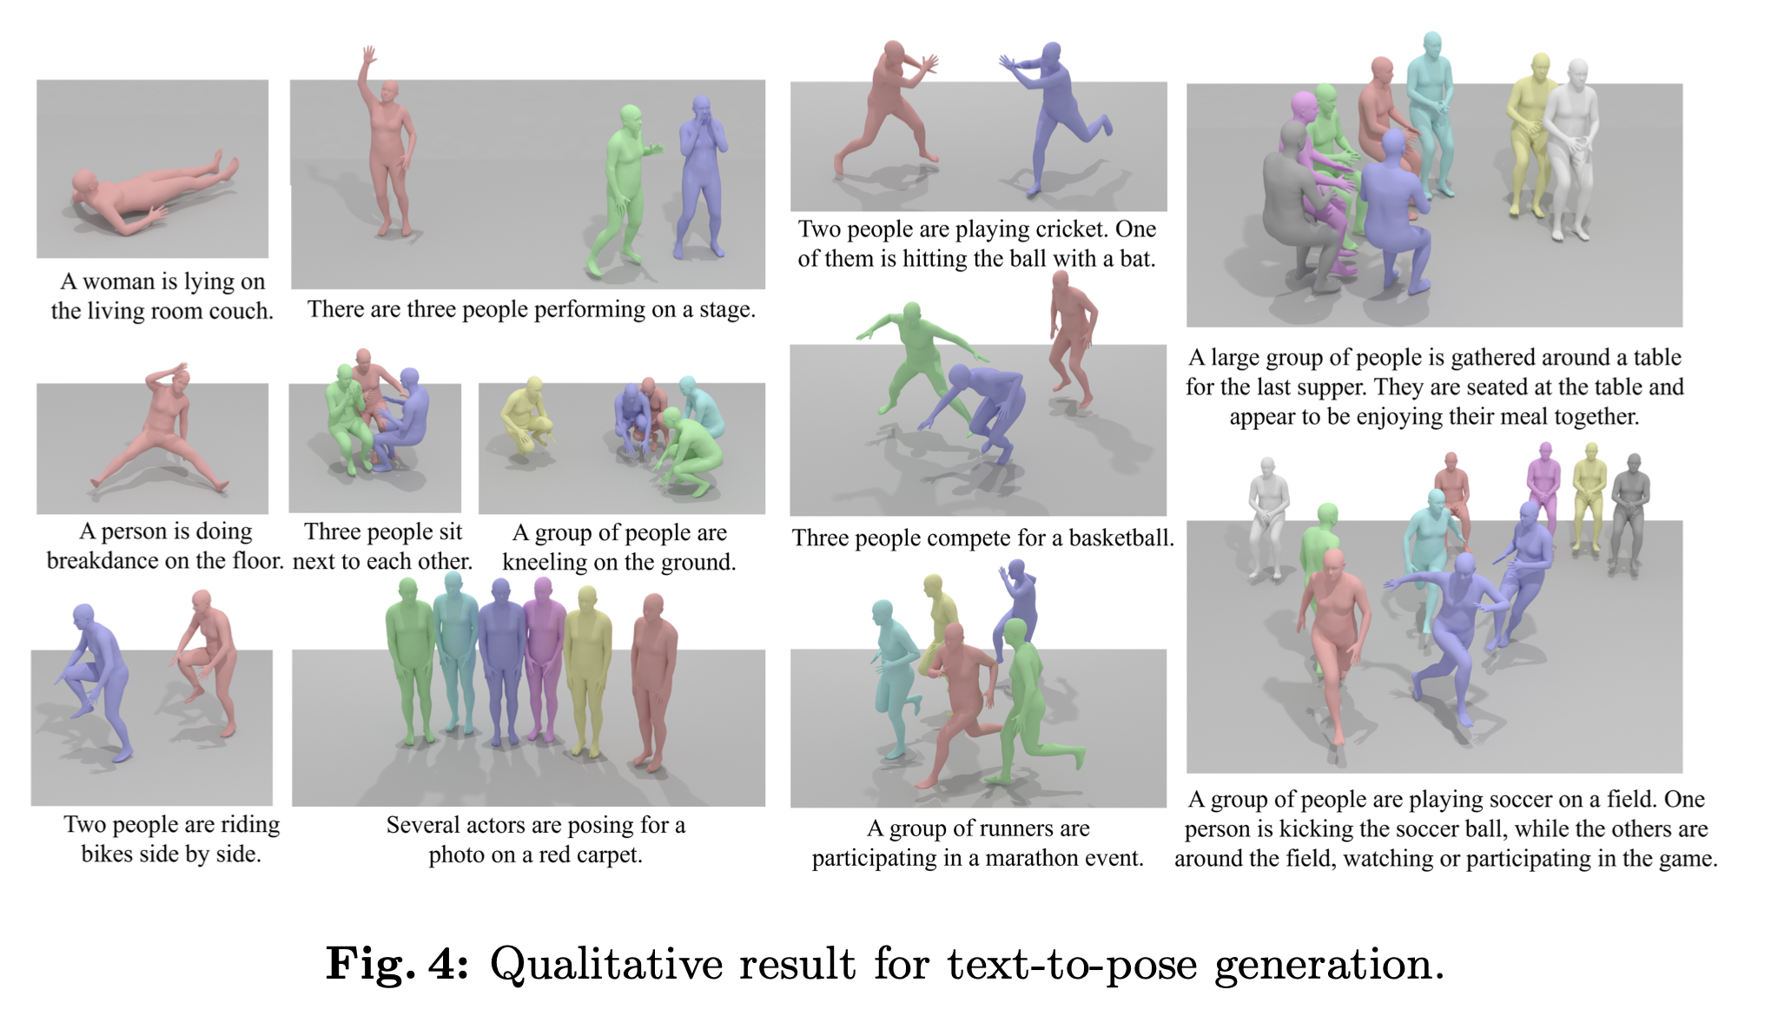
Results

Slide 22
Rethinking
FreeMotion
Provide a smart shortcuts to lift N-person motion synthesis from one/two- person motion dataset
N-person synthesis quality shown is not bad visually
Lack of quantitative evaluation metrics for N-person
Single-/Two-person synthesis visual quality seems to be traded off
LAION-Pose / WebVis Motion
Provide the first N-person motion dataset
N-person synthesis covers a broader range of text prompts
Sequences are short
Motion quality is limited from in-the-wild single-view reconstruction

Slide 23
Rethinking
High quality MoCap dataset of multi-person interaction
Versatile controllable multi-person interaction synthesis framework
FreeMotion
Provide a smart shortcuts to lift N-person motion synthesis from one/two- person motion dataset
N-person synthesis quality shown is not bad visually
Lack of quantitative evaluation metrics for N-person
Single-/Two-person synthesis visual quality seems to be traded off
LAION-Pose / WebVis Motion
Provide the first N-person motion dataset
N-person synthesis covers a broader range of text prompts
Sequences are short
Motion quality is limited from in-the-wild single-view reconstruction

