Slide 1
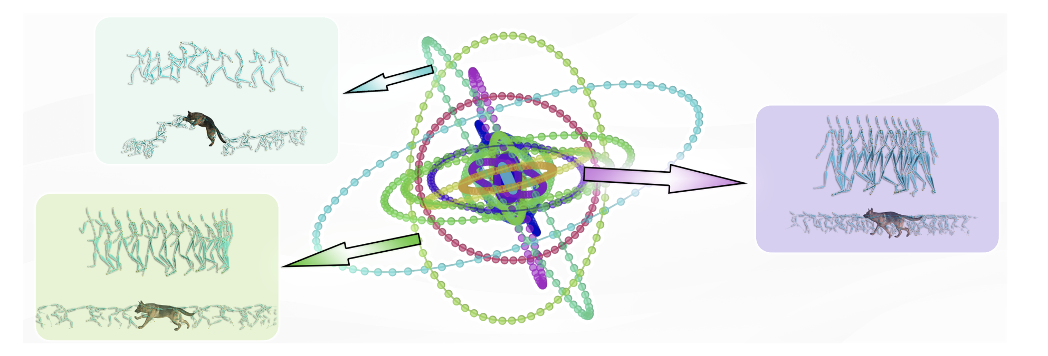
WalkTheDog: Cross-Morphology Motion Alignment via Phase Manifolds
Peizhuo Li, Sebastian Starke, Yuting Ye, Olga Sorkine-Hornung (SIGGRAPH 2024)
Presented by: Yilin Wang

Slide 2
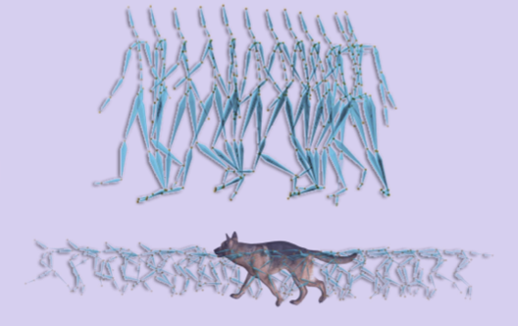
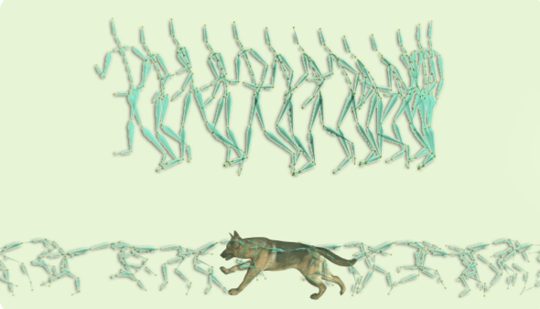
Motivation
Understanding the intrinsic structures and semantics of motion, regardless of the character’s morphology and skeletal structures
A person / a dog walks
A person / a dog runs

Slide 3
Phase Manifold of Motions
Periodic Structure of Motion
Frequency-scaled motion alignment (MotionBlending, Fstyle)
Phase + NN for motion application (DeepPhase, PFNN)
Learn a common phase manifold
➔ 1D phase
➔ Discrete amplitude vector
Each connected component is an ellipse embedded in a high-dimensional space.

Slide 4
Methodology
Construction of the Phase Manifold
Mapping each frame to a point on the phase manifold

Slide 5
Methodology
Vector Quantized Periodic Autoencoder(VQ-PAE)
Phase linearity: the phase 𝜙 increase as linearly as possible over time.
Amplitude constancy: the amplitude A as constant as possible over time.

Slide 6
Methodology
Vector Quantized Periodic Autoencoder(VQ-PAE)
Shallow 2-layer 1D convolutional encoder

Slide 7
Methodology
Vector Quantized Periodic Autoencoder(VQ-PAE)
Temporal signal → phase & frequency
Phase calculation

Slide 8
Methodology
Vector Quantized Periodic Autoencoder(VQ-PAE)
Vector quantization layer
Shared codebook

Slide 9
Methodology
Vector Quantized Periodic Autoencoder(VQ-PAE)

Slide 10
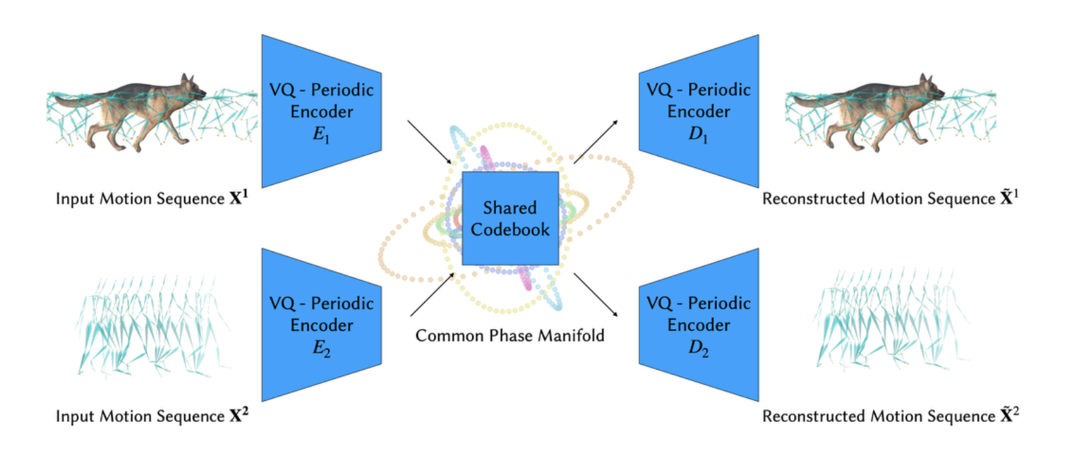
Methodology
Learning a common phase manifold through VQ-PAEs

Slide 11
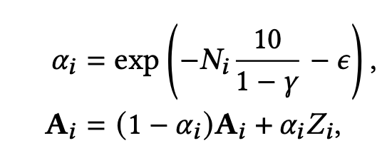
Methodology
Learning a common phase manifold through VQ-PAEs
Reinitialization of A at every training iteration

Slide 12
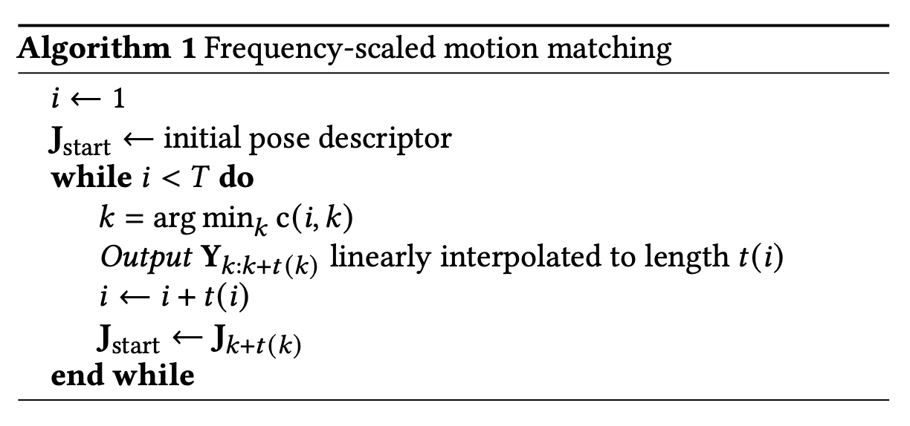
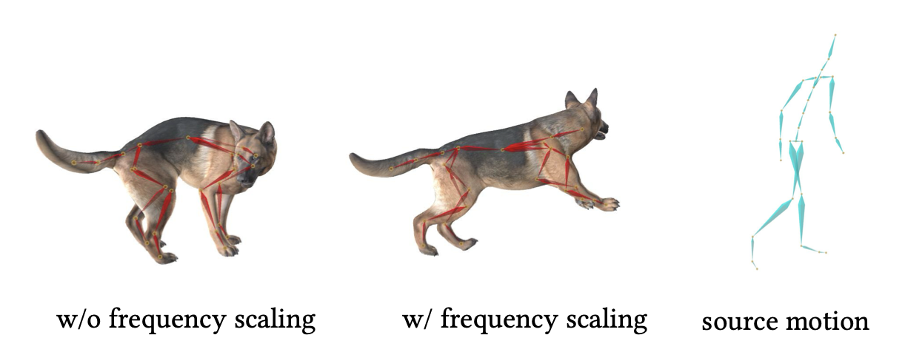
Methodology
Frequency-scaled motion matching

Slide 13
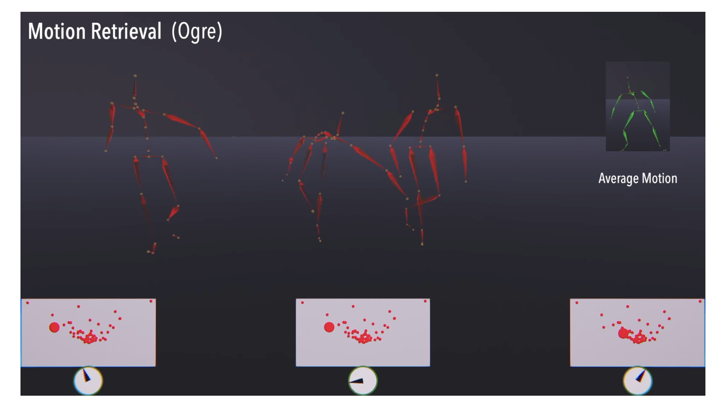
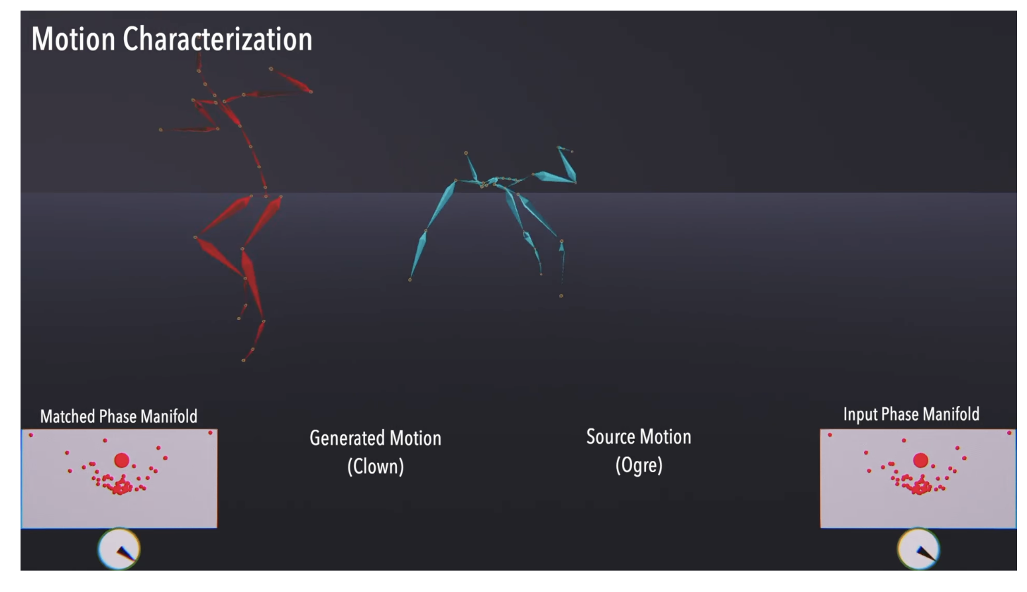
Applications
link

Slide 14
Questions…

