Slide 1
Animate Anyone: Consistent and Controllable Image-to-Video Synthesis for Character Animation
Li Hu, Xin Gao, Peng Zhang, Ke Sun, Bang Zhang, Liefeng Bo
Institute for Intelligent Computing, Alibaba Group
MusePose: a Pose-Driven Image-to-Video Framework for Virtual Human Generation
Zhengyan Tong, Chao Li, Zhaokang Chen, Bin Wu†, Wenjiang Zhou
Lyra Lab, Tencent Music Entertainment
Yande Li June 10, 2024

Slide 2
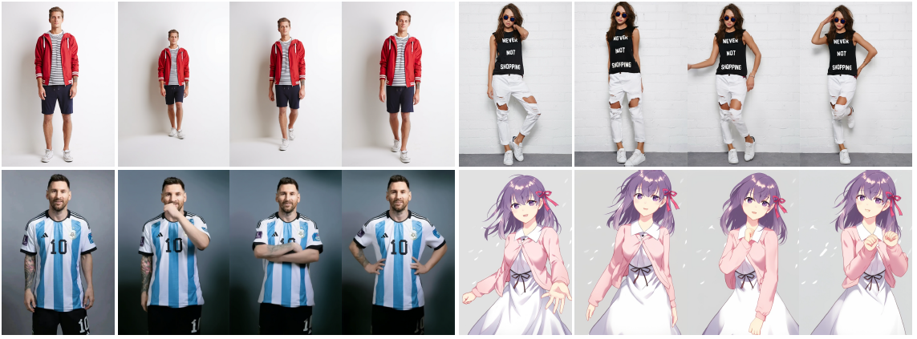
Introduction
Character Animation aims to generating character videos from still images through driving signals, which has many potential applications such as online retail, entertainment videos, artistic creation and virtual character.
However, the generated videos still exhibit issues such as local distortion, blurred details, semantic inconsistency, and temporal instability, which impede the widespread application of these methods.
Notes:
Currently, diffusion models have become the mainstream in visual generation research, owing to their robust generative capabilities. However, challenges persist in the realm of image-to-video, especially in character animation, where
temporally maintaining consistency with detailed information from character remains a formidable problem. To address these problems, they introduced a novel framework leveraging diffusion models for character animation.

Slide 3
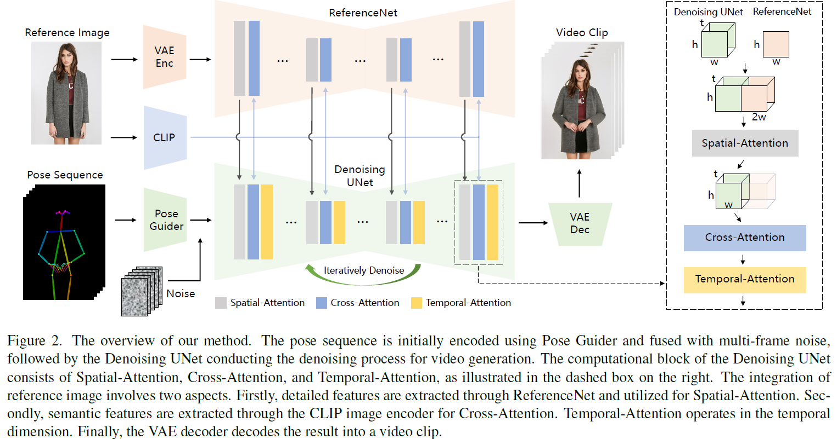
Proposed Method
Notes:
In this paper, to preserve consistency of appearance features from reference image, they designed ReferenceNet to merge detail features via spatial attention.
To ensure controllability and continuity, an efficient pose guider is introduced to direct character’s movements;
In addition, they employed an effective temporal modeling approach to ensure smooth inter-frame transitions between video frames.

Slide 4
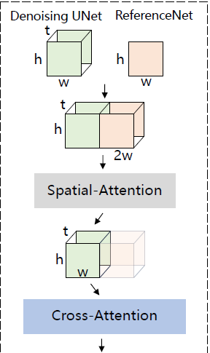
ReferenceNet
The framework of ReferenceNet is identical to the denoising Unet, excluding the temporal layer;
ReferenceNet inherits weights from the original SD;
How to integrate features from ReferenceNet into the denoising Unet?
$x1$ from denoising Unet
$x2$ from ReferenceNet
Copy $x2$ by $t$ times and concatenate it with $x1$ along $w$ dimension;
Perform self-attention and extract the first half of the feature map as the output;
Cross-attention is employed using the CLIP image encoder.
Notes:
Given a feature map x1 from denoising Unet and x2 from ReferenceNet, they first copy x2 by t times and concatenate it with x1 along w dimension.
Then we perform self-attention and extract the first half of the feature map as the output.

Slide 5
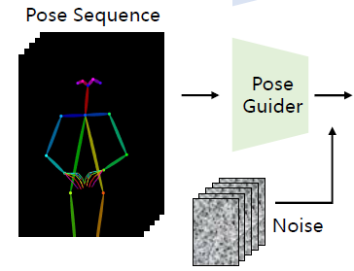
Pose Guider
The lightweight Pose Guider utilizes four convolution layers (4×4 kernels, 2×2 strides, using 16,32,64,128 channels) to align the pose image with the same resolution as the noise latent.
Subsequently, the processed pose image is added to the noise latent before being input into the denoising UNet.
The Pose Guider is initialized with Gaussian weights, and in the final projection layer, they employ zero convolution.
Notes:
Different from other methods, as the denoising UNet needs to be fine-tuned, they choose not to incorporate an additional control
network to prevent a significant increase in computational complexity.

Slide 6
Temporal Layer
Given a feature map
reshape
self-attention
+
reshape
Perform temporal self-attention along the dimension $t$.
The feature from temporal layer is incorporated into the original feature through a residual connection.
The temporal layer ensures temporal smoothness and continuity of appearance details, obviating the need for intricate motion modeling.

Slide 7
Training Strategy
The training process is divided into two stages:
In the first stage, training is performed using individual video frames. The ReferenceNet and Pose Guider are trained during this stage. The optimization objective is to enable the model to generate high-quality animated images under the condition of a given reference image and target pose.
The weights of the VAE’s Encoder and Decoder, as well as the CLIP image encoder, are all kept fixed.
In the second stage, they introduce the temporal layer into the previously trained model and initialize it using pretrained weights from AnimateDiff. During this stage, they only train the temporal layer while fixing the weights of the rest of the network.

Slide 8
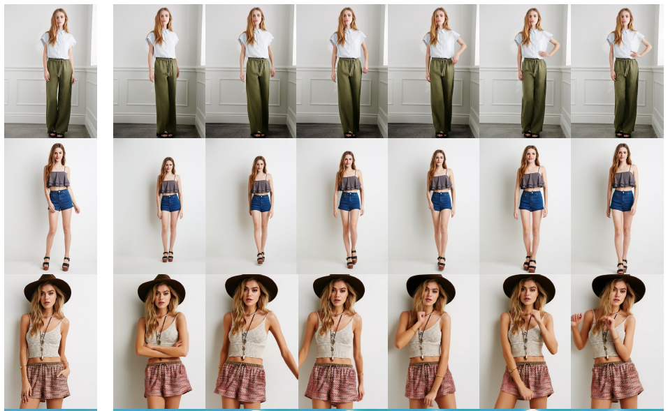
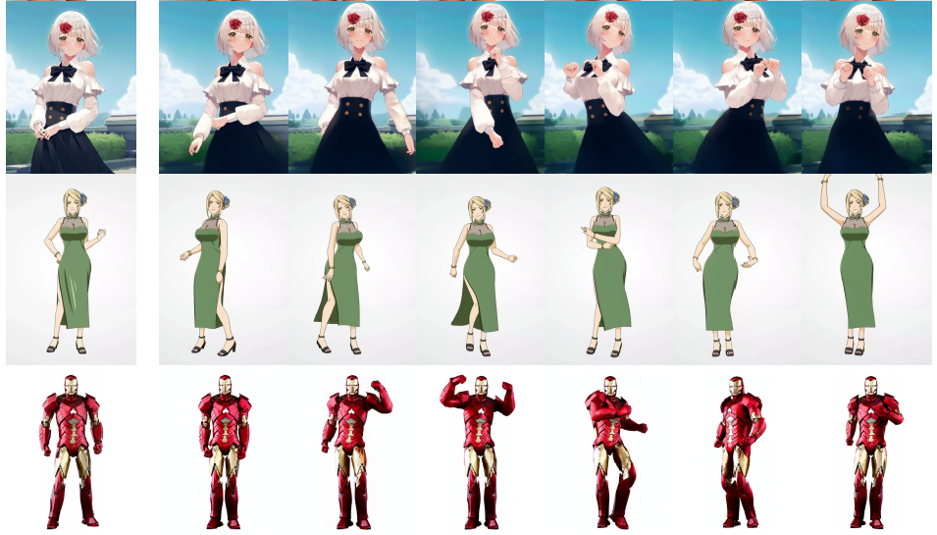
Qualitative Results
Qualitative Results. Given a reference image (the leftmost image), the approach demonstrates the ability to animate diverse characters, encompassing full-body human figures, half-length portraits, cartoon characters, and humanoid figures. The illustration showcases results with clear, consistent details, and continuous motion.

Slide 9
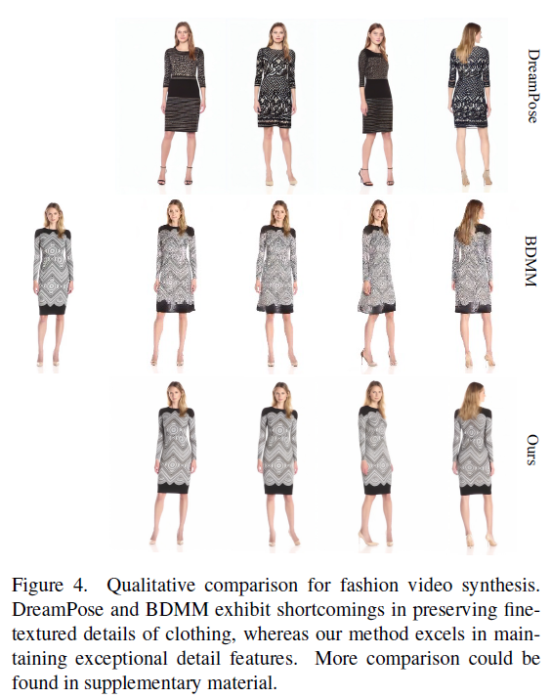
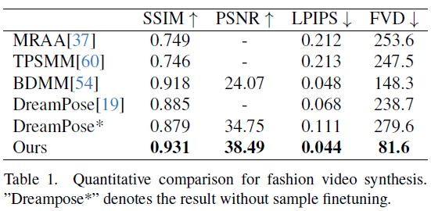
Fashion Video Synthesis
Notes:
Fashion Video Synthesis aims to turn fashion photographs into realistic, animated videos using a driving pose sequence. Experiments are conducted
on the UBC fashion video dataset, which consists of 500 training and 100 testing videos, each containing roughly 350 frames.
Result outperforms other methods, particularly exhibiting a significant lead in video metric.

Slide 10
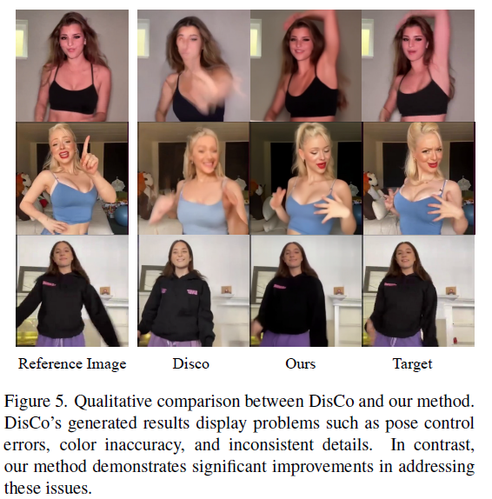
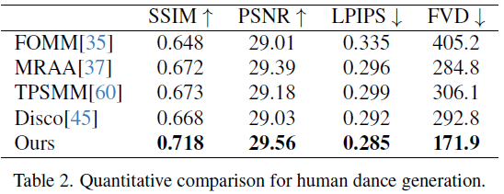
Human Dance Generation
Notes:
They utilized the TikTok dataset, comprising 340 training and 100 testing single human dancing videos (10-15 seconds long).
The model can grasp the foreground-background relationship from the subject’s motion, negating the necessity for prior human segmentation.

Slide 11
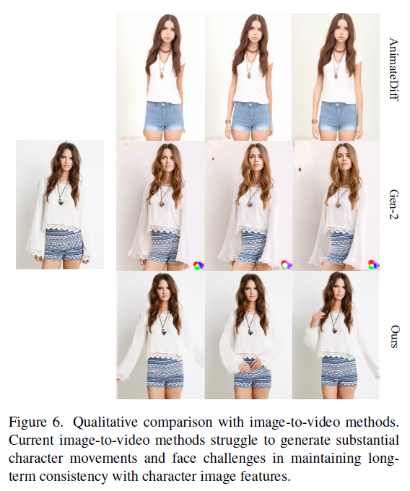
General Image-to-Video Methods
Notes:
As these two methods do not perform pose control, they only compare their ability to maintain the appearance fidelity to the reference image.
As depicted in Fig. 6, current image-to-video methods face challenges in generating substantial character movements and struggle to maintain long-term appearance consistency in videos,
thus hindering effective support for consistent character animation.

Slide 12
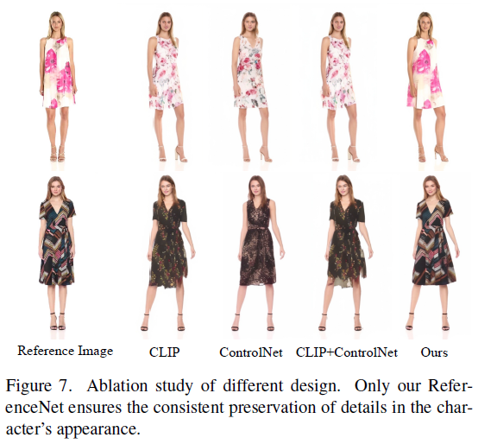
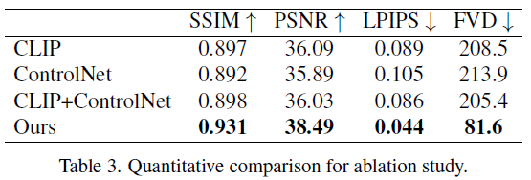
Ablation study
Using only the CLIP image encoder to represent reference image features without integrating ReferenceNet
initially finetuning SD and subsequently training ControlNet with the reference image.
integrating the above two designs.
Notes:
Experiments are conducted on the UBC fashion video dataset.

Slide 13
Limitations
First, similar to many visual generation models, their model may struggle to generate highly stable results for hand movements, sometimes leading to distortions and motion blur.
Second, since images provide information from only one perspective, generating unseen parts during character movement is an ill-posed problem which encounters potential instability.
Third, due to the utilization of DDPM, our model exhibits a lower operational efficiency compared to non-diffusion-model-based methods.

Slide 14
Moore-AnimateAnyone

Slide 15
Moore-AnimateAnyone
Face Reenactment

Slide 16
MusePose: a Pose-Driven Image-to-Video Framework for Virtual Human Generation
Zhengyan Tong, Chao Li, Zhaokang Chen, Bin Wu†, Wenjiang Zhou
Lyra Lab, Tencent Music Entertainment

Slide 17
Overview
MusePose is a diffusion-based and pose-guided virtual human video generation framework. The main contributions could be summarized as follows:
The released model can generate dance videos of the human character in a reference image under the given pose sequence. The result quality exceeds almost all current open source models within the same topic.
They released the pose align algorithm so that users could align arbitrary dance videos to arbitrary reference images, which SIGNIFICANTLY improved inference performance and enhanced model usability.
They fixed several important bugs and made some improvement based on the code of Moore-AnimateAnyone.

Slide 18
MusePose

Slide 19
Thanks for Listening
Notes:
.

