Slide 1
Learning Physically Simulated Tennis Skills from Broadcast Videos
Journal Club presented by Yilin Wang

Slide 2
Outline
Introduction
Methodology
Results and Evaluation
Discussion

Slide 3
Introduction
Data → unannotated broadcast tennis videos of different players
Output→ controllers for physically simulated characters
Simulated characters: hit consecutive incoming tennis balls using a diverse set of tennis skills
Controllers: can be used to produce single / two simulated characters playing tennis rallies

Slide 4
Introduction
Diverse Tennis Skills
Serve
Forehand topspin
Backhand topspin
Slice

Slide 5
Introduction
Different Player Styles
Djokovic style
Nadal style

Slide 6
Introduction
Two Player Rallies
Mid camera
Corner camera
High camera
Djokovic VS. Federer

Slide 7
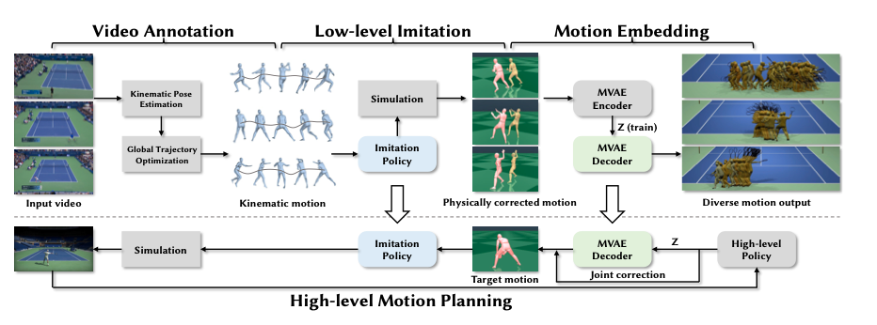
Methodology
Video annotation
Low-level imitation policy
Motion embedding
High-level motion planning policy
Notes:
First, we estimate 2D and 3D player poses and global root trajectories to create a kinematic motion dataset (Section 4).
Second, a low-level imitation policy is trained to imitate the kinematic motion for controlling the low- level behaviors of the simulated character and generate a physically corrected motion dataset (Section 5).
Next, we fit a conditional VAE to the corrected motion dataset to learn a low-dimensional motion embedding that produces human-like tennis motions (Section 6).
Finally, a high-level motion planning policy is trained to generate target kinematic motion by combining body motion output from the motion embedding with predicted corrections for the character’s wrist motion.

Slide 8
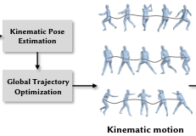
Video Annotations
Data Source
13 US Open match videos
Matches of three players (Federer, Nadal, Djokovic) playing against each other / other players
Motion and Pose estimation
Track two players on both sides → YOLOv4*
2D keypoints extraction → ViTPose*
SMPL parameters estimation → HybrIK*
Ball contact annotation → manual
Manually label the frames where a player makes ball contact
Different player identity annotation → manual
Manually label player identity
* YOLOv4: Optimal Speed and Accuracy of Object Detection
* ViTPose: Simple Vision Transformer Baselines for Human Pose Estimation
* HybrIK: Hybrid Analytical-Neural Inverse Kinematics for Body Mesh Recovery

Slide 9
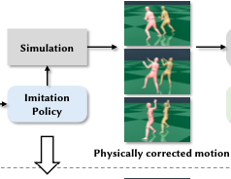
Low-Level Imitation Policy
Correct physically implausible artifacts such as jitter, foot skating, and ground penetration
State, action, rewards
Training
First stage ➔ pretrain policy on high-quality mocap database AMASS
Second stage ➔ fine-tune the policy using tennis kinematic motion dataset
joint rotation
Actuating
characters
Non-root
joint torques
velocity
[PD controllers]
root
joint torques
← Adding residual forces to root*
joint position
keypoint
energy penalty
* Residual force control for agile human behavior imitation and extended motion synthesis.

Slide 10
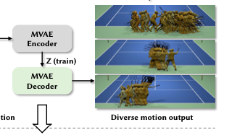
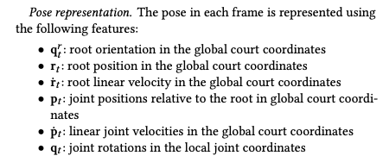
Motion Embedding
Motion VAE (MVAE) *
Learns a low-dimensional latent space using
Autoregressive manner
Input → current pose + possible transitions(z)
Output → next pose
Pose representation
Motion phase
Output motion phase variable based on the shot-cycle state machine*
𝜃 = 𝜋 denotes when the player makes ball contact and 𝜃 = 0 𝑜𝑟 𝜃 = 2𝜋 denotes when the player recovers (the opponent makes ball contact).
Learned through semi-supervised setting (annotate only 20% of all shots)
Coefficient for KL divergence is the most critical for good generation
𝛽 = 0.5 effectively balances the flexibility and motion quality of the learned motion embedding

Slide 11
High-Level Motion Planning Policy
Generate kinematic motion trajectories that resemble human behaviors
Hybrid control approach
MVAE → full-body motion
High-level policy → wrist motion
State
Character state & Ball state
Control targets
Desired placement of the character’s next shot
Binary variable indicating the desired spin direction of the next shot (topspin/backspin)
Actions
Two euler angles for wrist joint (excluding twist)
Twist angle for the elbow joint

Slide 12
High-Level Motion Planning Policy
Reward Function
Hitting the ball reward
Ball bounce reward
Head facing towards the ball → Offset angle between head’s facing direction and head-ball direction
Hand contacting racket for two-handed backhands → Move the free hand close to the racket handle by solving inverse kinematics for joints along the arm
Curriculum Learning
First stage ➔ quickly explore the motion embedding and control character to move in the right direction
Second stage ➔ control racket to hit the ball over net to the simplified one of the three fixed positions
Final stage ➔ sampling continuous target positions spanning the entire court

Slide 13
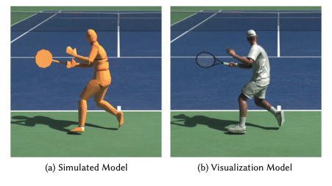
Physics Modeling of Tennis
Tennis racket and grip
Tennis racket: two solid cylinders with similar dimensions and masses
Racket head → a rigid flat cylinder (restitution=0.9 and friction=0.8)
Grip → directly attaching the end of the racket’s handle to the character’s wrist joint
model different grips by modifying the racket orientation
Tennis ball
A rigid sphere with the same radius and mass as a real tennis ball (restitution=0.9 and friction=0.8)
Air friction and effects of spin
Air drag force
Magnus force

Slide 14
Results and Evaluation
Experimental Set up
Physics simulations → Issac Gym*
Policy training → Proximal Policy Optimization(PPO)*
Metrics
Task Performance Metrics
Hit rate
Bounce-in rate
Bounce position error
Motion Quality Metrics
Jitter → average third derivatives of all joint positions
Foot sliding → average foot displacement in two adjacent frames

Slide 15
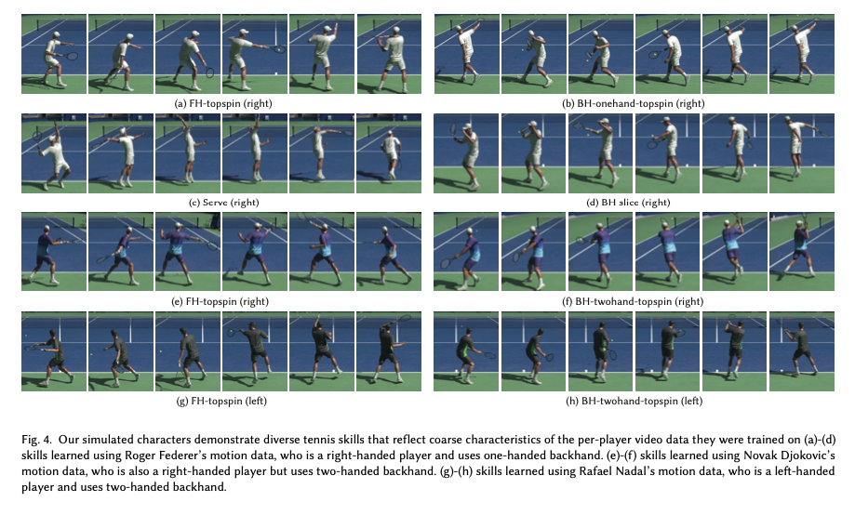
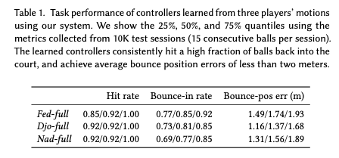
Results and Evaluation
Learning Complex Tennis Skills
Task performance
Different player styles

Slide 16
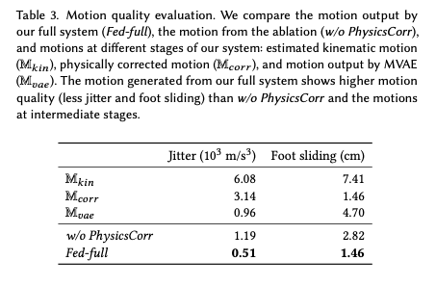
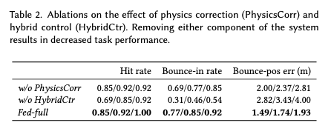
Results and Evaluation
Tackling Low-Quality Demonstrations
Motion quality evaluation
Hybrid control for wrist motion

Slide 17
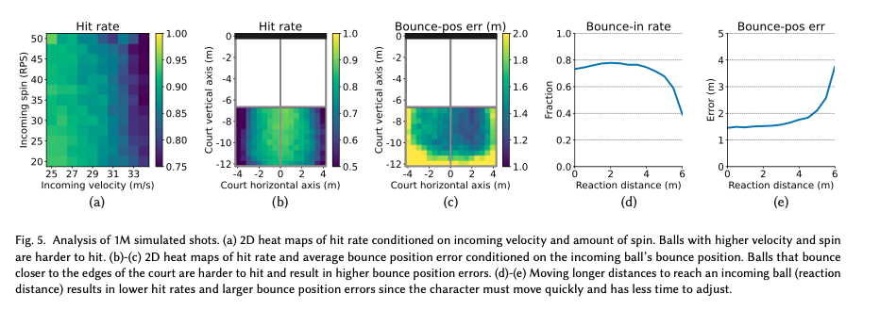
Results and Evaluation
Analysis of One Million Simulated Shots
Incoming ball’s velocity and spin
Incoming ball’s bounce position
Reaction distance

Slide 18
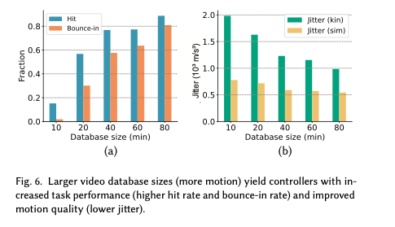
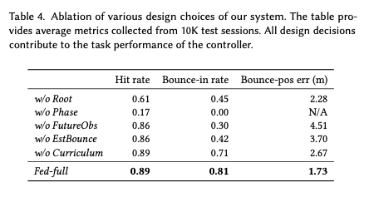
Results and Evaluation
Ablation Study
Various design choices
Effect of residual forces
Sensitivity to database size

Slide 19
Discussion…

Slide 20
Thank you

