Slide 1
Journal Club
SMPLer-X: Scaling Up Expressive Human Pose and Shape Estimation
NIPS 2024
Zhongang Cai (1,2,3), Wanqi Yin (2,4), Ailing Zeng (5), Chen Wei (2), Qingping Sun (2),
Yanjun Wang (2), Hui En Pang (1,2), Haiyi Mei (2), Mingyuan Zhang (1),
Lei Zhang (5), Chen Change Loy (1), Lei Yang (2,3), Ziwei Liu (1)
S-Lab, Nanyang Technological University, (2) SenseTime Research, (3) Shanghai AI Laboratory,
(4) The University of Tokyo, 5 International Digital Economy Academy (IDEA)
Notes:
As a key idea to overcome the extreme sparsity and ambiguities of sensor inputs, we integrate 6D head poses obtained from the head-mounted cameras for motion estimation. To enable capture in expansive indoor and outdoor scenes, we propose an algorithm to track and update floor level changes to define head poses, coupled with a multi-stage Transformer-based regression module. We also introduce novel strategies leveraging visual cues of egocentric images to further enhance the motion capture quality while reducing ambiguities.
democratize motion capture for the general public
we also explore scenarios where the signals among the individuals are shared and the egocentric observations from one person can be used as sparse third-person views for the others, which can be additionally used for our motion optimization module.
We first apply an off-the-shelf monocular SLAM [53] with the egocentric video I. From the SLAM, we obtain the 3D pointcloud W of the environment and camera pose at each time C = {Ct }Tt=0 , defined in the world coordinate.
Notably, in non-flat spaces as in Fig. 3, the z-directional component of Ht defined in the world coordinate does not necessarily reflect the metric height of the person because the height should be defined from the actual floor the person is currently standing. Thus, we compute the height of the head Ht by tracking and updating the floor level ft ∈ R at time t accordingly.
From egocentric video I, we first apply DROID-SLAM [53], noted for its accuracy and robustness compared to classical SLAM systems, to estimate camera trajectory C and reconstruct the 3D pointcloud W.
Because the camera center C may not be necessarily the same as the head joint location, we compute the fixed transcam formation Thead to transform the camera pose into the head cam pose, resulting in H defined w.r.t world coordinate. Thead is computed by approximating the camera location in a surface point of SMPL mesh.
To accurately define head height h, we introduce an algorithm to update floor level ft at time t based on network output (motion and foot contact) obtained until time t − 1 with 3D pointcloud W.
we adopt a multi-stage method as in [68] by introducing end-effector positions as intermediate representations. Specifically, we separate the system Fest into two submodules F end and F body (we drop the subscript ‘est’ on these submodule names for brevity). The first submodule F end takes {xτ }N τ =0 as input and generates end-effector positions N ×12 (hands and feet) {xmid}N. The input {xτ } and τ τ =0 ∈ R mid {xτ } are fed into submodule F body . The F body regresses N the output motion {m̂τ }N τ =0 and also foot contact {cτ }τ =0 lf rf lf rf where cτ = {cτ , cτ }. cτ and cτ indicate the contact probability of the left and right foot at time τ .
In submodule F end , the features generated by the Transformer encoder are converted into mid-representations {xmid} by a 2-layer MLP.
In submodule τ F body , the output of the Transformer encoder is first converted into foot contact probabilities {cτ }. The contact probability and Transformer encoder output are concatenated and converted to output motion {m̂τ }.
[Loss terms]
We use off-the-shelf models [21, 41] to obtain visual cues ϕE and ϕT.
Instead of directly optimizing the motion output from Mreg to Φ, we utilize the motion manifold-based method demonstrated in [26, 36].
Motion optimization is done by searching an optimal latent vector among the manifold. From the initial latent vector z = E(X), where X is computed from Mreg, the optimal latent vector z∗ is found by minimizing loss L = Lvis + Lreg + Lcontact .3 Lvis enforces to meet the provided visual cues:
To build training data from motion datasets, we synthesize IMU signals using wrist poses, following the protocol in [31, 67, 68].
For demonstrations with real-world IMU data using smartwatches, we apply filtering to reduce noise as in [31] beforehand.
Evaluation Metrics. Mean Per Joint Position Error (MPJPE): Mean Per Joint Velocity Error (MPJVE): Jitter:
Thus, here, we compare our estimation module Fest with previous SOTAs based on (1) 6 IMUs (full body) [31, 67], and (2) VR devices (upper body, 6 DoF) [18],
IMU Baselines (Full Body): We compare ours with PIP [67] and TIP [31]. Both estimate motion from 6 IMU sensors on the full body; head, wrists, pelvis, and legs.
VR Baselines (Upper Body): We consider AGRoL [18], the state-of-the-art method for tracking full body motion from 3 6DoF (position and orientation) sensor signals from the head and both wrists, as a baseline.
Dataset. We follow the previous approaches [31, 67] by training the models on AMASS [43] dataset and evaluating on the TotalCapture [56] dataset with real IMU data.
For quantitative comparison, we generate train/test/validation split from a subset of AMASS dataset (CMU [57], HDM05 [48], BMLMovi [19]). We first evaluate our motion estimation module and AGRoL on the testing split of AMASS dataset. Additionally, we also demonstrate the generalization ability of the modules by testing on the HPS [23] dataset.
For quantitative evaluation, we capture our own dataset by wearing XSens MVN Link [10] and our lightweight setups together, where we use XSens as ground truth data.
Although the off-the-shelf models (e.g., DROID-SLAM) in our method are robust and show reliable results in most cases, our method does not work in rare catastrophic failures of the off-the-shelf models.
[Doesn’t handle body shape]
Readings IMU Sensor Signals from Smartwatches. For demonstrations with smartwatches, we use Apple Watch SE2 [1] and the SensorLog app [8] to record and access IMU sensor data. From the recorded sensor signals, IMU rotations are obtained from “motionQuaternion” and accelerations from “motionAcceleration” of the Apple Watch OS [2]. The sensor data are recorded in 30 FPS. Furthermore, we apply an average filter on the acceleration data (window length: 7).
Head-Mounted Camera. We use GoPro cameras for the head-mounted camera. To determine the timecode (in microseconds) when the camera shutter is pressed, we use the Open-GoPro Python SDK [4] to activate the camera shutter.
For coordinate alignment, the user has to follow 4 steps: (1) put the smartwatches (IMU sensors) on the calibration board for 3 seconds as in Fig. 8 (a); (2) wear the watches and stand in T-pose for 3 seconds; (3) put the camera on 4 positions on the calibration board as in Fig. 8 (b); (4) stand still for 10 seconds and swing arms up and down as in Fig. 10 for time synchronization.
The scale of arbitrary coordinates of SLAM is set by measuring the distances in the calibration board in Fig. 8. The initial height h0 is given by measuring the distance between the board and the floor the user stands on during the alignment procedure. The camera poses before and after alignment are in Fig. 9.
The initial time synchronization between
IMU sensors and the head-mounted camera is set by the timecodes generated from the sensors. However, empirically we found there were minor errors in the timecode and therefore should be adjusted. For the adjustment, the user is asked to stand still and swing their arms up and down, as in Fig. 10 (a). When the hands move up to the highest position close to the camera (Fig. 10 (a)), the IMU sensor signals show a specific peak as in Fig. 10 (b). The time synchronization is done by aligning the two. We empirically found out that swinging is more robust than clapping, as in some cases the force transmitted to the wrist sensor during clapping can cause sensor peaks to spike.

Slide 2
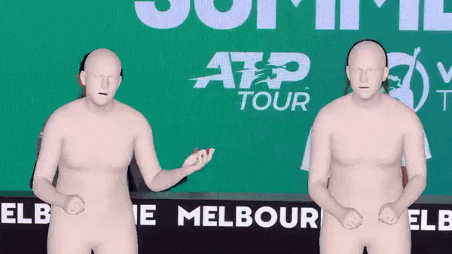
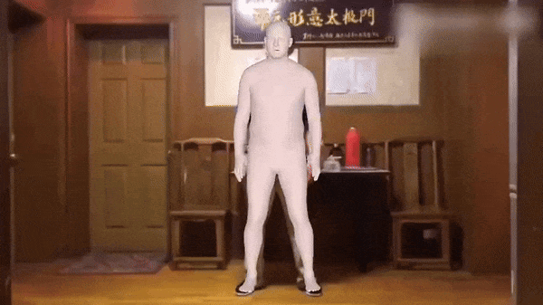
Contributions
Proposing a generalist foundation vision model for single-view RGB video expressive human pose and shape estimation
Benchmarking the generalizability of EHPS datasets
Videos: https://caizhongang.com/projects/SMPLer-X/

Slide 3
Datasets
Training is done using the datasets mentioned in the Table.
Evaluation is done on the following datasets:
AGORA
UBody
EgoBody
3DPW
EHF
Selection criteria:
Accurate SMPL/SMPL-X
Close to real-life scenarios
Widely used
Pre-defined test set
SMPLer-X: Table 1

Slide 4
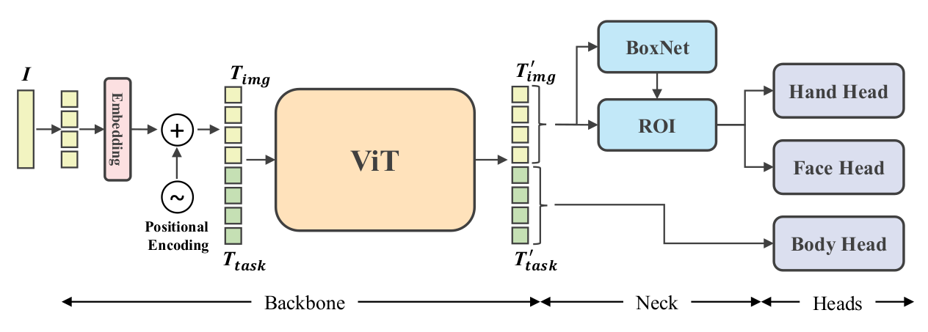
Architecture
Uses only a single-view RGB image as input
Only works for single-person scenarios
SMPLer-X: Figure 4

Slide 5
Training
Training is done using 16 V100 GPUs, with batch size 512 and for 10 epochs. Totaling an average of 500 GPU hours per model
To compensate for the imbalance in dataset lengths at the training time, datasets are weighted based on their generalizability ranking
SMPLer-X: Table 1

Slide 6
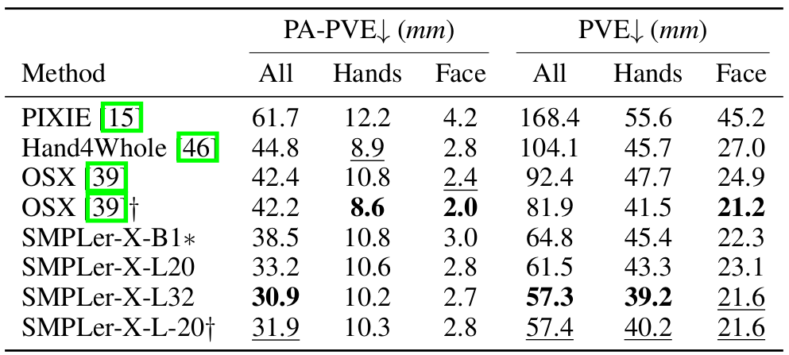
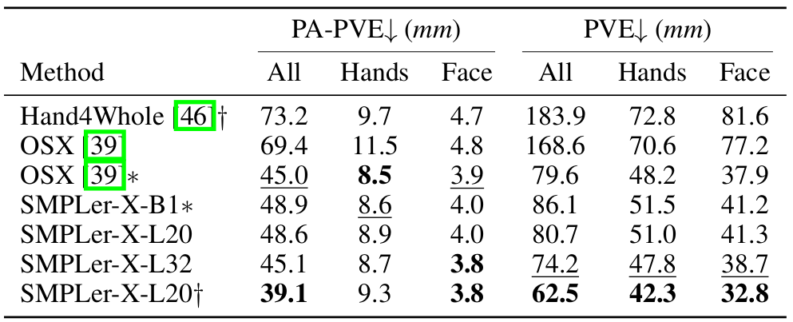
Results: evaluation (0)
AGORA
UBody
SMPLer-X: Table 4 & 6

Slide 7
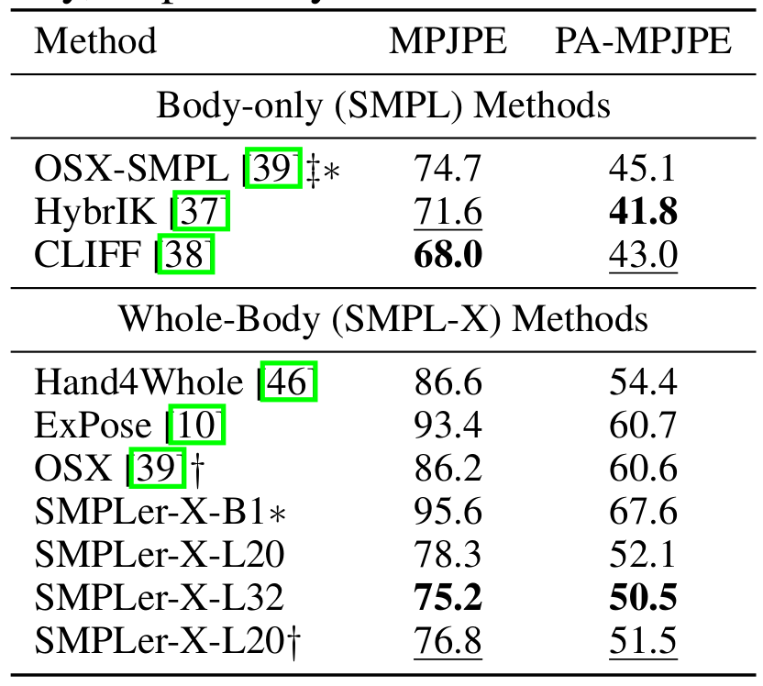
Results: evaluation (0)
EHF
3DPW
EgoBody
SMPLer-X: Table 5 & 7 & 10

Slide 8
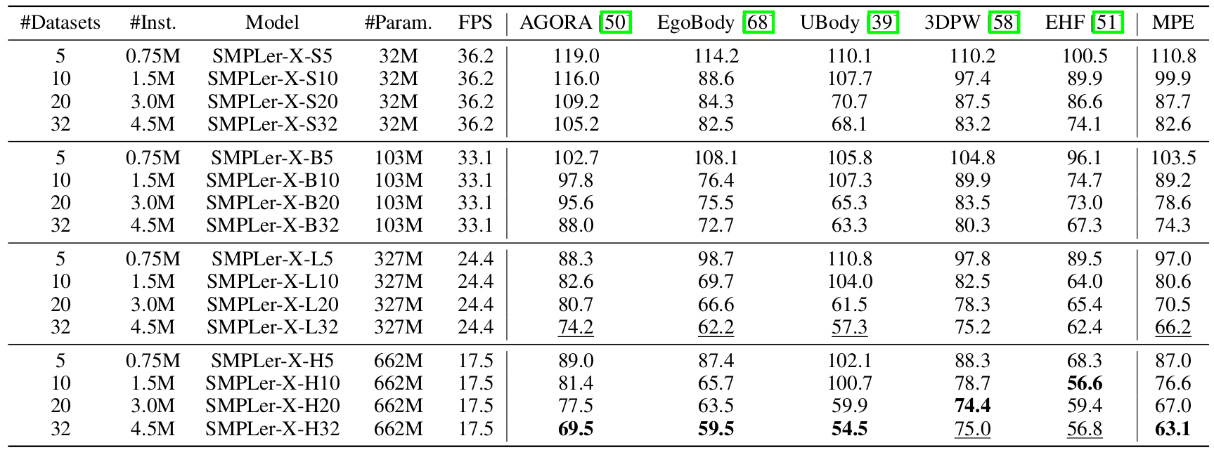
Results: scaling
Model size (+ more data) is directly correlated with the reduced accuracy
SMPLer-X: Table 2

Slide 9
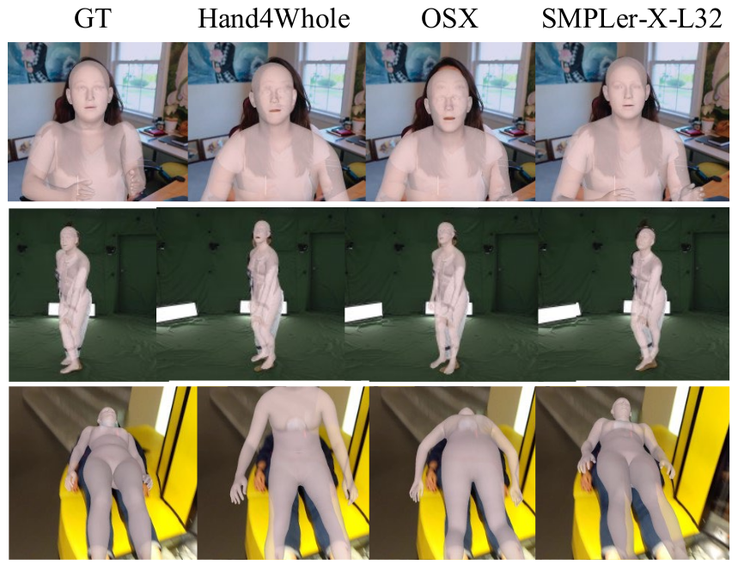
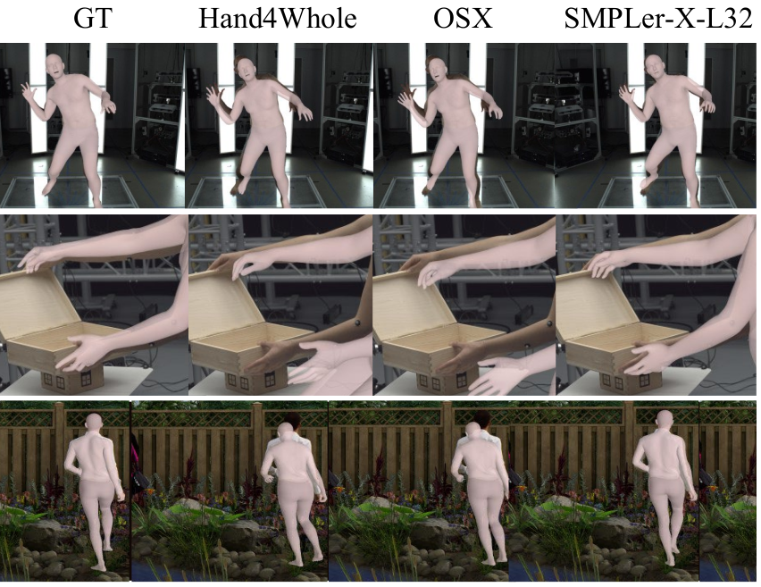
Results: visualization
SMPLer-X: Figure 5

Slide 10
Conclusions
More training data leads to better performance in terms of MPE
A larger foundation model performs better at any given amount of data. However, the marginal benefits of scaling up decrease for the larger models
The foundation model always performs better for each dataset than the model trained only on the training set of that dataset
Fine-tuning the foundation model on a new dataset is faster than training a model from scratch and results in better performance
SMPL only datasets can be used to increase the foundation model training data by converting SMPL parameters to SMPL-X

Slide 11
Dataset evaluation
Dataset size is not strongly associated with it’s performance
In-the-wild datasets (contain diverse scenes) generalize better
Knowledge learned from synthetic datasets are transferable to real-world scenarios
Pseudo-SMPL-X annotations are more helpful than pseudo-SMPL annotations for model generalizability
SMPLer-X: Figure 3

Slide 12
Appendix: fine-tuning
SMPLer-X: Table 12

