Slide 1
Sora
Journal Club presented by Matthew Mu

Slide 2
Contents
One fundamental question is
How a model can efficiently perceive and learn from real-world information.
Introduction
Technology
Compressed Representation: VAEs
Generative Modeling: DiTs
Prompt Engineering: VLMs
Discussion

Slide 3
Language understanding
a-woman-wearing-purple-overalls-and-cowboy-boots-taking-a-pleasant-stroll-in-Antarctica-during-a-winter-storm
a-woman-wearing-purple-overalls-and-cowboy-boots-taking-a-pleasant-stroll-in-Mumbai-India-during-a-winter-storm
a-woman-wearing-purple-overalls-and-cowboy-boots-taking-a-pleasant-stroll-in-Johannesburg-South-Africa-during-a-winter-storm

Slide 4
Prompting with images and videos
In an ornate, historical hall, a massive tidal wave peaks and begins to crash. Two surfers, seizing the moment, skillfully navigate the face of the wave.

Slide 5
Connecting Videos

Slide 6
Significance of Sora
Long duration: up to 1minute
High resolution: up to 1080p
Good temporal consistency
Accurately interpret and execute complex human instructions
“World Simulator”: Potential to simulate the complexity of physical and digital worlds

Slide 7
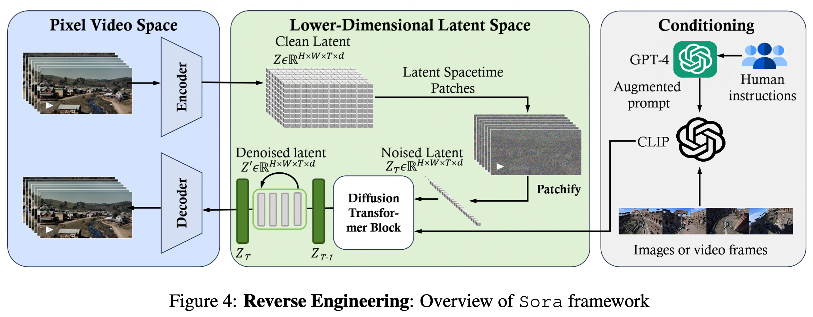
Technology *
Sora is a diffusion transformer with flexible sampling dimensions.
(1) A time-space compressor first maps the original video into latent space.
(2) A ViT then processes the tokenized latent representation and outputs the denoised latent representation.
(3) A CLIP-like conditioning mechanism receives LLM-augmented user instructions and potentially visual prompts to guide the diffusion model to generate styled or themed videos.
*The technology part of this presentation is highly based on the review: “Sora: A Review on Background, Technology, Limitations, and Opportunities of Large Vision Models”

Slide 8
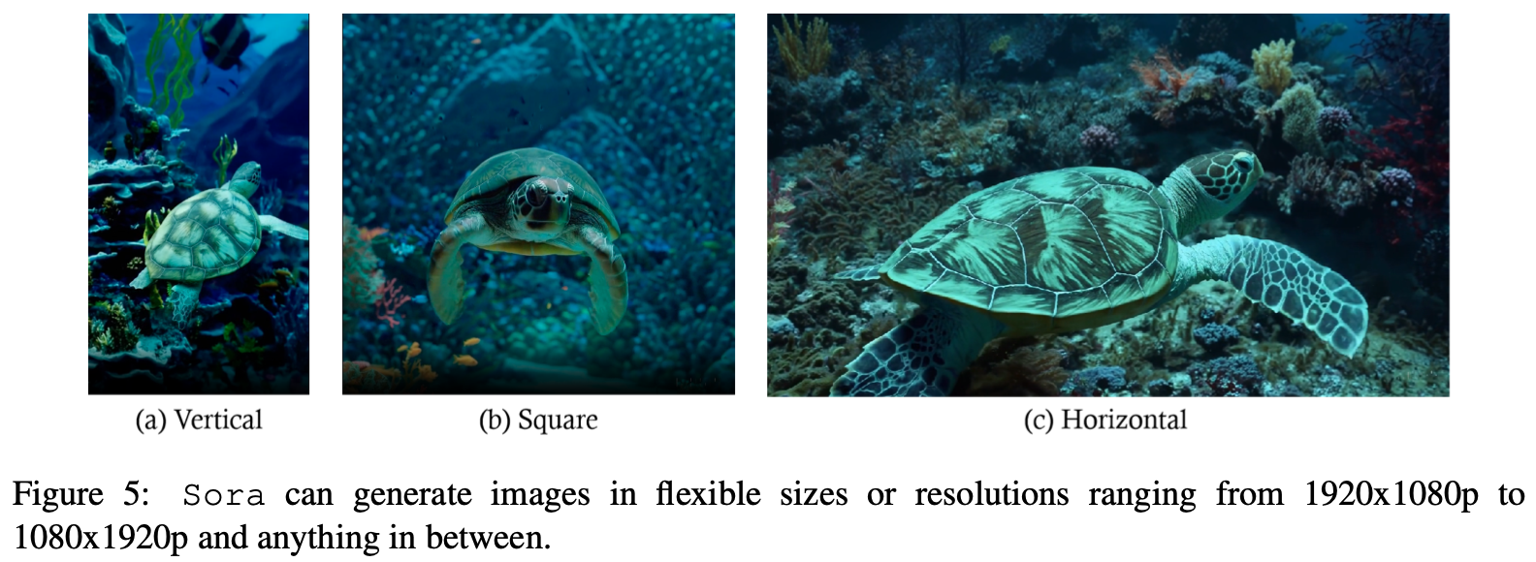
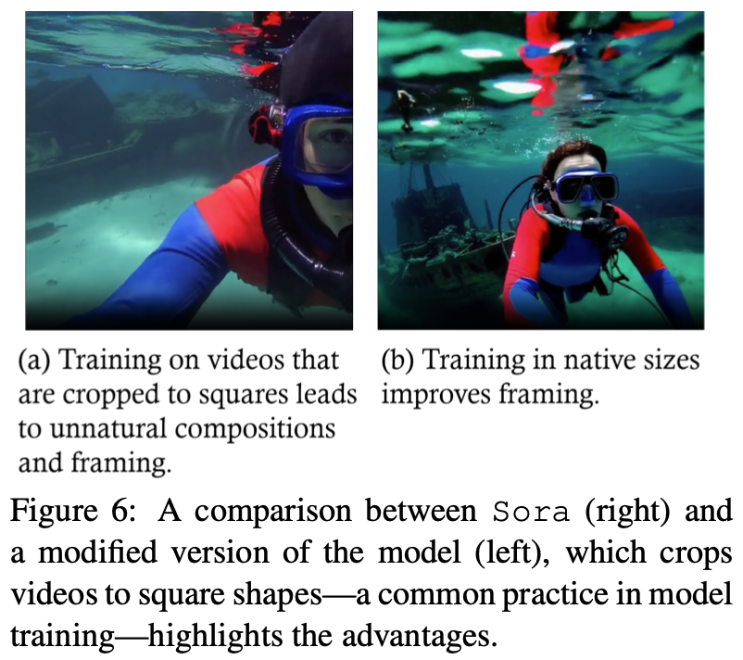
Variable Durations, Resolutions, Aspect Ratios
“Leveraging computation over human-designed features leads to more effective and flexible AI systems.” -Richard Sutton*
*“The bitter lesson.” http://www.incompleteideas.net/IncIdeas/BitterLesson.html

Slide 9
Variable Durations, Resolutions, Aspect Ratios
“Leveraging computation over human-designed features leads to more effective and flexible AI systems.” -Richard Sutton*
“Leveraging computation”
How? Efficiency?
*“The bitter lesson.” http://www.incompleteideas.net/IncIdeas/BitterLesson.html

Slide 10
Compressed Representation
First, Compress videos into a lower-dimensional latent space
Second, Decomposing the representation into spacetime patches
*An example [suspicion]
*https://zhuanlan.zhihu.com/p/684795460

Slide 11
Compressed Representation
First, Compress videos into a lower-dimensional latent space
Second, Decomposing the representation into spacetime patches
Auto-Encoders, 2D or 3D

Slide 12
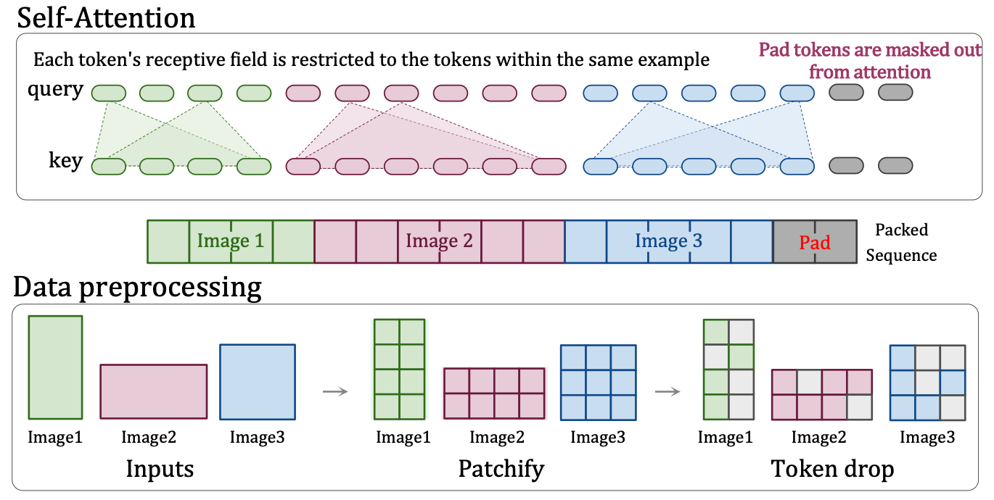
Compressed Representation
First, Compress videos into a lower-dimensional latent space
Second, Decomposing the representation into spacetime patches (Tokenization) -> Efficiency for learning and perceiving
Spacetime Patchification : Patch n’ Pack* (PNP) packs multiple patches from different images in a single sequence
*Patch n’ Pack: NaViT, a Vision Transformer for any Aspect Ratio and Resolution

Slide 13
Patch n’ Pack
Spacetime Patchification: Patch n’ Pack* (PNP) packs multiple patches from different images in a single sequence
Handle Diverse Resolutions:
Absolute embeddings vs Fractional embeddings
Continuous resolution-agnostic
“The substantial increase in the number of training examples processed within the allocated compute budget as the primary contributor to the improved performance over ViT”
*Patch n’ Pack: NaViT, a Vision Transformer for any Aspect Ratio and Resolution

Slide 14
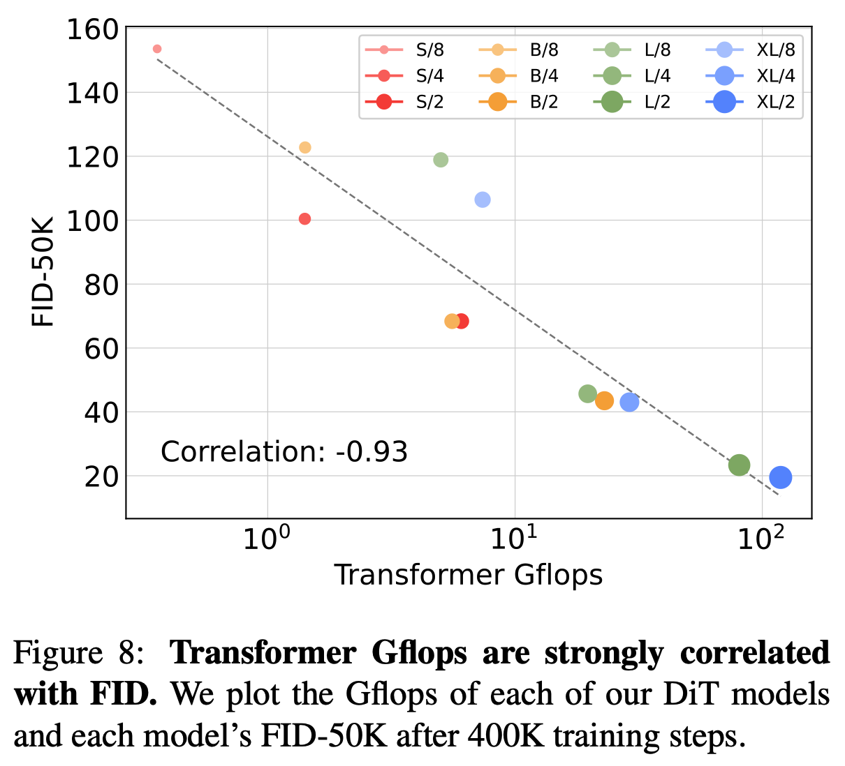
Generative Modeling: Diffusion Transformer
Properties of DiT/ViT
Flexibility:
Relations of tokens/pixels are controlled only by attention vs Convolution.
Token length, patch size, perception field
Scalability:
Depth, Width, Number of token -> Gflops
e.g. PNP
*Scalable Diffusion Models with Transformers

Slide 15
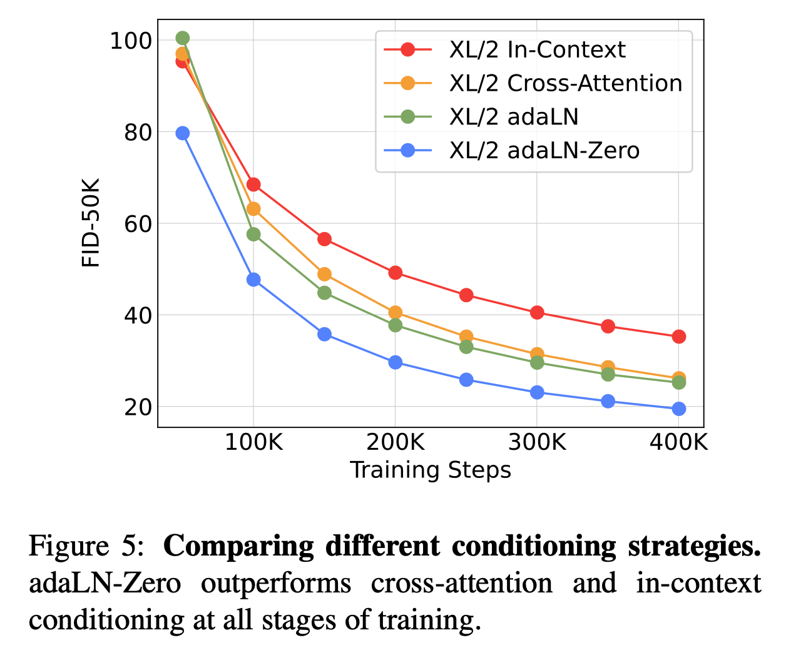
Diffusion Transformer
Process conditions:
Prior work on ResNets has found that initializing each residual block as the identity function is beneficial.
Empirically, it also works in ViT.
Recall works on model fine-tuning/ parameter efficient fine-tuning (PEFT).
*Scalable Diffusion Models with Transformers

Slide 16
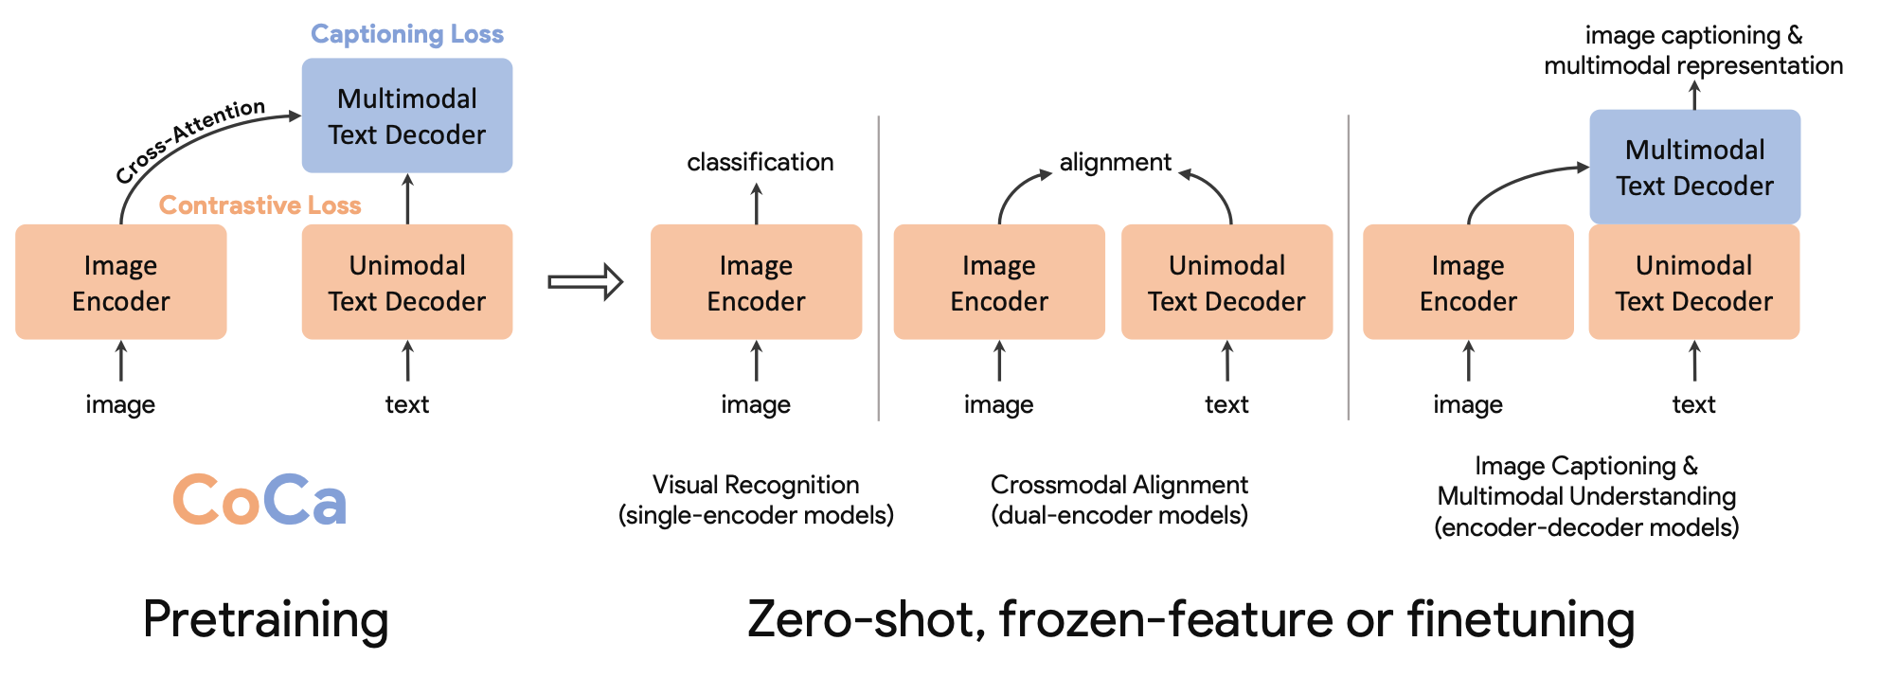
Prompt Engineering: Captioning with VLM
Related: DALL·E 3
[Hypothesis] the quality of text-image pairs that the model is trained on determines the performance of the resultant text-to-image model
Training a descriptive captioner and utilizing the captioner’s generated data for fine-tuning.
Contrastive captioners (CoCa): jointly train an image captioner with a CLIP architecture and a language model objective
Related: GPT-4V
Align user prompts with the format of those descriptive captions in training data
Prompt extension step, GPT-4V is used to expand user inputs to detailed descriptive prompts.
*Scaling up visual and vision-language representation learning with noisy text supervision
Coca: Contrastive captioners are image-text foundation models
Improving image generation with better captions

Slide 17
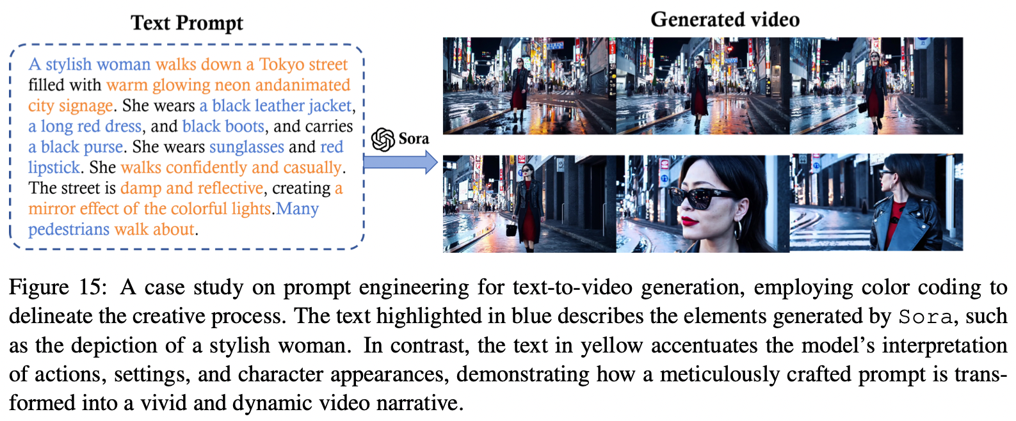
Prompt Extension
Text prompt engineering is vital
Crafting detailed descriptions: bridge the gap between human creativity and AI’s execution capabilities.
*Optimizing prompts for text-to-image generation

Slide 18
Discussion…

Slide 19
Useful links
https://twitter.com/sainingxie/status/1758433679238471744
https://github.com/lichao-sun/SoraReview
https://openai.com/research/video-generation-models-as-world-simulators
https://zhuanlan.zhihu.com/p/684795460

