Slide 1
Journal Club
Mocap Everyone Everywhere:
Lightweight Motion Capture With Smartwatches and a Head-Mounted Camera
CVPR 2024
Jiye Lee (1), Hanbyul Joo (1)
(1) Seoul National University
Notes:
As a key idea to overcome the extreme sparsity and ambiguities of sensor inputs, we integrate 6D head poses obtained from the head-mounted cameras for motion estimation. To enable capture in expansive indoor and outdoor scenes, we propose an algorithm to track and update floor level changes to define head poses, coupled with a multi-stage Transformer-based regression module. We also introduce novel strategies leveraging visual cues of egocentric images to further enhance the motion capture quality while reducing ambiguities.
democratize motion capture for the general public
we also explore scenarios where the signals among the individuals are shared and the egocentric observations from one person can be used as sparse third-person views for the others, which can be additionally used for our motion optimization module.
We first apply an off-the-shelf monocular SLAM [53] with the egocentric video I. From the SLAM, we obtain the 3D pointcloud W of the environment and camera pose at each time C = {Ct }Tt=0 , defined in the world coordinate.
Notably, in non-flat spaces as in Fig. 3, the z-directional component of Ht defined in the world coordinate does not necessarily reflect the metric height of the person because the height should be defined from the actual floor the person is currently standing. Thus, we compute the height of the head Ht by tracking and updating the floor level ft ∈ R at time t accordingly.
From egocentric video I, we first apply DROID-SLAM [53], noted for its accuracy and robustness compared to classical SLAM systems, to estimate camera trajectory C and reconstruct the 3D pointcloud W.
Because the camera center C may not be necessarily the same as the head joint location, we compute the fixed transcam formation Thead to transform the camera pose into the head cam pose, resulting in H defined w.r.t world coordinate. Thead is computed by approximating the camera location in a surface point of SMPL mesh.
To accurately define head height h, we introduce an algorithm to update floor level ft at time t based on network output (motion and foot contact) obtained until time t − 1 with 3D pointcloud W.
we adopt a multi-stage method as in [68] by introducing end-effector positions as intermediate representations. Specifically, we separate the system Fest into two submodules F end and F body (we drop the subscript ‘est’ on these submodule names for brevity). The first submodule F end takes {xτ }N τ =0 as input and generates end-effector positions N ×12 (hands and feet) {xmid}N. The input {xτ } and τ τ =0 ∈ R mid {xτ } are fed into submodule F body . The F body regresses N the output motion {m̂τ }N τ =0 and also foot contact {cτ }τ =0 lf rf lf rf where cτ = {cτ , cτ }. cτ and cτ indicate the contact probability of the left and right foot at time τ .
In submodule F end , the features generated by the Transformer encoder are converted into mid-representations {xmid} by a 2-layer MLP.
In submodule τ F body , the output of the Transformer encoder is first converted into foot contact probabilities {cτ }. The contact probability and Transformer encoder output are concatenated and converted to output motion {m̂τ }.
[Loss terms]
We use off-the-shelf models [21, 41] to obtain visual cues ϕE and ϕT.
Instead of directly optimizing the motion output from Mreg to Φ, we utilize the motion manifold-based method demonstrated in [26, 36].
Motion optimization is done by searching an optimal latent vector among the manifold. From the initial latent vector z = E(X), where X is computed from Mreg, the optimal latent vector z∗ is found by minimizing loss L = Lvis + Lreg + Lcontact .3 Lvis enforces to meet the provided visual cues:
To build training data from motion datasets, we synthesize IMU signals using wrist poses, following the protocol in [31, 67, 68].
For demonstrations with real-world IMU data using smartwatches, we apply filtering to reduce noise as in [31] beforehand.
Evaluation Metrics. Mean Per Joint Position Error (MPJPE): Mean Per Joint Velocity Error (MPJVE): Jitter:
Thus, here, we compare our estimation module Fest with previous SOTAs based on (1) 6 IMUs (full body) [31, 67], and (2) VR devices (upper body, 6 DoF) [18],
IMU Baselines (Full Body): We compare ours with PIP [67] and TIP [31]. Both estimate motion from 6 IMU sensors on the full body; head, wrists, pelvis, and legs.
VR Baselines (Upper Body): We consider AGRoL [18], the state-of-the-art method for tracking full body motion from 3 6DoF (position and orientation) sensor signals from the head and both wrists, as a baseline.
Dataset. We follow the previous approaches [31, 67] by training the models on AMASS [43] dataset and evaluating on the TotalCapture [56] dataset with real IMU data.
For quantitative comparison, we generate train/test/validation split from a subset of AMASS dataset (CMU [57], HDM05 [48], BMLMovi [19]). We first evaluate our motion estimation module and AGRoL on the testing split of AMASS dataset. Additionally, we also demonstrate the generalization ability of the modules by testing on the HPS [23] dataset.
For quantitative evaluation, we capture our own dataset by wearing XSens MVN Link [10] and our lightweight setups together, where we use XSens as ground truth data.
Although the off-the-shelf models (e.g., DROID-SLAM) in our method are robust and show reliable results in most cases, our method does not work in rare catastrophic failures of the off-the-shelf models.
[Doesn’t handle body shape]
Readings IMU Sensor Signals from Smartwatches. For demonstrations with smartwatches, we use Apple Watch SE2 [1] and the SensorLog app [8] to record and access IMU sensor data. From the recorded sensor signals, IMU rotations are obtained from “motionQuaternion” and accelerations from “motionAcceleration” of the Apple Watch OS [2]. The sensor data are recorded in 30 FPS. Furthermore, we apply an average filter on the acceleration data (window length: 7).
Head-Mounted Camera. We use GoPro cameras for the head-mounted camera. To determine the timecode (in microseconds) when the camera shutter is pressed, we use the Open-GoPro Python SDK [4] to activate the camera shutter.
For coordinate alignment, the user has to follow 4 steps: (1) put the smartwatches (IMU sensors) on the calibration board for 3 seconds as in Fig. 8 (a); (2) wear the watches and stand in T-pose for 3 seconds; (3) put the camera on 4 positions on the calibration board as in Fig. 8 (b); (4) stand still for 10 seconds and swing arms up and down as in Fig. 10 for time synchronization.
The scale of arbitrary coordinates of SLAM is set by measuring the distances in the calibration board in Fig. 8. The initial height h0 is given by measuring the distance between the board and the floor the user stands on during the alignment procedure. The camera poses before and after alignment are in Fig. 9.
The initial time synchronization between
IMU sensors and the head-mounted camera is set by the timecodes generated from the sensors. However, empirically we found there were minor errors in the timecode and therefore should be adjusted. For the adjustment, the user is asked to stand still and swing their arms up and down, as in Fig. 10 (a). When the hands move up to the highest position close to the camera (Fig. 10 (a)), the IMU sensor signals show a specific peak as in Fig. 10 (b). The time synchronization is done by aligning the two. We empirically found out that swinging is more robust than clapping, as in some cases the force transmitted to the wrist sensor during clapping can cause sensor peaks to spike.

Slide 2
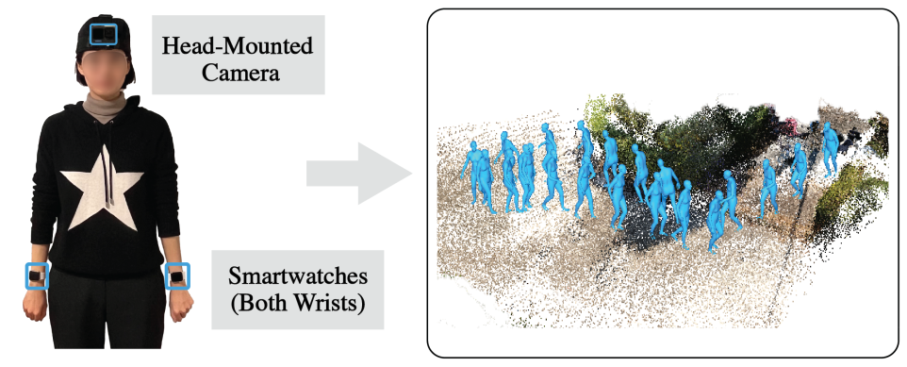
Problem
3D global human pose estimation with sparse (3) sensors
No attempt at body shape/mesh estimation
Mocap Everyone Everywhere: Fig. 1

Slide 3
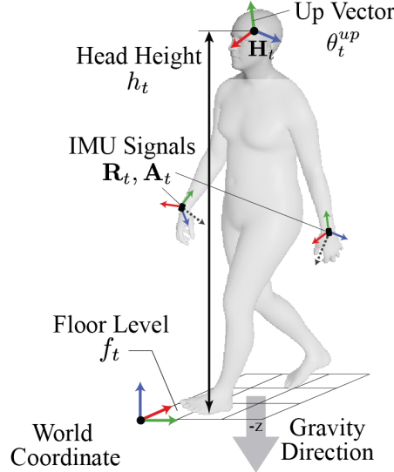
Sensors
Head: GoPro camera
Location
Orientation
Floor-level/head-height
Hands: Apple Watch SE2
Rotation
Acceleration
Mocap Everyone Everywhere: Fig. 3

Slide 4
Pipeline
Used off-the-shelf SLAM software (DROID SLAM) to build world point-cloud
Use a transformer to predict 3D skeleton keypoints based on head position and hands IMU data
Optimize the predicted 3D skeleton using occasionally available visual cues
Mocap Everyone Everywhere: Fig. 2

Slide 5
Contributions
Floor level prediction using head-cam video and SLAM
Training sensor data synthesize based on available pose estimation datasets (AMASS, TotalCapture)
Model architecture/pipeline

Slide 6
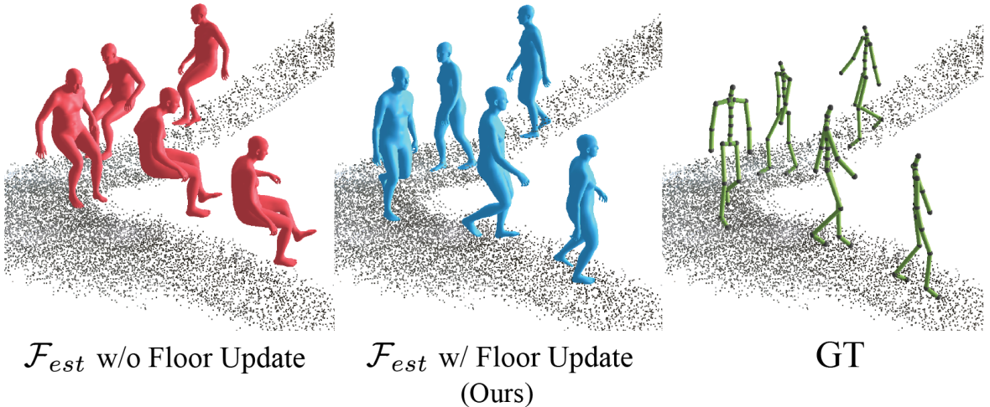
Floor level estimation
person height = global head position - floor level
Mocap Everyone Everywhere: Fig. 5

Slide 7
Sensor data synthesize
Hand joint rotation obtained directly from the SMPL model in the pose estimation dataset (AMASS, TotalCapture)
Hand joint acceleration is estimated based on the location of temporally adjacent hand joints using the above equation
Mocap Everyone Everywhere: Eq. 8

Slide 8
Model (0)
x^{mid} is the 3D position of body skeleton end-points (hands and feet)
End-points predictor
Mocap Everyone Everywhere: Fig. 4

Slide 9
Model (1)
x and x^{mid} are fed to the second network
Feet contact probabilities are calculated as a intermediary target/value
Encoder embeddings and contact probabilities are fed to a linear network for full-body pose estimation
Full-body predictor
Mocap Everyone Everywhere: Fig. 4

Slide 10
Model
Mocap Everyone Everywhere: Eq. 2, 3, 4

Slide 11
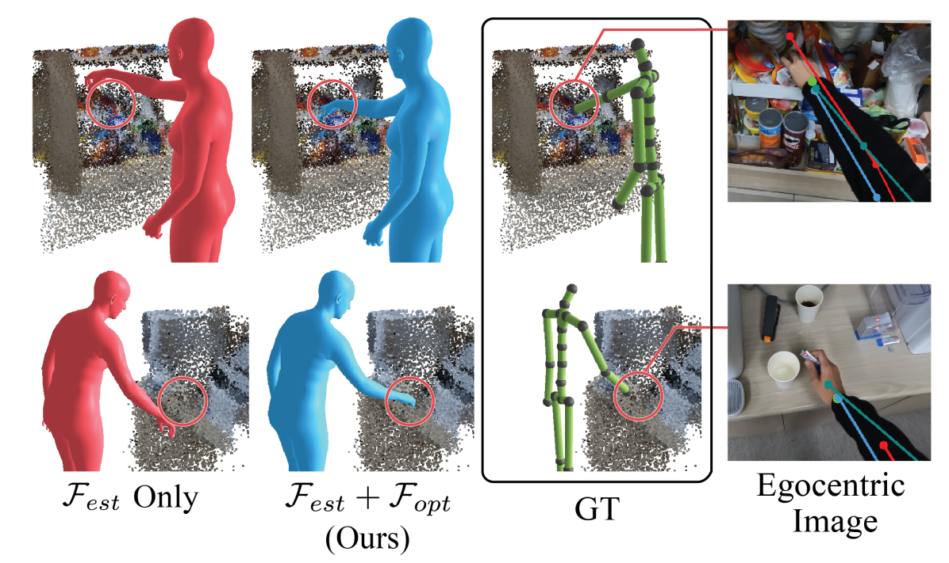
Visual skeleton optimization
Minimize the projection error of the hands on the head camera plane
Mocap Everyone Everywhere: Fig. 6

Slide 12
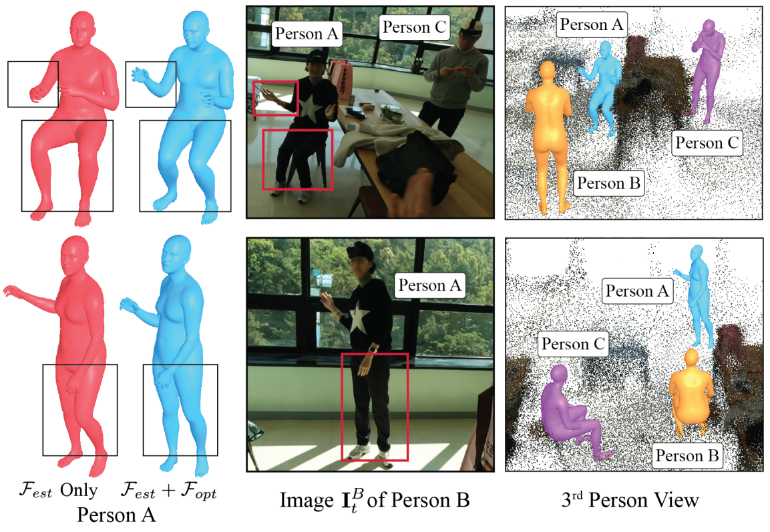
Multi-person optimization
Minimize the projection error of skeleton points on the head camera plane
Requires person tracking and assignment
Mocap Everyone Everywhere: Fig. 7

Slide 13
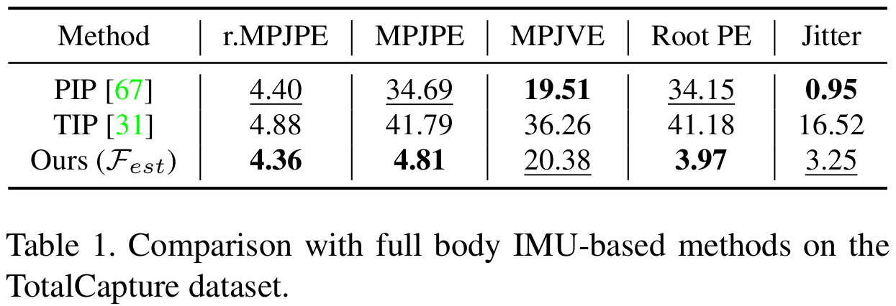
Evaluation: theoretical (0)
MPJPE: Mean Per Joint Position Error (cm)(r = relative)
MPJVE: Mean Per Joint Velocity Error (cm/s)
Root PE: Root Position Error
Jitter: Rate of change of acceleration
Mocap Everyone Everywhere: Tab. 1

Slide 14
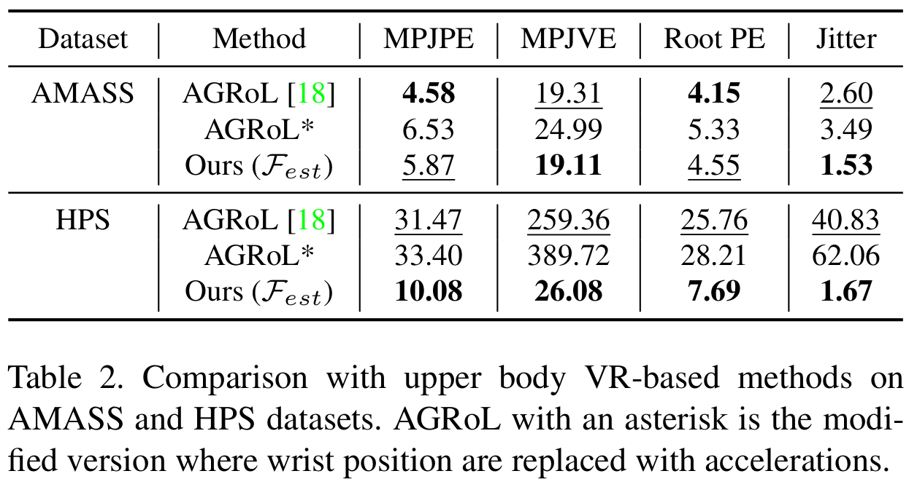
Evaluation: theoretical (1)
Mocap Everyone Everywhere: Tab. 2

Slide 15
Evaluation: empirical (0)
Test using camera and IMU sensors in real world experiments
Ground truth obtained using XSens MVN Link IMU-base pose-estimation kit
Mocap Everyone Everywhere: Tab. 5

Slide 16
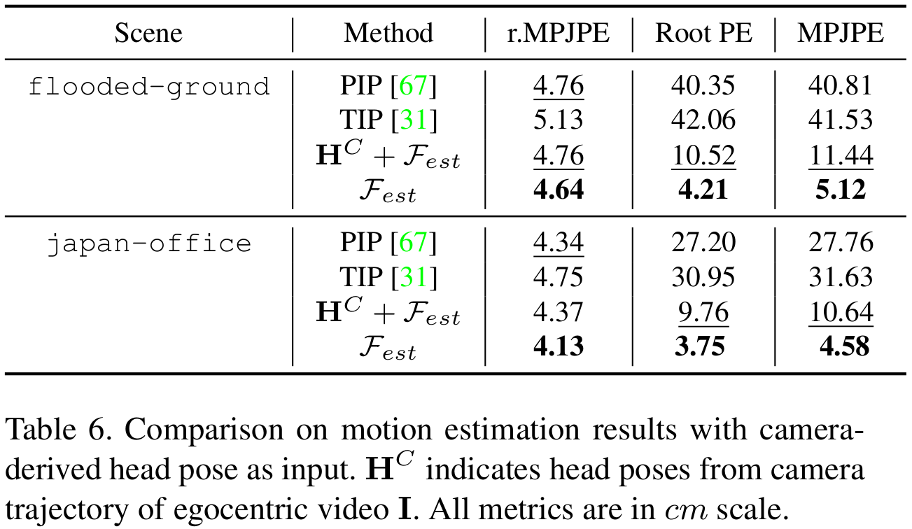
Evaluation: empirical (1)
Mocap Everyone Everywhere: Tab. 6

Slide 17
Limitations
Evaluation is not based on a solid real-world ground truth
The system is sensitive to fast motions
They have not released the source-code yet

Slide 18
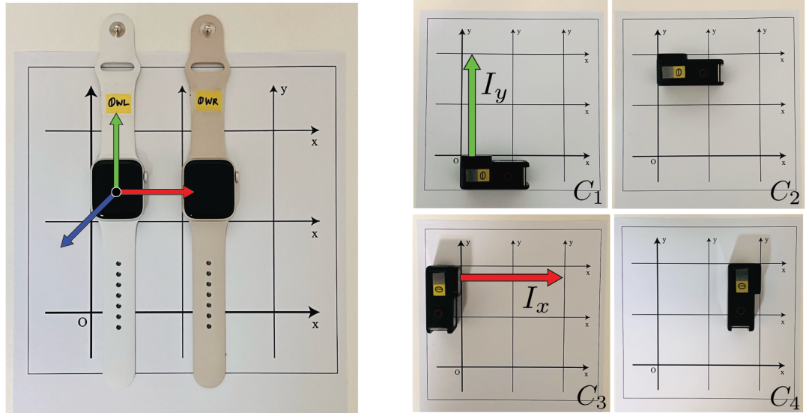
Appendix: calibration (0)
Calibration the initial position and orientation by putting the camera and watches on pre-calibrated boards
Mocap Everyone Everywhere: Fig. 8

Slide 19
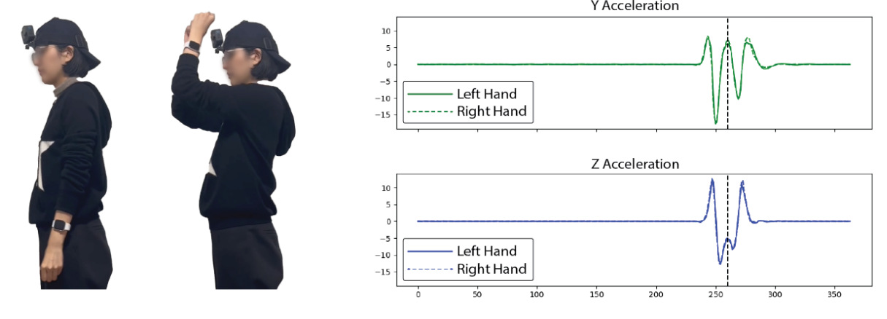
Appendix: calibration (1)
Swing the hand in front of the camera for smart-watch + head-camera synchronization
Synchronization for the rest of sequence is done using timestamps
Mocap Everyone Everywhere: Fig. 10

